Slide 1

WU Vienna — IIB
Introduction to Statistics
Descriptive Statistics – Hypothesis Testing
Dr. Arne Floh
Senior Lecturer, WU Vienna (Wirtschaftsuniversität Wien)
arne.floh@wu.ac.at | LinkedIn

Slide 2




Overview
01
02
03
04
Introductory
Example
Measurement
Scales
Descriptive
Statistics
Inductive
Statistics
The Tico Taco case and why marketing analytics matters
Nominal, ordinal, interval, and ratio scales
Central tendency, variability, distributions
Hypothesis testing, p-values, significance

Slide 3
Chapter 1
Introductory Example
The Tico Taco case and the need for marketing analytics

Slide 4

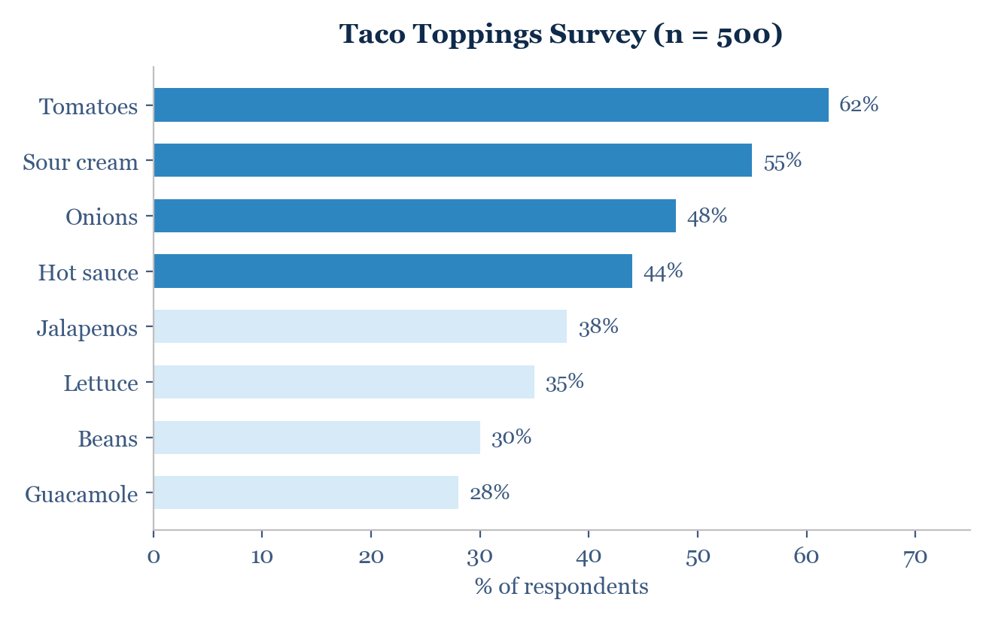
Tico Taco's Super Taco Option
The Case
Tico Taco, a chain of Mexican fast-food restaurants in Wichita, Kansas (est. 1962), considered offering a "Super Sonic Taco" at its 17th store. The Research Questions: 1) Who is the target market? 2) What topping options do customers prefer? 500 men under 30 were surveyed about their taco preferences.

Slide 5

Why Marketing Research?
A marketing research study was undertaken to identify the target market and determine what options the Super Sonic Taco should offer.
How to test the assumptions?
Hypothesis testing determines if the predicted profile (men under 30, not health-conscious) is supported by data.
How to determine the best options?
Descriptive statistics (frequencies, proportions) reveal which toppings are most popular among the target group.
What are the statistical differences?
The first question calls for inductive statistics (inference); the second calls for descriptive statistics (summarization).

Slide 6
Chapter 2
Measurement Scales
Nominal, ordinal, interval, and ratio — the foundation of data analysis

Slide 7
Primary Scales of Measurement
Permissible statistics
Scale
Characteristics
Example
Descriptive
Inferential
Nominal
Numbers identify and classify objects
Gender, brand
Percentages, mode
Chi-square, binomial test
Ordinal
Numbers indicate relative position; magnitude unknown
Rankings, preferences
Percentile, median
Rank order correlation, Friedman ANOVA
Interval
Differences between objects can be compared; zero is arbitrary
Temperature, attitudes
Range, mean, SD
t-tests, ANOVA, regression, factor analysis
Ratio
Zero point is fixed; ratios can be computed
Age, income, costs
Geometric mean, harmonic mean
Coefficient of variation
Higher-level scales contain more information and allow more analytical operations.

Slide 8
Illustration of Primary Scales
The horse-racing example shows how the same event can be measured at four different scale levels — each adding more mathematical information.
Scale
Description
Example
Permissible statistics
Nominal
Numbers assigned to riders
Rider 7, 11, 3
Percentages, mode
Ordinal
Rank order of winners
1st, 2nd, 3rd
Percentile, median
Interval
Performance rating (0-10)
9.6, 9.1, 8.2
Range, mean, SD
Ratio
Time to finish (seconds)
13.4, 14.1, 15.2
All arithmetic

Slide 9
Chapter 3
Descriptive Statistics
Central tendency, variability, and the shape of distributions

Slide 10
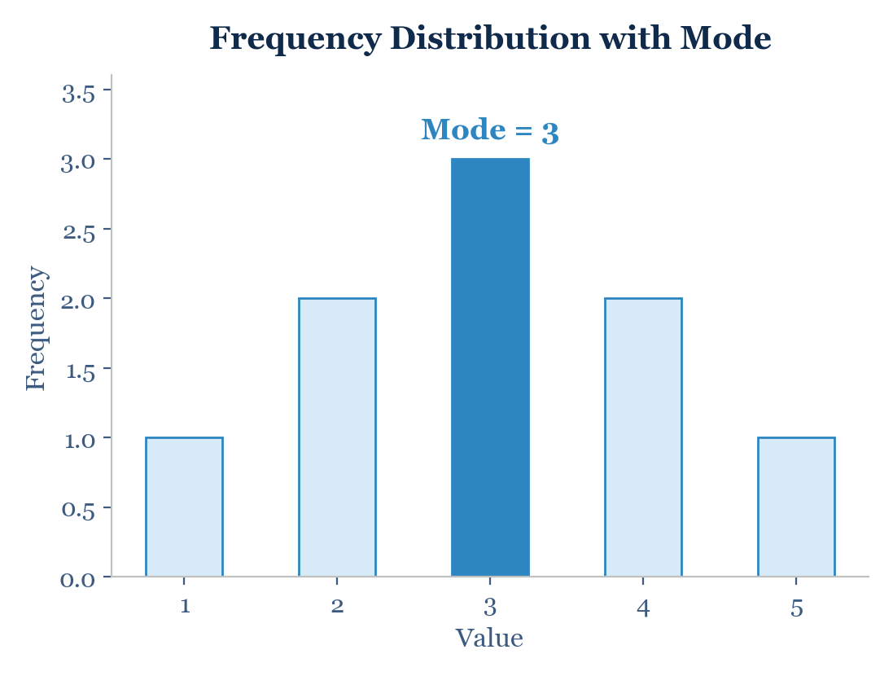
Central Tendency: The Mode
Definition
Mode: The most frequently occurring score in a data set. Bimodal: A distribution with two modes. Multimodal: A distribution with several modes. The mode is applicable to all scale levels, including nominal data.
Note: For bimodal or multimodal distributions, all modes should be reported.

Slide 11
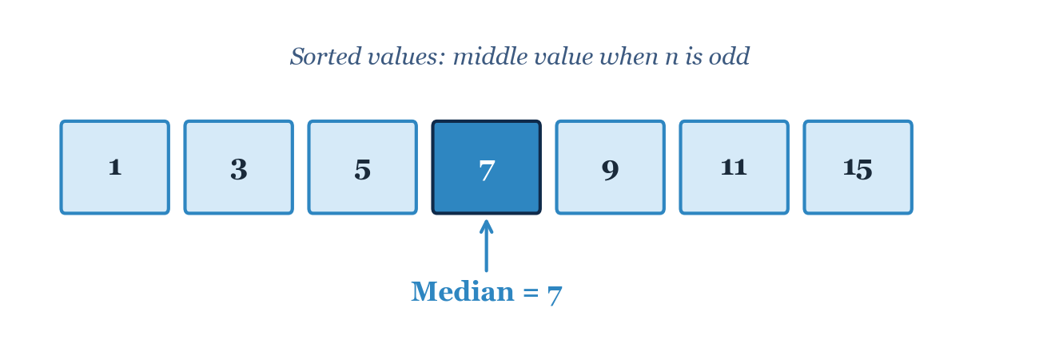
Central Tendency: The Median
The Median is the middle score when all scores are arranged in order. Odd n: The single middle value. Even n: The average of the two middle values. The median is robust to outliers — preferred for skewed distributions (e.g., income, property prices).

Slide 12
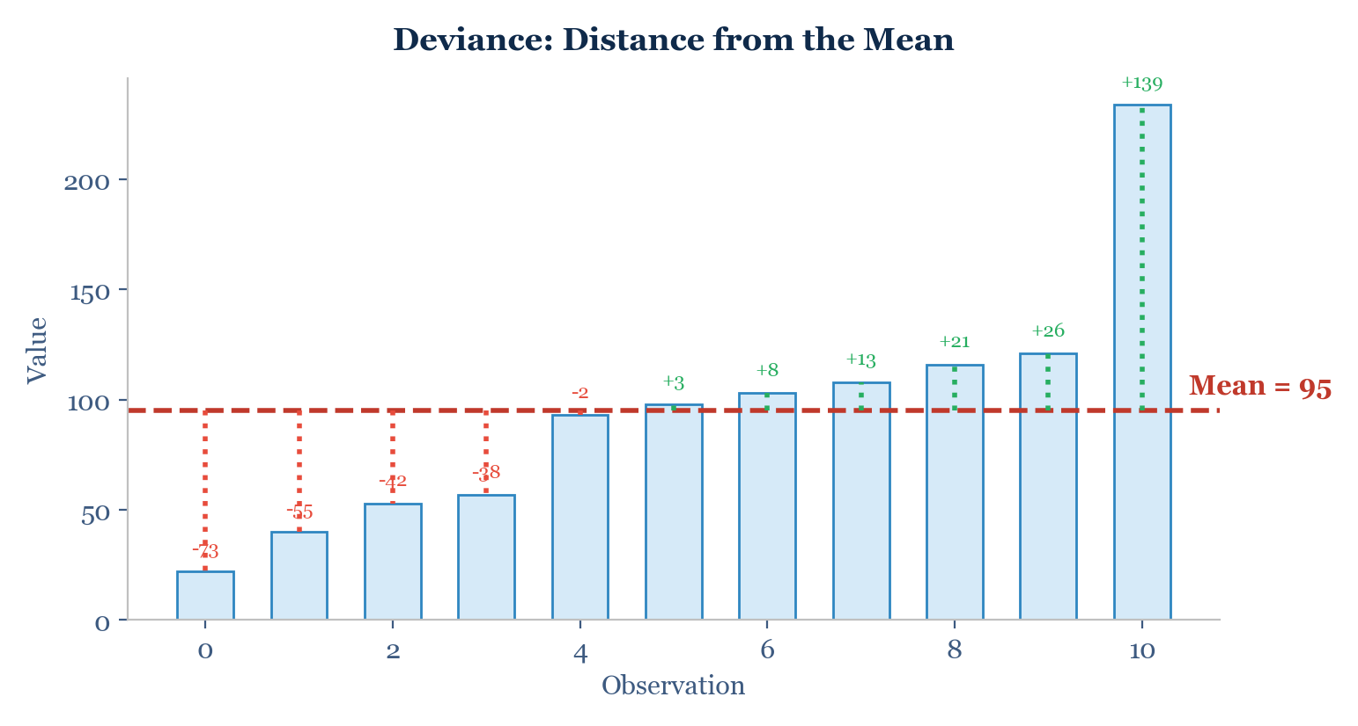
Central Tendency: The Mean
Definition & Example
Mean (x-bar): The sum of all scores divided by the number of scores. x-bar = SUM(xi) / n Facebook friends example (n = 11):
22, 40, 53, 57, 93, 98, 103,
108, 116, 121, 234
sum = 1045 x-bar = 1045 / 11 = 95 Sensitive to outliers — one extreme value (234) pulls the mean away from the center.

Slide 13
Dispersion: Range and Deviance
Measuring Spread
Range:
Range = Max - Min
For Facebook data: 234 - 22 = 212
Deviance:
How different each score is from the mean.
deviancei = xi - x-bar
Problem: Positive and negative deviations cancel out when summed. Solution: square each deviance.

Slide 14
Variance and Standard Deviation
Sum of Squared Errors (SS)
Total dispersion. Size depends on number of scores — not comparable across samples.
SS = SUM(xi - x-bar)^2
Variance (s^2)
Average squared deviance. Penalizes larger deviations disproportionately. Units are squared.
s^2 = SS / (n - 1)
Standard Deviation (s)
Square root of variance. Same units as original variable. Most widely used measure of spread.
s = sqrt(SS / (n - 1))
Facebook example: Variance = 3224.6 friends^2 | SD = sqrt(3224.6) = 56.8 friends

Slide 15
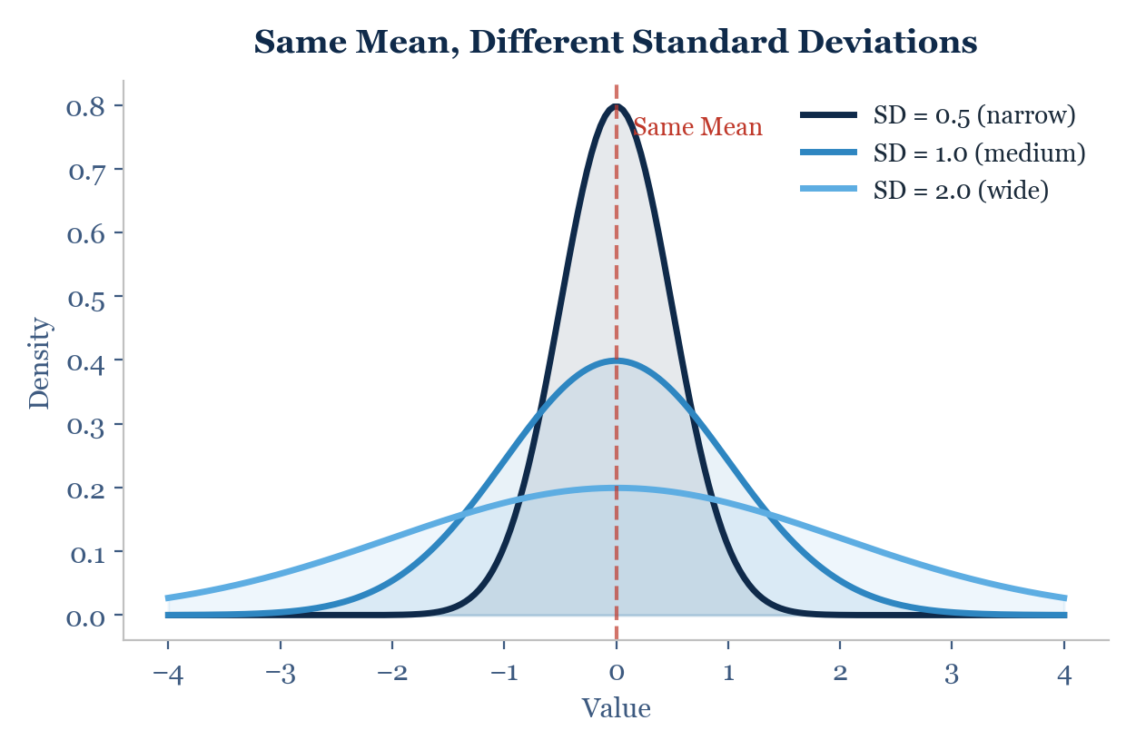
Same Mean, Different Spread
Key Insight
Two distributions can have the same mean but very different spreads. Narrow SD: Data points cluster tightly around the mean. Wide SD: Data points are widely dispersed. Always report both central tendency and variability.

Slide 16

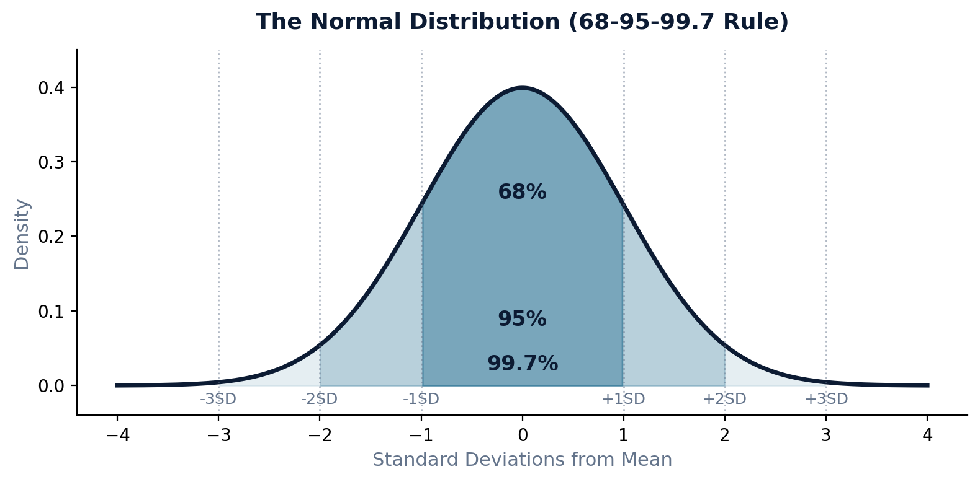
The Normal Distribution
The Bell Curve
Symmetric, bell-shaped distribution fully defined by mean and standard deviation. 68-95-99.7 Rule:
68% within ±1 SD
95% within ±2 SD
99.7% within ±3 SD
Approx. 5% of values fall more than 2 SD from the mean — the basis for the 0.05 significance threshold.

Slide 17

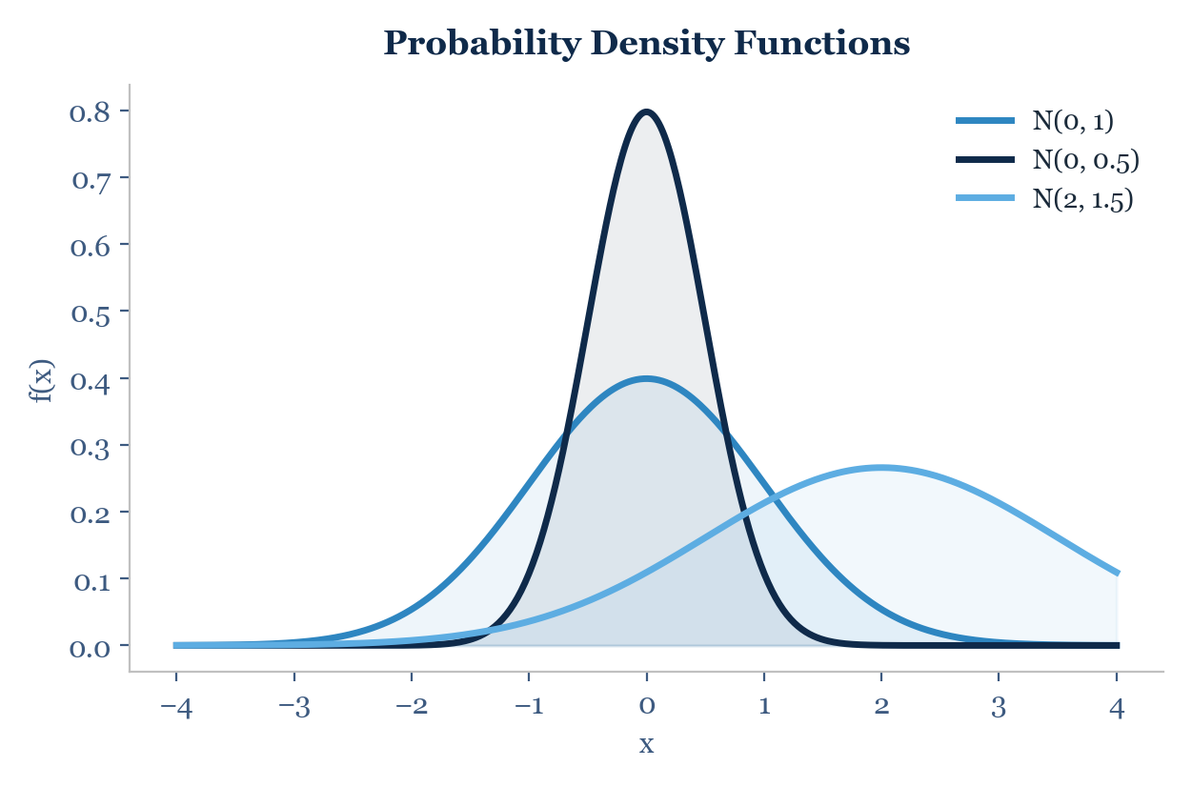
Probability Density Function
PDF Properties
The probability density function f(x) describes the relative likelihood of a random variable taking a given value. The area under the curve always equals 1 (total probability). Different means (mu) shift the curve left or right. Different SDs (sigma) make it narrower or wider. P(a < X < b) is the area under the curve between a and b.

Slide 18
Chapter 4
Inductive Statistics
Hypothesis testing, significance levels, p-values, and t-tests

Slide 19

Why Do We Need Inductive Statistics?
Key Concepts
Population (N)
Population: The aggregate of all elements sharing common characteristics for the research problem. Census: A complete enumeration of all population elements. Sample: A subgroup selected for participation in the study. We need inference because we almost never have census data. We must generalize from sample to population.
All elements sharing
common characteristics
Generalize to population
▲ Inference
▼ Sampling
Sample
(n)
Select subset from population

Slide 20

Purpose of Hypothesis Testing
Hypothesis testing makes a judgement about the difference between sample statistics or between a sample statistic and a hypothesized population parameter.
Hypothesis of Association
Customer satisfaction leads to customer loyalty.
Hypothesis of Difference
Female and male customers differ in terms of their customer satisfaction.
What is a Hypothesis?
A testable statement about the relationship between two or more variables or a proposed explanation for an observed phenomenon. Typically formulated as "if...then" or "the higher X, the higher Y" statements.

Slide 21
Process of Hypothesis Testing
1
Formulate H0 and Ha
▼
2
Select appropriate test
▼
3
Choose significance level (alpha)
▼
4
Collect data and calculate test statistic
▼
5
Determine probability (p-value)
▼
6
Compare p-value to alpha
▼
7
Make statistical decision
▼
8
Draw conclusion

Slide 22
Step 1: Formulating Hypotheses
Null Hypothesis (H0)
Alternative Hypothesis (Ha)
Statement of the status quo
Some difference or effect is expected
No difference, no effect
Accepting Ha leads to changes in opinions or actions
Refers to population parameter, not sample
The researcher's prediction
If H0 is not rejected, no changes are made
What we hope to find evidence for
Example: H0: Male and female customers do NOT differ in satisfaction. Ha: Male and female customers DO differ in satisfaction.

Slide 23
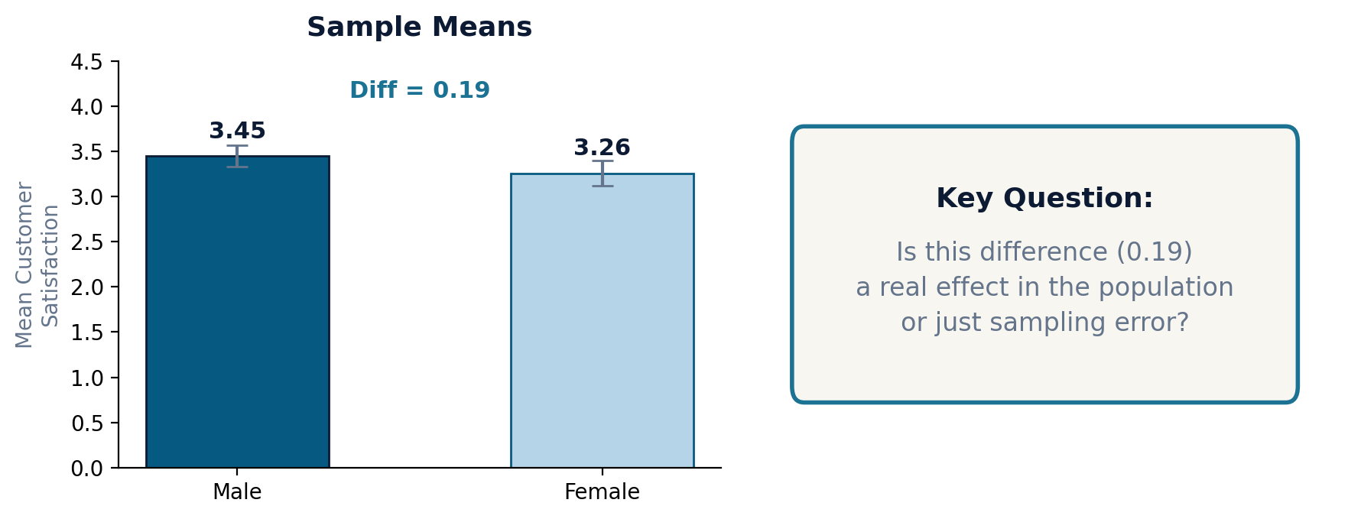
Example: Sample Means

Slide 24
Step 2: Select an Appropriate Test
Test Selection Principle
Gender Example: IV: Gender (nominal)
DV: Customer Satisfaction (metric)
=> t-Test for Independent Samples
The test statistic measures how close the sample has come to the null hypothesis. It follows a known distribution (normal, t, or chi-square), enabling probability calculations.
IV \ DV
DV Nominal
DV Metric
IV Nominal
Chi-Square
t-Test
ANOVA
IV Metric
Logistic
Regression
Correlation
Regression

Slide 25

Step 3: Choose the Level of Significance
ACTUAL
DECISION
Do not reject H0
Reject H0
H0 is TRUE
Correct
(True Negative)
TYPE I ERROR
(False Positive)
alpha error
H0 is FALSE
TYPE II ERROR
(False Negative)
beta error
Correct
(True Positive)
Power = 1 - beta
Type I error (alpha): Rejecting H0 when it is actually true (false positive). Controlled by setting alpha. Type II error (beta): Failing to reject H0 when it is false (false negative). Power = 1 - beta. Convention: alpha = 0.05 or 0.01

Slide 26
Type I and Type II Errors in Detail
Type I Error (alpha)
Type II Error (beta)
The Trade-Off
Occurs when sample results lead to rejecting H0 when it is true. The probability is called the level of significance or alpha. Set by the researcher (typically 0.05 or 0.01).
Occurs when sample results fail to reject H0 when it is false. The probability (beta) depends on the actual value of the population parameter. Unlike alpha, beta is not directly controlled by the researcher.
When choosing a significance level, there is an inherent trade-off: decreasing alpha (stricter) increases beta, and vice versa. A good test should reject H0 when it is false (high power).

Slide 27
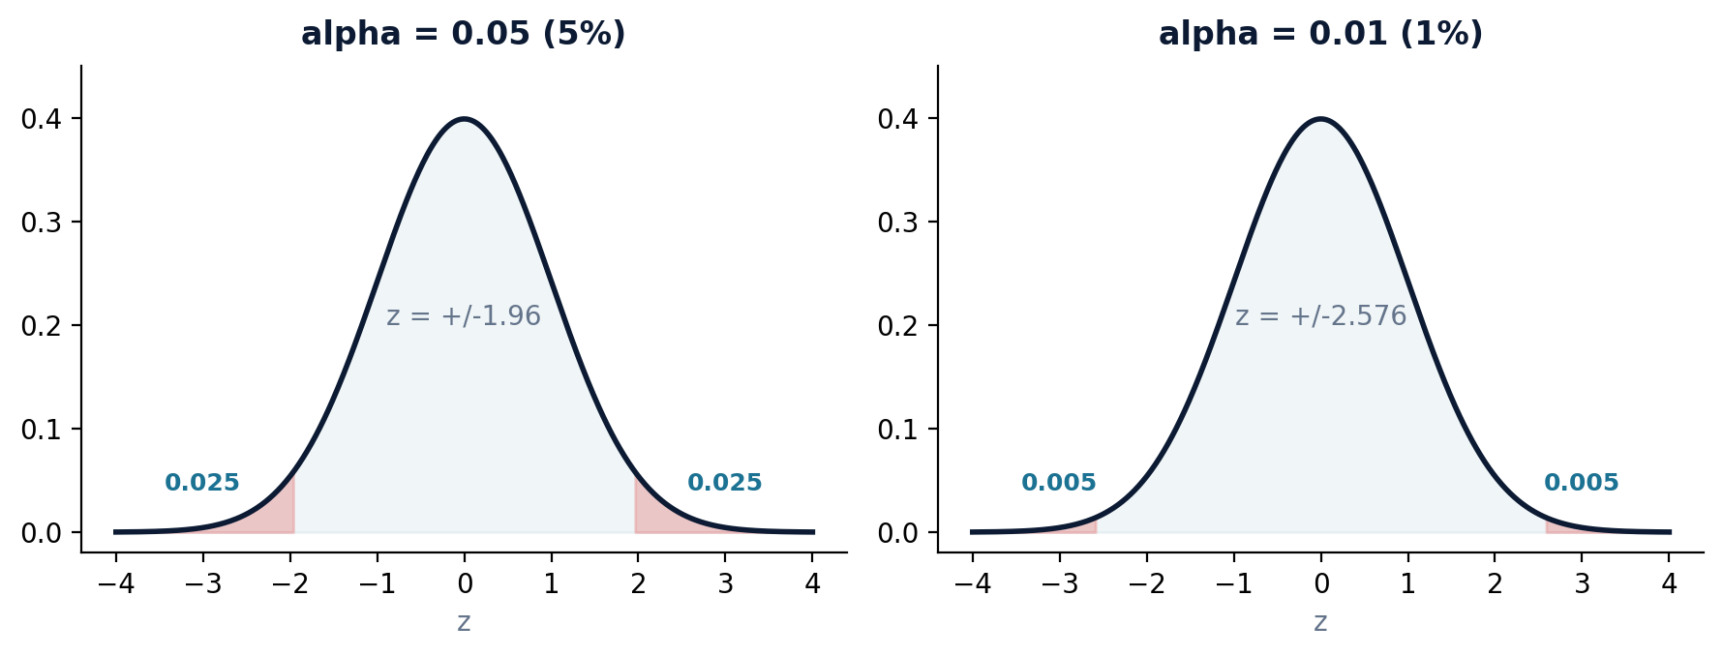
Significance Levels in Marketing
alpha = 0.05: 5% risk of false positive. Critical z = ±1.96. The standard in marketing research. | alpha = 0.01: 1% risk. Critical z = ±2.576. More conservative — used when false positives are costly.

Slide 28
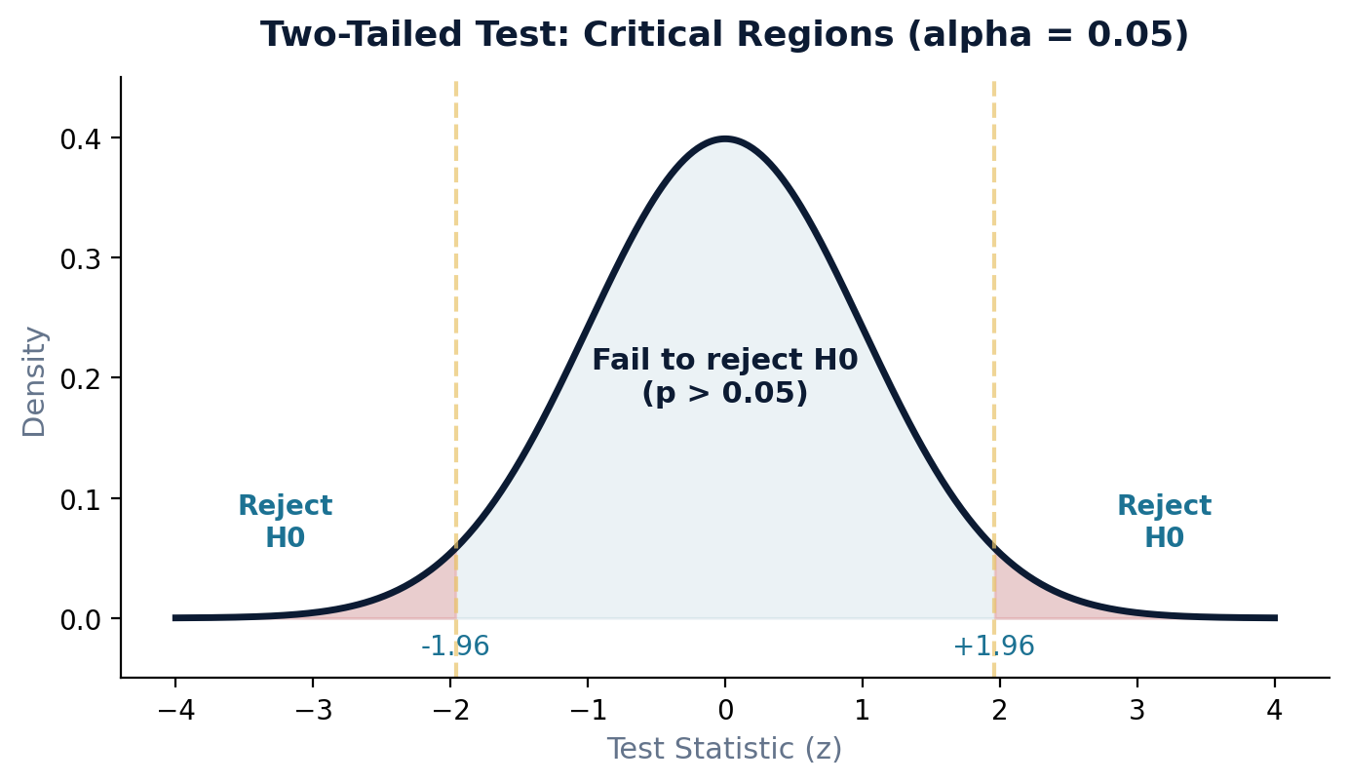
Steps 4-6: Test Statistic & p-Value
Interpreting p-Values
p < 0.05: Statistically significant. Strong evidence against H0. Reject H0. p > 0.05: Not statistically significant. Weak evidence against H0. Fail to reject H0. The p-value is the probability of observing a result as extreme as the data, assuming H0 is true. Smaller p does not mean a larger or more important effect.

Slide 29

Example: Applying the Hypothesis Test
Gender and Customer Satisfaction — p = 0.069 > 0.05. We fail to reject H0.
H0 / Ha
H0: Mean CS Male = Mean CS Female. Ha: Mean CS Male != Mean CS Female.
Test
t-Test for Independent Samples (IV nominal, DV metric).
alpha
Significance level alpha = 0.05 (marketing convention).
Result
Difference in sample means = 0.19. Calculated p-value = 0.069.
Decision
p (0.069) > alpha (0.05). Fail to reject H0. No significant difference.

Slide 30

Take-Aways
Descriptive statistics summarize data: central tendency (mean, median, mode) and variability (range, SD, variance).
Inductive statistics use samples to make inferences about populations — evidence must be evaluated statistically.
Measurement scale determines which operations are valid. Never compute a mean of nominal data.
Hypothesis testing follows a structured process: formulate H0/Ha, select test, set alpha, compute, decide.
Standard deviation is the most common measure of spread. Always report it alongside the mean.
Type I error (alpha): false positive. Type II error (beta): false negative. Convention: alpha = 0.05.
The normal distribution and the 68-95-99.7 rule underpin most inferential statistics.
A p-value < 0.05 is statistically significant. But significance does not equal practical importance.

Slide 31
Thank You
Questions?
arne.floh@wu.ac.at | linkedin.com/in/arnefloh
Dr. Arne Floh | WU Vienna

