Slide 1
Software
Engineering
Saeyslab Conference 2026

Slide 2
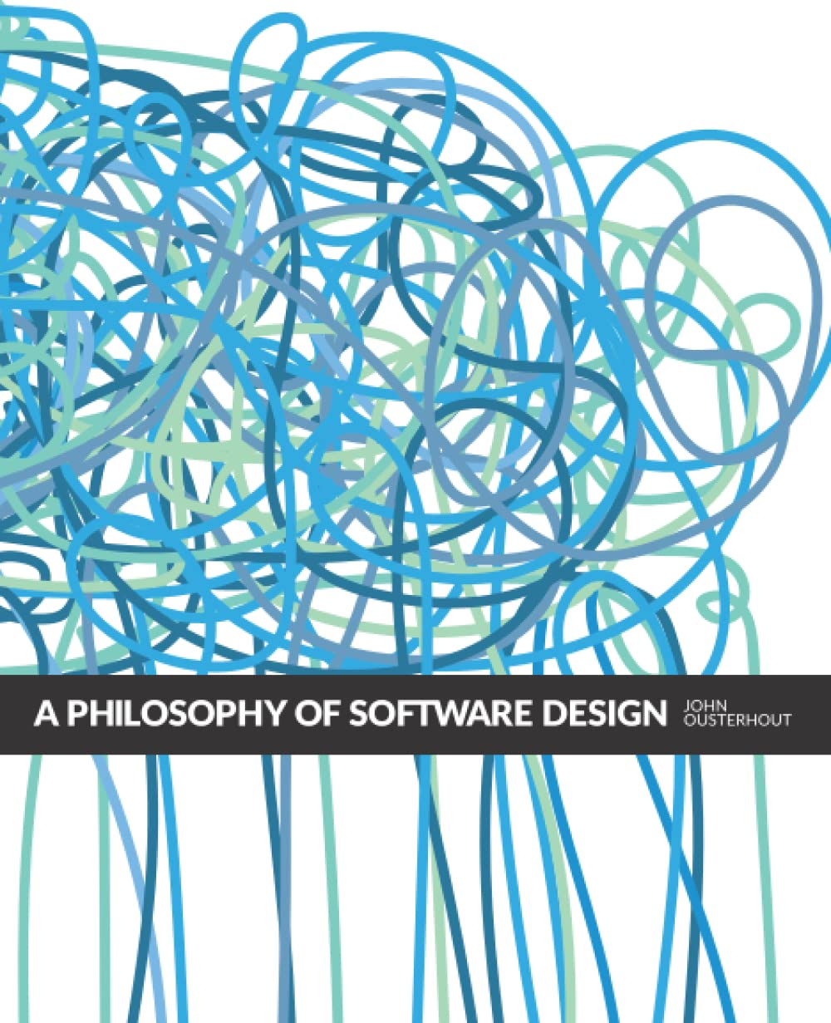

Sources

Slide 3
Why do we need “good code”?
Improves collaboration
  … with others
  … with your future self
  … with coding agents
Improves reproducibility
Makes it easier to discover and fix bugs
Makes it easier to make changes
  Which you will be doing at revision time
Notes:
This is not a plea “against agents”
Recognizing good code will help you use AI as well

Slide 4
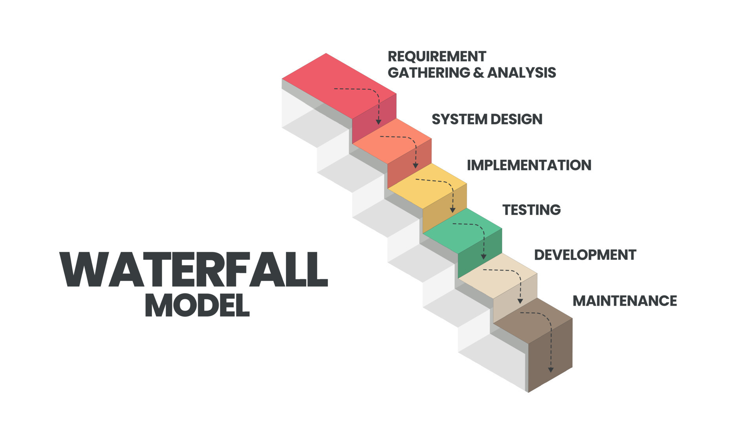





Slide 5
Complexity
Complexity is anything related to the structure of a software system that makes it hard to understand and modify the system.
Note: this is not the same as “has lots of features”

Slide 6
Symptoms of complexity
Change amplification
Cognitive load
Unknown unknowns
Notes:
Change amplification: simple change requires modifications in many places
Cognitive load: need to know a lot in order to complete a task
Unknown unknowns: it is not obvious what needs to be modified to complete a task

Slide 7
Causes of complexity
Dependencies
Obscurity
Notes:
Dependency: a piece of code cannot be understood and modified in isolation
Obscurity: important information is not obvious

Slide 8
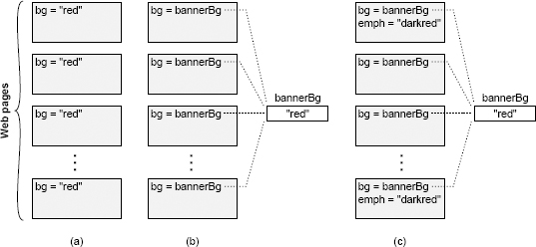
Complexity: example
Change amplification
Cognitive load
Unknown unknowns
Dependencies
Obscurity

Slide 9
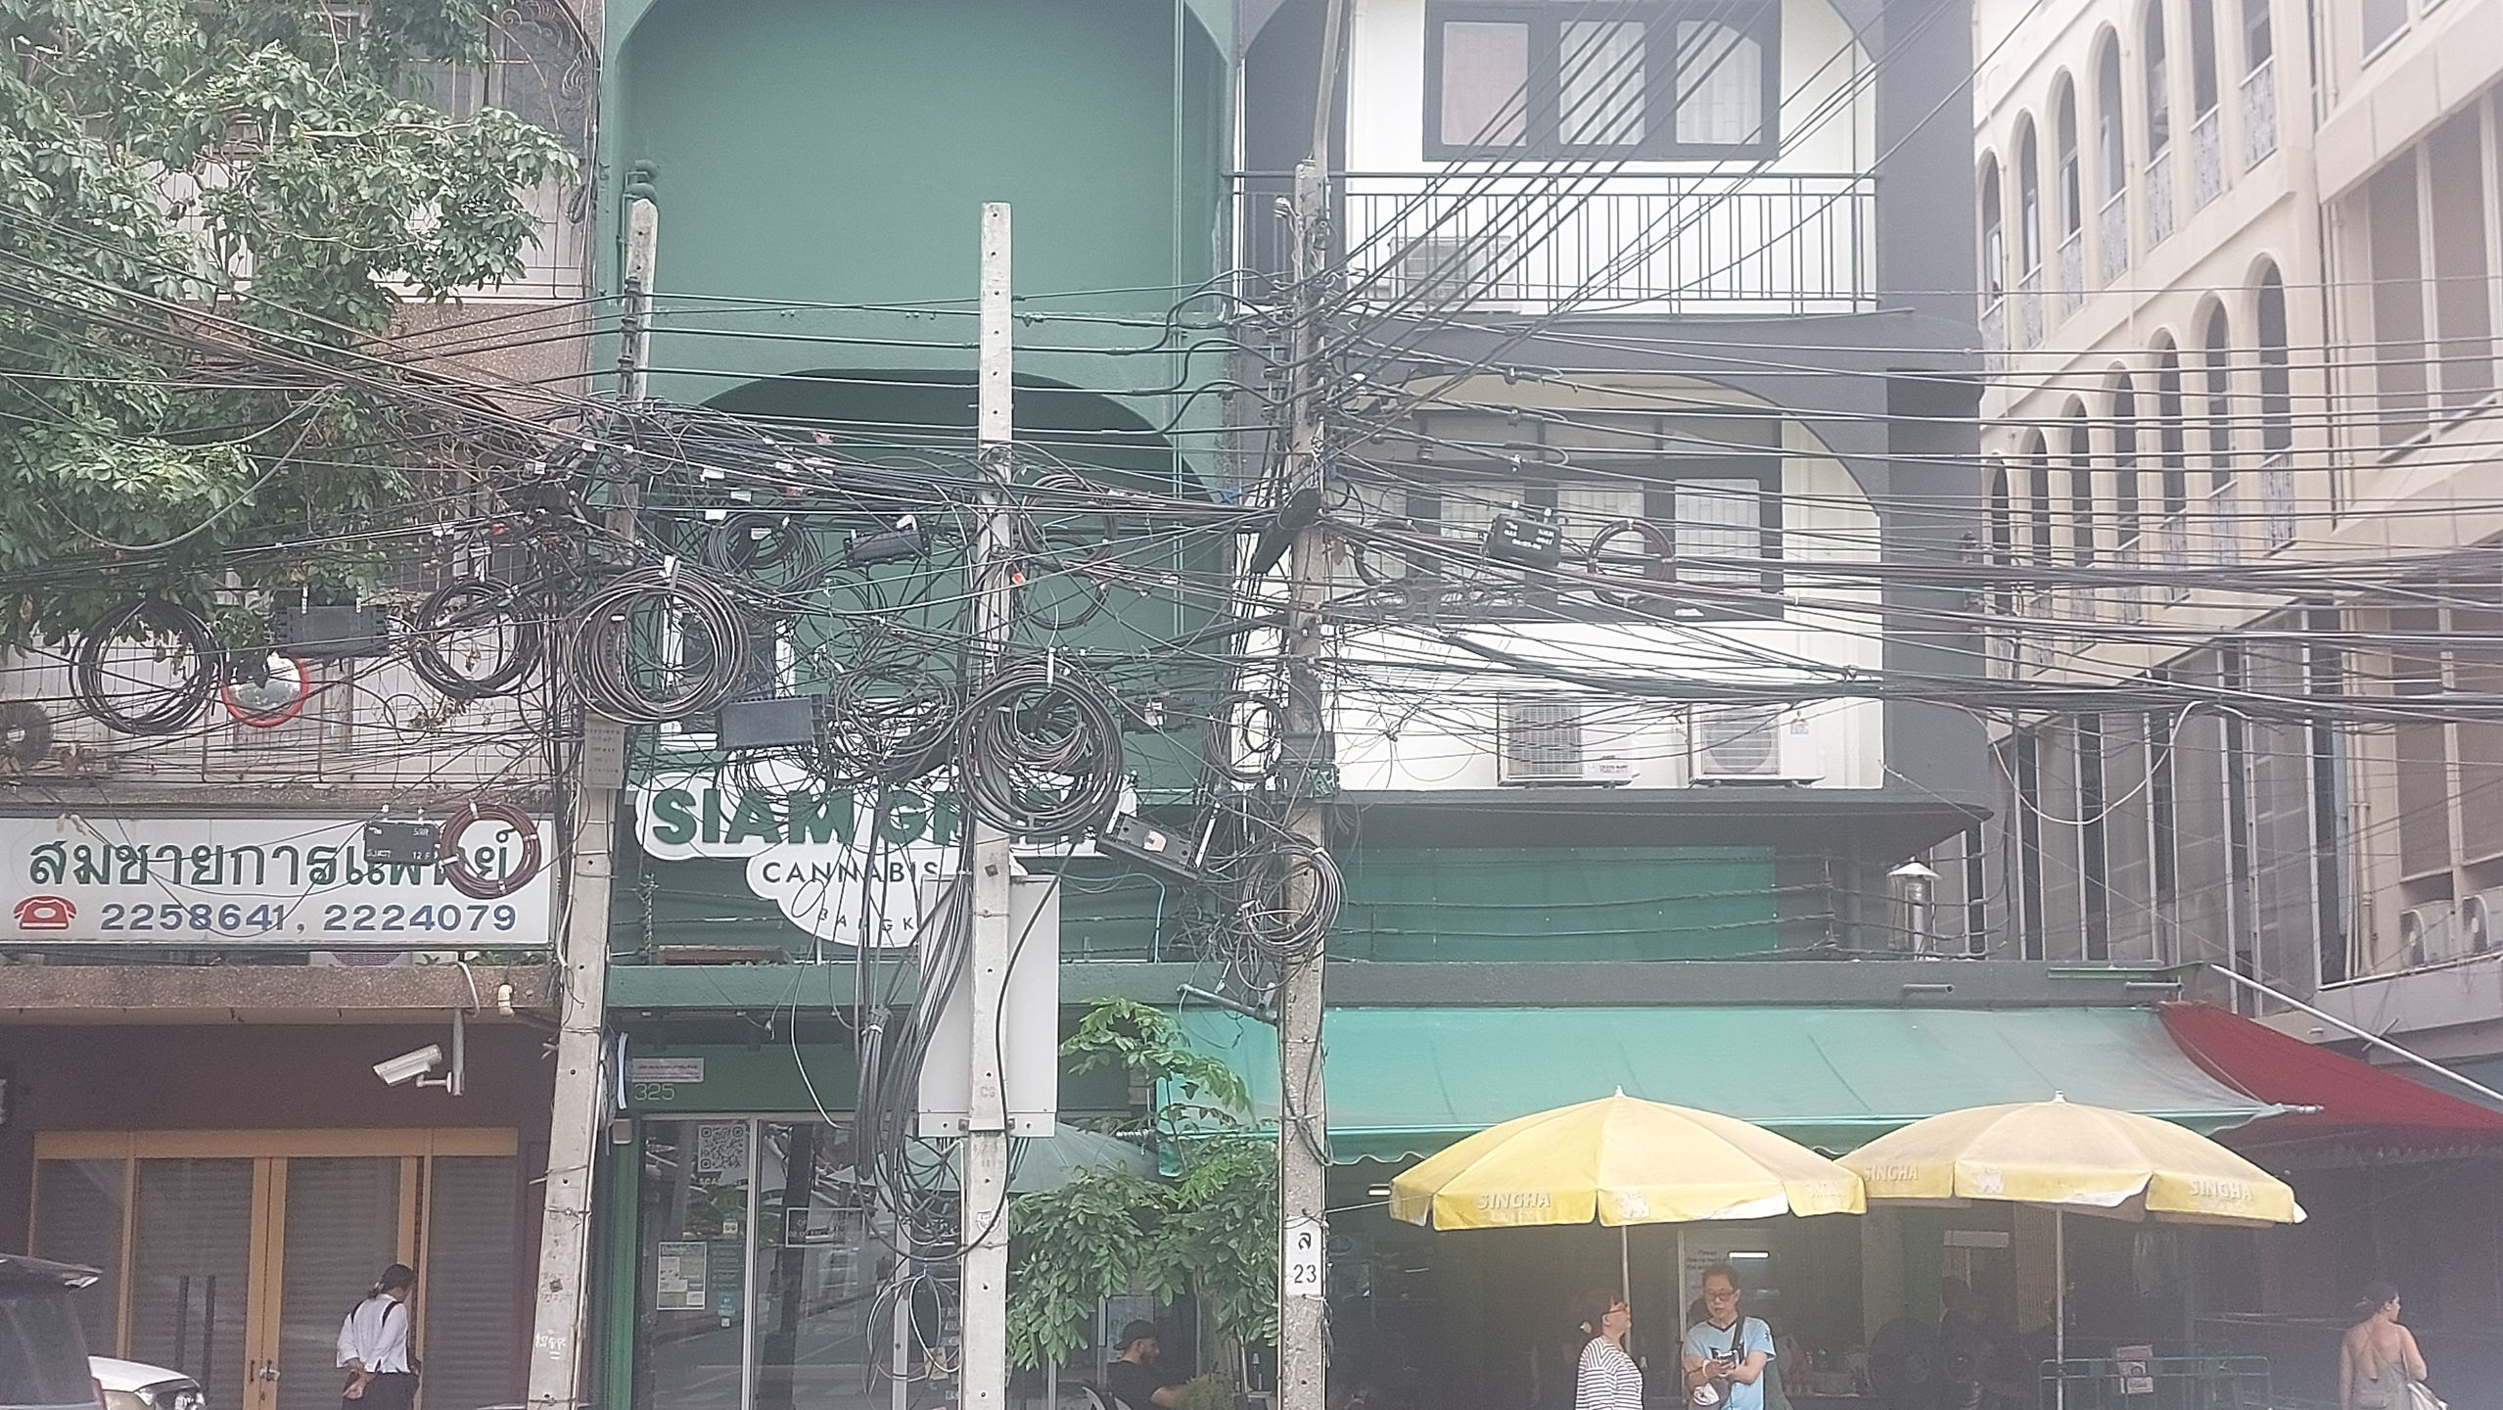
Notes:
Complexity is incremental

Slide 10
Properties of good code
Good code is obvious
Good code is easy to change (ETC)
Good code doesn’t repeat itself (DRY)

Slide 11
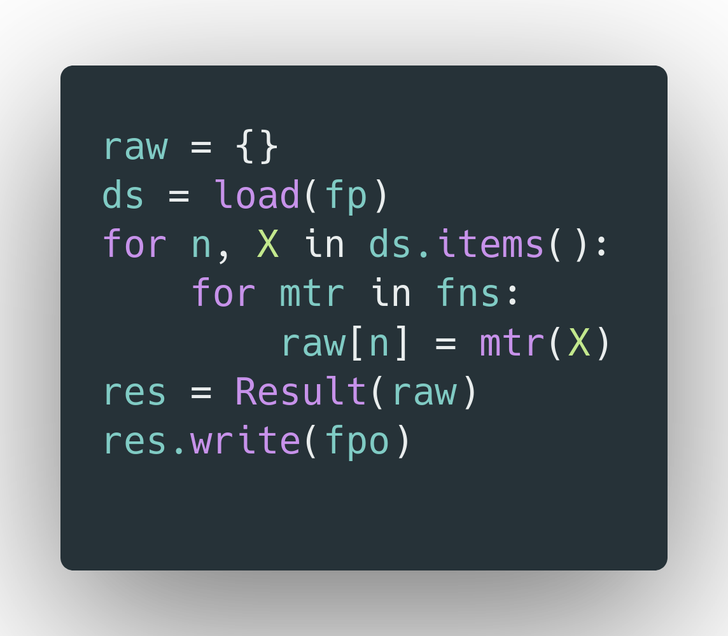
Good code is obvious

Slide 12
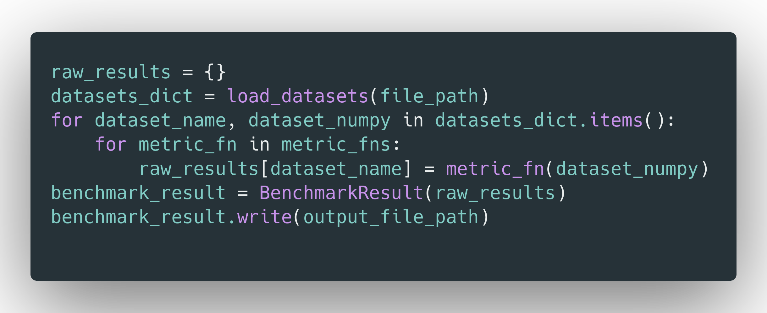
Good code is obvious

Slide 13
Reducing complexity
Make code simpler and more obvious
Make code more modular

Slide 14
Working Code Is Not Enough
Tactical programming: get it working
Strategic programming: investment mindset
Notes:
Tactical tornado: appears fast but leaves behind a mess
AI makes it easier to be a tactical tornado

Slide 15
Modular Design

Slide 16
Modular Design
A system is decomposed into independent modules
A module has an interface and an implementation
  Interface: what a developer needs to know to use the module
  Implementation: code that carries out promises made by the interface
The interface is what, the implementation is how
Notes:
In OOP the modules are typically classes, but the principle is more general

Slide 17
Abstraction

Slide 18
Comments

Slide 20
Testing

Slide 22
Tips & Tools

Slide 24
Design Patterns

