Slide 1
Personal effectiveness
Saeyslab Conference 2026

Slide 2
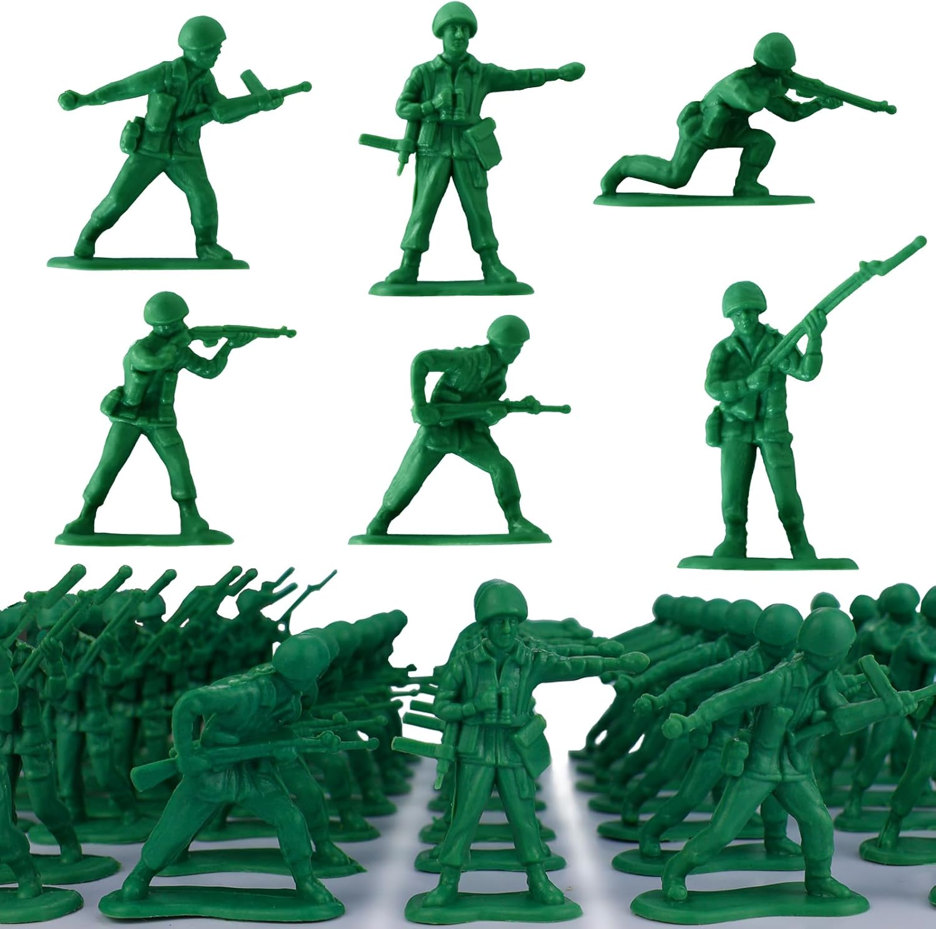
Rule 1: Do one thing at a time
Rule 2: Make sure it’s the right thing

Slide 3
Context Switching

Slide 4

Context switching is literally Hitler
A Portrait of Context Switching
Notes:
A computer with a single core can still run multiple programs
This happens through switching rapidly
You cannot actually multitask, what you’re doing is constantly switching
PROBLEM: when you switch, you lose focus!
Numbers don’t really matter here
LESS context switching means:
MORE productivity
MORE fulfillment in the job done
LESS anxiety
LESS mental exhaustion

Slide 5
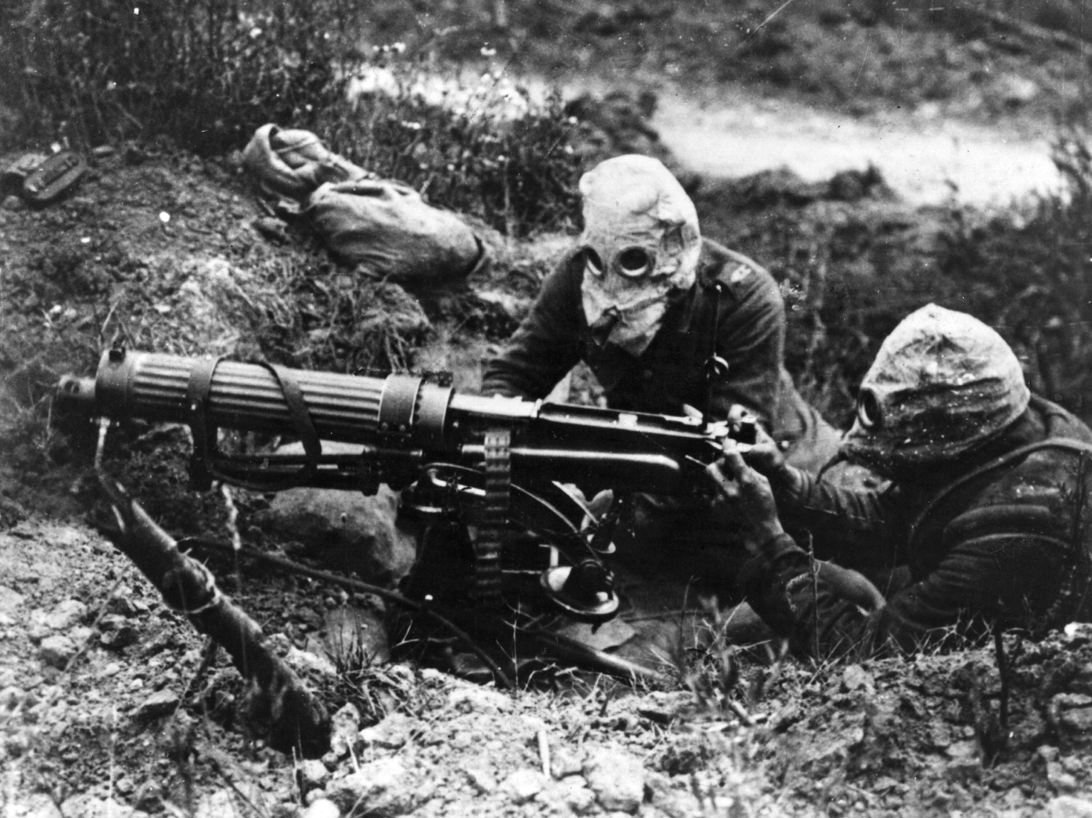


Your phone: the Battle of the Somme

Slide 6
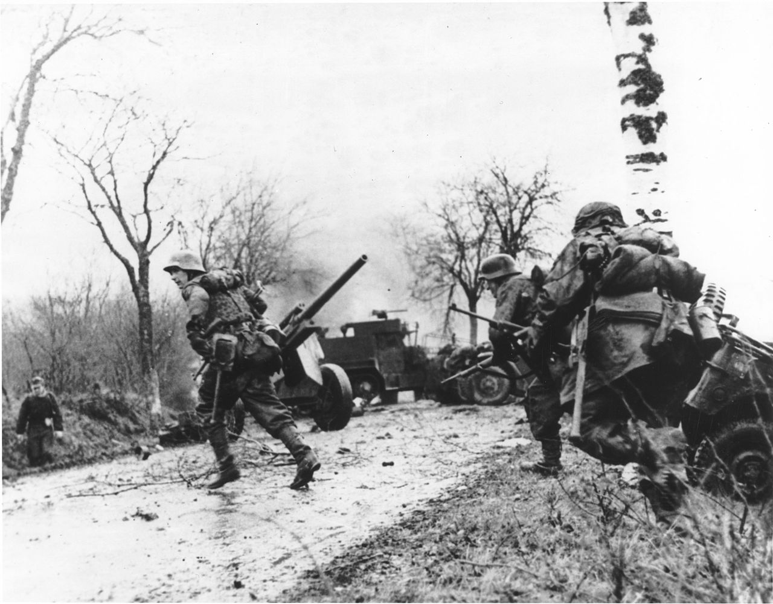



Email and instant messaging: the Ardennes Offensive

Slide 7
Deep Work: the underground resistance

Slide 8

I read and understood all of the solutions, but I still failed the exam!

Slide 9
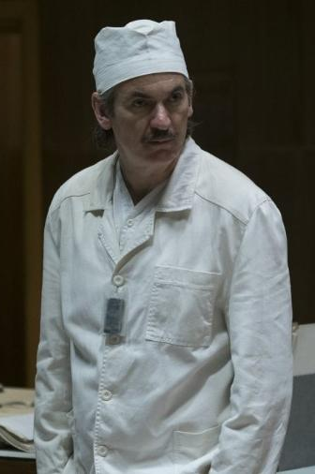
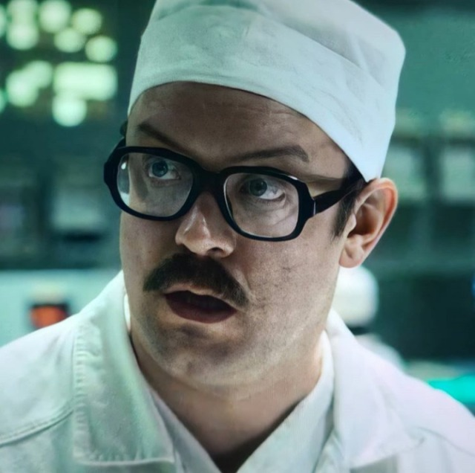

0 Roentgen
“We did everything right”
15000 Roentgen
“It exploded. The core exploded.”
3.6 Roentgen
“Not great, not terrible”

