Slide 1
Personal effectiveness
Saeyslab Conference 2026

Slide 2
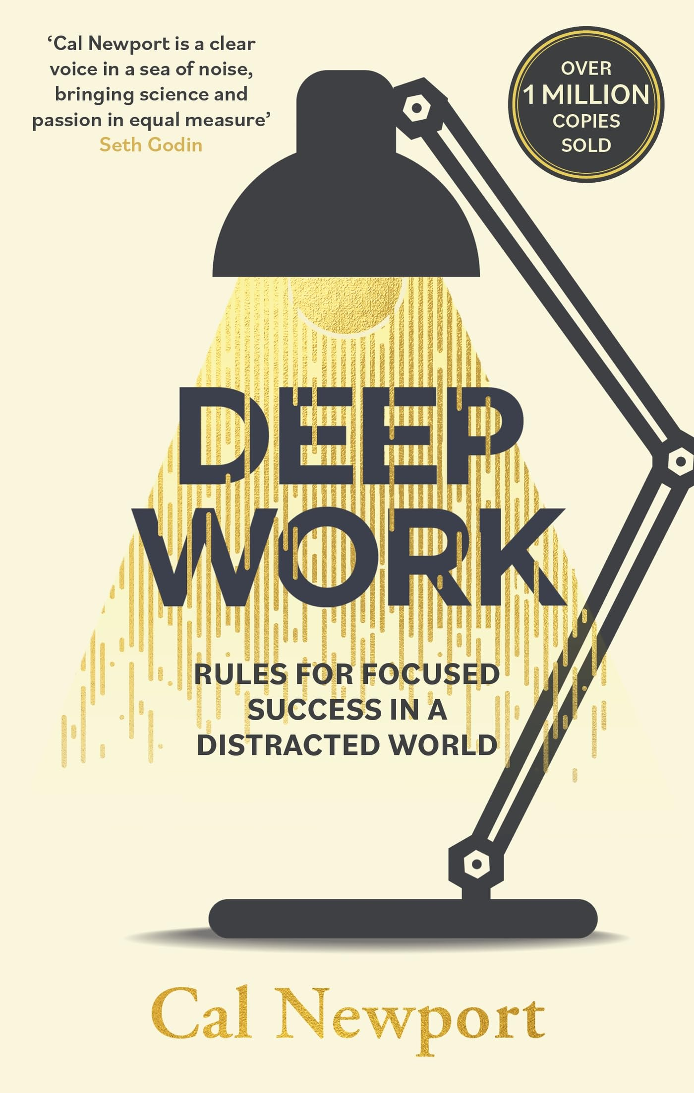
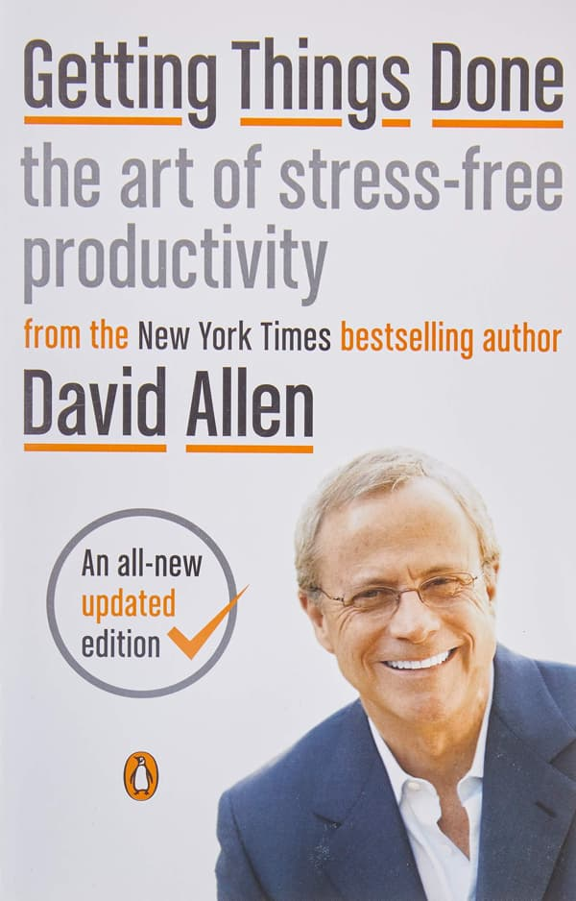
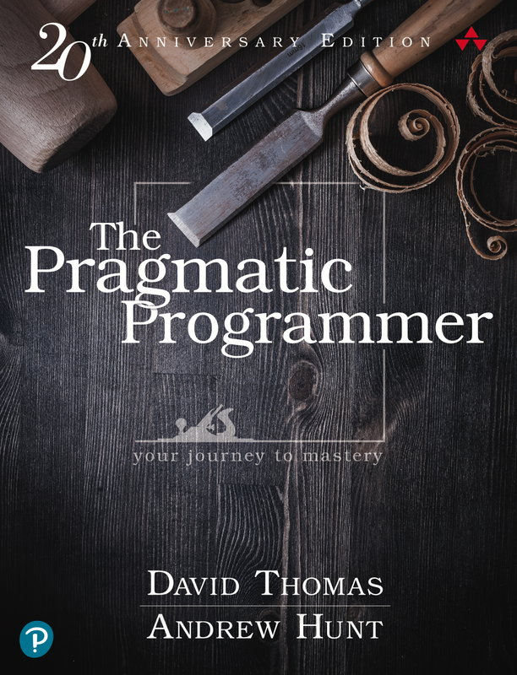
Sources

Slide 3
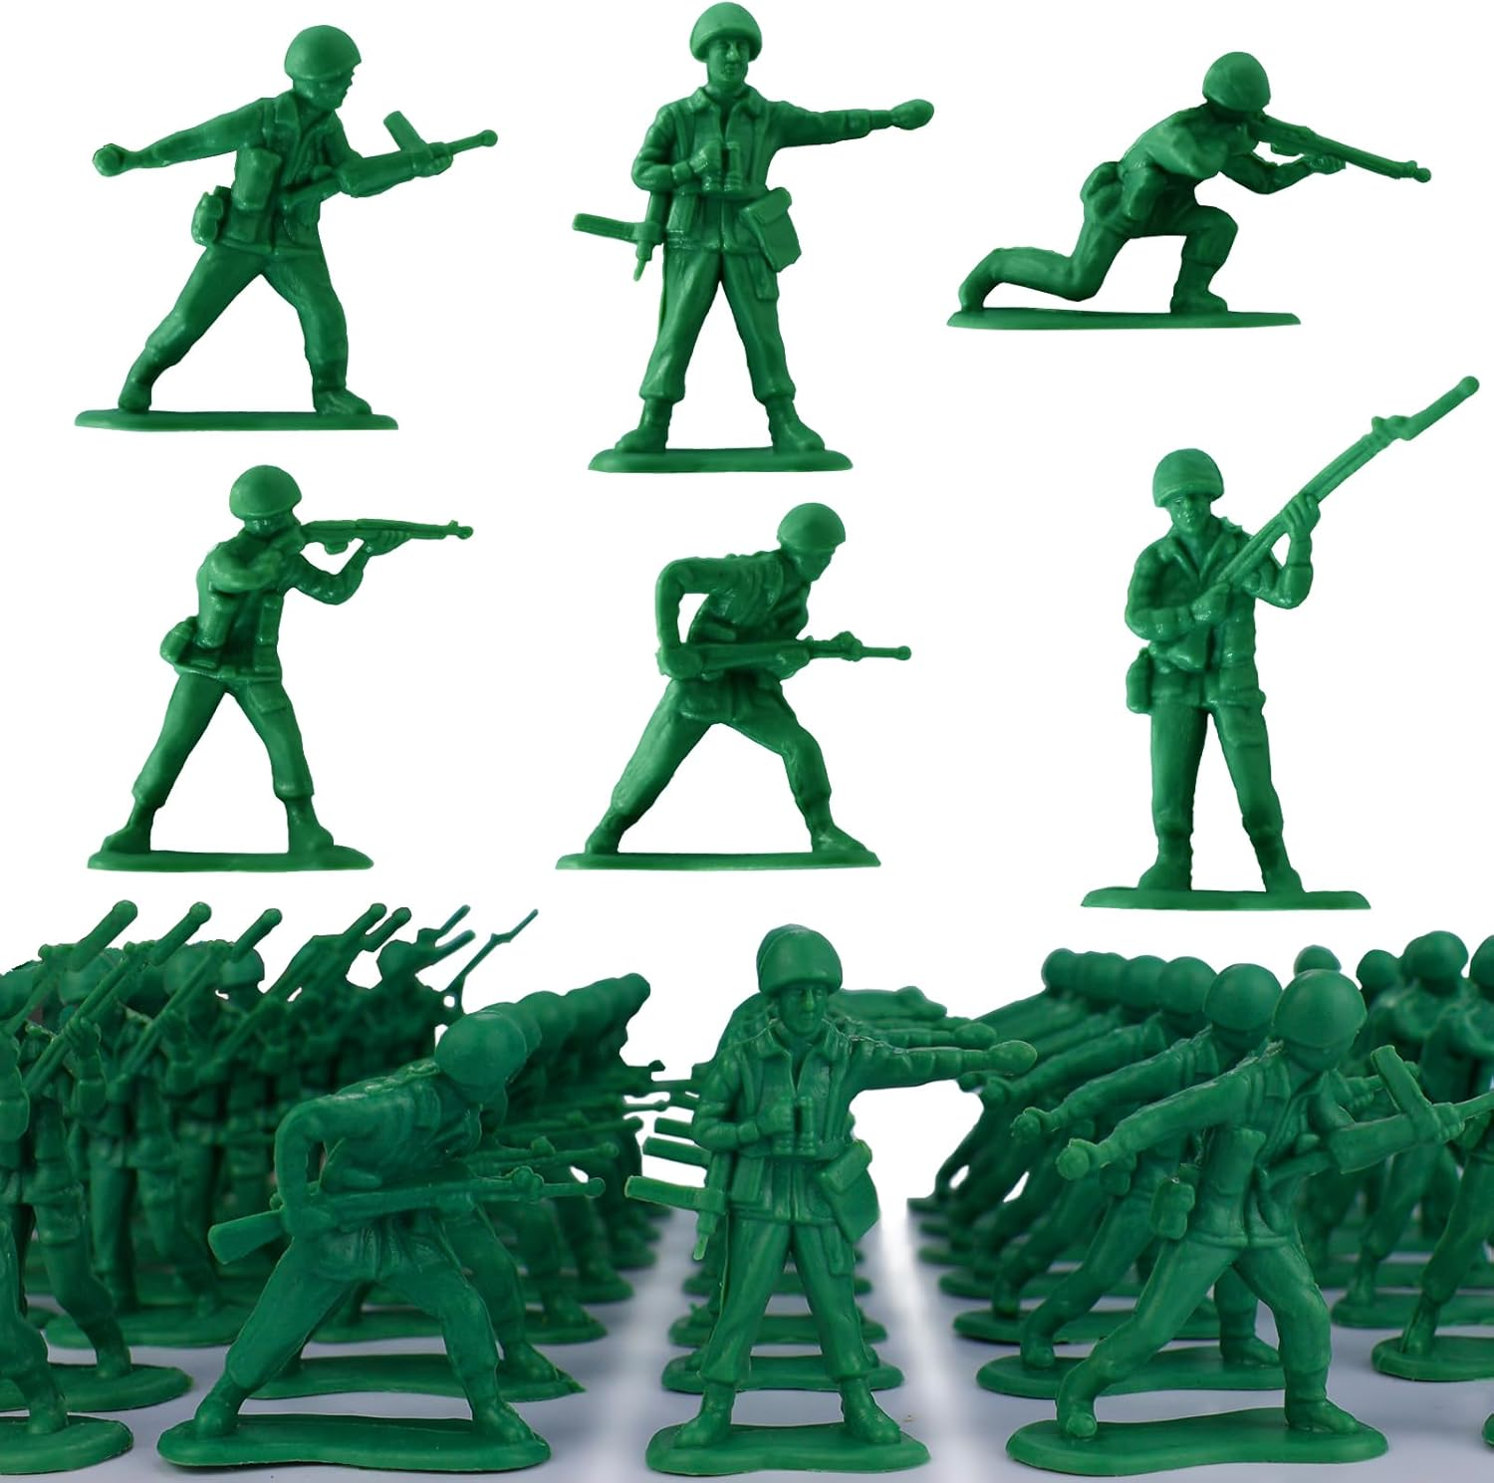
Rule 1: Do one thing at a time
Rule 2: Make sure it’s the right thing
Notes:
Attention economy: Mark Zuckerberg et al want to sell targeted ads
they want you looking at their platform at all times
they want to decide what you pay attention to, so they can monetize it
Your attention shapes your thoughts
Your thoughts shape your personality
This is a fight for self-determination

Slide 4
Context Switching

Slide 5
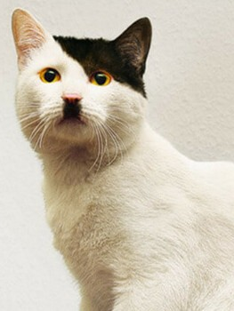
Context switching is literally Hitler
A Portrait of Context Switching
Notes:
A computer with a single core can still run multiple programs
This happens through switching rapidly
You cannot actually multitask, what you’re doing is constantly switching
PROBLEM: when you switch, you lose focus!
Numbers don’t really matter here
LESS context switching means:
MORE productivity
MORE fulfillment in the job done
LESS anxiety
LESS mental exhaustion

Slide 6
Deep vs. Shallow Work

Slide 7
Deep Work:
The Underground Resistance
Shallow Work:
The Occupying Force
Professional activities performed in a state of distraction-free concentration that push your cognitive abilities to their limit.
Non-cognitively demanding, logistical-style tasks, often performed while distracted.

Slide 8
Deep Work:
The Underground Resistance
Shallow Work:
The Occupying Force
Creates new value
Improves your skill
Is hard to replicate
Creates limited value
Does not improve skill
Is easy to replicate

Slide 9
Deep Work:
The Underground Resistance
Shallow Work:
The Occupying Force
Reading a difficult paper
Writing a research paper
Advanced programming
Replying to e-mails
Writing documentation
Basic programming

Slide 10
Quantifying depth
How long would it take to train a smart recent college graduate with no specialized training in my field to complete this task?

Slide 11
Deep vs. Shallow Work
Both types of work are necessary
Deep work should be overrepresented in your schedule
It usually isn’t because shallow work is easier
Deep work requires uninterrupted focus

Slide 12
Fighting Context Switching

Slide 13
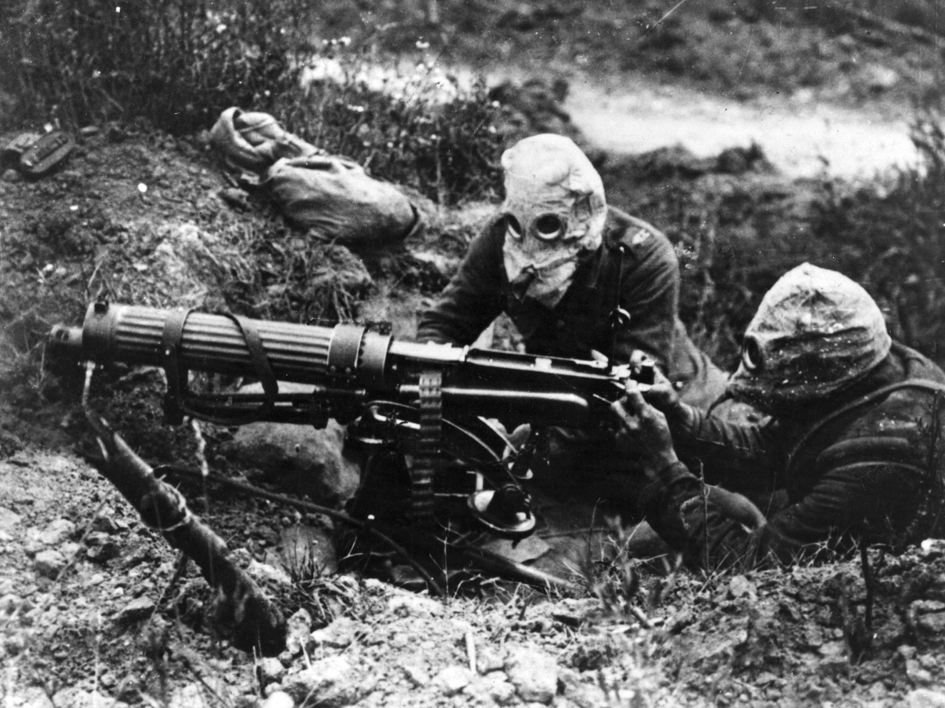


Your phone: the Battle of the Somme
Remove distracting apps
Use Work Mode
Put it away out of sight
Don’t accept the defaults
Monitor your screentime

Slide 14
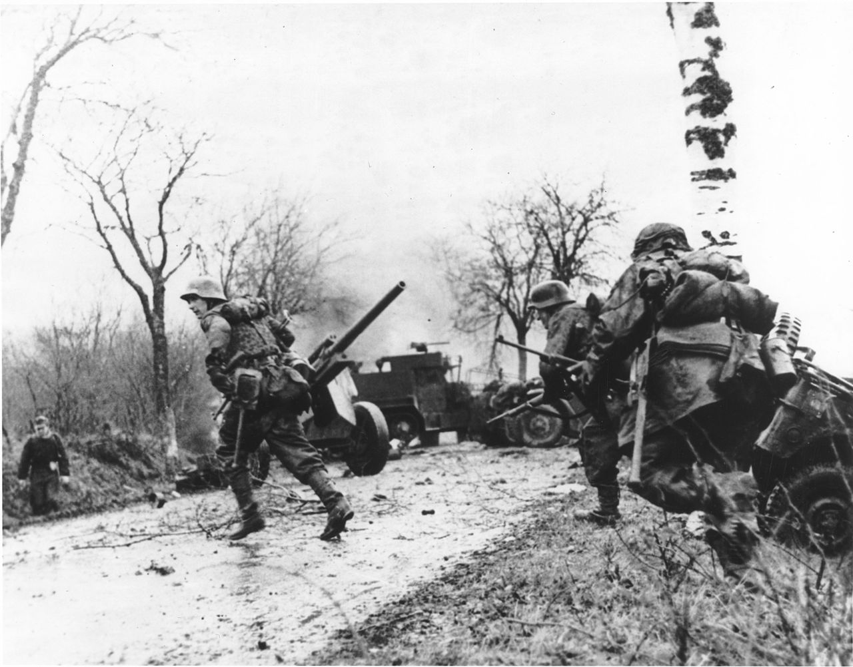



Email and instant messaging: the Ardennes Offensive
Close these apps during deep work
Put effort in your reply
Have a prepared meeting

Slide 15
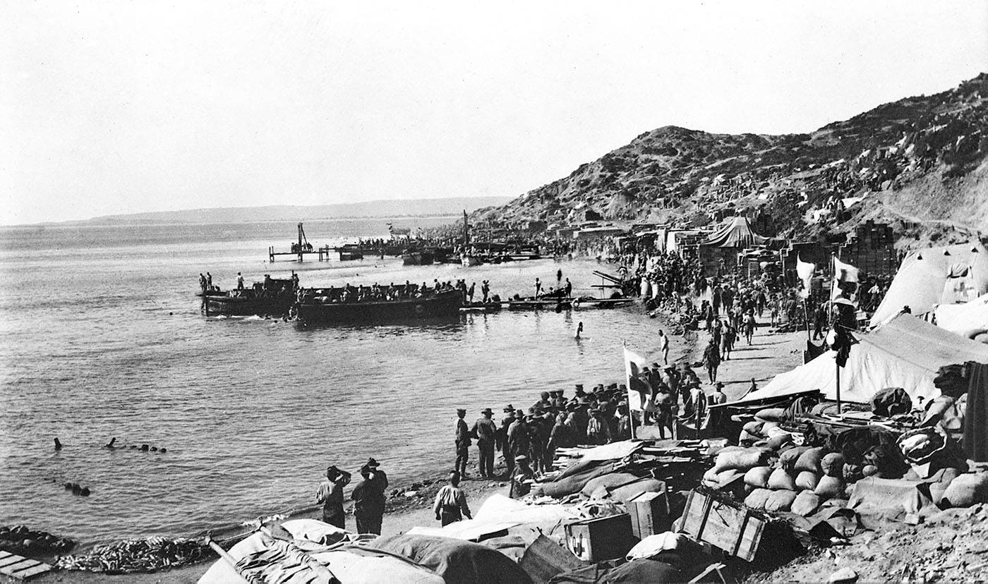

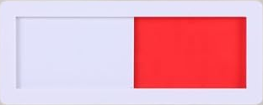
Open offices: the Gallipoli Campaign
Use and respect the red sliders
Get noise-cancelling headphones

Slide 16
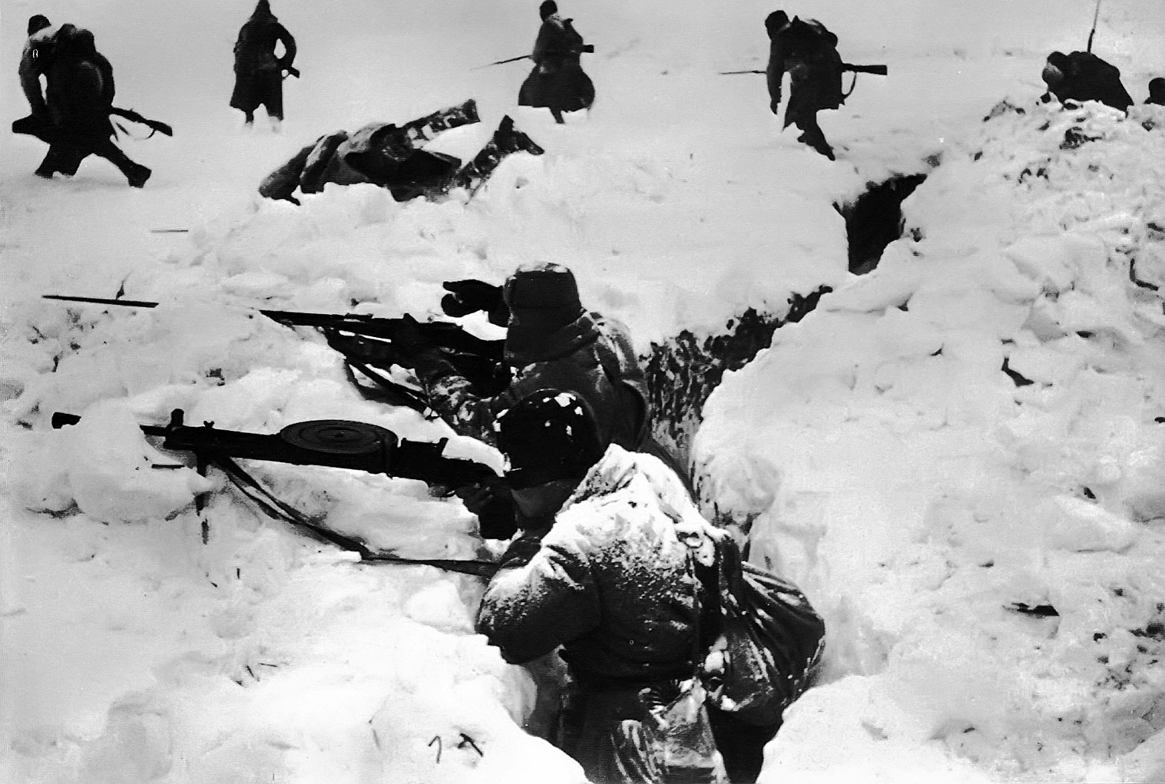


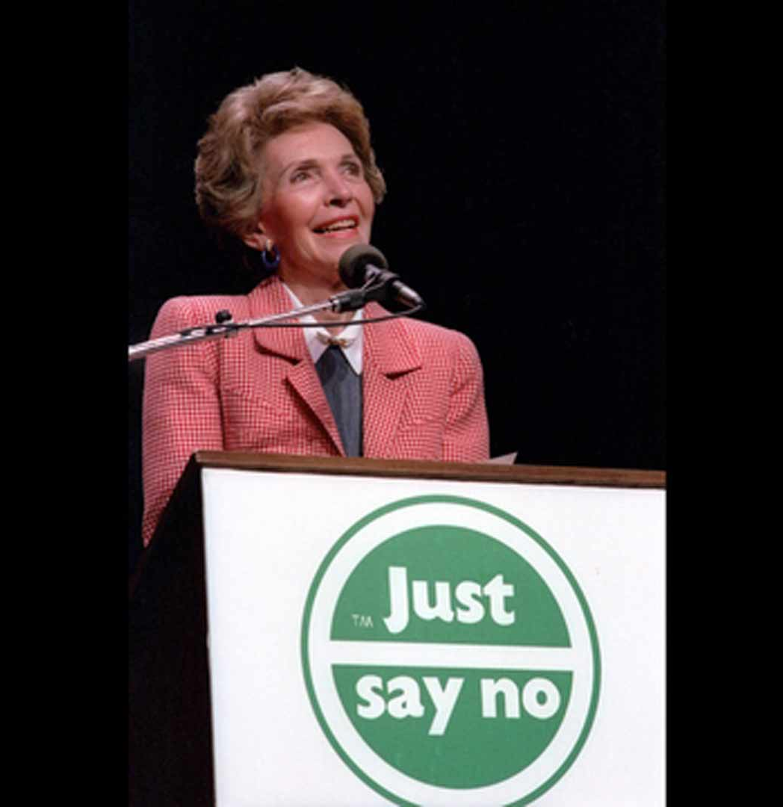
Algorithmically curated content: the Battle of Stalingrad
Reduces attention span
Is addictive
Makes your phone attractive
Hinders mental recovery
Just don’t

Slide 17
Doing Deep Work

Slide 18
Ritualize your deep work
Treat a deep work session like going to the cinema
  Phone on silent
  Have a drink ready
  Go to the toilet beforehand
  …
Tip: use a working_memory.txt file

Slide 19
Act on lead measures
Keep track of your deep work
Hold yourself accountable

Slide 20
Disconnecting from work
Downtime aids insight
Downtime helps recharge
  Remember the Battle of Stalingrad
Replacing downtime with work reduces quality
Implement a shutdown ritual

Slide 21
Embrace boredom
Take productive breaks
Practice mindfulness
Avoid permanent stimulation

Slide 22
Timeblock planning
Block deep work sessions as meetings
Respect a shallow work budget
Work backwards from your shutdown time

Slide 23
Rule 2: Make Sure
It’s The Right Thing

Slide 24
Multi-scale Planning

Slide 25
Multiscale planning and review
Core idea:
  Allow yourself to focus fully on the current task
  Without having to worry about the bigger picture
Multiscale planning and review
  Quarterly: ~ half day
  Weekly: ~ half hour
  Daily: ~ 10 minutes

Slide 26
Multiscale planning and review - Quarterly
Goal:
  Identify mid- to long-term goals for next quarter
  Review how you did last quarter
  Figure out what can be improved

Slide 27
Multiscale planning and review - Weekly
Goal:
  Select steps to take towards your quarterly goals
  Estimate if you are on track for those goals

Slide 28
Multiscale planning and review - Daily
Goal:
  Shut down for today
  Start tomorrow knowing exactly what you need to do

Slide 29
Getting Things Done

Slide 30
Getting Things Done: The Goal
[To be] confident that whatever you’re doing at the moment is just what you need to be doing – that having a beer with your staff after hours, gazing at your sleeping child in his or her crib at midnight, answering the e-mail in front of you, or spending a few informal minutes with the potential new client after the meeting is exactly what you ought to be doing, as you’re doing it.

Slide 31
Getting Things Done: What It Is Not
A piece of software
A way of organizing files and folders on your PC
A way to prevent having to do hard thinking

Slide 32
Getting Things Done: Core Ideas
Develop a capture habit
Record obligations in a trusted system
Transform “stuff” into concrete Next Actions
Notes:
Reduces stress and anxiety
Avoids procrastination
Helps devote your full attention to a given task
Eliminate distraction and stress about what you’re not doing

Slide 33
Stuff
Anything you have allowed into your psychological or physical world that doesn’t belong where it is, but for which you haven’t yet determined what, exactly, it means to you, with the desired outcome and the next action step.
Notes:
“stuff” will keep tabs open in your brain

Slide 34
Exercise
What is on your mind right now?
What is the desired outcome?
What is the very next physical action?
Notes:
- What is most on your mind right now (professional or personal)
- Single sentence: desired outcome
- Very next physical action
- How do you feel?
- Why does it help? => not “getting organized” or “setting priorities”, but just thinking
- You have probably done this before: make a list

Slide 35
The GTD System
Capture
Clarify
Organize
Reflect
Engage
Notes:
Capture what has our attention
Clarify what each item means and what to do about it
Organize the results
Reflect on the resulting options
Choose which option to engage with

Slide 36
Capture
Get it all out of your head
Minimize the number of capture locations
Empty capture locations regularly

Slide 37
Clarify
What is it?
Is it actionable?
  No: trash / reference / Someday Maybe
  Yes: What is the next action?
    Do it
    Delegate it
      Put it in a Waiting For list
    Defer it
      To your calendar
      To a (project-specific) Next Action list
Notes:
<2 minutes => do it
Delegate it: does not need to be “down”
Defer it: to (project-specific) next action list

Slide 38
Reflect
In your weekly review, go through:
  Projects
  Waiting For
  Next Action lists
  Someday/Maybe
Question: why do many people feel good about their work the week before they leave on vacation?

Slide 39
Engage
Calendar defines the hard landscape
Next Action lists define the rest

Slide 40
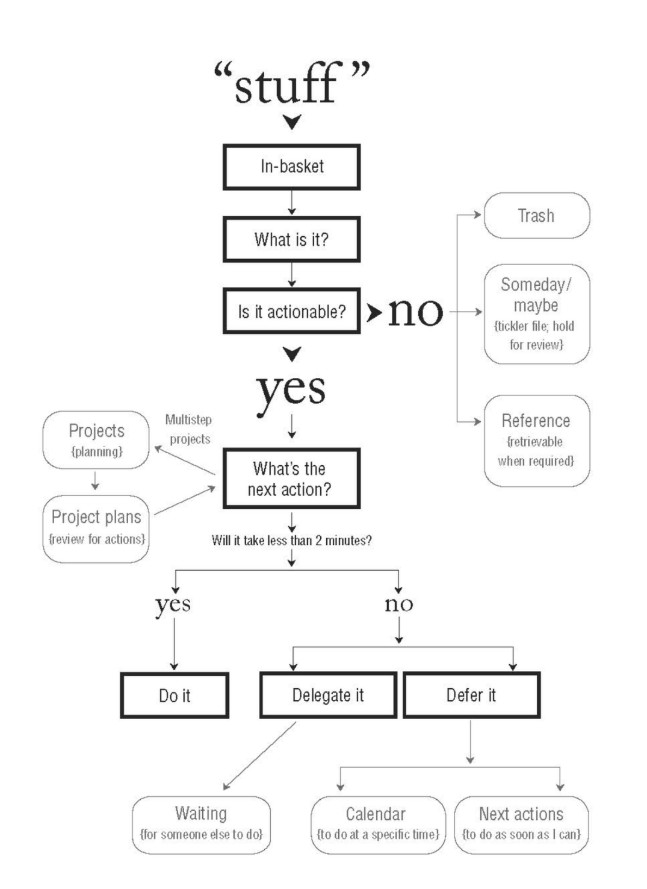
Summary

Slide 41
Getting Things Done: Takeaways
I recommend reading the book (I have free epubs)
  Idem for Deep Work
There are loads of tutorials online
Feel free to cherry pick
Notes:
Example of cherry picking: just the 2-minute rule already helps a lot

Slide 42
Taking Notes

Slide 43
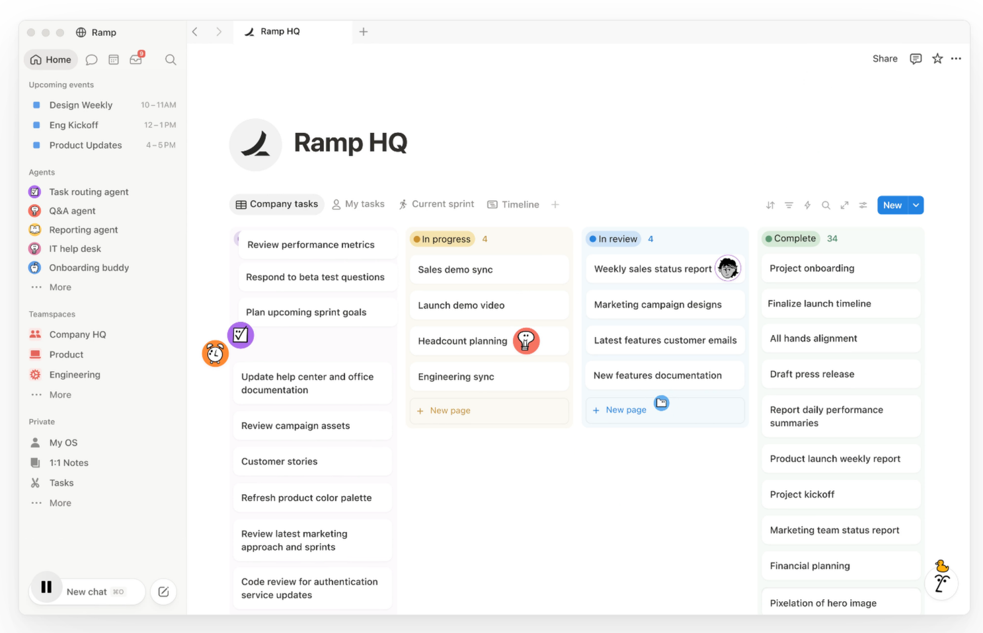
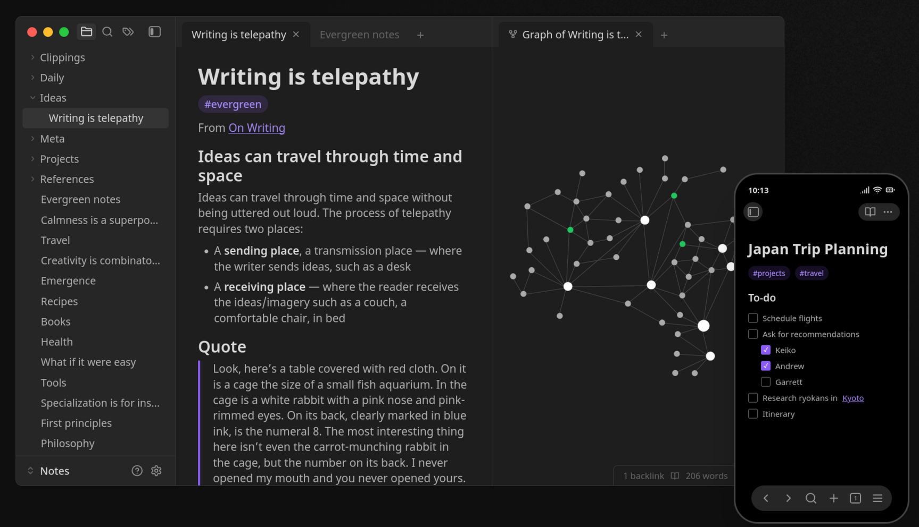
Obsidian vs. Notion

Slide 44
Obsidian
Notion
Local
Markdown files
Simple out of the box
  Plugins available
Cloud
Less control over data
More powerful

Slide 45
General tips
Link often
Use backlinks
Keep a diary
DEMO
Notes:
DEMO
Principal components analysis
Note per person
Highlight: no more blank page

Slide 46
Cognitive Fitness
Notes:
Aerobics: 1960s
Attention span dropping since smartphones
AI makes this even worse
We need “aerobics” for our minds

Slide 47
A basic cognitive fitness plan
Read every day
Landlining
Don’t avoid writing
Go on thinking walks
Learn a hard skill
KPIs:
  Reading test
  Productive meditation test
Notes:
- Read every day = 10.000 steps a day
- Landlining = stop smoking
- Don’t avoid writing = take the bike/stairs
- Go on thinking walks = intense workout
- Learn a skill = practice a sport
- Reading test: difficult but understandable book
- Meditation test: focus and make progress internally

Slide 48

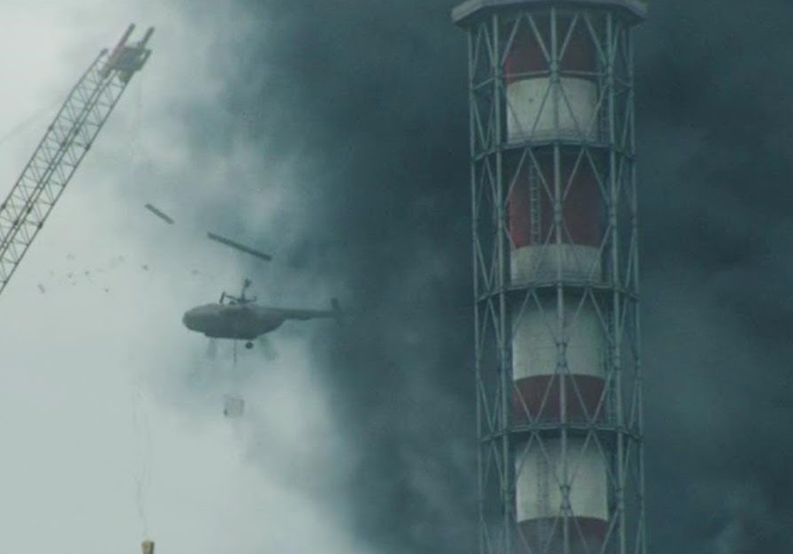
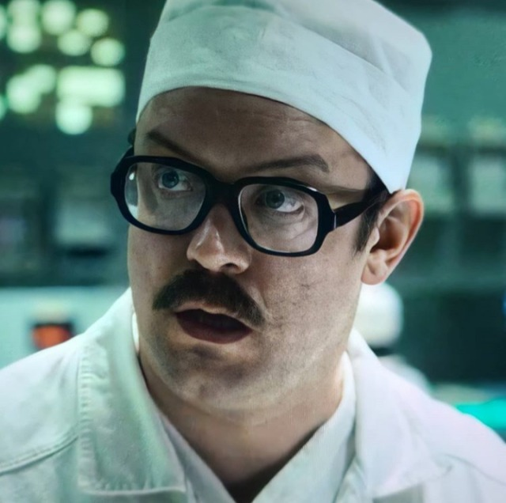
Avoid the path of least resistance
A simple system that makes you feel in control of your work
A nice dashboard with an overview of all of your projects
A system so complex, it introduces friction
15000 Roentgen
“It exploded. The core exploded.”
0 Roentgen
“We did everything right”
3.6 Roentgen
“Not great, not terrible”
Notes:
- Focusing is hard, we feel resistance.
- The path of least resistance is often procrastination
- Remember: embrace boredom

Slide 49
Avoid the path of least resistance
Procrastinotion
A simple system that makes you feel in control of your work
A nice dashboard with an overview of all of your projects
A system so complex, it introduces friction
15000 Roentgen
“It exploded. The core exploded.”
0 Roentgen
“We did everything right”
3.6 Roentgen
“Not great, not terrible”

Slide 50
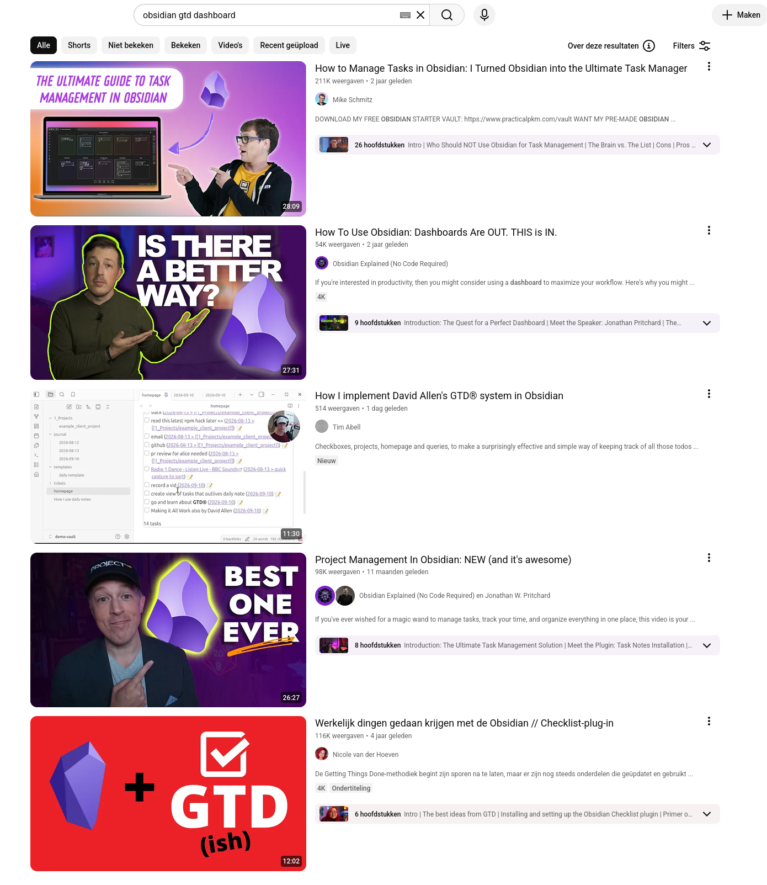
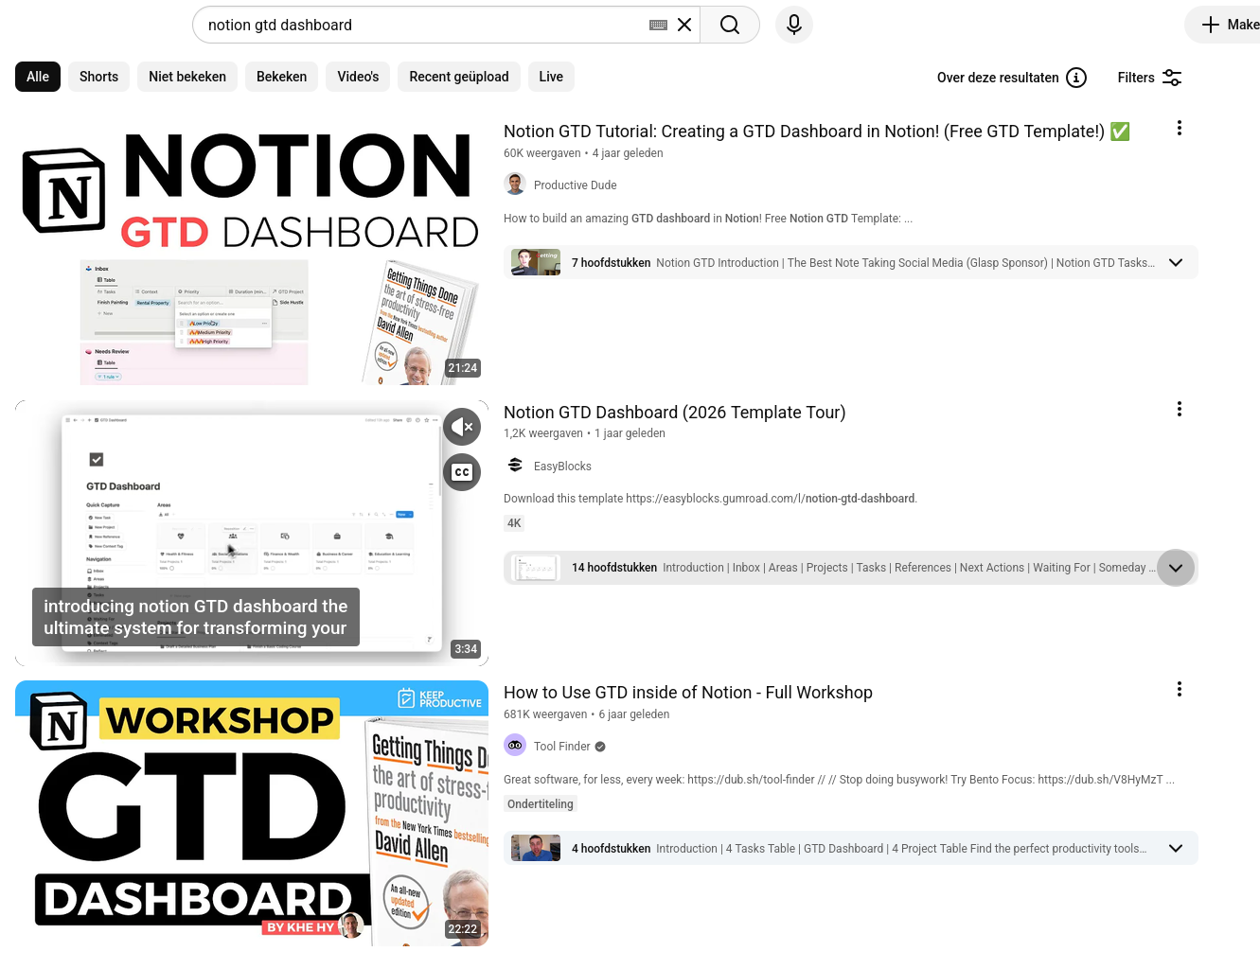

Slide 51
Procrastinotion
Feels like work
Is not actually useful
But is more fun than actual work

Slide 52
Avoid the path of least resistance
Task: Use AI to implement a script to parse 1000 CSV-files and extract specific information.
Estimated time required without AI: 3 hours
Implement the script
20 minutes
Implement the script
Generate a PDF report
3 hours
Implement the script
Generate a PDF report
Publish a package
Write 10 pages of documentation
1 day
15000 Roentgen
“It exploded. The core exploded.”
0 Roentgen
“We did everything right”
3.6 Roentgen
“Not great, not terrible”
Notes:
With AI coding we can have something similar:
Building with AI is fun and feels like work
But make sure that what you’re building is useful

Slide 53
Your Knowledge Portfolio
Invest regularly
Diversify
Manage risk
Buy low, sell high
Review and balance
Notes:
- Invest regularly: Learn something just for the sake of learning.
- Diversify: Learn about things outside of your comfort zone
- Manage risk: Learn about established as well as new, less stable concepts
- Buy low, sell high: Identify emerging technologies/concepts
- Review and balance: Think about which concepts might be worthwhile learning about

Slide 54

Me in high school
I read and understood all of the solutions, but I still failed the exam!
Learning is an active process
Notes:
This can happen if you use agents, but also:
- Watching youtube videos
- Reading and mindlessly following tutorials
- Looking at math
- Summarizing just by highlighting
Instead, do something active:
- Play around with a tutorial
- Recreate the math
- Summarize in your own words

Slide 55
Keeping Track of the Literature

Slide 56
Keeping Track of the Literature
In theory
  Subscribe to newsletters of relevant journals
  Go through them once a week
  Save papers to read in Zotero
  Schedule a weekly literature time block
In practice
  I never get around to this and am hopelessly behind literature somebody please help me aaaaaaa
  Question: How do you do it?

Slide 57
Sources (I have free PDFs and epubs)

