Slide 1
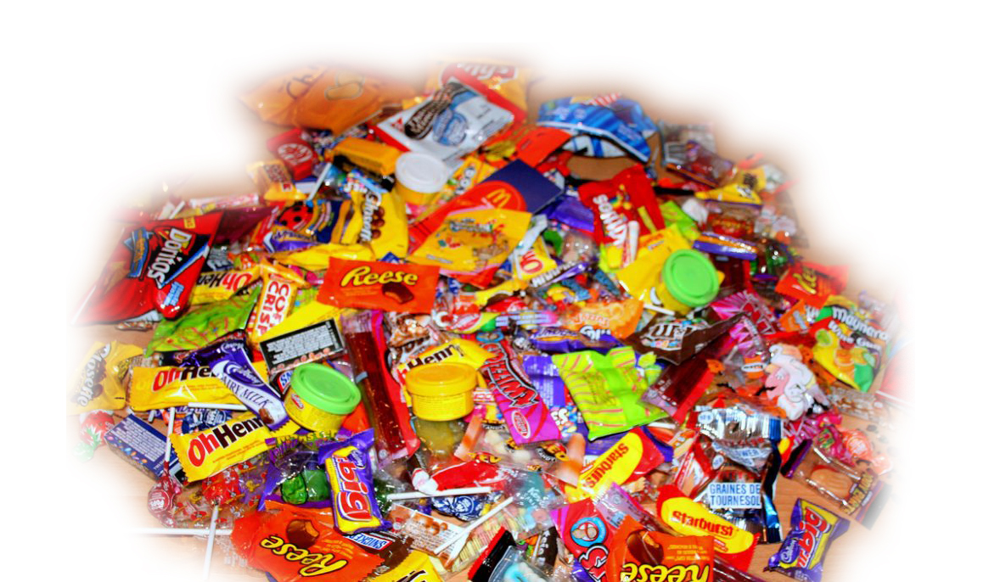
Super Candy Task
Arne Haak 2020-10-13
Original Photo:
Bren/Flickr, Creative Commons License

Slide 2
Concept Overview
Data Exploration
Fitting a simple linear model with logistic regression:
Inputs: Features of candy
Output: “Win” probability (preference of this candy over other candies)
Evaluation: How well does the model explain the test data?
Application of model to search for super candy

Slide 3
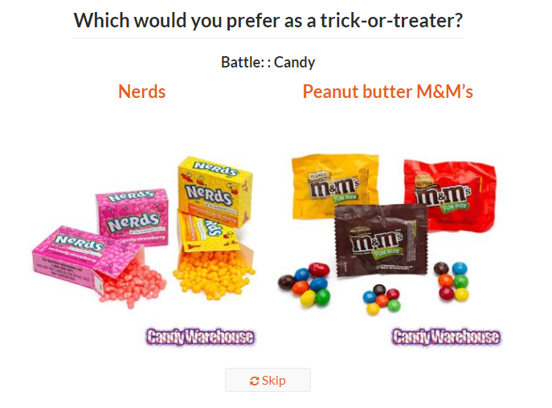
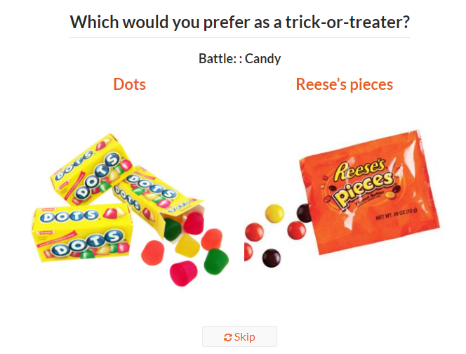
Data (1/2): Candy Online Survey
http://walthickey.com/2017/10/18/whats-the-best-halloween-candy/

Slide 4
Data (2/2)
Setup:
Online voting
Question: "Which would you prefer as a trick-or-treater?"
Random matchup of two sweets, vote which one is more preferred
Time: October 2017
Voters:
No regional limitation (online voting), but sweets are from the North American market
8371 different IP addresses
269k votes (per IP address: average 32, median 11)
Criticism:
Only 85 samples
Only 29 unique samples (with unique binary feature vectors)
This is not a buying decision, i.e., the price has no influence here
Nutritional values (calories, sugar, fat, ...) do not matter here, as packages cannot be inspected
Food taste is not tested, i.e., meaningful voting only for known sweets

Slide 5
Execution
(See Jupyter notebook)

Slide 6
Conclusion (1/2)
Data is not sufficient for the given problem
Oversimplified linear model of binary ingredient information does not represent human sense of taste properly
E.g., combination of different ingredients, like chocolate and fruits
Improvement ideas:
Collect better data:
Actual buying decisions from stores
More precise representation of ingredients
Use more complex models

Slide 7
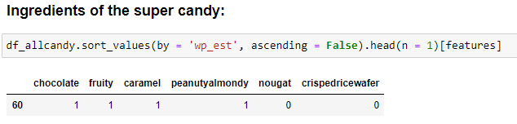
Conclusion (2/2)
It’s understood that the data is insufficient and the model is oversimplified
If we accept the concept, anyway, there is a list of top 50 highest ranking candies in the Jupyter notebook (for alignment with the existing candy portfolio), with the following #1 super candy:

