Slide 1
Project Name
Survey Results
Arne Lienemann
Consumer Insights | Global Portfolio Management

Slide 2
Results

Slide 3
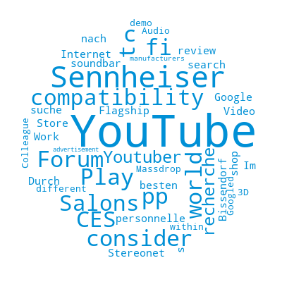
Open comments
Where did you hear about the AMBEO Soundbar? (n = 24).

Slide 4
Results
Online shop specialized on hi-fi products
Where did you buy the AMBEO Soundbar? (n = 343).

Slide 5
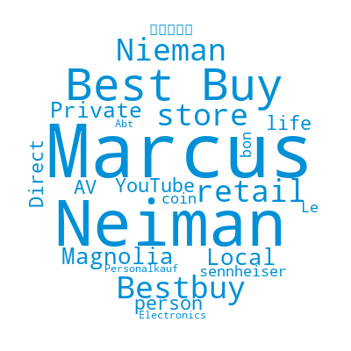
Open comments
Where did you buy the AMBEO Soundbar? (n = 25).

Slide 6

Open comments
How important were the following reasons for your purchase of the AMBEO Soundbar? (n = 13).

Slide 7
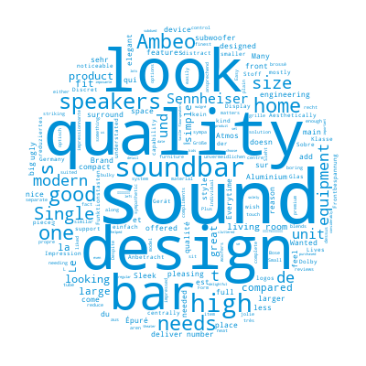
Open comments
You ranked "design" to be one of the most important purchase drivers. Please explain why. (n = 55).

Slide 8
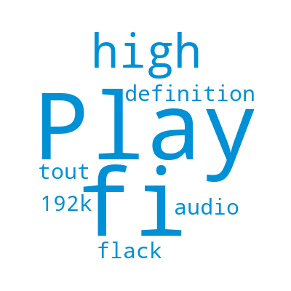
Open comments
For which usage situations did you mainly intend to use the AMBEO Soundbar? (n = 2).

Slide 9
Results
No, I did not listen to the AMBEO Soundbar before getting it.
Before getting the AMBEO Soundbar, were you able to listen to it? (n = 343).

Slide 10

Open comments
Before getting the AMBEO Soundbar, were you able to listen to it? (n = 12).

Slide 11
Results
Yes, the AMBEO Soundbar replaced a 5.1 system.
Did the AMBEO Soundbar replace an existing audio system of yours? (n = 343).

Slide 12
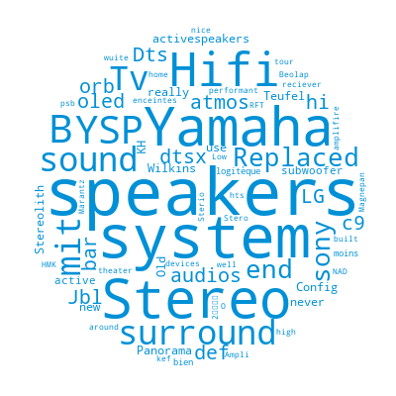
Open comments
Did the AMBEO Soundbar replace an existing audio system of yours? (n = 35).

Slide 13
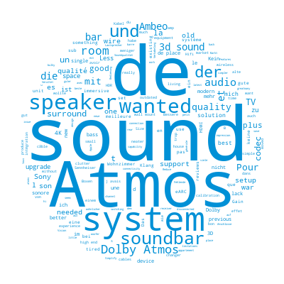
Open comments
Why did you decide to replace your existing audio system? (n = 260).

Slide 14
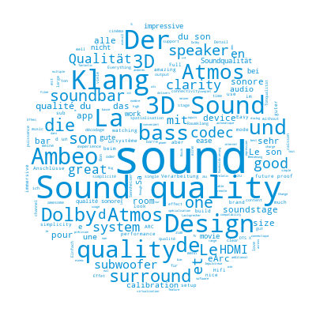
Open comments
What do you especially like about the AMBEO Soundbar? (n = 334).

Slide 15
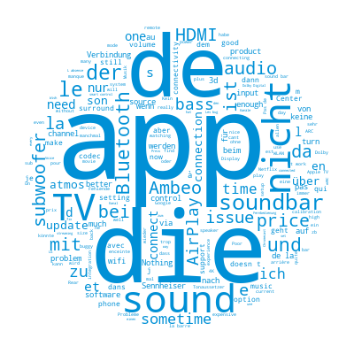
Open comments
What do you especially dislike about the AMBEO Soundbar? (n = 336).

Slide 16
Results
Like very well
Which of these statements best describe how much you like or dislike the AMBEO Soundbar? (n = 343).

Slide 17
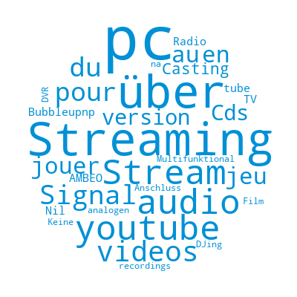
Open comments
How often do you use your AMBEO Soundbar in the following usage occasions? (n = 17).

Slide 18
Results
It varies and is really depending on my personal mood and the social setting I am in.
Listening to music (n = 261).

Slide 19
Results
I am fully diving into the content and blend out everything else around me
Watching a movie (n = 342).

Slide 20
Results
I am fully diving into the content and blend out everything else around me
Watching series (n = 320).

Slide 21
Results
It varies and is really depending on my personal mood and the social setting I am in.
Listening to podcasts (n = 58).

Slide 22
Results
It varies and is really depending on my personal mood and the social setting I am in.
Watching sports (n = 207).

Slide 23
Results
It varies and is really depending on my personal mood and the social setting I am in.
Watching TV shows (n = 271).

Slide 24
Results
I am fully diving into the content and blend out everything else around me
Gaming (n = 174).

Slide 25
Results
It varies and is really depending on my personal mood and the social setting I am in.
Listening to (daily) news (n = 178).

Slide 26
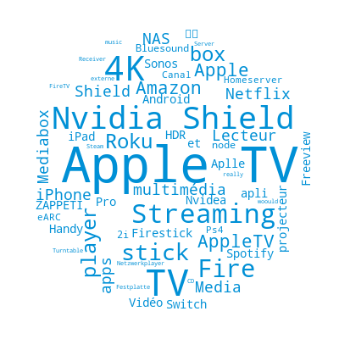
Open comments
When you are using your AMBEO Soundbar, which sources are the most prevalent ones? (n = 97).

Slide 27
Results
50 to 59 inches
What is the size of your TV that you connect your AMBEO Soundbar with? (n = 343).

Slide 28
Results
2
How many devices have you connected with your AMBEO Soundbar via HDMI-port? (n = 343).

Slide 29
Results
No
Are you using a dedicated subwoofer together with your AMBEO Soundbar? (n = 343).

Slide 30
Results
Standing on a side board
Where did you place your AMBEO Soundbar? (n = 343).

Slide 31
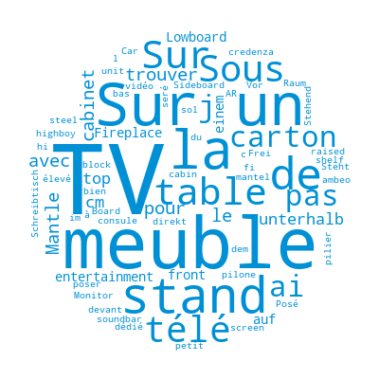
Open comments
Where did you place your AMBEO Soundbar? (n = 34).

Slide 32
Results
251-350 sqft. / 24-32 m²
What is the approximate size of the room your AMBEO Soundbar is in? (n = 343).

Slide 33
Results
No, I am not controlling the AMBEO Soundbar via voice assistant
Are you using a voice assistant to control your AMBEO Soundbar? (n = 343).

Slide 34
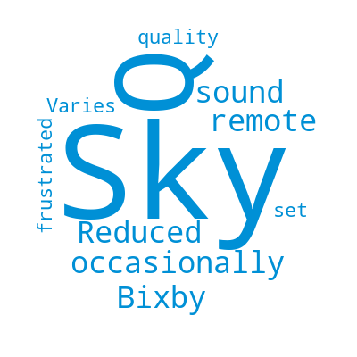
Open comments
Do you in general use any voice assistants? (n = 7).

Slide 35
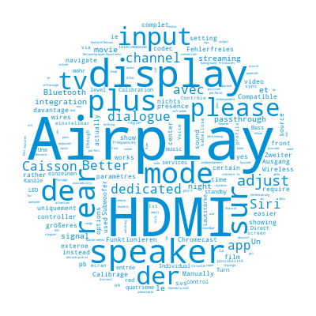
Open comments
If you could for the future choose up to two features to be added to your AMBEO Soundbar, which ones would you choose? (n = 61).

Slide 36
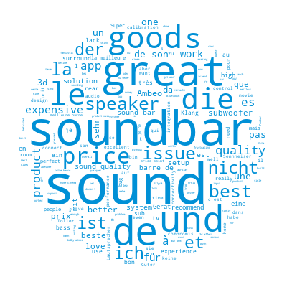
Open comments
Please explain your decision: (n = 323).

Slide 37
Results
Male
I am… (n = 343).

Slide 38
Results
25-34 years
Please state your age. (n = 343).

Slide 39
Results
Urban
In which area do you live? (n = 343).

Slide 40
Results
Employee (full-time or part-time)
What is your current occupation? (n = 343).

Slide 41
Thank you
Contact
Arne Lienemann
Consumer Insights | Global Portfolio Management
Arne.Lienemann@Sennheiser-ce.com

