Slide 1
DC Bikeshare Impact
A Preliminary Review of How Bikeshare Stations Impact Residential Property Value

Slide 2
Presentation Overview
Hypothesis and analysis questions
Data sources
Overall process
Data collection and cleanup
Analysis process
Results
Conclusions and lessons learned

Slide 3
Hypothesis and Analysis Questions
The addition of bikeshare stations to neighborhoods in Washington, DC lead to an increase in neighborhood residential property values.
Are home values higher in neighborhoods with more bike share stations?
Do home values increase at a higher rate in the months following bike station installation compared to months prior to install?
Does bike share enter the market based on a specific metric associated with home values?

Slide 4

Data Sources
Zillow
ZHVI: Zillow Home Value Index (ZHVI) is the median Zestimate valuation for a given geographic area on a given day.
Neighborhood monthly ZHVI for 2001 – present via downloadable Excel
Neighborhood location data (latitude and longitude) data via API (XML)
~90 neighborhoods (see RegionName figure)
Bikeshare
Ride data: Location and time metrics for every ride taken via Excel spreadsheet
Station installation date assumed to be first ride taken
Location as an intersection or key landmark
Google Places API
Explored but not used due to differences in neighborhood boundaries

Slide 5
Overall Process
Key Challenges
Collect station, neighborhood, and financial data
Map stations to neighborhoods
Combine financial data with bike data around neighborhoods
Analyze neighborhood pricing as a function of station installation timing
Conversion of API pull to XML
Identifying and implementing mapping code with dirty data
Data organization & time series alignment
Efficiently teasing out insight from

Slide 6
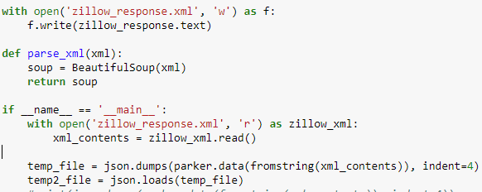
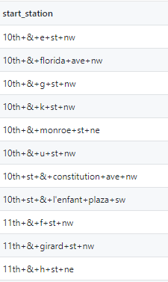
Data Collection and Cleanup
Zillow neighborhood location data API pull: convert from XML to JSON for use
Download Zillow monthly financial data for neighborhoods in Excel format
Manually clean to only include DC
Download bike share data in csv format
Develop a list of unique bike stations with addresses
Cleanup of station location needed
Data relatively static, so we utilized csv to store information throughout the process
Allowed for modular code price

Slide 7
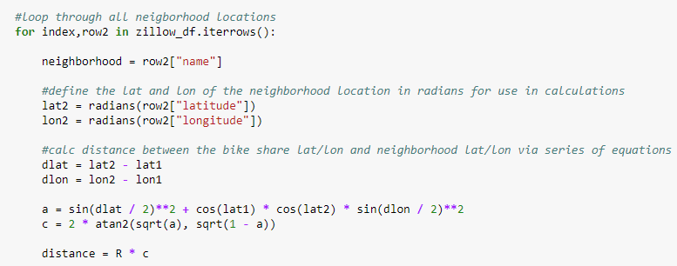
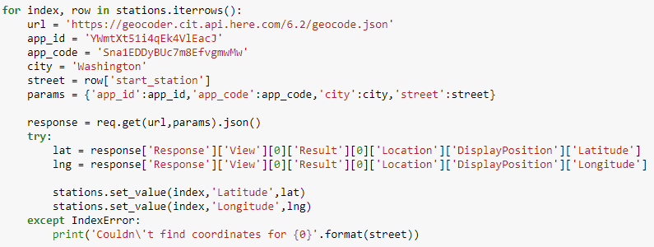
Map Bikeshare Location to Neighborhoods
Convert bike share intersections to latitude and longitude
Cleanup of text format required
Calculate the shortest distance between the bike station and all neighborhood lat/lon via a nested loop, and assign the neighborhood

Slide 8
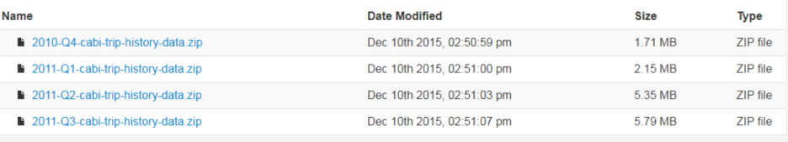
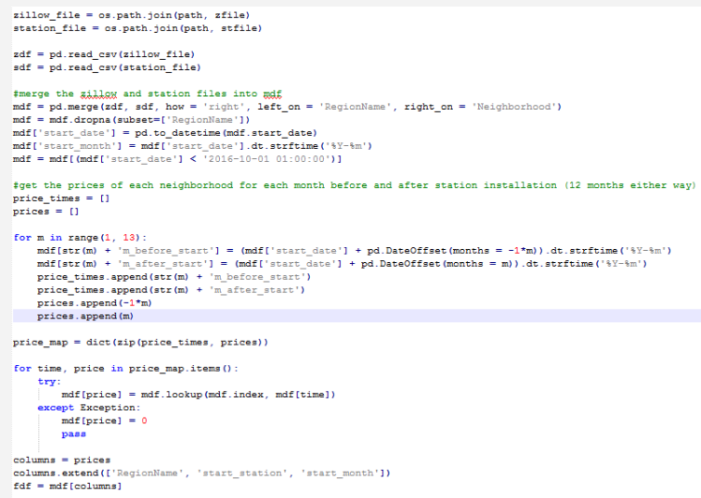
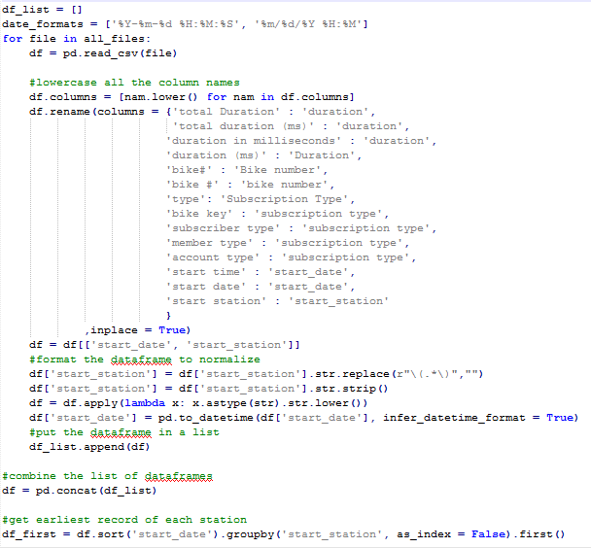
Combine Financial and Bike Share Data
Downloaded 7 years worth of bike share CSVs
Merged and normalized the bike share data
Used a join to combine Zillow and bike share data

Slide 9
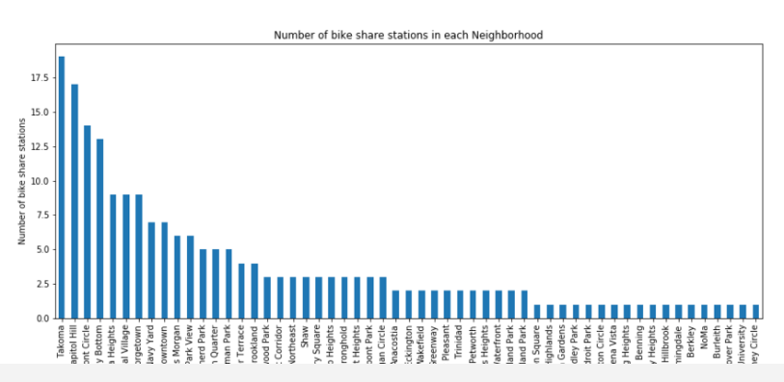
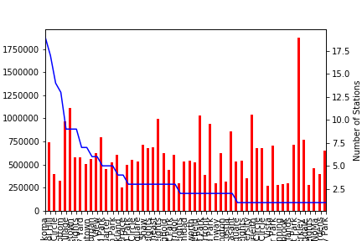
Results: Bike Share Stations per Neighborhood
Simple number of stations by neighborhood
Home prices (bars), with blue line overlaid as number of stations on secondary axis

Slide 10
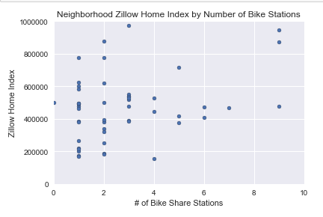
Results: Average Neighborhood ZHVI (Oct 2017)
Wide range of prices for neighborhoods with 1-2 stations
No neighborhood with >5 stations had ZHVI<$400K
Function of density?

Slide 11
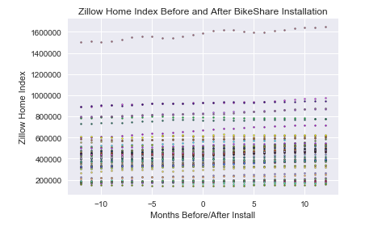
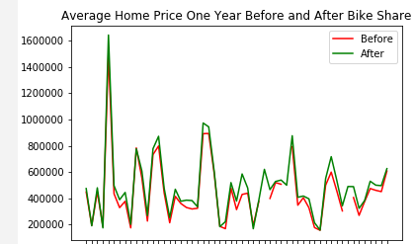
Results: All Monthly Data
No immediately apparent visual trend
More detailed stat analysis required to tease out any significant trend

Slide 12
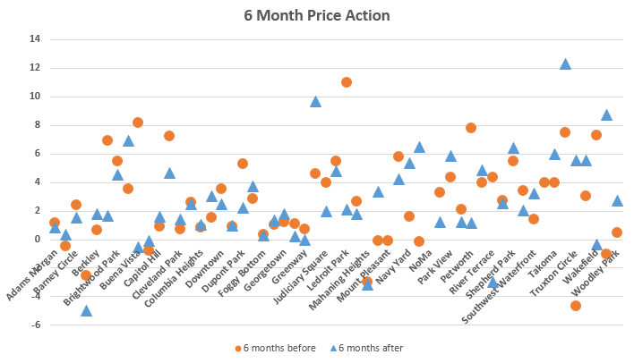
Results: ZHVI Price Changes Before/After Station

Slide 13
Conclusions
Lessons Learned
No clear trend between number of bike stations and home values
No clear trend between home value increases and addition of bike share
Possible indicator that bike share avoids installing a high density of stations in neighborhoods with lower home values – more statistical analysis needed
Rate of change analysis would be the next step
An approach that begins with a more granular statistical analysis by neighborhood may be more appropriate
E.g., regression and significance analysis of a single neighborhood based on bike station installations
Look for home-level price data in closer proximity to stations, instead of neighborhood-level data
A lot of factors go into home price – it may not be feasible to isolate the impacts of bike share stations at a neighborhood scale, even with additional and more rigorous analysis.

