Slide 3



















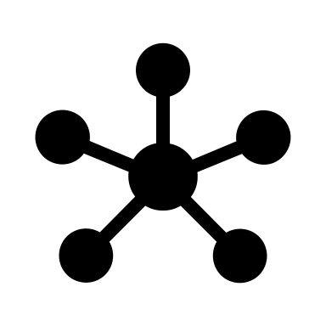

Slide 4
schreuder.ai
delete
deleted
dopamine

Slide 5
tutch

