Slide 1
Big Data and Post-Quantum Cryptography
A Performance Benchmark of NIST-Selected Communication Standards with Large Payloads
Arnab Ghosh

Slide 2
Cryptography
Designing and attacking secret codes
Creating secure channels of communication
Computerized cryptography is primarily based in mathematics
Modern ciphers use hard math problems to guarantee security

Slide 3
Hard Math Problems
Nearly impossible to solve without brute forcing…
UNLESS you have the key!
Give the key to your partner, and exchange your messages freely

Slide 4
Hard Math Problems
Pioneered by RSA – utilizes the prime number factorization problem (Schneier)
Prime number factorization: how to factor very large numbers? (Schneier)
Nigh unto impossible without brute force; but easy with a given factor (Schneier)
Considered intractable – theoretically impossible without brute forcing (Schneier)

Slide 5

Hard Math Problems
Elliptic Curve Cryptography - a new mathematical problem (Dhillon and Kalra)
Based on the discrete logarithm problem:

Slide 6
Models of Computation
Classical
Quantum
The standard – nearly all computers in the world
Bits (0s and 1s) to store data
Makes calculations individually
(in a theoretical manner)
Precise and thorough
New – very few concrete use cases for quantum computing
Qubits – a superposition between 0 and 1
May do many calculations at once
(in a theoretical manner)
Imprecise and Noisy

Slide 7
Shor’s Algorithm
There is currently a single concrete use case for quantum computers
Shor’s Algorithm – can solve BOTH the prime factorization problem and discrete logarithm problem (Shor)
Reduce intractable problems to the order finding problem; then, solve with order-finding problem (Shor)
Greatest threat to modern computing, ever

Slide 8
Regev’s Algorithm
Theoretical improvement over Shor’s algorithm (Regev)
Convert Shor’s algorithm from a 2nd-degree polynomial -> 3/2-degree polynomial time (Regev)
Published in August 2023
Severely increases threat posed by quantum computers

Slide 9
Lit Review
NIST recently standardized three protocols for post-quantum cryptographic communication (“Module-Lattice-Based Key Encapsulation Mechanism Standard”)
One of these, FIPS 203, defines a KEM using Kyber; therefore, we wish to test it (“Digital Signature Standard”)
Kyber works on ARM very well – advantageous in SoC and IoT workloads (Liu and Seo)
Kyber is very fast on small computers, with small payloads - but not tested on big ones (Seyhan et al.)

Slide 10
Are are the NIST-selected post-quantum cryptographic algorithms feasible with large payloads?

Slide 11
The Method
Benchmark two algorithms: Kyber (Post-quantum) and ECC (state of the art)
Use KEM implementations of both algorithms. A KEM is a set of three algorithms…
Key generation
Encryption
Decryption
(“Module-Lattice-Based Key Encapsulation Mechanism Standard”)
Test: Memory usage, Processor usage, and time taken
Memory usage, processor usage less important (as seen later)

Slide 12
Why this Method?
ECC is the gold standard of fast, traditional, state-of-the-art cryptography
Kyber is outlined by NIST as the preferred post-quantum cryptographic algorithm
Error may be introduced by using our own implementation
Use the standard, official, NIST-specified Kyber implementation
Based on 2018 Pennsylvania State University algorithmic analysis study

Slide 13
Why this Method?
Other studies about post-quantum cryptographic algorithms also test Kyber using a KEM
(Ristov and Koceski)
(Dhillon and Kalra)
Combination of more classic studies which study encryption and decryption separately
2021 Study of Post-Quantum Cryptographic feasibility on small systems
Kyber implementation from official Kyber implementation in C++
ECC implementation from CryptoPP (standard library)

Slide 14
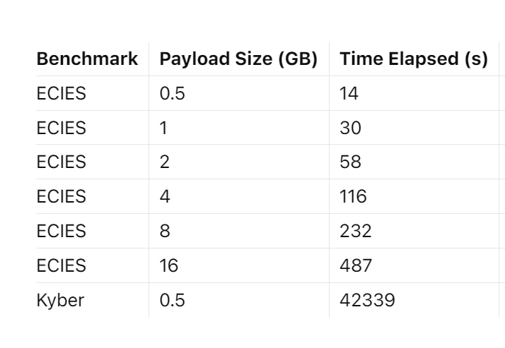
Results
CPU and Memory was consistent, with no significant change across different parameters.
This is likely due to segmentation, which is inherent to Kyber.
We segment ECC as well to maintain consistency

Slide 15
Results
Segmentation minimizes performance impact… but also prevents us from taking full advantage
This corroborates Kyber’s effectiveness in small systems (due to segmentation)
However… this also compromises ability with large payloads
Not feasible with large payloads

Slide 16
Conclusions
Post-quantum cryptography as specified by NIST is not feasible with large payloads
We do not take advantage of parallelization
Not part of official specification
Non-linear and unpredictable increases/decreases to productivity
Future research direction
We do not try to desegment the algorithm
Not part of official specification
Huge ramifications to overall algorithm family

Slide 17
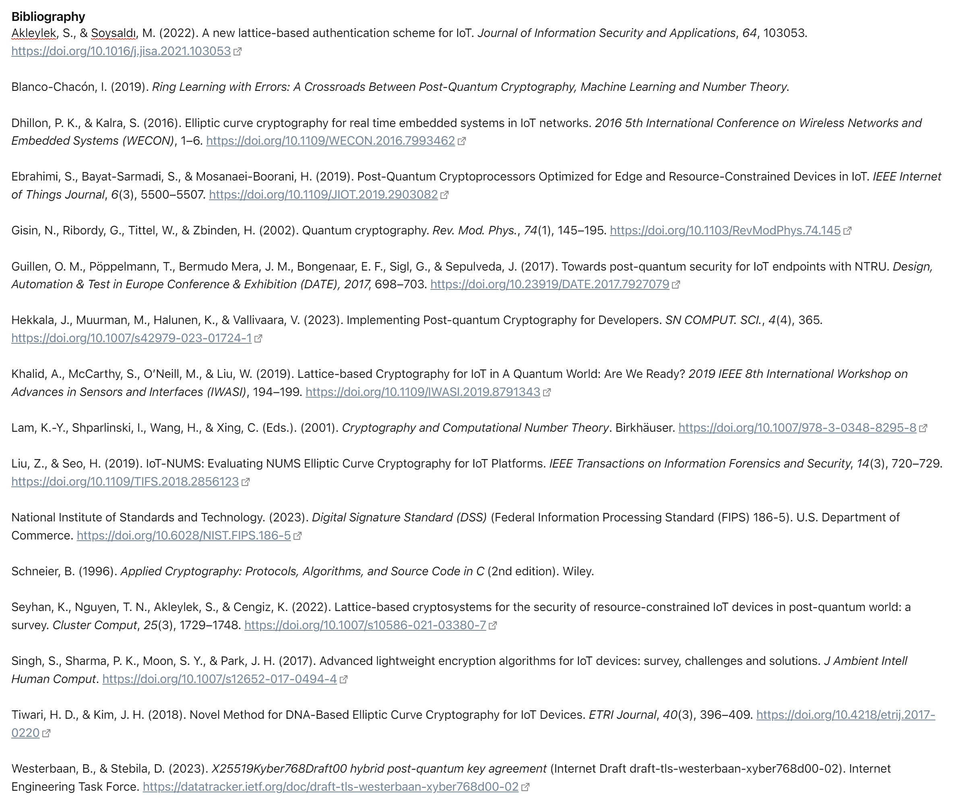
Works Cited

