Slide 1
Topic Analysis
Moving on to Dan Brown!
Notes:
I thought maybe I’d get somewhere with another “bag of words” unstructured technique that’s popular now: topic analysis.

Slide 2
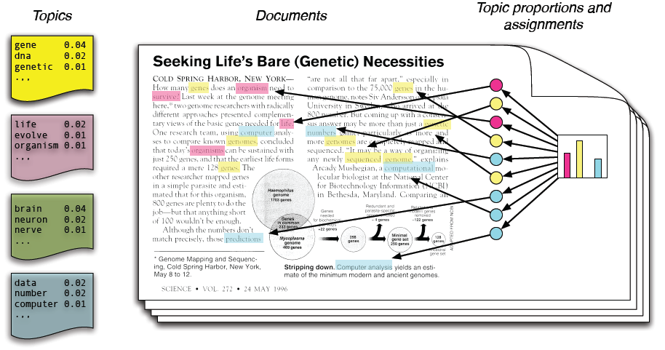
Blei (2011)
Notes:
A snippet from a classic article. Generative model of document – topic relationships. Topic is a collection of vocabulary which describes a document – probabilistic generation.

Slide 3
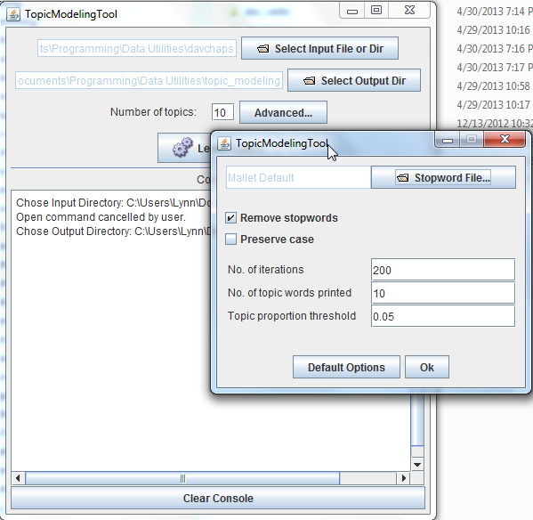
Topic Modeling Tool (GUI)

Slide 4
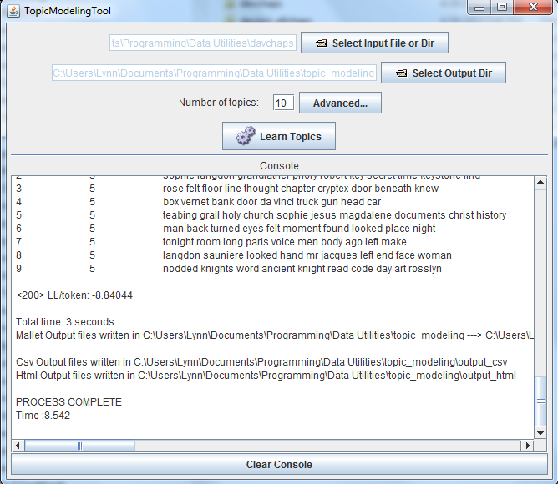
Post run…

Slide 5
Pros/Cons vs CMD-Line Mallet
Pros
Cons
Allows stopword file specifying
Produces csv and html output in a near dir structure
Has a GUI (simpler to just get going)
Runs with defaults, so no optimize-interval or other cmd line options
No diagnostic output (a command-line option)
Not super-well doc’d
Tutorial on cmd line usage: http://programminghistorian.org/lessons/topic-modeling-and-mallet

Slide 6
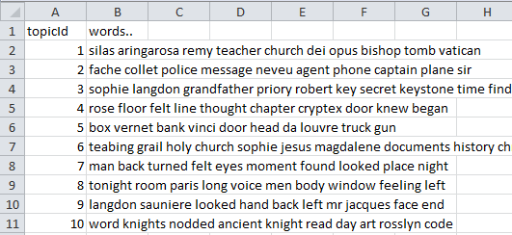

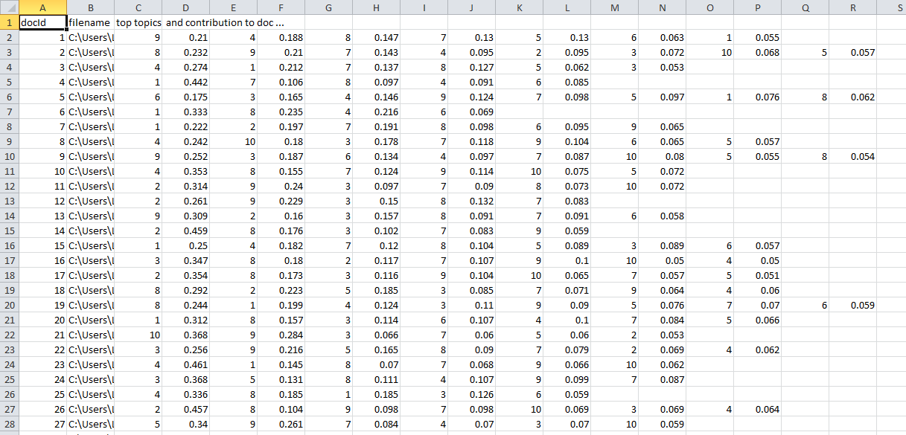
2 of the 3 CSV Output files

Slide 7
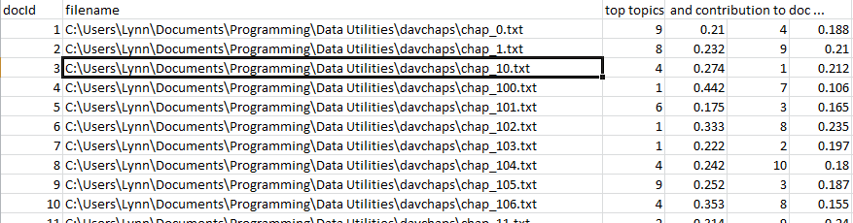
Notice a horrible thing here:

Slide 8
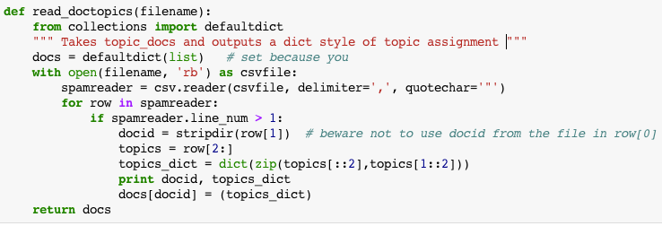
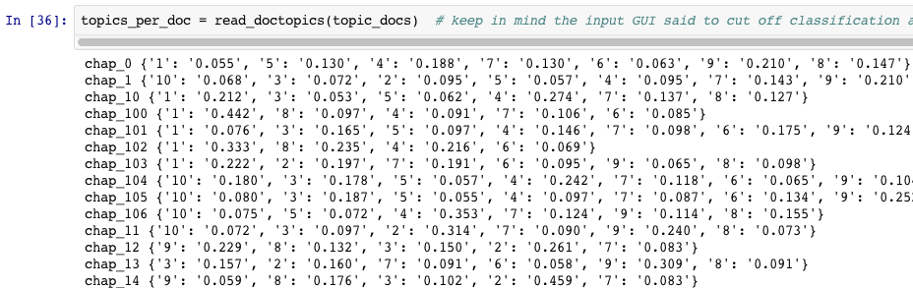
My notebook has lots of code to process these files…

Slide 9
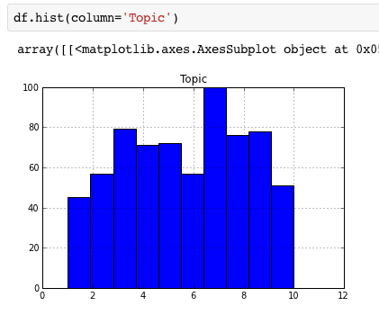
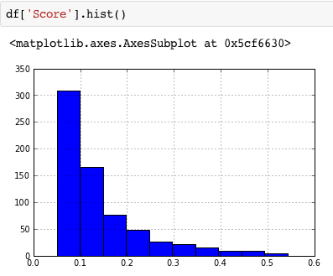
A few pandas stats…
107 chapters, 10 topics “requested”…
Topic proportion distribution…

Slide 10
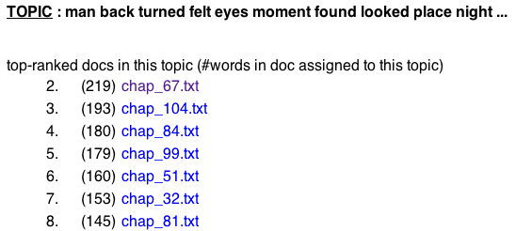
The default HTML output is a little lacking…
A bipartite graph of chapters and topics is an obvious vis method….

Slide 11
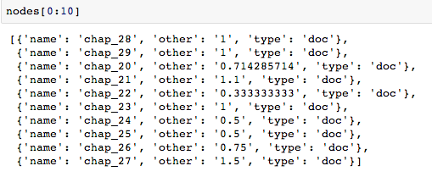
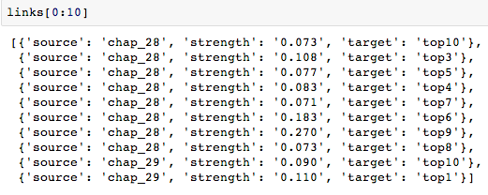
Network JSON in D3.js

Slide 12
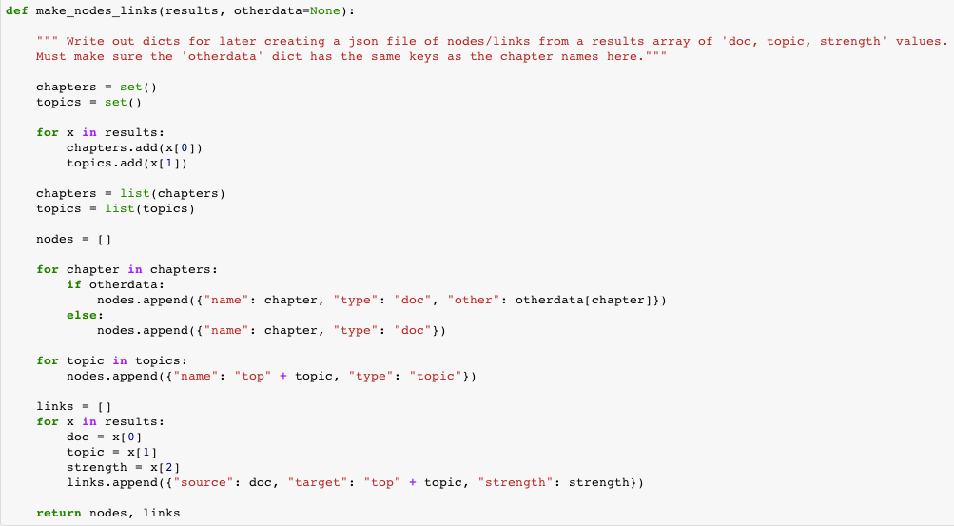
Making the objects:
Make objects of nodes, links, and any extra data values on each that you want…
Notes:
See the ipynb file.

Slide 13
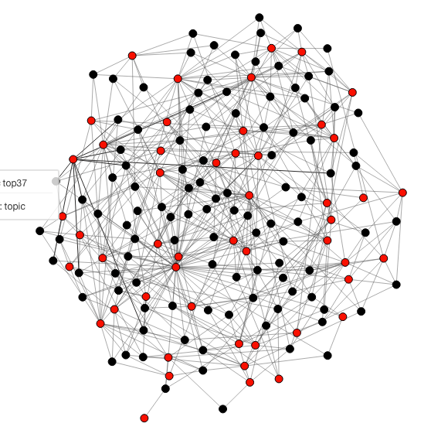
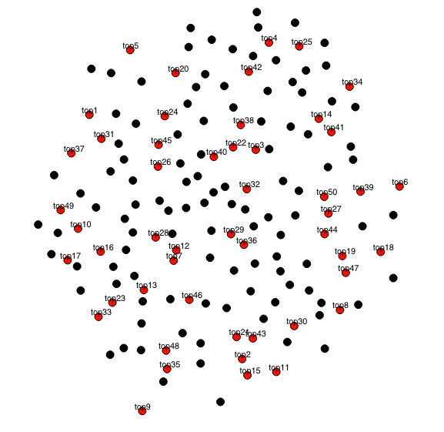
Let’s try a hairball!
Notes:
This is 50 topics, though. A bit much. Just showing relationships between chapters and topics in simple d3 force directed layout. See http://www.ghostweather.com/essays/talks/openvisconf/topic_docs_network/index_simple.html for demo.

Slide 14
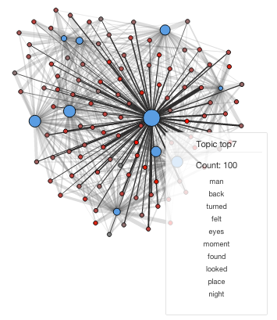
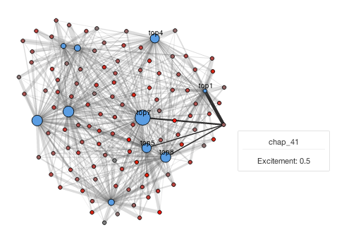
Improving the network’s UI…
Demo:
http://www.ghostweather.com/essays/talks/openvisconf/topic_docs_network/index_better.html
Adding strength, highlight effect, another variable, and informative tooltips.

Slide 15

Tricks in D3 – scales:

Slide 16
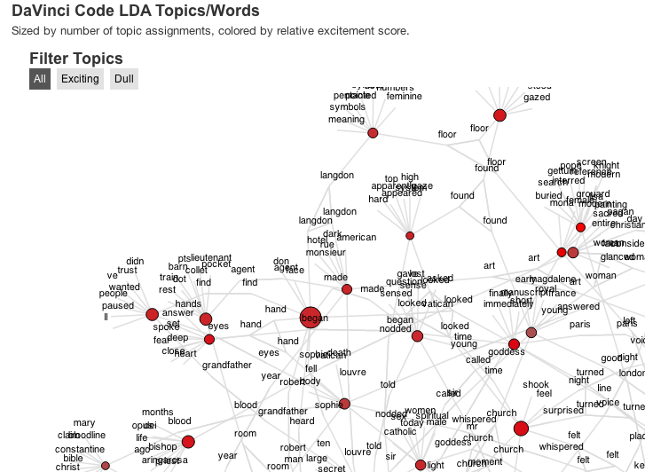
Maybe I need One More Tool. Any word relations of interest?
Let’s try another hairball…
Demo: http://www.ghostweather.com/essays/talks/openvisconf/topic_words_network/index.html
Notes:
For this tool I used Jim Vallandingham’s network code from the flowingdata tutorial – my first major use of coffeescript. I intended to try the radial layout, but ended up not. There was a lot of preprocessing of the stats to get the topics related to chapter “excitingness.”

Slide 17
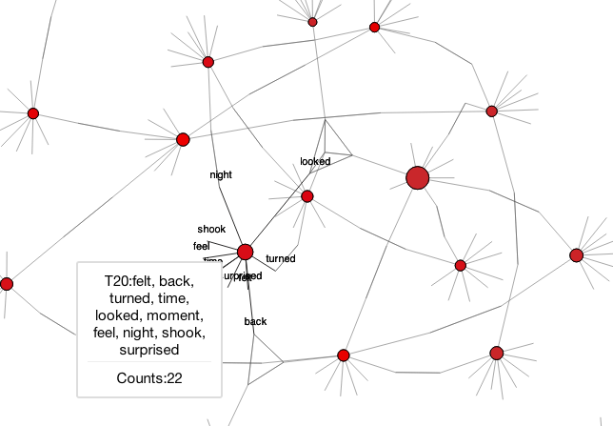
Filtered to only the “exciting” nodes…
Small “constellations” show shared words (an accident that’s useful!)
Notes:
On rollover, you can see the links, and since I created links between shared words (colored in blue), you can see little constellations for them, which I liked. This could’ve been simplified, of course.

Slide 18
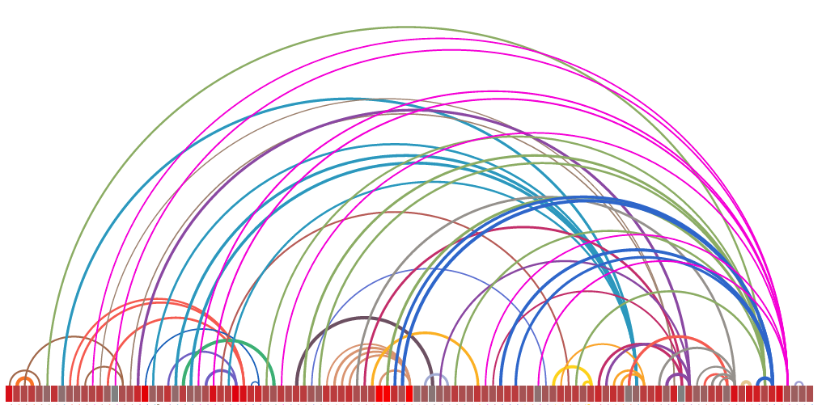
Another tool:
DaVinci Code topics to chapters mapping
Topics (48ish) per chapter (108)
“Excitement” rating color scale avg by chapter, ordered (obviously)
Chapter 1… to Chapter 108
Notes:
Built another tool to see if there was anything in this – showing them as ordered chapters connected by the “best” matching topics.

Slide 19
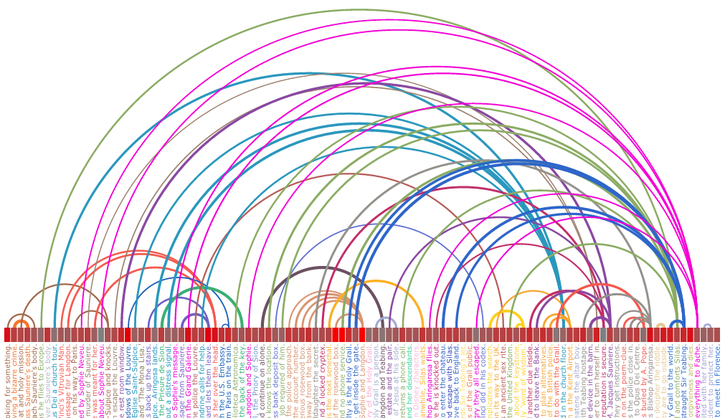
But, maybe I need chapter summaries…. So I can relate them to the topics?
Ah, but since it’s svg/d3…
var chart = chart.append("g").attr("translate","0," + y).attr("transform","rotate(90 600 600)");
Notes:
Outsource the summary writing for each chapter, to make it easier to see how topics relate to chapter contexts. … Add them as text under the leaves (the boxes that represent chapters). Now it’s hard to read – so use svg cute rotate trick and some resizing…!

Slide 20
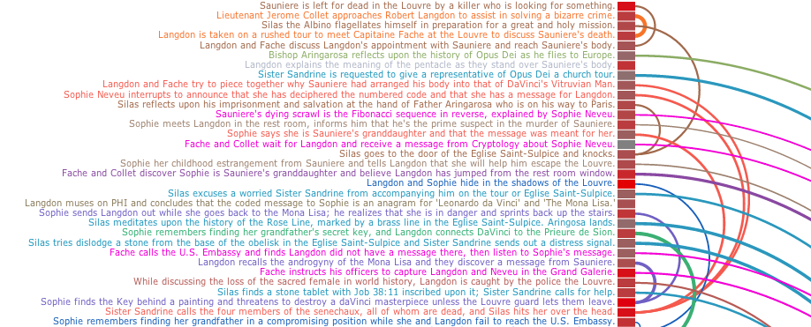
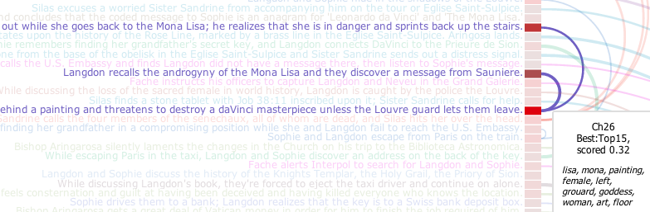
Add some topic-tooltips and fade-outs….
Demo: http://www.ghostweather.com/essays/talks/openvisconf/topic_arc_diagram/TopicArc.html
Notes:
Some UI niceties I added to make it slightly usable, even for myself. Unfortunately I had to shorten the text my friend created for each chapter; the originals were pretty hilarious…

Slide 21
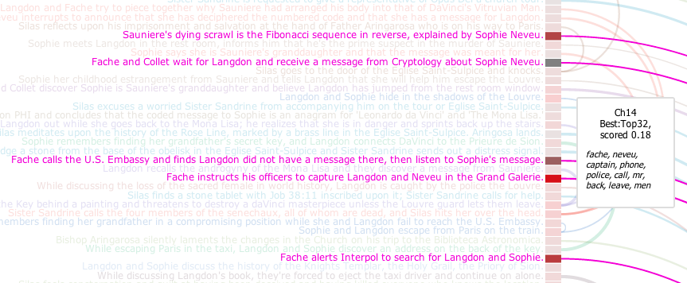
But what did this show?
Some topics are just neither exciting nor dull – topic clustering (as I did it) had little to do with action scenes. It’s slightly helpful for topics, though ☺
These nodes are shaded from gray (dull) to red (exciting)

Slide 22
Resources for Topic Analysis
David Mimno’s java Mallet is “the one everyone uses”:
http://mallet.cs.umass.edu/index.php
The R mallet package is rather nice, too: http://www.cs.princeton.edu/~mimno/R/
This is a GUI wrapper for mallet that outputs nice csv and html pages: https://code.google.com/p/topic-modeling-tool/
Some pure python (and C) implementations (toy code, primarily) are listed on Blei’s website: http://www.cs.princeton.edu/~blei/topicmodeling.html

Slide 23
A Few More References
Applied Machine Learning with Scikit-Learn:http://scikit-learn.github.io/scikit-learn-tutorial/index.html
Naïve Bayes for text in Scikit-Learn: http://scikit-learn.org/stable/modules/naive_bayes.html#naive-bayes
Stochastic Gradient Descent in Scikit-Learn: http://scikit-learn.org/0.13/modules/sgd.html
Nice tutorial overview of working with text data: scikit-learn.github.io/scikit-learn-tutorial/working_with_text_data.html
Bearcart by Rob Story – Rickshaw timeseries graphs from python pandas datastructure in 4 lines (https://github.com/wrobstory/bearcart)
LDA topic modeling tool with UI - https://code.google.com/p/topic-modeling-tool/
Scott Weingart’s nice overview of LDA Topic Modeling in Digital Humanities: http://www.scottbot.net/HIAL/?p=221
Elijah Meeks’ lovely set of articles on LDA & Digital Humanties vis: https://dhs.stanford.edu/comprehending-the-digital-humanities/
Jim Vallandingham’s tooltip code and a great demo/tutorial: http://flowingdata.com/2012/08/02/how-to-make-an-interactive-network-visualization/
Rickshaw for timeseries graphs: https://github.com/shutterstock/rickshaw

