Slide 1
Approval

Slide 2
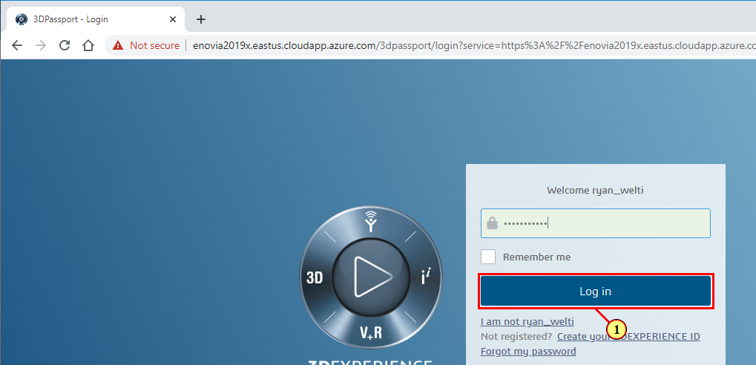
3DPassport - Login - Google Chrome
(1) Click Log In

Slide 3
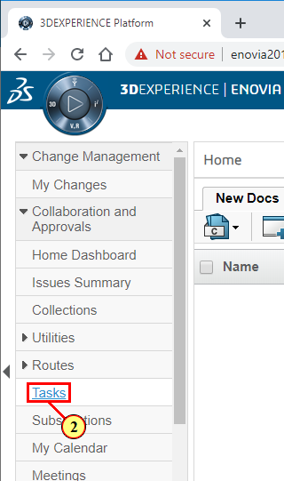
3DEXPERIENCE Platform - Google Chrome
(2) Click Tasks

Slide 4
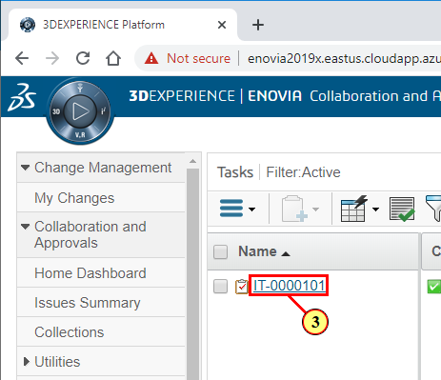
3DEXPERIENCE Platform - Google Chrome
(3) Select the Assigned Task

Slide 5
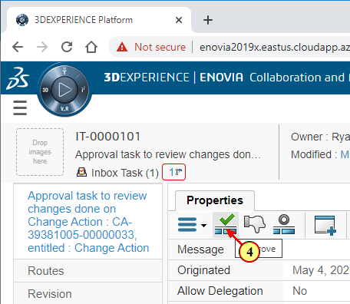
3DEXPERIENCE Platform - Google Chrome
(4) Click to approve

Slide 6
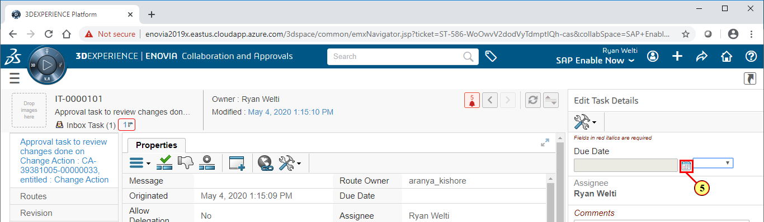
3DEXPERIENCE Platform - Google Chrome
(5) Click
.

Slide 7
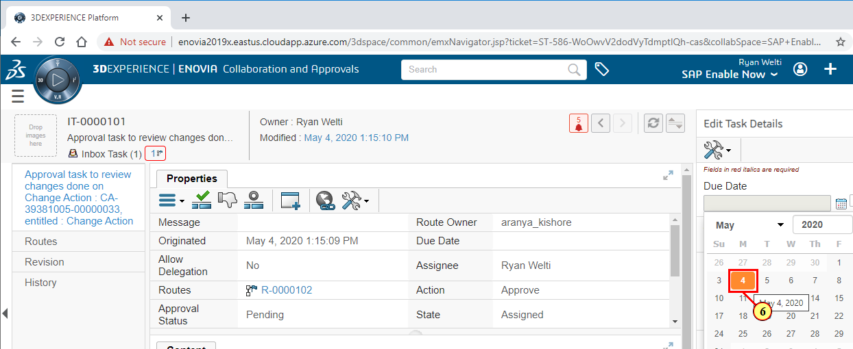
3DEXPERIENCE Platform - Google Chrome
(6) Select due date

Slide 8
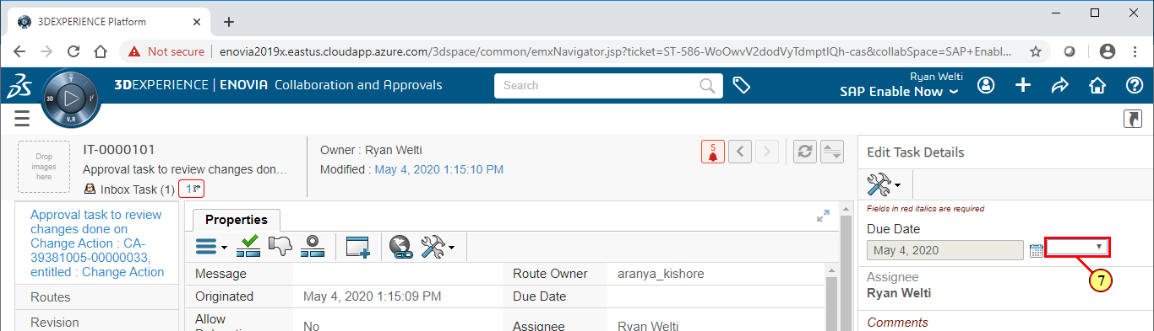
3DEXPERIENCE Platform - Google Chrome
(7) Click
.

Slide 9
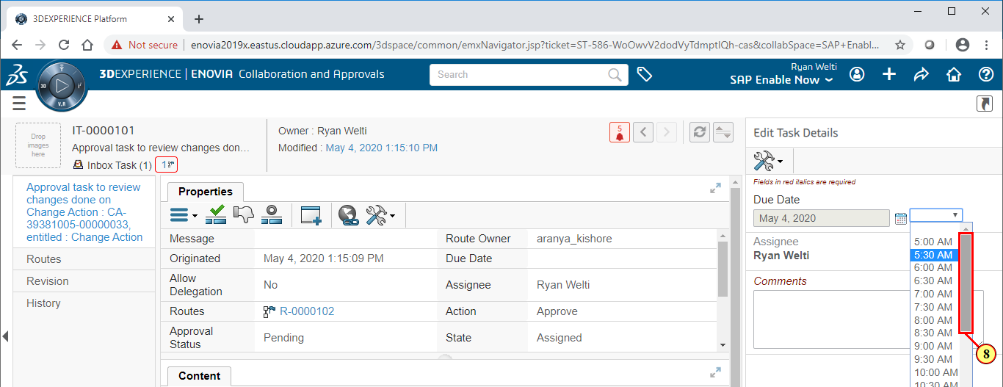
3DEXPERIENCE Platform - Google Chrome
(8) Select time

Slide 10
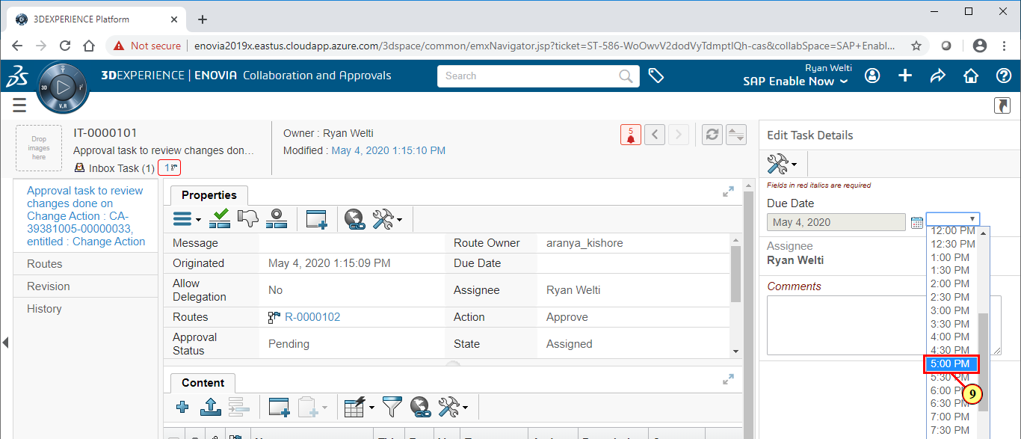
3DEXPERIENCE Platform - Google Chrome
(9) Select 5:00 pm

Slide 11
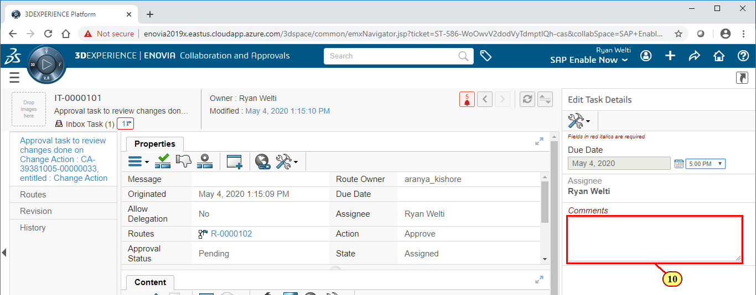
3DEXPERIENCE Platform - Google Chrome
(10) Select the comments field to add an associated message with your approval.

Slide 12
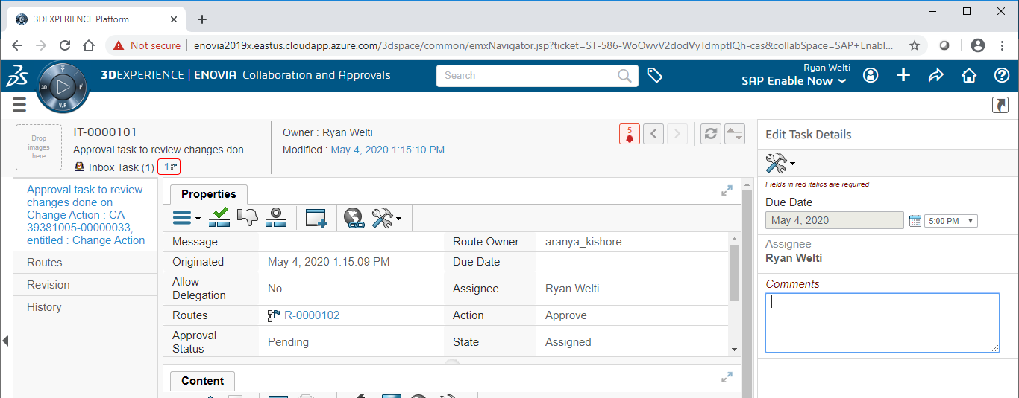
3DEXPERIENCE Platform - Google Chrome

Slide 13
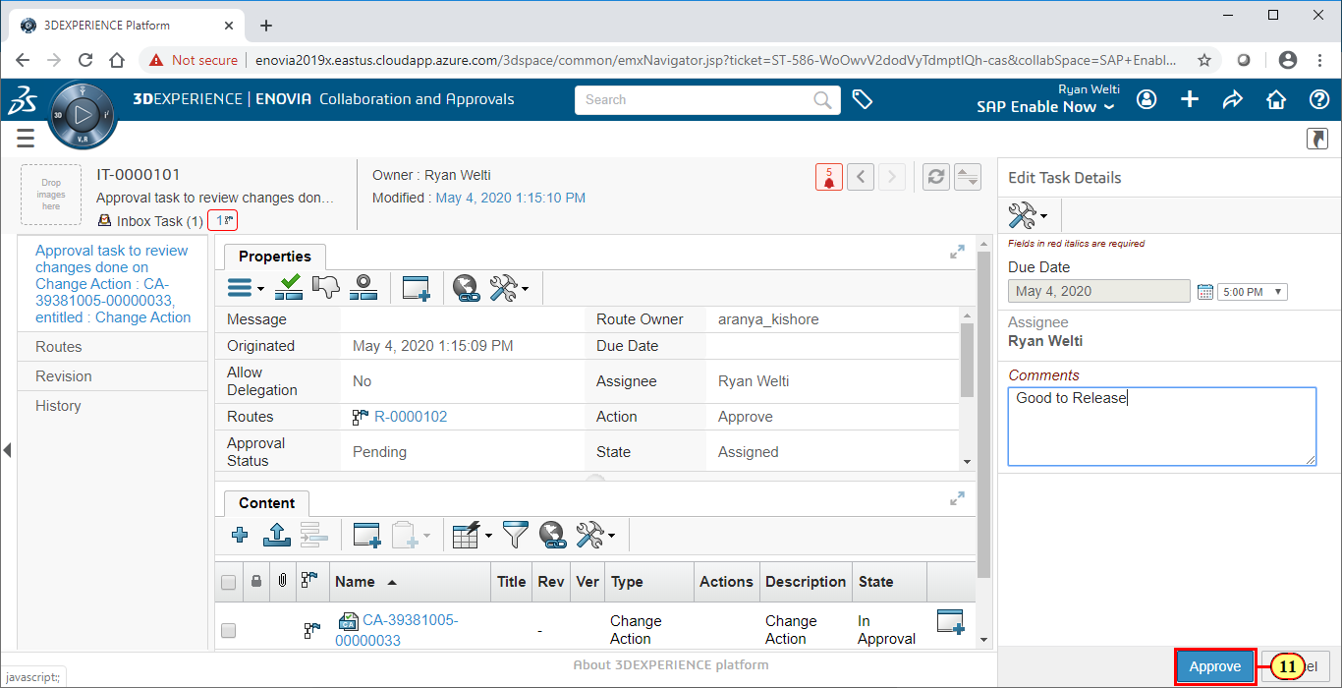
3DEXPERIENCE Platform - Google Chrome
(11) Click Approve

Slide 14
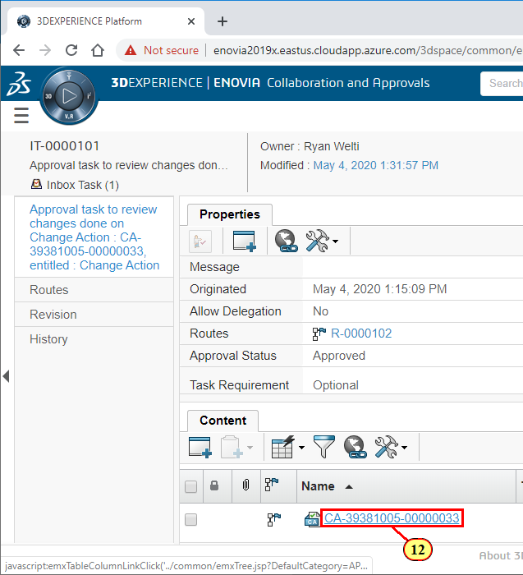
3DEXPERIENCE Platform - Google Chrome
(12) Select the Approved Task to ensure the state is complete

Slide 15
3DEXPERIENCE Platform - Google Chrome

Slide 16
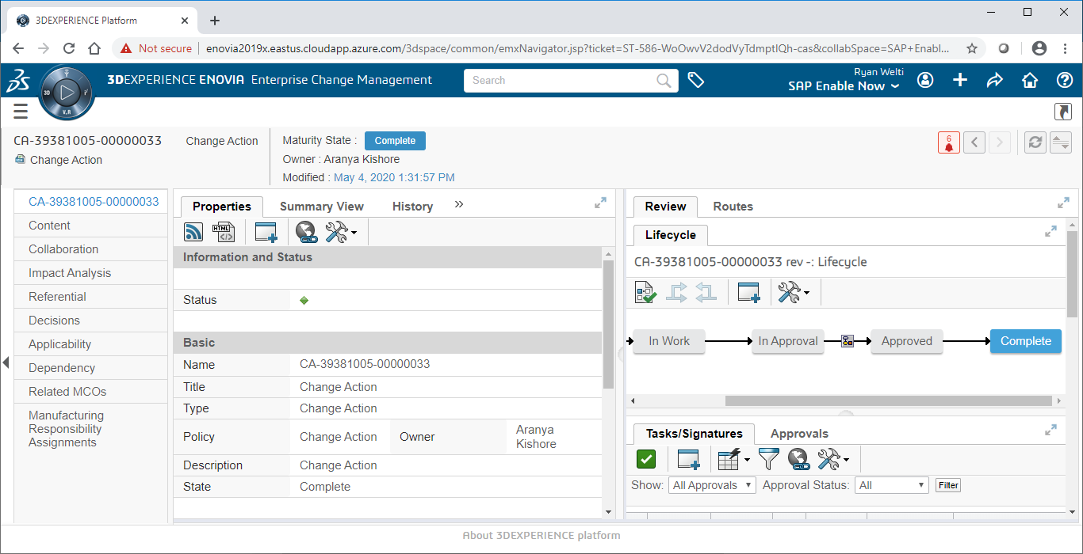
3DEXPERIENCE Platform - Google Chrome

