Slide 1
Box size
Margin size
Border size
The text or image is displayed here
Padding size
Content size

Slide 2
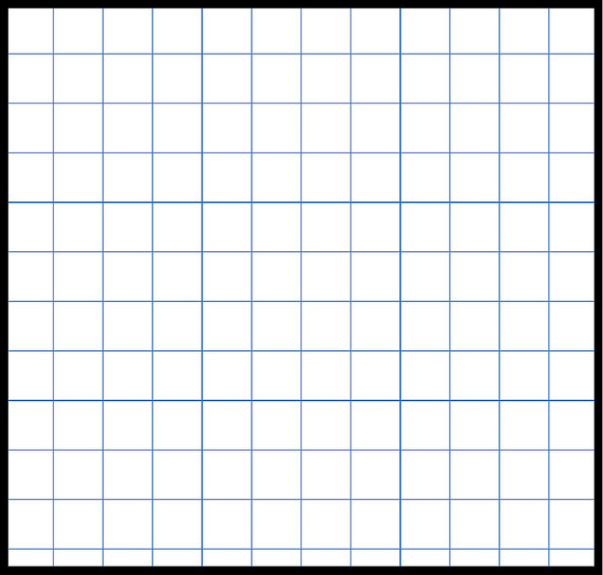
X direction →
0 1 2 3 4 5 6 7 …
Y direction →
0 1 2 3 4 5 6 7 …

Slide 3



$$\frac{π}{2}$$
$$π$$
$$2π$$
¼ circle
½ circle
full circle
Math.PI / 2
Math.PI
Math.PI * 2

Slide 4
radius

Slide 5
x,y

Slide 6
hello
x,y

