Slide 1
Unit 1 – Basic Programming Concepts
We will learn:
The Javascript programming language
Concepts that apply to many other programming languages
How to create and style a web page
Connecting Javascript to a web page

Slide 2
Web page basics
Lesson 1.1

Slide 3
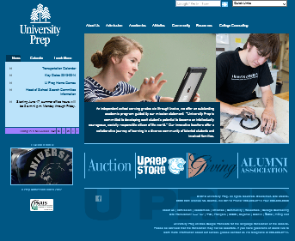
How a web browser works (1)
your laptop
Uniform Resource Locator (URL)
http://www.universityprep.org/
What protocol should I used to communicate?
Hypertext Transfer Protocol (HTTP)
Which computer(s) should I communicate with?
www.universityprep.org
What path am I interested in?
/
http://www.universityprep.org/

Slide 4

How a web browser works (2)
your laptop
www.universityprep.org
/
http://www.universityprep.org/
...
<img src="http://www.universityprep.org/z_img/logo-uprep.png">
…
<div style="background-color:#a07ffe">
Today is a NO SCHOOL DAY
</div>
…
Hypertext Markup Language (HTML)

Slide 5
How a web browser works (3)
your laptop
www.universityprep.org
/z_img/logo-uprep.png
http://www.universityprep.org/

Slide 6
How a web browser works (4)
your laptop
http://www.universityprep.org/

Slide 7
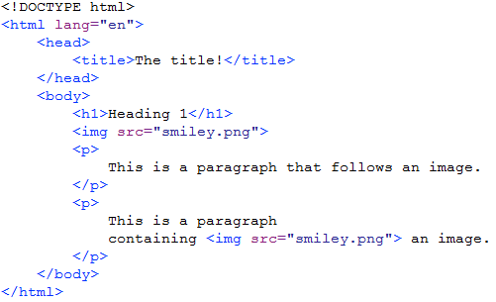
A closer look at HTML (1)
What version of the HTML language is this document written in?

Slide 8
A closer look at HTML (2)
The html element

Slide 9
A closer look at HTML (3)
The body element

Slide 10
A closer look at HTML (4)
A paragraph element

Slide 11
A closer look at HTML (5)
An image element

Slide 12
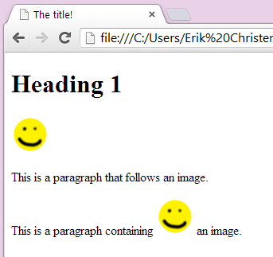
A closer look at HTML (6)

Slide 13
A closer look at HTML (7)

Slide 14
A closer look at HTML (8)
Start tag for html element
Start tag for image element
End tag for html element

Slide 15
A closer look at HTML (9)
The source attribute of the image element

Slide 16
Exercise 1.1.1
https://universityprep.schoology.com

