Slide 1
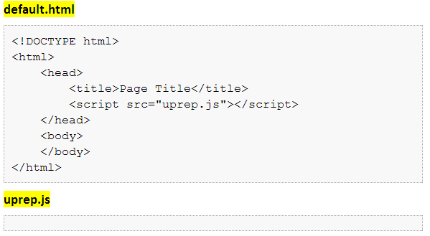
Put all the files in same folder
Put files in same folder

Slide 2
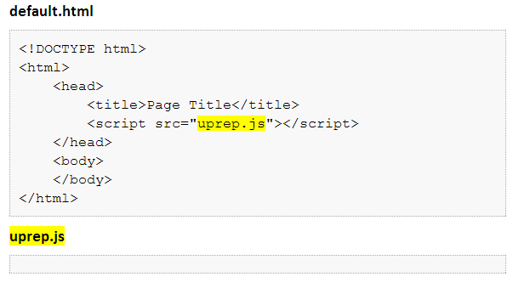
Use the right Javascript file name
File name should match

Slide 3
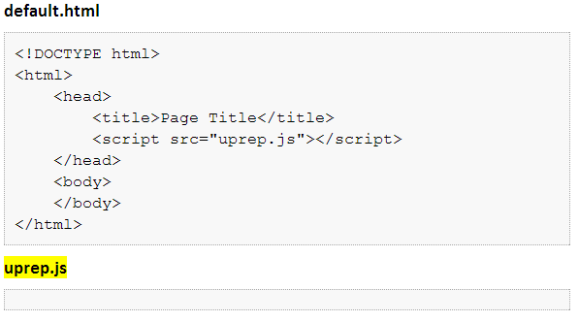
Avoid spaces in file names
Avoid spaces in file names

Slide 4
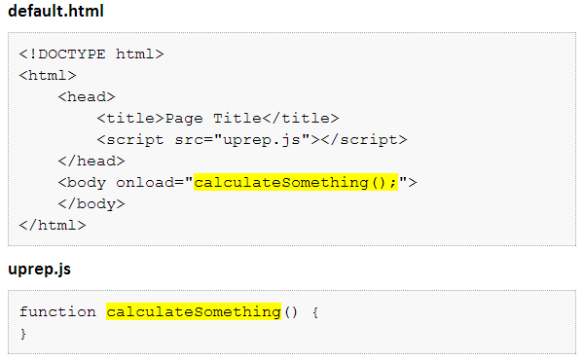
Call the right function when page loads
Should match name of one of the functions

Slide 5
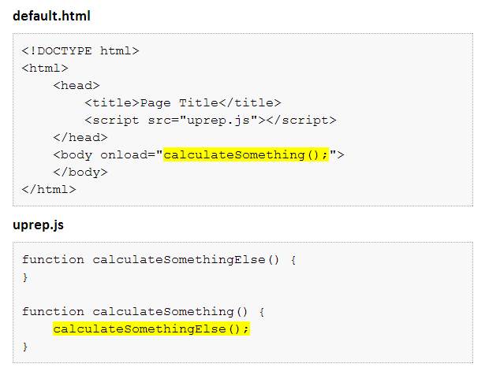
Call the functions you need to run
Make sure you call all the functions you need

Slide 6
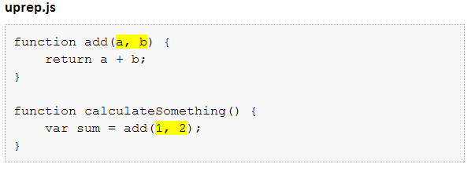
Add a parameter for each value a function expects
Calling with two values? Then you need two parameters.

Slide 7
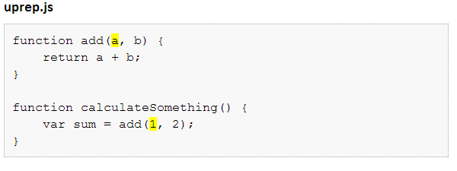
The order of parameters matters
The first value is used for the first parameter, the second value is for the second, and so on.

Slide 8
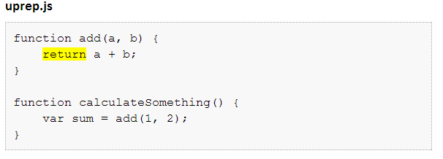
Return a value if your function has an output
Remember to use return if function has an output

Slide 9
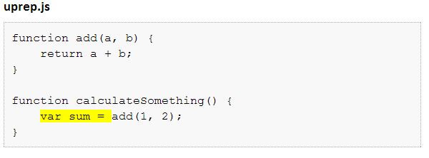
Use the value returned
Remember to use the value returned by a function

Slide 10
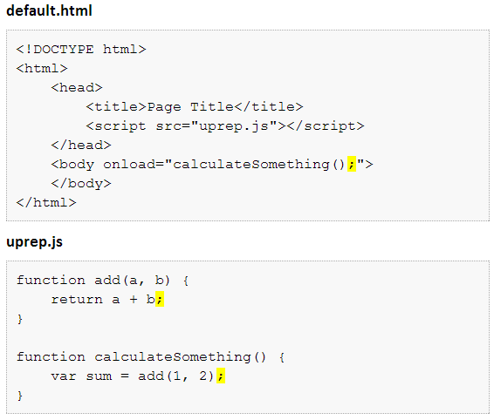
Put semicolons at the end of each statement
Remember a semicolon after each statement

Slide 11
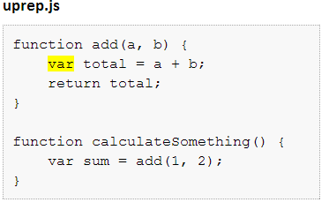
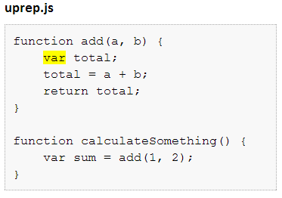
Define the variables you need
Define each variable you need

