Slide 1
Cascading Style Sheets (CSS)

Slide 2
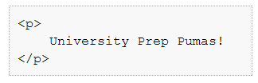

Do your pages have style?

Slide 3
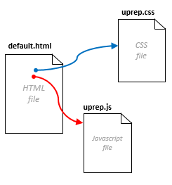
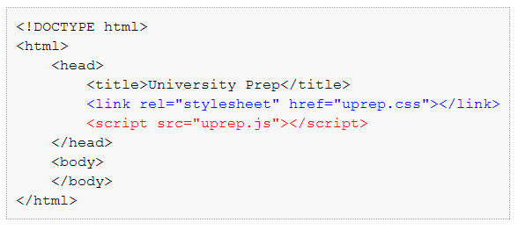
How does CSS work?

Slide 4
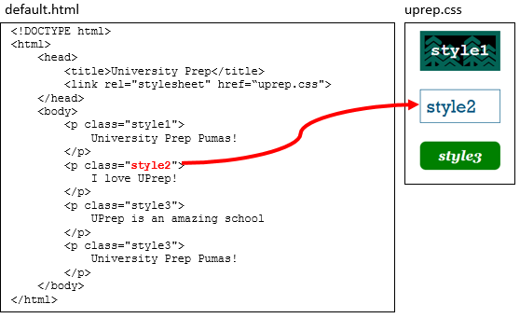
What is in a CSS file?

Slide 5
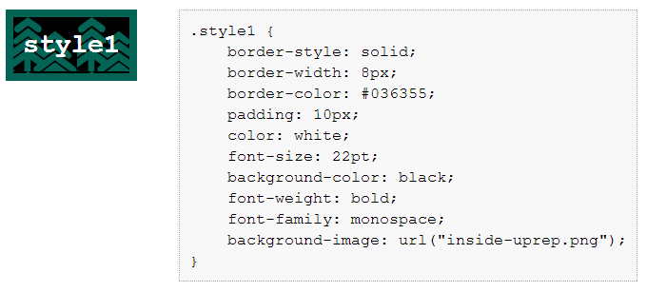

How do we write a style?

Slide 6


Another language!?
What web
designers need to know
What web developers need to know
Jason Falk,
web designer
Erik,
web developer
CSS
HTML
Javascript

Slide 7
Go for it!
Try to be done with 1.4.1 today…
And be started on 1.4.2…

