Slide 1
Document Object Model (DOM)
Lesson 4

Slide 2
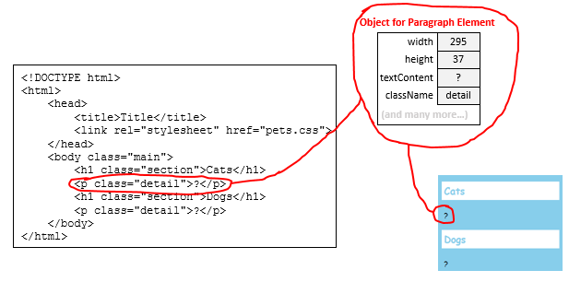
Every element has an object

Slide 3
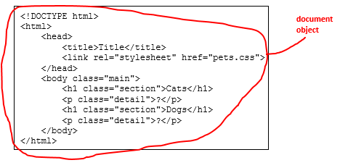
The object for <html> is called document

Slide 4
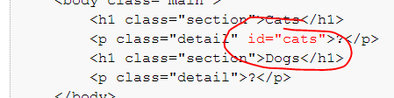
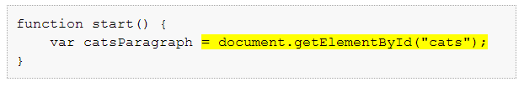
We can “find” the object for an element…
…but we have to name it first

Slide 5
Once we find an object, we can:
Use the textContent property
The text inside the element
Use the innerHTML property
The HTML inside the element
Use the className property
The name of the style used by the element
(etc)

