Slide 1
Strings and text output
Lesson 4

Slide 2
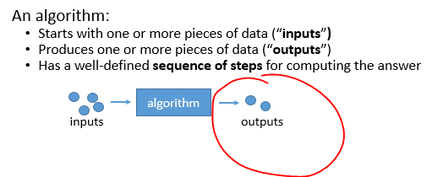

Slide 3
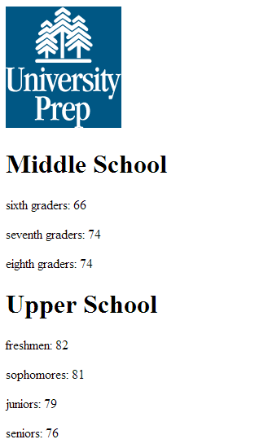
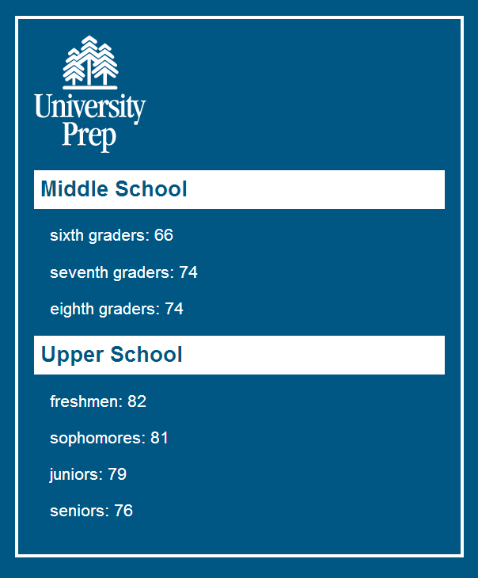
We will be creating this page
Create the page without styling (HTML)
Style the page (CSS)
Fill in the number of students (Javascript)
Build the page completely from Javascript
Add a special character ©
Your own experiments…
compare

Slide 4
Javascript Strings
function someFunction() {
var a = 123;
var b = "saber-toothed cat";
var c = "house cat";
var difference = b - c;
}
Large teeth?

Slide 5
Exercises
1.4.1
  Introduction to CSS
1.4.2
  UPrep: HTML
  UPrep: CSS
1.4.3
  Working with string values
1.4.4
  UPrep: Filling in values from Javascript
1.4.5
  UPrep: Making page in Javascript
1.4.6
  UPrep: Adding special character ©
1.4.7
  Review questions
1.4.8 (optional)
  Your choice!

Slide 6
Timeline
Days to work on this:
  Wed
  Thu
  Mon
  Tues
Coming up next…
  Graphics + animation + things bouncing around the screen

