Slide 1
Examples of representing data structures in memory
(TEMPLATE)
x
1
numberOfSpaceships
2
y
2
spaceships
sum
3
game
"hello"
x
34
y
344
school
sixth
x
34
seventh
true
y
344
eighth
124
array
34
34

Slide 2
uprep.css
CSS file
default.html
HTML file
uprep.js
Javascript file

Slide 3
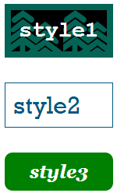
default.html
uprep.css
<!DOCTYPE html>
<html>
<head>
<title>University Prep</title>
<link rel="stylesheet" href=“uprep.css">
</head>
<body>
<p class="style1">
University Prep Pumas!
</p>
<p class="style2">
I love UPrep!
</p>
<p class="style3">
UPrep is an amazing school
</p>
<p class="style3">
University Prep Pumas!
</p>
</body>
</html>

Slide 4
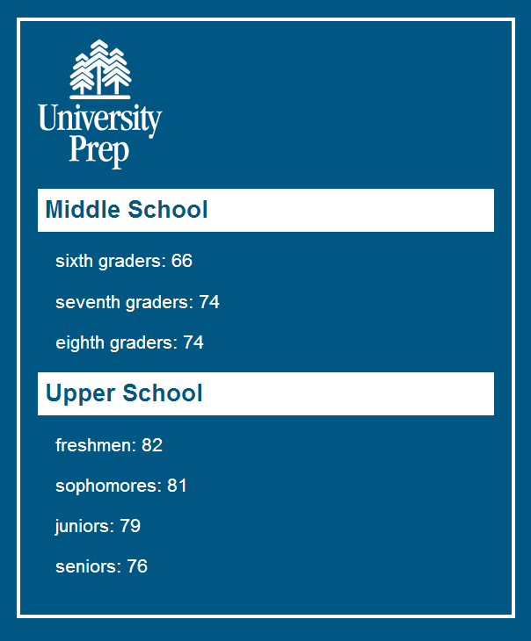
Body Element
Image Element
Header Element
Paragraph Element

Slide 5
Style for Body Element
background-color
border-style
border-width
border-color
margin
font-family
padding
Style for Header Element
background-color
padding
font-size
color
Style for Paragraph Element
margin
font-size
color

Slide 6
What is an Algorithm?
An algorithm:
Starts with one or more pieces of data (“inputs”)
Produces one or more pieces of data (“outputs”)
Has a well-defined sequence of steps for computing the answer
Algorithms:
Must have steps that are understandable!
Must give an answer (don’t compute forever!)
Must give a correct answer for any input data
A very simple algorithm:
x + 1
algorithm
inputs
outputs

Slide 7
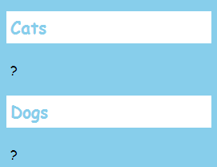
Object for Paragraph Element
width
295
height
37
<!DOCTYPE html>
<html>
<head>
<title>Title</title>
<link rel="stylesheet" href="pets.css">
</head>
<body class="main">
<h1 class="section">Cats</h1>
<p class="detail">?</p>
<h1 class="section">Dogs</h1>
<p class="detail">?</p>
</body>
</html>
textContent
?
className
detail
(and many more…)

Slide 8
width
295
catsParagraph
height
37
textContent
?
className
detail
(and many more…)

Slide 9
<!DOCTYPE html>
<html>
<head>
<title>Title</title>
<link rel="stylesheet" href="pets.css">
</head>
<body class="main">
<h1 class="section">Cats</h1>
<p class="detail">?</p>
<h1 class="section">Dogs</h1>
<p class="detail">?</p>
</body>
</html>
document object

Slide 10
<!DOCTYPE html>
<html>
<head>
<title>Title</title>
<link rel="stylesheet" href="pets.css">
</head>
<body class="main">
<h1 class="section">Cats</h1>
<p class="detail">123</p>
<h1 class="section">Dogs</h1>
<p class="detail">456</p>
</body>
</html>

