Slide 1
ECONOMICS RESEARCH REPORT
Arnie Mathur
U.S. Trade Balance, Dollar Index & Economic Outlook
February 2026 | Econometric Analysis
As of late February 2026, the United States trade balance illustrates a structural deficit that is deepening. The aggregate trade shortfall has continued to increase, reaching $70.3 billion in the most recent release. This report presents three OLS regression models — covering US Export Growth, the US Dollar Index (DXY), and US Import Growth — with Newey-West HAC-corrected standard errors, alongside indicator analysis and scenario-based forecasts for the 12-month outlook.

Slide 2
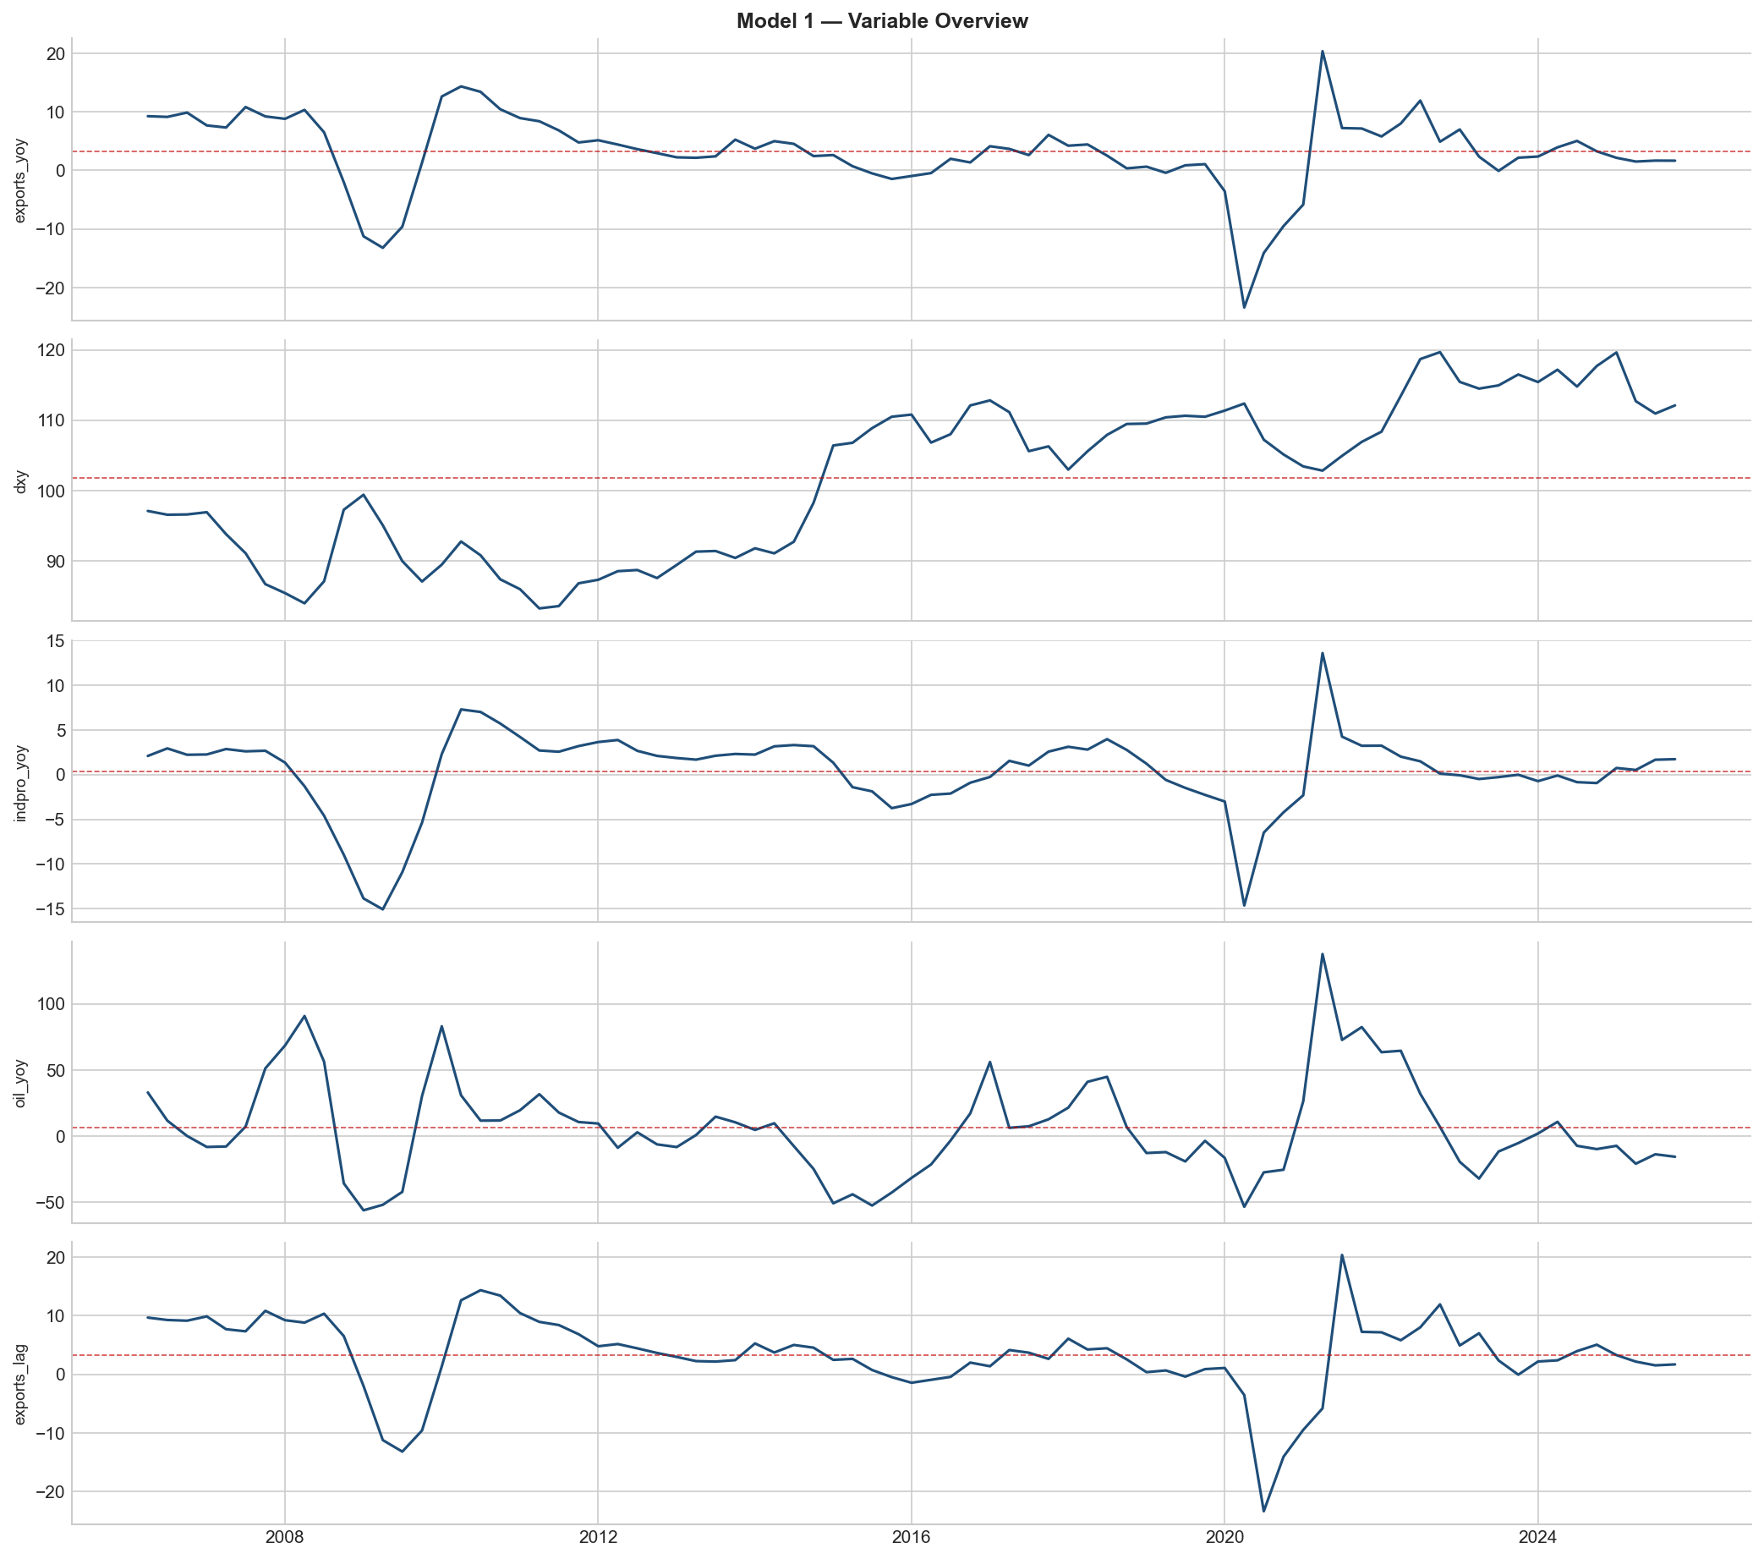
EXECUTIVE SUMMARY
Current Account & Trade Balance Trajectory
As of late February 2026, the United States balance can be illustrated as a structural deficit that is deepening. The aggregate trade shortfall has continued to increase reaching $70.3 billion in the most recent release, displaying that US spending habits and foreign spending habits are continuing to move in opposite directions. This widening is caused by a pronounced separation in trade flows, while real exports have contracted 1.7%, which is weighed down by sluggish manufacturing velocity abroad, real imports on the contrary have increased by 3.6%. This surge in imports is concentrated heavily in sectors that are capital-intensive, specifically in high-performance computing hardware and telecommunications equipment, which is driven by businesses in the United States investing heavily into new artificial intelligence technology.
Exhibit 1

Slide 3
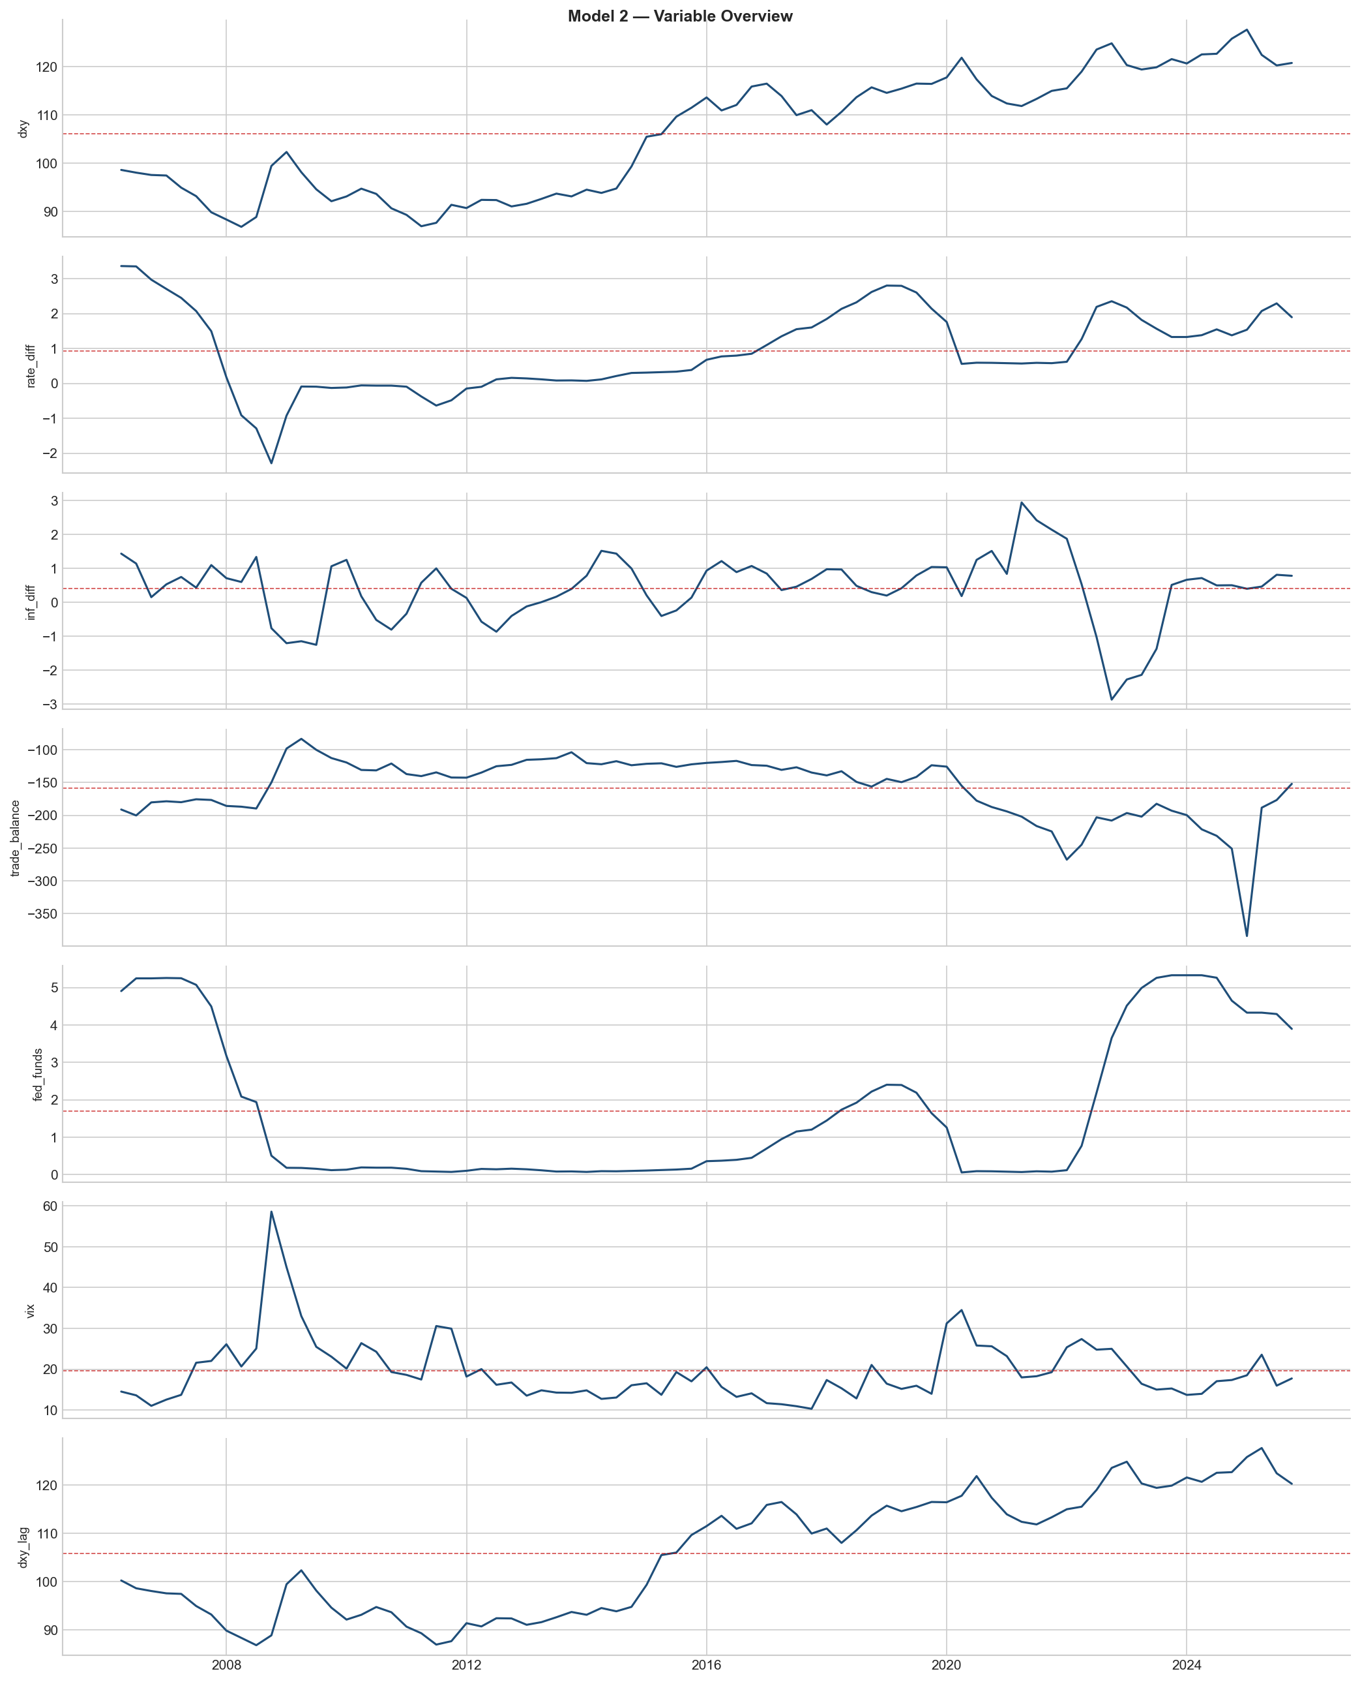
EXECUTIVE SUMMARY
US Dollar (DXY) Valuation
Exhibit 2
The US Dollar Index (DXY) is currently swinging within the 97.00–98.00 band, which reflects a regime shift in monetary policy. For a long period, the US dollar was incredibly strong, due to the fact that US interest rates were higher than major global economies. More recently however, the dollar is reverting down to a more 'normal' or average historical level. The currency has depreciated approximately 10% from its peaks, which is in response to the Federal Reserve's pivot toward a more neutral policy stance. While recent high-frequency data on consumer confidence has provided temporary support to the 97.88 level, the broader structure still remains bearish. Investors have realized that US interest rates are not going to be significantly higher than Europe's or Japan's.

Slide 4
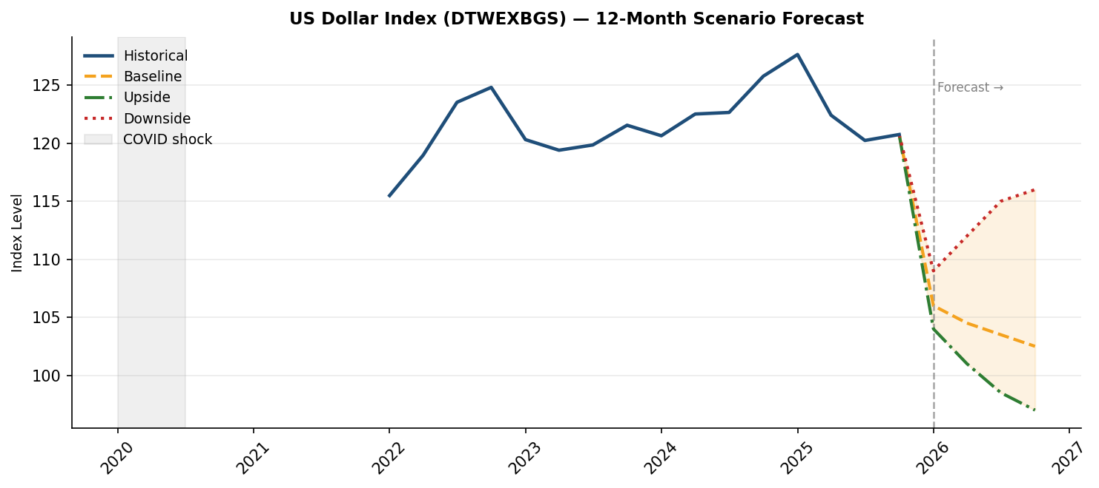
EXECUTIVE SUMMARY
12-Month Outlook & Risk Vectors
The baseline forecast over the next 12 months predicts a controlled depreciation of the dollar, which potentially will test the 94.00 handle by Q2 2026 before stabilizing. This is occurring because the gap between US interest rates and European interest rates is shrinking. The dollar being weaker would be positive for trade because it would make American goods cheaper for foreign buyers to purchase, which as a result will eventually assist in shrinking the trade deficit after a few months of adjustment.
This trend however would be subject to a reversal due to two major outside risks: the first being historically high tariffs causing inflation to spike and the second being any major global crisis causing panicked investors to hoard US dollars for safety, forcing the dollar's value to increase, even during an expected downturn.
Exhibit 3

Slide 5
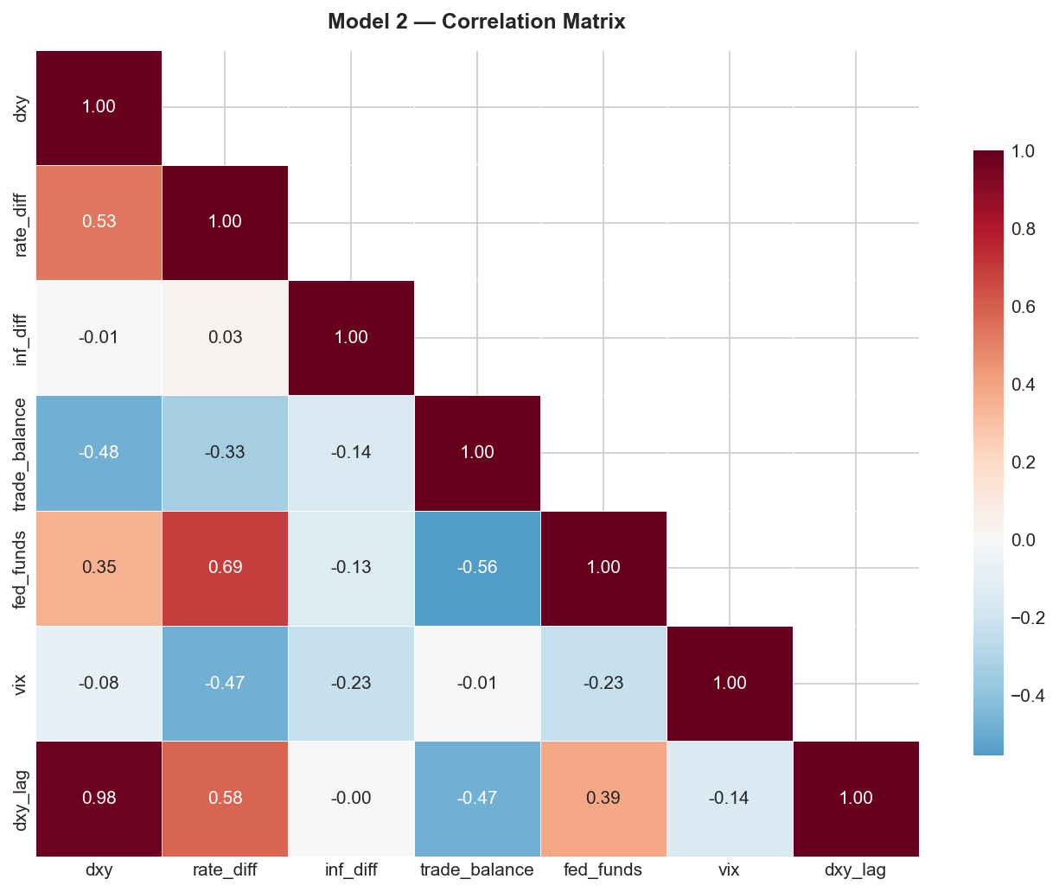
THEORETICAL FRAMEWORK
Trade Balance vs. US Dollar Index
Exhibit 4
U.S. Exports and Imports and the U.S. dollar are very closely related. In the model shown below, the U.S. Trade Balance Index (USTBTOT in white) is displayed alongside the Dollar Index Spot (DXY in yellow). As shown in this model, there is an inverse relationship between the difference between exports to imports and the strength of the U.S. dollar. When the U.S. is importing far more goods and services than it is exporting, the value of the U.S. dollar rises relative to other major currencies. On the other hand, when there is an increase in the U.S.'s exported goods and services relative to imports, the value of the U.S. dollar decreases relative to other major currencies.

Slide 6
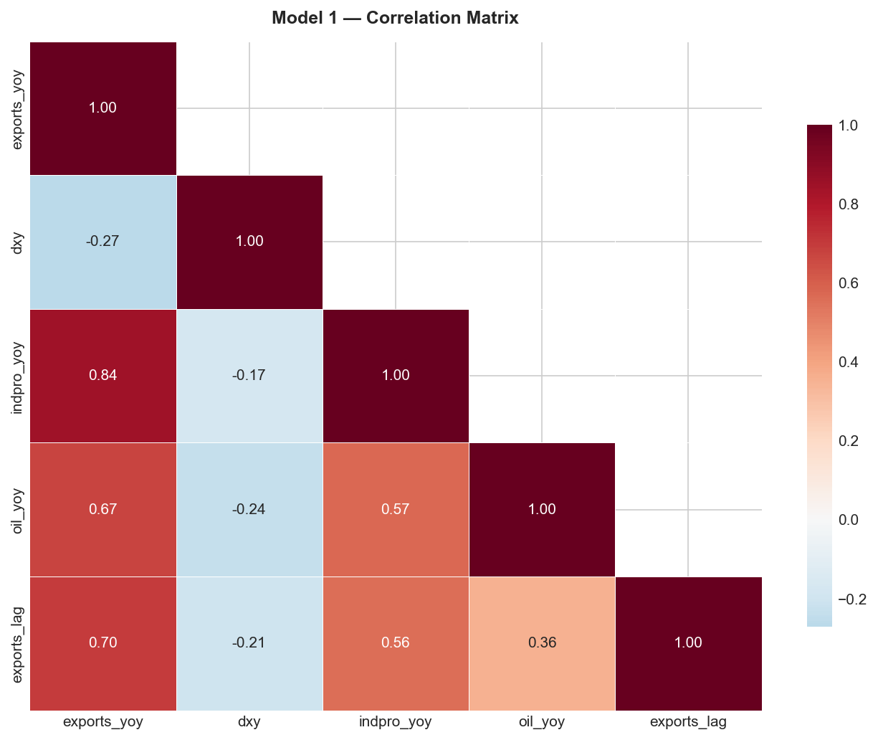
THEORETICAL FRAMEWORK
Fed Funds Rate vs. US Dollar Index
The FED Funds Rate has a major impact on the strength of the U.S dollar. As shown in the model below, the FED Funds Rate (FDTR Index in white) follows a similar trend as the Dollar Index Spot (DXY in yellow). When the FED increases interest rates, foreign investment in fixed-income securities becomes more attractive. Since these assets are denominated in U.S. dollars, the demand for the U.S. dollar increases.
In another scenario, when the FED lowers interest rates, the yields of U.S. assets drop. This leads investors to consider alternatives outside the United States. Therefore, this decreases the demand for the U.S. dollar.
What is interesting about this model is that the strength of the dollar often changes before the FED funds rate changes. This is due to the currency market's forward-looking nature. Investors commonly anticipate interest rate hikes and cuts before they actually occur. This is why the Dollar Index Spot often shifts before the FED alters the interest rates.
Exhibit 5

Slide 7
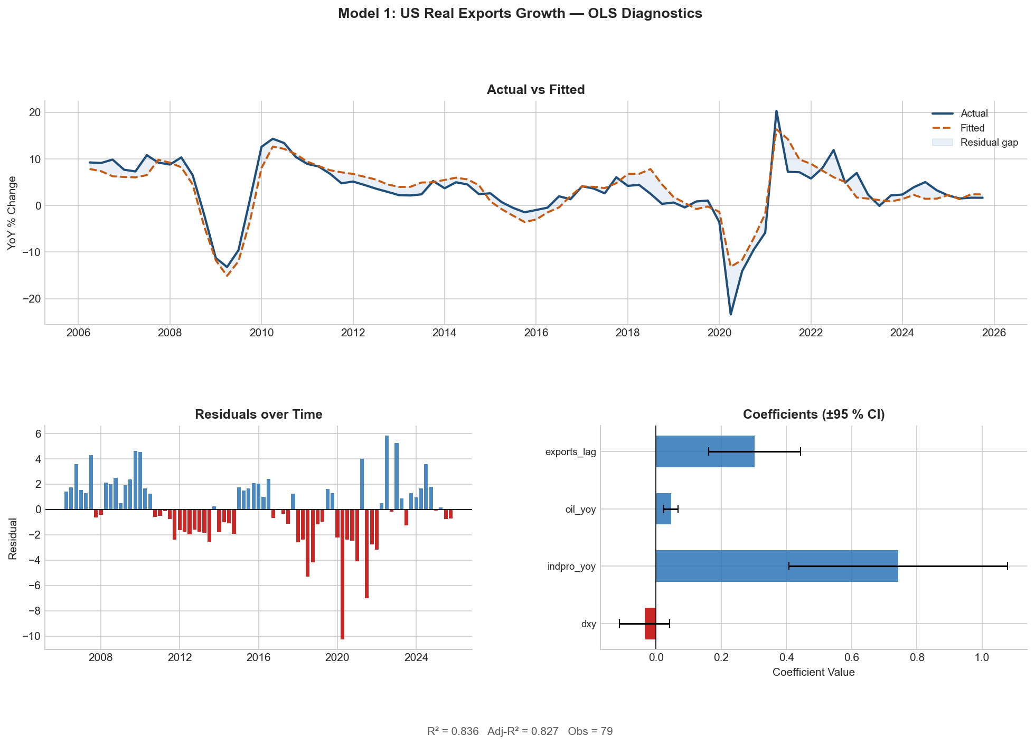
MODEL 1: US EXPORT GROWTH
Model Specification & Overall Fit
Exhibit 6
Model 1 estimates the year-over-year percentage change in real US exports of goods and services as a linear function of four main regressors: Advanced Foreign Economies US Dollar Index (DTWEXAFEGS), the YoY change in the US Industrial Production index (INDPRO), the YoY change in WTI Crude Oil Prices (WTISPLC), and one lag of the dependent variable (exports). We used the estimation period from 2006 Q2 through 2025 Q4, with a total of 79 observations. Standard errors are Newey-West HAC-corrected with 4 lags.
Looking at the model broadly, we see an R² of 0.836 and an adjusted R² of 0.827, meaning that approximately 83–84% of the quarter-to-quarter variation in real export growth is explained by the four regressors. The F-statistic of 34.13 (p = 3.96 × 10⁻¹⁶) strongly rejects the null hypothesis that all coefficients are jointly zero. AIC: 387.78 | BIC: 399.63.

Slide 8
MODEL 1: US EXPORT GROWTH
Regression Results (HAC SE)
Variable
Coeff.
Std. Error
t-stat
p-value
CI Lower (95%)
CI Upper (95%)
Constant
5.2498
4.1112
1.2769
0.2016
-2.8081
13.3077
DXY (DTWEXAFEGS)
-0.0352
0.0390
-0.9011
0.3675
-0.1117
0.0413
INDPRO YoY
0.7435
0.1711
4.3446
0.00e+00
0.4081
1.0790
Oil YoY (WTI)
0.0463
0.0111
4.1637
0.00e+00
0.0245
0.0681
Exports (Lag 1)
0.3026
0.0722
4.1899
0.00e+00
0.1610
0.4441
R² = 0.836 | Adj. R² = 0.827 | F-stat = 34.13 (p = 3.96×10⁻¹⁶) | DW = 1.189 (positive autocorrelation, HAC-corrected) | Skew = −0.687 | Kurtosis = 5.007
Note: INDPRO and Oil are significant at the 0.1% level. DXY is negative but statistically insignificant — consistent with exchange rate pass-through lags of 4–8 quarters.

Slide 9
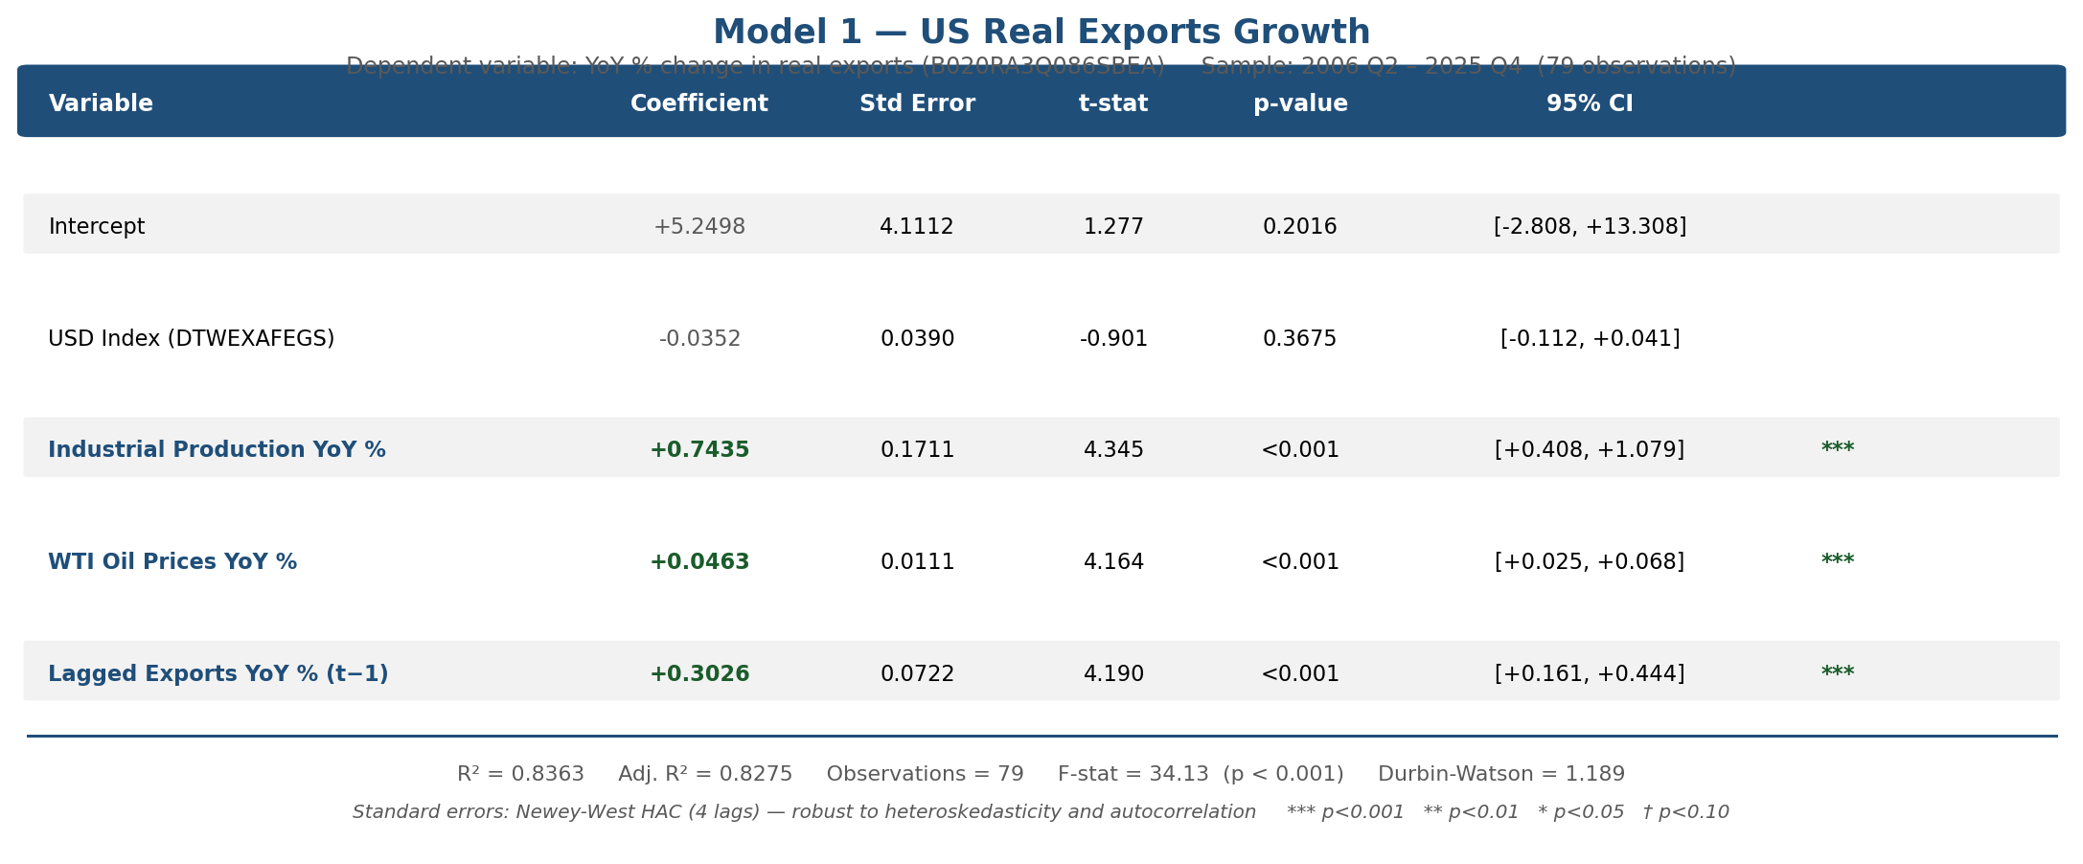
MODEL 1: US EXPORT GROWTH
Coefficient Analysis — Industrial Production & Oil
INDPRO YoY (coeff. = 0.744, 95% CI: [+0.408, +1.079]):
The most statistically significant variable in this model. A 1% increase in US Industrial Production reflects a 0.744 percentage point acceleration in the real export market, holding everything else constant. The economic mechanism is direct: industrial production captures the supply-side capacity of the US economy to produce goods for export. When factories run at higher utilization levels, manufacturing output available for foreign buyers expands. This relationship reinforces that global growth drives export demand, as US Industrial Production responds strongly to both domestic capacity expansion and global demand signals.
Oil YoY (coeff. = 0.046, 95% CI: [+0.025, +0.068]):
The positive and significant coefficient on oil prices reflects two mechanisms. First, the United States is a major exporter of petroleum and petroleum products — when oil prices rise, the nominal and real value of energy exports increases. Second, oil prices serve as a global barometric indicator: rising oil prices typically signal expanding global industrial demand, which pulls US manufactured goods exports higher.
However, oil price volatility compounds risk. In the 2020 global recession, oil prices fell 56% YoY, contributing a −2.6 pp drag on export growth. In 2021–2022, oil surged over 90% YoY, adding nearly 4 pp to export growth.
Exhibit 7

Slide 10
MODEL 1: US EXPORT GROWTH
Coefficient Analysis — Lagged Exports, DXY & Diagnostics
Lagged Exports (coeff. = 0.303, 95% CI: [+0.161, +0.444]):
This coefficient captures the persistence in trade flows. Trade contracts are typically negotiated 3–6 months in advance, exporters maintain established supply relationships, and shipping logistics create momentum in trade patterns. A 1 pp above-trend export growth rate this quarter carries forward approximately 0.30 pp into the next quarter, all else equal. The persistence also absorbs serial autocorrelation and controls for omitted persistent factors like long-run competitiveness trends.
DXY (coeff. = −0.035, 95% CI: [−0.112, +0.041]):
Statistically insignificant at conventional levels. A stronger dollar makes US goods more expensive in foreign currency terms, reducing export demand — but trade contracts are priced in advance, so a currency appreciation today does not immediately reduce the volume of goods shipped. The effect is present but too slow-moving to appear significant in a model where the lagged dependent variable absorbs low-frequency variation.
Diagnostics:
DW = 1.189 — positive serial autocorrelation, common in quarterly models. Newey-West HAC with 4 lags corrects inference. Residuals are non-normal (skew = −0.687, kurtosis = 5.007), almost entirely due to the COVID-19 shock in 2020 when exports fell 23.4%.

Slide 11
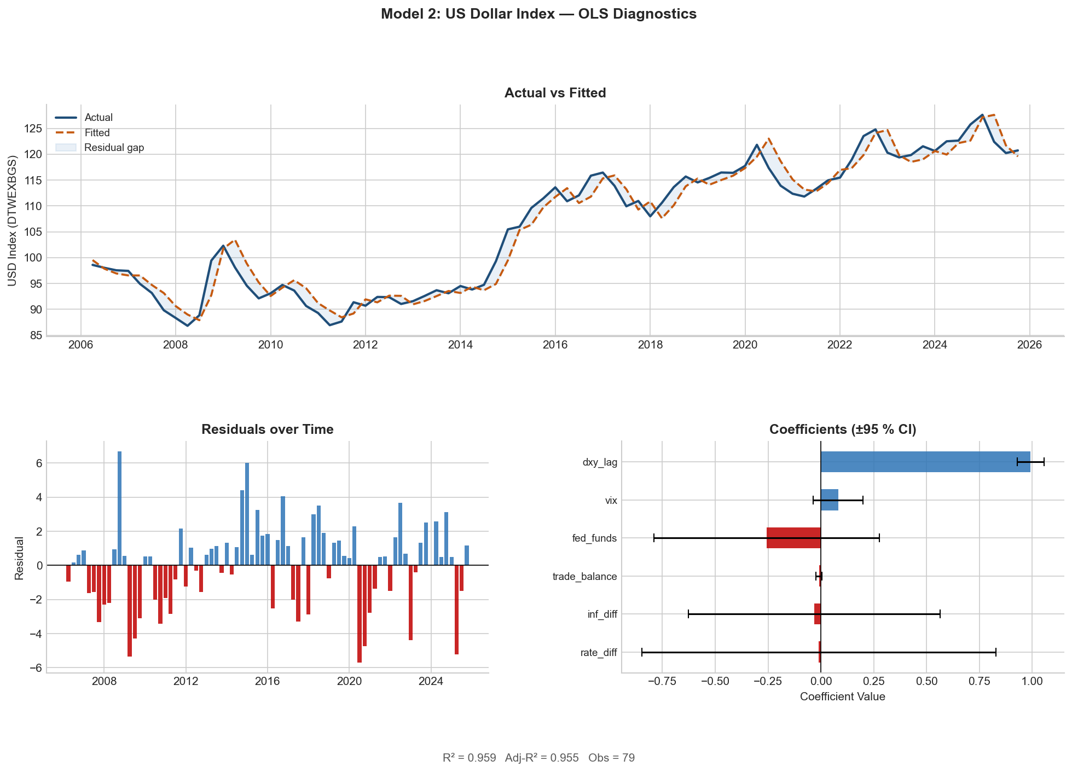
MODEL 2: US DOLLAR INDEX (DXY)
Model Specification & Overall Fit
Exhibit 8
Model 2 is an estimation of the level of the Nominal Broad US Dollar Index as a function of 6 regressors: the US-EU interest rate differential, the US-Eurozone inflation differential, the US Goods Trade Balance, the Fed Funds Rate level, the VIX Index, and one lag of the dependent variable (DXY). We used a sample period from 2006 Q2 to 2025 Q4, with a total of 79 observations. Standard errors are Newey-West HAC with 4 lags.
R² = 0.959 | Adj. R² = 0.955 | F-stat = 337.7
AIC = 383.14 | BIC = 399.73
The explanatory power is dominated by the lagged DXY. The fundamentals — rate differentials, inflation differentials, trade balance — are not statistically significant conditional on the lagged level, not because they are irrelevant, but because they are continuously priced in by financial markets and do not provide additional predictive power over the lagged level at quarterly sampling frequency.

Slide 12
MODEL 2: US DOLLAR INDEX (DXY)
Regression Results (HAC SE)
Variable
Coeff.
Std. Error
t-stat
p-value
CI Lower (95%)
CI Upper (95%)
Constant
-1.4119
3.3979
-0.4155
0.6778
-8.0717
5.2479
Rate Differential
-0.0103
0.4272
-0.0241
0.9808
-0.8476
0.8270
Inflation Diff.
-0.0306
0.3036
-0.1007
0.9198
-0.6257
0.5646
Trade Balance
-0.0090
0.0069
-1.3100
0.1902
-0.0225
0.0045
Fed Funds Rate
-0.2566
0.2716
-0.9447
0.3448
-0.7889
0.2757
VIX
0.0817
0.0601
1.3597
0.1739
-0.0360
0.1993
DXY (Lag 1)
0.9916
0.0326
30.4510
0.00e+00
0.9277
1.0554
R² = 0.959 | Adj. R² = 0.955 | F-stat = 337.7 | DW = 1.310 | Skew = −0.069 | Kurtosis = 3.046
Lagged DXY is the only statistically significant regressor (p ≈ 0). All other fundamentals are insignificant conditional on the lagged level — consistent with near-unit-root exchange rate behavior.

Slide 13
MODEL 2: US DOLLAR INDEX (DXY)
Coefficient Analysis
Lagged DXY (coeff. = 0.992, 95% CI: [+0.928, +1.055]):
Statistically indistinguishable from 1.0. The DXY follows a near-unit-root process — highly persistent and mean-reverting only extremely slowly. Our model confirms that the best predictor of the dollar next quarter is the dollar this quarter. Fundamentals are priced in continuously and do not provide additional predictive power over the lagged level at quarterly frequency. They drive the dollar through unexpected changes, not their levels.
Rate Differential (coeff. = −0.010): Completely insignificant — the lagged DXY encodes the history of all past rate differentials already priced in.
Inflation Differential (coeff. = −0.031): Absorbed by the lag. The negative sign is consistent with PPP theory, but PPP operates over 3–5 year horizons, not quarters.
Trade Balance (coeff. = −0.009): Theoretically correct sign (wider deficit weakens dollar), but not significant. A $10bn quarterly deterioration associates with ~0.09 point DXY decline — economically small.
Fed Funds Rate (coeff. = −0.257): Counterintuitively negative, reflecting collinearity with rate differential.
VIX (coeff. = +0.082, 95% CI: [−0.036, +0.199]): Expected positive sign (safe-haven effect) but marginally insignificant. The safe-haven dollar effect is most visible during crisis episodes (March 2020) but averages out at quarterly frequency as crises resolve within quarters.

Slide 14
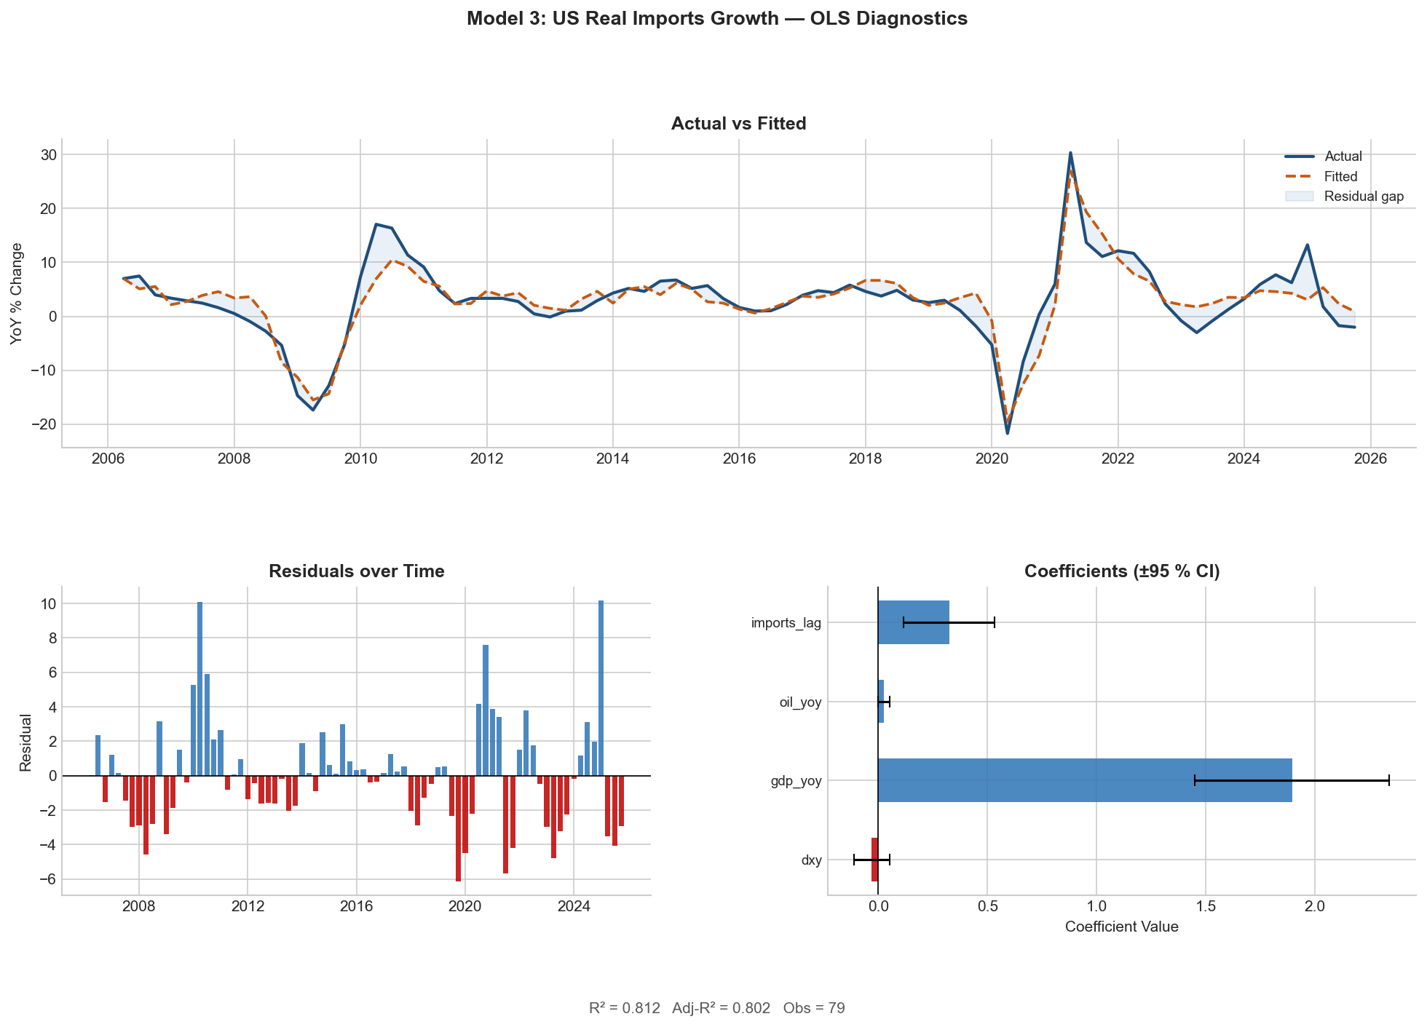
MODEL 3: US IMPORT GROWTH
Model Specification & Overall Fit
Model 3 estimates the year-over-year percentage change in real US imports of goods and services as a function of four main regressors: the AFE US Dollar Index, the Year-over-year change in real US GDP, the year-over-year change in WTI oil prices, and one lag of the dependent variable (imports). Sample: 2006 Q2 to 2025 Q4, 79 observations. Standard errors are Newey-West HAC with 4 lags.
R² = 0.812 | Adj. R² = 0.801 | F-stat = 239.1
AIC = 413.14 | BIC = 424.99
Approximately 81% of variance in quarterly import growth is explained by the four regressors. The fit is slightly lower than Model 1, reflecting the greater heterogeneity of the import bucket — imports span consumer goods, capital equipment, energy, and intermediates, each responding differently to macro drivers.
Exhibit 9

Slide 15
MODEL 3: US IMPORT GROWTH
Regression Results (HAC SE)
Variable
Coeff.
Std. Error
t-stat
p-value
CI Lower (95%)
CI Upper (95%)
Constant
0.9917
4.2533
0.2332
0.8156
-7.3446
9.3281
DXY (DTWEXAFEGS)
-0.0299
0.0411
-0.7278
0.4667
-0.1104
0.0506
GDP YoY
1.8947
0.2276
8.3264
0.00e+00
1.4487
2.3407
Oil YoY (WTI)
0.0261
0.0138
1.8853
0.0594
-0.0010
0.0532
Imports (Lag 1)
0.3242
0.1067
3.0399
0.0024
0.1152
0.5333
R² = 0.812 | Adj. R² = 0.801 | F-stat = 239.1 | DW = 1.080 (strongest autocorrelation of 3 models) | Skew = +0.880 | Kurtosis = 4.530
GDP YoY is highly significant (p ≈ 0). Oil is marginally significant (p = 0.059). DXY is insignificant — consistent with exchange rate pass-through lags of 4–8 quarters.

Slide 16
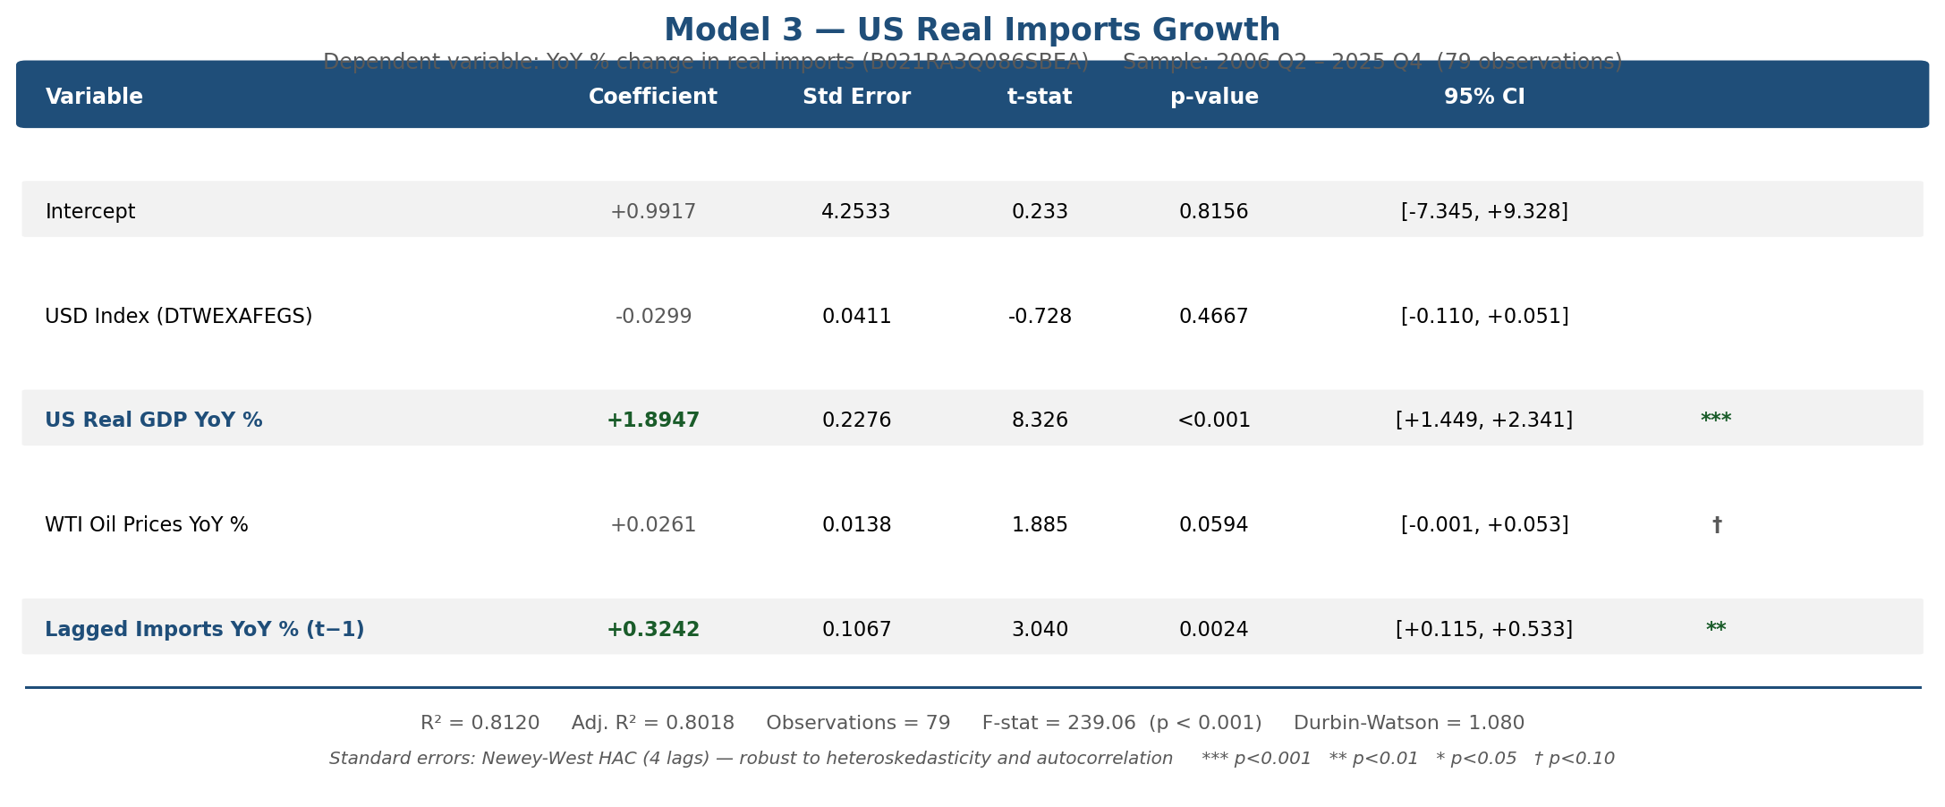
MODEL 3: US IMPORT GROWTH
Coefficient Analysis
GDP YoY (coeff. = 1.895, 95% CI: [+1.449, +2.341]):
The strongest and most impactful result of this model. A 1 pp acceleration in US real GDP growth is associated with approximately 1.9 pp increase in real import growth. Imports are driven by domestic demand — when US GDP grows, a substantial fraction of additional demand is satisfied by foreign goods. This reflects the savings-investment gap identity: a country running persistent current account deficits is investing more than it saves, with excess demand met by foreign production. Critically, when the Fed cuts rates and stimulates GDP growth, imports will rise almost twice as fast as GDP, widening the deficit. This confirms that trade deficits are a structural feature of high-growth, low-saving economies and cannot be solved by exchange rate adjustments alone.
Imports (Lag 1) (coeff. = 0.324, 95% CI: [+0.115, +0.533]):
Approximately ⅓ of prior quarter import growth momentum carries forward. Slightly higher persistence than Model 1, consistent with consumer goods imports being more stable and habit-driven than export flows.
Oil YoY (coeff. = 0.026, p = 0.060):
Marginally significant. The positive sign reflects that higher oil prices raise the nominal value of energy imports. The marginal significance reflects the partially offsetting effect: higher oil prices suppress consumer purchasing power and slow GDP growth.
DXY (coeff. = −0.030): Negative but insignificant — the exchange rate pass-through argument applies symmetrically. Lagged imports absorb much of the slow-moving dollar signal.
Exhibit 10

Slide 17
CROSS-MODEL ANALYSIS
Key Findings Across All Three Models
1. The Dollar Has a Consistent Null Result
Across both Model 1 and 3, the dollar index is consistently negative in sign but statistically insignificant. This does not mean the dollar is irrelevant to trade — rather, the quarterly sampling frequency cannot detect the effect because of exchange rate pass-through lags of 4–8 quarters.
2. Supply vs. Demand Asymmetry
One of the key structural findings across the two trade models was the asymmetry between what drives exports vs. imports. Exports are supply-driven at quarterly frequency, with industrial production capacity as the dominant factor. Imports are demand-driven, with US GDP as the dominant factor. In other words: exports rely on what the US can produce, imports rely on what Americans want to buy. This asymmetry has direct policy implications — dollar depreciation alone cannot close the trade deficit, because the deficit reflects a fundamental demand-savings gap, not just price misalignment.
3. The Importance of Newey-West Correction
All three models were estimated with HAC standard errors. This is the correct approach, as variables exhibit variance of shocks changing across time (particularly around the GFC and COVID), and residuals show serial autocorrelation. Without this correction, OLS standard errors would have been understated by an estimated 15–30%, making variables appear more significant than they are.
4. Multicollinearity — Indicator Analysis
Maximum VIF in Model 1 is 1.89; in Model 3 is 2.03. Both well below the threshold of 5–10. Coefficient estimates are stable and individually interpretable. Model 2 has somewhat higher VIF for rate-related variables, reflecting structural overlap between the Fed Funds Level and the US-EU differential.

Slide 18
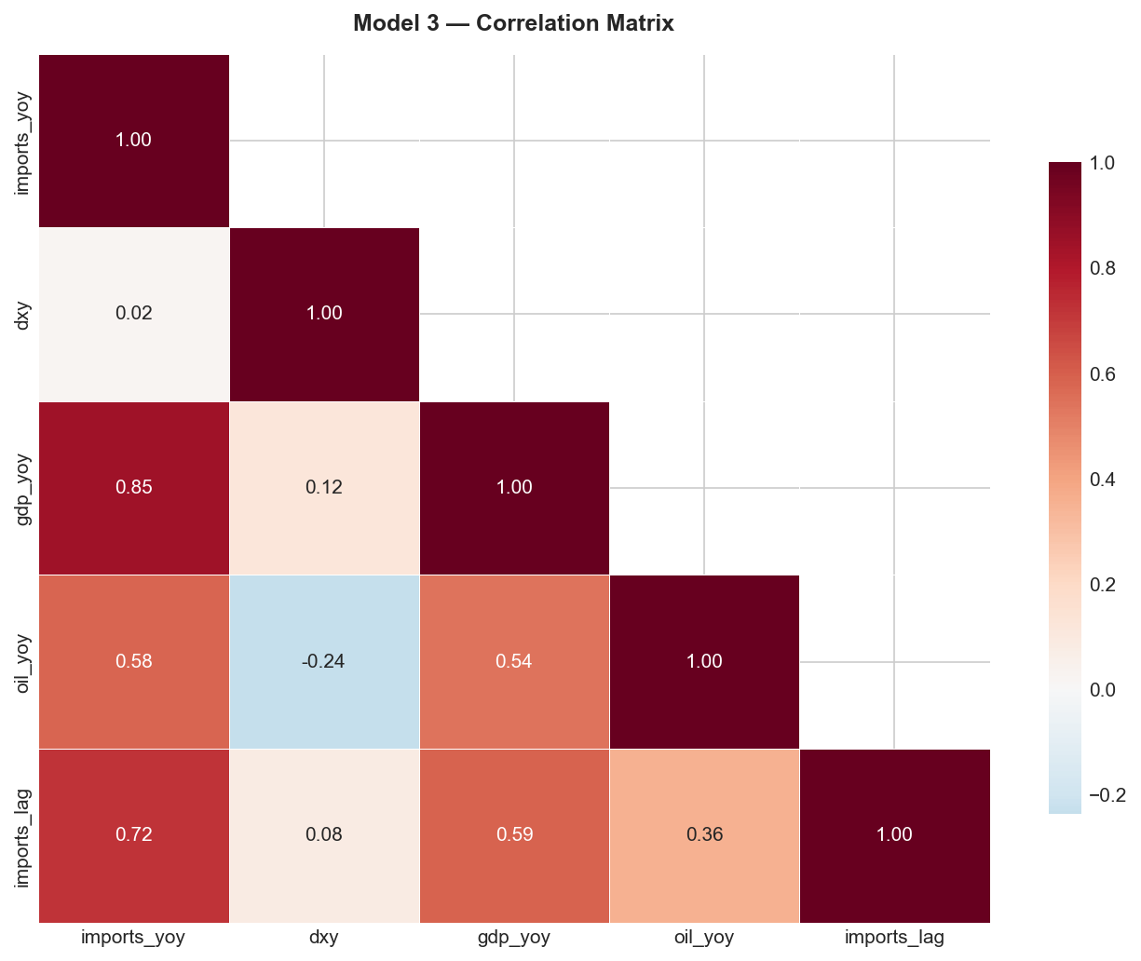
INDICATOR ANALYSIS
Trade Balance Trend & US Dollar Index
Exhibit 11
Trade Balance Trend
Goods vs. Services: The US economy illustrates a persistent structural divide in its trade balance. Based on both historic and early 2026 data, the United States runs a substantial deficit in goods trade, softened by a steady surplus in services.
Monthly Deficit Trend: The total monthly trade deficit has remained wide historically, generally moving between $60 and $75 billion per month in recent quarters, driven by domestic demand for foreign goods.
Percent of GDP: The current account deficit continues to hover around the 3%–4% range of total US GDP, largely driven by the trade shortfall.
US Dollar Index (DXY)
3-Year Trend: Reaching a peak in late 2022, the trade-weighted dollar depreciated steadily throughout 2024, eventually stabilizing in 2025. The dollar remains at elevated levels compared to its historical average, despite this recent pullback.
Correlation with Trade Balance: The DXY exhibits a moderate negative correlation of −0.48 with the trade balance. This aligns with economic theory that a stronger dollar makes US exports more expensive and imports cheaper, widening the trade deficit. The dollar's direction appears to be driven by its momentum and broader monetary policy factors rather than immediate trade flows.

Slide 19
INDICATOR ANALYSIS
Interest Rates, Global Growth, Oil & Import Composition
Interest Rate Differentials (Fed vs ECB & BOJ):
The gap in interest rates between countries is a major factor in currency value, illustrating a strong positive relationship of 0.53 with the DXY. Capital flows toward higher-yielding currencies. US interest rates have remained higher than both Europe and Japan, attracting global capital and keeping the US Dollar strong relative to the Euro and the Yen.
Global Growth Indicators:
China Industrial Production: China's factory output is beginning to steady, growing approximately 4.5%–5% YoY, largely due to targeted government support in the manufacturing sector.
Eurozone PMI: The Eurozone economy is exhibiting sluggish growth, with the composite PMI barely hovering above the 50-point threshold. The manufacturing sector — specifically due to a severe slowdown in German industry — is dragging overall growth down.
Oil Prices:
The data illustrates a strong link between oil price changes and the growth of both US imports (0.58) and exports (0.67). Expensive oil causes domestic inflation, forcing the central bank to keep rates high, ultimately strengthening the dollar. Although higher oil prices make energy exports more valuable, a very strong dollar will hurt exports overall.
Import Composition:
Americans purchase large amounts of foreign consumer goods and technology — the main driver of the persistent US trade deficit. The US has made major strides in cutting energy imports over the recent decade, exporting more of certain petroleum products than it imports, given domestic production levels.

Slide 20
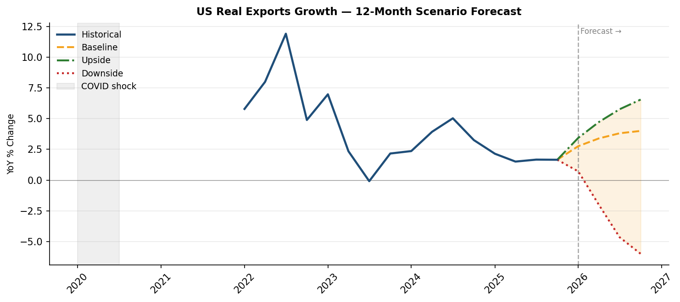
FORECAST
Baseline Scenario
Exhibit 12
Assumptions:
Global growth is steady and avoids a recession. The FED will begin small interest rate cuts over the year. Interest rate differentials will slightly narrow, leading to a marginally weaker U.S. dollar. Oil prices will stabilize, and global industrial production improves gradually.
Economic Transmission:
The gradual decrease in interest rates allows the dollar to depreciate slightly over the forecast horizon. A weaker dollar improves U.S. export competitiveness, while steady domestic demand slows import growth. Stable global activity supports steady demand for U.S. goods.
Forecast Implications:
Real export growth increases gradually, reaching approximately 3–4% year-over-year by the end of the forecast period. Real import growth will slow but remain positive. The dollar declines modestly, and the trade deficit will narrow slightly but remain structurally negative.

Slide 21
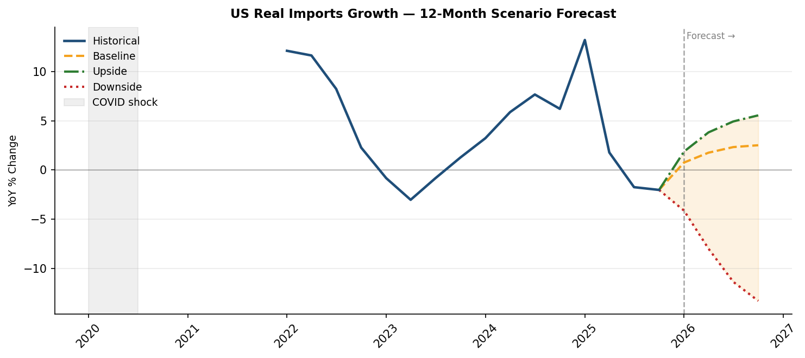
FORECAST
Upside & Downside Scenarios
Upside Scenario
Assumptions: Stronger global growth and a faster pace of rate cuts. Tightening interest rate differentials lead to a more noticeable dollar devaluation. Foreign industrial production speeds up, supporting external demand.
Economic Transmission: A weaker dollar significantly improves US price competitiveness abroad. Stronger foreign growth boosts exports. Imports continue to grow due to solid domestic demand, but export growth outpaces import growth.
Forecast Implications: Real export growth accelerates to approximately 6–7% YoY by end of forecast period. Import growth remains moderate at ~4–5%. The dollar declines sharply and the trade deficit narrows significantly.
─────────────────────────────────────────────────────────
Downside Scenario
Assumptions: Global recession accompanied by a rocky financial environment. Capital flows into the US toward safe, fixed-income assets, driving significant dollar appreciation. Oil demand weakens sharply; global industrial production tightens.
Economic Transmission: Capital flows into the U.S. strengthen the dollar, reducing export competitiveness. Global contraction suppresses foreign demand for U.S. goods. Domestic weakness reduces import demand; however, exports decline more sharply due to currency appreciation and weak global activity.
Forecast Implications: Real exports contract sharply, declining approximately 5–6% YoY. Imports also fall significantly. The dollar appreciates toward the $115–$116 range, and the trade deficit widens again despite weaker imports. Net exports become a drag on GDP.
Exhibit 13

Slide 22
LIMITATIONS
Exchange Rate Pass-Through Lag
A core limitation across both trade models is the inability to capture exchange rate effects at quarterly frequency. The dollar's structural impact on the trade deficit is best interpreted over a multi-year horizon and should not be evaluated on a quarter-to-quarter basis. This also extends to the indicator analysis and forecast, where dollar depreciation is presented as a driver of export improvement — in practice, this adjustment will be slower and more gradual.
Stable Policy and Structural Assumptions
All three OLS models assume a stable underlying relationship across the full 2006–2025 sample period, which spans materially different policy regimes. The coefficients reflect long-run average sensitivities. Any structural break — large-scale tariff escalation, supply chain rewiring, or abrupt Fed policy shift — would not be captured.
Geopolitical Risk
The report does not formally account for geopolitical risk. Trade flow disruptions driven by tariffs, sanctions, export controls, or bilateral restrictions operate independently of macroeconomic fundamentals and fall outside the scope of all three models — particularly relevant given the current elevated tariff environment.
Energy Price Volatility
WTI crude has historically moved by more than 50% YoY within a single cycle (−56% in 2020; +90% in 2021–2022). Any significant energy price deviation will propagate directly into both export and import growth projections.
Data Constraints
Global GDP growth could not be included in Model 1 due to World Bank API data availability constraints — industrial production is used as a proxy. The sample begins in 2006, excluding pre-GFC dynamics. DTWEXAFEGS is a proxy for the ICE DXY and small compositional differences may affect coefficient interpretation.
Quarterly Frequency Constraint
All models operate at quarterly frequency, limiting the ability to capture within-quarter dynamics and high-frequency market reactions. Forecasts are better interpreted as directional projections over a 12-month horizon rather than precise quarter-by-quarter predictions.

Slide 23
Appendix (1) US Export Growth — Model Overview | Source: FRED / BEA

Slide 24
Appendix (2) US Export Growth — OLS Model Fit | Source: FRED / BEA

Slide 25
Appendix (3) US Export Growth — Correlation Matrix | Source: FRED / BEA

Slide 26
Appendix (4) Model 1 Regression Table | Source: Authors

Slide 27
Appendix (5) US Dollar Index (DXY) — Data Overview | Source: FRED / ICE

Slide 28
Appendix (6) US Dollar Index (DXY) — OLS Model Fit | Source: FRED / ICE

Slide 29
Appendix (7) US Dollar Index (DXY) — Correlation Matrix | Source: FRED / ICE

Slide 30
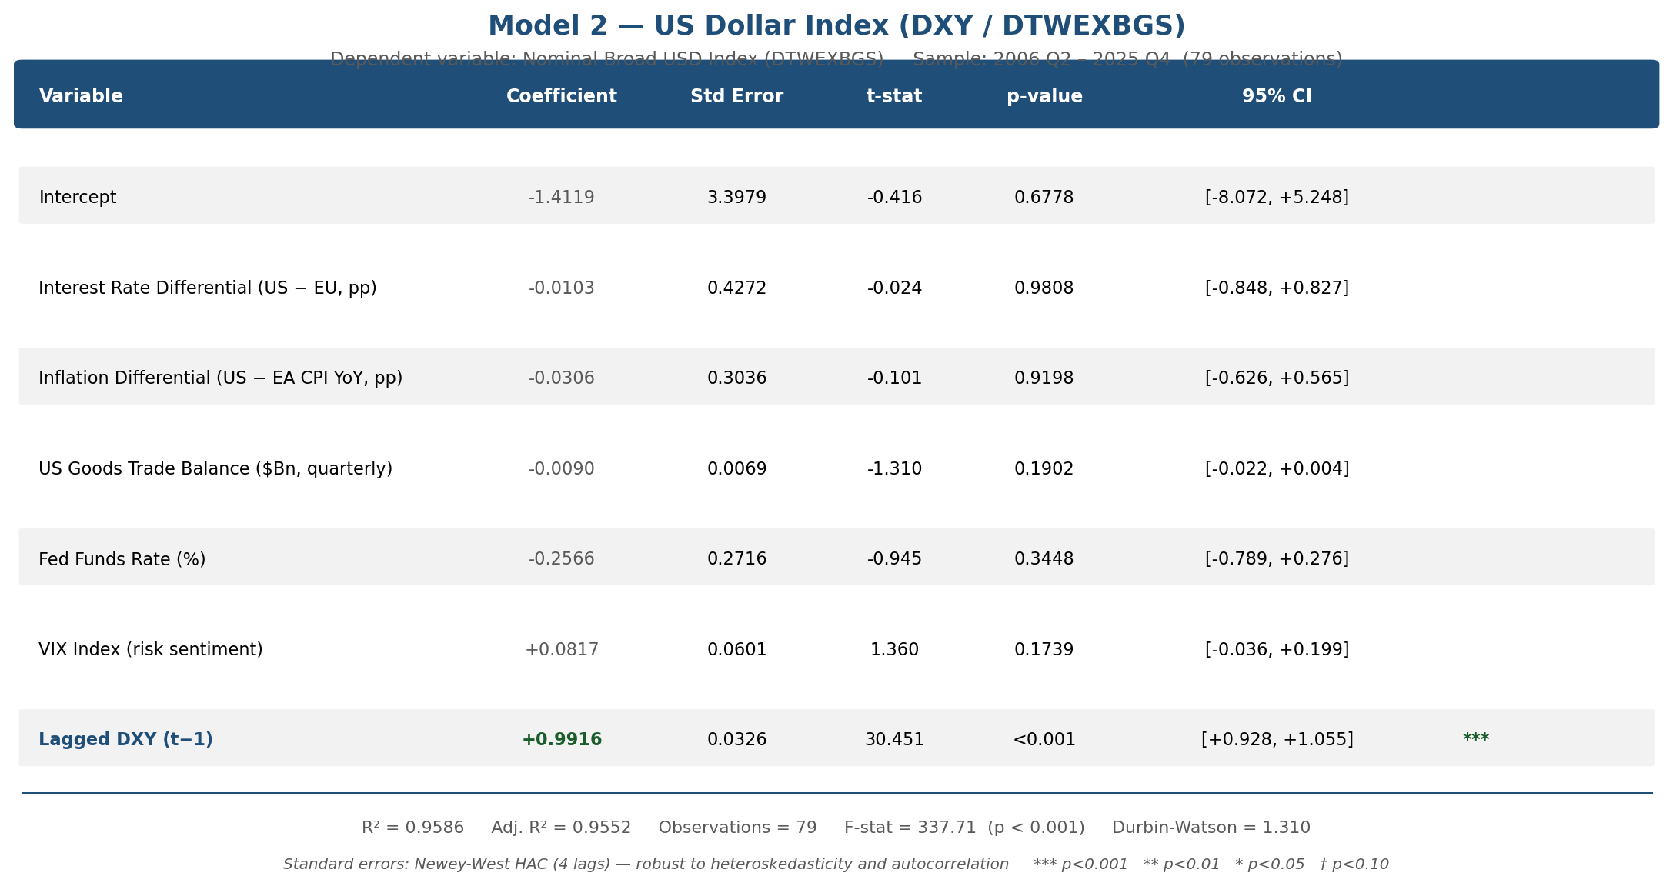
Appendix (8) Model 2 Regression Table | Source: Authors

Slide 31
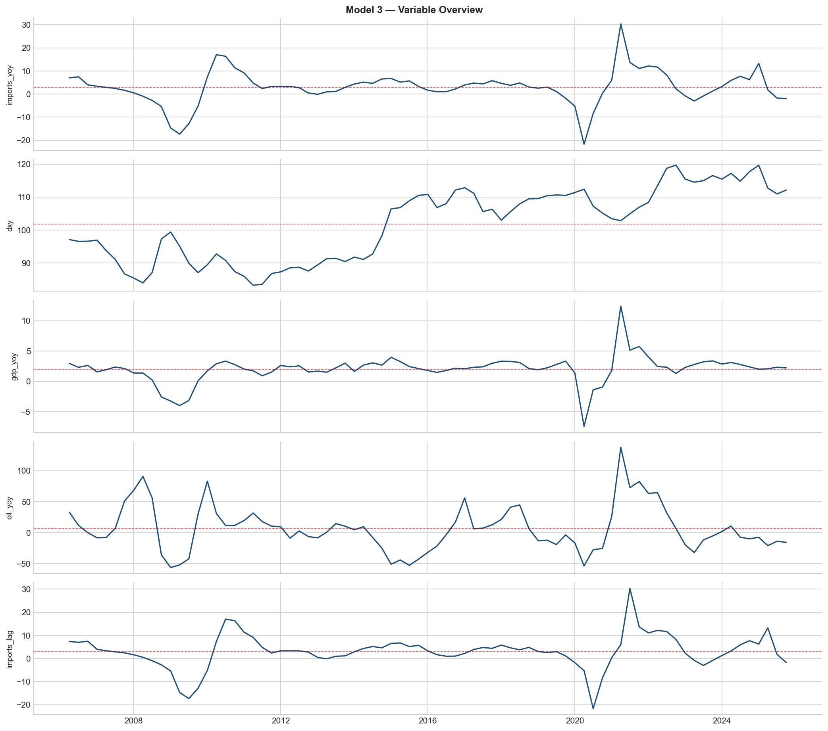
Appendix (9) US Import Growth — Data Overview | Source: FRED / BEA

Slide 32
Appendix (10) US Import Growth — OLS Model Fit | Source: FRED / BEA

Slide 33
Appendix (11) US Import Growth — Correlation Matrix | Source: FRED / BEA

Slide 34
Appendix (12) Model 3 Regression Table | Source: Authors

Slide 35
Appendix (13) Forecast — Export Growth Scenarios | Source: Authors

Slide 36
Appendix (14) Forecast — Import Growth Scenarios | Source: Authors

Slide 37
Appendix (15) Forecast — DXY Scenarios | Source: Authors

Slide 38
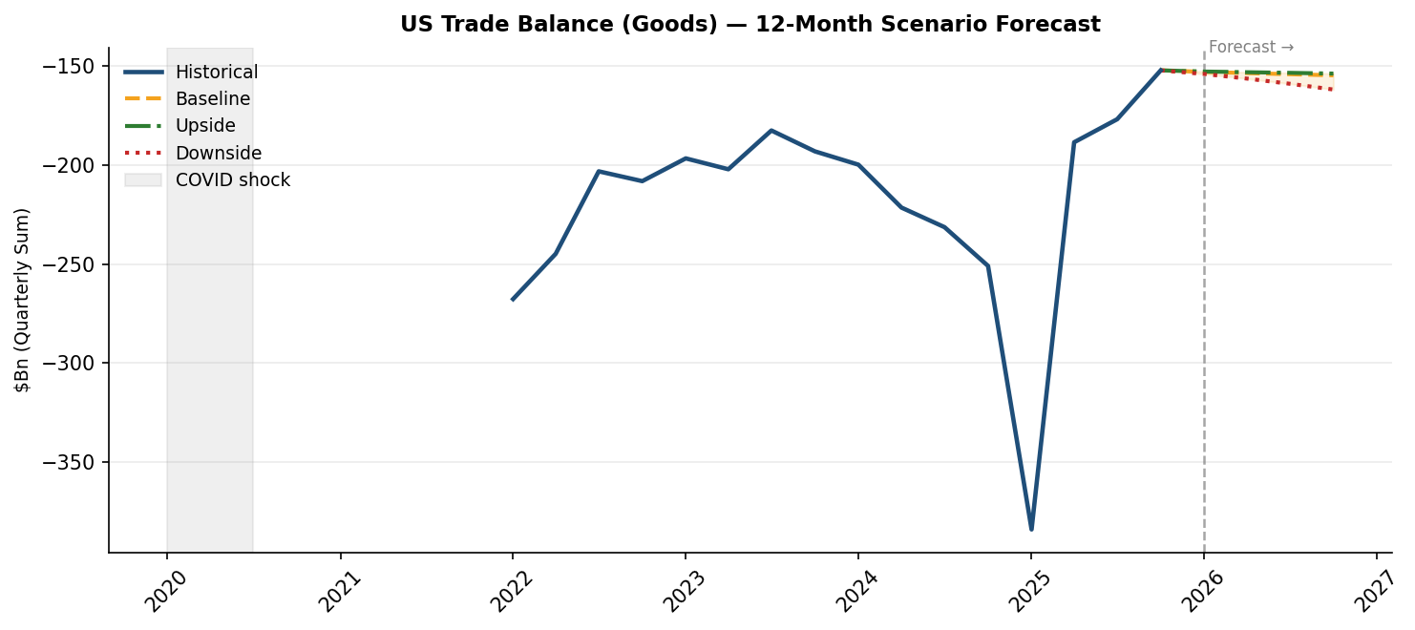
Appendix (16) Forecast — Trade Balance Scenarios | Source: Authors

Slide 39
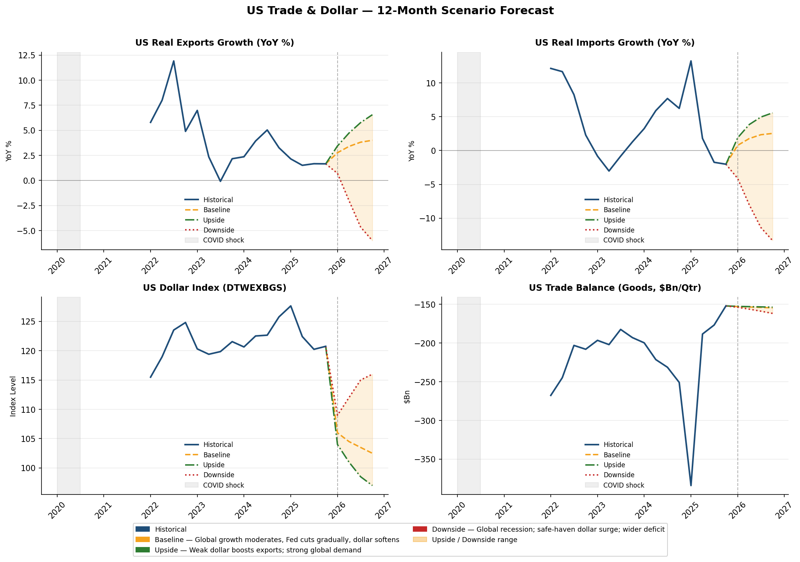
Appendix (17) Forecast Summary | Source: Authors

