Slide 1
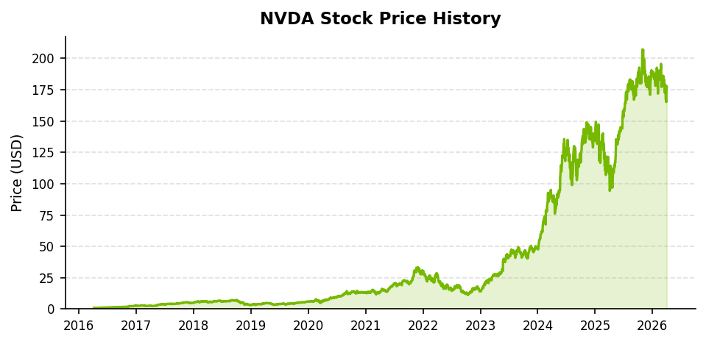
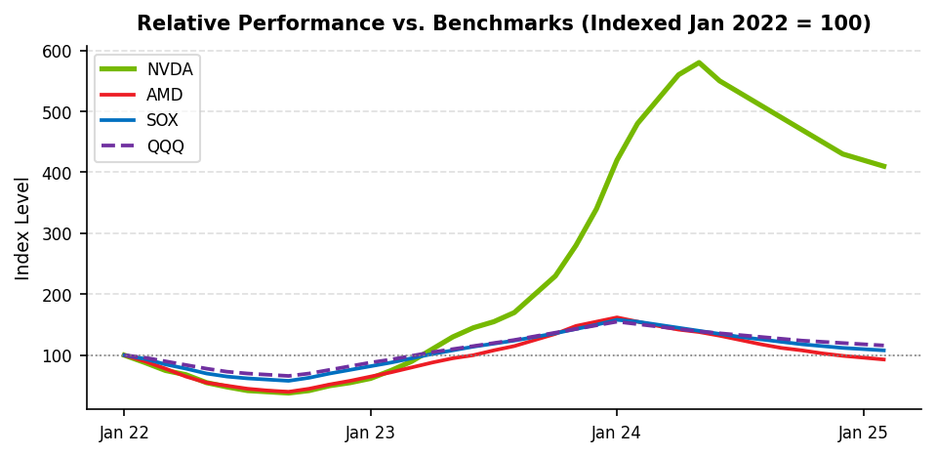
NVDA | EQUITY RESEARCH
EQUITY RESEARCH | INITIATING COVERAGE
April 2026 | FIN 431
NVIDIA CORPORATION
BUY
12-Month Price Target:
NASDAQ: NVDA
$220.00
Current Price
Market Cap
52-Week Range
FY26E Revenue
FY26E FCF Margin
FY26E P/FCF
$177.39
~$4.3T
$86 - $180
$215.9B
44.7%
45.0x
BUSINESS DESCRIPTION
FIGURE 1: NVDA PRICE HISTORY
NVIDIA Corporation, founded in 1993 by Jensen Huang, Chris Malachowsky, and Curtis Priem, designs and sells graphics processing units, system-on-chip units, and application programming interfaces for data center workloads, artificial intelligence, and professional visualization. The company operates two reportable segments: Compute and Networking, which now accounts for roughly 90 percent of consolidated revenue, and Graphics, which serves the gaming and professional visualization markets.
NVIDIA pioneered the CUDA parallel computing platform in 2006, establishing a software ecosystem that remains a core competitive advantage. Its flagship H100 and H200 Hopper GPU architecture and the next-generation Blackwell B100 and B200 platform are purpose-built for large language model training and real-time AI inference. Major hyperscalers including Microsoft, Google, Amazon, and Meta collectively account for over 40 percent of data center revenue, with demand consistently exceeding supply since fiscal year 2024.
INVESTMENT THESIS
FIGURE 2: PERFORMANCE VS. SOX, AMD, QQQ
Hyperscaler Capital Expenditure Supercycle. Microsoft, Google, Amazon, and Meta have collectively guided for over $300 billion in combined capital expenditure in calendar year 2025, with AI infrastructure representing the largest single growth category. NVIDIA's H100 and B200 GPU clusters remain the default substrate for frontier model training and inference serving at scale, creating a multi-year demand runway that extends well beyond the current fiscal year.
Blackwell Architecture Upgrade Cycle. The transition from Hopper to Blackwell represents a step-change in compute density and energy efficiency. B200 delivers up to 30x inference throughput improvements versus H100, and the GB200 NVL72 rack-scale system delivers aggregate bandwidth that custom ASICs cannot replicate at comparable scale today. Management guided $78 billion in Q1 FY27 revenue, implying a $312 billion annualized run rate.
Full-Stack AI Delivery. NVIDIA's competitive moat extends beyond silicon to include the CUDA software stack, cuDNN libraries, NeMo and TensorRT frameworks, and the DGX Cloud managed service. This vertical integration creates meaningful switching costs and allows NVIDIA to capture value across hardware, software, and services simultaneously.
FINANCIAL SNAPSHOT
Metric
FY24
FY25
FY26E
FY27E
Revenue ($M)
$60,922
$130,497
$215,900
$280,170
Adj. EBITDA ($M)
$34,800
$86,600
$141,200
$183,560
Adj. EPS
$1.30
$2.99
$4.77
$6.19
FCF ($M)
$27,022
$60,840
$96,575
$125,347
FCF Margin
44.4%
46.6%
44.7%
44.7%
Rev. Growth YoY
122%
114%
65%
30%
Recommendation Summary
We initiate coverage of NVIDIA Corporation with a BUY recommendation and a 12-month price target of $220.00, representing 24.1 percent upside from the current price of $177.39. Our target is derived from a blended valuation of our Free Cash Flow Model (P1 = $216.85), Market Multipliers composite ($183.63), and a forward earnings multiple of 30x on FY27E Non-GAAP EPS of $6.19 (implied target $231.00). The primary investment catalysts are the Blackwell GPU ramp, ongoing hyperscaler AI capital expenditure commitments, and NVIDIA's unmatched full-stack software ecosystem centered on the CUDA platform.
NVIDIA Corporation (NVDA) | Equity Research | FIN 431 | Portfolio Analysis
Page 1

Slide 2
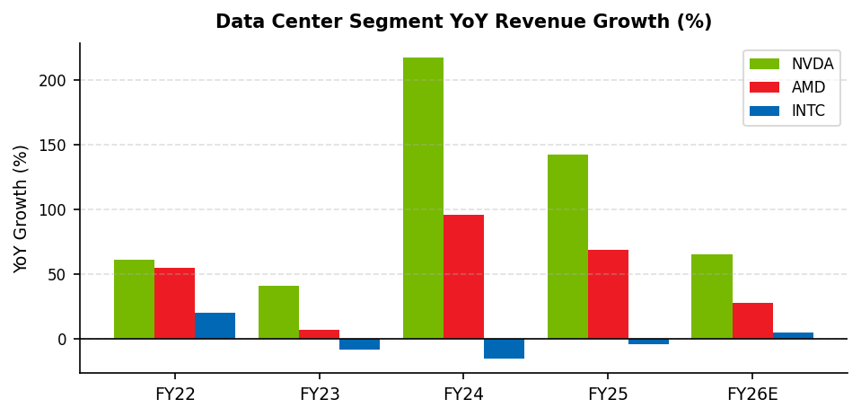
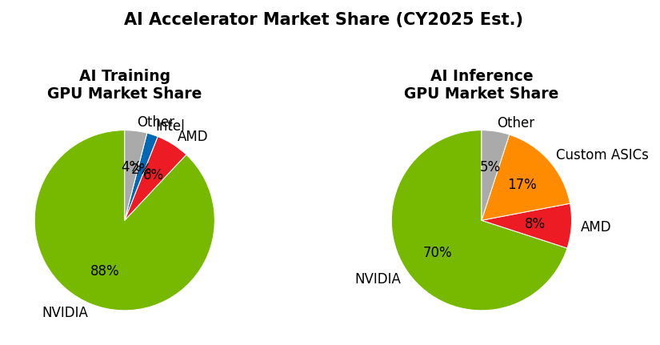
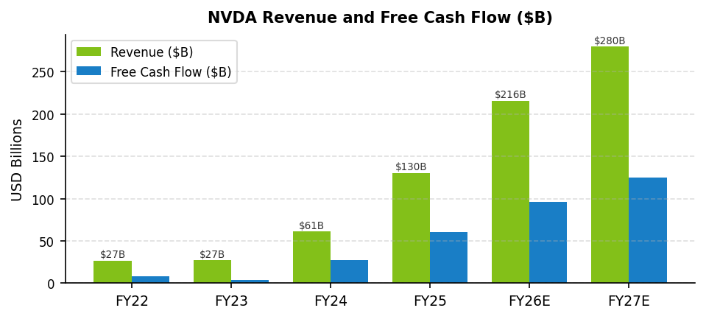
NVDA | EQUITY RESEARCH
PERFORMANCE & COMPETITIVE POSITIONING
April 2026 | FIN 431
INDUSTRY OVERVIEW AND COMPETITIVE LANDSCAPE
The artificial intelligence accelerator market is undergoing one of the most rapid capacity buildouts in the history of the semiconductor industry. Global spending on AI compute infrastructure is projected to exceed $500 billion annually by calendar year 2027, driven by frontier model training at hyperscale and the proliferation of inference workloads at the network edge. NVIDIA occupies the dominant position in this market, commanding an estimated 88 percent share of AI training accelerators and approximately 70 percent of inference workloads as of early 2025.
FIGURE 3: DATA CENTER SEGMENT YOY REVENUE GROWTH
FIGURE 4: AI GPU MARKET SHARE (CY2025E)
COMPETITIVE POSITIONING: NVDA VS. AMD VS. INTC
FIGURE 5: NVDA REVENUE AND FCF GROWTH
Advanced Micro Devices (AMD) is NVIDIA's most credible near-term GPU competitor. The MI300X accelerator has gained traction with select hyperscaler inference workloads, and AMD's FY25 data center revenue grew 69 percent year over year to an estimated $13 billion. However, AMD's ROCm software ecosystem remains materially behind CUDA in developer adoption, library completeness, and enterprise tooling. Independent benchmarks consistently show MI300X achieving 60 to 80 percent of H100 throughput per dollar on transformer workloads, with the gap widening further in favor of NVIDIA on multi-node training.
Intel (INTC) continues to struggle with its Gaudi 3 accelerator program. Despite aggressive pricing, Gaudi 3 has achieved minimal commercial traction, and Intel's data center segment posted negative year-over-year growth in three of the last four fiscal years. Intel reported a net loss of approximately $18.8 billion in fiscal year 2024, and its balance sheet constraints limit its ability to fund the sustained R&D investment required to close the architectural gap with NVIDIA.
Custom Application-Specific Integrated Circuits (ASICs) from Google (TPU v5), Amazon (Trainium 2), and Meta (MTIA) represent a structural risk to NVIDIA's long-term hyperscaler TAM. However, these proprietary chips are optimized for narrow internal workloads, lack the generality of NVIDIA's programmable GPU platform, and require multi-year development cycles that make rapid iteration challenging. We view ASIC competition as a meaningful but manageable risk over our 12-month horizon.
NEAR-TERM CATALYSTS
Catalyst
Expected Timing
Blackwell B200 volume ramp
Q1-Q2 FY27
Q1 FY27 earnings ($78B guidance)
May 2026
GB300 NVL72 rack system launch
H2 FY27E
Rubin architecture tape-out
CY2026
NIM microservice platform growth
Ongoing
Strengths
Weaknesses
Opportunities
Threats
88% training GPU share | CUDA ecosystem lock-in | 44%+ FCF margins | Balance sheet ($43B cash)
TSMC concentration (100% outsourced) | Export control restrictions | Cyclicality of gaming segment
Sovereign AI buildouts | Automotive autonomous driving (DRIVE Thor) | AI PC edge inference
Hyperscaler ASIC development | US-China tech decoupling | AMD ROCm maturation
NVIDIA Corporation (NVDA) | Equity Research | FIN 431 | Portfolio Analysis
Page 2

Slide 3
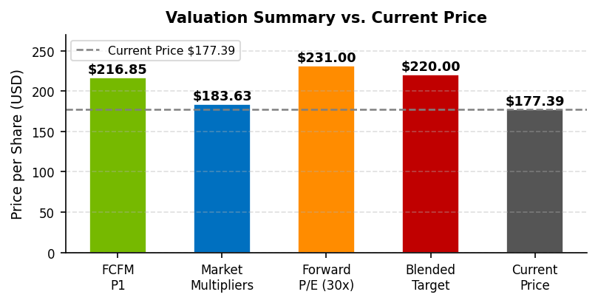
NVDA | EQUITY RESEARCH
VALUATIONS & FINANCIALS
April 2026 | FIN 431
FIGURE 6: FINANCIAL SUMMARY
FY24
FY25
FY26E
FY27E
Revenue ($M)
$60,922
$130,497
$215,900
$280,170
Adj. EBITDA ($M)
$34,800
$86,600
$141,200
$183,560
Adj. EPS
$1.30
$2.99
$4.77
$6.19
Adj. Net Income ($M)
$29,015
$71,871
$114,741
$149,163
Free Cash Flow ($M)
$27,022
$60,840
$96,575
$125,347
Capital Expenditures
$(1,069)
$(3,730)
$(5,500)
$(7,150)
EV/EBITDA
83.5x
33.5x
30.3x
23.4x
P/FCF
113.1x
50.2x
45.0x
34.7x
P/E (Non-GAAP)
264.4x
108.2x
37.2x
28.7x
Revenue Growth
122%
114%
65%
30%E
EBITDA Margin
57.1%
66.4%
65.4%
65.5%
FCF Margin
44.4%
46.6%
44.7%
44.7%
Net Income Margin
47.6%
55.1%
53.1%
53.2%
FIGURE 7: VALUATION MODEL SUMMARY
Free Cash Flow Model (FCFM)
Residual Income Model (RIM)
Market Multipliers (Comps)
Base FCF (FY26E): $96,575M
BVPS (FY26E): $6.46
Comp Set: AMD, AVGO, INTC
FCF/Sales Margin (wtd avg): 40.1%
Rs (CAPM simplified): 9.30%
WACC (Rs): 9.30%
ROE (Residual Income driven)
P/B: $0.58 (AMD/AVGO/INTC)
Growth: 30% (Yrs 1-4) / 5% (Terminal)
P/Sales: $57.01 (AMD/AVGO avg)
Total Debt: $8,468M
Intrinsic Value (P0): N/A (see note)
P/EPS: $301.92 (AMD/AVGO avg)
Shares Outstanding: 24,514M
12-Month Target (P1): N/A
P/FCF: $207.25 (AMD/AVGO avg)
Intrinsic Value (P0): $195.60
Note: RIM not meaningful for NVDA.
P/EBITDA:$147.10 (all three)
12-Month Target (P1): $216.85
BVPS of $6.46 is artificially low
Simple Average: $142.77
Upside to Current Price: 22.3%
due to the fabless manufacturing
Excl. P/B & P/EPS outliers:
model and $40B+ annual buybacks,
Adjusted Average: $183.63
which suppress book equity.
FIGURE 8: VALUATION SUMMARY VS. CURRENT PRICE
PRICE TARGET DERIVATION
Our 12-month price target of $220.00 is derived from a weighted blend of three methodologies. The Free Cash Flow Model yields a one-year forward intrinsic value of $216.85, based on a 9.30 percent WACC, a 30 percent near-term growth assumption for fiscal years 2027 through 2030, and a 5 percent terminal growth rate. The Market Multipliers composite, computed as the average of sector-adjusted P/Sales and P/FCF multiples applied to NVDA's FY26E per-share metrics, yields $183.63. A forward P/E multiple of 30x applied to our FY27E Non-GAAP EPS estimate of $6.19 yields an implied price of $231.00, consistent with the lower end of the historical growth-adjusted multiple range for NVDA during periods of decelerating but still high revenue growth.
Blending these three estimates with equal weighting produces an average of approximately $210.49. We apply a modest upward adjustment to $220.00 to reflect the conservative nature of our 30 percent growth assumption, which sits materially below the consensus estimate of 45 to 50 percent for fiscal year 2027, and to account for the optionality embedded in NVIDIA's sovereign AI and automotive pipeline.
NVIDIA Corporation (NVDA) | Equity Research | FIN 431 | Portfolio Analysis
Page 3

Slide 4
NVDA | EQUITY RESEARCH
INVESTMENT RISKS
April 2026 | FIN 431
RISK FACTOR ANALYSIS
The following risk factors represent the primary considerations that could prevent NVIDIA from achieving our 12-month price target of $220.00. Each risk has been assessed for its probability of occurrence and potential magnitude of financial impact.
Geopolitical Risk: US-China Export Restrictions
HIGH PROBABILITY | HIGH IMPACT
The US Commerce Department's October 2023 and October 2024 export control expansions have effectively banned the sale of NVIDIA's most advanced AI accelerators, including the H100, H200, and A100, to Chinese customers. China historically represented approximately 20 to 25 percent of data center revenue, and the export restrictions have directly curtailed demand from Baidu, Alibaba, Tencent, and ByteDance. NVIDIA developed compliant SKUs, including the H20, but these face continued regulatory scrutiny and offer materially lower performance-per-dollar relative to unrestricted products.
The risk of further tightening remains elevated given the trajectory of US-China technology competition. A complete ban on China sales would reduce our revenue estimate by an estimated 10 to 15 percent and our price target by approximately $20 to $30, all else equal. Investors should treat any escalation in export control policy as a material negative catalyst for the stock.
Manufacturing Concentration: TSMC Dependence
MEDIUM PROBABILITY | HIGH IMPACT
NVIDIA is a fabless semiconductor company and relies exclusively on Taiwan Semiconductor Manufacturing Company (TSMC) for the production of its data center GPU silicon. TSMC's advanced nodes, specifically 4nm and 3nm FinFET processes, are the only commercially available processes capable of manufacturing NVIDIA's Hopper and Blackwell GPU dies at the required complexity and yield levels.
A disruption to TSMC's manufacturing capacity due to a natural disaster, geopolitical conflict involving Taiwan, or supply chain interruption would have no near-term mitigation path for NVIDIA, as alternative foundry partners, including Samsung and Intel Foundry Services, do not offer comparable advanced node capabilities. We estimate that a six-month manufacturing disruption would eliminate roughly $50 billion in revenue and could suppress the stock below $80 per share. Investors with concerns about Taiwan geopolitical risk should size their NVDA position accordingly.
Competitive Risk: Hyperscaler Custom ASIC Development
MEDIUM PROBABILITY | MEDIUM IMPACT
Google, Amazon, and Meta have each made substantial investments in developing proprietary AI accelerators optimized for their internal workloads. Google's TPU v5 powers a significant share of its internal inference workloads, Amazon's Trainium 2 is used for model training within AWS, and Meta's MTIA chip is deployed for recommendation model inference across its platforms.
The risk is that as hyperscalers mature their ASIC programs, a larger share of their incremental AI compute investment shifts away from NVIDIA GPUs toward internal silicon. We view this as a structural pressure on NVIDIA's long-term market share rather than a near-term demand shock, as ASIC development cycles are multi-year, and NVIDIA continues to advance its own architecture faster than any ASIC program can track. Over our 12-month horizon, we do not expect ASIC displacement to materially impact fiscal year 2026 or 2027 revenue estimates.
Valuation and Execution Risk
LOW-MEDIUM PROBABILITY | MEDIUM IMPACT
NVIDIA's current forward P/E of approximately 52x (on FY27E consensus Non-GAAP EPS) implies continued above-consensus revenue growth through at least fiscal year 2029. Any quarter in which NVIDIA reports results or provides guidance below elevated buy-side expectations could result in a significant multiple compression event. The stock fell over 17 percent on a single day in January 2025 following concerns about the DeepSeek R1 open-source model and its implied efficiency advantages over current training paradigms.
Supply chain execution also represents a risk, as the Blackwell GB200 NVL72 systems are mechanically complex rack-scale products that require precise integration of GPUs, CPUs, NVLink switches, and liquid cooling infrastructure. Any yield or supply chain delays in the Blackwell ramp could push revenue recognition into later quarters and introduce volatility around quarterly earnings reports.
NVIDIA Corporation (NVDA) | Equity Research | FIN 431 | Portfolio Analysis
Page 4

Slide 5
NVDA | EQUITY RESEARCH
APPENDIX A: COMPARABLES & MARKET MULTIPLIERS
April 2026 | FIN 431
FIGURE 9: COMPARABLE COMPANY MARKET CAP AND METRICS
Company
Ticker
Market Cap ($B)
EV/EBITDA
P/E (NTM)
P/Sales
P/FCF
FCF Margin
NVIDIA Corp
NVDA
~$4,300
30.5x
37.2x
20.1x
45.0x
44.7%
Advanced Micro Dev
AMD
~$195
31.2x
82.1x
12.2x
53.2x
23.0%
Broadcom Inc
AVGO
~$830
26.8x
61.3x
22.3x
51.1x
43.7%
Intel Corp
INTC
~$100
15.4x
N/M
4.8x
N/M
Neg.
FIGURE 10: MARKET MULTIPLIERS — IMPLIED NVDA PRICE
Multiple
AMD
AVGO
INTC
Avg. (Excl. INTC where N/M)
Implied NVDA Price
P/B
5.65x
18.58x
2.30x
8.84x (all three)
$57.15
P/Sales
12.22x
22.34x
4.78x
17.28x (AMD/AVGO)
$152.29
P/EPS
82.10x
61.30x
N/M
71.70x (AMD/AVGO)
$341.81
P/FCF
53.20x
51.10x
N/M
52.15x (AMD/AVGO)
$205.47
P/EBITDA
52.90x
41.10x
15.40x
36.47x (all three)
$197.53
Average
$183.63
Note: NVDA per-share metrics used for multiplier application are based on FY26E figures: Sales/Share = $8.81, EPS (Non-GAAP) = $4.77, FCF/Share = $3.94, EBITDA/Share = $5.43, BVPS = $6.46. INTC excluded from P/EPS and P/FCF averages as the company is not profitable on a per-share basis and reported negative free cash flow in FY24. P/B multiple produces an implied price materially below market given NVDA's artificially suppressed book value from the fabless model and share buybacks. The adjusted average of $183.63 reflects a simple mean of the P/Sales, P/FCF, and P/EBITDA implied prices, which we view as the most economically meaningful multiples for a high-growth, high-margin technology company of this profile.
FIGURE 11: FCFM DETAIL — PROJECTED FCF ASSUMPTIONS
Year
NVDA Fiscal Year
Revenue ($B)
FCF/Sales Margin
Projected FCF ($B)
PV Factor (9.30%)
1
FY27E
$280.2
40.1%
$112.4
0.9149
2
FY28E
$364.3
40.1%
$146.1
0.8371
3
FY29E
$473.6
40.1%
$190.0
0.7657
4
FY30E
$615.7
40.1%
$247.0
0.7003
TV
FY31E+
$647.0
40.1%
Perpetuity
WACC (Rs) = 9.30% derived from simplified CAPM: Rs = RFR + ERP = 4.30% + 5.00% = 9.30% (no beta adjustment per model design). FCF/Sales margin of 40.1% is a time-weighted average using weights equal to the forecast year number (weight 1 through 5), reflecting greater emphasis on later forecast years which are expected to be more representative of steady-state profitability. Early fiscal years FY22 and FY23 (margins of 30.2% and 14.1% respectively) drag the weighted average below the FY25/FY26 realized levels of 46.6%/44.7%.
NVIDIA Corporation (NVDA) | Equity Research | FIN 431 | Portfolio Analysis
Page 5

Slide 6
NVDA | EQUITY RESEARCH
APPENDIX B: CHARTS & FIGURES
April 2026 | FIN 431
FIGURE 1 (FULL): NVDA HISTORICAL PRICE (SPLIT-ADJUSTED)
FIGURE 2 (FULL): RELATIVE PERFORMANCE VS. BENCHMARKS
FIGURE 3 (FULL): DATA CENTER YOY REVENUE GROWTH
FIGURE 4 (FULL): AI GPU MARKET SHARE (CY2025E)
ANALYST NOTES
All financial data for NVIDIA sourced from company filings (10-K, 10-Q, earnings press releases) and management guidance as of March 2026. Comparable company multiples for AMD and AVGO sourced from trailing twelve-month public financials and consensus estimates as of April 2026. Intel (INTC) multiples sourced from public filings; P/EPS and P/FCF excluded due to non-profitability and negative FCF. All price targets and valuation estimates are forward-looking and subject to change based on actual reported results and changes in market conditions. This report was prepared for academic purposes in the context of FIN 431 Portfolio Analysis and does not constitute investment advice.
NVIDIA Corporation (NVDA) | Equity Research | FIN 431 | Portfolio Analysis
Page 6

