Slide 1
TECHNOLOGY SECTOR INDUSTRY ANALYSIS
Arnie Mathur
S&P North American Technology Sector | SPGSTI
May 2026 | Sector Analysis Presentation

Slide 2
SECTOR DESCRIPTION
S&P North American Technology Sector (SPGSTI)
Sector Overview
• SPGSTI covers all GICS Information Technology securities plus internet retail, interactive home entertainment, and interactive media sub-industries
• 10-year return of 706.33% versus 249.89% for the S&P 500
• Outperformed the S&P 500 over 1, 3, 5, and 10 year periods
Three Key Sub-Industries
• Semiconductors (SOX) | 39.63% of sector
• Computer chips powering AI, smartphones, cars, medical equipment
• Revenue up 148% from 2019 to 2025
• Software Infrastructure (NQRPCI) | 20.04% of sector
• Cloud computing, SaaS, enterprise platforms
• Highest gross margins (73 to 77%) and EPS growth (241%)
• Consumer Electronics (S5CONE) | 16.24% of sector
• Led by Apple with 21% global market share
• Services segment growing 15 to 20% annually at 70% gross margins

Slide 3
ECONOMIC AND SOCIAL FACTORS
Key Drivers Affecting Technology Sector Performance
Economic Factors
• Interest rates and disposable income | sector is sensitive to economic cycles
• Manufacturing and component costs | fragile global supply chains create margin risk
• Corporate IT budgets | AI investment is accelerating but freezes during uncertainty
• R&D intensity | companies must innovate continuously or risk obsolescence
• Inflation | thins margins but benefits companies with pricing power
Social Factors
• Digital literacy and adoption rates determine how quickly the sector can grow
• If technology is too difficult to use or does not fit societal needs, the market stalls
• Demographic shifts, including aging populations, reshape demand across sub-industries
• Consumer brand loyalty is a key competitive advantage in consumer electronics

Slide 4
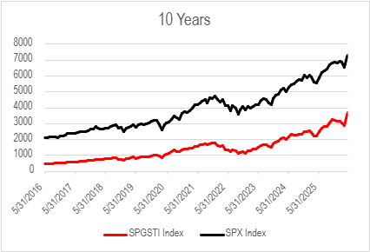
PERFORMANCE RETURNS
Sector and Sub-Industry Index Performance
SPGSTI vs. S&P 500
• SPGSTI 10-year return: 706.33%
• S&P 500 10-year return: 249.89% (2.8x difference)
• Tech sector outperformed over all measured time horizons (YTD – 10 Years)
Exhibit 1 | SPGSTI vs. S&P 500 (10 Years)
Sub-Industry 3-Year Returns
• Semiconductors (SOX): +275.43%
• Software Infrastructure (NQRPCI): +74.54%
• Consumer Electronics (S5CONE): +133.12%
• S&P 500: +77.91%

Slide 5
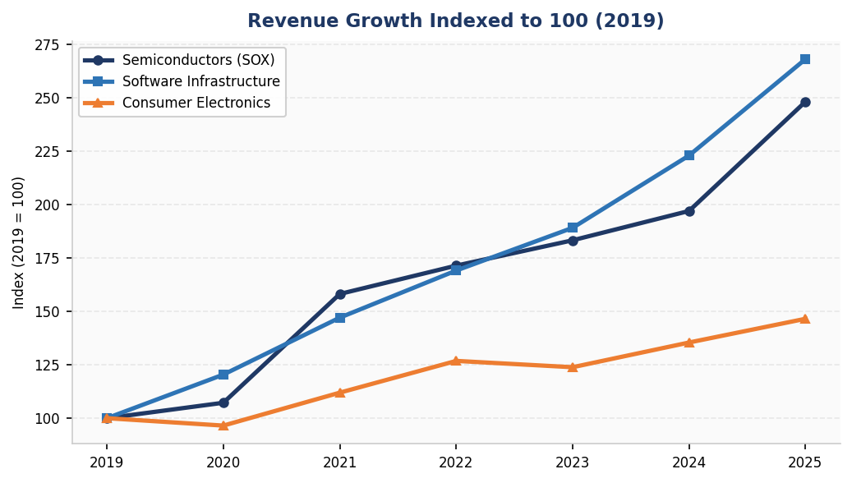
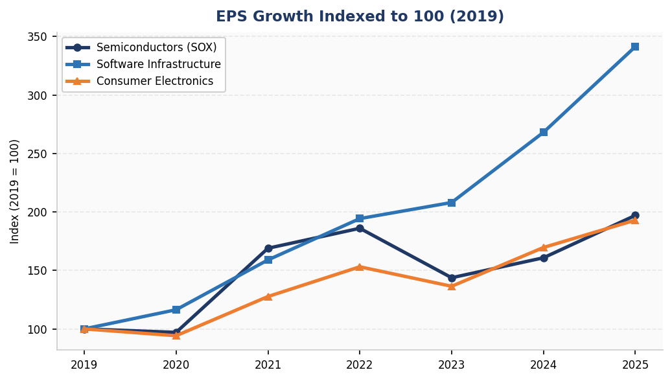
FINANCIAL ANALYSIS
Revenue and EPS Growth Across All Three Sub-Industries
Exhibit 2 | Indexed Revenue Growth (2019 = 100)
Exhibit 3 | Indexed EPS Growth (2019 = 100)

Slide 6
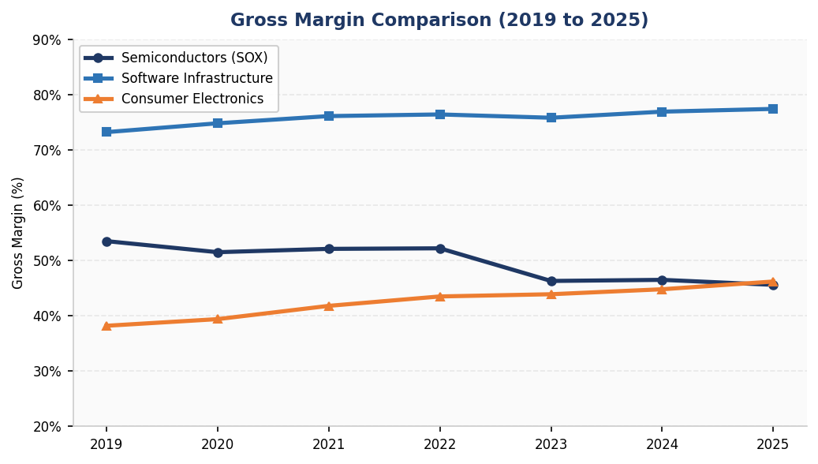
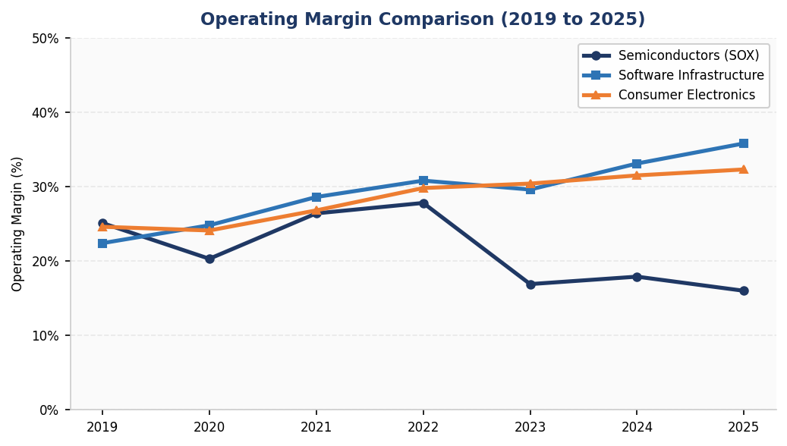
FINANCIAL ANALYSIS
Margin Comparison Across All Three Sub-Industries
Exhibit 4 | Gross Margin Comparison
Exhibit 5 | Operating Margin Comparison

Slide 7
FINANCIAL ANALYSIS
Sub-Industry Financial Highlights (2019 to 2025)
Semiconductors (SOX)
• Revenue per share: +148% ($347.7 to $862.4)
• EPS: +97% ($97.2 to $191.5)
• R&D investment up 141%, reaching $140.9 per share
• Cyclical downturn in 2022 to 2023, sharp recovery by 2025
Consumer Electronics (S5CONE)
• Revenue per share: +46% ($412.8 to $604.7)
• EPS: +93%, largely buyback-driven
• Gross margin expanded from 38.2% to 46.2%
• Services segment growing 15 to 20% annually
Software Infrastructure (NQRPCI)
• EPS: +241% ($38.5 to $131.4), strongest growth of all three
• Gross margins 73 to 77%, highest in the sector
• Operating margin expanded from 22% to 36%
• Cloud providers committing $100B+ in combined capex for 2025

Slide 8
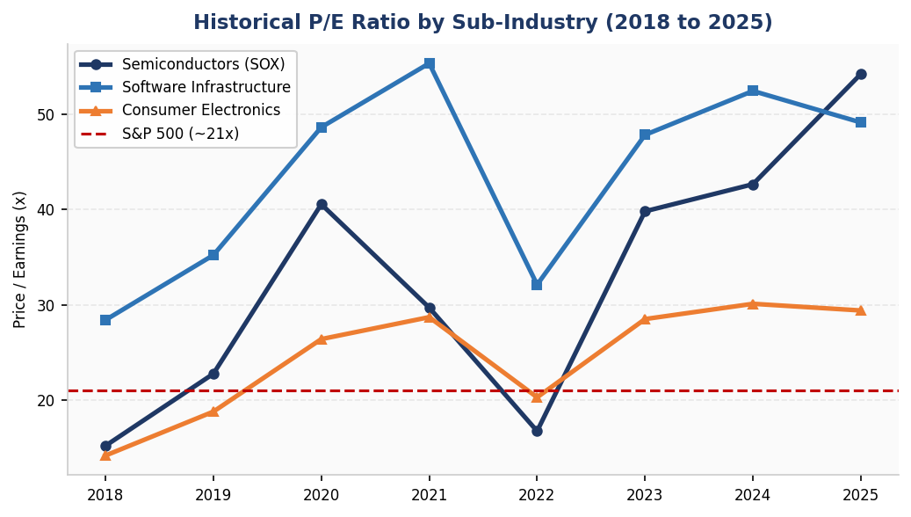
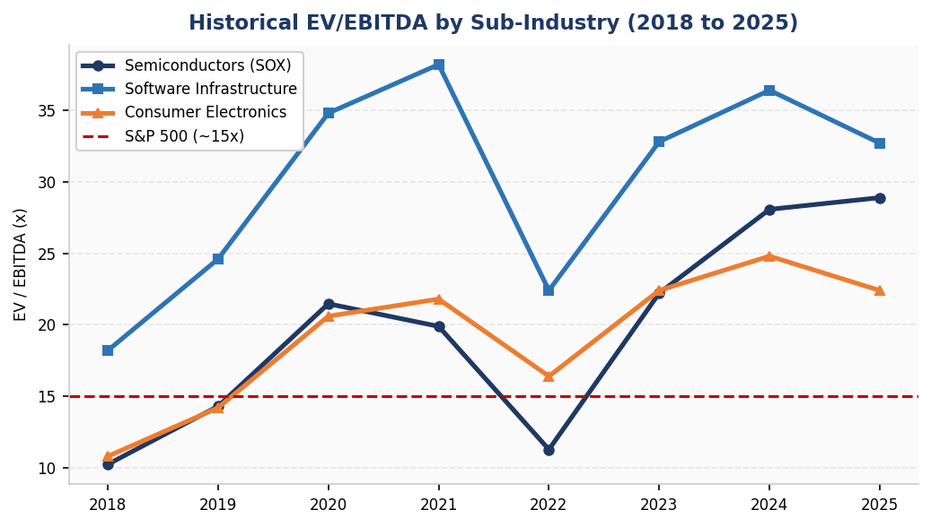
VALUATION MULTIPLIERS
Historical Multiples and Current Snapshot
Exhibit 6 | Historical P/E Ratio (2018 to 2025)
Key Valuation Takeaways
• All three sub-industries trade at a significant premium to the S&P 500 (~21x P/E)
• SOX trailing P/E of 54.2x compresses to 28.8x on 2026 forward earnings
• Software Infrastructure: highest quality premium, 77% gross margins justify 49x P/E
• Consumer Electronics: most reasonable valuation at 29x trailing P/E
• P/Book for Consumer Electronics (43.7x) is distorted by Apple buybacks, not a reliable metric
• EV/EBITDA across sub-industries has trended up consistently, reflecting AI premium
Exhibit 7 | Historical EV/EBITDA (2018 to 2025)

Slide 9
VALUATION MULTIPLIERS
Valuation and Profitability Summary Table (2025)
Exhibit 8 | Valuation Multiples and Profitability by Segment
Metric | S&P 500 | Semiconductors (SOX) | Software Infrastructure | Consumer Electronics
P/E (Trailing) | ~21.0x | 54.2x | 49.1x | 29.4x
P/E (Forward 2026E) | ~18.5x | 28.8x | 39.0x | 26.0x
P/Book | ~4.5x | 6.7x | 19.8x | 43.7x
P/Cash Flow | ~18.0x | 27.8x | 28.5x | 27.5x
EV/EBITDA | ~15.0x | 28.9x | 32.7x | 22.4x
FCF Yield | ~4.5% | 1.8% | 2.4% | 3.1%
Gross Margin | ~37% | 45.6% | 77.4% | 46.2%
Operating Margin | ~17% | 16.0% | 35.8% | 32.3%

Slide 10
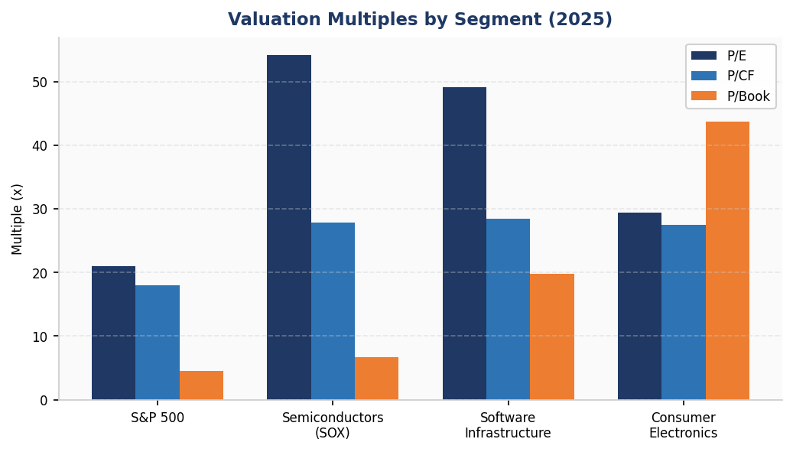

Slide 11
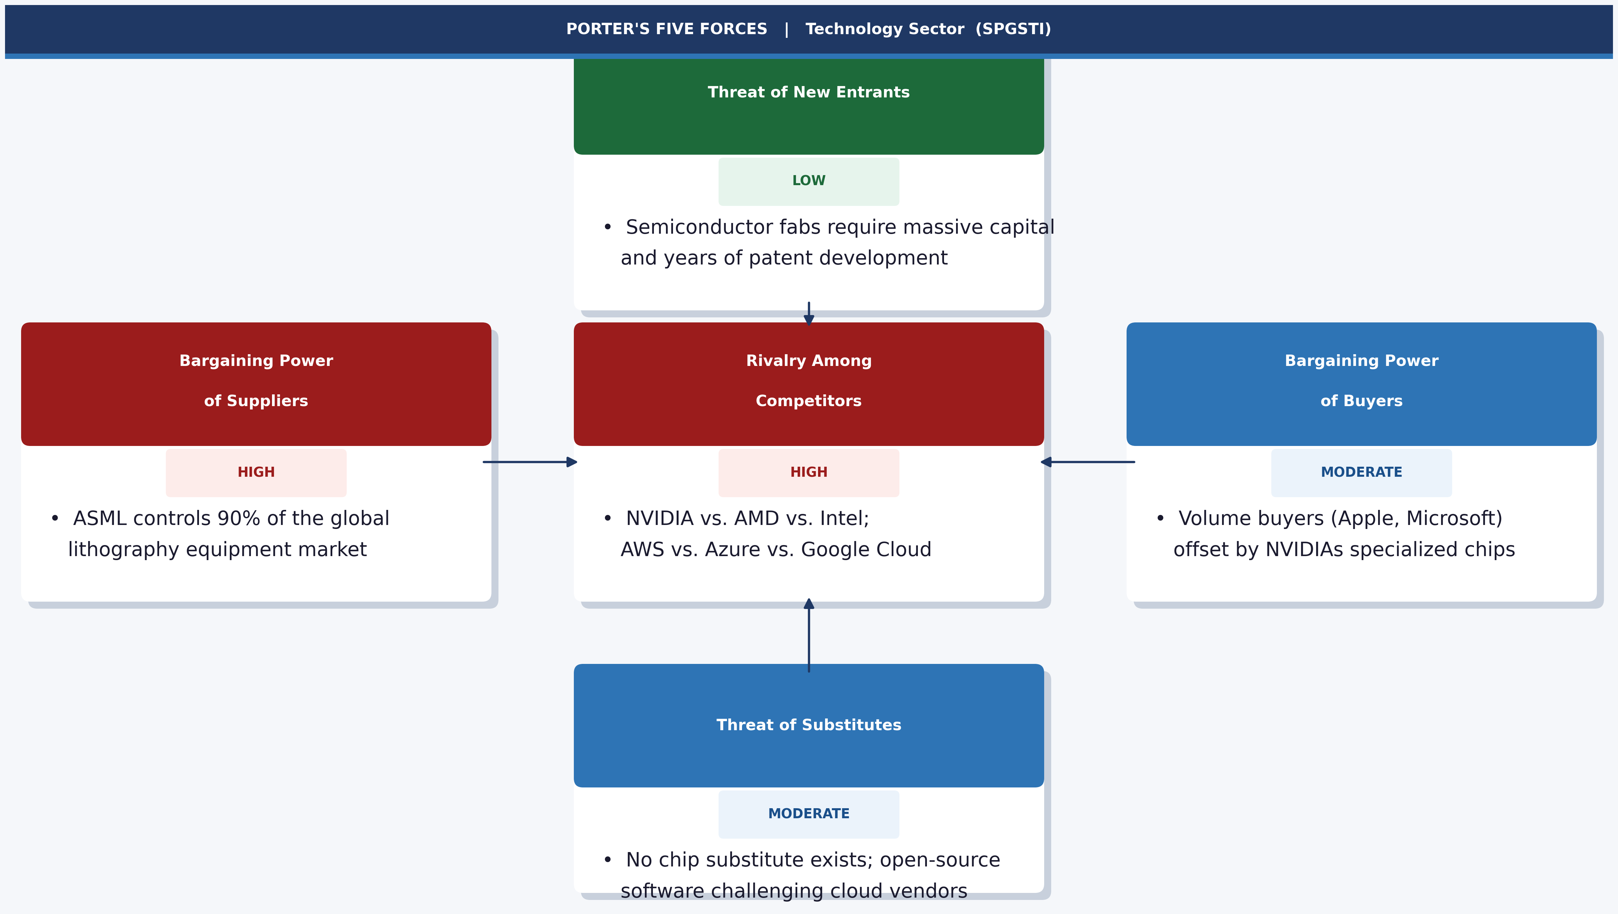
PORTER'S FIVE FORCES
Competitive Dynamics Across All Three Sub-Industries

Slide 12
SECTOR RECOMMENDATIONS
Investment Recommendations | Technology Sector (SPGSTI)
Sector Call: OVERWEIGHT vs. S&P 500
• AI is a structural, multi-year investment cycle across chips, cloud, and devices
• 706% ten-year sector return reflects sustained fundamental outperformance
• Forward 2026 multiples compress materially as earnings catch up
Sub-Industry Rankings
• No. 1 | Software Infrastructure (OVERWEIGHT)
• Best risk-adjusted returns. Recurring revenue, 77% gross margins, AI cloud tailwind
• Preferred names: Microsoft, Salesforce
• No. 2 | Semiconductors (OVERWEIGHT, higher risk)
• Highest earnings growth but cyclical. Size position with caution
• Preferred names: NVIDIA, Broadcom, TSMC
• No. 3 | Consumer Electronics (NEUTRAL)
• Hold, do not add.
Key Risks to the Thesis
• U.S. and China trade tensions and export controls on advanced chips
• Federal Reserve rate increases would compress elevated growth multiples
• AI capex slowdown if enterprise ROI on AI investments is questioned
• Semiconductor inventory correction cycle (has repeated every 2 to 3 years)
• Antitrust and regulatory risk for Microsoft, Google, and Apple

