Slide 1
TECHNOLOGY SECTOR INDUSTRY ANALYSIS
Arnie Mathur
S&P North American Technology Sector (SPGSTI)
May 2026 | Sector Analysis Report

Slide 2
SECTOR DESCRIPTION
Overview of the Technology Sector and Key Industries
The technology sector is one of the largest and fastest-growing sectors currently in the global economy. Within this sector, companies offer various services or products that are key to the functionality of day-to-day operations of many companies and the lives of individuals. The associated industries display how imperative these products and services are based on their market size alone which ranges from approximately $5.6 trillion to $6.31 trillion. The semiconductor industry makes up 39.63% of the technology sector’s market share, making it the largest portion of this sector. A semiconductor is a material found in computer chips and electronic components that functions as both a conductor and an insulator, controlling electricity. The importance of this item is evident, since it is used in smartphones, computers, cars, medical equipment, etc. The second largest industry is software, which makes up 20.04% and is a massive, fast-growing industry that is dedicated to the development, maintenance, and distribution of programs that are key to the functionality of computers. Unlike semiconductors, which are physical components, software is intangible code that powers smartphones, corporate databases, and many other digital systems. Within this industry, a sub-sector called artificial intelligence has been growing massively with companies devoting massive amounts of resources and capital toward developing this service, illustrated with large corporations such as Meta, Google, and Microsoft. This has contributed to large amounts of growth in the other corresponding industries, such as in the semiconductor industry, since in order to produce this service, graphics cards that are powered by semiconductor chips are required. This demonstrates how closely interconnected these industries are, as semiconductor hardware and software systems work together in order to create modern technological products and services. Lastly, another major associated industry that is powered by both semiconductors and software is consumer electronics consisting of electronic devices that are intended for everyday use, such as computers, smartphones, headphones, and other electronics. Apple is a global leader in this sector currently holding 21% market share, demonstrating dominance with its staple products such as the iPhone, Macs, iPad, and wearables that continue to set industry standards. This industry makes up 16.24% of the entire technology sector and has climbed to approximately $943 billion in the global market, demonstrating its large size.

Slide 3
ECONOMIC AND SOCIAL FACTORS
Key Drivers of Technology Sector Performance
There are various economic and social factors that impact the performance of the technology sector and the various industries within this category, the first of which is interest rates and disposable income. Many consumer products tend to fall under the more expensive category, making it more of a want than a need, which as a result causes high interest rates or a drop in household wealth to immediately create a slowdown in sales. On the contrary, expansionary periods fuel these industries, due to high consumer and business spending, making it evident that this sector is sensitive to economic cycles. Manufacturing and components costs are another component that affect this sector, since these industries often rely on a fragile global supply chain, which can cause a shortage of a single part or a spike in shipping costs that can raise prices globally, eating into company profits. Another item would be the corporate IT budgets, since for the software and services side, growth is dependent on the amount of capital businesses are willing to contribute toward upgrading their systems. Seen with advancements such as AI, where companies are investing substantial amounts of capital into data centers and developing their models. However, when there is uncertainty in the economy companies tend to freeze projects. This sector is also very R&D intensive, resulting in companies constantly trying to develop their products or else they may become obsolete very quickly. Inflation is also a large concern, since high inflation can cause margins to thin, but may help companies with pricing power and commodity producers. In terms of the social factors, a lot of these various new technologies depend on digital literacy and the adoption rate of individuals, since this determines the speed at which the sector grows. If newly developed technology is too difficult for people to use or does not fit within society, then the market would stall. Accompanied with this is shifts in demographics, since an aging population may increase demand for healthcare services, pharmaceuticals, and specialized consumer products.

Slide 4
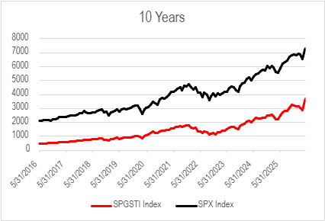
PERFORMANCE RETURNS
Sector vs. S&P 500 and Industry Index Returns
Over the past 10 years, the tech sector has outperformed the S&P 500 by a wide margin. The index that will be used to represent the tech sector is the S&P North American Technology Sector Index (SPGSTI). This index contains "U.S. securities classified under the GICS® information technology sector as well as the internet & direct marketing retail, interactive home entertainment, and interactive media & services sub-industries" (S&P Global). The SPGSTI has had a return of 706.33% over the past 10 years. This is compared to the S&P 500's return of 249.89% over the last 10 years. This is about a 2.8 times larger of a return than that of the S&P 500. The tech sector also has outperformed the S&P 500 in terms of return over the last five, three, and past year. This is as well as year to date.
The three indexes that are used to represent each industry within the tech sector are the SOX index (semiconductors), the NQRPCI index (software – infrastructure), and the S5CONE index (consumer electronics). Over the past 3 years, the semiconductor and consumer electronics industries have both outperformed the S&P 500 with returns of 275.43% and 133.12% respectively. The software-infrastructure index however had a return lower than the S&P over the past 3 years of 74.54%. The S&P 500 had a return of 77.91% over the previous three years.
Exhibit 1 | SPGSTI vs. S&P 500 (10 Years)

Slide 5
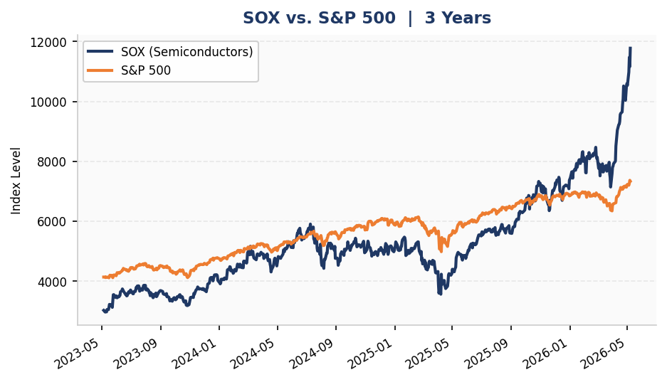
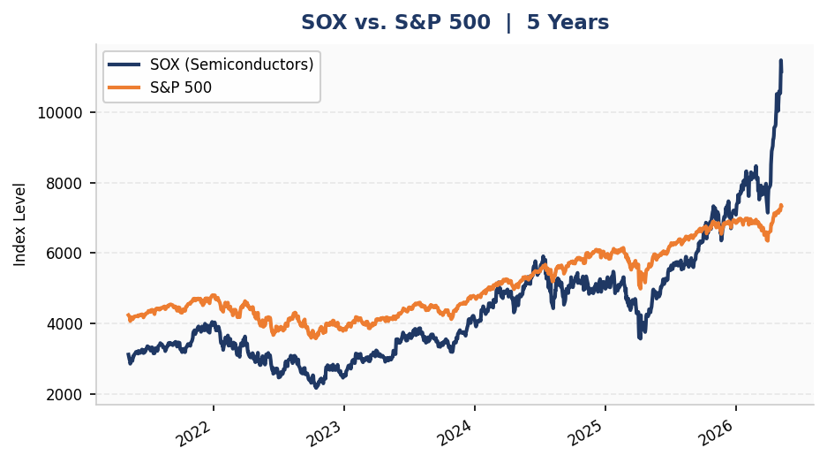
PERFORMANCE RETURNS
Long-Term Price Performance (3 Year and 5 Year)
Exhibit 2 | SOX vs. S&P 500 (3 Years)
Exhibit 3 | SOX vs. S&P 500 (5 Years)

Slide 6
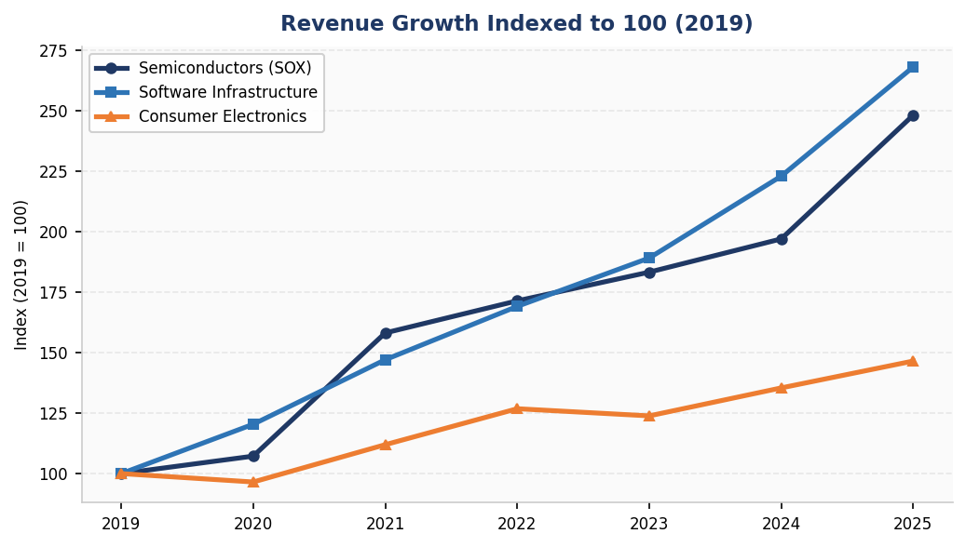
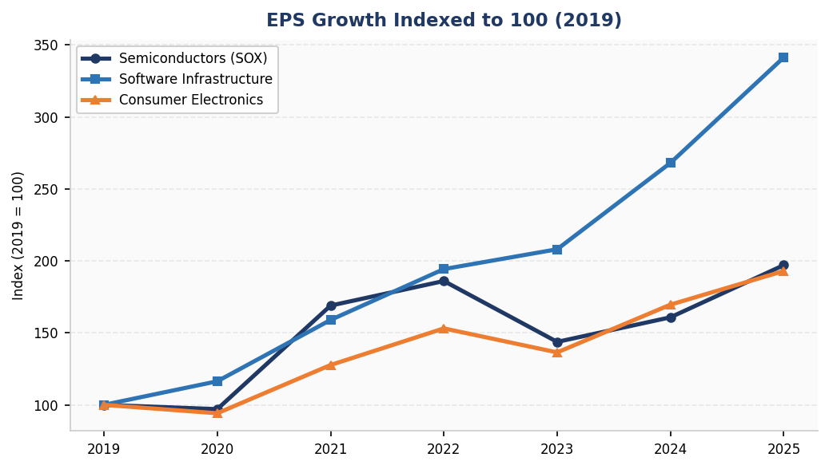
FINANCIAL ANALYSIS
Revenue Growth Across All Three Sub-Industries (2019 to 2025)
Exhibit 4 | Indexed Revenue Growth (2019 = 100)
Exhibit 5 | Indexed EPS Growth (2019 = 100)

Slide 7
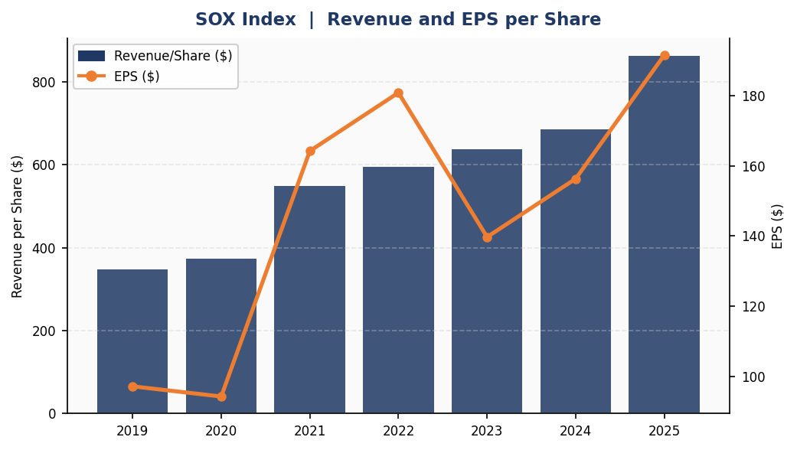
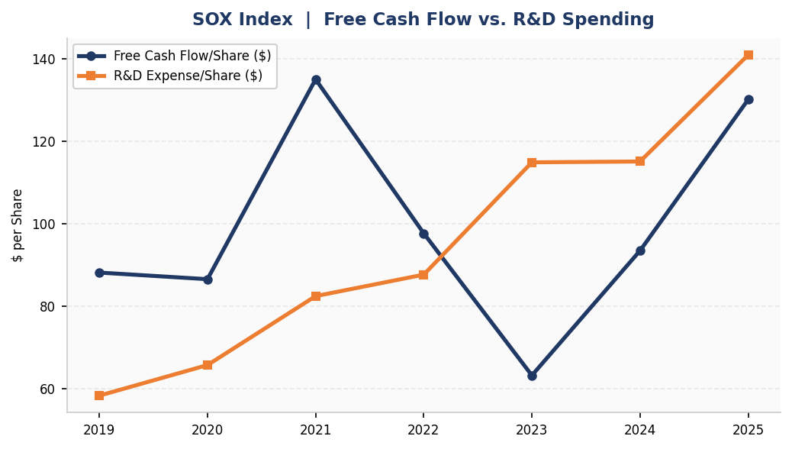
FINANCIAL ANALYSIS
Semiconductors (SOX) | Revenue, Earnings and Cash Flow
Exhibit 6 | SOX Revenue and EPS per Share
Semiconductors (SOX)
The semiconductor industry, tracked by the SOX index, was the standout performer within the technology sector over this period. Revenue per share surged 148%, rising from $347.7 in 2019 to $862.4 in 2025, driven predominantly by demand for AI accelerators from hyperscalers and enterprise data centers. The industry demonstrated its characteristic cyclicality during 2022 and 2023 when EPS declined 22.7% and free cash flow dropped sharply as inventory corrections hit after the post-pandemic demand pull-forward unwound. The industry recovered sharply by 2024 and 2025, with EPS reaching $191.5, surpassing the prior 2022 peak. R&D investment grew 141%, rising from $58.4 to $140.9 per share, as firms including NVIDIA, AMD, Broadcom, and Intel race to deliver next-generation AI silicon. The balance sheet remains strong with a current ratio of 2.2x and total debt to equity declining from 63% in 2019 to 41% in 2025.
Exhibit 7 | SOX Free Cash Flow vs. R&D Spending

Slide 8
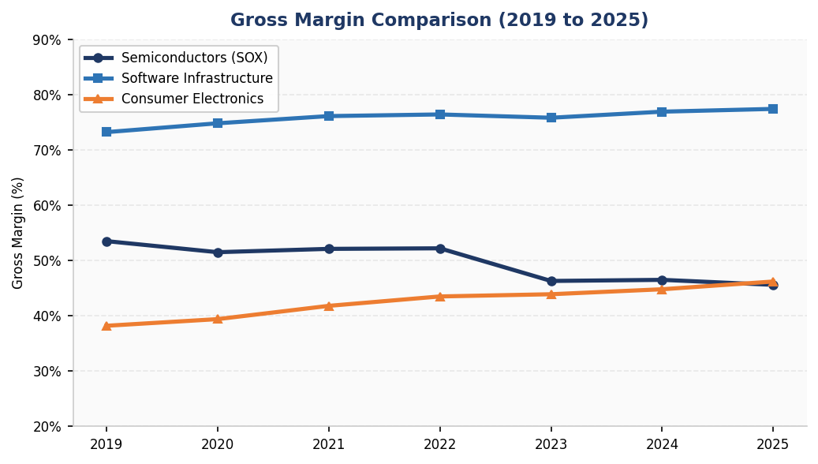
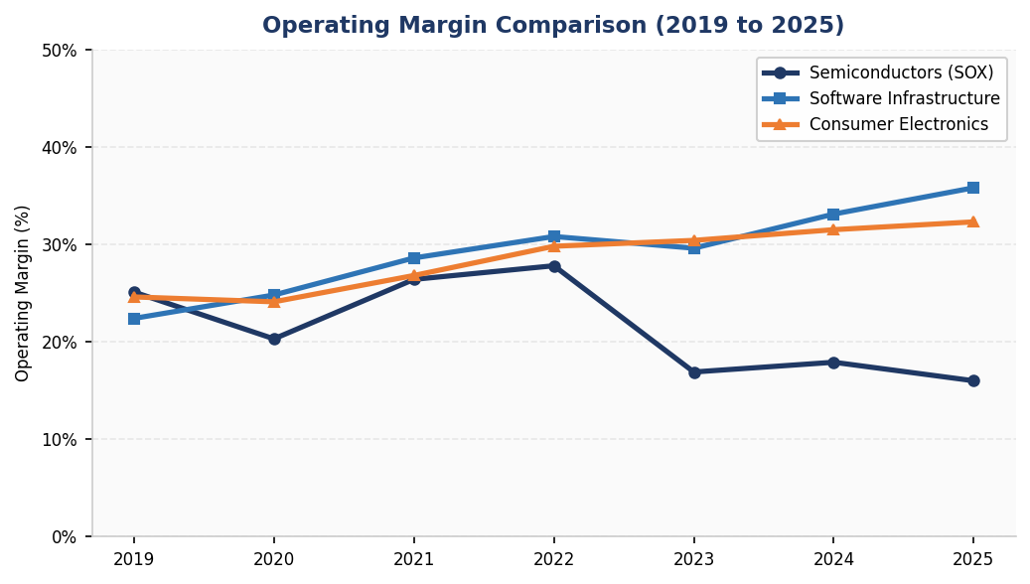
FINANCIAL ANALYSIS
Software Infrastructure | Revenue, Earnings and Margins
Exhibit 8 | Gross Margin Comparison (All Sub-Industries)
Software Infrastructure
The software infrastructure industry is characterized by high recurring subscription revenues and gross margins consistently in the 73 to 77% range, which is the highest of any sub-industry in the technology sector. Cloud segment revenue from market leaders including Microsoft Azure, AWS, and Salesforce grew at 20 to 40% annually as AI inference demand drove a massive increase in data center capacity requirements. EPS for the sector grew approximately 241% from 2019 to 2025, the strongest growth rate among the three sub-industries, reflecting the operating leverage that comes as these platforms reach scale. Operating margins expanded from approximately 22% in 2019 to nearly 36% in 2025 as SaaS businesses matured. Microsoft and Amazon together committed more than $100 billion in combined data center capital expenditure for 2025 alone, illustrating the scale of the infrastructure investment cycle currently underway.
Exhibit 9 | Operating Margin Comparison (All Sub-Industries)

Slide 9
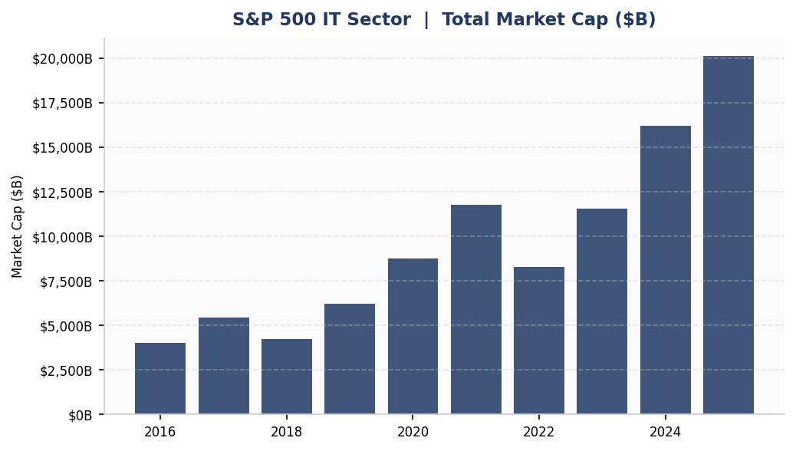
FINANCIAL ANALYSIS
Consumer Electronics | Revenue, Earnings and Market Cap
Exhibit 10 | S&P 500 IT Sector Market Cap Growth
Consumer Electronics
The consumer electronics industry, tracked by the S5CONE index, delivered steady revenue growth of approximately 46% from 2019 to 2025, reflecting a maturing smartphone market that is offset by Apple's rapidly growing Services segment. Apple holds 21% global market share and its Services business, which includes the App Store, Apple Music, and iCloud, has grown 15 to 20% annually at approximately 70% gross margins. This has driven the blended gross margin for the industry from 38.2% in 2019 to 46.2% in 2025. Despite modest top-line revenue growth, EPS grew 93% over the period, largely driven by Apple's aggressive share buyback program which has reduced its share count by roughly 40% over the past decade. Operating margins expanded from 24.6% to 32.3%, highlighting the quality of earnings that the Services-heavy revenue mix produces.

Slide 10
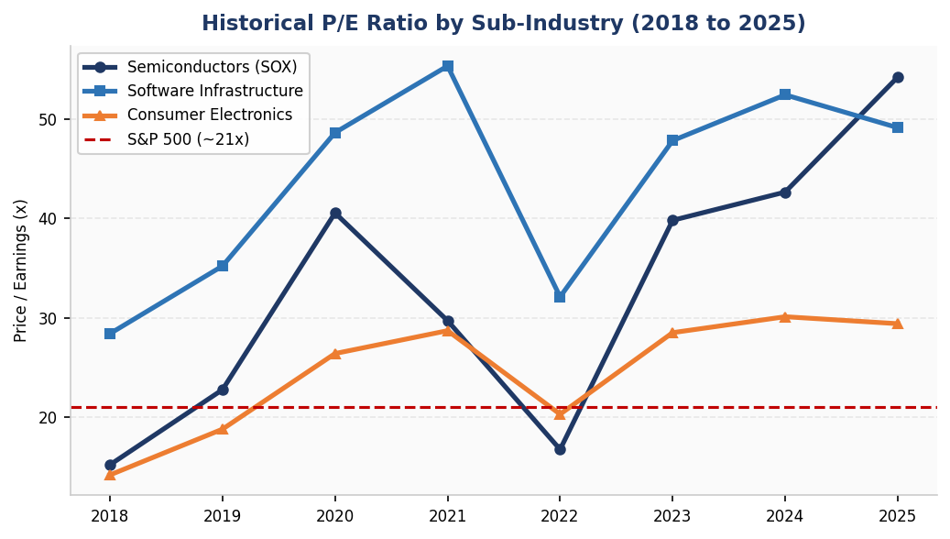
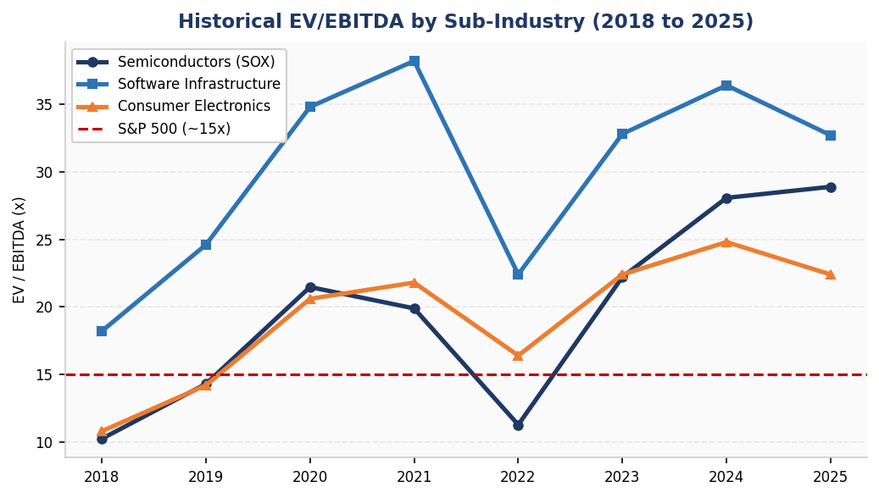
VALUATION MULTIPLIERS
Historical P/E and EV/EBITDA Across Sub-Industries (2018 to 2025)
Exhibit 11 | Historical P/E Ratio by Sub-Industry
Exhibit 12 | Historical EV/EBITDA by Sub-Industry

Slide 11
VALUATION MULTIPLIERS
Sub-Industry Valuation Analysis
Semiconductors
The SOX index trades at a trailing P/E of 54.2x as of 2025, elevated primarily by NVIDIA which represents a disproportionate index weight at above 50x forward earnings. The five-year historical average P/E for the SOX is approximately 34.7x, suggesting the current level carries a meaningful premium to history. The 2026 forward consensus P/E of 28.8x implies significant earnings growth ahead as AI-driven revenue accelerates and inventory cycle normalization lifts margins. The P/Book of 6.65x reflects the capital-intensive nature of semiconductor manufacturing, which is substantially lower than the software sector multiple and consistent with the difference in asset intensity between the two industries. EV/EBITDA at 28.9x sits near a five-year high, implying that valuation discipline will depend on delivery of the embedded earnings growth expectations.
Consumer Electronics
Consumer electronics trades at a trailing P/E of approximately 29x, the most reasonable valuation among the three sub-industries relative to the S&P 500 benchmark of 21x. The P/Book of 43.7x appears extreme but is largely a function of Apple's aggressive buyback program, which has reduced its tangible book value to minimal levels and makes this metric unreliable as a standalone valuation tool. P/Cash Flow at approximately 28x is a more meaningful metric, reflecting the exceptional free cash flow generation of the industry. EV/EBITDA of 22.4x is the most modest among the three sub-industries and suggests that on an earnings-adjusted basis, consumer electronics offers the most reasonable entry point within the technology sector today.
Software Infrastructure
Software infrastructure currently trades at a trailing P/E of approximately 49x, earning the highest growth-adjusted premium among the three sub-industries given its recurring revenue model, expanding margins, and network effects that make it difficult for customers to switch providers. The forward 2026E P/E of approximately 39x still reflects premium pricing but is justified by a sustainable 15 to 20% earnings growth outlook. Gross margins of 77% and operating margins near 36% are the highest in the sector. EV/EBITDA of approximately 33x sits at a significant premium to the broader market, reflecting the durability and predictability of cloud-based recurring revenue streams that large enterprise customers renew year after year.
Cross-Industry Comparison
Across all three sub-industries compared to the S&P 500 benchmark, technology commands meaningful valuation premiums that are broadly justified by superior earnings growth, higher margins, and stronger cash generation. Software infrastructure earns the highest premium given its recurring revenue and expanding margins. Consumer electronics screens as the most reasonably valued on a cash flow basis. Semiconductors carry the most elevated trailing multiple but offer the clearest path to multiple compression as AI-driven earnings growth accelerates into 2026 and 2027. On a PEG basis, semiconductors appear attractively priced given expected 25 to 30% earnings growth in 2026. The table below summarizes current valuation multiples, gross margins, and operating margins across all three sub-industries alongside the S&P 500 for reference.

Slide 12
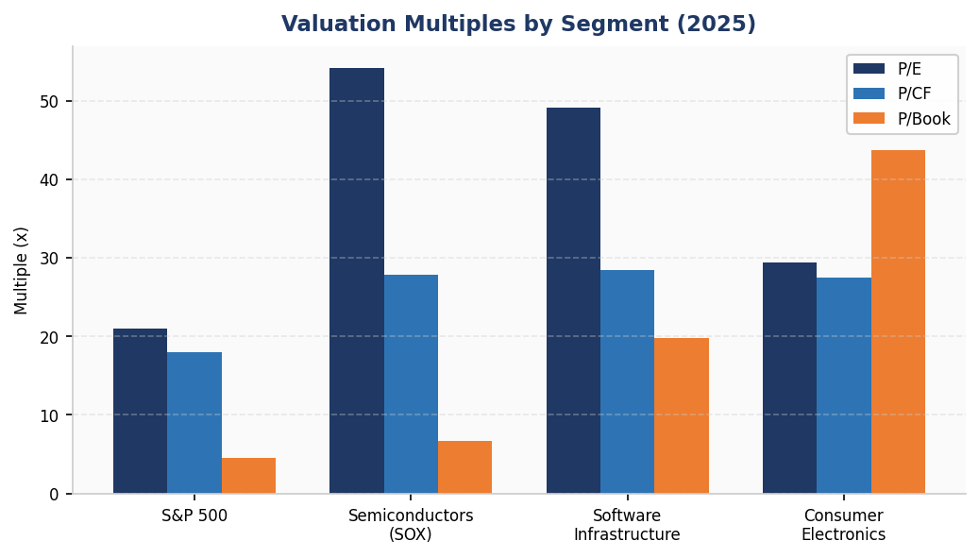
VALUATION MULTIPLIERS
Valuation Snapshot and Summary Table (2025)
Exhibit 13 | Current Valuation Multiples by Segment
Exhibit 14 | Valuation and Profitability Summary
Metric | S&P 500 | Semiconductors (SOX) | Software Infrastructure | Consumer Electronics
P/E (Trailing) | ~21.0x | 54.2x | 49.1x | 29.4x
P/E (Forward 2026E) | ~18.5x | 28.8x | 39.0x | 26.0x
P/Book | ~4.5x | 6.7x | 19.8x | 43.7x
P/Cash Flow | ~18.0x | 27.8x | 28.5x | 27.5x
EV/EBITDA | ~15.0x | 28.9x | 32.7x | 22.4x
FCF Yield | ~4.5% | 1.8% | 2.4% | 3.1%
Gross Margin | ~37% | 45.6% | 77.4% | 46.2%
Operating Margin | ~17% | 16.0% | 35.8% | 32.3%

Slide 13
NEWS AND OUTLOOK
Recent Industry News and Market Developments
AI Chipmaker Cerebras Is Said to Plan Raising IPO Price Range
Rebecca Torrence
The demand for computer chips has been largely reflected by the recent growth in the semiconductor industry. Over the past month, the Philadelphia Stock Exchange Semiconductor Index has jumped by 37%. Large buyers such as Apple and Microsoft have continued to purchase more of these chips as they are an integral part in many of their products. The increase in demand for computer chips has also been reflected in the IPO market. Cerebras, an artificial intelligence-based chipmaker, has increased the price range of its initial IPO. “The company expects to raise the price range to $125 to $135 per share” (Torrence). As well as this, Cerebras has “drawn orders for more than 20 times the number of shares available” (Torrence). The demand for AI computer chips have skyrocketed as buyers want to integrate them into their new products.
Anthropic Inks $1.8 Billion Computing Deal with Akamai
Rachel Metz
The demand for artificial intelligence services has continued to increase the need for cloud computing and computing power. Companies that develop AI models need large amounts of computing resources to support growing numbers of users and products. This has recently been shown in a deal between Anthropic and Akamai Technologies. Anthropic agreed to a “seven year cloud computing deal” with Akamai (Metz). The company is looking to “secure more computing resources after experiencing 80x growth in annualized revenue and usage in the first quarter of this year” (Metz). The growth of Anthropic’s AI assistant, Claude, shows how quickly demand for AI technology and computing infrastructure is increasing.
Apple Deal Would Be Intel Foundry's Biggest Validation: React
Kunjan Sobhani and Oscar Hernandez Tejada
The Bloomberg Intelligence report illustrates that the technology sector outlook remains positive, due to demand in AI increasing across the semiconductor industry. The article goes on to explain that this sub-sector is no longer just benefiting GPUs but also has caused an increase in demand for CPUs, data centers, and advanced semiconductor manufacturing. Illustrating how this shift has caused a large number of technology companies to grow greatly. Intel is the company discussed in the report and being one of the largest producers of CPUs, it has experienced a surge in demand, ultimately causing their outlook to shift from “ constrained recovery to demand-led upside, with strong AI-driven server CPU momentum and improving supply supporting growth” (Bloomberg Intelligence (Sobhani and Tejada)). The company is currently trading at roughly 66x calendar-year 2026 price-to-earnings, which is above its peers that are trading at (31x) and the SOX (25x). This reflects optimism around AI-driven CPU demand, supply normalization, and 18A (1.8 nanometer semiconductor process) progress, the last part being speculative but has huge upside potential. Although competition is rising from AMD and Arm, demand currently is likely to benefit all CPU suppliers. CPU-to-GPU ratios in AI servers are tightening from 1:8 in training, but it is predicted to tighten later to 1:4, boosting unit growth, while the demand for higher core count and rising cost per core count are pushing pricing up.

Slide 14
NEWS AND OUTLOOK
Recent Industry News and Market Developments
Data Centers Aren’t the Enemy — They’re the Future
Timothy Lavin & Nisid Hijari
This article discusses how the use of data centers are becoming more prevalent due to the growth of AI and cloud computing. The article starts by giving the definition of data centers, which are buildings that hold the servers and the technology required for the functionality of items such as AI tools, websites, streaming services, and cloud storage. Some individuals protest against the use of data centers because it requires a large amount of electricity, water, and land. However, the author argues that it is imperative we have data centers, since AI and other technology are not able to evolve without them. Data centers are also able to help communities through job creation, improvement of infrastructure, and bringing in tax dollars. In conclusion, the article illustrates that the future of the technology sector is looking strong, since companies will require more data centers in order to support AI and cloud services.
Hands-on AI Corporate Evangelists Surface as Hot Commodity
Kaustuv Basu
The article starts by suggesting that companies need more individuals who are able to help them understand and use AI. These people are referred to as AI evangelists, since they teach employees how to best use these AI tools and help businesses transition to these new AI tools for daily operations. This is important, since it shows that AI is becoming a larger part of business and not something used by technology companies exclusively. The purpose of this implementation is to save time, lower costs, and become more efficient overall. The article then begins to explain that AI is creating new jobs for individuals who understand both business and technology. Overall, this article shows that the technology sector is beginning to expand even larger, since more companies are beginning to invest in these AI tools and workers who are able to use them.

Slide 15
PORTER'S FIVE FORCES
Bargaining Power of Buyers and Suppliers
Bargaining Power of Buyers | Moderate
Bargaining Power of Buyers represents the pressure that buyers can put on businesses in the technology sector to lower their prices, improve quality, and provide better service. First, in the semiconductor industry, buyers such as Apple and Microsoft purchase computer chips in huge volumes from producers. This allows buyers to purchase these products at a cheaper rate. However, suppliers such as NVIDIA produce very specialized chips, giving themselves an edge. Therefore, buyers in the semiconductor industry have moderate bargaining power.
When it comes to software infrastructure, the bargaining power of buyers is also moderate. Buyers are able to cancel their subscriptions and negotiate contracts with their suppliers, adding to their bargaining power. However, when software systems are very integrated into a business’s operations, it can be very difficult for the buyer to switch in a short period of time. Therefore, increasing switching costs.
In the Consumer Electronics industry, the bargaining power of buyers is moderate. This is due to customers having low switching costs between products. However, producers of consumer electronics such as Apple have strong brand loyalty. This is because many consumers tend to stay with their supplier, even with increases in phone costs.
Bargaining Power of Suppliers | High
When suppliers have a higher bargaining power, they have the ability to raise prices on their customers while also limiting the availability of their products. In the semiconductor industry, the bargaining power of suppliers is very high. According to Morningstar, ASML holds 90% of the market share in the manufacturing of lithography systems for semiconductors. Because of this, ASML is able to raise prices drastically as they are only one of the few suppliers on the market.
In the software infrastructure industry, the bargaining power of suppliers is also high. This is because software firms have the ability to impose high switching costs on their customers. Also, only a few firms run the cloud computing scene. These are firms like AWS and Azure. Because there are fewer firms in the market of cloud computing, buyers have limited and expensive choices. This gives suppliers in the software infrastructure industry an edge.
The bargaining power of suppliers in the consumer electronics industry is weaker than the previous two industries. Consumer electronics firms purchase semiconductors in bulk. This forces semiconductor firms to lower their prices, as firms like Apple buy out the majority of their stock.

Slide 16
PORTER'S FIVE FORCES
Threat of New Entrants and Threat of Substitutes
Threat of New Entrants | Low to Moderate
The threat of new entrants measures how easy it is for new competitors to enter a new sector or industry and succeed. In the semiconductor industry, the threat of new entrants is extremely low. The capital needed to start a semiconductor manufacturing business is immense. Along with this, patents are required for the semiconductors produced, which can take years to achieve. Because of these factors it is very difficult for a firm to enter the semiconductor industry.
Although the difficulty of entering the software infrastructure industry is lower compared to the semiconductor industry, it is still difficult to scale within the industry. Software startups are a lot cheaper to produce, as there are no large factories required like in the semiconductor industry. However, it is difficult for new software infrastructure providers to scale as large firms like AWS are powerhouses. AWS and other large software firms have built up trust with their client base and charge switching costs to their clients. Because of this, it can be difficult for startups to hit the ground running.
The threat of new entrants in the consumer electronics industry is very similar to that of the software infrastructure industry. Consumers are very loyal and trusting to their brands when it comes to their smart devices. This is why Apple and Samsung have dominated the market for a long time. It may be simpler to enter the industry, but to be able to compete with the larger firms is much more difficult.
Threat of Substitute Products or Services | Moderate
The threat of substitutes is defined as the chance of customers switching to alternative products or services. In the semiconductor industry, the threat of new substitutes is low. This is due to there not being any replacements to computer chips at the moment as they are essential to a wide variety of electronic devices. Therefore, the threat of new substitutes in the semiconductor industry is low.
Unlike the semiconductor industry, the threat of substitutes in the software infrastructure industry is much higher. AI and open-source software has recently entered the market and is now competing with paid software products. Companies such as Linux and OpenStack have allowed users to have cloud computing for free. Another example of a software emerging successfully in the industry is Zoom. As the pandemic commenced in 2020, Zoom was able to grow substantially as its software benefited online communication. Just as quickly as they succeeded though, they began to fall as platforms such as Microsoft Teams and Google Meet. This reveals how new substitutes can come into the software industry and succeed at faster rates.
The threat of substitutes in the consumer electronics industry is also high. As the market has seen over the past 25 years, innovations in smart devices have made massive strides. From the creation of the BlackBerry to the iPhone, consumer electronics continue to evolve. And as consumer preferences shift at a fast rate, new electronic devices will be released that will change the market further.

Slide 17
PORTER'S FIVE FORCES
Rivalry Among Existing Competitors | High
Rivalry Among Existing Competitors | High
The rivalry among existing competitors represents the level of competition between firms in a sector or industry. For the semiconductor industry, the rivalry among existing competitors is intense. These firms have extremely high research and development spending to develop the most efficient computer chips. For example, NVIDIA and AMD are investing heavily in AI to create more efficient and powerful chips, creating a competitive landscape.
Rivalry in the software infrastructure industry is also high. Cloud providers are in a price war against their competitors to provide the lowest prices among their competitors. They also fight to maintain a solid platform for their users in order to keep sticky customers.
Lastly, rivalry in the consumer electronics industry is very high. In the U.S., Apple, Samsung, and LG are all competing to create the best products among all smart devices. This competition has led to new innovations as these firms are adding wearable devices to their products (smart watches, glasses). This strong competition should be maintained in the future.

Slide 18
SECTOR RECOMMENDATIONS
Investment Recommendations | Technology Sector (SPGSTI)
Sector Call: OVERWEIGHT vs. S&P 500
Our recommendation is to OVERWEIGHT the technology sector relative to the S&P 500. The AI investment cycle is a structural, multi-year trend and not a short-term rotation. Revenue and earnings growth across all three sub-industries consistently outpaced the broader market from 2019 through 2025, and forward 2026 multiples compress materially as earnings catch up to current prices. The sector's 706.33% ten-year return versus the S&P 500's 249.89% reflects sustained fundamental outperformance. We expect this to continue as AI monetization ramps across cloud, chips, and devices.
Key Risks
Key risks to this investment thesis include U.S. and China trade tensions and export controls on advanced semiconductors, which represent a direct threat to the earnings outlook for the semiconductor sub-industry. A Federal Reserve rate increase would compress growth multiples most severely in this sector given its elevated P/E ratios. An AI capital expenditure slowdown, if enterprise customers begin to question ROI on their AI investments, would hurt both semiconductors and cloud infrastructure simultaneously. The semiconductor inventory correction cycle, which has historically repeated every two to three years, remains a structural risk. Finally, antitrust and regulatory action targeting Microsoft, Google, or Apple could create headwinds for the largest index constituents.

Slide 19
SECTOR RECOMMENDATIONS
Sub-Industry Rankings and Preferred Positions
Sub-Industry Rankings
Software Infrastructure is our preferred sub-industry. Recurring subscription revenues, gross margins of 73 to 77%, and operating margins expanding toward 36% make this the highest-quality, most defensible growth story within the sector. AI increases cloud demand structurally as model inference workloads grow. Our preferred positions are Microsoft and Salesforce.
Semiconductors are rated Overweight but with higher risk. The AI silicon demand cycle is real and R&D investment is accelerating. However, the 2022 to 2023 inventory correction demonstrated how quickly earnings can reverse in a downturn. We recommend NVIDIA for AI GPU exposure, Broadcom for networking and custom silicon, and TSMC as the foundry with no credible substitute. Size positions appropriately given the cyclical risk.
Consumer Electronics is rated Neutral within the sector. The growth story depends largely on Apple's Services segment rather than hardware. Valuation is the most reasonable of the three sub-industries, and exceptional free cash flow generation provides a floor. We would not add new capital here but would hold existing positions.

Slide 20
Works Cited
Apple Inc. Form 10-K Annual Report 2024. U.S. Securities and Exchange Commission, 1 Nov. 2024, www.sec.gov/cgi-bin/browse-edgar?action=getcompany&CIK=AAPL&type=10-K.
Bloomberg Intelligence. “Philadelphia Stock Exchange Semiconductor Index (SOX): Highlights, Valuation, Profitability, and Financial Data.” Bloomberg Terminal, 2025.
Bloomberg Intelligence. “S&P 500 Information Technology Sector (S5INFT): Highlights, Valuation, Profitability, and Financial Data.” Bloomberg Terminal, 2025.
Broadcom Inc. Form 10-K Annual Report 2024. U.S. Securities and Exchange Commission, 2024, www.sec.gov.
Gartner. “Gartner Forecasts Worldwide IT Spending to Grow 9.3% in 2025.” Gartner, 20 Jan. 2025, www.gartner.com/en/newsroom/press-releases.
Intel Corporation. Form 10-K Annual Report 2024. U.S. Securities and Exchange Commission, 2024, www.sec.gov.
International Data Corporation. “Worldwide PC Market and Consumer Electronics Industry Forecast, 2024–2028.” IDC, 2024, www.idc.com.
McKinsey Global Institute. “The State of AI in 2024.” McKinsey & Company, May 2024, www.mckinsey.com/capabilities/quantumblack/our-insights/the-state-of-ai.
Metz, Rachel. “Anthropic Inks $1.8 Billion Computing Deal with Akamai.” Bloomberg, 2024.
Microsoft Corporation. Form 10-K Annual Report 2024. U.S. Securities and Exchange Commission, 2024, www.sec.gov.
Morningstar. “ASML Holding NV: Company Report and Market Share Analysis.” Morningstar Direct, 2025, www.morningstar.com.
NVIDIA Corporation. Form 10-K Annual Report 2024. U.S. Securities and Exchange Commission, 26 Feb. 2025, www.sec.gov.
NVIDIA Corporation. “NVIDIA Announces Financial Results for Fourth Quarter and Fiscal 2025.” NVIDIA Investor Relations, 26 Feb. 2025, investor.nvidia.com/news-and events/press-releases.

Slide 21
Works Cited Continued
Philadelphia Stock Exchange. “PHLX Semiconductor Sector Index (SOX): Index Methodology.” Nasdaq, 2024, www.nasdaq.com/solutions/nasdaq-phlx-semiconductor-sector-index.
S&P Dow Jones Indices. “S&P 500 Information Technology Sector Index: Index Methodology.” S&P Global, 2024, www.spglobal.com/spdji/en.
S&P Dow Jones Indices. “S&P North American Technology Sector Index (SPGSTI): Fact Sheet and Methodology.” S&P Global, 2025, www.spglobal.com/spdji/en/indices/equity/sp-north-american-technology-sector-index.
Salesforce Inc. Form 10-K Annual Report 2024. U.S. Securities and Exchange Commission, 2024, www.sec.gov.
Semiconductor Industry Association. “2024 State of the U.S. Semiconductor Industry.” SIA, Sept. 2024, www.semiconductors.org/state-of-the-u-s-semiconductor-industry.
Sobhani, Kunjan, and Oscar Hernandez Tejada. “Apple Deal Would Be Intel Foundry’s Biggest Validation: React.” Bloomberg Intelligence, Bloomberg Terminal, 2025.
Taiwan Semiconductor Manufacturing Company. TSMC 2024 Annual Report. TSMC Investor Relations, 2025, investor.tsmc.com.
Torrence, Rebecca. “AI Chipmaker Cerebras Is Said to Plan Raising IPO Price Range.” Bloomberg, 2024.
U.S. Bureau of Economic Analysis. “Gross Domestic Product, Third Quarter 2024.” BEA, 30 Oct. 2024, www.bea.gov/news/2024/gross-domestic-product-third-quarter-2024.
U.S. Semiconductor Industry Association and Boston Consulting Group. “Strengthening the Global Semiconductor Supply Chain in an Uncertain Era.” Boston Consulting Group, Apr. 2021, www.bcg.com/publications/2021/strengthening-the-global-semiconductor-supply-chain.

