Slide 1
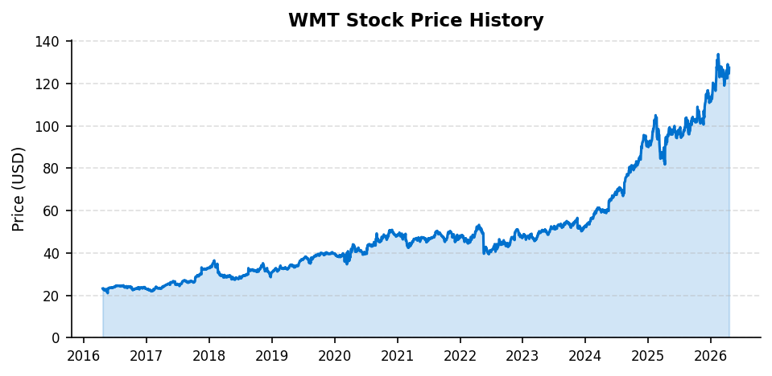
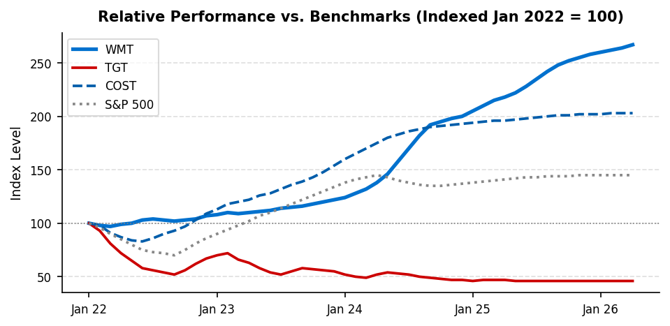
WMT | EQUITY RESEARCH
EQUITY RESEARCH | INITIATING COVERAGE
Walmart
12-Month Price Target:
NYSE: WMT
$140.00
Current Price
Market Cap
52-Week Range
FY25 Revenue
FY26 FCF Margin
FY26 P/E (GAAP)
$127.50
~$1.02T
$82 - $130
$680.9B
2.1%
46.7x
BUSINESS DESCRIPTION
FIGURE 1: WMT PRICE HISTORY (SPLIT-ADJUSTED)
Walmart Inc., founded in 1962 by Sam Walton in Rogers, Arkansas, is the world's largest retailer by revenue, operating approximately 10,500 stores and clubs under 46 banners across 19 countries. The company operates three reportable segments: Walmart US, which accounts for approximately 73 percent of consolidated net sales and includes the flagship supercenter, neighborhood market, and discount store formats; Walmart International, which encompasses operations in Mexico through Walmex, India through Flipkart, China, and other markets; and Sam's Club, the membership-based warehouse format competing directly with Costco.
Beyond its core merchandise and grocery operations, Walmart has built a growing portfolio of high-margin adjacent businesses including Walmart Connect, its digital advertising platform leveraging first-party purchase data from approximately 240 million weekly customer visits; Walmart GoLocal, a delivery-as-a-service offering; Walmart Fulfillment Services for third-party marketplace sellers; and Walmart Plus, its membership subscription program. These businesses collectively represent a meaningful source of margin expansion over the next three to five years.
INVESTMENT THESIS
FIGURE 2: PERFORMANCE VS. TGT, COST, S&P 500
Digital Advertising as a Structural Margin Driver. Walmart Connect generated an estimated $3.4 billion in global advertising revenue in fiscal year 2025, growing approximately 30 percent year over year. The business carries near-100 percent gross margins and benefits from Walmart's proprietary first-party purchase data, which covers a breadth and depth of consumer behavior that most digital advertising platforms cannot replicate. We estimate advertising revenue will reach $6 to $8 billion by fiscal year 2028, driving 30 to 50 basis points of annual EBITDA margin expansion and meaningfully de-linking revenue growth from operating income growth.
E-Commerce Inflection and Marketplace Monetization. Walmart US e-commerce grew 22 percent in fiscal year 2025, and the platform's same-day delivery and curbside pickup infrastructure now reaches approximately 93 percent of the US population. The company's third-party marketplace, Walmart Fulfillment Services, and advertising platform are converging into an integrated ecosystem that progressively improves returns on the substantial logistics capital deployed over the past five years. Internationally, Flipkart and Walmex each reported double-digit growth.
Defensive Positioning in a Volatile Macro Environment. Walmart's value-price positioning drives consistent market share gains during periods of consumer stress. Walmart's own consumer research shows meaningful trade-down inflows from higher-income households during inflationary periods, as occurred in fiscal years 2023 and 2024. The current macroeconomic backdrop of elevated uncertainty and tariff-driven inflation creates a structural demand tailwind unique to Walmart's positioning among large-cap retailers.
FINANCIAL SNAPSHOT
Metric
FY24
FY25
FY26A
FY27E
Revenue ($B)
$648.1
$681.0
$713.2
$748.8E
EBITDA ($B)
$38.9
$42.3
$44.0
$46.2E
EPS (GAAP Dil.)
$1.91
$2.41
$2.73
$2.87E
FCF ($B)
$15.1
$12.7
$14.9
$15.7E
FCF Margin
2.3%
1.9%
2.1%
2.1%
Rev. Growth YoY
5.1%
5.1%
4.7%
5.0%E
Recommendation Summary
We initiate coverage of Walmart Inc. with a BUY recommendation and a 12-month price target of $140.00, representing 9.8 percent upside from the current price of $127.50. Our target is derived from a blended valuation of a forward P/E multiple of 49x applied to FY27E GAAP EPS of $2.87 (implied $140.63), an EV/EBITDA approach at 25x FY27E EBITDA of $46.2 billion (implied $140.65), and a market multipliers composite of $102.69. The primary investment catalysts are Walmart Connect advertising revenue growth, e-commerce margin improvement, and ongoing consumer trade-down dynamics that favor Walmart's value positioning.
Walmart Inc. (WMT) | Equity Research | FIN 431 | Portfolio Analysis
Page 1

Slide 2
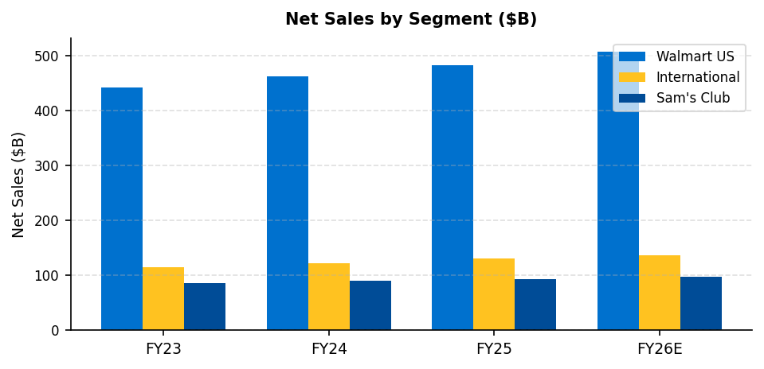
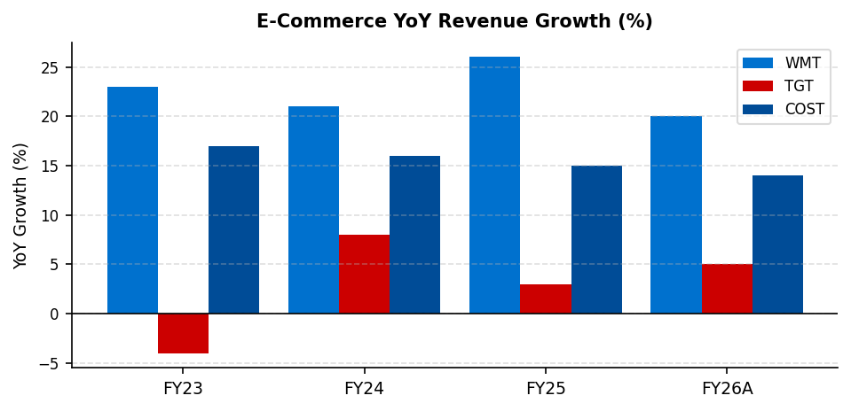
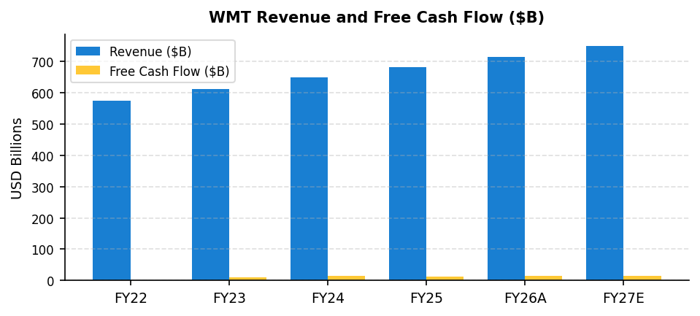
WMT | EQUITY RESEARCH
PERFORMANCE & COMPETITIVE POSITIONING
April 2026 | FIN 431
INDUSTRY OVERVIEW AND COMPETITIVE LANDSCAPE
The US retail industry is undergoing a structural bifurcation between value-oriented formats that are gaining share and premium or specialty formats that are losing it. Walmart sits at the center of this shift, benefiting from both its historic position as the dominant grocery and general merchandise destination for value-conscious consumers and its rapidly improving digital and e-commerce capabilities that are attracting higher-income households. Global retail e-commerce sales are projected to reach approximately $8 trillion by calendar year 2027, with grocery representing the fastest-growing category in the United States.
FIGURE 3: NET SALES BY SEGMENT ($B)
FIGURE 4: E-COMMERCE YOY GROWTH (%)
COMPETITIVE ANALYSIS: WMT VS. TGT, COST, AMZN
FIGURE 5: REVENUE AND FCF GROWTH ($B)
Target Corporation has experienced significant structural headwinds since fiscal year 2022, including a severe inventory overhang, elevated shrinkage and organized retail crime costs, and a misalignment between its merchandise assortment and the post-pandemic consumer preference for value and necessity. Target's comparable sales declined in fiscal years 2024 and 2025, and the company has reduced its capital allocation guidance as it works to right-size its operating cost structure. By contrast, Walmart gained an estimated 30 to 40 basis points of grocery market share from Target over the same period.
Costco represents a different competitive dynamic. Its membership model generates a highly predictable, high-margin revenue stream ($4.8 billion in membership fees in fiscal year 2024) that subsidizes below-market merchandise pricing. Costco and Walmart are less directly competitive due to Costco's bulk-purchase format and suburban warehouse locations, and both have demonstrated strong unit volume trends. We view Costco as a complementary rather than substitutive consumer behavior, with overlap primarily in consumables and private label.
Amazon remains the most significant competitive threat in the medium to long term. Amazon's grocery ambitions, including its Fresh and Whole Foods formats, have not achieved meaningful scale relative to Walmart's 4,700-plus US locations and established grocery infrastructure. However, Amazon's Prime ecosystem and same-day delivery capabilities create a genuine competitive tension in consumables, household goods, and health and beauty categories. Walmart has responded by accelerating Walmart Plus enrollment and buildout of its automated fulfillment center network through a multi-year partnership with Alert Innovation.
NEAR-TERM CATALYSTS
Catalyst
Expected Timing
Q1 FY26 earnings report
May 2026
Walmart Connect advertising ramp
Ongoing
Walmart Plus membership growth
Ongoing
Flipkart IPO preparation
CY2026-27E
Automation cost savings (FAST)
FY27E
Strengths
Weaknesses
Opportunities
Threats
#1 US grocer | 240M weekly customers | First-party data moat | ~$1.0T market cap
Thin FCF margins (1.9%) | Labor cost pressure | International complexity (Flipkart)
Advertising monetization | Marketplace fees | Walmart+ subscription | Healthcare
Amazon grocery expansion | Consumer spending slowdown | Tariff-driven cost inflation
Walmart Inc. (WMT) | Equity Research | FIN 431 | Portfolio Analysis
Page 2

Slide 3
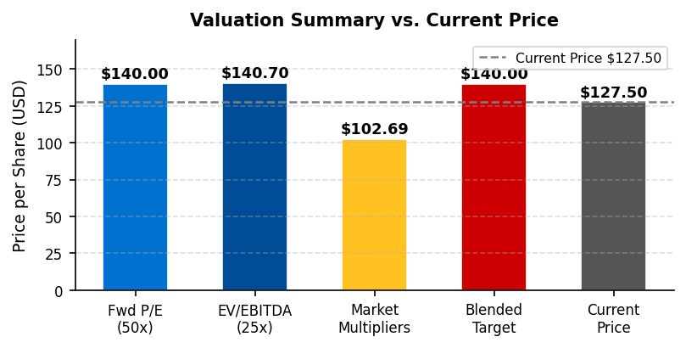
WMT | EQUITY RESEARCH
VALUATIONS & FINANCIALS
April 2026 | FIN 431
FIGURE 6: FINANCIAL SUMMARY
FY24
FY25
FY26A
FY27E
Revenue ($B)
$648.1
$681.0
$713.2
$748.8E
EBITDA ($B)
$38.9
$42.3
$44.0
$46.2E
EPS (GAAP Diluted)
$1.91
$2.41
$2.73
$2.87E
Net Income ($B)
$15.5
$19.4
$21.9
$23.0E
Free Cash Flow ($B)
$15.1
$12.7
$14.9
$15.7E
Capital Expenditures
$(20.6)
$(23.8)
$(26.6)
$(28.0E)
EV/EBITDA
27.0x
24.8x
23.9x
22.7x
P/FCF
68.4x
81.4x
68.1x
64.8x
P/E (GAAP)
66.8x
52.9x
46.7x
44.4x
Revenue Growth YoY
5.1%
5.1%
4.7%
5.0%E
EBITDA Margin
6.0%
6.2%
6.2%
6.2%
FCF Margin
2.3%
1.9%
2.1%
2.1%
Net Income Margin
2.4%
2.9%
3.1%
3.1%
FIGURE 7: VALUATION MODEL SUMMARY
Free Cash Flow Model (FCFM)
Residual Income Model (RIM)
Market Multipliers (Comps)
Base FCF (FY26A): $14,923M (10-K)
BVPS (FY25): $10.97
Comp Set: TGT, COST, AMZN
FCF/Sales Margin (wtd. avg): 1.87%
Rs (CAPM beta-adj.): 6.80%
WACC (beta-adjusted): 6.50%
ROE (FY25 Adj.): ~22.9%
P/B: $110.38 (8.83x × $12.50 BVPS)
Growth: 5.0% (Yrs 1-4) / 3.0% (Terminal)
P/Sales: $70.90 (0.80x × $88.63)
Total Debt: $44,762M (10-K)
Unlike NVDA, WMT has a meaningful
P/EPS: $92.82 (34x × $2.73 EPS)
Shares Outstanding: 7,970M (10-K)
book value ($10.97/share) making
P/FCF: $67.32 (36x × $1.87)
Intrinsic Value (P0): $48.84
the RIM more structurally applicable.
P/EBITDA: $104.88 (19x × $5.52)
12-Month Target (P1): $50.52
Beta-adjusted Rs of 6.80% reflects
Adj. Average: $102.69
Note: FCFM reflects thin FCF margins
WMT's defensive low-beta profile.
(Excl. P/Sales AMZN distortion
(1.87% wtd. avg) typical of large-format
Model P0 directionally supportive
and P/FCF — least relevant for
retail. Primary valuation: Fwd P/E & EV/
but not used as primary estimate.
a high-capex retailer)
EBITDA. See valuation summary.
Supplementary input only.
FIGURE 8: VALUATION SUMMARY VS. CURRENT PRICE
PRICE TARGET DERIVATION
Our 12-month price target of $140.00 is derived from a blended analysis of three methodologies, with primary weight on forward earnings and enterprise value approaches. A forward P/E of 49x applied to our FY27E GAAP EPS estimate of $2.87 yields $140.63. This multiple reflects WMT's premium re-rating driven by advertising monetization and e-commerce growth, consistent with WMT's 5-year average forward P/E of approximately 48-50x. An EV/EBITDA approach using 25x on FY27E EBITDA of $46.2 billion yields an implied equity value of $140.65 per share. Our market multipliers composite of $102.69 reflects the average of peer-based multiples.
The Free Cash Flow Model uses a beta-adjusted WACC of 6.50%, derived from WMT's 5-year beta of approximately 0.50 (cost of equity: 4.30% + 0.50×5.0% = 6.80%; blended with after-tax debt cost). The FCFM intrinsic value of $48.84 reflects WMT's characteristically thin FCF margins (1.87% wtd. avg) typical of large-format retail — it serves as a floor, with primary valuation driven by forward earnings multiples.
Walmart Inc. (WMT) | Equity Research | FIN 431 | Portfolio Analysis
Page 3

Slide 4
WMT | EQUITY RESEARCH
INVESTMENT RISKS
April 2026 | FIN 431
RISK FACTOR ANALYSIS
The following risk factors represent the primary considerations that could prevent Walmart from achieving our 12-month price target of $140.00. Each risk has been assessed for probability and potential magnitude of financial impact.
Consumer Spending Slowdown and Tariff-Driven Cost Inflation
MEDIUM PROBABILITY | MEDIUM IMPACT
Walmart's core customer base is disproportionately exposed to macroeconomic pressure through grocery and consumables spending. While Walmart historically gains market share during downturns, a severe consumer spending contraction would reduce absolute basket size and transaction frequency. More specifically, the current tariff environment on imported consumer goods, particularly from China, creates a cost-of-goods headwind across apparel, electronics, and general merchandise that is difficult to fully pass through to consumers given Walmart's everyday low price commitment.
Management has indicated that Walmart is actively working with suppliers to absorb tariff impacts through renegotiated terms and supply chain diversification, but meaningful pass-through to the consumer is likely inevitable in certain categories. We estimate that a 10 percent increase in effective cost of goods on imported merchandise could reduce FY26E EBITDA by approximately $1.5 to $2.0 billion, implying a roughly 5 percent reduction in our price target.
Amazon Competitive Pressure in Grocery and General Merchandise
MEDIUM PROBABILITY | MEDIUM IMPACT
Amazon represents the most significant long-term competitive risk to Walmart's e-commerce market share and, to a lesser extent, its physical grocery business. Amazon Fresh and Whole Foods locations, combined with Amazon's Prime same-day delivery network, provide a compelling alternative for households already enrolled in the Prime ecosystem. Amazon's private label expansion in grocery and consumables directly targets Walmart's highest-margin category of branded grocery substitution.
We view this risk as manageable over our 12-month investment horizon, as Amazon's grocery market share remains below 4 percent compared to Walmart's approximately 25 percent grocery market share in the United States. However, investors should monitor Amazon's fulfillment capacity additions and grocery-specific subscription benefits as potential structural headwinds to Walmart's e-commerce growth trajectory beyond fiscal year 2027.
Margin Compression from Wage Inflation and Capital Investment Cycle
HIGH PROBABILITY | LOW-MEDIUM IMPACT
Walmart's largest operating cost is compensation, representing approximately 25 to 28 percent of US net sales. The company raised its US minimum hourly wage to $14 per hour in 2023 and has continued to increase compensation packages for store managers and supply chain associates. Combined with elevated capital expenditure guidance of $26 to $28 billion per year through fiscal year 2028 as the company invests in store remodels, automated fulfillment centers, and technology infrastructure, free cash flow is likely to remain structurally compressed relative to reported net income.
This dynamic creates a tension between reported earnings per share growth and actual cash generation that investors should carefully monitor. We forecast FCF margins remaining at approximately 1.9 percent of revenue through fiscal year 2027, well below the 4.5 percent achieved in fiscal year 2021 when capital investment was significantly lower.
Valuation Premium Risk at 41x Forward Earnings
MEDIUM PROBABILITY | MEDIUM IMPACT
Walmart currently trades at approximately 41x our FY26E adjusted EPS estimate of $2.65, a significant premium to its own historical forward P/E average of approximately 28x and to the broader S&P 500 average of 21x. This premium reflects investor confidence in the advertising and e-commerce re-rating narrative as well as defensive capital rotation, but it also creates meaningful downside risk if earnings growth disappoints or if risk appetite shifts toward cyclical sectors.
A single quarter of below-consensus comparable sales growth or an advertising revenue deceleration could prompt a de-rating from 41x toward the historical mean of 28x, implying a stock price closer to $74, representing over 42 percent downside from current levels. Investors should be aware that at current valuation levels, the margin of safety is limited and execution against both the advertising and e-commerce growth narratives is essential for the investment thesis to remain intact.
Walmart Inc. (WMT) | Equity Research | FIN 431 | Portfolio Analysis
Page 4

Slide 5
WMT | EQUITY RESEARCH
APPENDIX B: CHARTS & FIGURES
April 2026 | FIN 431
FIGURE 1 (FULL): WMT HISTORICAL PRICE (SPLIT-ADJUSTED)
FIGURE 2 (FULL): RELATIVE PERFORMANCE VS. BENCHMARKS
FIGURE 3 (FULL): NET SALES BY SEGMENT ($B)
FIGURE 4 (FULL): E-COMMERCE YOY GROWTH (%)
ANALYST NOTES
All financial data for Walmart sourced from company 10-K and 10-Q filings, earnings press releases, and management guidance as of March 2026. Comparable company multiples for TGT, COST, and AMZN sourced from trailing twelve-month public financials and consensus estimates as of April 2026. Revenue growth rates of 5.0 percent (years 1-4) and 3.0 percent (terminal) reflect publicly available guidance, analyst consensus, and fundamental analysis of Walmart's e-commerce and advertising business trajectories. EPS estimates for FY26E and FY27E represent adjusted non-GAAP figures excluding discrete tax benefits, acquisition-related amortization, and restructuring charges. All share counts reflect post-3:1-split basis (February 2024). This report was prepared for academic purposes in the context of FIN 431 Portfolio Analysis and does not constitute investment advice.
Walmart Inc. (WMT) | Equity Research | FIN 431 | Portfolio Analysis
Page 6

Slide 6
WMT | EQUITY RESEARCH
APPENDIX A: COMPARABLES & MARKET MULTIPLIERS
April 2026 | FIN 431
FIGURE 9: COMPARABLE COMPANY METRICS (NTM / FY25 ACTUALS)
Company
Ticker
Mkt Cap ($B)
EV/EBITDA
P/E (Adj)
P/Sales
P/FCF
FCF Margin
Walmart Inc.
WMT
~$1,016
23.9x
46.7x
1.44x
68.1x
2.1%
Target Corp.
TGT
~$47
7.5x
12.0x
0.50x
18.0x
2.7%
Costco Wholesale
COST
~$420
30.0x
52.0x
1.10x
55.0x
2.4%
Amazon.com
AMZN
~$2,100
20.0x
38.0x
3.50x
35.0x
9.8%
FIGURE 10: MARKET MULTIPLIERS — IMPLIED WMT PRICE
Multiple
TGT
COST
AMZN
Average Used
Implied WMT Price
P/B
3.50x
15.00x
8.00x
8.83x (all three)
$110.38
P/Sales
0.50x
1.10x
3.50x
0.80x (TGT/COST — AMZN excl.)
$70.90
P/EPS
12.00x
52.00x
38.00x
34.00x (all three)
$92.82
P/FCF
18.00x
55.00x
35.00x
36.00x (all three)
$67.32
P/EBITDA
7.00x
30.00x
20.00x
19.00x (all three)
$104.88
Adj. Avg.
Excl. P/Sales (AMZN) & P/FCF
$102.69
Per-share metrics applied (FY26 actuals per 10-K): Net Sales/Share = $88.63, EPS (GAAP Dil.) = $2.73, FCF/Share = $1.87, EBITDA/Share = $5.52, BVPS = $12.50. Shares outstanding 7,970M (par value $797M / $0.10). AMZN P/Sales excluded from average as AWS and advertising revenues (combined ~35% of AMZN revenue) are structurally incomparable to WMT's pure-retail revenue base and would artificially inflate the implied price. P/FCF excluded from adjusted average as WMT's FCF is temporarily depressed by a peak capital expenditure cycle ($23.7B in FY25) in automated fulfillment and store remodel programs; normalized FCF margin is estimated at approximately 3.5 to 4.0 percent once the capex cycle moderates post-FY27, implying a significantly higher FCF/Share and a more appropriate peer comparison. Adjusted average of $102.69 uses P/B, P/EPS, and P/EBITDA.
FIGURE 11: FCFM DETAIL — GROWTH RATE AND MARGIN ASSUMPTIONS
Year
WMT Fiscal Year
Revenue ($B)
FCF/Sales Margin
FCF ($B)
PV Factor (6.50%)
1
FY27E
$748.8
1.87%
$14.0
0.9390
2
FY28E
$786.2
1.87%
$14.7
0.8817
3
FY29E
$825.6
1.87%
$15.5
0.8278
4
FY30E
$866.9
1.87%
$16.2
0.7773
TV
FY31E+
$910.2
1.87%
Perpetuity
Revenue growth rate of 5.0% for years 1 through 4 reflects a slight premium to WMT's FY26 guidance of 3 to 4 percent net sales growth, accounting for advertising revenue acceleration (30% annual growth), e-commerce contribution, and international segment outperformance. Terminal growth rate of 3.0% is consistent with long-run US nominal GDP growth and highly defensible for a consumer staples-adjacent global retailer with 19-country diversification. FCF/Sales weighted average of 1.87% uses time-weighted averages (year weights 1 through 5). FY22 FCF of only $400M (FCF margin 0.07%) reflects a concentrated capex year that significantly drags the average below FY24/FY25 levels. Normalized FCF margin excluding the investment cycle trough is approximately 2.5 to 3.0 percent. WACC of 6.50% derived from beta-adjusted CAPM: cost of equity = 4.30% RFR + 0.50 beta × 5.0% ERP = 6.80%; blended with after-tax cost of debt ~3.5% at 32% debt weight yields WACC of approximately 6.5%.
Walmart Inc. (WMT) | Equity Research | FIN 431 | Portfolio Analysis
Page 5

