Slide 1

Automated Airport Baggage Handling System

Slide 2
Team Members and respective roles:

Slide 3


Our project simulates an automated airport luggage management system using autonomous guided vehicles (AGVs). The software coordinates the movement, queuing, and smart charging of AGVs to efficiently handle baggage processing in a busy airport environment.

Slide 4
Domain Description
The system manages multiple AGVs that transport luggage and require periodic charging at limited charging stations.
It includes modules for scheduling tasks (TaskManager), managing waiting queues for charging (QueueManage), and monitoring each charging station’s status (ChargingStation).
Robust error handling is provided through custom exceptions like StationBusyException, ensuring AGVs don’t try to use a busy charger.
The project emphasizes concurrency, as AGV tasks and queueing run in parallel threads to simulate real-world, simultaneous operations.
We use automated unit tests to verify that core features, such as task assignment and queue management, behave correctly under various scenarios.

Slide 5
The system must manage multiple autonomous guided vehicles (AGVs) and coordinate their charging at limited charging stations.
It should assign tasks, maintain an ordered queue for charging requests, and monitor the status of each station.
The solution must support parallel (threaded) operation to simulate real-world scenario where AGVs operate concurrently.
Robust error handling is required to prevent two AGVs from charging at the same station simultaneously.
Automated unit tests should be used to verify correct behavior for task management and queue operations.
System Requirements

Slide 6
Class Diagram

Slide 7
Input/Output
Input | Output
AGV charging requests | Charging status logs
AGV/task assignments | Task completion info
AGV arrival events | Updated AGV & queue states
User/config commands | Error messages, system status

Slide 8
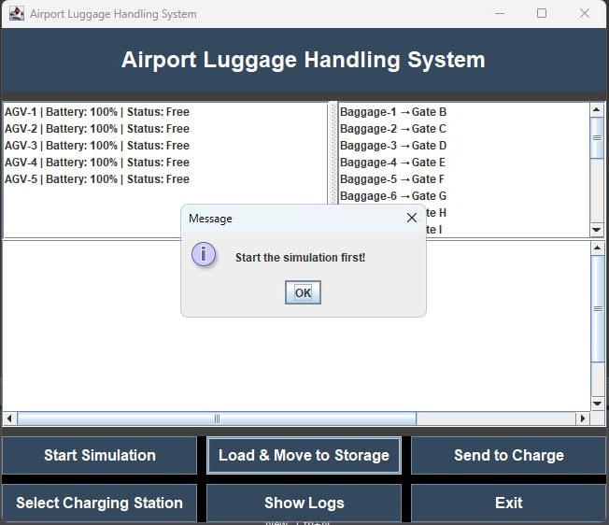
AABHS Interface

Slide 9
AABHS Interface

Slide 10
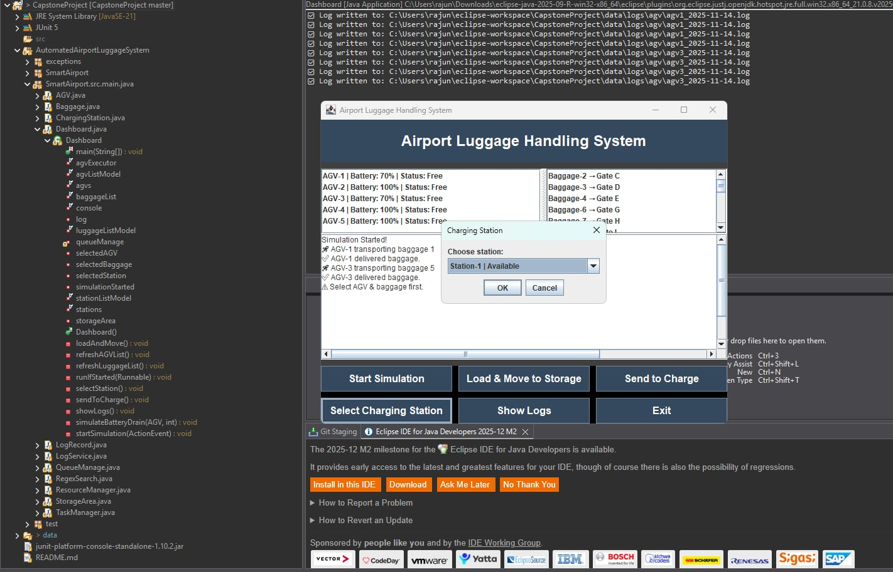
AABHS Interface

Slide 11
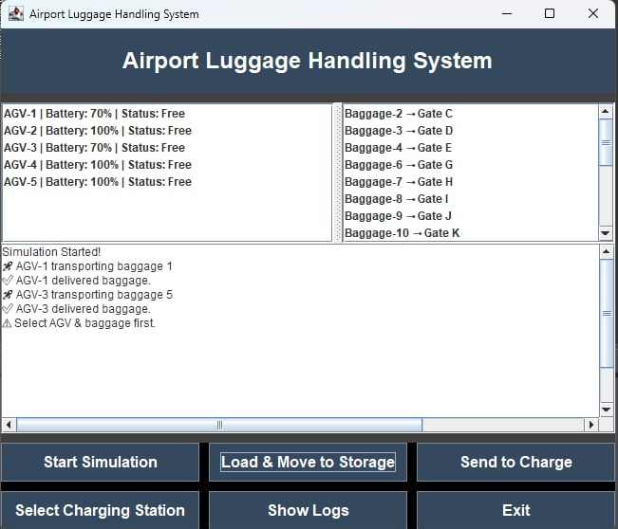
AABHS Interface

Slide 12

Concurrency and Threads in the System
The system uses concurrent threads to simulate real-world simultaneous operation of multiple AGVs.
Each AGV runs tasks in parallel, requesting charging and communicating with queue and station managers.
Synchronized methods and locking ensure thread-safe updates, like assigning charging stations without conflicts.
This concurrency model improves simulation realism and system responsiveness.
Challenges such as race conditions and deadlocks are mitigated by careful design of task assignment and queue management logic.

Slide 13
Unit Test Results
Add screenshots of GUI

Slide 14
Conclusion
Successfully developed a modular and concurrent system simulating airport luggage handling with AGVs and charging stations.
Designed clear coordination between task management, queue handling, and charging station availability to ensure efficient operation.
Employed custom exception handling to robustly manage error scenarios like busy charging stations.
Implemented multi-threading to mimic real-world parallel AGV operations and prevent resource conflicts.
Validated system behavior with comprehensive unit tests to ensure reliability and correctness under different scenarios.

Slide 15

Any Questions?

