Slide 1
Balloon shooting game using modern opengl (3.3)
Presented By:
Arnob Sarker
Roll : 1807088

Slide 2
Outlines
Introduction
Keyboard Controls
Features

Slide 3
Introduction
OpenGL 3.3 is used to simulate Sea port in computer graphics.
Basic objects that are created in this project are as below
1. Balloon
2. Shooting gun
3. Bullet
4. Shooting room
5. Scoreboard
6. Timer
7. Start screen
8. Game over screen

Slide 4
Key Controls(View)
Press W: Forward
Press S: Backward
Press A: Left
Press D: Right
Press UP: Gun up
Press Down: Gun down
Press Left: Gun left
Press Right: Gun right
Press G: Shoot
Press R: Start game

Slide 5
Key Controls(Lighting)
Press 1: Direction Light
Press 2: Point Light
Press 3: Spot Light
Press 4: Ambient
Press 5: Diffuse
Press 6: Specular

Slide 6
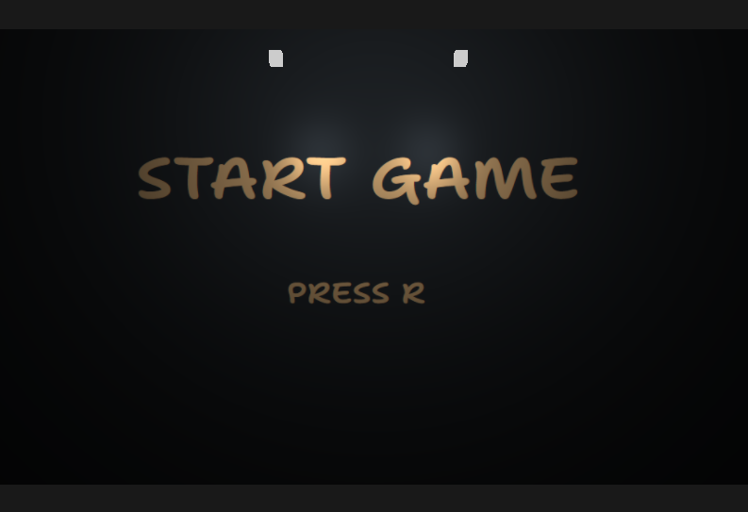
Features
Figure 1: Start Screen

Slide 7
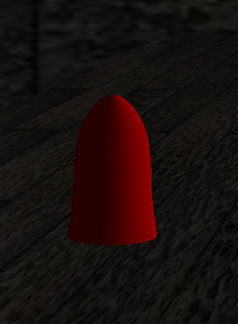
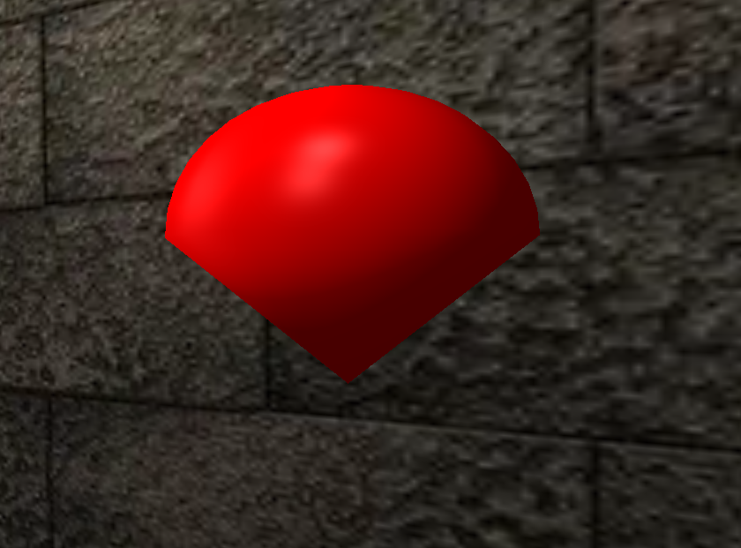
Features (Contd.)
Figure 2: Balloon
Figure 3: Bullet

Slide 8
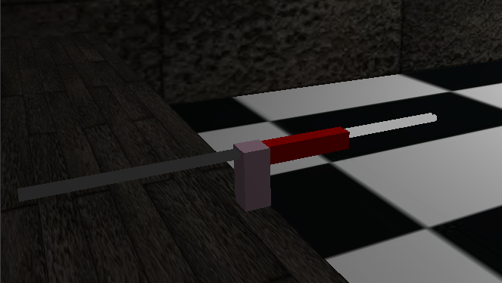
Features (Contd.)
Figure 4: Gun

Slide 9
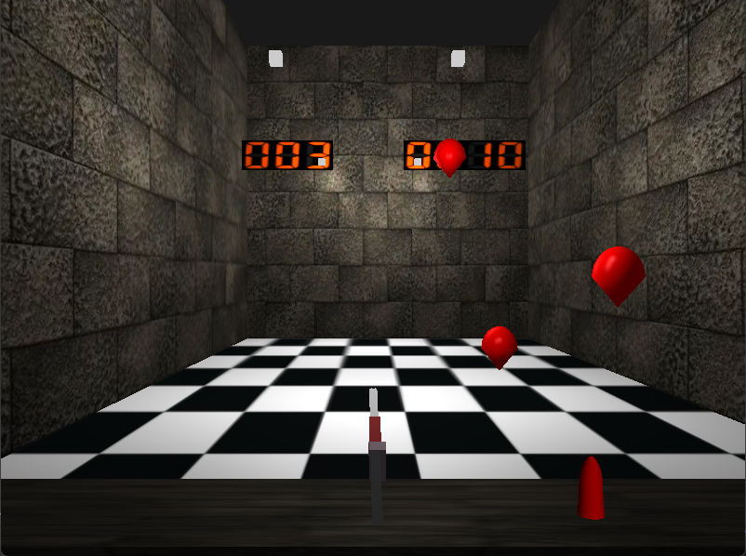
Features (Contd.)
Figure 5: Shooting Room

Slide 10
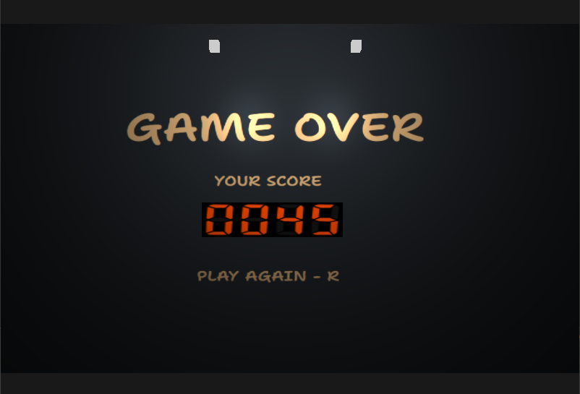
Features (Contd.)
Figure 6: Game over screen

Slide 11
References
https://learnopengl.com
https://en.wikipedia.org/wiki/Computer_graphics

Slide 12
Thank You

