Slide 1
2D Heat Conduction Equation
Solve in MATLAB
Course No: EEE 212 · Numerical Technique Laboratory
Section: L-2, T-1, Section B
Submitted To
Submitted By
Dr. Maruf Ahmed — Assistant Professor
Md. Kamrul Hasan — Lecturer
Arnob Pal · ID: 2306095
Ziaur Rahman Zihan · ID: 2306096
Bangladesh University of Engineering & Technology
EEE 212 · Numerical Technique Laboratory · BUET

Slide 2
TABLE OF CONTENTS
01 | Abstract
02 | Introduction & Background
03 | Theory Overview
04 | Algorithm Flowchart
05 | System Architecture
06 | Implementation Steps
07 | GUI Overview
08 | Parameter Analysis
09 | Solver Capabilities
10 | Limitations & Challenges
11 | Conclusion

Slide 3
ABSTRACT
2D Heat Conduction FEM Solver in MATLAB
🎯 Objective
🔧 Method
🔬 Key Idea
Solve the 2D steady-state heat conduction (Laplace) equation over complex L-shaped domains.
Finite Element Method (FEM) using T3 triangular elements with linear shape functions.
Domain discretized into triangular elements; temperature approximated via nodal shape functions.
💻 Tool
📊 Output
💻 Tool
📊 Output
MATLAB App Designer GUI for interactive parameter input and real-world scenario simulation.
Temperature distribution visualized via patch plots with color interpolation and colorbars.
MATLAB App Designer GUI for interactive parameter input and real-world scenario simulation.
Temperature distribution visualized via patch plots with color interpolation and colorbars.

Slide 4
INTRODUCTION & BACKGROUND
Why 2D Heat Conduction Matters
Heat transfer is central to engineering: circuit design, power systems, aerospace structures, and energy devices.
The 2D heat equation models how temperature varies spatially under given physical conditions.
Analytical solutions fail for irregular geometries, non-uniform materials, and complex boundary conditions.
Numerical methods — especially FEM — bridge this gap with high accuracy.
FEM Overview
Mesh the domain into triangular elements
Assign shape functions per node
Derive element-level equations
Assemble global stiffness matrix
Apply boundary conditions
Solve for temperature field
Project Goals
Develop a robust FEM solver for 2D steady-state heat equation
Implement Dirichlet & Robin (convection) boundary conditions
Analyze thermal behavior with MATLAB App Designer GUI

Slide 5
THEORY OVERVIEW
Governing Equations & FEM Formulation
Governing Equation (Laplace)
Boundary Conditions
∂/∂x(k · ∂T/∂x) + ∂/∂y(k · ∂T/∂y) = 0
Dirichlet (left boundary): T(0,y) = T_boundary
Robin / Convection: -k∇T·n = h(T - T∞)
h = convection coefficient, T∞ = 20°C ambient
Results in a 3rd-Kind Boundary Value Problem
Isotropic material: kx = ky = k
Net heat flux into any control volume = 0 (steady state)
[B] Matrix — Shape Function Gradients
[D] & Stiffness Matrix [Kc]
[B] = [ b₁/2A b₂/2A b₃/2A ]
[ c₁/2A c₂/2A c₃/2A ]
[D] = [ k 0 ]
[ 0 k ]
Kc = t · A · [B]ᵀ [D] [B]
Constant gradient across each T3 element → constant heat flux
t = thickness, A = triangle area

Slide 6
ALGORITHM FLOWCHART
FEM Heat Transfer Solver — Step-by-Step
START
1. Input Parameters (k, h, t, T_boundary, Blocks)
2. Generate T3 Mesh (geom + conodesc)
3. Identify Boundary Conditions
4. Compute Material Matrix [D]
5. Element Loop: Compute [B], Area, Kc, Kh, fe
CONVECTION
EDGE CHECK
(Step 5)
6. Assemble Global [KK] and {fg}
7. Apply Dirichlet BCs & Solve: {T} = [KK]\{fg}
8. Plot Temperature Distribution + END

Slide 7
SYSTEM ARCHITECTURE
FEM Solver Pipeline
⚙️
🔲
🔢
📐
📌
➗
🌡️
INPUT
Parameters
MESH
Generator
FEM
Solver
Matrix
Assembly
Boundary
Processor
Linear
Solver
VISUALIZ-
ATION
geom array
conodesc array
[B], [D] matrices
[KK], {fg}
nf / convect flags
patch() plot
MATLAB backslash
Node coordinates (nnd×2)
Element-node connectivity (nel×3)
Shape gradients & material property
Global stiffness & force
DOF numbering & edge detection
Color-interpolated temperature map
{T} = [KK]\{fg} — LU decomposition

Slide 8
IMPLEMENTATION — STEP 1 & 2
Input Handling & Mesh Generation
Step 1: Input Handling (GUI Variables)
k = app.ThermalConductivityEditField.Value;
h = app.HeatConvectionCoefficientEditField.Value;
thick = app.ThicknessinmmEditField.Value;
Block = app.NumberofBlocksEnterbetween1to4EditField.Value;
InitialBoundedTemp = app.BoundedTemperatureInitialEditField.Value;
GUI reads: k, h, thickness, T_boundary, Blocks
DOF = 1 per node (temperature)
Geometry constants: a = 70/7 mm (fixed step size)
Step 2: Mesh Generation (T3 Elements)
T3_mesh_final_term_axisymmetric
% Output arrays:
% geom (nnd × 2) — node coordinates
% conodesc (nel × 3) — element connectivity
% Each quad cell → 4 T3 triangles
% Center node added at cell midpoint
Each rectangular block divided into quadrilateral cells
Each quad → 4 T3 triangles via center node
geom: stores (x, y) of every node
conodesc: 3 node indices per element
Nodes shared at block interfaces — no duplication

Slide 9
IMPLEMENTATION — STEP 3 & 4
Boundary Identification & Material Matrix
Step 3: Boundary Identification
% Dirichlet: nodes at x = 0
if geom(i,1) == 0
Nodal_loads(i,1) = InitialBoundedTemp;
end
% Convection edges: x=70, y=0/70, steps
if all(geom(conodesc(i,[j k(j)]),1) == 70)
convect(i,j) = 1;
end
Dirichlet: nodes where x = 0 get fixed temperature
Convective edges detected by coordinate checks
Convect flag = 1 for exposed boundary edges
Robin BC applied on: x=70, y=0/70, step faces
Step 4: Material Matrix [D]
dee = [ThermalConductivity 0;
0 ThermalConductivity];
% Isotropic: kxx = kyy = k
Isotropic material: equal conductivity in x and y
2×2 diagonal matrix — simple and efficient
User-specified k from GUI drives both diagonal entries
Used in: Kc = t · A · [B]ᵀ [D] [B]

Slide 10
IMPLEMENTATION — STEP 5
Element Matrix Calculation
Step 5: [B] Matrix, Area & Stiffness Matrices
A = 0.5*det([1 x1 y1; 1 x2 y2; 1 x3 y3]);
% Shape function gradient coefficients
b1=(y2-y3)/(2A); b2=(y3-y1)/(2A); b3=(y1-y2)/(2A);
c1=(x3-x2)/(2A); c2=(x1-x3)/(2A); c3=(x2-x1)/(2A);
% [B] matrix (2×3)
bee = [b1 b2 b3; c1 c2 c3];
% Conduction matrix
kc = thick * A * bee' * dee * bee;
% Convection matrix (for boundary edges)
kh = thick * h * cee; % cee from edge lengths L
ke = kc + kh;
Area A computed via determinant of nodal coordinates
B matrix: constant gradient — key FEM advantage for T3
Kc = t·A·[B]ᵀ[D][B] — conduction stiffness matrix
Convection matrix Kh adds hL/6·[2 1;1 2] per exposed edge
Total element stiffness: Ke = Kc + Kh
Force vector: fe = h·T∞·L/2·[1;1] per convection edge
Key FEM Equations
Kc = t·A·[B]ᵀ[D][B] Kh = h·L·t/6·[2 1; 1 2] fe = h·T∞·L·t/2·{1;1}
T(x,y) = N₁T₁ + N₂T₂ + N₃T₃ Nᵢ = (aᵢ + bᵢx + cᵢy) / 2A

Slide 11
IMPLEMENTATION — STEP 6, 7 & 8
Assembly, Boundary Conditions & Solving
Step 6 – 7: Global Assembly & Dirichlet BCs
% Assemble element into global KK
kk = form_kk(kk, ke, g); % steering vector g
fg = form_fg(fg, fe, g);
% Enforce Dirichlet: subtract fixed contributions
fg(i) = fg(i) - sum(kk(i,idT)*Nodal_loads(idT));
% Zero rows/cols of fixed DOFs, set diagonal=1
kk(idT,:) = 0; kk(:,idT) = 0;
kk(idT(i),idT(i)) = 1;
fg(idT) = Nodal_loads(idT); % set known T
Steering vector g maps local DOFs to global positions
form_kk and form_fg functions loop over element DOFs
Dirichlet BC: row/col zeroed, diagonal = 1, RHS = T_boundary
Ensures fixed nodes retain prescribed temperature exactly
Step 8: Solve & Visualize
% MATLAB backslash = LU decomposition
tg = kk \ fg;
% Patch plot with color interpolation
patch('Faces',conodesc,'Vertices',geom,...
'FaceVertexCData',tg,'FaceColor','interp');
colorbar;
MATLAB \ operator: efficient LU factorization
tg: temperature at all free nodes
patch() renders each triangle colored by temperature
colorbar shows temperature scale in °C

Slide 12
GUI OVERVIEW — MATLAB App Designer
App Features
MATLAB App Designer Interface
Parameter | Symbol | Description
Thermal Conductivity | k | Material heat conduction [W/m·K]
Heat Convection Coeff. | h | Surface-to-fluid heat transfer [W/m²·K]
Thickness (mm) | t | Out-of-plane domain thickness
Boundary Temperature | T_b | Fixed temperature at x=0 [°C]
Number of Blocks | — | L-domain complexity (1–4)
Show Plot
Runs main FEM solver with current GUI inputs
Run Application
Triggers real-world scenario (CPU / Building)
Scenario Dropdown
Select Electronic Cooling or Building Wall
Result Label
Shows scenario parameters after execution
Live Mesh
Patch plot updates on each button press

Slide 13
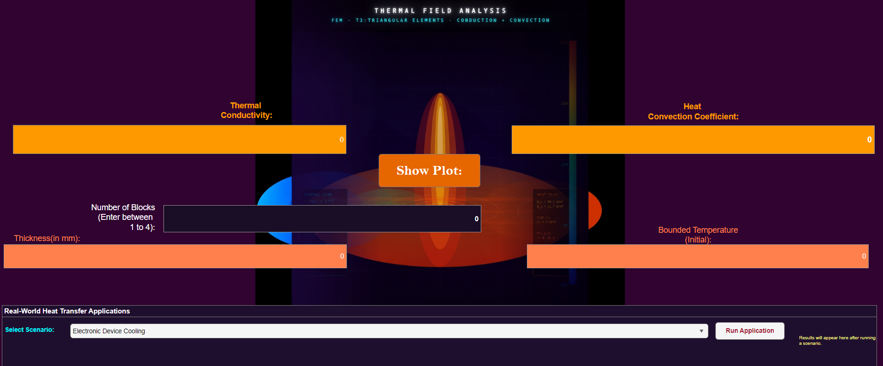
GUI OVERVIEW — MATLAB App Designer
MATLAB App Designer Interface
Built with MATLAB App Designer — uifigure with numeric edit fields, dropdown menus, and push buttons. Real-world scenarios trigger a dedicated FEM sub-solver with scenario-specific physics parameters. Results annotated with T_max and T_min directly on the plot.

Slide 14
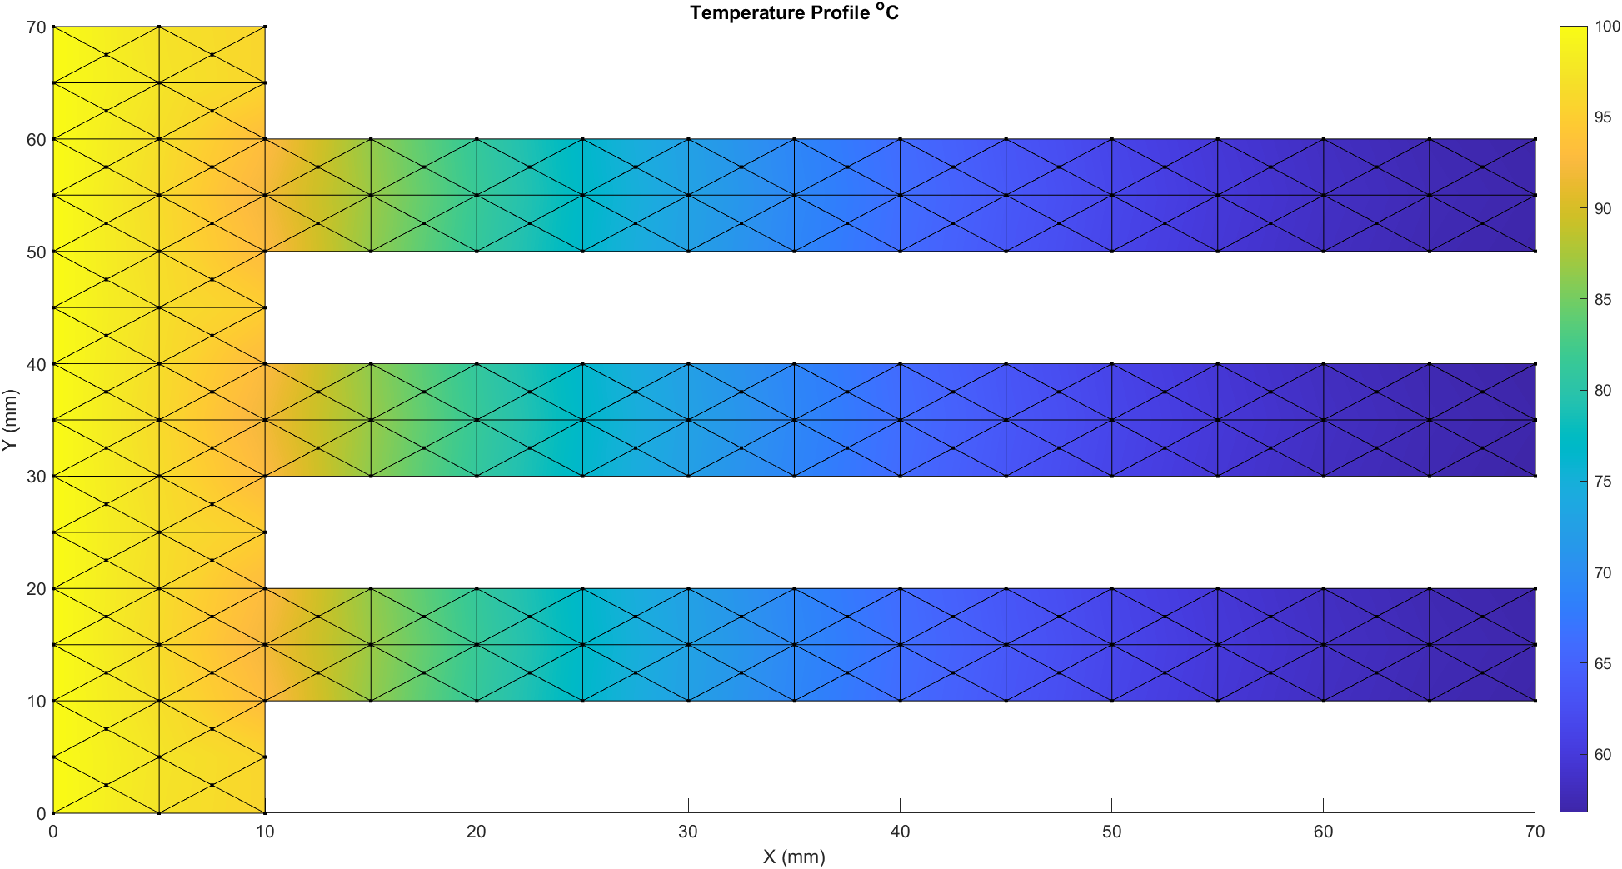
GUI Results —Case 1
Sample Result 1 — Baseline (k=500, h=1, t=10mm, T=100°C, Blocks=4)
Input Parameters (GUI)
Temperature Distribution (MATLAB Output)
Thermal Conductivity (k)
500 W/(m·K)
Convection Coefficient (h)
1 W/(m²·K)
Thickness (t)
10 mm
Boundary Temperature
100°C
Number of Blocks
4
Observation
High thermal conductivity with very low convection → heat distributes uniformly across domain. Temperature gradient decays gently from left boundary.
Smooth lateral heat spread; entire domain retains high temperature.

Slide 15
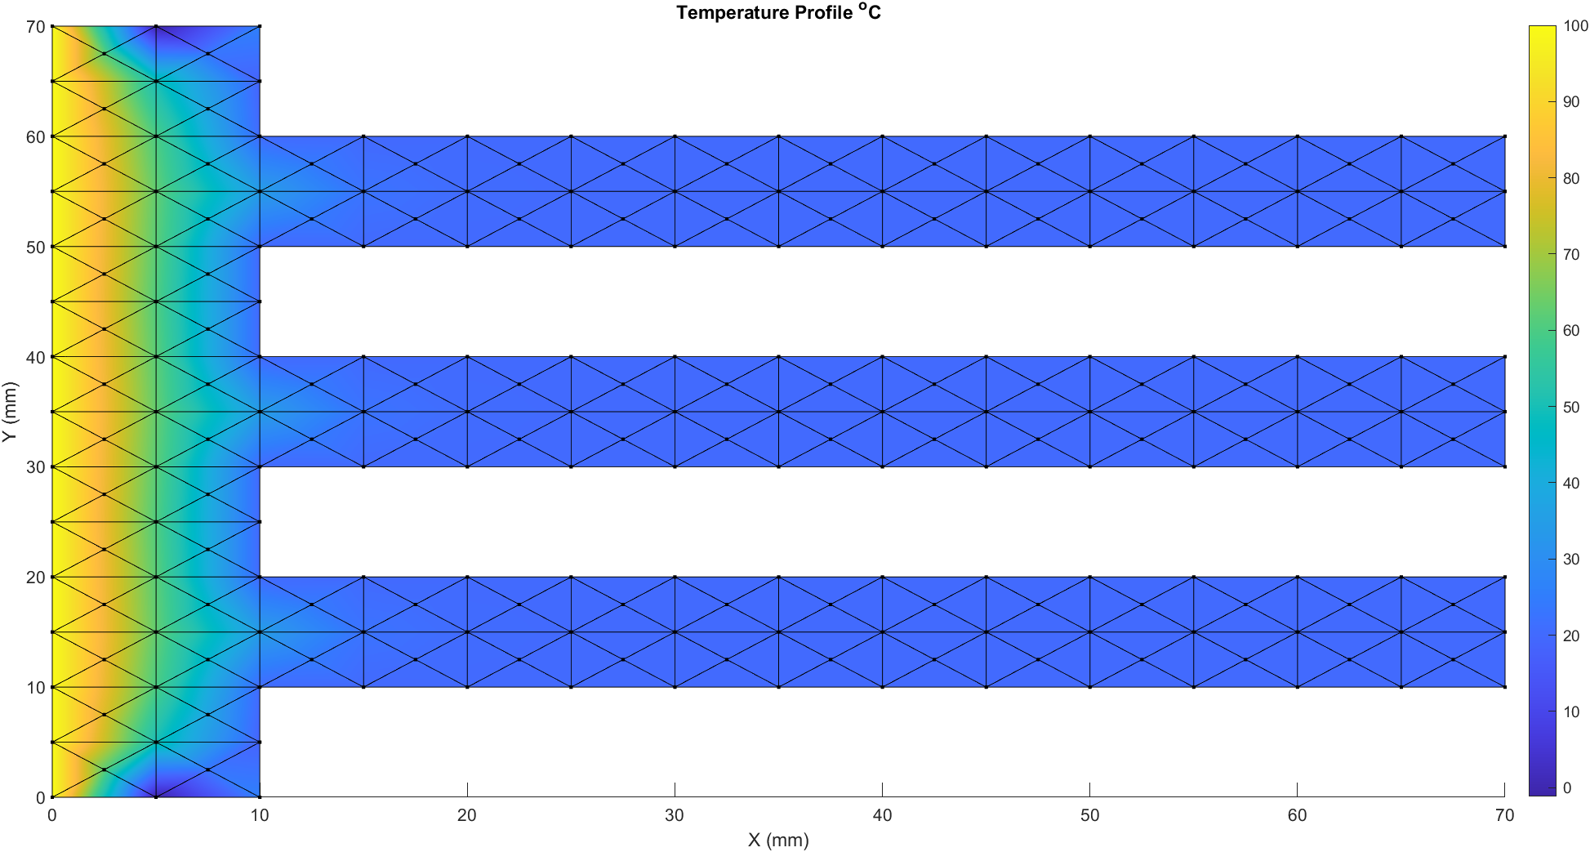
GUI Results —Case 2
Sample Result 2 — Low k (k=1, h=100, t=10mm, T=100°C, Blocks=4)
Input Parameters (GUI)
Temperature Distribution (MATLAB Output)
Thermal Conductivity (k)
1 W/(m·K)
Convection Coefficient (h)
100 W/(m²·K)
Thickness (t)
10 mm
Boundary Temperature
100°C
Number of Blocks
4
Observation
Low conductivity with strong convection → heat is trapped near source boundary. Sharp temperature drop across domain.
Heat localizes near x=0; most domain cools to near-ambient temperature.

Slide 16
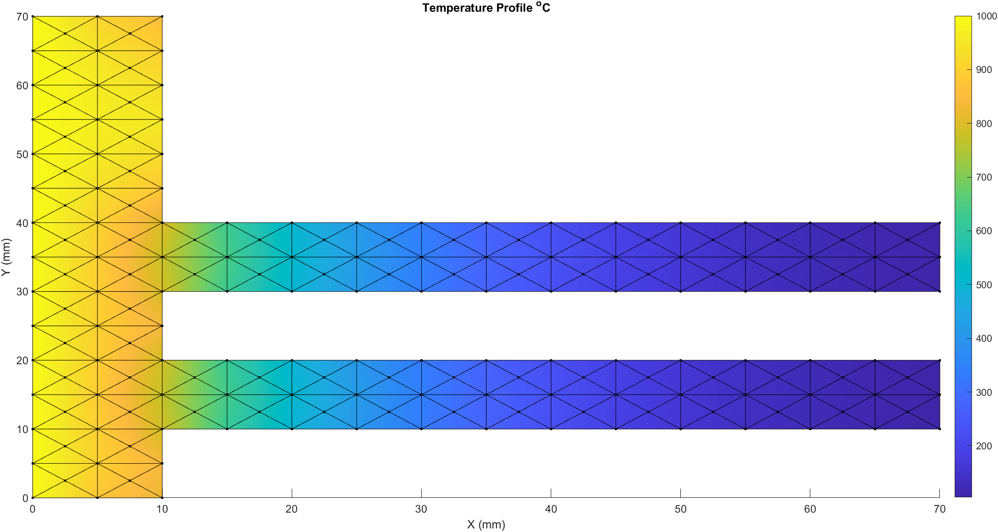
GUI Results —Case 3
Sample Result 3 — High k (k=1000, h=10, t=10mm, T=1000°C, Blocks=3)
Input Parameters (GUI)
Temperature Distribution (MATLAB Output)
Thermal Conductivity (k)
1000 W/(m·K)
Convection Coefficient (h)
10 W/(m²·K)
Thickness (t)
10 mm
Boundary Temperature
1000°C
Number of Blocks
3
Observation
Very high conductivity → heat penetrates deep into domain with moderate convection losses. Uniform high temperature throughout.
Temperature spreads widely; minimal loss across domain extent.

Slide 17
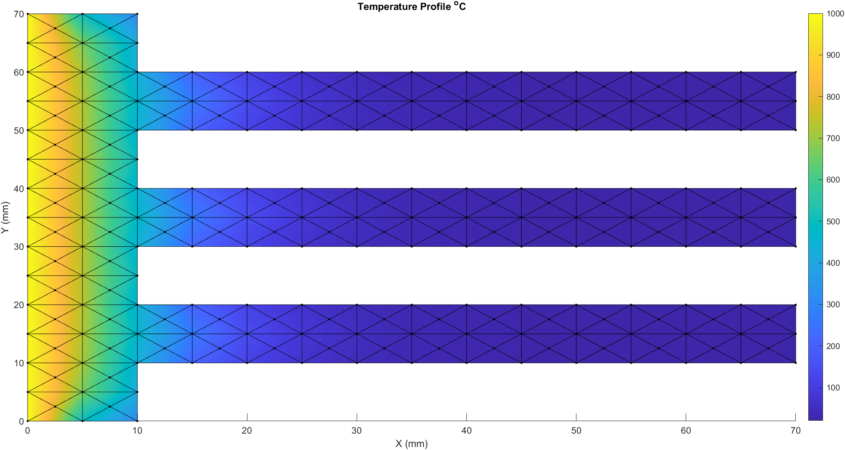
GUI Results —Case 4
Sample Result 4 — k=0.001, h=0.0001, t=1e+05, T=1000°C, Blocks=4
Input Parameters (GUI)
Temperature Distribution (MATLAB Output)
Thermal Conductivity (k)
0.001 W/(m·K)
Convection Coefficient (h)
0.0001 W/(m²·K)
Thickness (t)
10 mm
Boundary Temperature
1000°C
Number of Blocks
4
Observation
Very high thickness → the overall temperature decreases. The thicker materials allows more heat to escape via convection, resulting in a cooler domain and a less steep temperature gradient compared to thinner samples.

Slide 18
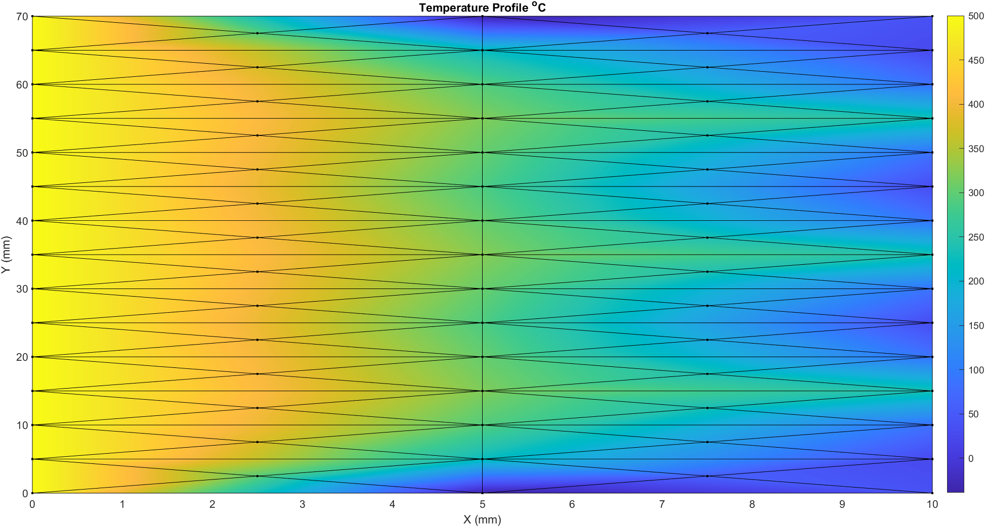
GUI Results —Case 5
Sample Result 4 — k=10, h=20, t=1mm, T=500°C, Blocks=1
Input Parameters (GUI)
Temperature Distribution (MATLAB Output)
Thermal Conductivity (k)
10 W/(m·K)
Convection Coefficient (h)
20 W/(m²·K)
Thickness (t)
1 mm
Boundary Temperature
500°C
Number of Blocks
1
Observation
Single block = full rectangular domain 10mm×70mm. Smooth linear gradient from left to right.

Slide 19
PARAMETER ANALYSIS
Effect of Parameter Variation on Temperature Distribution
Thermal Conductivity (k)
↑ INCR
Higher k → heat spreads more uniformly → gradual gradient across domain
↓ DECR
Lower k → heat concentrated near hot boundary → steep gradient
Convection Coefficient (h)
↑ INCR
Higher h → more aggressive surface cooling → faster temperature drop
↓ DECR
Lower h → weaker cooling → heat penetrates deeper into domain
Thickness (t)
↑ INCR
Higher t → scales Kc and Kh proportionally → profile shape unchanged
↓ DECR
Lower t → thin plate assumption; same distribution but scaled matrices
Boundary Temperature (T_b)
↑ INCR
Higher T_b → entire domain shifts to higher temperatures uniformly
↓ DECR
Lower T_b → cooler domain; ambient convection becomes relatively dominant
Mesh Density (Blocks)
↑ INCR
Finer mesh → higher accuracy, captures sharp gradients better
↓ DECR
Coarser mesh → faster computation, may miss thermal hotspots

Slide 20
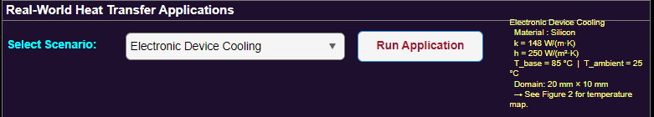
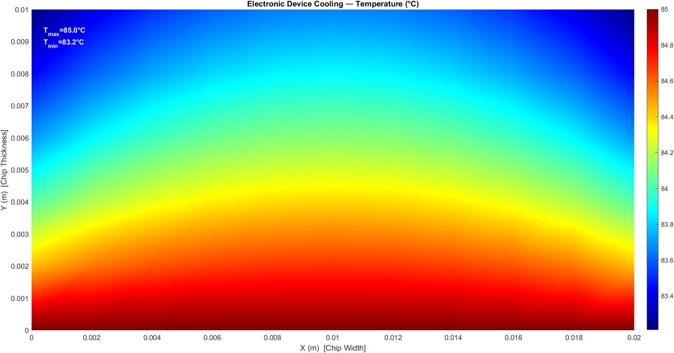
Real-World Application — Case 01: Electronic Device Cooling
Application Panel (GUI)
Temperature Distribution (T_max=85.0°C, T_min=83.2°C)
Physics Parameters
Material:
Silicon
Thermal Conductivity:
k = 148 W/(m·K)
Convection Coeff.:
h = 250 W/(m²·K)
Base Temperature:
T_base = 85°C
Ambient Temp.:
T_ambient = 25°C
Domain Size:
20 mm × 10 mm chip
Heat flows radially from chip base (y=0). High conductivity silicon allows rapid thermal spreading. Convection on top/sides cools the device. Very small temperature gradient (ΔT ≈ 1.8°C) confirms efficient thermal management.
BC: Bottom edge:
Fixed T = 85°C (heat source)
BC: Top/Left/Right:
Convection h=250, T=25°C

Slide 21
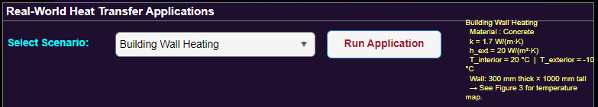
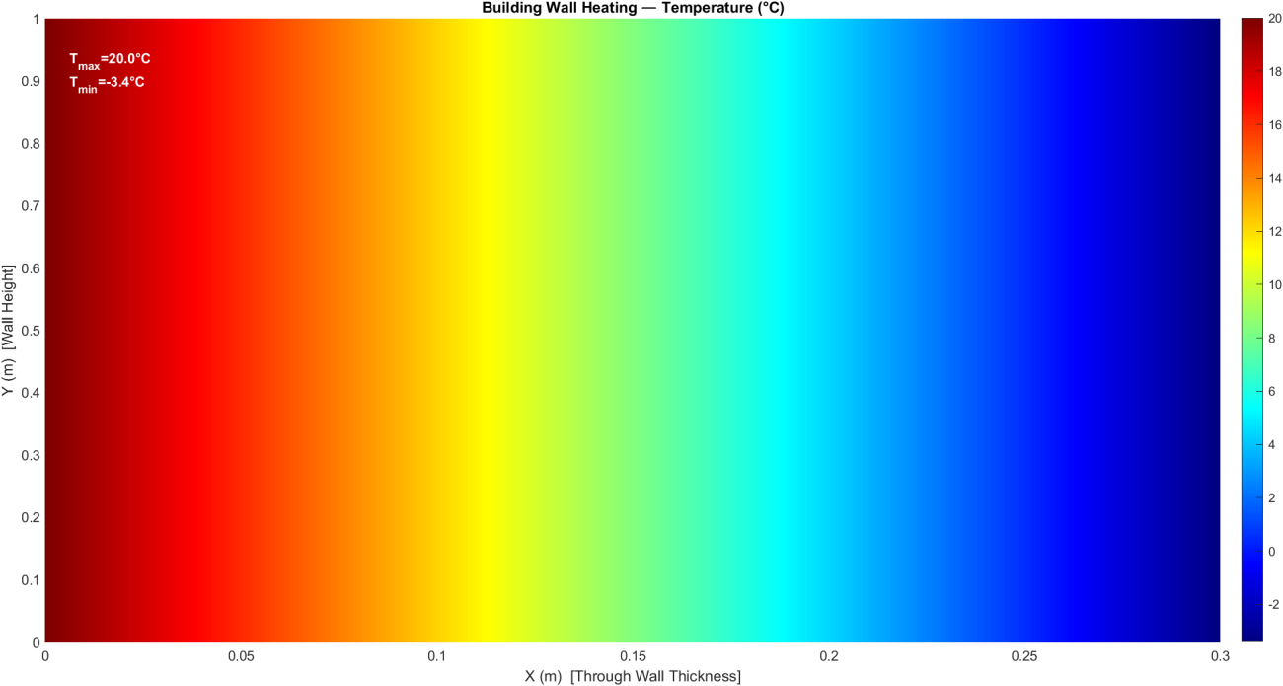
Real-World Application — Case 02: Building Wall Heating
Application Panel (GUI)
Temperature Distribution (T_max=20.0°C, T_min=−3.4°C)
Physics Parameters
Material:
Concrete
Thermal Conductivity:
k = 1.7 W/(m·K)
Ext. Convection Coeff.:
h_ext = 20 W/(m²·K)
Interior Temperature:
T_interior = 20°C
Exterior Temperature:
T_exterior = −10°C
Domain Size:
300mm × 1000mm wall
Temperature drops linearly through the 300mm concrete wall from 20°C (interior) to −3.4°C near the exterior. This models classic winter heat loss — the steep gradient highlights poor insulation in concrete without additional layers.
BC: Left edge (x=0):
Fixed T = 20°C (heated room)
BC: Right edge (x=Lx):
Convection to −10°C outside

Slide 22
SOLVER CAPABILITIES & LIMITATIONS
Strengths and Challenges of the FEM Implementation
✅ Solver Capabilities
⚠️ Limitations & Challenges
Handles complex L-shaped geometry via multi-block meshing
Supports both Dirichlet (fixed T) and Robin (convection) BCs
FEM-based accurate temperature distribution results
Interactive MATLAB App Designer GUI
Two real-world scenarios: CPU & Building wall
Adaptive domain via configurable block count (1–4)
Color-interpolated patch plots with T_max / T_min annotations
Fine mesh → high computational cost and memory usage
Linear T3 elements → constant gradient per element (approximation error)
Node ordering errors can cause incorrect area / matrix values
GUI parameters constrained — only 4 block configurations
FEM formulation complexity: steep learning curve
Dirichlet enforcement requires careful row/column manipulation
No transient analysis — steady-state only in current version

Slide 23
CONCLUSION
✅
FEM successfully implemented for 2D steady-state heat equation using T3 triangular elements.
💻
MATLAB App Designer GUI enhances usability — intuitive parameter control and scenario simulation.
🌡️
Accurate temperature distribution obtained via robust matrix assembly and LU decomposition.
🏭
Real-world scenarios validated: CPU cooling (Silicon) and Building wall (Concrete) modeled correctly.
🔬
Project bridges theory and practice — FEM formulation, mesh generation, and MATLAB implementation.
Future Work: Transient analysis · Higher-order elements · 3D extension · Adaptive mesh refinement · Parallel computing

