Slide 1
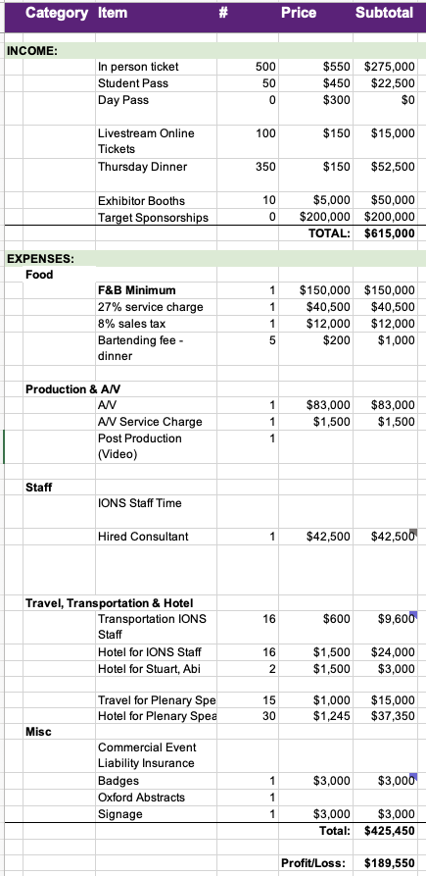
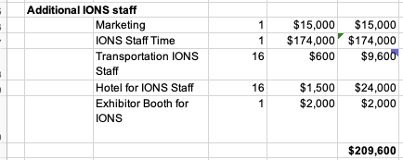
Consciousness Science 2026 budget
Base budget
The budget breaks even at 500 participants (see right).
A worst case scenario with 300 participants results in a $80k surplus.
A best case scenario with 800 participants results in a $354k surplus.
(Previous conferences have had about 700 participants.)
Additional IONS specific optional expenses
The conference could be fully managed by contractor Abi Behar Montefiore, as she has in the past. This is included in the budget and priced at $45k for six months, starting July 1st.
Optional IONS staff full production is estimated to requite an additional $209k.

