Slide 1
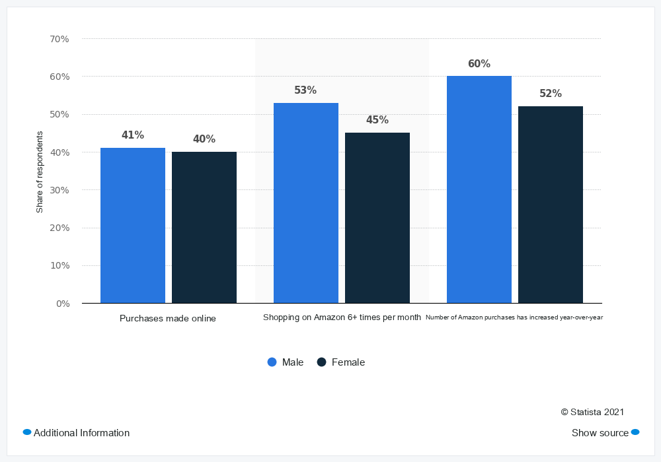
MInfoVisQA
SAME INFORMATION / NEW LANGUAGE
Same information.
Different language.
Can a model still find the same answer?
MInfoVisQA
A multilingual benchmark for
information-rich visual question answering
Real benchmark images. Recorded results.
Charts + visual tables / 24 languages
01 / 06
Notes:
Sources: https://huggingface.co/datasets/arnodjiang/MInfoVisQA ; site/assets/demo/evidence.json and transcript.html. Scene 1 of the 46-second research demonstration. Real images are independent replaceable objects. Text and shapes editable; radar native chart. Observed EN/JA case is one recorded pair; radar is LQA, distinct from fixed-English example.

Slide 2
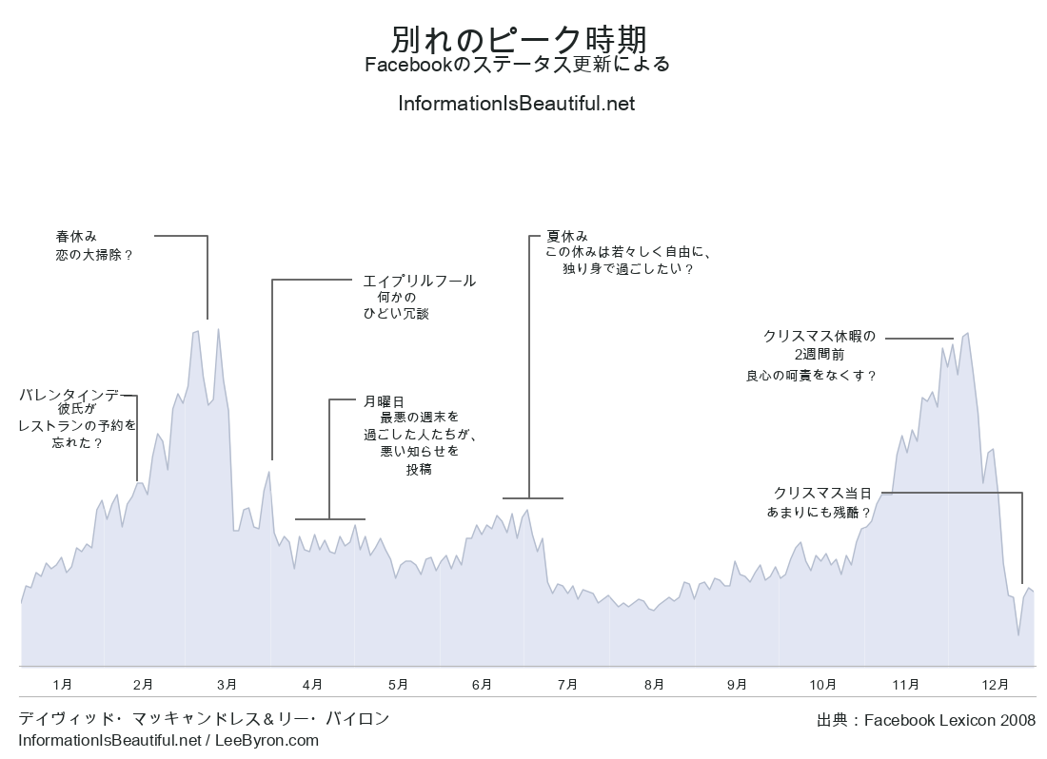
MInfoVisQA
SAME INFORMATION / NEW LANGUAGE
One chart. One question.
On average, which season records the highest number of breakups?
Japanese visual
QUESTION
English
MODEL
GPT-5.6-Luna
REFERENCE
Winter
Only the visual
Autumn
language changes.
Charts + visual tables / 24 languages
02 / 06
Notes:
Sources: https://huggingface.co/datasets/arnodjiang/MInfoVisQA ; site/assets/demo/evidence.json and transcript.html. Scene 2 of the 46-second research demonstration. Real images are independent replaceable objects. Text and shapes editable; radar native chart. Observed EN/JA case is one recorded pair; radar is LQA, distinct from fixed-English example.

Slide 3
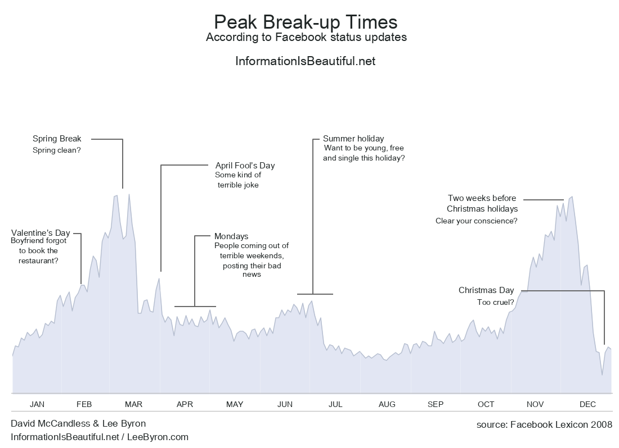
MInfoVisQA
SAME INFORMATION / NEW LANGUAGE
A language switch. A different answer.
Same seed, same English question, same model and recorded run.
English visual
Japanese visual
Winter
Autumn
Reference: Winter | Observed example; not a general language ranking.
ChartQAPro source case: 32a59a1788ab3cc9f351
Charts + visual tables / 24 languages
03 / 06
Notes:
Sources: https://huggingface.co/datasets/arnodjiang/MInfoVisQA ; site/assets/demo/evidence.json and transcript.html. Scene 3 of the 46-second research demonstration. Real images are independent replaceable objects. Text and shapes editable; radar native chart. Observed EN/JA case is one recorded pair; radar is LQA, distinct from fixed-English example.

Slide 4

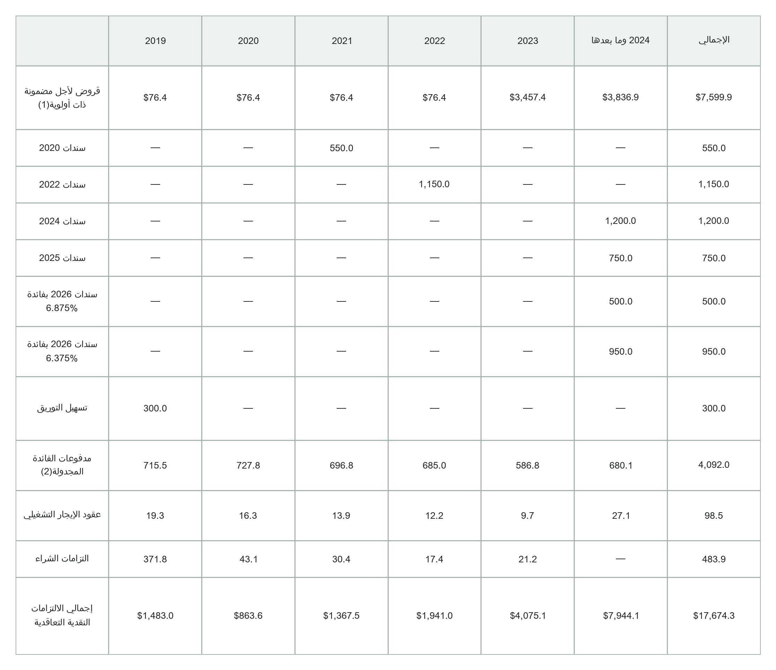
MInfoVisQA
SAME INFORMATION / NEW LANGUAGE
Beyond a single chart.
Parallel chart and visual-table images preserve numerical content and structure.
ChartQA / grouped bars
TableVQA-Bench / visual table
Visual language: Arabic
EN
ZH
JA
KO
FR
DE
ES
PT
RU
AR
HI
IT
NL
PL
TR
VI
ID
TH
SW
FA
UR
BN
TA
TE
Charts + visual tables / 24 languages
04 / 06
Notes:
Sources: https://huggingface.co/datasets/arnodjiang/MInfoVisQA ; site/assets/demo/evidence.json and transcript.html. Scene 4 of the 46-second research demonstration. Real images are independent replaceable objects. Text and shapes editable; radar native chart. Observed EN/JA case is one recorded pair; radar is LQA, distinct from fixed-English example.

Slide 5
MInfoVisQA
SAME INFORMATION / NEW LANGUAGE
Language profiles reveal the variation.
LQA accuracy (%) / question and answer language match the visual language.
24-language mean
GPT-6-Astra
82.8%
Gemini-3.8-Flash
80.4%
GPT-5.6-Luna
74.9%
Qwen3.5-9B
50.4%
Four selected models from the paper.
Means use published, rounded scores.
Charts + visual tables / 24 languages
05 / 06
Notes:
Sources: https://huggingface.co/datasets/arnodjiang/MInfoVisQA ; site/assets/demo/evidence.json and transcript.html. Scene 5 of the 46-second research demonstration. Real images are independent replaceable objects. Text and shapes editable; radar native chart. Observed EN/JA case is one recorded pair; radar is LQA, distinct from fixed-English example.

Slide 6
MInfoVisQA
SAME INFORMATION / NEW LANGUAGE
One benchmark. Two ways to ask.
LQA
Visual = question = answer language
24 settings
XQA
Fixed English or Chinese QA; change the visual
23 + 23 settings
128
24
8,960
25
seed questions
languages
QA configurations
evaluated models
Explore the data. Compare language robustness.
arnodjiang.github.io/MInfoVisQA
Charts + visual tables / 24 languages
06 / 06
Notes:
Sources: https://huggingface.co/datasets/arnodjiang/MInfoVisQA ; site/assets/demo/evidence.json and transcript.html. Scene 6 of the 46-second research demonstration. Real images are independent replaceable objects. Text and shapes editable; radar native chart. Observed EN/JA case is one recorded pair; radar is LQA, distinct from fixed-English example.

