Slide 1
Finding yogis in the US
Capstone project by Wei Fung Hui

Slide 2
Background
Yoga becomes very popular in the US
City dwellers love yoga as it proves to be beneficial to our physical and mental health
Many new business ideas now targeting yoga practioners who are usually young and successful young adult
This study tries to help these new businesses look for an ideal spot to open their first retail shop in the US

Slide 3
Question statement
Where should we open a new shop selling yoga gear or new age products where “yogis” or yoga practictioners would love to buy?
The above points us to look for where can we find a US city and its area with the highest number/concentration of yoga studios (i.e. highest potential customer traffic)

Slide 4
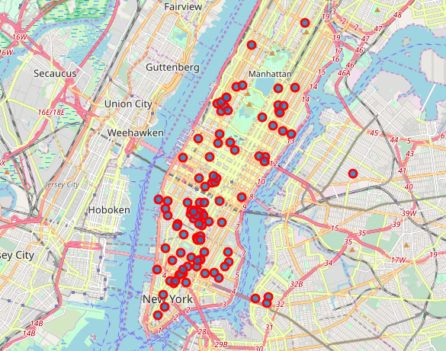
NYC, LA or Chicago?
NYC
foursquare data shows that NYC has 239 studios (#1)
the maps also shows that yoga studious in NYC very densely distributed

Slide 5
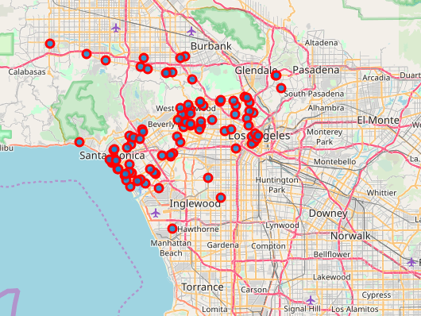
NYC, LA or Chicago?
foursquare data shows that LA has 212 studios (#2)
the maps also shows that yoga studious in LA quite sparsely distributed
LA

Slide 6
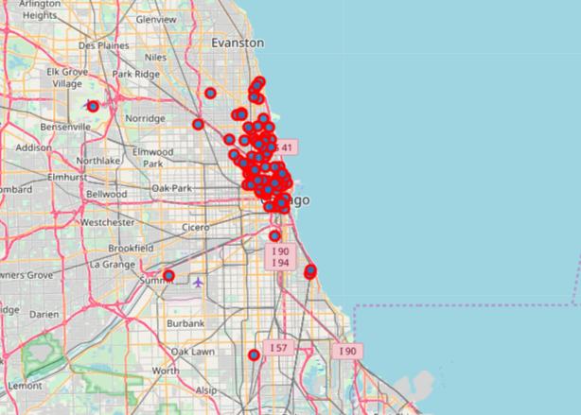
NYC, LA or Chicago?
foursquare data shows that Chicago has 190 studios (#1)
the maps also shows that yoga studious in Chicago are very densely distributed
Chicago

Slide 7
We pick NYC…
It as the highest number of yoga studios
It has the highest concentration of yoga studios – our calculation shows that the average distance of each yoga studios in NYC is 0.025 mile (vs 0.093 mile in LA & 0.042 mile in Chicago)
This implies that we can get the highest customer traffic in NYC

Slide 8
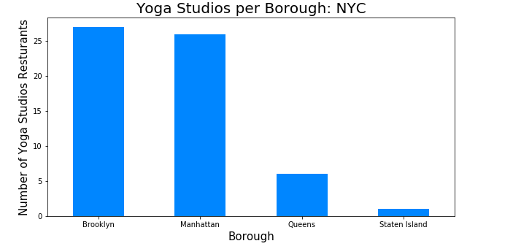
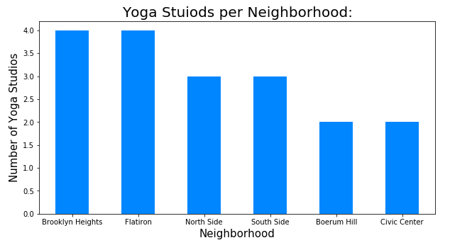
Then, where in NYC?
We try to combine NYC city data with foursquare data to look for the ideal neighbourhoods
The graphs below concludes that Brooklyn Height in Brooklyn could be an ideal spot

Slide 9
Conclusion and possible follow-ups
Based on our previous analysis, Brooklyn Height would be an ideal spot to open a new shop selling yoga gear or new age products given its potential customer traffic (i.e. highest concentration and number of yogis)
Further analysis could also take into account
Rental price
Traffic from tourists
Potential competitors around the region

