Slide 1
Annual software testing symposium #sts18
Denver
August 28th, 2018

Slide 2
Basic Postman API testing
Lessons learned using the basic Postman API tool to automate ReST API messages (micro services) validation along with manual checking the API supported Web, Mobile, other applications.
First, Basic (Free) Postman API features
Second, API Request/Response checks
Third, Runner and Command Line Execution
Fourth, Web spot checks of API Failures
Fifth, Conclusion and Summary

Slide 3
Postman API Overview
Postman API, https://www.getpostman.com, Java Script internet based testing tool that automates building, sending, receiving and evaluating ReST API messages (Plus)
Able to export to file system and Import from file system (Plus)
Developers use and like more than cURL command line (Plus)
Internet documents, videos, training and support (Plus)
Newman, https://www.npmjs.com/package/newman, command line tool to execute Postman API tests with JUNIT results for CI/CD (Jenkins, TeamCity, Scripts) tool integration (Plus)

Slide 4
Validate API and Web overview
Public SaaS ReST API messages and supported Web App.
Web App: http://www.dishanywhere.com/
Provide Dish Network subscribers with Shows and Movies videos for on demand watching. Along with
Promote up-sales and new customers
Subscriber’s Guide and Network Information
Subscriber’s DVR Remote Recording and Watching on demand
Sport Team and League Information
The Dish Network on-demand ReST APIs controls about 90% of what this Web App and similar Mobile App displays, along with providing data to other applications.

Slide 5

Sample Web Site

Slide 6
Postman API request Groups (PLUS)
API requests grouped in Collections, Folders, Sub-Folders
These all have Description, Authorization, Pre-requests Script, Test Script and Requests
Collection: Top level group also has Variables
Request (Send, Request, Get Response)
Folder: Next Level group
Request (Send, Request, Get Response)
Sub-Folders: Next level groups
Request (Send, Request, Get Response)

Slide 7
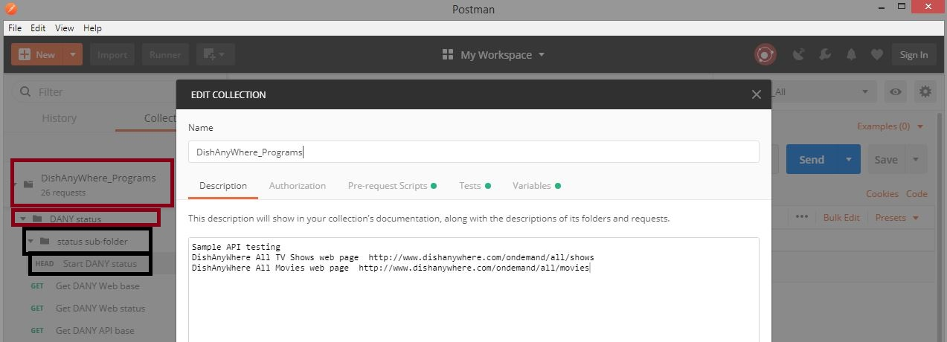
Collection, Folder, Sub-Folder
Collection: DishAnyWhere_Programs
Folder: DANY status
Sub: status sub-folder
Req: HEAD Start DANY status
Req: Get DANY Web base

Slide 8
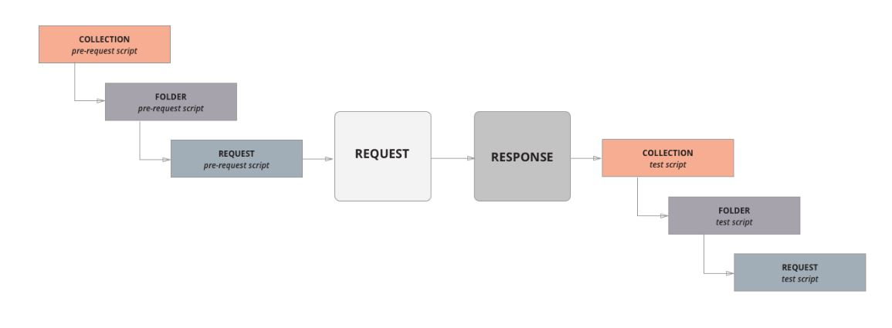
Postman script execution order
Per Request Script Execution Order: https://www.getpostman.com/docs/v6/postman/scripts/intro_to_scripts

Slide 9
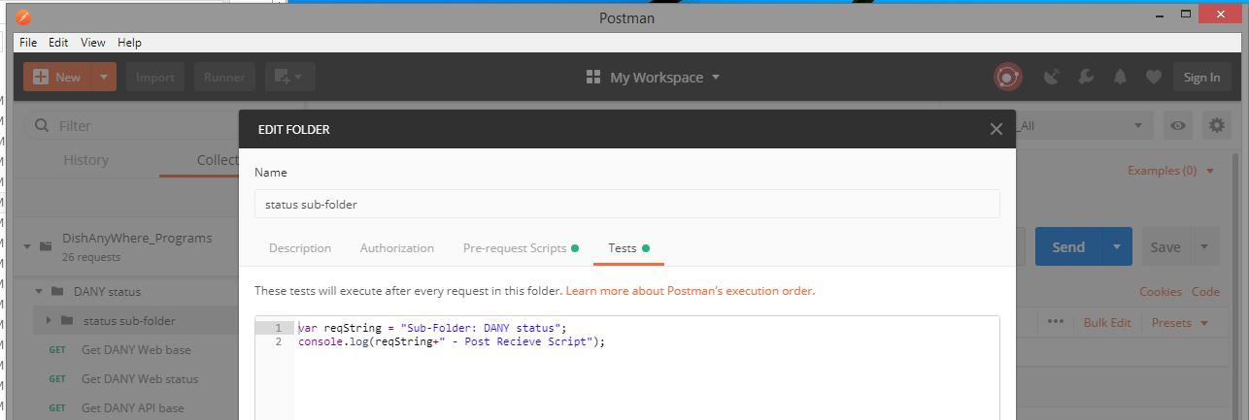
Sub-Folder Test Script
PLUS: console.log(<string>) sends <string> to Postman Console

Slide 10
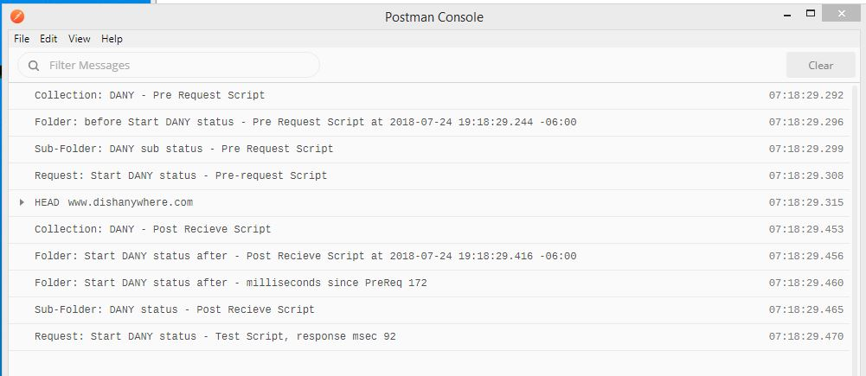
Postman output console (PLUS)
Besides console.log(<string>) also has
Request: Method, URL, Path, Query parameters
Request Headers; Response Headers; Response Body

Slide 11
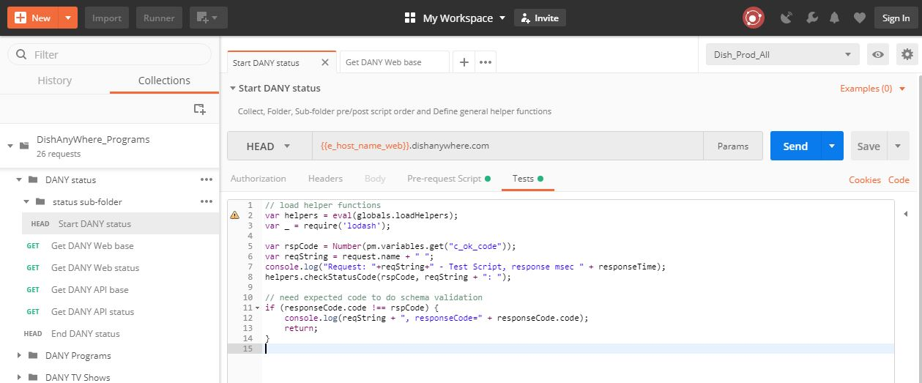
API Request Area
Method, URI, arguments
Authorization, Headers, Body, Pre-request script, Tests script

Slide 12
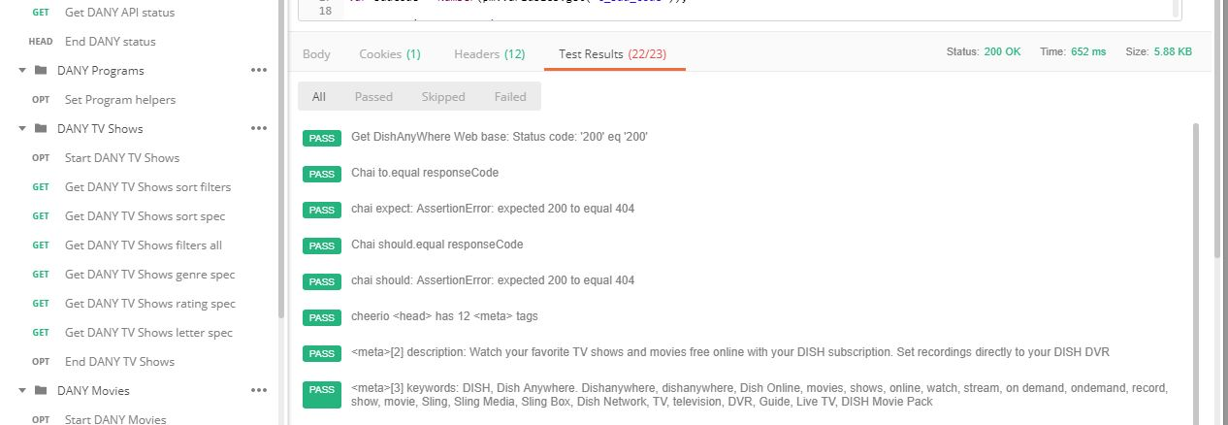
API Response Area
Response Body display in different formats: HTML, XML, JSON, Text.
Default format based on response header: Content Type value
Response Cookies, Headers
Response Test Results
Each test compare result with output tests with AssertionError when False
Via tests[<output string>] = <Boolean>

Slide 13
API Script Variables (PLUS)
API Script Variables and their priority https://www.getpostman.com/docs/v6/postman/environments_and_globals/variables
Global, Collection, Environment : String type (Minus)
Store via to-string functions; Use via from-string functions
Global: share values between Pre-Request and Test scripts
Collection: Initial value via Collection Set,
Only in its Collection (folders, subfolders and request)
Environment: Initial set via Environment. (Minus)
Have multiple Environments for different test execution types
Local: Any JavaScript types only in its Pre-Request or Test script
Data: only Execution Iteration via Runner or Command Line

Slide 14
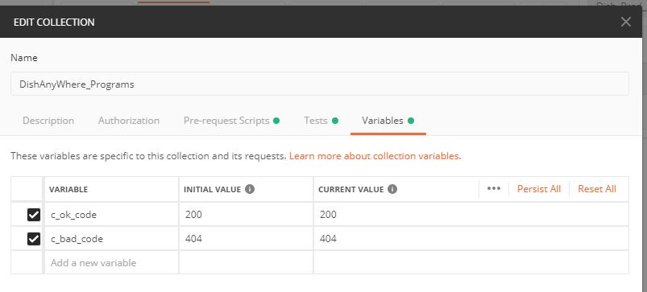
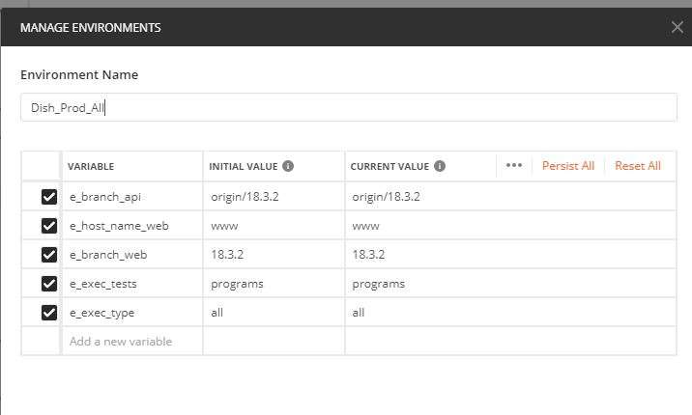
Initial Variable Values (PLUS)

Slide 15
Generate Code Snippets (PLUS)
Generate API Request Code Snippets
Uses current variable key values
Formats: HTTP, cURL, C#, Java, JavaScript, PHP, Python, Ruby
Request: Get DANY Web base
GET {{e_host_name_web}}.dishanywhere.com
curl -X GET \
http://www.dishanywhere.com \
-H 'Cache-Control: no-cache' \
-H 'Postman-Token: dba1dab9-7204-4585-ad49-59b094e11f08'

Slide 16
Request execution Order (PLUS)
https://www.getpostman.com/docs/v6/postman/scripts/branching_and_looping
Normal API Request order is linear from top to bottom Request in Collection, Folder, Sub-Folder
State-machine like execution order
Change this order via postman.setNextRequest(<request_name>)
Where <request_name> the name or ID of the subsequent request and the collection runner will take care of the rest
May be used in the pre-request or the test script. In case of more than one assignment, the last set value is used.
When postman.setNextRequest() is absent in a request, the collection runner defaults to linear execution and moves to the next request
Stop execution,when <request_name> is null

Slide 17
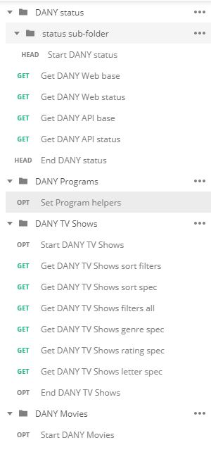
Change execution Order (PLUS)
Request: Set Program helpers (Test Script)
// set next test group via environment variable
switch(environment.e_exec_tests.toLowerCase()) {
case "status":
postman.setNextRequest(null);
break;
case "movies":
postman.setNextRequest("Start DANY Movies");
break;
case "programs":
postman.setNextRequest("Start DANY TV Shows");
break;
case "shows":
postman.setNextRequest("Start DANY TV Shows");
break;
default:
postman.setNextRequest(null);
break;
}

Slide 18
Built-in Java Script packages (PLUS)
https://www.getpostman.com/docs/v6/postman/scripts/postman_sandbox_api_reference
chai for BDD expect and should validation
Request: GET DANY Web base (Test Script)
cheerio for HTML paring and validation
Request: GET DANY Web base (Test Script)
lodash for numbers strings arrays and objects utilities
Request: GET DANY API base (Pre-Request Script, Test Script)
momentum for date-time utilities
Folder: DANY status (Pre-Request Script, Test Script)
tv4 for JSON schema validation
Helper Function: tv4 to define verify schema, pattern-validate functions
Request: Get DANY API base (Pre-Request Script, Test Script)

Slide 19
Create, Use Common Functions
Helper functions definition via Set Global variables (Minus)
Request: Start DANY status (Pre-request script)
// define helper functions
postman.setGlobalVariable("loadHelpers", function loadHelpers() {
let helpers = {};
helpers.CompareSame = function testCompare(compString, compA, compB) {
tests[compString + ": '" + compA + "' is '" + compB +"'"] = compA == compB; };
helpers.CompareEqual = function testEqual(compString, compA, compB) {
tests[compString + ": '" + compA + "' is '" + compB +"'"] = compA === compB; };
. . .
// check response status code value
helpers.checkStatusCode = function verifyStatusCode(
statusCode, msgString = "") {
helpers.CompareEqual(msgString + " Status code",responseCode.code, statusCode); };
. . .
// ...additional helpers
return helpers;
} + '; loadHelpers();');

Slide 20
Create, Use Common Functions
Helper functions usage via eval Global variables (Minus)
Request: Start DANY status (Test script)
// load helper functions
var helpers = eval(globals.loadHelpers);
var _ = require('lodash');
var rspCode = Number(pm.variables.get("c_ok_code"));
var reqString = request.name + " ";
console.log("Request: "+reqString+" - Test Script, response msec "
+ responseTime);
helpers.checkStatusCode(rspCode, reqString + ": ");

Slide 21
Basic Postman API testing
First, Basic (Free) Postman API features
Second, API Request/Response checks
Third, Runner and Command Line Execution
Fourth, Web spot checks of API Failures
Fifth, Conclusion and Summary

Slide 22
Check DISH Web’s Branch release
GET http://www.dishanywhere.com/
Contain web html meta tag with release information
<meta content="Dish Anywhere" name="dany" data-branch="18.3.3" data-hash=". . . ">
Request: Get DANY Web base (Test Script)
var webDataBranch = metaDanyHTML.attr('data-branch');
helpers.CompareSame("Web Deploy Branch: ", webDataBranch, environment.e_branch_web);
postman.setGlobalVariable("g_Web_Branch", webDataBranch);

Slide 23
Check DISH Web’s API URL Path
GET www.dishanywhere.com/health/config_check
Contains web release/build information
"branch": "18.3.3", "hash": ". . . ."
Contains URL for its ReST API messages (micro services) path
"radish_url": "http://radish.dishanywhere.com/",
Request: Get DANY Web status (Test Script)
var webBranch = globals.g_Web_Branch;
helpers.CompareSame(reqString + " branch:",respBody.git.branch, webBranch);
. . .
var danyBaseURL = "http://" + environment.e_host_name_web + ".dishanywhere.com";
helpers.CompareSame(sesString + ".dany_base_url:", session.dany_base_url, danyBaseURL);

Slide 24
Check DISH API Branch Release
GET http://radish.dishanywhere.com/health/config_check
Contains API release/build information
"branch": "origin/18.3.3", "hash": " . . ."
Request: Get DANY API status (Test Script)
var respBody = JSON.parse(responseBody);
var apiBranch = environment.e_branch_api;
helpers.CompareSame(reqString + " branch:",respBody.git.branch, apiBranch);

Slide 25
Dish Web Programs
Displays Subscriber viewable (unlocked) TV Shows or Movies
GET http://www.dishanywhere.com/ondemand/all/shows
GET http://www.dishanywhere.com/ondemand/all/movies
Get Sort By Values (API Request)
GET http://radish.dishanywhere.com/v20/dol/shows/sorts.json
GET http://radish.dishanywhere.com/v20/dol/movies/sorts.json
Get Filter (Genres, Ratings, Starting Letters) Values (API Request)
GET http://radish.dishanywhere.com/v20/dol/shows/filters.json
GET http://radish.dishanywhere.com/v20/dol/movies/filters.json
Display Programs via specific Sort and Filter Value (API Request)

Slide 26
Dish API programs Sorts
GET http://radish.dishanywhere.com/v20/dol/shows/sorts.json
[{"name": "What's Hot", "slug": "whats_hot”},
{"name": "Recently Added", "slug": "recent"},
{"name": "Title", "slug": "name"},
{"name": "Most Popular", "slug": "most_popular"}
]
GET http://radish.dishanywhere.com/v20/dol/movies/sorts.json
[{"name": "Release Date", "slug": "date"},
{"name": "Critics Rating", "slug": "rating"},
{"name": "Tomatometer Rating", "slug": "tomatometer"},
{"name": "Title", "slug": "name"},
{"name": "Most Popular", "slug": "most_popular"}
]

Slide 27
Dish API programs Filters
GET http://radish.dishanywhere.com/v20/dol/shows/filters.json
{"genres":[{"name": "All","slug": "all"},{"name": "Action","slug":”action"},
... , {"name": "Thriller", "slug": "thriller"}],
"ratings":[{"name": "All","slug": "all"},{"name": "TVY","slug":"tvy"},
... , {"name":"TV14","slug":"tv14"},{"name":"TVMA", "slug":"tvma"}],
"a-z:[{"name":"A", "slug":"a"},{"name":"B", "slug":"b"},
... , {"name":"Z","slug":"z"},{"name":"#","slug":"123"}]
}
GET http://radish.dishanywhere.com/v20/dol/movies/filters.json
{"genres":[{"name":"All","slug":"all"},{"name":"Action","slug":"action"},
... , {"name":"Thriller","slug":"thriller"}],
ratings":[{"name":"All","slug":"all"},{"name":"G","slug":"g"},
... , {"name":"NC17","slug":"nc17"},{"name":"NR","slug":"nrao"}],
a-z":[{"name":"A","slug":"a"},{"name":"B","slug":"b"},
... , {"name":"Z","slug":"z"},{"name":"#","slug":"123"}]}

Slide 28
Dish Display Programs
Display Programs via specific Sort and Filter Values (API Request)
Via Only by Sort Value
GET http://radish.dishanywhere.com/v20/dol/shows.json?sort=name
GET http://radish.dishanywhere.com/v20/dol/movies.json?sort=name
Via Only by Filter Genre Value
GET http://radish.dishanywhere.com/v20/dol/shows.json?genres=newscast
GET http://radish.dishanywhere.com/v20/dol/movies.json?genres=drama
Via Only by Filter Rating Value
GET http://radish.dishanywhere.com/v20/dol/shows.json?ratings=tvy7
GET http://radish.dishanywhere.com/v20/dol/movies.json?ratings=r
Via Only by Filter Starting Letter Value
GET http://radish.dishanywhere.com/v20/dol/shows.json?a-z=p
GET http://radish.dishanywhere.com/v20/dol/movies.json?a-z=s

Slide 29
Check Dish API Programs
General API Response:
Response Code Ok
Positive item count (Allow Zero for special cases)
Program General: (General TV Shows, Movies)
Name has positive length
Type is Program with Kind as Show or Movies via Request
Description at least 5 characters long
Rating array values same as Rating List of array values
Has at least 1 Genre
Has at least 1 Network (Channel)
Specific Sort, Genre, Rating, Starting Letter(Specific Sort, Filter)
Sort: Items in request Order (only Title sorted request)
Genre: Each Item’s Genre Array has the Filter Genre
Rating: Each Item’s Rating Array has the Filter Rating
Starting Letter: Each item’s Name begins with the Filter Letter

Slide 30
Basic Postman API testing
First, Basic (Free) Postman API features
Second, API Request/Response checks
Third, Runner and Command Line Execution
Fourth, Web spot checks of API Failures
Fifth, Conclusion and Summary

Slide 31
POSTMAN Collection Runner (PLUS)
Execute Collection, Folder, Sub-Folder Requests with a specific Environment with for N iteration and Data-file.
Has Recent Runs with
Iteration counter
API Request
Pass/Failed Test Results
Filter for Passed, Failed or Both

Slide 32
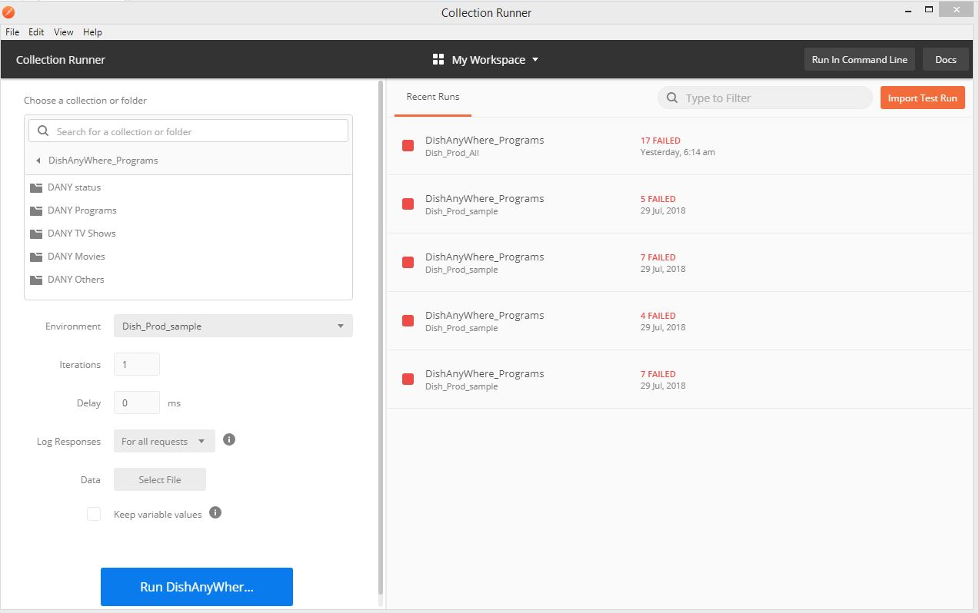
Collection Runner: Setup (PLUS)

Slide 33
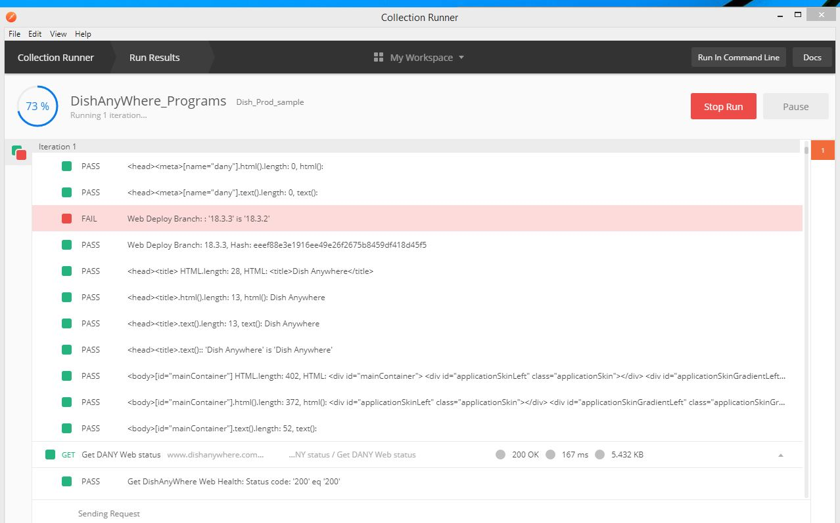
Collection Runner: executing

Slide 34
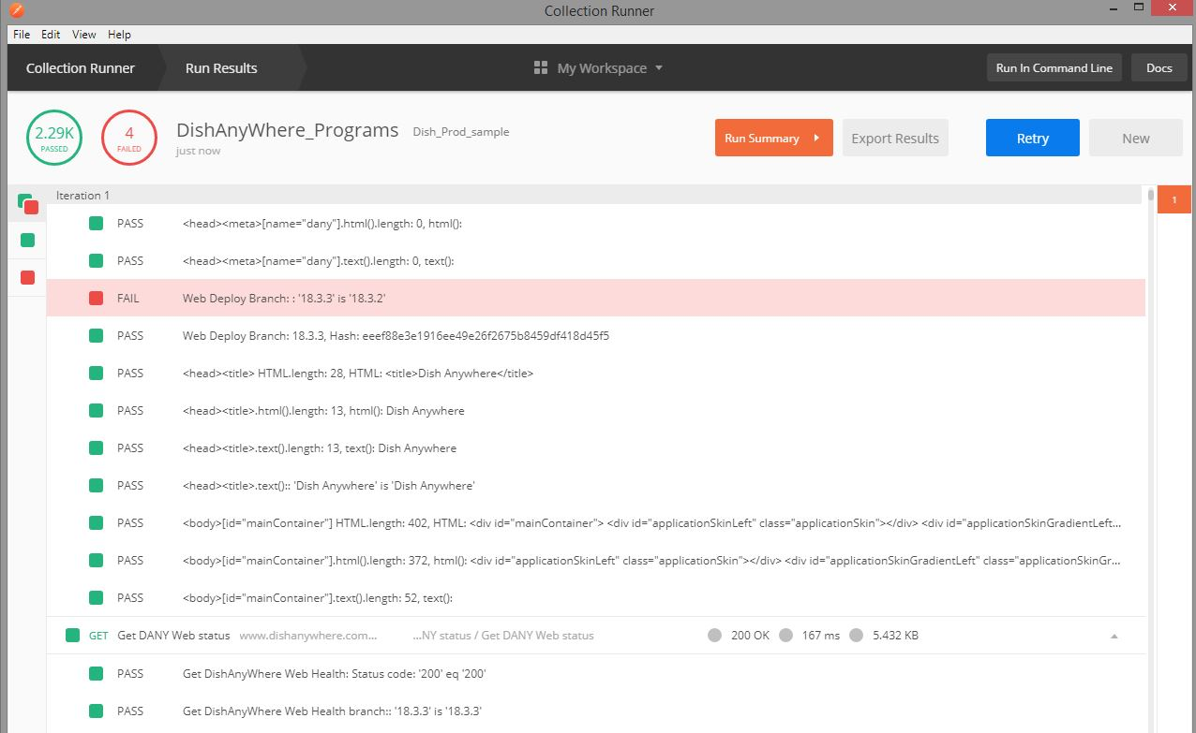
Collection Runner: DONE (PLUS)

Slide 35
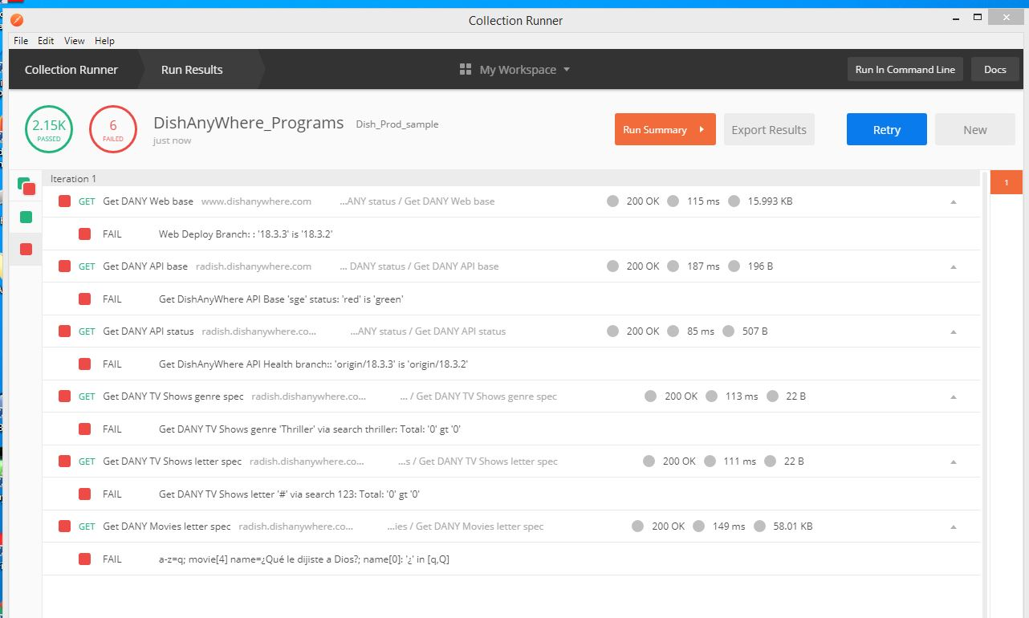
Collection Runner: FAIL (PLUS)

Slide 36
Newman Command Line (PLUS)
Execute Collection Requests with a specific Environment generating reports (Unix/Linux Shell version)
newman run $postman_run -e $post_out_env -r junit,cli --timeout-request $req_timeout
Have Problem maintaining many Postman Environment files (Minus)
Branch Build/Release ID (Web, API, tools)
What APIs to test (Status, Shows, Movies, Networks)
Where is API URL target (Production, Pre-Prod, Beta, SQA-test)
Execution type (Smoke, Install, Feature, Regression)
Noticed: Postman Environment file are text editor JSON readable
"values": [
{"enabled": true,"key":"e_branch_web","value":"18.3.2","type":"text“},
{"enabled": true,"key":"e_branch_api","value":"origin/18.3.2","type":"text“},
. . . ]

Slide 37
Newman Command Line
Solution to maintaining many Postman Environment files (Plus)
Write program that inputs a Postman Environment file and CSV Key-Value pair file
Outputs a Postman Environment File with changing any found Key’s to have their pair value
Example CSV Key-Pair file
row,Variable,Value,Meaning
1,e_branch_web,18.3.0,web version
2,e_branch_api,origin/18.3.0,api version
Output Postman Environment File
"values": [
{"enabled": true,"key":"e_branch_web","value":"18.3.0","type":"text“},
{"enabled": true,"key":"e_branch_api","value":"origin/18.3.0","type":"text“},
. . . ]
Found easier to maintain many CSV Key-Pair files (Plus)

Slide 38
Newman Executing (PlUS)
Get DANY API status
┌
│ 'Collection: DANY - Pre Request Script'
│ 'Folder: before Get DANY API status - Pre Request
│ Script at 2018-08-12 20:09:14.759 -06:00'
└
GET radish.dishanywhere.com/health/config_check [200 OK, 1.02KB, 124ms]
┌
│ 'Collection: DANY - Post Receive Script'
│ 'Folder: Get DANY API status after - Post Receive Script at 2018-08-12 20:09:14.926 -06:00'
│ 'Folder: Get DANY API status after - milliseconds since PreReq 167'
└
√ Get DishAnyWhere API Health: Status code: '200' eq '200'
3. Get DishAnyWhere API Health branch:: 'origin/18.3.3' is 'origin/18.3.0'

Slide 39
Newman Summary Results (PLUS)
Postman start at Sun, Aug 12, 2018 8:09:08 PM
┌─────────────────────────┬──────────┬──────────┐
│ │ executed │ failed │
├─────────────────────────┼──────────┼──────────┤
│ iterations │ 1 │ 0 │
├─────────────────────────┼──────────┼──────────┤
│ requests │ 6 │ 0 │
├─────────────────────────┼──────────┼──────────┤
│ test-scripts │ 19 │ 0 │
├─────────────────────────┼──────────┼──────────┤
│ prerequest-scripts │ 19 │ 0 │
├─────────────────────────┼──────────┼──────────┤
│ assertions │ 47 │ 3 │
├─────────────────────────┴──────────┴──────────┤
│ total run duration: 2s │
├───────────────────────────────────────────────┤
│ total data received: 19.23KB (approx) │
├───────────────────────────────────────────────┤
│ average response time: 134ms │
└───────────────────────────────────────────────┘
Postman ended at Sun, Aug 12, 2018 8:09:15 PM

Slide 40
Newman Failure Details (PLUS)
Used: dish_chg_vars.csv
Postman start at Sun, Aug 12, 2018 8:09:08 PM
# failure detail
1. AssertionError Web Deploy Branch: : '18.3.3' is '18.3.0'
expected false to be truthy
at assertion:14 in test-script
inside "DANY status / Get DANY Web base"
2. AssertionError Get DishAnyWhere API Base 'sge' status: 'red' is 'green'
expected false to be truthy
at assertion:3 in test-script
inside "DANY status / Get DANY API base"
3. AssertionError Get DishAnyWhere API Health branch:: 'origin/18.3.3' is 'origin/18.3.0'
expected false to be truthy
at assertion:1 in test-script
inside "DANY status / Get DANY API status"
Postman ended at Sun, Aug 12, 2018 8:09:15 PM

Slide 41
Newman JUNIT XML Result file (PLUS)
<testcase name="Web Deploy Branch: : '18.3.1' is '18.1.1'" time="0.282" classname="JUnitXmlReporter.constructor">
<failure type="AssertionFailure">
<![CDATA[Failed 1 times.]]>
<![CDATA[Collection JSON ID: fdeb44ba-76ea-424b-9a8c-39645bca44b9.]]>
<![CDATA[Collection name: DishAnyWhere_Programs.]]>
<![CDATA[Request name: DANY status / Get DANY Web base.]]>
<![CDATA[Test description: Web Deploy Branch: : '18.3.1' is '18.1.1'.]]>
<![CDATA[Error message: expected false to be truthy.]]>
<![CDATA[Stacktrace: AssertionError: expected false to be truthy
at Object.eval sandbox-script.js:15:2).]]>
</failure>
</testcase>

Slide 42
Basic Postman API testing
First, Basic (Free) Postman API features
Second, API Request/Response checks
Third, Runner and Command Line Execution
Fourth, Web spot checks of API Failures
Fifth, Conclusion and Summary

Slide 43
API Programs Sample Failures
Used: dish_progs_smp_vars.csv
Failures not reported on previous slides
Postman start at Sun, Aug 12, 2018 8:24:26 PM
# failure detail
3. AssertionError a-z=q; show[4] name=¿Quién Da Más?; name[0]: '¿' in [q,Q]
4. AssertionError a-z=q; show[5] name=¿Quién da más?; name[0]: '¿' in [q,Q]
5. AssertionError sort=name; movie[8] name=1 Message; desc.length: '0' ge '5'
6. AssertionError a-z=q; movie[4] name=¿Qué le dijiste a Dios?; name[0]: '¿' in [q,Q]
Postman ended at Sun, Aug 12, 2018 8:25:17 PM

Slide 44
API Programs All Failures
Used: dish_progs_all_vars.csv
Failures not reported on previous slides
Postman start at Sun, Aug 12, 2018 8:29:44 PM
# failure detail
04. AssertionError sort=name; show[1] name=10 Minute Solutions; desc.length: '0' ge '5'
05. AssertionError sort=name; show[3] name=100 Code; desc.length: '0' ge '5'
06. AssertionError sort=name; show[6].name > show[5].name: '12 Corazones' gt '12 Corazones'
07. AssertionError sort=name; show[6].search > show[5].search: '12_corazones_e1570408' gt '12_corazones_e32940'
08. AssertionError Get DANY TV Shows genre 'Thriller' via search thriller: Total: '0' gt '0'
11. AssertionError Get DANY TV Shows letter '#' via search 123: Total: '0' gt '0'
13. AssertionError a-z=l; movie[9] name= La Casa De Beatriz; name[0]: ' ' in [l,L]
15. AssertionError Get DANY Movies letter '#' via search 123: Total: '0' gt '0'
Postman ended at Sun, Aug 12, 2018 8:34:03 PM

Slide 45
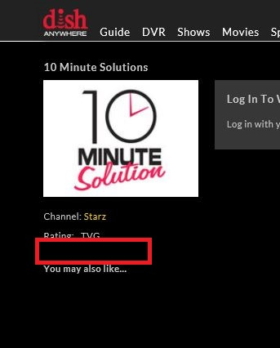
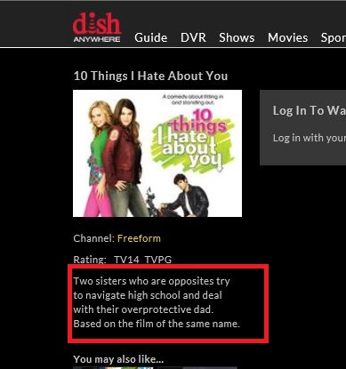
TV SHOW: 10 Minute Solutions
AssertionError sort=name; show[1] name=10 Minute Solutions; desc.length: '0' ge '5'

Slide 46
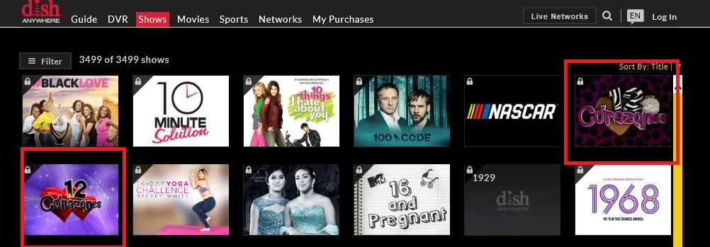
TV SHOW: '12 Corazones'
AssertionError sort=name; show[6].name > show[5].name: '12 Corazones' gt '12 Corazones'
AssertionError sort=name; show[6].search > show[5].search: '12_corazones_e1570408' gt '12_corazones_e32940'

Slide 47
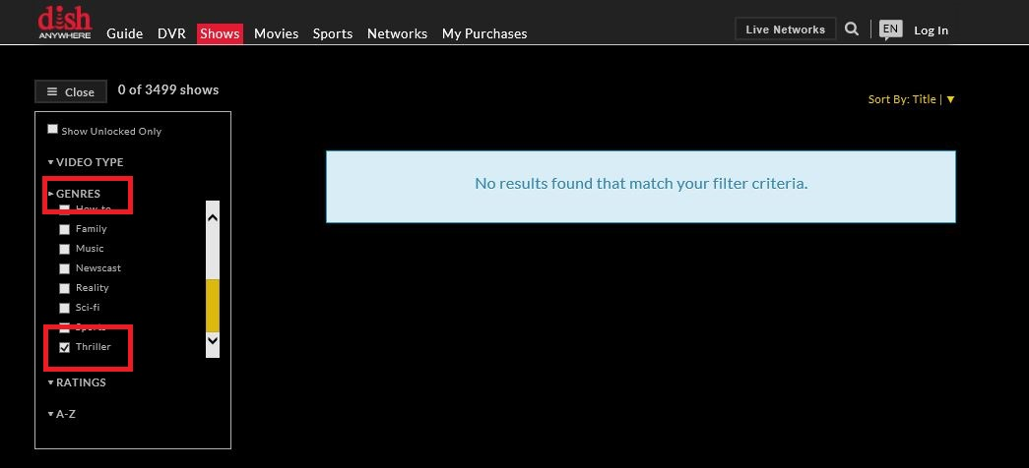
TV SHOW: Genre Thriller
AssertionError Get DANY TV Shows genre 'Thriller' via search thriller: Total: '0' gt '0'

Slide 48
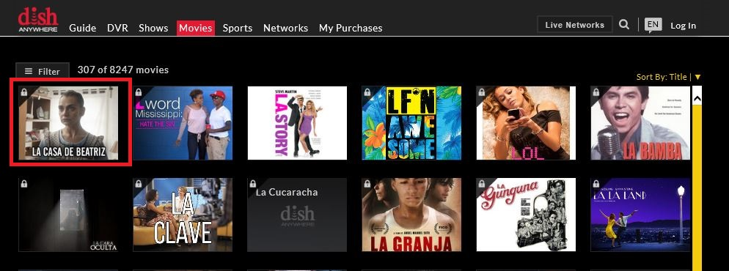
Movie : Starts letter L
AssertionError a-z=l; movie[9] name= La Casa De Beatriz; name[0]: ' ' in [l,L]

Slide 49
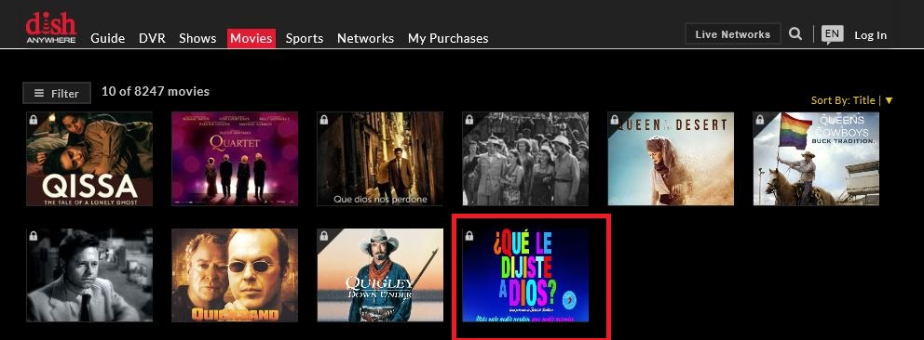
Movie : Starts letter Q
AssertionError a-z=q; movie[4] name=¿Qué le dijiste a Dios?; name[0]: '¿' in [q,Q]

Slide 50
Movie : Starts letter Q
AssertionError a-z=q; movie[4] name=¿Qué le dijiste a Dios?; name[0]: '¿' in [q,Q]

Slide 51
Basic Postman API testing
First, Basic (Free) Postman API features
Second, API Request/Response checks
Third, Runner and Command Line Execution
Fourth, Web spot checks of API Failures
Fifth, Conclusion and Summary

Slide 52
Basic Postman API: Plus
Java Script: builds, sends, receives, evaluates API ReST messages
Export to File System, Import from File System
Developers use it and like more than cURL command line
Internet documents, videos, training and support
Command Line Execution tool
Console Output, Summary Results, Failure Details
Support Ci/CD Junit XML result format
Environment exported format supports variable value changes
Groups API Requests in to Folder-like Hierarchy
Support Output Console information
Different variable types (Global, Environment, Collection, Local, Data)
Initialize Global, Environment, Collection variable values
Generate Code Snippets in different languages
State Machine Request Execution order with override ability
Built-in Popular Java Script Node Packages
Tool based Collection Execution: Results Pass, Fail summary

Slide 53
Basic Postman API: Conclusion
Minus:
Global, Environment, Collection variable stored as string
Store via to-string functions (example: JSON.stringify, toString)
Use via from-string functions (example: JSON.parse, parseInt)
Helper Variables that define common functions and libraries
Paid Versions support libraries and other shareable functions
Would like ability to load non-built-in Java Node Packages and personal packages
Too Many Environments (group of Environment variables)
Convert Environment via CSV files before Command Line execution
Prefer many CSV files to many Environments
Conclusion:
Overall Very Good Tool for API ReST testing
Major problem: Helper Variables for common functions and libraries
DONE
Slides, Postman Collection, Shell Scripts, etc.
https://github.com/arnold-miller0/Postman-Denver-Aug-2018

