Slide 1
Simple Random vs. Cluster
By Arnold Miller, Sr. SDET (SW QA-Tester)
ASQ Boulder (Section 1313)
Boulder, CO, USA
23 Jan 2020

Slide 2
Sampling Methods
Sampling method refers to the way that observations are selected from a population to be in the sample for a survey sample
https://stattrek.com/survey-research/sampling-methods.aspx
The reason for conducting a sample survey is to estimate the value of some attribute of a population.
Population parameter. A population parameter is the true value of a population attribute.
Sample statistic. A sample statistic is an estimate, based on sample data, of a population parameter

Slide 3
Non-Probability Sample Methods
Do not know the probability that each population element will be chosen,
Cannot be certain that each population element has a non-zero chance of being chosen.
Two Main types are:
Voluntary sample. Made up of people who self-select into the survey. Often, these folks have a strong interest in the main topic of the survey.
Convenience sample. Made up of people who are easy to reach.

Slide 4
Probability Sample Methods
Each population element has a known (non-zero) chance of being chosen for the sample.
Main Sampling Methods
Simple Random
Stratified
Cluster
Multistage
Systematic Random

Slide 5
Simple Random Sampling
Property
The population consists of N objects.
The sample consists of n objects.
All possible samples of n objects are equally likely to occur
Example: Lottery method.
Each of the N population members is assigned a unique number.
The numbers are placed in a bowl and thoroughly mixed.
A blind-folded researcher selects n numbers.
Survey only members that have the selected numbers

Slide 6
Stratified Sampling
Property
Population is divided into groups (strata), based on some characteristic.
Then, within each group, a probability sample (like: Simple Random Sampling) is selected.
In stratified sampling, the groups are called strata.
The sample includes elements from each stratum.
Example: US National Elections
Divide the population into groups or strata, based on geography like US States
Within each stratum use simple randomly select survey respondents.

Slide 7
Cluster Sampling
Property
Every member of the population is assigned to one, and only one, group.
Each group is called a cluster.
A sample of clusters is chosen, using a probability method (like: Simple Random Sampling).
Survey only individuals within sampled clusters
the sample includes elements only from sampled clusters
Example: Items in Group
Each Group has 10 times.
Select Groups via Simple random sampling
Survey all or simple random items in Selected Group

Slide 8
Multistage Sampling
Property
Select a sample by using combinations of different sampling methods.
Example
Stage 1, Use cluster sampling to choose clusters from a population.
Stage 2, Use simple random sampling to select a subset of elements from each chosen cluster for the final sample.

Slide 9
Systematic Random Sampling
Property
Create a list of every member of the population.
From the list, we randomly select the first sample element from the first k elements on the population list.
Thereafter, we select every kth element on the list.
Every possible sample of n elements is not equally likely (not a simple random sample)
Example
Have 24,000 items in some order
Random select first item from first 50 items
Second select item is first random plus 50; Third select item is first random plus 100; etc.
Survey has total 480 items (Which is 24,000 / 50)

Slide 10
Confidence Interval
Best for Simple Random Samples
Plus or Minus error value reported based on
Confidence level: Percentage certain for the interval. Normal 95% or 99%
Sample Size: numbers of items surveyed. The more the better but no linear
Population Size: Total number that could be surveyed
Percentage: Likely outcome via population size
https://www.surveysystem.com/sscalc.htm
Sample | Population | Percent | 95% Cnf | 99% Cnf
600 | 6,300 | 50% | 3.81% | 5.01%
600 | 63,000 | 50% | 3.98% | 5.24%
600 | 630,000 | 50% | 4.00% | 5.26%
600 | 6,300,000 | 50% | 4.00% | 5.27%

Slide 11
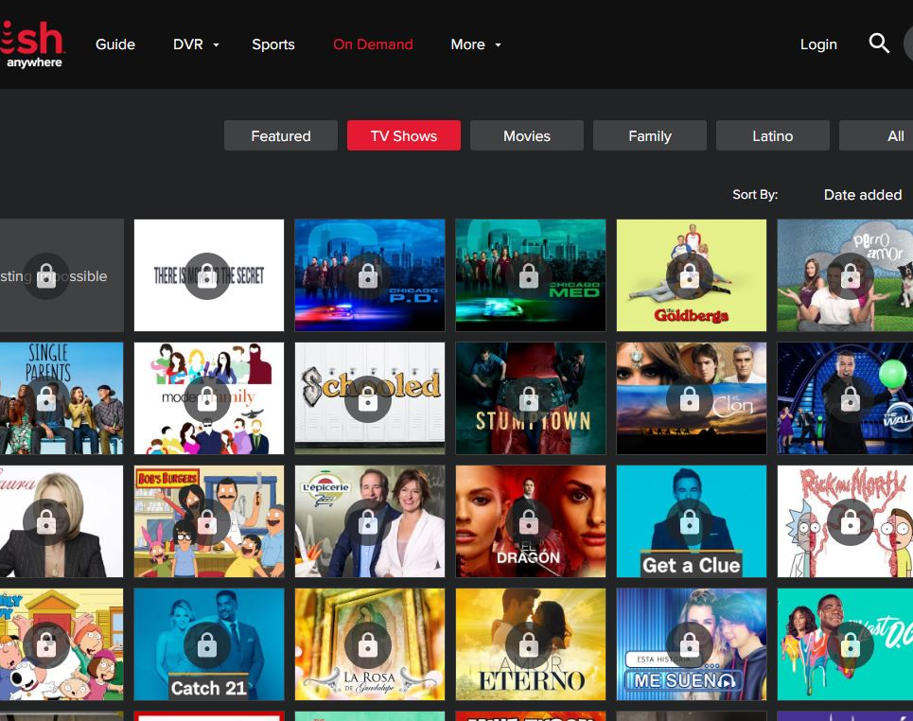
Example: Compare Probability Sample Methods
On-Demand TV Shows (about 6,300 total population)
Web Site displays TV Shows in sort groups of 100 (like: Popular, Title, Critics, Date added, Relevance)
Other Groupings (Genre, View Rating, Start Letter)
Evaluate TV Shows for attributes: Description, View Rating, Genre, Network, Image
Percentage has all these attributes
Percentage missing each one attribute
No Description
No View Rating
No Genre
No Network
No Image

Slide 12
Example: Sampling Models
Total Population (sort: Title) 63 groups of 100, just like Web site
Simple Random 600 individual items: Execution Baseline
Stratified Start Letter with pro-rated Simple Random individual items
600 items pro-rated via Strata population with minimum 1 per Strata
Cluster 60 Simple Random groups of 10. Evaluate all items in group
Convent first 100 each Sort; first 50 each Genre, View Rating; first 25 each Start Letter
Genre (Action, Comedy, Drama, How-to, Family, Sci-Fi, Sports, etc.)
View Rating (G, PG, PG-13, R, NR, TV-Y, TV-G, TV-PG, TV-14, TV-MA)

Slide 13
Execution time vs Random Base line
Sampling Methods (Summary)
Total Populate (Sort: Title) All 6300 items (120% baseline)
Simple Random (Sort: Title) Execution Baseline (average 5 min 30 sec)
Stratified (Sort: Title) 600 random pro-rated Start Letter (110% baseline)
Cluster (Sort: Title) 60 Simple Random groups of 10; (25% baseline)
Convent 100 each Sort; 50 each Genre, View Rating; 25 each Letter (85% baseline)

Slide 14
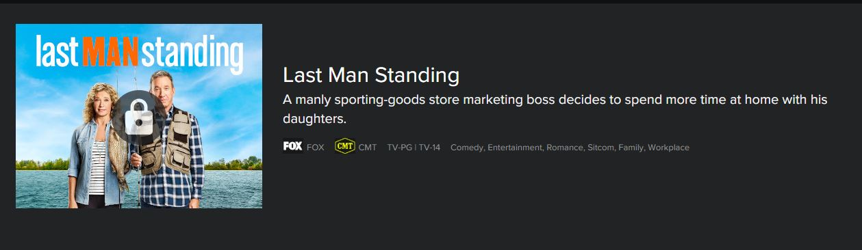
Example: Attribute – Have All
Historically: 80.8% have Description, View Rating, Genre, Network, Image
Sample | Population | Percent | 95% Cnf | 99% Cnf
600 | 6,300 | 80.8% | 3.00% | 3.95%

Slide 15

Example: Attribute – No Description
Historically: 17.3% are missing Description
Sample | Population | Percent | 95% Cnf | 99% Cnf
600 | 6,300 | 17.3% | 2.88% | 3.79%

Slide 16
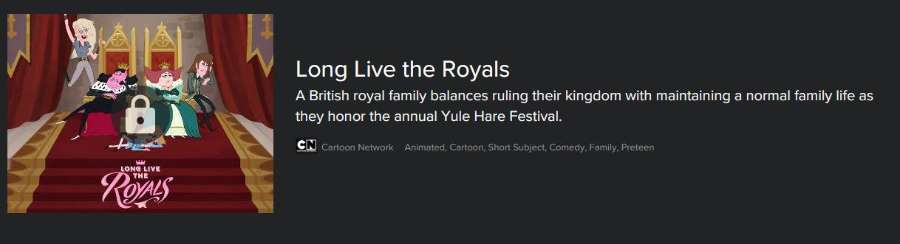
Example: Attribute – No View Rating
Historically: 1.0% are missing View Rating
Sample | Population | Percent | 95% Cnf | 99% Cnf
600 | 6,300 | 1.0% | 0.76% | 1.00%

Slide 17

Example: Attribute – No Genre
Historically: 1.8% are missing Genre
Sample | Population | Percent | 95% Cnf | 99% Cnf
600 | 6,300 | 1.8% | 1.01% | 1.33%

Slide 18

Example: Attribute – No Network
Historically: 1.0% are missing Network
Sample | Population | Percent | 95% Cnf | 99% Cnf
600 | 6,300 | 1.0% | 0.76% | 1.00%

Slide 19
Cluster: Issue (19 Jan 2020)
No Network: 3 same TV Show Titles have 13 of 15;
No Rating: 2 same TV Show Titles have 9 of 12;
No Image: 1 same TV Show Title has 4 of 12;
Missing | Franchise Id | TV Show Title
Network, Rating | building_off_the_grid_e2139260 | Building Off the Grid
Network, Rating | building_off_the_grid_e2697018 | Building Off the Grid
Network, Rating, Image | building_off_the_grid_e2793630 | Building Off the Grid
Network, Rating | building_off_the_grid_e3006918 | Building Off the Grid
Network, Desc, Rating, Image | building_off_the_grid_e3033997 | Building Off the Grid
Network, Desc, Rating, Image | building_off_the_grid_e2939102 | Building Off the Grid
Network, Image | building_off_the_grid_e3454375 | Building Off the Grid
Network, Rating | building_off_the_grid_e2966006 | Building Off the Grid

Slide 20

Example: Attribute – No Image
Historically: 1.6% are missing Image
Sample | Population | Percent | 95% Cnf | 99% Cnf
600 | 6,300 | 1.6% | 0.96% | 1.26%

Slide 21
Conclusion and Thanks
Via this Compare and Analysis
Prefer Cluster (sort: Title) 75% less time than Simple Random
More Cluster Analysis via Sort: Popular, Date added, Critics, Relevance
Continue Simple Random or Stratified
When Cluster outside 95% limits
At least weekly to spot check Cluster
Thanks
Arnold Miller, Sr. SDET (Sw. QA-Tester)
Email: arnold.miller0@gmail.com
Linkedin: http://www.linkedin.com/pub/arnold-miller/13/47b/a87

