Slide 1
Validate ML/AI via Statistical Sampling
By Arnold Miller, Sr. SDET (SW QA-Tester)
Agile Testing & Test Automation Summit
Denver, CO, USA
19 Dec 2019

Slide 2
Machine Learning / Artificial Intelligence
Examples
Self-Driving Vehicle; Hazard Warnings
Disability Vision, Sound Recognition
Security Physical, Cyber; Threat Detection
Equipment and Health Diagnostics
Election Voting Predictions
Call Center, Customer Care Analysis

Slide 3
Validation via Sampling Methods
Sampling method refers to the way that observations are selected from a population to be in the sample for a survey sample
https://stattrek.com/survey-research/sampling-methods.aspx
The reason for conducting a sample survey is to estimate the value of some attribute of a population.
Population parameter. A population parameter is the true value of a population attribute.
Sample statistic. A sample statistic is an estimate, based on sample data, of a population parameter

Slide 4
Non-Probability Sample Methods
Do not know the probability that each population element will be chosen,
Cannot be certain that each population element has a non-zero chance of being chosen.
Two Main types are:
Voluntary sample. Made up of people who self-select into the survey. Often, these folks have a strong interest in the main topic of the survey.
Convenience sample. Made up of people who are easy to reach.

Slide 5
Probability Sample Methods
Each population element has a known (non-zero) chance of being chosen for the sample.
Main Sampling Methods
Simple Random
Stratified
Cluster
Multistage
Systematic Random

Slide 6
Simple Random Sampling
Property
The population consists of N objects.
The sample consists of n objects.
All possible samples of n objects are equally likely to occur
Example: Lottery method.
Each of the N population members is assigned a unique number.
The numbers are placed in a bowl and thoroughly mixed.
A blind-folded researcher selects n numbers.
Survey only members that have the selected numbers

Slide 7
Stratified Sampling
Property
Population is divided into groups (strata), based on some characteristic.
Then, within each group, a probability sample (like: Simple Random Sampling) is selected.
In stratified sampling, the groups are called strata.
The sample includes elements from each stratum.
Example: US National Elections
Divide the population into groups or strata, based on geography like US States
Within each stratum use simple randomly select survey respondents.

Slide 8
Cluster Sampling
Property
Every member of the population is assigned to one, and only one, group.
Each group is called a cluster.
A sample of clusters is chosen, using a probability method (like: Simple Random Sampling).
Survey only individuals within sampled clusters
the sample includes elements only from sampled clusters
Example: Items in Group
Each Group has 10 times.
Select Groups via Simple random sampling
Survey all or simple random items in Selected Group

Slide 9
Multistage Sampling
Property
Select a sample by using combinations of different sampling methods.
Example
Stage 1, Use cluster sampling to choose clusters from a population.
Stage 2, Use simple random sampling to select a subset of elements from each chosen cluster for the final sample.

Slide 10
Systematic Random Sampling
Property
Create a list of every member of the population.
From the list, we randomly select the first sample element from the first k elements on the population list.
Thereafter, we select every kth element on the list.
Every possible sample of n elements is not equally likely (not a simple random sample)
Example
Have 24,000 items in some order
Random select first item from first 50 items
Second select item is first random plus 50; Third select item is first random plus 100; etc.
Survey has total 480 items (Which is 24,000 / 50)

Slide 11
Confidence Interval
Best for Simple Random Samples
Plus or Minus error value reported based on
Confidence level: Percentage certain for the interval. Normal 95% or 99%
Sample Size: numbers of items surveyed. The more the better but no linear
Population Size: Total number that could be surveyed
Percentage: Likely outcome via population size
https://www.surveysystem.com/sscalc.htm
Sample | Population | Percent | 95% Cnf | 99% Cnf
620 | 6,500 | 50% | 3.74% | 4.93%
620 | 65,000 | 50% | 3.92% | 5.16%
620 | 650,000 | 50% | 3.93% | 5.18%
620 | 6,500,000 | 50% | 3.94% | 5.18%

Slide 12
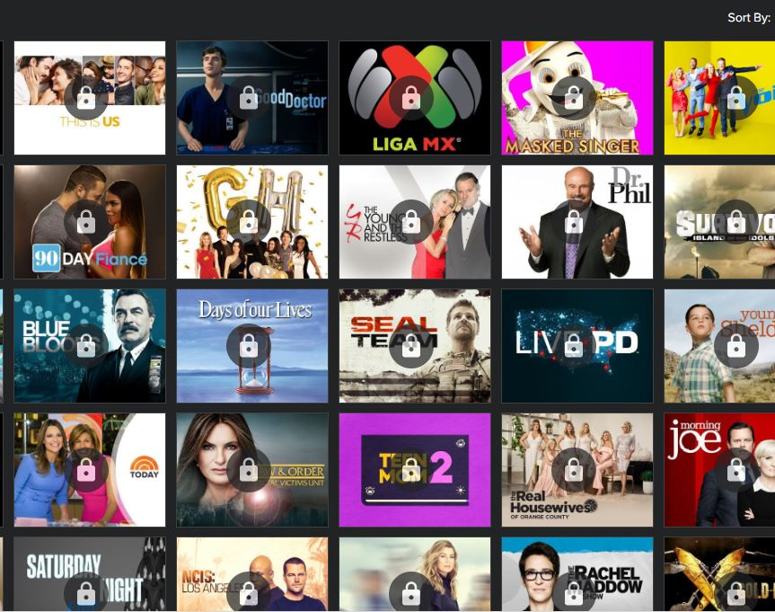
Example: Compare Probability Sample Methods
On-Demand TV Shows (about 6,500 total population)
Web Site displays TV Shows in groups of 100 (Popular, Title, Critics, Added Date)
Evaluate TV Shows for attributes: Description, View Rating, Genre, and Network
Percentage has all these attributes
Percentage missing each one attributes
No Description
No View Rating
No Genre
No Network

Slide 13
Example: Models Evaluation Execution time
Total Population via 65 groups of 100, just like Web site
Execution time about 7.2 minutes (50% more than Simple Random)
Simple Random 620 individual items
Execution time about 4.8 minutes (Baseline execution time)
Stratified via Starting Letter Strata with pro-rated Simple Random individual items
620 individual items pro-rated via Strata population with minimum 1 per Strata
Execution time about 5.3 minutes (10% more than Simple Random)
Cluster via 62 Simple Random groups of 10
Evaluate all items in group
Execution time about 1.2 minutes (about 75% less than Simple Random)

Slide 14

Example: Attribute – Have All
Historically: 80% have Description, View Rating, Genre and Network
Sample | Population | Percent | 95% Cnf | 99% Cnf
620 | 6,500 | 80% | 2.99% | 3.94%

Slide 15

Example: Attribute – No Description
Historically: 17% are missing Description
Sample | Population | Percent | 95% Cnf | 99% Cnf
620 | 6,500 | 17% | 2.81% | 3.70%

Slide 16
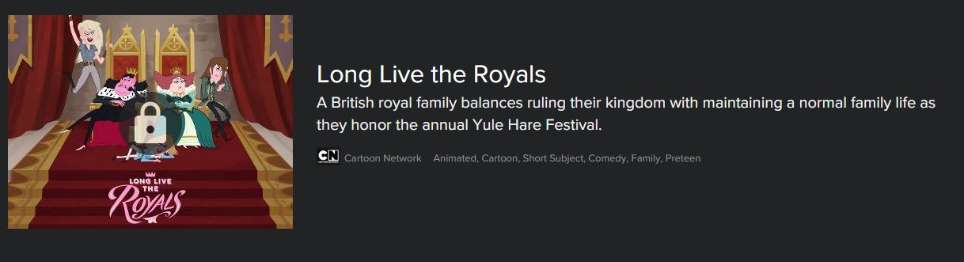
Example: Attribute – No View Rating
Historically: 2% are missing View Rating
Sample | Population | Percent | 95% Cnf | 99% Cnf
620 | 6,500 | 2% | 1.05% | 1.38%

Slide 17

Example: Attribute – No Genre
Historically: 2% are missing Genre
Sample | Population | Percent | 95% Cnf | 99% Cnf
620 | 6,500 | 2% | 1.05% | 1.38%

Slide 18

Example: Attribute – No Network
Historically: 2% are missing Network
Sample | Population | Percent | 95% Cnf | 99% Cnf
620 | 6,500 | 1% | 0.74% | 0.98%

Slide 19
Example: Conclusion
All these Methods seem to evaluate within 95% Confidence Interval
Simple Random individual items
Stratified via Starting Letter with pro-rate simple random
Cluster via Simple Random groups of 10 (all evaluated)
Choose daily Cluster as takes 75% less time than Simple Random
Continue weekly Simple Random and Stratified methods

Slide 20
Your Follow-up and Thanks
Based on this information
You should be able to expand the example
To Validate Machine Learning Algorithms using
Probability (Statistical) Sample Methods
Thanks
Arnold Miller, Sr. SDET (Sw. QA-Tester)
Email: arnold.miller0@gmail.com
Linkedin: http://www.linkedin.com/pub/arnold-miller/13/47b/a87

