Slide 1
Two flavors of priors
Andrew Arnold
Natalie Klein & Casey Gibson
Monday, June 19, 2023
Notes:
Presentation Title Slide Notes
“UNCLASSIFIED” marking of slides is not a security requirement and may be deleted from the Slide Master (View › Master › Slide Master). In general, slides should be marked “UNCLASSIFIED” if there is potential for confusion or misinterpretation of something that could be deemed classified. For guidance on marking slides containing classified and unclassified controlled information, see the Protecting Information Web site at http://int.lanl.gov/security/protectinfo/.

Slide 2

The Art of Picking Priors
$$p\left(x | y\right) = p\left(y | x\right) {⋅ \left[p\left(y\right)\right]}^{−1} ⋅ p(x)$$
marginalized likelihood
posterior
likelihood
prior
Notes:
Content Slide Notes
“UNCLASSIFIED” marking of slides is not a security requirement and may be deleted from the Slide Master (View › Master › Slide Master). In general, slides should be marked “UNCLASSIFIED” if there is potential for confusion or misinterpretation of something that could be deemed classified. For guidance on marking slides containing classified and unclassified controlled information, see the Protecting Information Web site at http://int.lanl.gov/security/protectinfo/.

Slide 3
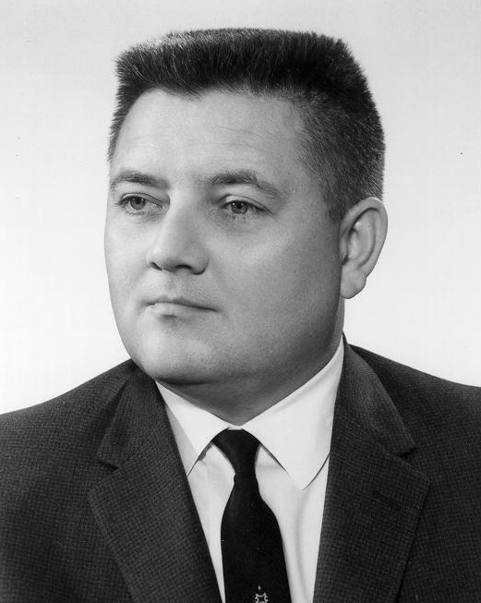
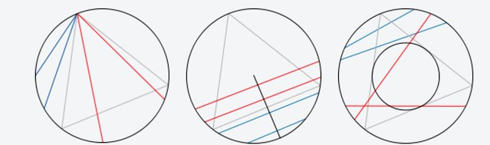



The Art of Picking Priors
$$p\left(x | y\right) = p\left(y | x\right) {⋅ \left[p\left(y\right)\right]}^{−1} ⋅ p(x)$$
marginalized likelihood
posterior
likelihood
prior
“.. every circumstance left unspecified in the statement of the problem defines an invariance property (i.e., a transformation to an equivalent problem) which that solution must have.”
-E.T. Jaynes, Prior Probabilities
$$p=1/3$$
$$p=1/2$$
$$p=1/4$$
Notes:
Content Slide Notes
“UNCLASSIFIED” marking of slides is not a security requirement and may be deleted from the Slide Master (View › Master › Slide Master). In general, slides should be marked “UNCLASSIFIED” if there is potential for confusion or misinterpretation of something that could be deemed classified. For guidance on marking slides containing classified and unclassified controlled information, see the Protecting Information Web site at http://int.lanl.gov/security/protectinfo/.

Slide 4
The Art of Picking Priors
$$p\left(x | y\right) = p\left(y | x\right) {⋅ \left[p\left(y\right)\right]}^{−1} ⋅ p(x)$$
marginalized likelihood
posterior
likelihood
prior
“.. every circumstance left unspecified in the statement of the problem defines an invariance property (i.e., a transformation to an equivalent problem) which that solution must have.”
-E.T. Jaynes, Prior Probabilities
*
$$p=1/3$$
$$p=1/2$$
$$p=1/4$$
Notes:
Content Slide Notes
“UNCLASSIFIED” marking of slides is not a security requirement and may be deleted from the Slide Master (View › Master › Slide Master). In general, slides should be marked “UNCLASSIFIED” if there is potential for confusion or misinterpretation of something that could be deemed classified. For guidance on marking slides containing classified and unclassified controlled information, see the Protecting Information Web site at http://int.lanl.gov/security/protectinfo/.

Slide 5
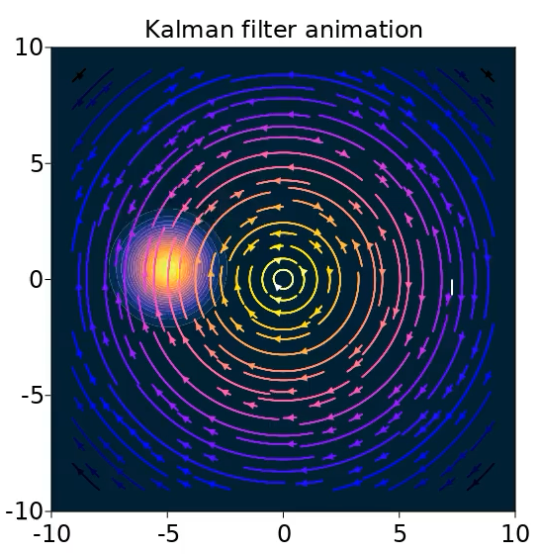
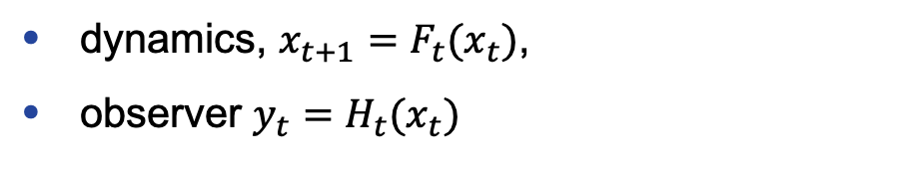
1st Flavor: State inference
$$p\left(x_{t} | y_{t}\right) = p\left(y_{t} | x_{t}\right) {⋅ \left[p\left(y_{t}\right)\right]}^{−1} ⋅ p(x_{t})$$
dynamics, $x_{t+1}=F_{t}(x_{t})$,
observer $y_{t}=H_{t}(x_{t})$
Notes:
Content Slide Notes
“UNCLASSIFIED” marking of slides is not a security requirement and may be deleted from the Slide Master (View › Master › Slide Master). In general, slides should be marked “UNCLASSIFIED” if there is potential for confusion or misinterpretation of something that could be deemed classified. For guidance on marking slides containing classified and unclassified controlled information, see the Protecting Information Web site at http://int.lanl.gov/security/protectinfo/.

Slide 6
1st Flavor: State inference
$$p\left(x_{t} | y_{t}\right) = p\left(y_{t} | x_{t}\right) {⋅ \left[p\left(y_{t}\right)\right]}^{−1} ⋅ p(x_{t})$$
dynamics, $x_{t+1}=F_{t}(x_{t})$,
observer $y_{t}=H_{t}(x_{t})$
Only a snapshot?
Notes:
Content Slide Notes
“UNCLASSIFIED” marking of slides is not a security requirement and may be deleted from the Slide Master (View › Master › Slide Master). In general, slides should be marked “UNCLASSIFIED” if there is potential for confusion or misinterpretation of something that could be deemed classified. For guidance on marking slides containing classified and unclassified controlled information, see the Protecting Information Web site at http://int.lanl.gov/security/protectinfo/.

Slide 7
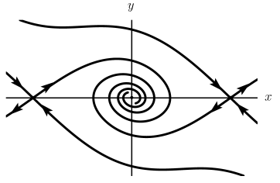
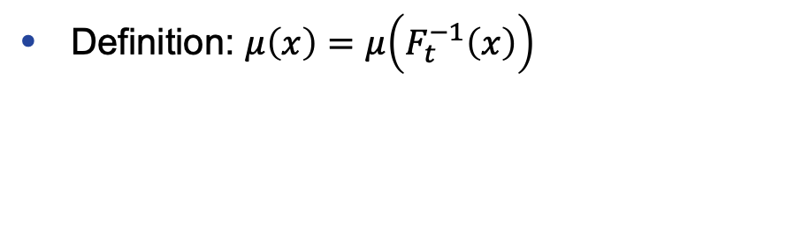
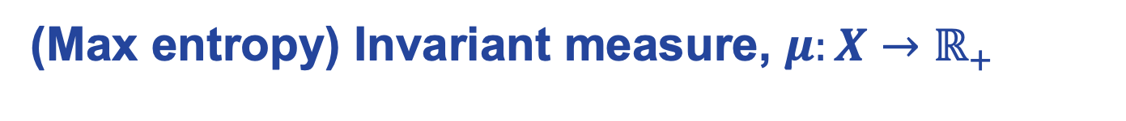
1st Flavor: State inference
$$p\left(x_{t} | y_{t}\right) = p\left(y_{t} | x_{t}\right) {⋅ \left[p\left(y_{t}\right)\right]}^{−1} ⋅ p(x_{t})$$
dynamics, $x_{t+1}=F_{t}(x_{t})$,
observer $y_{t}=H_{t}(x_{t})$
Only a snapshot?
(Max entropy) Invariant measure, $μ:X→ℝ_{+}$
Definition: $μ\left(x\right)=μ\left(F_{t}^{−1}\left(x\right)\right)$
Notes:
This is essentially what Gibbs assumed in setting up statistical mechanics; maximum entropy distribution.

Slide 8
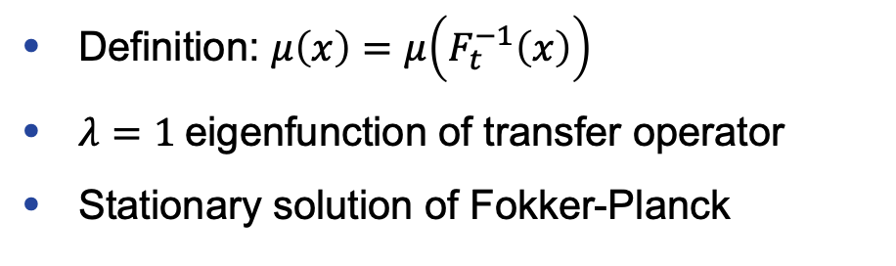
1st Flavor: State inference
$$p\left(x_{t} | y_{t}\right) = p\left(y_{t} | x_{t}\right) {⋅ \left[p\left(y_{t}\right)\right]}^{−1} ⋅ p(x_{t})$$
dynamics, $x_{t+1}=F_{t}(x_{t})$,
observer $y_{t}=H_{t}(x_{t})$
Only a snapshot?
(Max entropy) Invariant measure, $μ:X→ℝ_{+}$
Definition: $μ\left(x\right)=μ\left(F_{t}^{−1}\left(x\right)\right)$
$λ=1$eigenfunction of transfer operator
Stationary solution of Fokker-Planck
Notes:
Content Slide Notes
“UNCLASSIFIED” marking of slides is not a security requirement and may be deleted from the Slide Master (View › Master › Slide Master). In general, slides should be marked “UNCLASSIFIED” if there is potential for confusion or misinterpretation of something that could be deemed classified. For guidance on marking slides containing classified and unclassified controlled information, see the Protecting Information Web site at http://int.lanl.gov/security/protectinfo/.

Slide 9
1st Flavor: State inference
$$p\left(x_{t} | y_{t}\right) = p\left(y_{t} | x_{t}\right) {⋅ \left[p\left(y_{t}\right)\right]}^{−1} ⋅ p(x_{t})$$
dynamics, $x_{t+1}=F_{t}(x_{t})$,
observer $y_{t}=H_{t}(x_{t})$
Only a snapshot?
(Max entropy) Invariant measure
NNs!
Definition: $μ\left(x\right)=μ\left(F_{t}^{−1}\left(x\right)\right)$
$λ=1$eigenfunction of transfer operator
Stationary solution of Fokker-Planck
Wasserstein loss
DeepKoopman
Neural PDE
Notes:
Content Slide Notes
“UNCLASSIFIED” marking of slides is not a security requirement and may be deleted from the Slide Master (View › Master › Slide Master). In general, slides should be marked “UNCLASSIFIED” if there is potential for confusion or misinterpretation of something that could be deemed classified. For guidance on marking slides containing classified and unclassified controlled information, see the Protecting Information Web site at http://int.lanl.gov/security/protectinfo/.

Slide 10
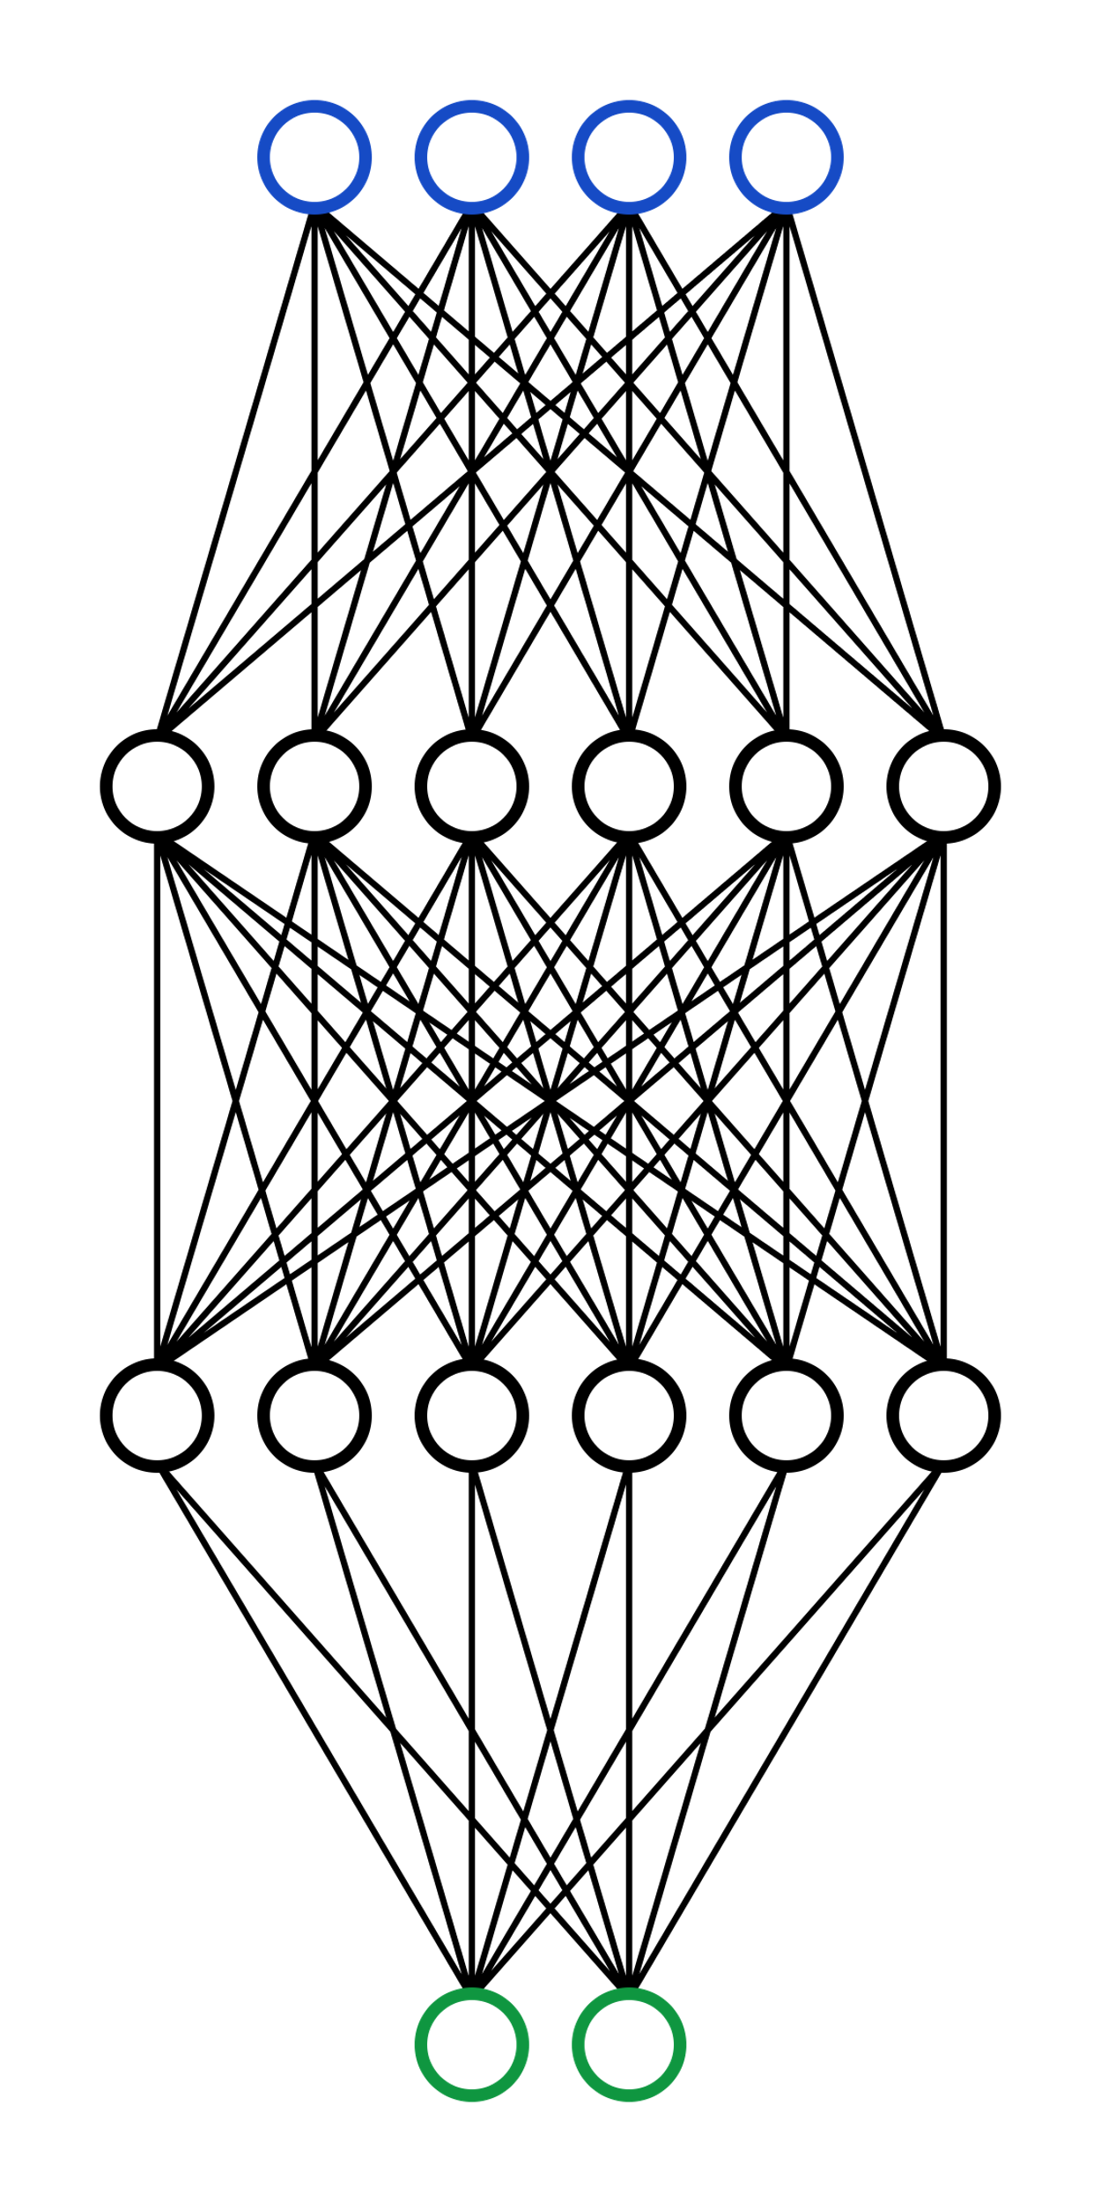
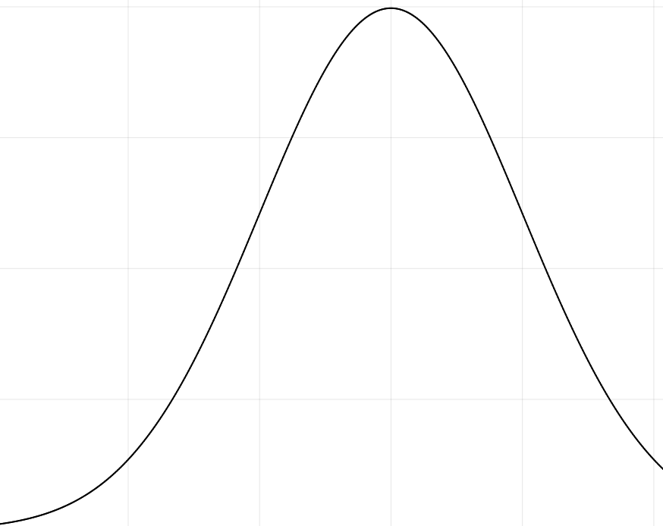
2nd Flavor: Model selection
$$p\left(w | 𝒟\right) = p\left(𝒟 | w\right) {⋅ \left[p\left(𝒟\right)\right]}^{−1} ⋅ p(w)$$
Train by inference rather than minimizing loss.
Gives a measure of confidence in model.
Notes:
Content Slide Notes
“UNCLASSIFIED” marking of slides is not a security requirement and may be deleted from the Slide Master (View › Master › Slide Master). In general, slides should be marked “UNCLASSIFIED” if there is potential for confusion or misinterpretation of something that could be deemed classified. For guidance on marking slides containing classified and unclassified controlled information, see the Protecting Information Web site at http://int.lanl.gov/security/protectinfo/.

Slide 11
2nd Flavor: Model selection
$$p\left(w | 𝒟\right) = p\left(𝒟 | w\right) {⋅ \left[p\left(𝒟\right)\right]}^{−1} ⋅ p(w)$$
Train by inference rather than minimizing loss.
Priors over:
Weight space - easy
or
Function space - interpretable
Gives a measure of confidence in model.
Notes:
If the NN is trying to make a relation between observation and state, a prior of invariant measure should be a statement of maximum ignorance about how y and x are related.

Slide 12
Project proposal
Modify Senseiver as Bayesian network
Test training by various inference techniques (MCMC, variational)
Impose dynamics-ignorant function-space prior
Learn invariant measure
DeepKoopman
Wasserstein loss
Optional: Modify the above to be Bayesian networks
Use invariant measure as prior to learn conditioning on observations (Senseiver)
Compare against dynamics-ignorant prior

