Slide 1
Commentaries on Problems
Judge Team
ICPC 2020 Asia YOKOHAMA Regional

Slide 2
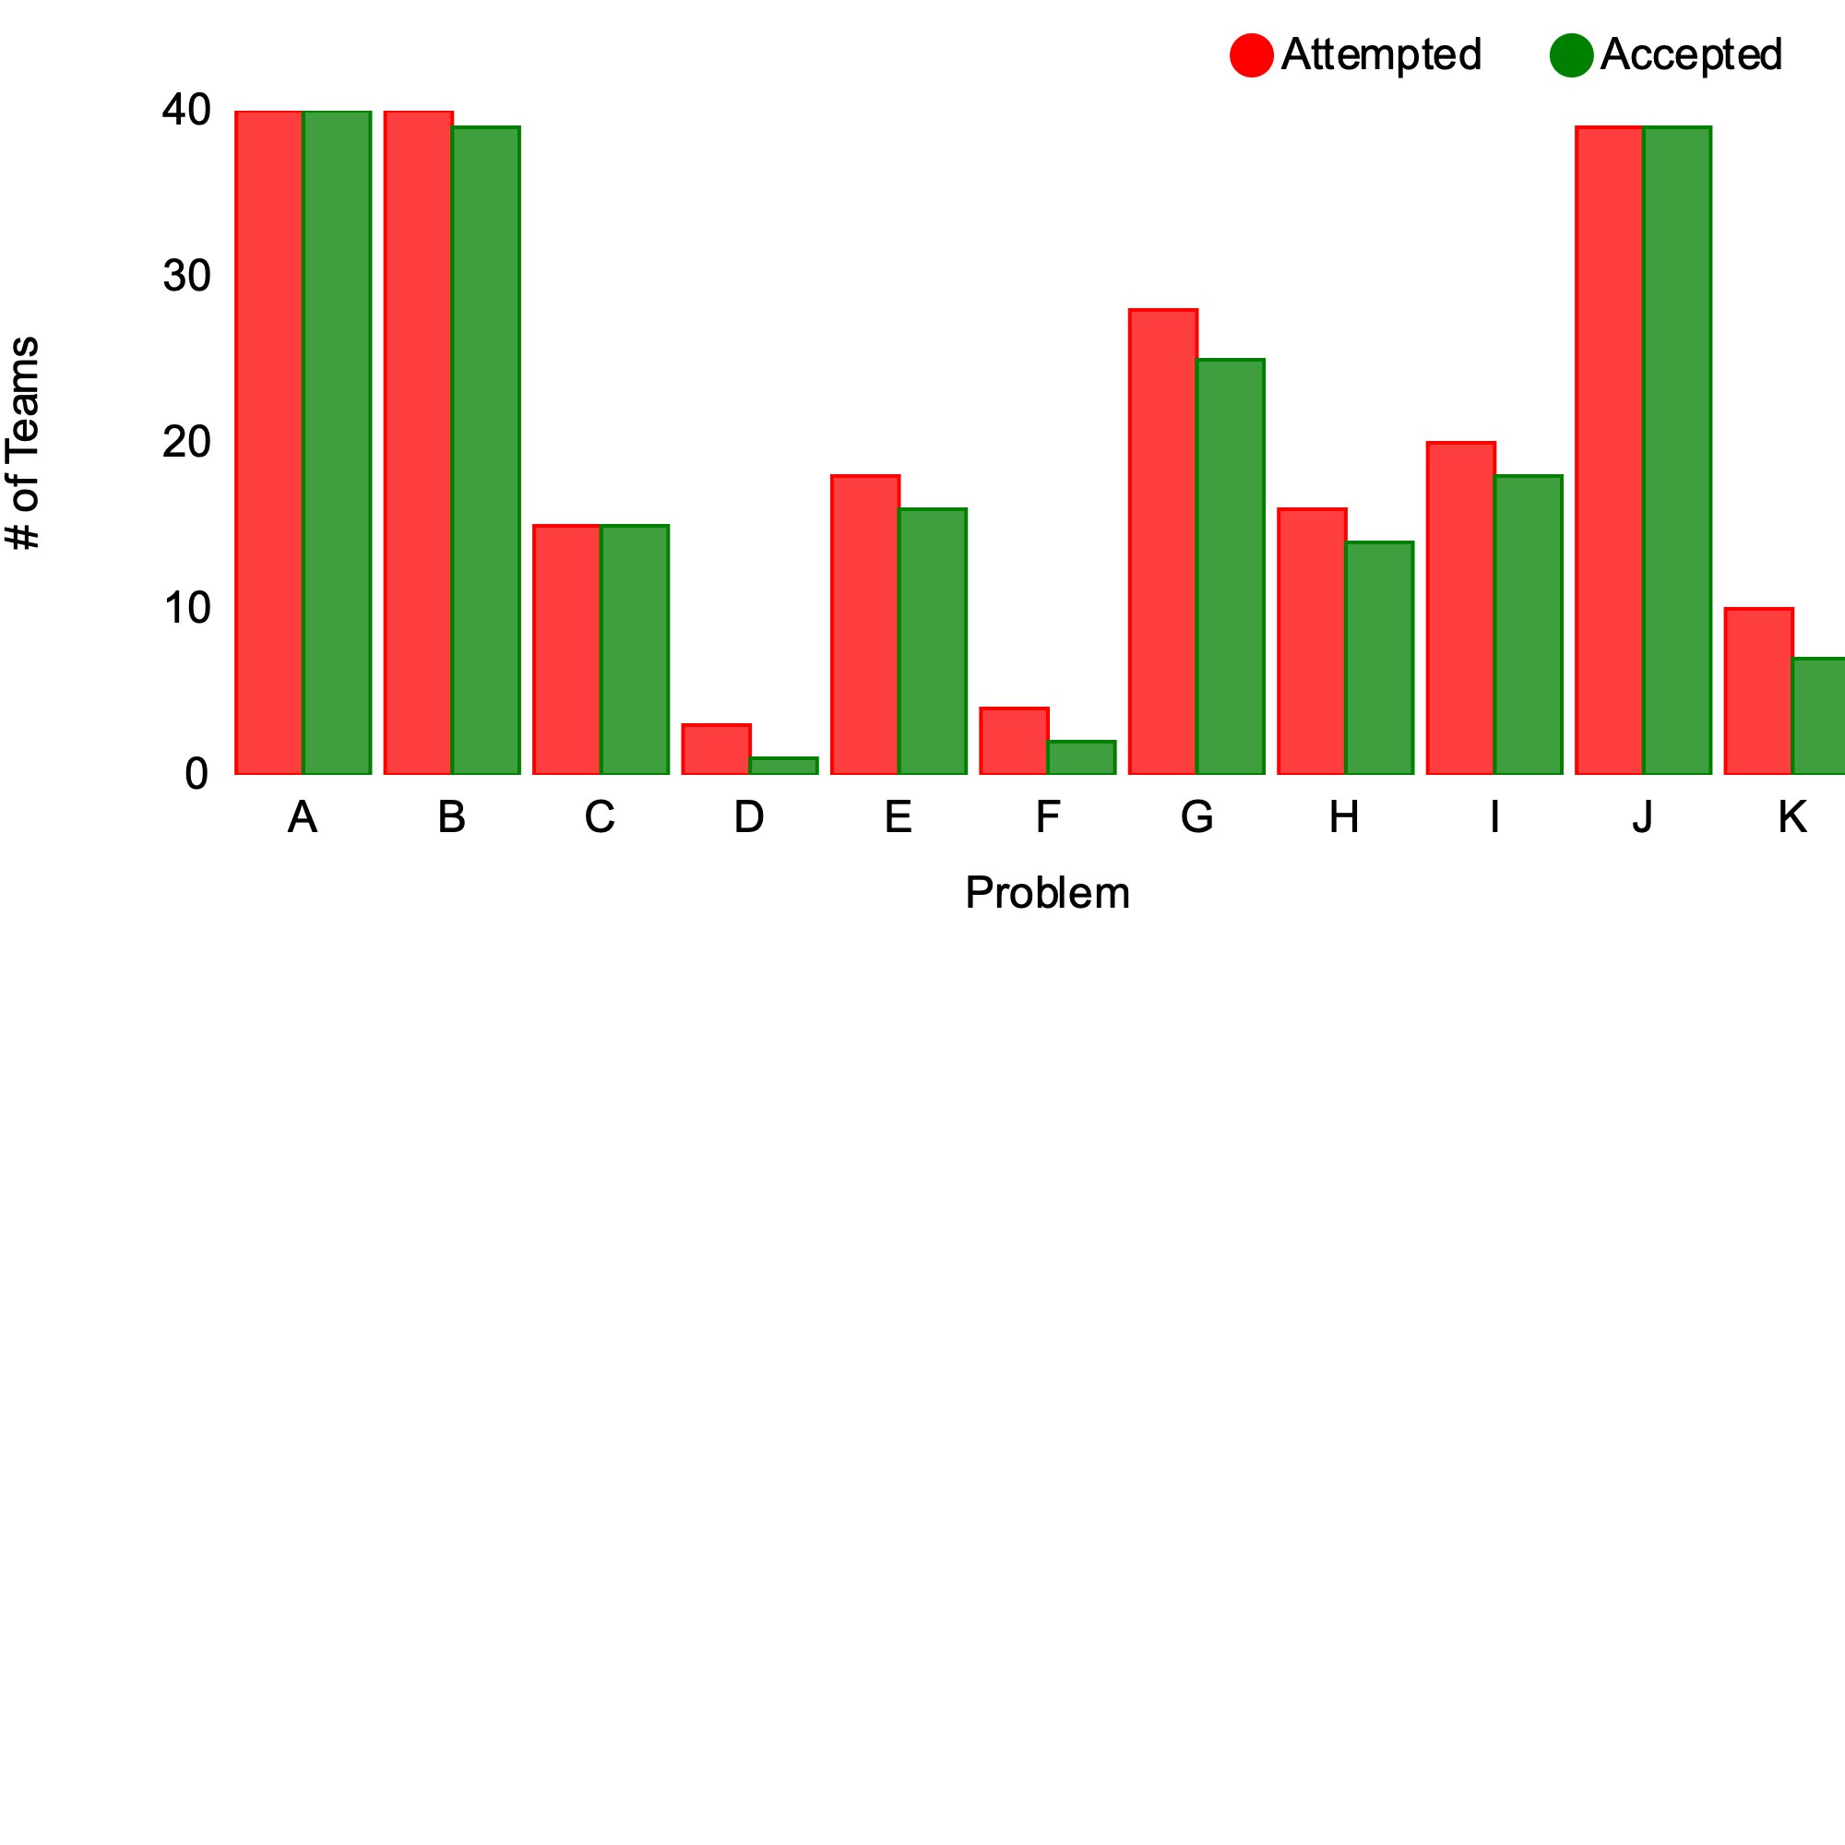
Problem vs. #Teams @Freeze

Slide 3
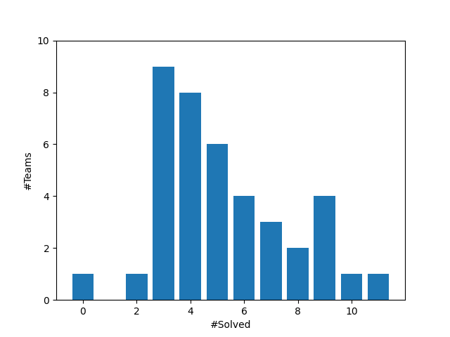
#Solved vs #Teams @Freeze

Slide 4
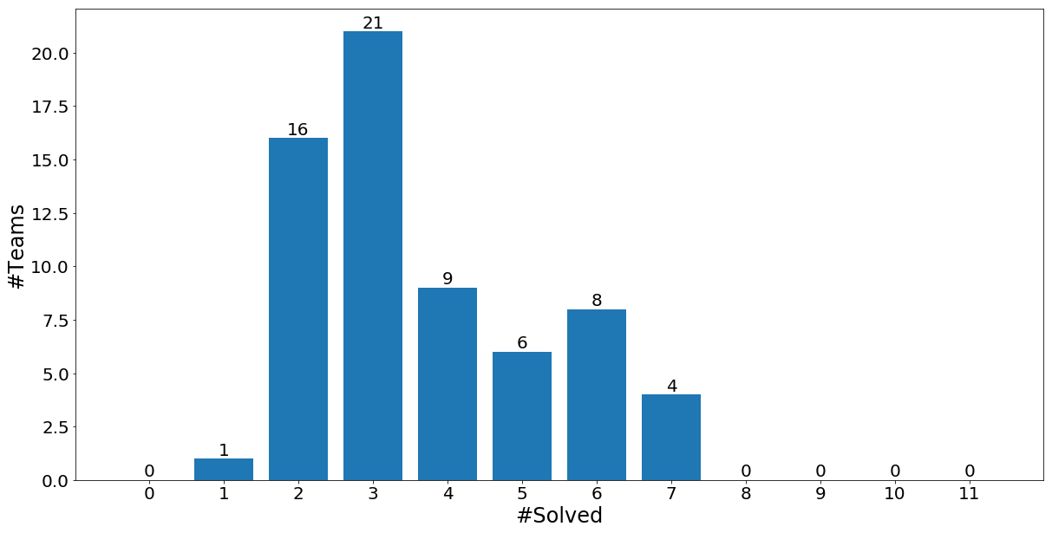
cf. 2019’s #Solved vs #Teams

Slide 5
cf. 2018’s #Solved vs #Teams

Slide 6
Commentaries
Decreasing order of #attempt teams (tie-breaking by alphabetical order)
A → B → J → G → I → E → H → C → K → F → D

Slide 7
A:Three-Axis Views

Slide 8

Story
An object, a subset of $n×n×n$ cubes, can make three silhouettes of $n×n$ squares by three parallel lights perpendicular to its faces

Slide 9
Story
An object, a subset of $n×n×n$ cubes, can make three silhouettes of $n×n$ squares by three parallel lights perpendicular to its faces

Slide 10
Story
An object, a subset of $n×n×n$ cubes, can make three silhouettes of $n×n$ squares by three parallel lights perpendicular to its faces

Slide 11
Problem
An object, a subset of $n×n×n$ cubes, can make three silhouettes of $n×n$ squares by three parallel lights perpendicular to its faces
?
Can you make such an object to make the given silhouettes?

Slide 12


Solution ( $O(n^{3})$ )
Begin with the full $n×n×n$ cube
Remove cubes blocking the light to make a blight cell
Check if the remaining cubes make the silhouettes
Removal of blocking cubes

Slide 13
B: Secrets of Legendary Treasure

Slide 14
Problem (1/2)
Numbers from 1 to X were partitioned into two lists, each sorted in ascending order, but……………….
4
5
7
10
11
13
1
2
3
6
8
9
12

Slide 15
Problem (2/2)
Numbers from 1 to X were partitioned into two lists, each sorted in ascending order, but ……………….
some of the numbers were lost!
Please restore the original pair of lists. (Any one of them is accepted when there are multiple possibilities.)
5
13
3
8
12

Slide 16
Solution (Greedy algorithm)
Repeat finding where to put the least unused number:
The leftmost unknown pos of the either of the list,
such that the next right known number is smaller.
5
13
1?
3
8
12

Slide 17
Solution
[Proof outline of the greedy method] show that “if there’s a solution that fills y (y>x) to the greedy choice position, then filling the least value x also leads to another solution.” Rotating {x, x+1, …, y} in the former solution gives you the latter.
[Other approaches]
Memoized search
BFS-like search
State (a,b) reachable ⬄ partitioning {1..a+b} into lists of length a and b is possible without contradiction

Slide 18
J: Formica Sokobanica

Slide 19
Formica Sokobanica
Formica Sokobanica is named after a computer game.
A worker arranges boxes in a warehouse by pushing them.
The worker cannot push multiple boxes simultaneously.

Slide 20
Problem Description
=
A variant of the computer game.
The worker is an ant.
Topology of the field is a tree.
The worker can push a nut to any adjacent vacant room (AVR).

Slide 21
Problem Description: objective
Count up the number of rooms the ant can reach.
U
=

Slide 22
Solution
Depth first search while keeping track of if the ant is pushing a nut or not
Ant can enter a room if
neither the ant is pushing nor the room contains a nut, or
the room has one or more AVRs

Slide 23
Solution
The ant is considered to lose its nut when it enters a room with ≥2 AVRs
=
U

Slide 24
G:To be Connected, or not to be, that is the Question

Slide 25
Problem Summary
Divide the nodes into two groups (by a threshold) and remove edges connecting nodes in different groups

Slide 26
Problem Summary
Make the subgraph connected by adding new edges
1. New edges must connect nodes in different groups
2. Each node can be incident with at most one new edge

Slide 27

Necessary Conditions
Let $G$ be the graph where each connected component corresponds to a node
$\left|V\left(G\right)\right|≤\left|E\left(G\right)\right|+1$ is necessary for connectivity

Slide 28



Necessary Conditions
$$\left|V\left(G\right)\right|=c\left(G_{s}\right)+c(G_{l})$$
$$\left|E\left(G\right)\right|≤min⁡(\left|V\left(G_{s}\right)\right|, |V\left(G_{l}\right)|)$$
$$c\left(G_{s}\right)+c\left(G_{l}\right)≤\min\left(\left|V\left(G_{s}\right)\right|, \left|V\left(G_{l}\right)\right|\right)+1$$
(* $c\left(H\right)$ is the number of connected components of $H$)
$$G_{l}$$
$$G_{s}$$

Slide 29
Necessary Conditions
$$\left|V\left(G\right)\right|=c\left(G_{s}\right)+c(G_{l})$$
$$\left|E\left(G\right)\right|≤min⁡(\left|V\left(G_{s}\right)\right|, |V\left(G_{l}\right)|)$$
$$c\left(G_{s}\right)+c\left(G_{l}\right)≤\min\left(\left|V\left(G_{s}\right)\right|, \left|V\left(G_{l}\right)\right|\right)+1$$
(* $c\left(H\right)$ is the number of connected components of $H$)
This is actually sufficient
$$G_{l}$$
$$G_{s}$$

Slide 30

Compute Values
The numbers of nodes and connected components for $G_{s}$ can be calculated by checking nodes from smaller values
Same for $G_{l}$ by checking nodes from larger values

Slide 31
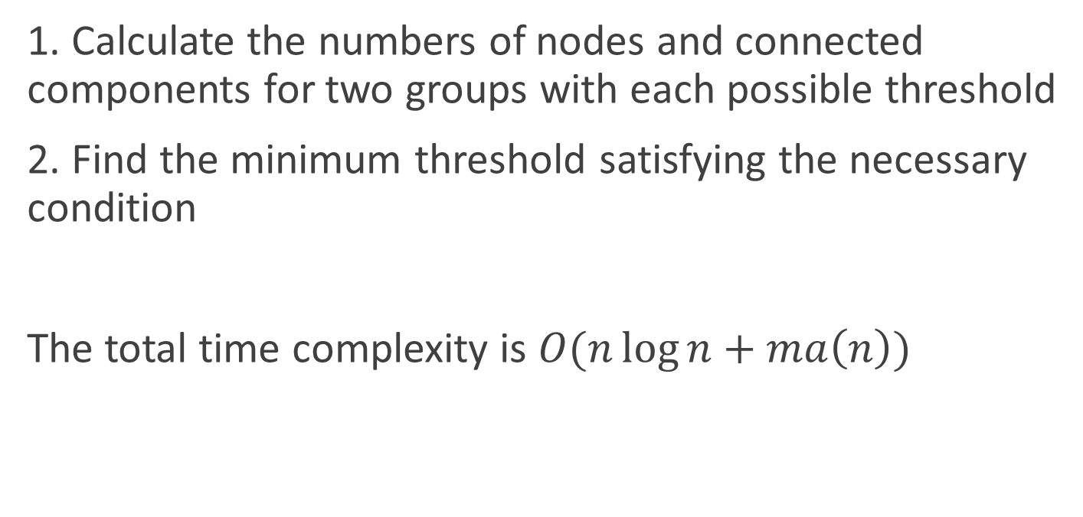
Summary
1. Calculate the numbers of nodes and connected components for two groups with each possible threshold
2. Find the minimum threshold satisfying the necessary condition
The total time complexity is $O(n\log{n}+ma\left(n\right))$

Slide 32
I:High-Tech Detective

Slide 33



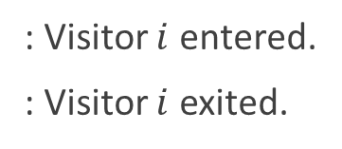
Problem Description
You are given a list of $2n$ events describing the entry and the exit of $n$ persons. - Each ID is appeared once for its entry and once for its exit. - Some of the ID(s) are missing.
Your task is to calculate the number of consistent ways to fill the missing ID(s) modulo 1,000,000,007.
1
2
1
3
2
4
3
4
1
?
?
?
2
4
?
4
1
3
1
2
2
4
3
4
1
3
3
2
2
4
1
4
$$i$$
: Visitor $i$ entered.
: Visitor $i$ exited.
Note: We cannot exit before entry
×
$$i$$
1
2
3
3
2
4
1
4

Slide 34




Solution
We can categorize ID(s) into the following four groups:
- Case A: Both the entry and the exit logs are missing.
- Case B: Only the entry log remains.
- Case C: Only the exit log remains.
- Case D: Both logs remain.
We can safely exclude the case D’s logs from the input.
?
?
$$i$$
?
?
$$i$$
$$i$$
$$i$$
×
1
?
?
?
2
4
?
4

Slide 35
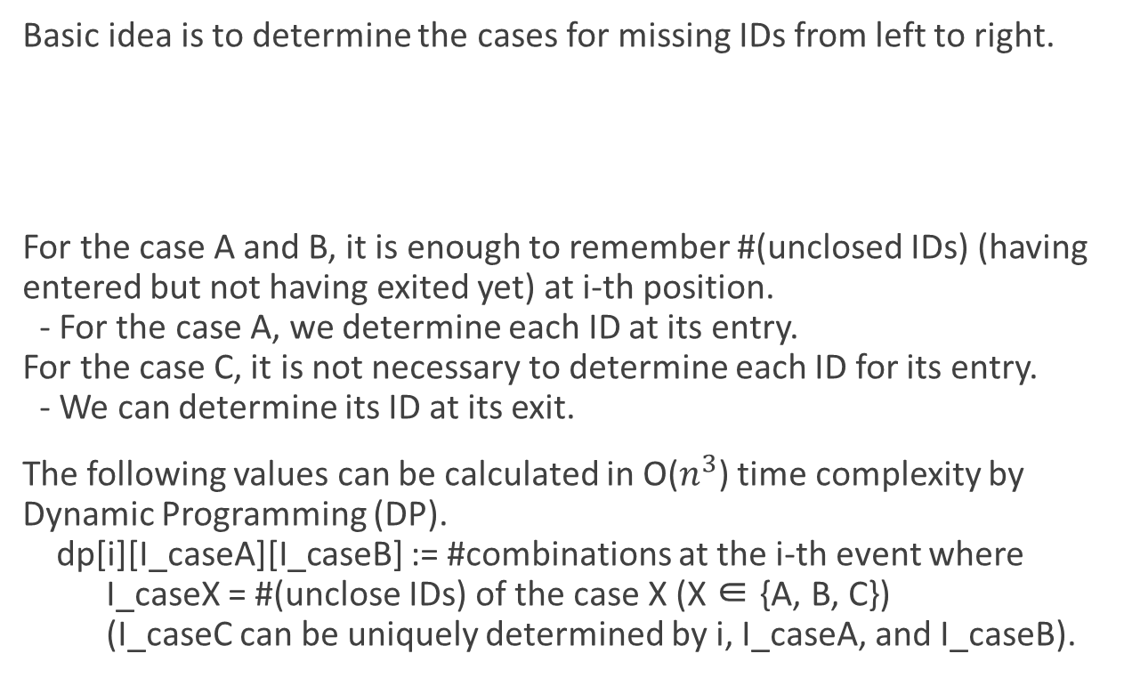
Solution
Basic idea is to determine the cases for missing IDs from left to right.
For the case A and B, it is enough to remember #(unclosed IDs) (having entered but not having exited yet) at i-th position. - For the case A, we determine each ID at its entry. For the case C, it is not necessary to determine each ID for its entry. - We can determine its ID at its exit.
The following values can be calculated in O($n^{3}$) time complexity by Dynamic Programming (DP). dp[i][I_caseA][I_caseB] := #combinations at the i-th event where I_caseX = #(unclose IDs) of the case X (X ∈ {A, B, C}) (I_caseC can be uniquely determined by i, I_caseA, and I_caseB).
Case
B
C
B
A
1
*
1
3
2
?

Slide 36
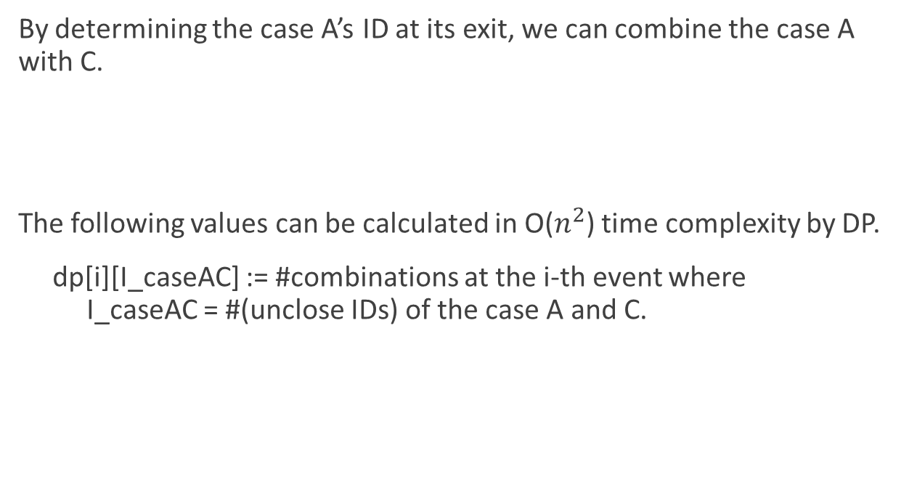
Solution
By determining the case A’s ID at its exit, we can combine the case A with C.
The following values can be calculated in O($n^{2}$) time complexity by DP.
dp[i][I_caseAC] := #combinations at the i-th event where I_caseAC = #(unclose IDs) of the case A and C.
Case
B
AC
B
AC
1
*
1
*
2
?

Slide 37
E: Jewelry Size

Slide 38
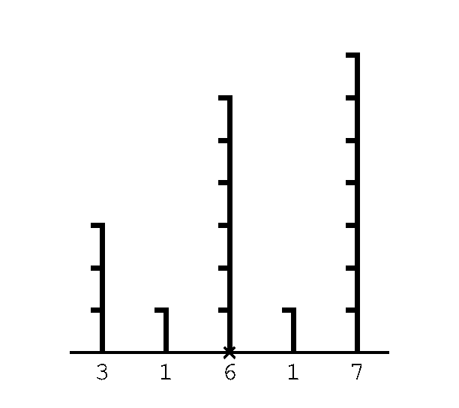
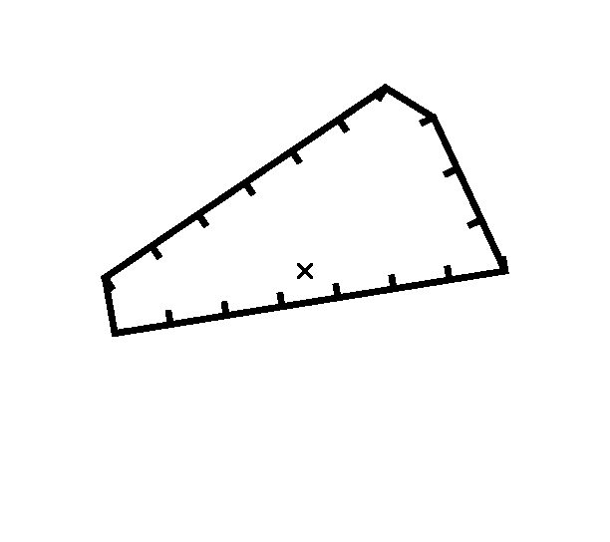
Story
- Given lengths of the edges of a polygon.

Slide 39
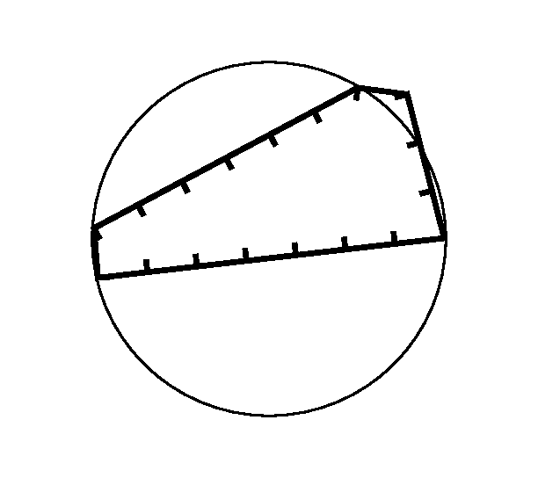
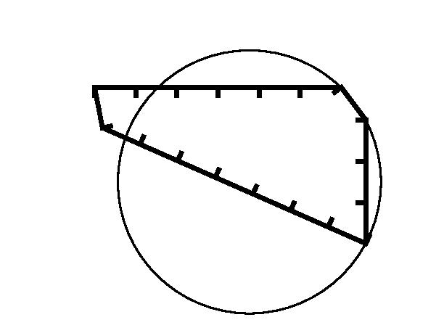
Story
- There are many polygons each of which has the edges with the given lengths.

Slide 40
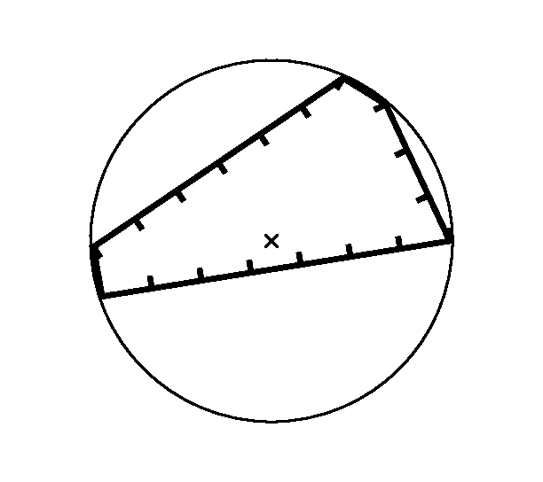
Story
- Your task is to find a polygon that has the circumscribed circle and print its radius.

Slide 41
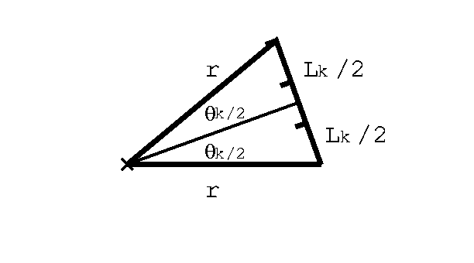

Solution
Fixing radius $r$ to an approximate value, compute angle ${θ }_{k}=2$ $asin⁡(\frac{L_{k}}{2r})$
Center

Slide 42
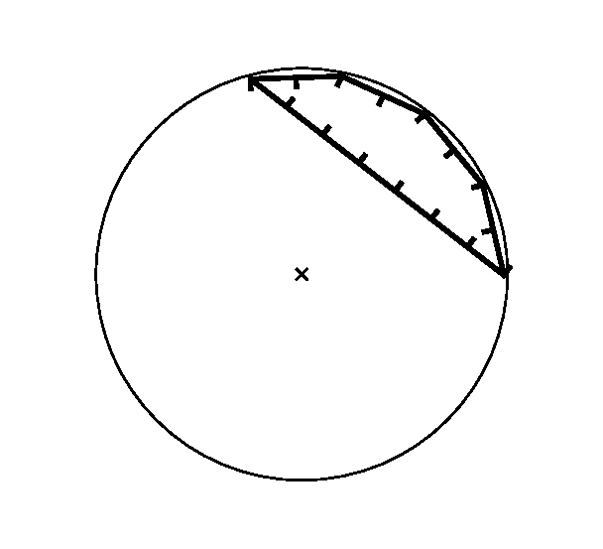
Solution
There are two patterns:

Slide 43
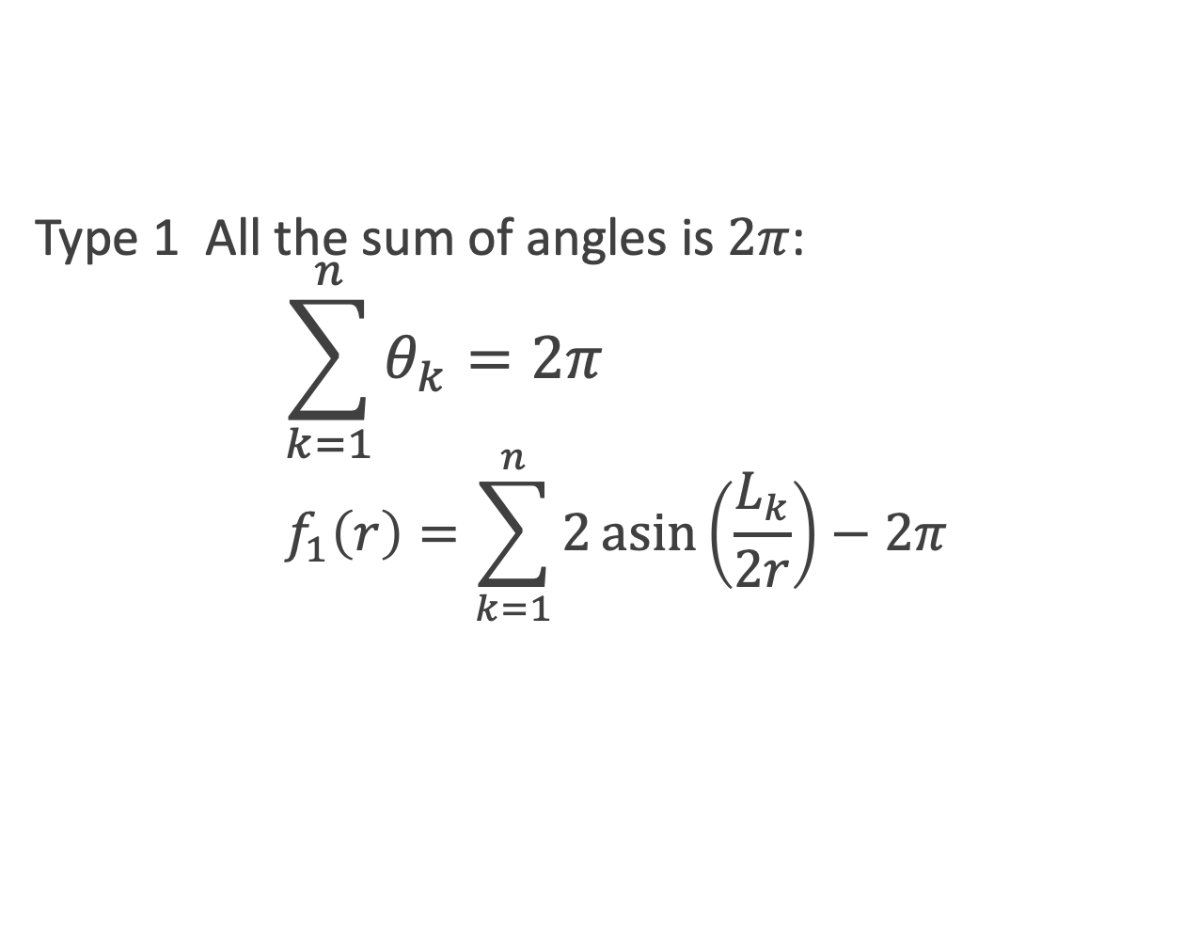
Solution
Type 1 All the sum of angles is $2π$: $$\sum_{k=1}^{n}{θ_{k}=2π} \\ f_{1}\left(r\right)=\sum_{k=1}^{n}{2\operatorname{asin}\left(\frac{L_{k}}{2r}\right)−2π}$$

Slide 44
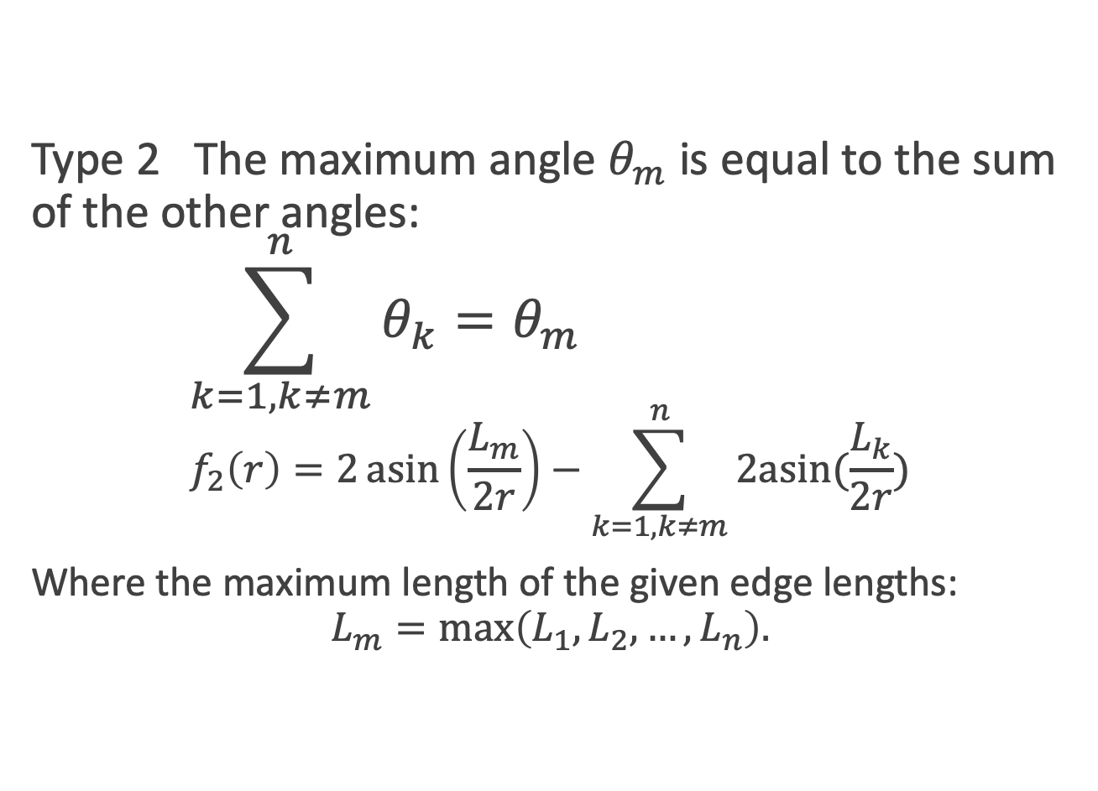
Solution
Type 2 The maximum angle $θ_{m}$ is equal to the sum of the other angles: $$\sum_{k=1,k≠m}^{n}{θ_{k}=θ_{m}} \\ f_{2}\left(r\right)=2\operatorname{asin}\left(\frac{L_{m}}{2r}\right)−\sum_{k=1,k≠m}^{n}{2asin⁡(\frac{L_{k}}{2r})}$$
Where the maximum length of the given edge lengths: $$L_{m}=\max\left(L_{1},L_{2}, …, L_{n}\right).$$

Slide 45
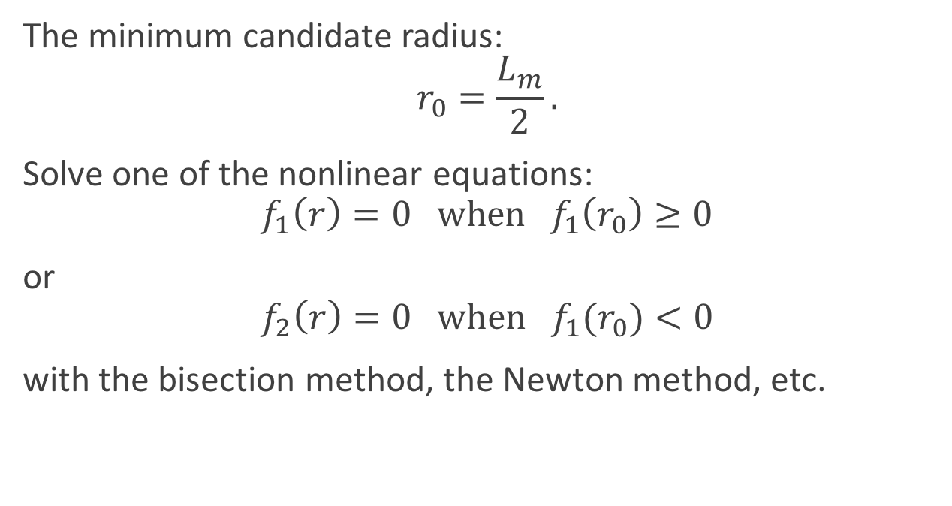
Solution
The minimum candidate radius: $$r_{0}=\frac{L_{m}}{2}.$$
Solve one of the nonlinear equations: $$f_{1}\left(r\right)=0 \text{when} f_{1}\left(r_{0}\right)≥0$$
or $$f_{2}\left(r\right)=0 \text{when} f_{1}(r_{0})<0$$
with the bisection method, the Newton method, etc.

Slide 46
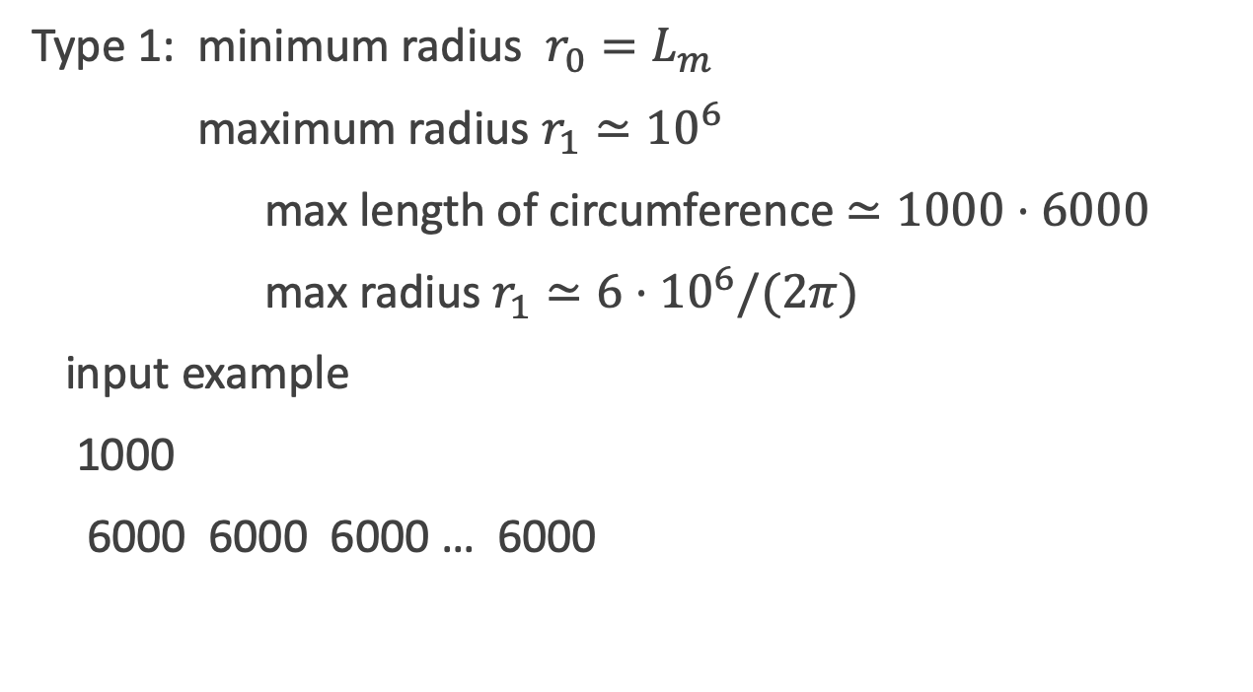
Solution
Type 1: minimum radius $r_{0}=L_{m}$
maximum radius $r_{1}≃{10}^{6}$
max length of circumference $≃1000⋅6000$
max radius $r_{1}≃6⋅{10}^{6}/(2π)$
input example
1000
6000 6000 6000 … 6000

Slide 47
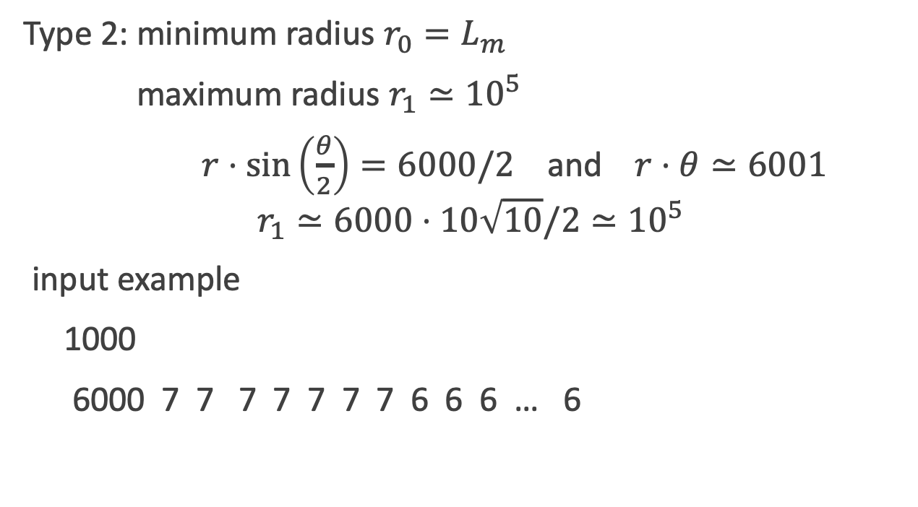
Solution
Type 2: minimum radius $r_{0}=L_{m}$
maximum radius $r_{1}≃{10}^{5}$
$r⋅\sin\left(\frac{θ}{2}\right)=6000/2$ and $r⋅θ≃6001$
$$r_{1}≃6000⋅10\sqrt{10}/2≃{10}^{5}$$
input example
1000
6000 7 7 7 7 7 7 7 6 6 6 … 6

Slide 48
H: LCM of GCDｓ

Slide 49
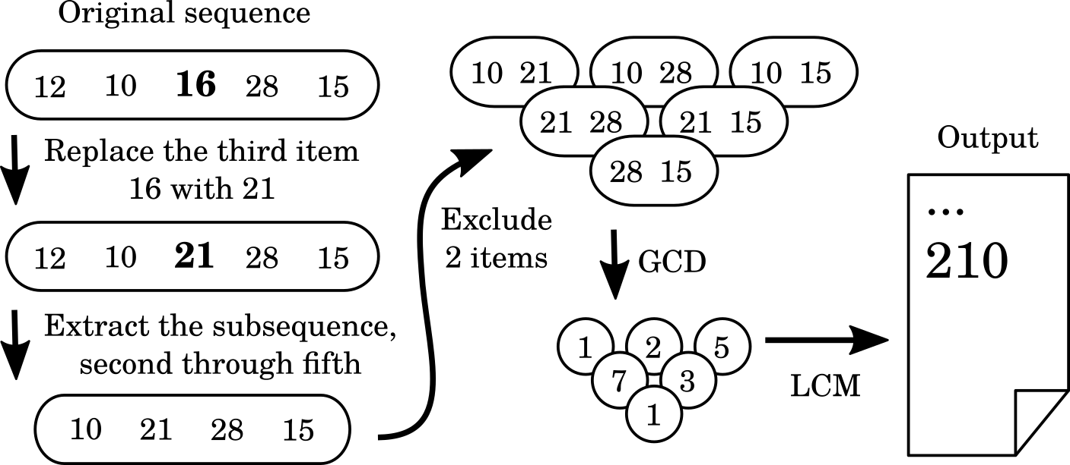

Problem
Find LCM of GCDs of the subsets of a given multiset of integers.
The subsets are those obtained by excluding some of the members of the given integer set.
Its naïve implementation requires taking GCD $O({{}_{n}^{}C}_{k})$ times, which is too computationally heavy to meet the time constraint.

Slide 50
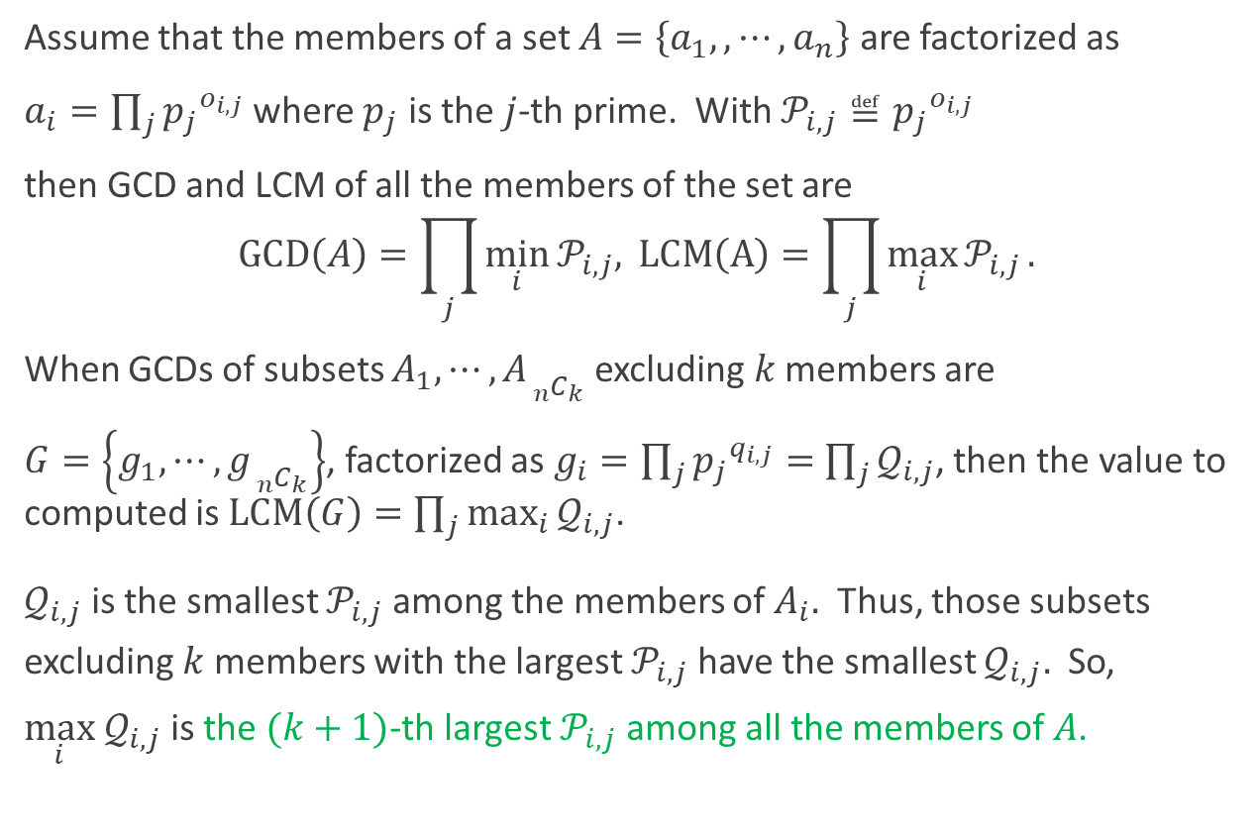
GCD, LCM, and Factorization
Assume that the members of a set $A=\left\{a_{1},,⋯, a_{n}\right\}$ are factorized as
$a_{i}=\prod_{j}{{p_{j}}^{o_{i,j}}}$ where $p_{j}$ is the $j$-th prime. With $𝒫_{i,j}≝{p_{j}}^{o_{i,j}}$
then GCD and LCM of all the members of the set are
$$GCD\left(A\right)=\prod_{j}{\min_{i}{𝒫_{i,j}}{,}} LCM\left(A\right)=\prod_{j}{\max_{i}{𝒫_{i,j}}}.$$
When GCDs of subsets $A_{1},⋯,A_{{{}_{n}^{}C}_{k}}$ excluding $k$ members are
$G=\left\{g_{1},⋯,g_{{{}_{n}^{}C}_{k}}\right\}$, factorized as $g_{i}=\prod_{j}{{p_{j}}^{q_{i,j}}=}$ $\prod_{j}{𝒬_{i,j}}$, then the value to computed is $LCM\left(G\right)=\prod_{j}{\max_{i}{𝒬_{i,j}}}$.
$𝒬_{i,j}$is the smallest $𝒫_{i,j}$among the members of $A_{i}.$ Thus, those subsets excluding $k$ members with the largest $𝒫_{i,j}$have the smallest $𝒬_{i,j}.$ So, $\max_{i}{ 𝒬}_{i,j}$ is the $(k+1)$-th largest $𝒫_{i,j}$among all the members of $A$.

Slide 51
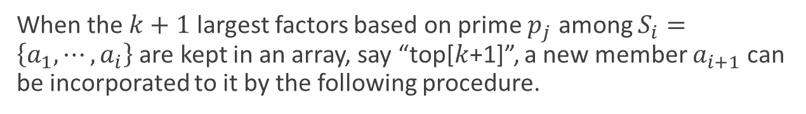

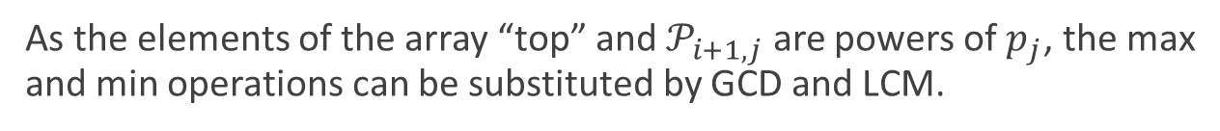
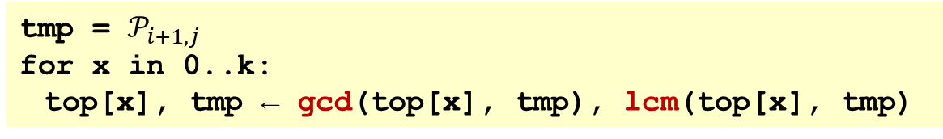
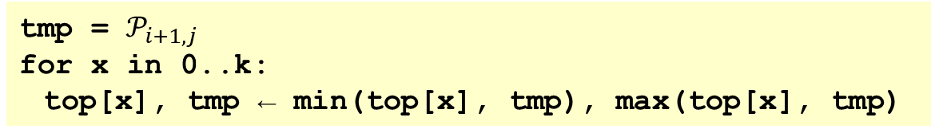
Finding the $(k+1)$-th Largest Factor Based on a Specific Prime
When the $k+1$ largest factors based on prime $p_{j}$ among $S_{i}=\left\{a_{1},⋯,a_{i}\right\}$ are kept in an array, say “top[$k$+1]”, a new member $a_{i+1}$ can be incorporated to it by the following procedure.
tmp = $𝒫_{i+1,j}$
for x in 0..k:
top[x], tmp ← min(top[x], tmp), max(top[x], tmp)
As the elements of the array “top” and $𝒫_{i+1,j}$ are powers of $p_{j}$, the max and min operations can be substituted by GCD and LCM.
tmp = $𝒫_{i+1,j}$
for x in 0..k:
top[x], tmp ← gcd(top[x], tmp), lcm(top[x], tmp)

Slide 52
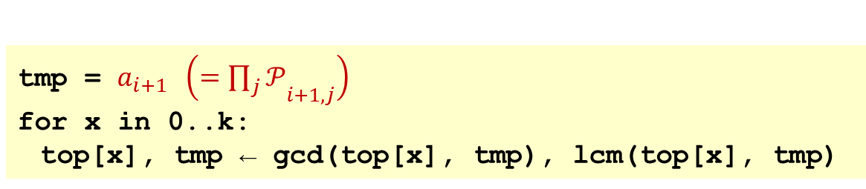

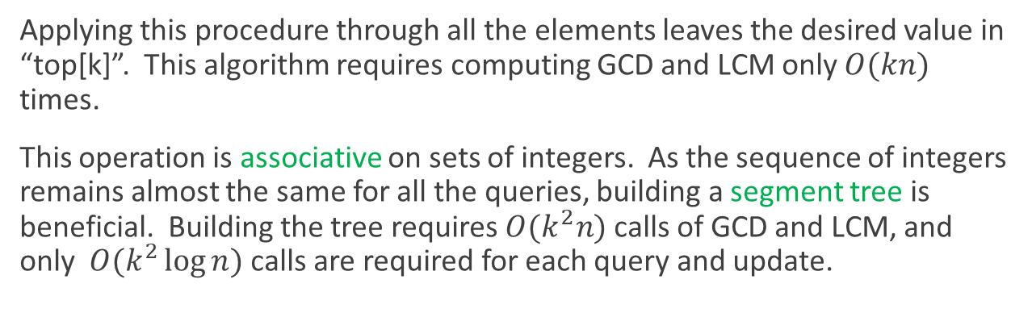
Finding the $(k+1)$-th Largest Factors Based on All the Primes
The procedure described above can be applied to all the factors based on all the primes simultaneously, as GCD and LCM work for factors based on different primes independently.
tmp = $a_{i+1}$ $\left({=\prod_{j}{𝒫}}_{i+1,j}\right)$
for x in 0..k:
top[x], tmp ← gcd(top[x], tmp), lcm(top[x], tmp)
Applying this procedure through all the elements leaves the desired value in “top[k]”. This algorithm requires computing GCD and LCM only $O(kn)$ times.
This operation is associative on sets of integers. As the sequence of integers remains almost the same for all the queries, building a segment tree is beneficial. Building the tree requires $O(k^{2}n)$calls of GCD and LCM, and only $O(k^{2}\log{n})$ calls are required for each query and update.

Slide 53
C:Short Coding

Slide 54
Problem 1/2
Find a program with the fewest possible number of lines to solve a given maze.
.##S...##.
..#...#...
..#...#...
.###...##.
..........
..........
.##....##.
.#.#..#...
.##...#...
.#.....G#.
S : Start
G : Goal
. : Vacant cell
# : Filled cell

Slide 55
Problem 2/2
You can use only the following commands:
Command | Description
GOTO l | Goto the l-th line in the program.
IF-OPEN l | Goto the l-th line in the program if can move forward
FORWARD | Move forward
LEFT | Turn left
RIGHT | Turn right

Slide 56
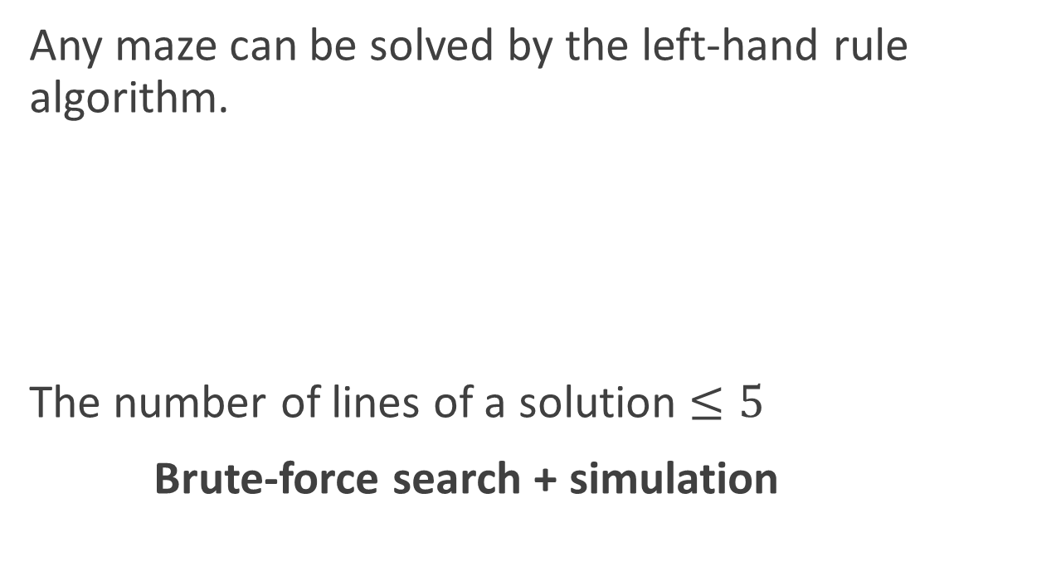
Solution
Any maze can be solved by the left-hand rule algorithm.
The number of lines of a solution $≤5$
Brute-force search + simulation
LEFT
IF-OPEN 5
RIGHT
GOTO 2
FORWARD

Slide 57
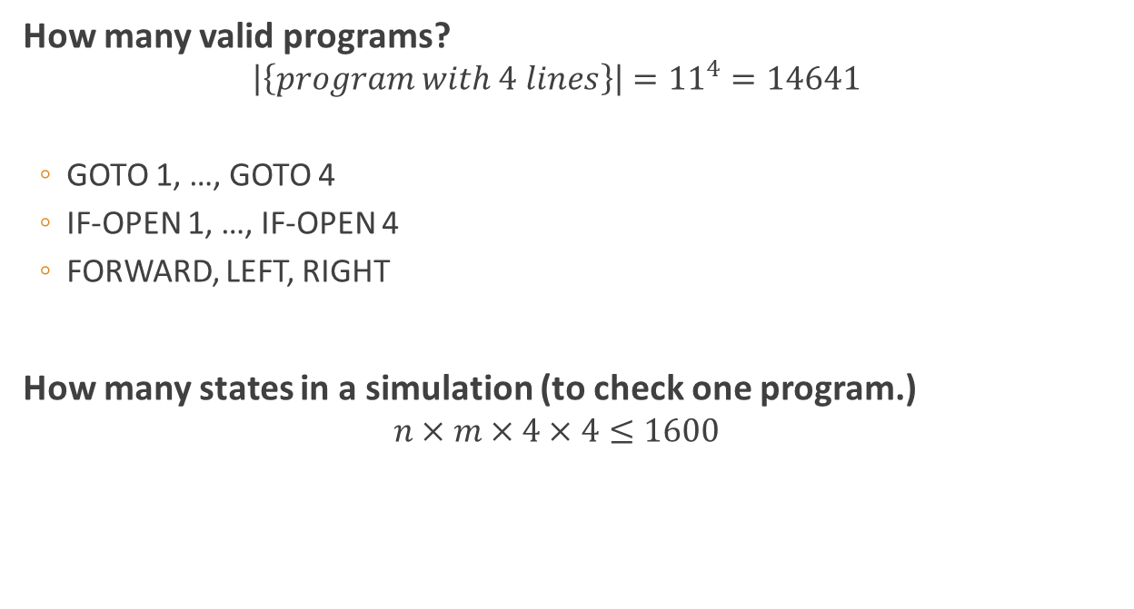
Estimation
How many valid programs?
$$\left|\left\{program with 4 lines\right\}\right|={11}^{4}=14641$$
GOTO 1, …, GOTO 4
IF-OPEN 1, …, IF-OPEN 4
FORWARD, LEFT, RIGHT
How many states in a simulation (to check one program.)
$$n×m×4×4≤1600$$
11 kinds of commands per line
Where
in maze
Which
line in the program
Which
direction

Slide 58
K:Suffixes may Contain Prefixes

Slide 59
Problem
Given a target string
Bullet string s has n suffixes, s(1) … s(n)
Score = sum of LCP(target, s(i))
Find bullet string, print the maximum score
LCP = length of longest common prefix

Slide 60
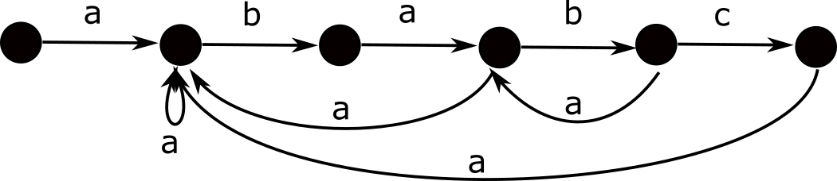
Solution
Build automaton
Dynamic programming

Slide 61
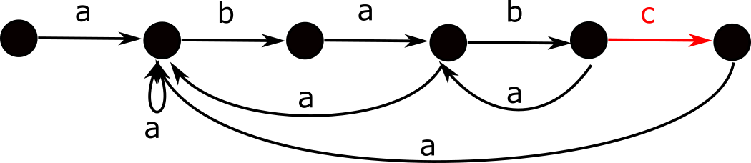
Automaton
Forward edge makes suffixes longer
abab
bab
ab
b
.
ababc
babc
abc
bc
c

Slide 62
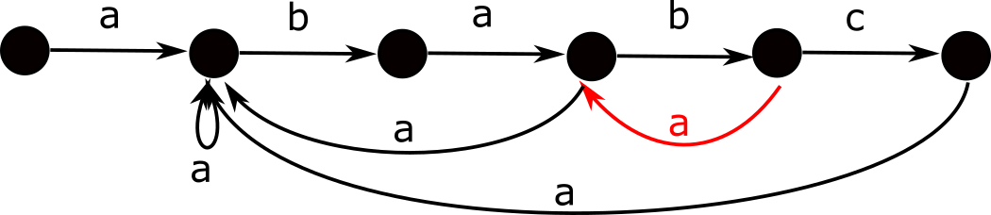
Automaton
Backward edge fixes some LCP scores
Precalculate backward edge scores
abab
bab
ab
b
.
ababa
baba
aba
ba
a
Fixed score 4

Slide 63
Automaton

Slide 64
Dynamic programming
dp(i, j) = maximum score
i letters of the bullet string
j-th node on the automaton
Forward edge from j to j+1
dp(i+1, j+1) ← max(dp(i+1, j+1), dp(i, j))
Backward edge from x to y
dp(i+1, y) ← max(dp(i+1, y), dp(i, x) + score(x, y))

Slide 65
Dynamic programming
O(anm)
a : kinds of letters, 26
m : length of target string
DFA has O(am) edges
O(nm)
NFA has O(m) edges

Slide 66
F: Solar Car

Slide 67
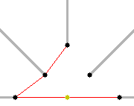

Problem Description
Number of poles are placed at the field.
Drives a car from pole s to t, and then from t to u within shortest route.
Poles cast infinitely long shadows, and the car cannot go across them.
First, s and u are chosen from each range, and t is chosen to maximize the length of the path.

Slide 68
Solution
Find the shortest path between each pair of poles.
O(n²)
Find t for all pairs (s, u).
O(n²)
Answer the queries.
Find cumulative sum and answer each query in O(1)
O(n²+q)

Slide 69
Step 1. (slow version O(n³))
Find the shortest path between each pair of poles (s, x).
Find convex hull O(n²) times

Slide 70
Step 1. (fast version O(n²))
Find the shortest path between each pair of poles (s, x).
update
Find all convex hull from s in O(n) times

Slide 71
Step 2. O(n²)
Find t for all pairs (s, u).
Let f(s, u) = t such that
The shortest route of s -> t -> u is clockwise.
t is chosen to maximize the shortest route
The answer is
max(dist(s, f(s, u)) + dist(u, f(s, u)),
dist(s, f(u, s)) + dist(u, f(u, s)))
Property: f(s, u-1) <= f(s, u) <= f(s+1, u)
Can be speeded up to O(n²)

Slide 72
D:Colorful Rectangle

Slide 73
Task
There are red, blue, green points on a plane.
Find the shortest perimeter of a colorful rectangle.
Colorful
Colorful
Not Colorful

Slide 74
Two types
By considering rotations and color swapping, we only need to consider the following two types of arrangements.
Type1
Type2

Slide 75
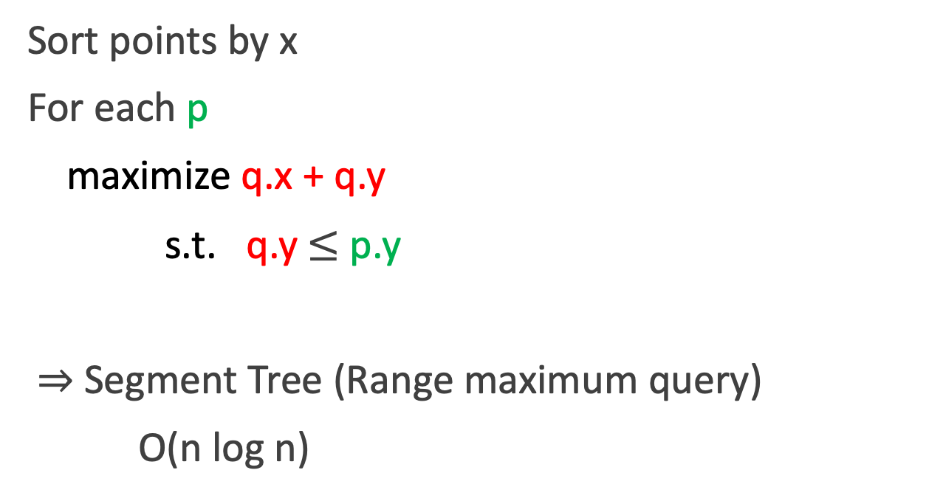
Type 0 (Easy problem)
Sort points by x
For each p
maximize q.x + q.y
s.t. q.y $≤$ p.y
$⇒$ Segment Tree (Range maximum query)
O(n log n)

Slide 76
Type 0 (Easy problem)
Sort points by x
Initialize segtree T
For each p
if p is red
T.insert(p.y, p.x+p.y)
if p is green
p.x+p.y-T.query(p.y)

Slide 77
Type 1
Sort points by x
Initialize segtree R and B
For each p
R.insert(p.y, p.x+p.y)
B.insert(p.y, R.query(p.y))
p.x+p.y-B.query(p.y)
O(n log n)

Slide 78
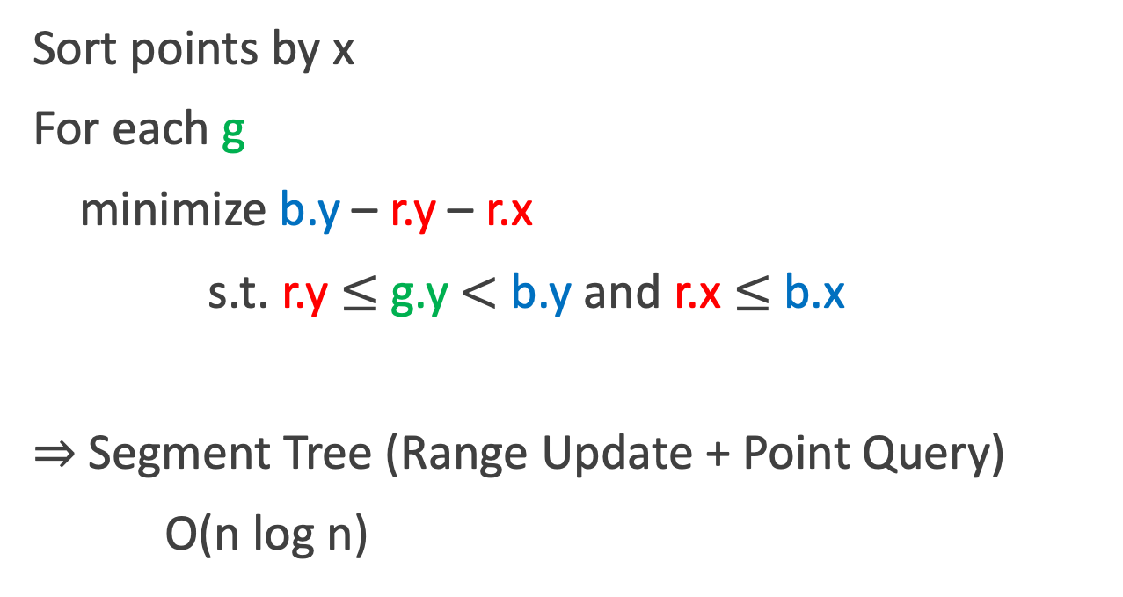
Type 2 (Difficult)
Sort points by x
For each g
minimize b.y – r.y – r.x
s.t. r.y $≤$ g.y $<$ b.y and r.x $≤$ b.x
$⇒$ Segment Tree (Range Update + Point Query)
O(n log n)

Slide 79
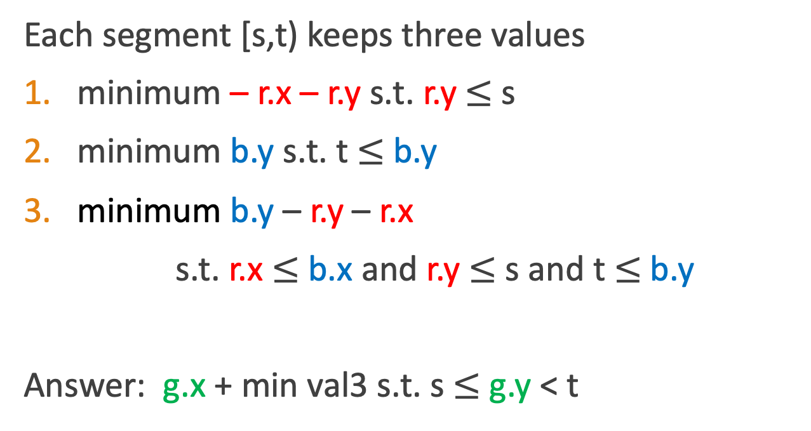
Type 2 (Difficult)
Each segment [s,t) keeps three values
minimum – r.x – r.y s.t. r.y $≤$ s
minimum b.y s.t. t $≤$b.y
minimum b.y – r.y – r.x
s.t. r.x $≤$ b.x and r.y $≤$ s and t $≤$b.y
Answer: g.x + min val3 s.t. s $≤$ g.y < t

Slide 80
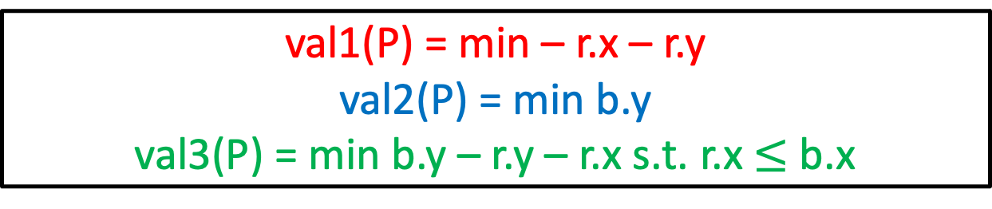
x
val1(P) = min – r.x – r.y
val2(P) = min b.y
val3(P) = min b.y – r.y – r.x s.t. r.x $≤$ b.x
Key Property
Push down
val1(L)
val2(L)
val3(L)
val1(R)
val2(R)
val3(R)
s
(s+t)/2
t
y
val1(L)=min(val1(L), val1(P))
val2(L)=min(val2(L), val2(P))
val3(L)=min(val3(L), val3(P), val1(L)+val2(P))

