Slide 1
IDS 462 Fall 2006
Lecture 5
Full Prepare & Build Logit Model

Slide 2
Agenda
Format all variables according to dictionary (as needed)
Practice using SIC to decide on best ‘linear transform’
Fill out some rows of the spreadsheet
  You do the remaining rows
For homework
  Transform and sweep variables
  Fill in the remaining rows of the spreadsheet
  Build your best model
  Compute percent of responses captured in the top 75% of the modeled names
  Build a lift chart

Slide 3
Formatting for L4, Etc.
Get the file Coil1.xls down from blackboard
  Remember it is in Lecture 3 folder
Bring into SAS as necessary
Bring down and run Lecture5Macros.sas
Run programming to keep only the 26 independent variables, format for L4, L3
  This is all in Lecture5Program.sas in the Lecture 5 Folder
  Remember to change location of initial coil1.xls reference

Slide 4
Graph Programs
Now re-run the graphs for 24 quantitative variables
Two differences between this program and the one you used to do previous homework:
  Dependent variable is response rate and not log odds
    If response rate is zero then log odds is undefined and can’t be plotted
  Uses original values of independent variables instead of deciles (10 groups of equal size)
    If independent variable has hundreds of values then need to use deciles
    What is the situation with this data?
      What does output of %FreqReport(Quant); tell us?

Slide 5
Graphic Output
  Can get 4 on a page in MS Word
  How use?
    Quickly look at all 26 graphs to see if variable needs transform
Use the suggested shape to test some transforms

Slide 6
Quadratic vs. Linear for MGEMOM
What does graph of MGEMOM (2nd graph) suggest?
How test?
  Review from last week
    What is adjusted R-squared?
    What is analog for logistic regression model?
    What number is better?

Slide 7
SC Results for MGEMOM
Summary of results for SC for MGEMOM
SC for linear model: 1,842
SC for quadratic: 1,850
So select linear model

Slide 8
Adjust MAANTH
What does first graph (MAANTH) show?
Sweep values greater than 3 into 3

Slide 9
Let’s Do A Few More
MGODRK2
MHHUUR2

Slide 10
Qualitative Variables
Run %CatToBinWithDrop() for
  MOSTYP
  MOSHOO
Why?

Slide 11
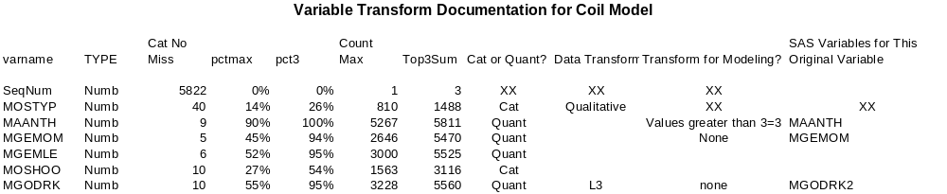
Very Important !
If you decide that the best relationship is quadratic (squared) then you must include the original variable name and the variable of the squared value
Also true for cubic relationship
If you choose inverse, log or sqrt, then just put new variable name in last column

Slide 12
Homework Part 1
You will build off this work to make a model
Print out a copy of your completed spreadsheet (on one page) and give it to me
Along with the 26 or so graphs
  Write a note on each graph regarding transforms and sweeps
  Even if the note is something like ‘No transform’, or just draw a straight line through the data points suggesting that the original form is fine

Slide 13
Build Transformed File
Use the programming in Lecture5Program (creating coil6 from coil5) to create a file that contains all the variables that you built with your transforms
  So all the variables in the right-most column of the sheet, plus the variables created as a result of %CatToBinWithDrop added to the original file
  So seqnum, resp and respholdout are also on the file

Slide 14
My Model Vs Your Model
I will now go over some programming, output and spreadsheet work using the model that is shown in Lecture5Program. This My Model.
You are to build Your Model for your memo using the results of your data cleansing and stepwise logistic regression
If you hand in your homework based on My Model then I will give you a zero for this assignment
  Yes, I will be able to tell the difference

Slide 15
Homework
Bring to me the beginning of next class
  Transform sheet, fully filled out
  26 graphs with notes on them
  Code and output from YOUR model
  Gains chart from YOUR model
  Notation on gains chart of the percent of responses from the holdout group captured in the top 75% of scored names
    You can just write it on the graph with a pen

Slide 16
Very Important!
This assignment will have the same weight as one of the memos
Please come to class with this work completed and ready to move to the next step
The next step is writing a memo from this model

