Slide 1
IDS 462 Lecture 1
SAS Basics
Factor Analysis

Slide 2
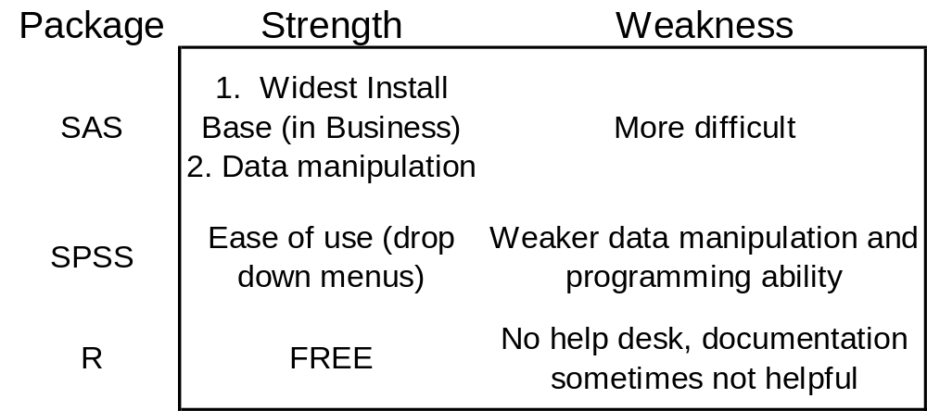
Strengths & Weaknesses of
Different Statistical Software
The outcome of this is that we will concentrate on SAS in this course

Slide 3
GUI Software
Graphical User Interface tools exist from both SAS (Enterprise Miner) and SPSS (Clementine), as well as others
These allow users to execute analysis without having to program
They are comparatively expensive
The emphasis of these packages is on analyzing the data, assuming the data is already well documented and reasonably ‘clean’
  Often figuring out the data and cleaning it is (much) more than half the project

Slide 4
SAS Basics
The first most important thing to understand about SAS, is that it is basically divided into two types of tasks
  The data step is used to manipulate data
  Procedures (abbreviated as procs) are used to execute statistical or other analyses

Slide 5
The Data Step
If you already have a SAS data set, then the way you manipulate data is with the following syntax
  Data new;
  Set old;
  Programming statements here;
  Run;

Slide 6
Procedures
For procedures, you name the procedure and point SAS at the data set. For example
  PROC MEANS DATA=SCORE MAXDEC=2 N MEAN STD RANGE MIN MAX;
  TITLE "Class Statistics";
  VAR RAW PERCENT;
  RUN;
What does this set of commands do?

Slide 7
Temporary vs. Permanent Files
To store a file permanently, you must set up a library and then write the data set to that library
  Otherwise, files are written to the work library and deleted at the end of the SAS session
To specify a library simply use a libname statement with quotes:
  Libname storage “H:\Storage”;

Slide 8
Storing A Permanent Data Set
Libname storage “H:\Storage”;
Data storage.MyNewData;
Set old;
Run;

Slide 9
First Memo: Factor Analysis
Tonight we will cover Factor Analysis
The file we will use is called dmefzip.sas7bdat
  This is a file containing census bureau demographics for all zip codes at that time
  This file is available on the Blackboard site if you can get in
  If not, see me

Slide 10
What is Factor Analysis
In short, it is a method for reducing a large number of variables down to a few underlying ‘Factors’, or themes in the data
The next 12 slides are from a presentation I made to a client explaining the use of Factor Analysis

Slide 11
Client Presentation:
Analysis Objective
The survey contains approximately 35 questions and 50 data points
Objective: Boil these 50 data points down to approximately 5 summary measures

Slide 12
Client Presentation:
Analysis Strategy
There are two alternatives for distilling the survey data into summary measures
  Industry knowledge
    Group questions that are known to relate to each other in this industry
  Relationship in data
    Group questions that are related in the survey data

Slide 13
Client Presentation:
Industry Knowledge Approach
Disadvantages
  Subjective
  Large number of questions makes this difficult

Slide 14
Client Presentation:
Data Driven Approach
Advantages
  Based on research data
Disadvantages
  Large number of variables makes it difficult to decide how to group them together
    See slide 11 (actually 17 in this presentation)

Slide 15
Client Presentation:
Data Driven Approach— Example
The following slides demonstrate how to overcome the problems of the data driven approach and therefore boil down multiple questions to a few summary measures
Example is based on US Census data for Zip Codes

Slide 16
Client Presentation:
Example-- Background
The association between two questions is commonly measured by their correlation
Recall that correlations near +/- 1 indicate strong relationships and near zero indicate no relationship
Arranging the correlations in a matrix allows us to examine which questions have strong relationships

Slide 17
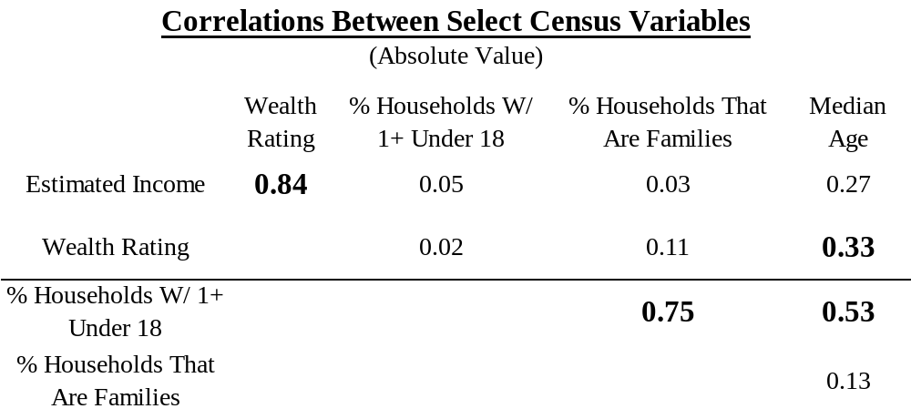
Client Presentation:
Example– What Do With Age?
Estimated Income is strongly related to Wealth Rating (correlation=.84). Also % Families and % HH’s with 1+ Under 18 are also highly correlated (.75).
But Median Age has a moderate relationship with Wealth (.33) and HH’s Under 18 (.53)
So how do we choose to group the Age variable? Does it go with ‘Wealth’ or with ‘Family Status’?
This problem increases as the number of variables increases

Slide 18
Client Presentation:
Factor Analysis
Fortunately, Factor Analysis is the statistical tool to handle this question
It looks for underlying factors in the data
  I.e. Affluence, Family Status
It groups the survey questions that best fit with these factors
  I.e. Estimated Income and Wealth, % Families and HH’s with 1+ Under 18, etc.

Slide 19
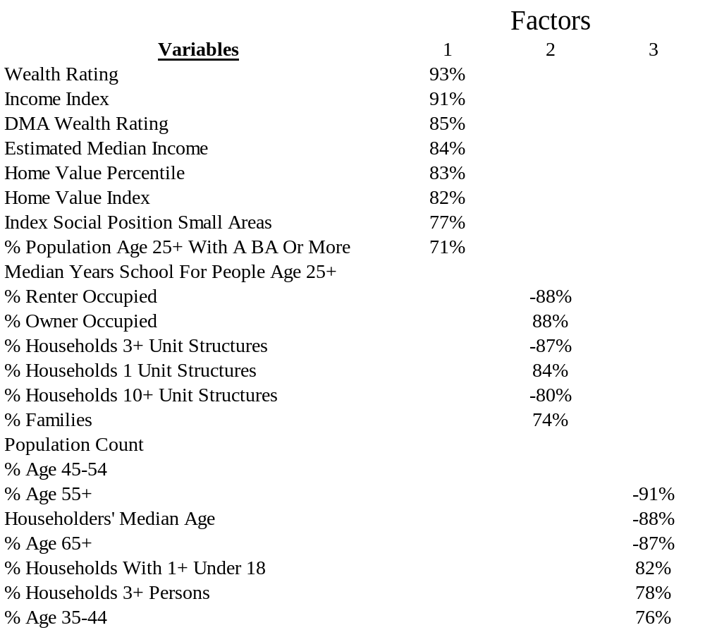
Client Presentation:
Example Findings
A PARTIAL report from a Factor Analysis on the Census data is shown at left
The results show 3 factors that can be termed Affluence, Family Status and Age
The figures indicate the general strength for each variable on each factor
Note that the actual analysis showed 5 total factors
[Let’s discuss this output some. Do you understand it?]

Slide 20
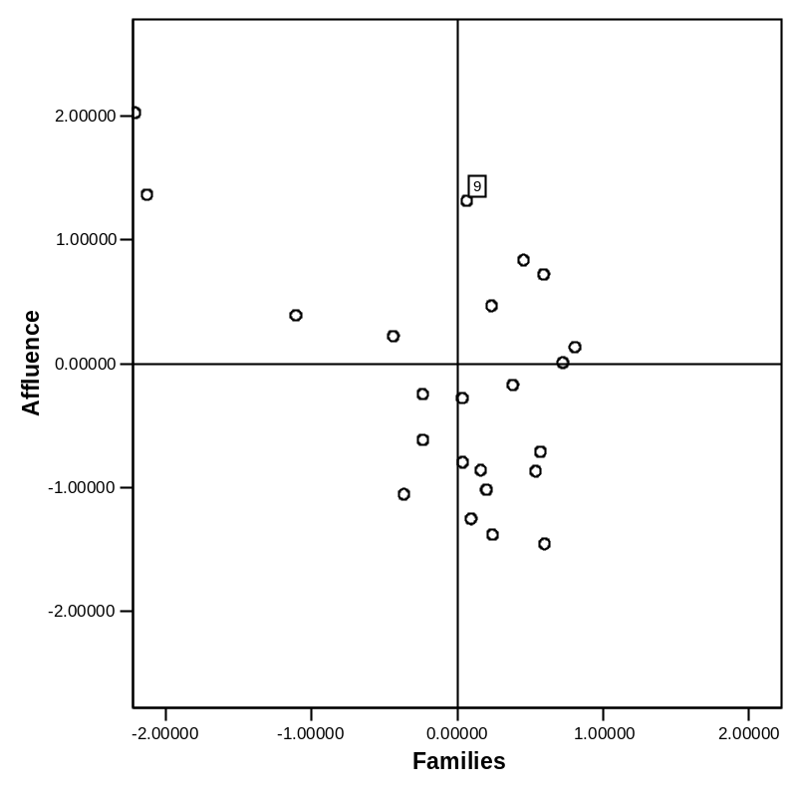
Client Presentation:
Factor Scores– Visual Presentation
After identifying the factors, each of the records can be scored on each factor and these scores displayed graphically
The graph at left shows a sample of Zips and how they score on Affluence and Family factors
Record 9 (marked w/ box) scores high on Affluence, but has the average number of Family characteristics
Sample Records Graphed on Affluence & Family

Slide 21
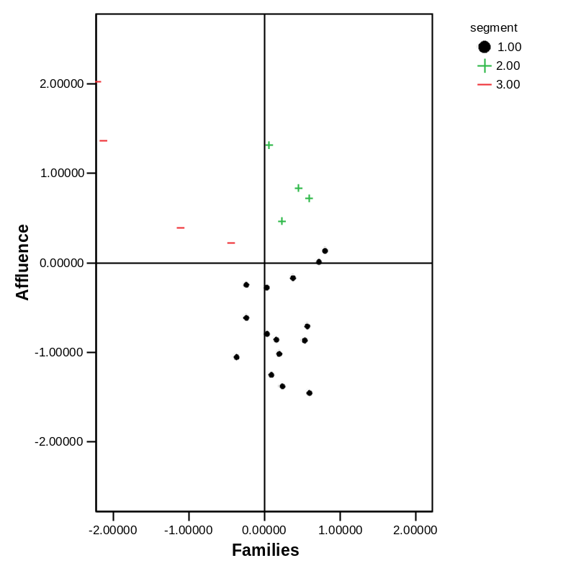
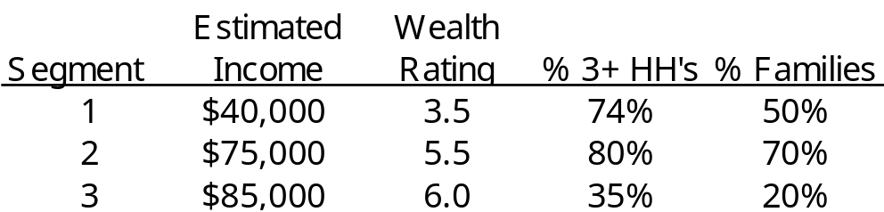
Client Presentation:
Next Step: Factor Scores– Segments
Sample Records Graphed With Segment
The graph at left shows a mock-up of how the chart would look using segments. We can also calculate summary statistics by segment
Larger symbols on chart show average factor scores by segment. This and the summary statistics gives readers additional information about where they fall relative to other companies
Note: Table averages are hypothetical

Slide 22
Client Presentation:
Data Considerations
Factor analysis requires a “large” number of responses
Amount of correlation in the data also influences the necessary number of responses
Conclusion: It is unlikely we can use these techniques if we only have 30 respondents
  Usually aim for more than 100
Number of missing responses is also an issue
I can investigate small-sample adjustments and ways to circumvent missing data problem

Slide 23
What Have We Learned
Factor Analysis Gives Parsimony
  We boil the information from a large number of variables down to a small number of factors that provide MOST of the information in the original variables
In a slightly more mathematical/geometrical interpretation, Factor Analysis draws axes through the longest ellipses in the structure of the data (illustration drawn on board)

Slide 24
Assumptions
Factor Analysis assumes the data is multivariate normal (MVN)
  It is moderately robust to this assumption
Business data is almost never MVN
  Contains binary, categorical variables etc.
  What to do?

Slide 25
‘Test’ for MVN Departure
Ultimately factor analysis runs on the correlation matrix of the data
I recommend that you execute the factor analysis using the standard correlation matrix and one using non-parametric correlations
If the results are anywhere near the same, then (loosely) the data are robust to the departure of MVN

Slide 26
Quality Control List for Analysis
Pare down to only numeric variables that are actually quantitative
Standardize remaining variables to mean zero and variance 1
Look at scree plot and understand proportion of variance
Move output to Excel
Summarize or classify Factors

Slide 27
Proc Contents
Un-compress your zipped data set, put it somewhere you can get to (like the desktop)
We need to figure out how to find the path for the desktop!
  Right-click on the DMEF file on your desktop and look at the path
  Copy and past that path into your libname statement
The Contents Procedure is very useful because it gives you a summary of the data in your data set
  Proc conents data=storage.dmefzip;
  Run;
I recommend printing this out
What do you see?

Slide 28
Variable Types
Proc contents tells us if the variables are stored in numeric or string format
I will show you how to have factor analysis run on all the quantitative variables in the data set
However, not all variables stored in numeric form are quantitative
  Example: ADICode. What does a smaller vs. larger value tell us vs. a variable like householder’s median age?

Slide 29
Preparation
In SAS execute the following program
  Change the directory to the spot that holds your data
  This program is in the assignments folder for Lecture 1
libname storage "D:\School\IDS462";
Note: adjust this as necessary
proc contents data=storage.dmefzip;
title "Contents of Zipcode Demographic File";
run;
title;
proc means data=storage.dmefzip;
title "Summary Statistics for Zipcode File";
run;
title;
proc means data=storage.dmefzip n nmiss maxdec=0;
title "Missing Values Report for Zipcode File";
run;
title;

Slide 30
Proc Means– Default
What does the output from the first proc means give?
What is good about it
What is bad

Slide 31
Proc Means– Adjusted
Second proc means output gives n and nmiss
What tell you?
What is implication for factor analysis
  Should we try to replace missing values or not?
  Why or why not?
MAKE SURE YOU UNDERSTAND THIS!

Slide 32
Quality Control List for Analysis
Pare down to only numeric variables that are actually quantitative
  What does this mean?
Standardize remaining variables to mean zero and variance 1
Look at scree plot and understand proportion of variance
Move output to Excel
Summarize or classify Factors

Slide 33
Removing & Standardizing
libname storage "C:\Documents and Settings\John Sparks\Desktop";
proc means data=storage.dmefzip n nmiss maxdec=0;
title "Missing Values Report for Zipcode File";
run;
title;
data prefactor;
set storage.dmefzip (drop=adicode branchcd countycd countynm dmacode filetype
msa multzip nielcode poffname rectype stateabr statecd);
run;
proc standard data=prefactor replace out=prefactor;
run;
proc means data=prefactor n nmiss maxdec=0;
title "Missing Values Report for Zipcode File After Mean Replacement";
run;
title;
proc standard data=prefactor out=storage.standard mean=0 std=1;
var _numeric_;
run;
proc means data=storage.standard nmiss mean std maxdec=0;
title "Report for Zipcode File After Standardization";
run;
title;

Slide 34
Moving From SAS to SPSS
This is easy because SPSS will read a SAS file
Going the other direction (from SPSS to SAS) is not as simple
Be aware that there is a piece of software called DBMS Copy--which is available at the labs and for purchase– that provides the ability to move to and from many different formats
  Unfortunately, it does not work so well for getting from SPSS to SAS, so we will not use it for that

Slide 35
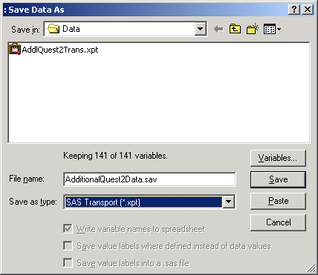
Note: SPSS to SAS
Using Transport File
The following steps show how to get from SPSS to SAS, but this is not part of what we are doing for this assignment. Keep this for reference
libname field "C:\FieldMuseum\Year3\Data";
libname insource xport 'C:\FieldMuseum\Year3\Data\AddlQuest2Trans.xpt';
proc copy in=insource out=field;
run;
proc contents data=field.sas;
run;
data Field.AddlQuest2;
set field.sas;
run;
SAVE TRANSLATE
OUTFILE='C:\FieldMuseum\Year3\Data\AddlQuest2Trans.xpt'
/TYPE=SAS /VERSION=X /MAP /REPLACE .

Slide 36
Open SPSS
Go to Start Menu
Math Stats Software and Open SPSS
  This will take a little while
What do you notice about the look of SPSS vs. SAS?

Slide 37
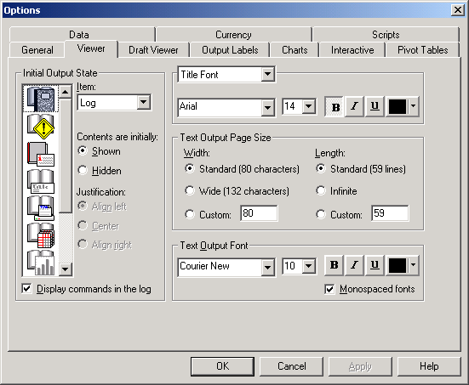
Getting Program Commands in Output Window
From SPSS go to Edit…Options
Then the Viewer tab
At lower left check the box next to the text “Display commands in the log”

Slide 38
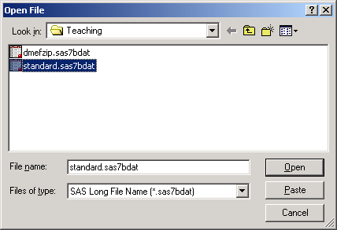
Method for SAS to SPSS
Go to File→ Open…Data
On File Type Menu scroll down to bottom to see SAS Long File Name
Select this and if you are pointing at the correct directory then you should see your file “Standard”
Double click to select

Slide 39
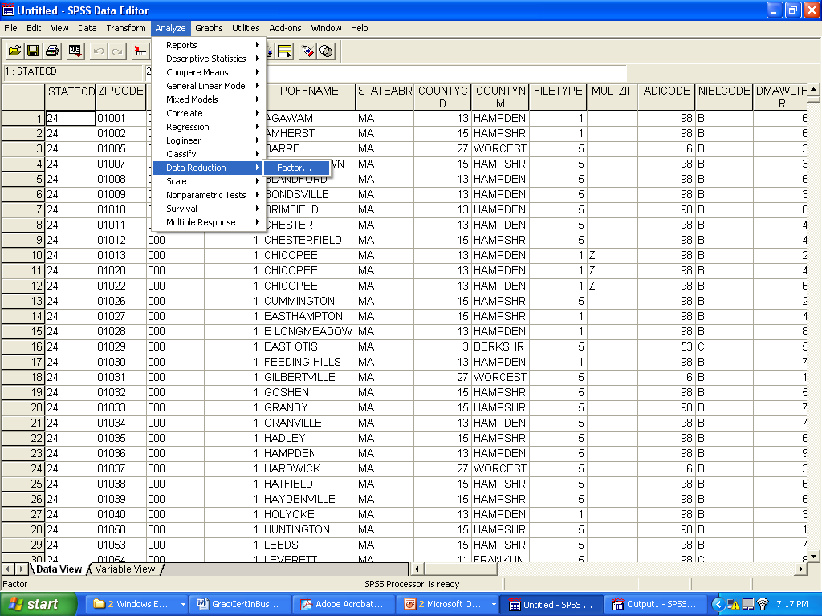
Factor Analysis in SPSS
Now I will show you how to do Factor Analysis using SPSS
Go to Analyze… DataReduction… Factor

Slide 40
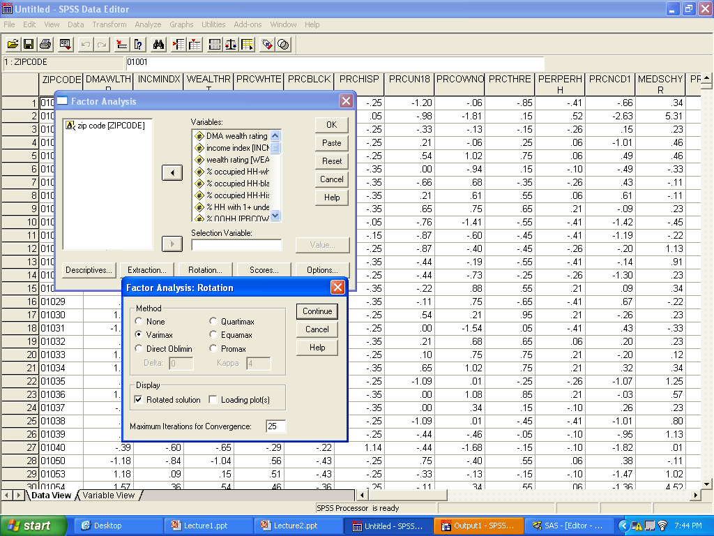
Factor Analysis Steps
Highlight all the variables except zip code (why?)
Under Rotation select varimax

Slide 41
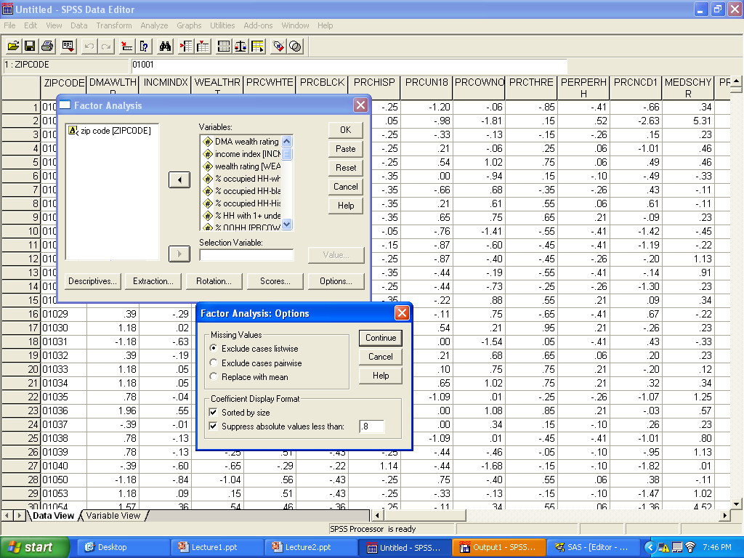
Factor Analysis Steps
Also, under options, check the bottom two boxes and put .8 into the box at lowest right
Hit continue, and the OK on the main menu
Now we will look at and discuss the output

Slide 42
Selecting Number of Factors
There are 32 variables. 1/32=3.1%. If we want factors that explain more variability than a single variable then we select the factors that account for 3.1% of the variance or more
  [Mathematically, this is the same as selecting factors with an eigenvalue greater than 1.0]
In some cases, this method does not work, so you can use the scree plot to make the decision differently, although more heuristically

Slide 43
Memo
Your boss wants to know
  “What are the major ways in which the US distinguishes itself demographically?”
  “I am building some demographic questions into a survey. What are the 5 or 6 important general demographic questions to ask on that survey?”

Slide 44
Programming Assignment
You need to be practicing some basics with SAS so I must assign some additional basic homework
Read Chapter 1
  HW 1.2, 1.4, 1.10
Turn in separately from memo
Data and a few lines of programming are available on Blackboard under Course Documents/ Lecture01
Due date: See Class Schedule on Blackboard

