Slide 1
IDS 462 Lecture 7
Comparison of Binary Response ‘Models’

Slide 2
Competitors to Logistic Regression
See slides in lecture 6
Let’s review briefly
Neural Net: Universal approximator
  Will learn any pattern, no matter how complex
  So main challenge is getting it to model the general trends and not the ‘noise’
  This is done by using Training, Test and Validation samples
    Builds model on training sample, assesses fit (like R-squared) on test sample
    When fit on test sample starts to go down, stop
    Then assess overall performance on Validation (holdout) sample
    Discuss: Why are 3 samples necessary for NN and not logistic regression?

Slide 3
CHAID Review
CHAID Tree
  Finds independent variable that will split the sample so that subgroups have biggest difference in ‘response rate’
    Accidents or voting for George Bush
  Then looks to split the sub-groups again
  Different subgroups can be split using different variables

Slide 4
Running NN and Tree–
Good News and Bad News
The bad news is that the software to build Neural Networks & Trees is available on a limited basis
  Used for IDS 572
  Available in other computer labs
The good news is that I have done them for you using Clementine from SPSS and I am giving you the scored records
But first, the next few slides are screen shots from SPSS Clementine showing how these techniques are done using a GUI data mining package
These packages are worth knowing about in general
  They have strengths and weaknesses which I lectured on at the beginning of the semester

Slide 5
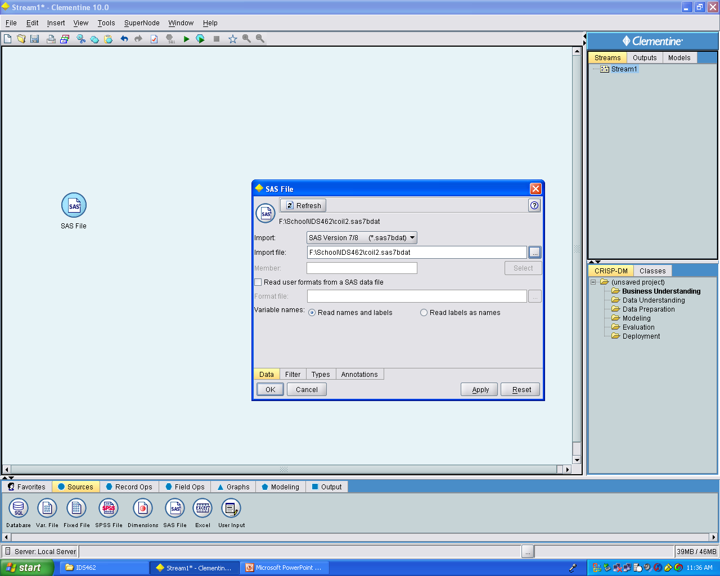
You create a ‘data source’ node (small circle to the left) and then use mouse clicks to point to your data

Slide 6
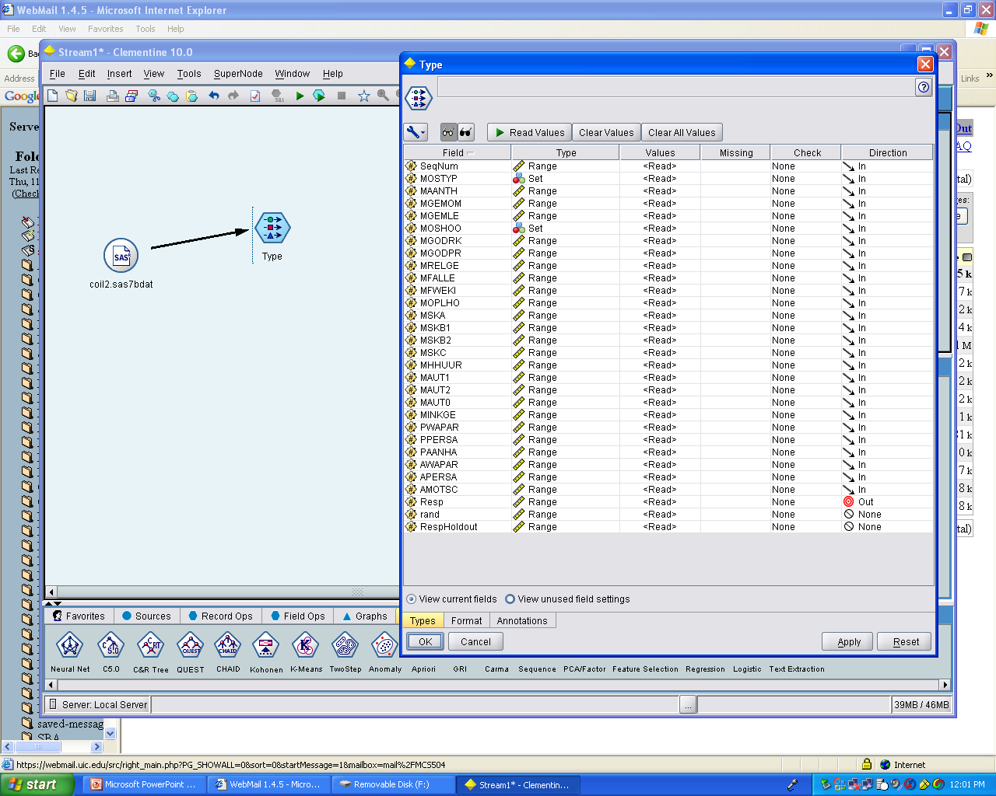
Next you set up a data filter to tell Clementine what types of variables are what
  Dependent
  Categorical
  Not used

Slide 7
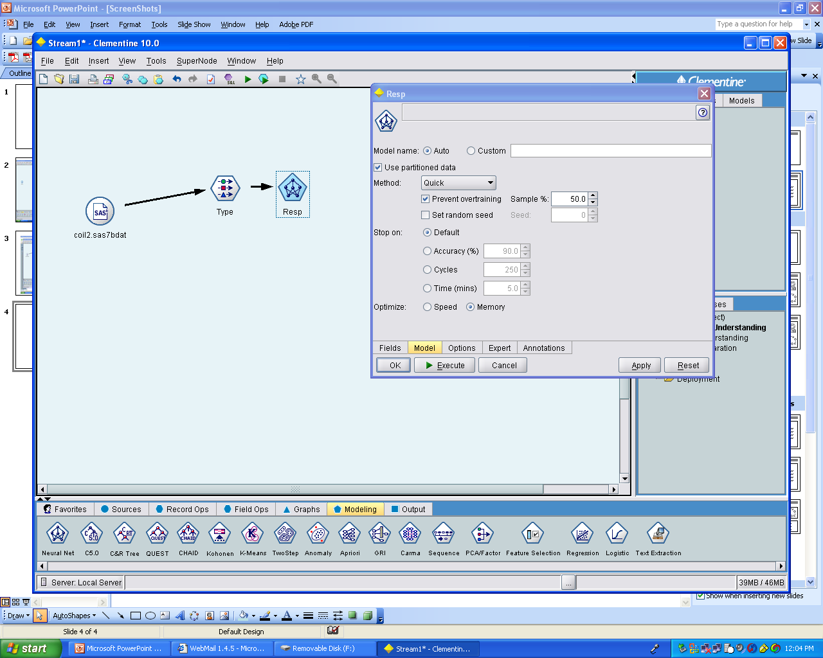
Next you connect a Neural Net node and you can use all the default settings for this example
Notice the Prevent Overtraining and 50% of sample options
If we already have a holdout sample for scoring, why use only 50% for training the neural net (that is, building the model)?
  Discussed previously

Slide 8
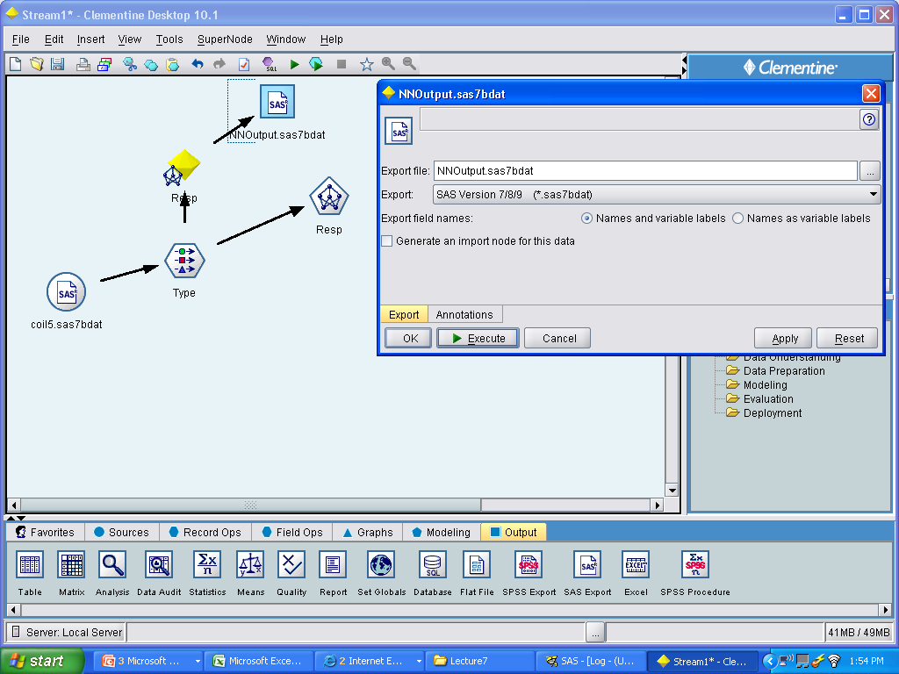
After executing the NN node you can attach an output node to make a SAS file (or others) and we can subsequently open the scored file in SAS

Slide 9
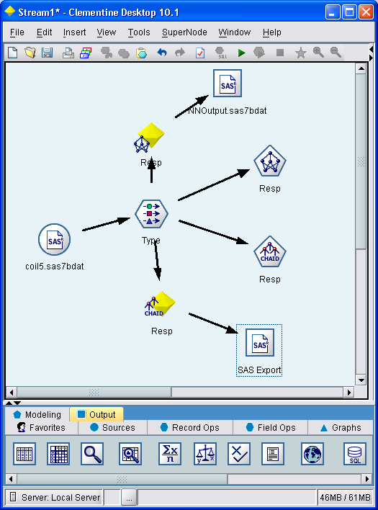
Now we can do the same basic thing for a CHAID analysis
Note: One of the default settings is that the tree will only split down 5 levels
Depending on the size of your file, you might want more

Slide 10
What Are the Results?
We will compare these to one Logistic Regression model
So that we are all working with the same set of figures for this assignment, use the scored records provided in RespAnalLR.sas7bdat for the logistic regression part of the assignment
  These are the scored records using a logistic regression model
Please download all the sas7bdat files and the file Lecture7 and run down to **Stop Here!!;
Let’s discuss the code in some detail, including the merging

Slide 11
Merging is Dangerous
Notice how pretty I have lined up the code for the merge so that it is almost like a table
I do this because merging is dangerous
If you make a mistake on the merge, it is easy to not detect it
Then you analyze, or send your client, the wrong data
Then you get fired

Slide 12
Merging Without By—DISASTER!!
It is not as difficult as you might think to write the merging code and forget the by statement (although it was appropriate in tonight’s program. I hope you understand)
This results in the records merging in sequential order without regard to any key variable (like seqnum)
I have seen this lead to DISASTER at least twice

Slide 13
Merging Without By
One of the problems about merging without a by statement is that SAS gives you no warning about this
On pg. 408 of the book (near the bottom) there is a system option that you can put into your code that will cause SAS to give you a warning or error if you merge without a by
I strongly suggest that you incorporate this into your personal SAS configuration if you do any complicated merging work as part of your SAS efforts

Slide 14
More Notes on Merging
SAS will not merge unless data sets are sorted by the key
A sas-sql option does exist to merge without the sort
Make sure you understand what the in= variables are and how to use them to control your merge
Read the notes in your log after the merge to understand how many records came in and out of the merge from your different files
The in= variables are temporary (they disappear after the merge), but you can use if statements to set their values to permanent SAS variables and then run freqs to get a more detailed understanding of the number of records from each file

Slide 15
Programming Assignment for Merging
Maybe changed due to schedule of topics for the class
The Class Schedule is the over-riding source for homework and due dates
Due: See Class Schedule
Problems 14.1, 14.3, 14.5, 14.7, 14.9, 14.11
No dataset names with characters from Lord of The Rings
You must use your last name for one of the datasets

Slide 16
Back to Memo: What Do We Have?
At this point we have the holdout sample scored using three different ‘modeling’ techniques
  Why did I put modeling in quotes?
We are going to see how the three of them compare in the following business situation

Slide 17
Business Question for Next Memo
The client says: The finance department wants me to cut my mail quantities to maximize the ROI for my mailings. Please use the major analytic techniques for response variables and tell me where I should cut the mail quantity to maximize ROI
But I also have to produce a certain amount of profit for my boss. So, could I cut it somewhere else to maximize the profit?
For the two cut points above, does one of them do a better job of meeting both goals?
Just for my understanding, tell me what techniques you used, and please show me the profit & revnue curve for all of them

Slide 18
Profitability Analysis for Mid-Term
Assume
  Fixed cost to produce a mailing: $10,000
  Variable cost: $1.00 per piece
  Revenue: $500 per response

Slide 19
Assume Non-Responders
Are Sampled Down
The response rate of 6% is far too high
Assume that the non-respondents are a 10% sample of the total non-respondents
Therefore the variable cost is $10.00 per record

Slide 20
How Answer Question
We need to produce a gains chart for all three models
We could do this in Excel, but if the mailing had more than 66,000 records then that would not be possible
So, YOU need to do some programming in SAS
Note: ROI is return on Investment or Profit/Cost
Profit is simply revenue minus fixed and variable costs
Any questions?
If not, then make a profit and ROI variable for each model in your SAS code below the merge

Slide 21
Now Back to the Excel
Make a spreadsheet out of the data set ‘compare’ using the right mouse click and copy/paste
Get the profit and ROI curves for all 3 ‘models’
Graph these. What do you see?

Slide 22
Next Memo Due
Due date is contained in Class Schedule
We will do a detailed outline next class period if we do not have time tonight
So you have an opportunity to come to the next class with your questions regarding this memo
  I suggest that you do so

