Slide 1
Ch. 7 Accounting from Kimball and Ross
IDS 521

Slide 2
Key concepts in this chapter
GL periodic snapshots and journal transactions
Chart of accounts
Period close
Year to date facts
Drilling down a Multi-ledger hierarchy
Hierarchies: Fixed depth positional, slightly ragged, and totally ragged
Consolidated fact tables

Slide 3
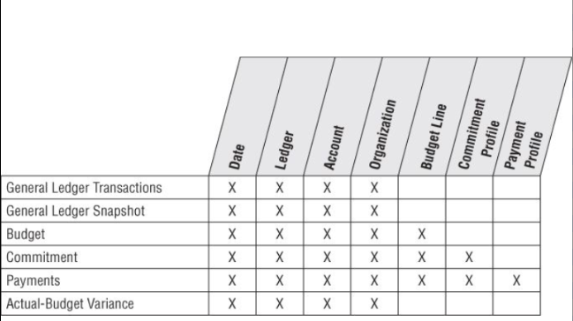
Accounting bus matrix
Notes:
What is a General Ledger? Data scattered among hundreds of tables; counter to need for fiscal transparency. Goals: Manage risk, streamline operations, identify potential cost savings.

Slide 4
General Ledger data

Slide 5
General Ledger data
GL Periodic snapshot
Chart of accounts
Period close
Year-to-date facts
GL Journal Transactions
Multiple Fiscal Accounting Calendars

Slide 6
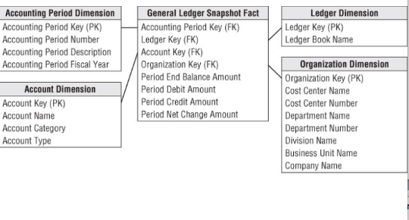
Period close
Notes:
Fig 7-2 GL Period snapshot- semi-additive facts; view at organization or accounts level; Constrain ledge to single value or see multiple entries. GL accounts don’t usually map to operational dimensions such as customer, product, service or facility.

Slide 7
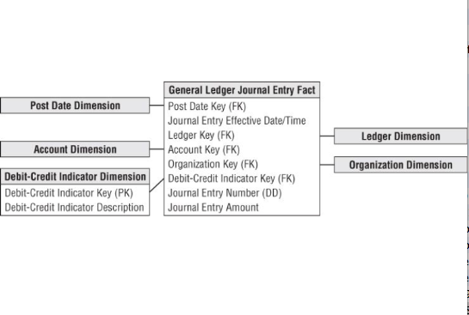
GL Journal Transactions
Notes:
Fig 7-3 GL Journal transactions. Find and investigate anomalies. Transaction level information; complements periodic snapshot.

Slide 8
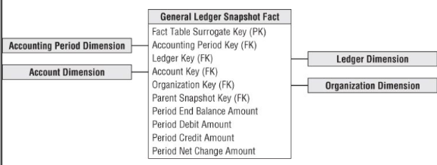
Drilling Down a Multilevel Hierarchy
Notes:
Fig 7-4 Table refers to itself. Parent-child relationship between rows.

Slide 9
SQL to drill down to the next lower level

Slide 10
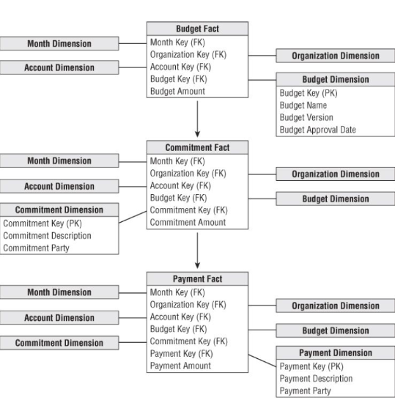
Chain of budget processes
Notes:
Budget fact: Advantages of recording only what has changed in each period: a) Easier to see what has changed and how much. b) Budget amount becomes fully additive across rows. c) Only need entries when something has changed – eliminating duplicate entries.

Slide 11
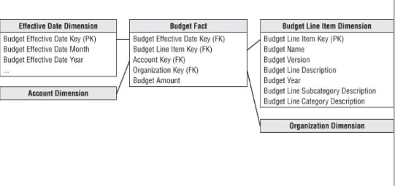
Budget schema
Notes:
Fig 7-6: Budget schema: A single line item can affect multiple GL accounts.

Slide 12
Fixed depth positional hierarchies
Fixed set of levels
Each level has a specific name
Examples:
day → fiscal period → year
day → month → year
fixed many to one hierarchy: executive, director, manager accounts

Slide 13
Slightly ragged variable depth
Example: Geographies vary in complexity.
Some locations have district and zone levels, while others do not.
Solution: Treat this like fixed-positional with minor propagation of attributes
e.g. if a location has no district, use the city name

Slide 14
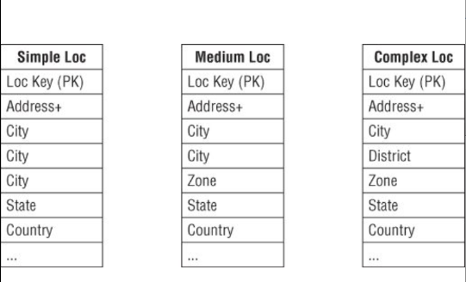
Slightly ragged variable depth

Slide 15
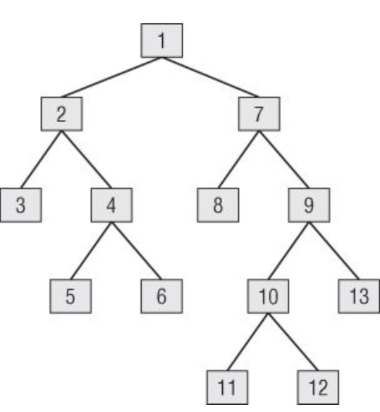
Ragged variable depth

Slide 16
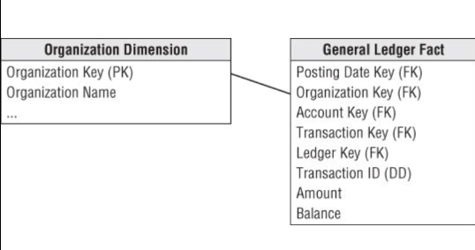
Organization dimension joined to fact table
Notes:
Fig 7-9 contains no information about the organizational rollup. Suppose you want to roll the budget up across portions of the tree, or all of the tree.

Slide 17
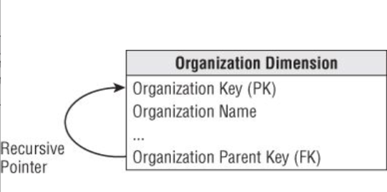
Classic parent/child recursive design

Slide 18
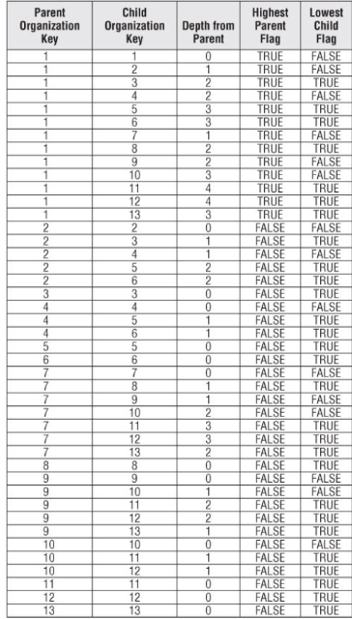
Notes:
fig 7-11 Org Map bridge table

Slide 19
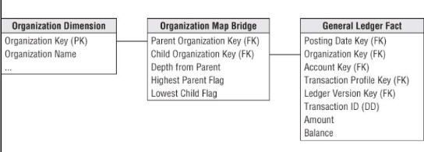

Slide 20
Using bridge tables to model variable ragged hierarchies
No need to traverse the tree at query time
e.g. Constrain the org bridge table on node #1 and simply fetch on some additive fact
get the entire tree in one query

Slide 21
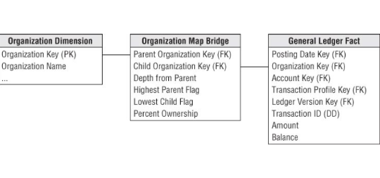
Shared ownership in a ragged hierarchy

Slide 22
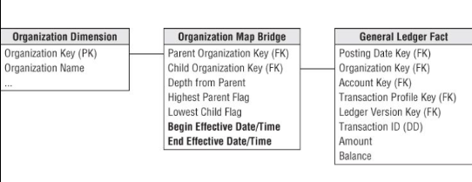
Time-varying ragged hierarchies

Slide 23
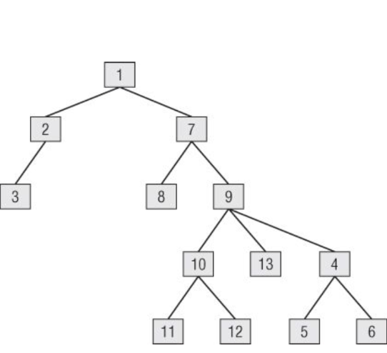
Modifying ragged hierarchies

Slide 24
Before

Slide 25
After

Slide 26
before and after
Notes:
Write the sql to modify the tree accordingly

Slide 27
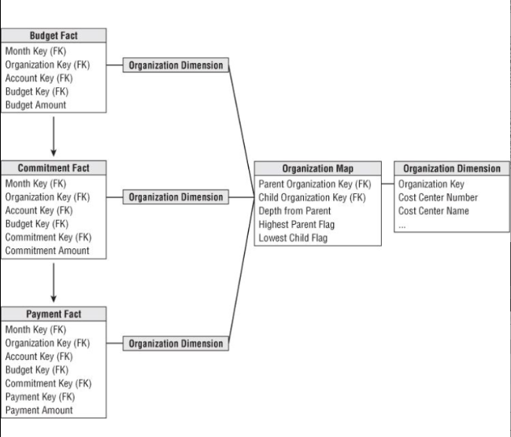
Drilling across and rolling up the budget chain

Slide 28
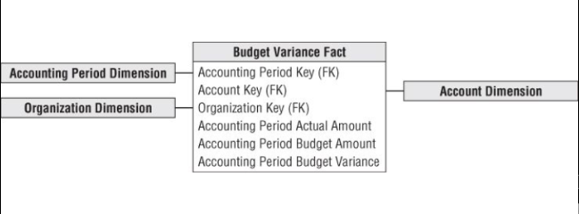
Consolidated fact table: actual versus budget
Notes:
consolidate to view difference between actual and budgeted amounts

