Slide 1
Indexes, Trees, and Hierarchies
IDS 521, Session 5, Sep. 28, 2015

Slide 2
We are in Week 5 of the accelerated RDBMS and SQL review phase. By now you should be able to:
Run all of the SQL examples in MySQL
Identify 1NF, 2NF, 3NF, and BCNF; given a schema and list of FD’s (sessions 1-2)
Write SQL to answer common patterns of: Negation, At most (at least), Exactly, Any or All (session 3)
Practical SQL topics (session 4)
Understand how three-valued logic handles Null values; and its impact in the SQL Where .. IN clause
Understand Distinct, and its better alternative in SQL to eliminate duplicate rows.
Identify correlated vs. uncorrelated subqueries
Given a database schema such as Sakila, write a SQL statement to answer basic business questions. (See next slide)
Use aggregate functions with group and order by; look up additional related SQL functions as necessary
Set operators such as Union, Exists, and In
This week (session 5):
Evaluate and troubleshoot a query, with the aid of the query execution plan (Explain)
Understand the costs and benefits of indexes; and when they are useful
Set up, query, and update a hierarchy using the nested hierarchy model

Slide 3
Sample questions we answered based on Sakila schema
List of customers that rent Comedies
Identify the staff member who handled the latest transaction prior to a specific date (e.g. 7/24/2005) a particular customer (e.g. customer 146)
Or the staff member who processed the last payment larger than 4 on or prior to the same date
List of addresses for both staff and customers who transacted payments after 8-01-2005
Count of rentals for each staff member where payments are greater than 6, between 4 and 6, between 2 and 4, and less than 2.
Can you think of other questions that can be answered with the Sakila schema?

Slide 4
Class exercise
Study the Sakila schema.
Write three business questions that can be answered with this schema; that we haven’t yet asked.

Slide 5
Class exercise
Study the Sakila schema.
Write three business questions that can be answered with this schema; that we haven’t yet asked.
Make a rough pass at each query and rank them in difficulty (easiest, medium, hardest).

Slide 6
Using indexes
Understanding costs and benefits

Slide 7
Indexes: Topics covered
Understanding costs and benefits.
When to use indexes; and when not to.
Using a query execution plan (Explain) to assess a SQL statement.

Slide 8
Indexes: Costs and Benefits
Costs
Creation at design time
Inserting into an existing database
Performing inserts, updates and deletes
Benefits
Query access; provided you are looking for specific rows
Joins between tables

Slide 9
Indexes: Costs
Indexes consume a lot of storage space
high storage cost; and long time to backup/restore
Updating or inserting indexed data requires high processing cost
CPU and I/O time
Each additional index can increase insert time by 100% (S. Faroult, Art of SQL, ch. 3)
Indexes slow down concurrent access
they are compact structures

Slide 10
Benefits: Indexes dramatically increase speed of queries
Accessing specific rows in a large table
Using the Where clause
Using the Like filter, as long as you match the left hand side (LHS)
Joining tables
Sorting

Slide 11
Limitations: Indexes rely on specific order of physical storage.
So indexes are not useful when you:
Use functions on indexed columns
e.g. where f(indexed_col) = ’some value’
Sort or do string matching on anything other than LHS of the indexed columns
Not useful for RHS matching such as: “Select id FROM some_table WHERE name LIKE ’%son’”
to find ids with names ending with “…son”
Aside: Please view the “Pattern matching” section in MySql documentation
Become familiar with the Like clause. Also learn to use the RegExp clause.
http://dev.mysql.com/doc/refman/5.0/en/pattern-matching.html
Learn how to use wildcards such as %, *, $..
When a full table scan is required (selecting all the data in a table)

Slide 12
Guideline: Create an index on columns that are used frequently in:
Where filter in Select statements
Also for string matching starting from left-hand side
E.g. “Select id FROM some_table WHERE name LIKE 'John%'”
to find ids with names beginning with “John”
Joins
Sorting

Slide 13
Accessing data: Index vs non-index columns
Indexes dramatically increase speed of:
Accessing specific rows in a large table
Finding a row using the Where clause
Using the Like filter
As long as you match the left hand side (LHS)
Avoid using wildcard characters on the LHS
Joining tables
Sorting

Slide 14
Diagnosing problematic SQL queries
Using the query execution plan (Explain)
Primary issues to identify: Often these cannot be avoided, but if you can avoid them you should.*
No index used, especially when using Where or a Join (NULL specified in the key column; also read notes under the extra column)
A large number of rows processed (the rows column)
A large number of indexes evaluated (the possible_keys column)
Tables of DERIVED, or DEPENDENT_SUBQUERY (the select_type column)
Please try the Explain with queries covered thus far in the course. For more information:
Explain syntax: http://dev.mysql.com/doc/refman/5.6/en/explain.html
Explain output: http://dev.mysql.com/doc/refman/5.6/en/explain-output.html
Notes:
* From “Effective MySql: Optimizing SQL Statements” (Oracle Press, 2011, chapter 2).

Slide 15
Using Indexes (examples)
show indexes from customer\G;
show indexes from rental\G;
explain select * from customer where last_name = "WOOD";
explain select * from customer where first_name = "Brian";
explain select count(*) from rental where rental_date <= '2005-9-30';
explain select count(*) from rental where rental_date = '2005-9-30';
explain select count(*) from customer where first_name = 'John';
Notes:
https://class2go.stanford.edu/db/Winter2013/problemsets/IndexesQuizVariation2

Slide 16
Trees and Hierarchies
Directed graphs with no cycles

Slide 17
Discussion topic: What are some examples of hierarchies?

Slide 18
Adjacency list model
Acquiring firm | Target firm | Acquisition date
2033721 | 1023538 | 2/28/90
1199509 | 2176413 | 4/11/90
1117781 | 1022728 | 1/18/94
1026016 | 1020603 | 1/28/94
1031506 | 1029923 | 3/4/94
1248612 | 1076712 | 3/21/94
1199844 | 1199714 | 4/5/94
1068762 | 1134386 | 5/6/94
1883693 | 1120754 | 5/12/94
1094369 | 1138889 | 7/1/94
1074790 | 1074156 | 8/1/94
1078921 | 1086533 | 8/16/94

Slide 19
Trees and hierarchies: Adjacency list model
Pros
Traditional programming method in procedural languages
Benefit: Easy to insert a new node
Cons
Difficult to ensure that there is only one root node, and there are no cycles
Need to traverse from node to node to answer questions
Lots of self-references to nodes

Slide 20
Path Enumeration Model, example
Node | Path
A | ‘a/’
B | ‘a/b/’
C | ‘a/c/’
D | ‘a/c/d’
E | ‘a/c/e’
F | ‘a/c/f’

Slide 21
Trees and hierarchies: Path Enumeration model
Pros
Querying is moderately difficult; easier than adjacency list
Cons
Path embeds multiple node names separated with a slash; violates first normal form
Lots of self-references to nodes
Integrity constraints are difficult to maintain

Slide 22
Nested Sets (we will focus on this one)
Pros
Elegant and easy to query
No self-referencing
Rgt and Lft numbers (in each row) convey a lot of useful information about positioning
Cons
Query performance can be slower
May be harder to update or insert new nodes
Notes:
Cit Joe Celko’s Ch. 36 in SQL for Smarties; as well as Mike Hillyer’s blog: http://mikehillyer.com/articles/managing-hierarchical-data-in-mysql/

Slide 23
Exercise: Draw the nested tree represented by this table, in a) linear tree diagram and b) sets representation
category_id | name | lft | rgt
1 | ELECTRONICS | 1 | 20
2 | TELEVISIONS | 2 | 9
3 | TUBE | 3 | 4
4 | LCD | 5 | 6
5 | PLASMA | 7 | 8
6 | PORTABLE ELECTRONICS | 10 | 19
7 | MP3 PLAYERS | 11 | 14
8 | FLASH | 12 | 13
9 | CD PLAYERS | 15 | 16
10 | 2 WAY RADIOS | 17 | 18
source: http://mikehillyer.com/articles/managing-hierarchical-data-in-mysql/
Notes:
source -- http://mikehillyer.com/articles/managing-hierarchical-data-in-mysql/

Slide 24
Containment property
All descendants of a node have lft and rgt number between the lft and rgt number of their parent nodes.
-- Get all the nodes in a subtree
SELECT node.name
FROM nested_category AS node,
nested_category AS parent
WHERE node.lft BETWEEN parent.lft AND parent.rgt
AND parent.name = 'ELECTRONICS'
ORDER BY node.lft;
Notes:
Revisit Cartesian product

Slide 25
Containment property
Retrieve a single path
SELECT parent.name
FROM nested_category AS node,
nested_category AS parent
WHERE node.lft BETWEEN parent.lft AND parent.rgt
AND node.name = 'FLASH'
ORDER BY node.lft;

Slide 26
Counting property
The lft and rgt number carry information about the location and nature of each subtree.
The root is always:
(lft, rgt) = (1,
2 *select COUNT(*) from nested_category)
A leaf is always:
rgt = lft + 1
Notes:
RETRie

Slide 27
Exercise
Write SQL to retrieve all of the leaves of the tree.
Write SQL to retrieve only the top parent node.

Slide 28
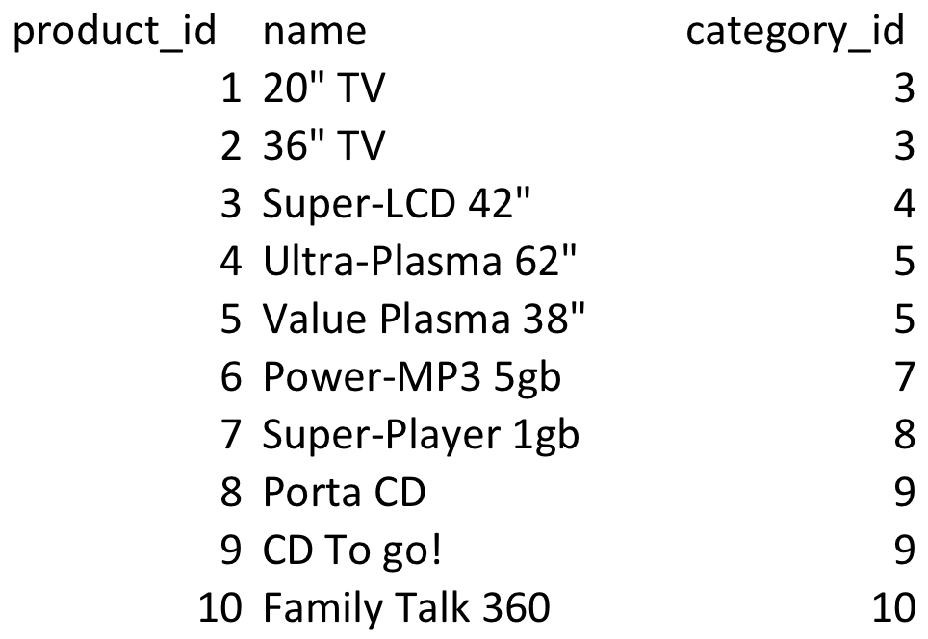
Product categories

Slide 29
Connect to product list details
NESTED CATEGORIES
PRODUCT LIST
category_id | name | lft | rgt
1 | ELECTRONICS | 1 | 20
2 | TELEVISIONS | 2 | 9
3 | TUBE | 3 | 4
4 | LCD | 5 | 6
5 | PLASMA | 7 | 8
6 | PORTABLE ELECTRONICS | 10 | 19
7 | MP3 PLAYERS | 11 | 14
8 | FLASH | 12 | 13
9 | CD PLAYERS | 15 | 16
10 | 2 WAY RADIOS | 17 | 18
Notes:
source -- http://mikehillyer.com/articles/managing-hierarchical-data-in-mysql/

Slide 30
Hierarchical aggregates
Retrieve our category tree, along with a product count for each category
SELECT parent.name, COUNT(product.name)
FROM nested_category AS node ,
nested_category AS parent,
product
WHERE node.lft BETWEEN parent.lft AND parent.rgt
AND node.category_id = product.category_id
GROUP BY parent.name
ORDER BY node.lft;

Slide 31
Hierarchical aggregates
Find the depth of each node
SELECT node.name, (COUNT(parent.name) - 1) AS depth
FROM nested_category AS node,
nested_category AS parent
WHERE node.lft BETWEEN parent.lft AND parent.rgt
GROUP BY node.name
ORDER BY node.lft;

Slide 32
Exercise
What other queries are possible on a tree?
Write one business question.

Slide 33
Discussion exercise
Given a product in the list, give the list of all other products that are within the same immediate parent category.
e.g. Given TUBE, the query returns LCD, and PLASMA

Slide 34
Delete a node: Must renumber the nodes after deleting any of them; to restore the counting property
1) Delete from nested_category where category_id = ___
2) UPDATE nested_category
set lft = (
Select count(*) from
(Select lft as seq_nbr From nested_category
UNION ALL
Select rgt as seq_nbr from nested_category) as LftRgt
where seq_nbr <= lft),
rgt = (Select count(*) from
(Select lft as seq_nbr From nested_category
UNION ALL
Select rgt as seq_nbr from nested_category) as LftRgt
where seq_nbr <= rgt);

Slide 35
Exercise: We have deleted the Televisions node (category_id = 2). Please finish renumbering the nodes based on the Update statement
category_id | name | LFT (OLD) | RGT (OLD) | LFT (NEW) | RGT (NEW)
1 | ELECTRONICS | 1 | 20 | 1 | 18
3 | TUBE | 3 | 4 | 2 | 3
4 | LCD | 5 | 6 | 4 | 5
5 | PLASMA | 7 | 8 | 6 | 7
6 | PORTABLE ELECTRONICS | 10 | 19
7 | MP3 PLAYERS | 11 | 14
8 | FLASH | 12 | 13
9 | CD PLAYERS | 15 | 16
10 | 2 WAY RADIOS | 17 | 18

