Slide 1
Ch. 5 Order Management from Kimball and Ross
IDS 521

Slide 2
Key concepts in this chapter
Orders transaction schema
Fact table normalization
Role-playing dimensions
Factors to determine single or multiple dimensions
Junk dimensions for misc. flags
Patterns to avoid with header and line items
Invoicing transaction schema with profit & loss facts
Audit dimension

Slide 3
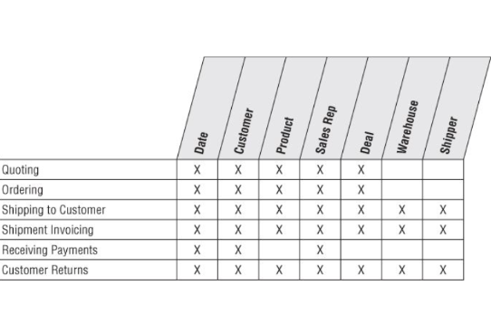
Order management bus matrix
Notes:
Why is this needed? Compared to procurement, retail sales, and inventory? What’s overlapping? What’s different here? What’s the business context; in comparison to what we studied before?

Slide 4
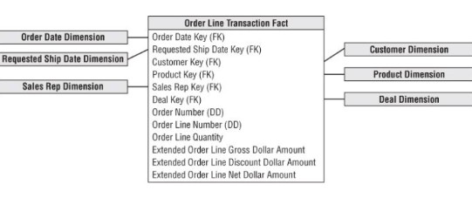
Orders transaction schema
Notes:
Granularity– one row for each line item on an order.

Slide 5
Fact table normalization
What would it mean to normalize facts by a measurement type dimension?
Suppose you started with 10 million order line fact table rows, each with six keys and four facts. If fact rows were normalized, how many fact rows would result?
What if you need to do arithmetic functions between facts? Is it easier with facts in the same row or with normalized facts?
Notes:
Math functions within rows are much easier in relational star schemas (in SQL); in most OLAP cube implementations, computations can cut a cube along any dimension

Slide 6
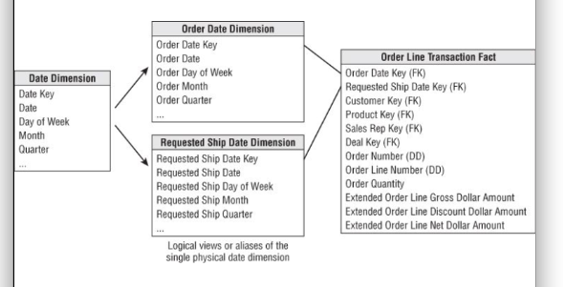
Role-playing dimensions
Notes:
You cannot joint two foreign keys to the same date dimension table; SQL interprets a two-way simultaneous join as requiring both dates to be identical. But you can use a signle physical date dimension table for these two views.

Slide 7
creating a view in SQL
create view order_date
(order_date_key, order_day_of_week, order_month, …) as
Select date_key, day_of_week, month, …
from Date
Notes:
SQL supports the concept of aliasing

Slide 8
Single or multiple dimensions
Suppose that you want to assign a sales representative to customers.
Should this be modeled as a separate dimension, or added to the customer dimension?
Notes:
Draw these out from an order; Customer; Sales organization.

Slide 9
Factors to determine single or multiple dimensions
Is the one-to-one or many-to-one relationship actually a many-to-many?
Does the sales rep and customer relationship vary over time or under influence of another dimension?
Is the customer dimension extremely large?
Do the sales rep and customer dimensions participate independently in other fact tables?
Does the business think about the sales rep and customer as separate things?

Slide 10
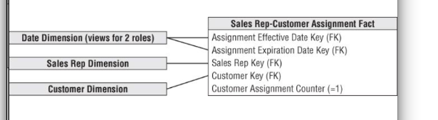
Factless Fact Table for Customer/Rep Assignments
Analyze complex assignment of sales reps to customers over time, even if no order activity has occurred.

Slide 11
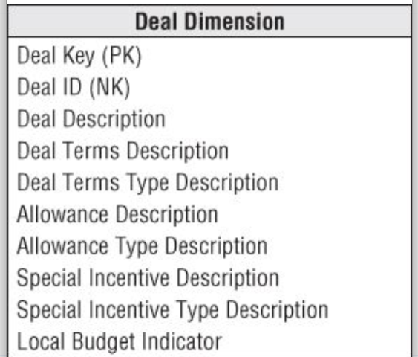
Deal dimension
Also known as the contract.
When should terms, allowances, and incentives be placed in the same or different tables?
Notes:
If these three items are usefully correlated, then package them into a single deal dimension. If uncorrelated, you end up generating the Cartesian product to these factors in the dimension; so it would make sense to split the dimension into separate components.

Slide 12
Degenerate dimension for Order Number
Link the data warehouse back to the operational databases.
Group separate line items on the order; and answer questions like “How many line items on an order, on average?”

Slide 13
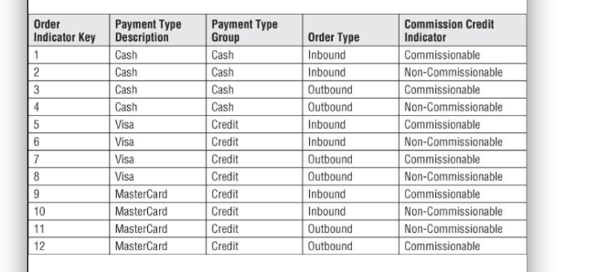
Junk dimensions for misc. flags
A number of miscellaneous indicators and flags; each with a small range of discrete values

Slide 14
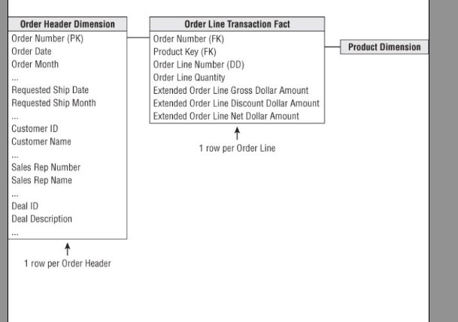
Patterns to avoid with header and line items
Notes:
Can you think of a business context where this is actually not a problem?

Slide 15
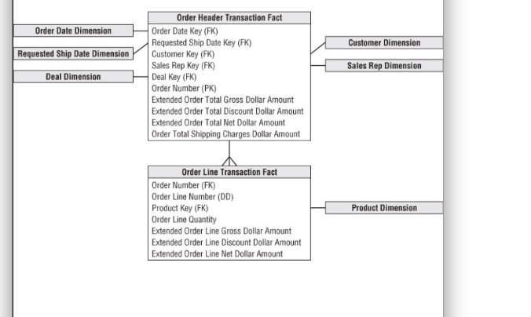
Another header/line pattern to avoid
Notes:
A large header fact table needs to be associated with an even larger fact table.

Slide 16
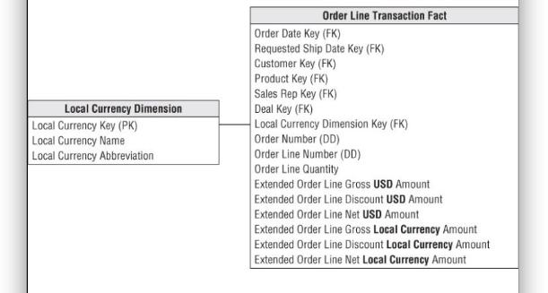
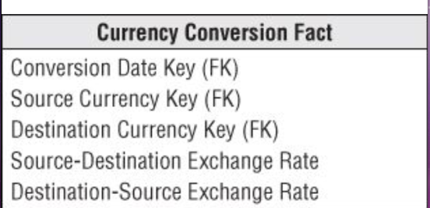
Multiple currencies
Notes:
intra-row extrapolation can be done in a view behind the scenes; use currency conversion fact when managers in any country want to see order volume in any currency.

Slide 17
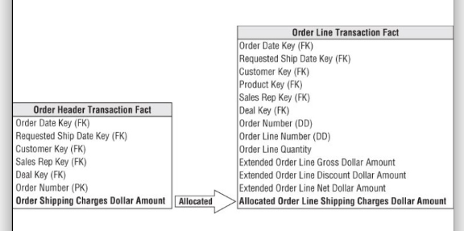
Transaction facts at different levels of granularity
Notes:
It’s useful to force all facts down to the lowest level. Don’t mix fact granularities within a single fact table. But it could be difficult for different departments to agree on how to do this.

Slide 18
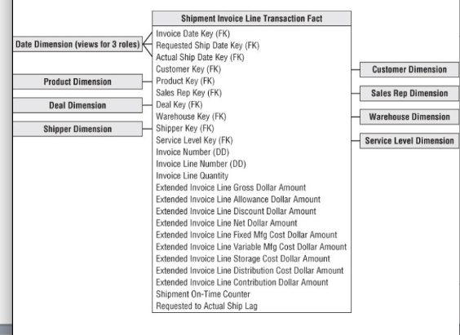
Invoicing transaction schema with profit & loss facts
Notes:
Invoices combine customers, products, and components of profitability. Good place to start for a DW/BI project. To the customer on the invoice: qty shipped, and extended amounts (unit rates multiplied by the qty shipped), including gross amount, deal-related allowance amount, discount amount, net amount. Also, bottom line contribution items, for internal use: fixed manufacturing cost, variable mfr cost, storage cost, distributino cost, contribution amount= net invoice-all costs. Now you can view PNL amount many different filters and dimensions! But not easy to capture all the cost facts; may require 10 different extracts and transformations from different systems.

Slide 19
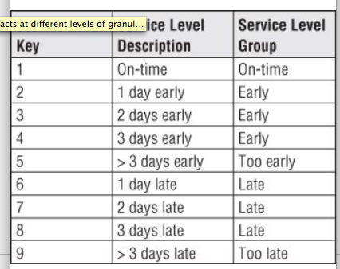
Service level
Notes:
Include a qualitative assessment of performance.

Slide 20
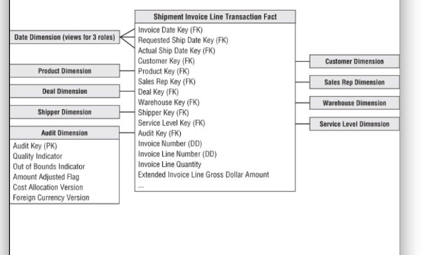
Audit dimension
Notes:
Keep track of: confidence in reported numbers, anomalous values encountered while processing data, version of cost allocation logic used in calculations, and version of foreign currency conversion rules.

Slide 21
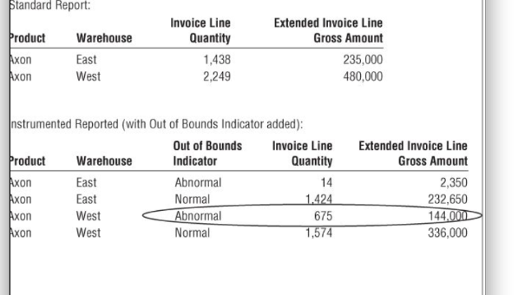
Audit dimension attribute on a standard report

Slide 22
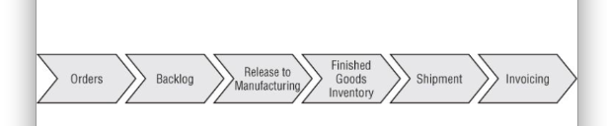
Accumulating snapshot for order fulfillment
Notes:
Order management as a pipeline. Revisit the tables we already have covered here– transaction tables in this process. How else can we model this process? Pros and cons of considering each of these as separate transaction fact table. Would a periodic snapshot be useful anywhere here? 1) Periodic: amount of product flowing through a pipeline spigot during a specified interval, and Avg amount of product sitting in each step of the pipeline in each day. 2) Accumulating: current state of an order; product movement velocities; avg number of days to move between milestones. lag calculations.

Slide 23
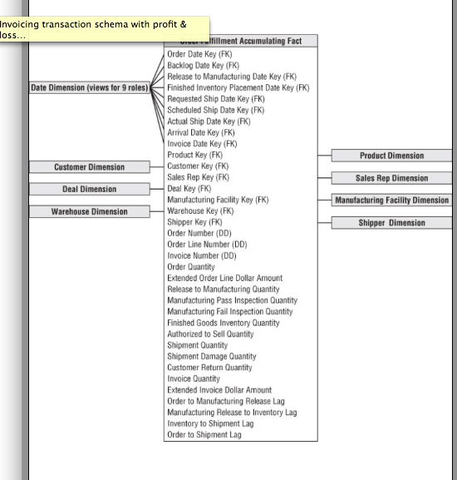
Order fulfillment accumulating snapshot fact table

