Slide 1
Ch. 3 Retail Sales from Kimball and Ross
IDS 521

Slide 2
Key concepts in this chapter
Four-step process for designing dimensional models
Fact table granularity
Transaction fact tables
Additive, non-additive, and derived facts
Dimension attributes, including indicators, numeric descriptors, and multiple hierarchies
Calendar date dimensions, plus time of day
Degenerate dimensions, such as transaction receipt number
Nulls in a dimensional model
Extensibility of dimensional models
Factless fact tables
Surrogate, natural, and durable keys
Snowflaked dimension attributes
Centipede fact tables with “too many dimensions”.

Slide 3
Four-step Dimensional Design Process
Step 1: Select the Business Process
Step 2: Declare the Grain
Step 3: Identify the Dimensions
Step 4: Identify the Facts

Slide 4
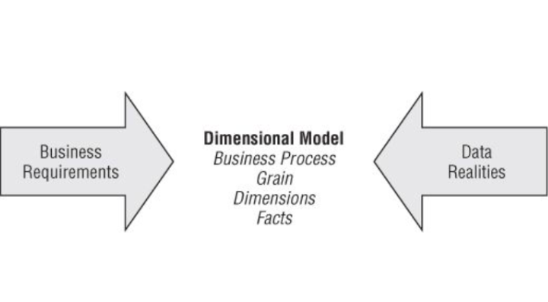
Key input to the four-step dimensional design process.

Slide 5
Step 1: Select the Business Process
Decompose the business initiative into the underlying processes
Not the same as functional departments

Slide 6
Step 2: Declare the Grain
What does a fact table row represent?
Examples:
One row per POS scan
One row per bill line item
One row per bill line item individual boarding pass
One row per daily inventory snapshot
One row per bank account

Slide 7
Step 3: Identify the dimensions
Descriptions that take on single values for each measurement (i.e. each row in fact table)
Examples: Date, product, customer, employee, and facility, etc…
Discrete, text-like attributes that flesh out each dimension table: what, where, when, why and how.

Slide 8
Step 4: Identify the facts
All facts must be true to the grain
e.g. numeric additive amounts, quantity, dollar cost, etc..

Slide 9
Retail Case Study
100 grocery stores spread across 5 states
Departments: produce, frozen food, dairy, meat, bakery, floral, grocery, health/beauty, etc.
60,000 SKU’s stock keeping units
Where is data collected?
point of sale (POS) scanners
back door delivery systems from vendors.

Slide 10
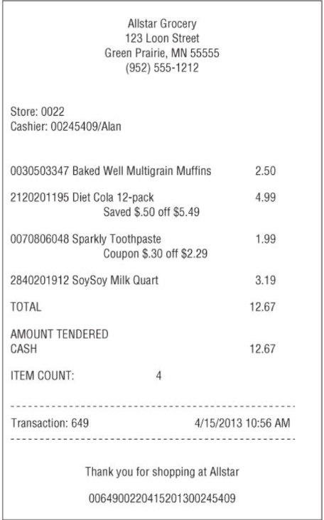

Slide 11
Objectives
Optimize pricing and promotions
e.g. what is the expected boost in revenue with a 50 cent reduction in price of a paper towel brand, with simultaneous ads and store displays?

Slide 12
Step 1: Identify the business process
Goal: Better understand customer purchases as captured by POS
Hence, business process is POS retail transactions

Slide 13
Step 1: Identify the business process
Goal: Better understand customer purchases as captured by POS
Hence, business process is POS retail transactions
Step 2: Selecting the grain
Find the most atomic/fine-grained level of detail
More dimensions will apply; more flexibility to drill down in into details
Easy to summarize detailed data, not to create details from summarized data

Slide 14
Step 2: Selecting the grain (continued)
Potential business questions:
What is the difference between sales on Monday versus Sunday?
Is it worthwhile to stock so many individual sizes of specific brands?
How many shoppers took advantage of the 50 cents off promotion on shampoo?
What is the impact of decreased sales when a competitive diet soda product is promoted heavily?

Slide 15
Step 3: Identify the dimensions
Product
Date of sale
Store
Promotion
Cashier
Method of payment

Slide 16
Step 4: Identify the facts
grain will guide this decision
example: individual product line items in the POS transaction
sales quantity
unit price
regular price
discount sales
cost (additive across dimensions)
etc…

Slide 17
Step 4: Identify the facts (continued)
Derived facts
better to store them than have users calculate them
Non-additive facts
e.g. Gross margin can’t be summarized along any one dimension (sum revenues and costs before dividing)
unit price makes no sense as an additive fact

Slide 18
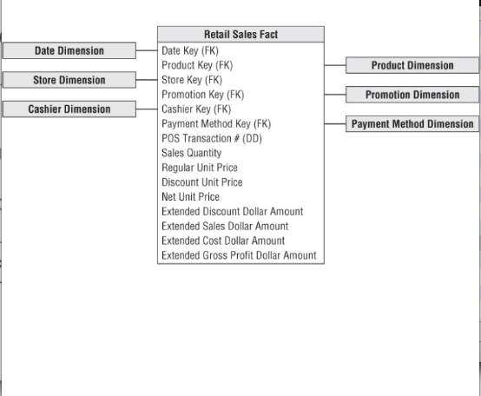
Measured facts in retail sales schema

Slide 19
Step 4: Identify the facts (continued)
Transaction Fact Tables: i.e. one row per transaction.
Quantities are additive.
Most common type of fact table.

Slide 20
Dimension table details
Date dimension
Almost every model needs one!
Build these in advance: 20 years is only about 7,300 rows of daily data
Include non-standard date attributes: weekends vs. weekdays, holidays, fiscal periods, etc..
Keep time of day as a separate dimension with 15 min or 1 min intervals.
Keep time in the fact table if there’s no need to filter by time of day.
Use textual attributes for flags and indicators: e.g. holiday or non-holiday

Slide 21
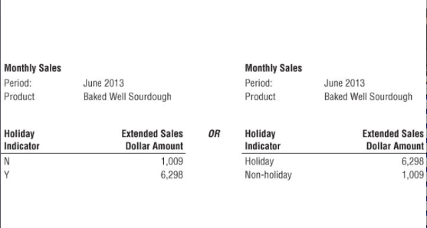
Sample reports with cryptic versus textual indicators

Slide 22
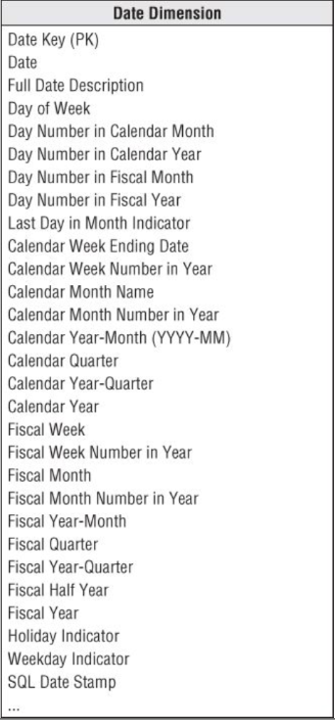
Date dimension

Slide 23
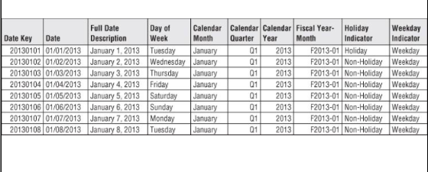
Date dimension sample rows

Slide 24
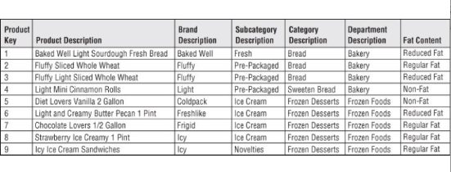
Flatten many-to-one hierarchies
Product dimension columns: Do not break up into separate tables

Slide 25
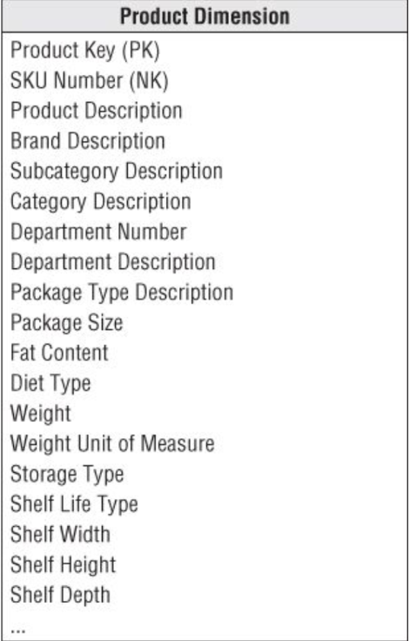
Product dimension table

Slide 26
Numeric values as attributes or facts
Attributes with embedded meaning – SKU Number:
preserve them in entirety
break down the meaningful component parts
example: List price for a product
changes infrequently
is numeric
if used in calculation, put in fact table
if for grouping and filtering, use it as a product dimension attribute

Slide 27
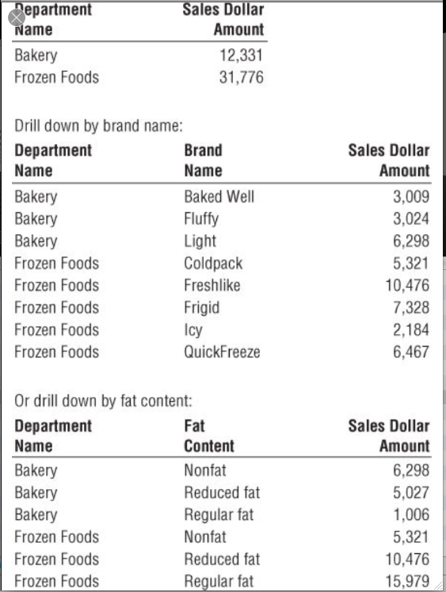
Drilling down on dimension attributes

Slide 28
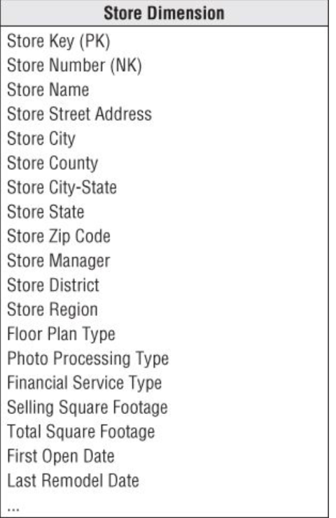
Multiple hierarchies in a dimension table

Slide 29
Dates within dimension tables
You can group and constrain multiple keys on nonstandard calendar attributes
Join multiple copies of a Date dimension using SQL views
create view first_open_date (first_open_day_number, first_open_month, …) as select day_number, month, …
from date

Slide 30
Promotion Dimension
Do products under promotion experience a gain in sales (lift) during the promotional period?
Do products under promotion show a drop in sales just prior to or after a promotion?
Are other products affected when a certain product is promoted – e.g. products in nearby shelves?
Is the promotion profitable?

Slide 31
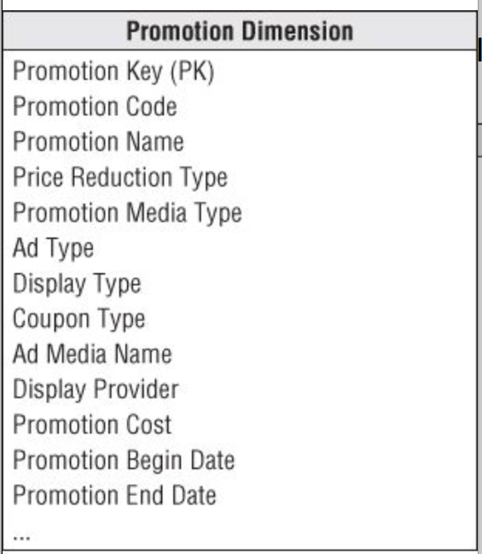
Promotion dimension table

Slide 32
Question 1: Promotion Dimension
When should we have separate dimensions for these causal mechanisms: price reduction, ads, displays and coupons?
If highly correlated, put them together into a single dimension.
Browse the dimension tables to see which attributes go together.
Otherwise, keep these entities as separate dimensions.

Slide 33
Question 2: Promotion Dimension
Where should the promotion cost attribute go?
Depends on the grain:
Dimension table
Fact table of the appropriate grain

Slide 34
Null foreign keys, attributes and facts
Null in fact table metrics are ok
Not ok in fact table keys!
Not ok in dimension tables – use unknown there instead.

Slide 35
Question: How to handle multiple methods of payment on one transaction?
e.g. You have a gift card with limited funds; you max it out, and pay the balance with your regular credit card.

Slide 36
Degenerate dimensions (DD) for transaction numbers:
A dimension key without a corresponding dimension table.
e.g. POS transaction number
Transaction header in a operational DB
POS is helpful for pulling together all the products in a single market basket transaction; to link back to the operational system

Slide 37
Retail sales extensibility
Why is it so easy to add a customer dimension?
Because POS was initially modeled at its most granular level.
All existing BI apps can run without any changes—because we did not alter the existing dimension keys or facts.
Premature summarization or aggregation limits your ability to add supplemental dimensions…

Slide 38
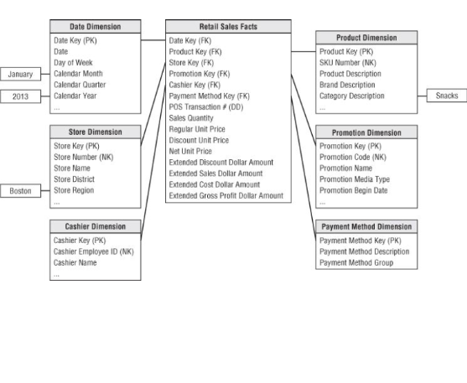
Querying the retail sales schema

Slide 39
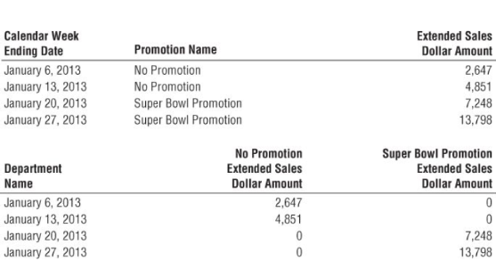
Querying results with cross-tabular report

Slide 40
Retail Sales Extensibility
Adding: new dimension attributes – all existing apps will be oblivious to the new attributes; a Not Available can be used for old dimension rows.
New dimensions: Add a new foreign key column and populate it correctly with values of the primary key from the new dimension.
New measured facts: Add them gracefully to the fact table.
The new fact measurements must match the grain of the existing table. Don’t mix grains in the same fact table.
Fact table is altered to add new columns, which are populated with new values.
Null values can also be put into fact rows that were old.

Slide 41
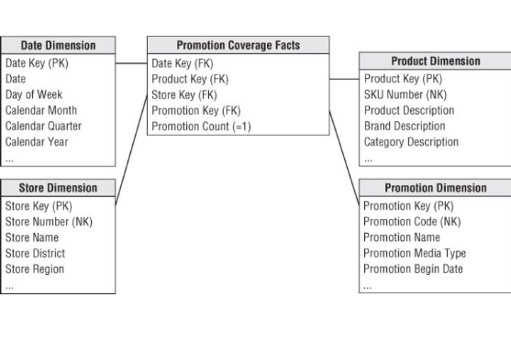
Promotion coverage factless fact table

Slide 42
Factless Fact tables
What products were on promotion but did not sell? Problem: The sales fact table records only the SKUs that actually sold.
Steps:
1) Query the promotion factless fact table to determine the universe of products that were on promotion on a given day.
2) Determine what products sold from the POS fact table.
3) Take the set difference between 1 and 2, the two lists. OLAP cubes typically contain explicit cells for non-behavior.

Slide 43
SQL exercise
Suppose you have a view of promoted products (call it PromotedProducts) and a view of products sold (call it ProductsSold).
Write the SQL query that would give us the set difference between PromotedProducts and ProductsSold:
Choose the following: A, B or C. If B or C, give your answer.
I have no clue
I can make a decent attempt, here it is:
I feel confident it is:

Slide 44
Dimension Table surrogate keys
Integers assigned sequentially as needed to populate a dimension
No business significance, other than to join dimension tables to the fact table

Slide 45
Best practice: Avoid using natural keys to join facts and dimension tables; use the surrogate key.
Buffer the data warehouse from operational changes
Integrate multiple source systems: a common surrogate mapped to multiple natural keys
Improve performance (operational codes are often bulky)
Identify null or unknown conditions
Support dimension attribute change tracking – multiple surrogate keys for a single natural key.

Slide 46
Dimension Natural and Durable Supernatural keys
Natural keys (NK) are assigned and used by operational source systems
business keys, production keys, and operational keys
May have multiple natural keys corresponding to multiple different sources
maybe with different component parts such as product line of business and country of origin
Natural keys may change
due to unexpected business rules (like a merger between firms)
to handle either duplicate entries
to handle data integration from multiple sources
ETL needs to assign permanent durable identifiers, known as (persistent/durable) supernatural keys.
Remains immutable for the life of the system

Slide 47
Fact table surrogate keys
Simple integer, devoid of any business content.
Not as critical as are dimension table surrogate keys
helps in back room ETL processing

Slide 48
Benefits of fact table surrogate key
Immediate unique identification
Backing out or resuming a bulk load
Replacing updates with inserts plus deletes
Main fact table is not determined by a set of dimensional foreign keys
More efficient

Slide 49
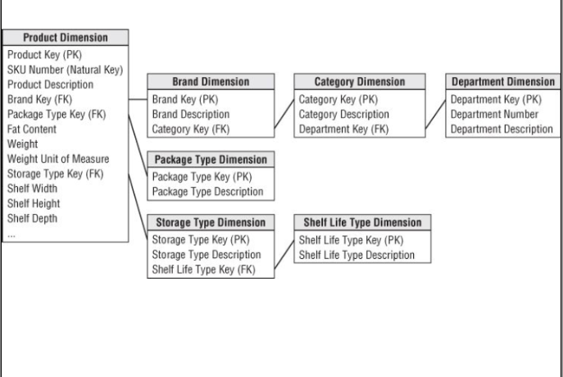
Resisting normalization urges—snowflaking

Slide 50
Problems with normalization -- snowflakes
Creates unnecessary complexity
Slower query performance with multiple joins
Space saving is insignificant—dimension tables are already small
300,000 thousand rows of a 18-byte code is about 5.4 MB
Makes it harder for users to browse within a dimension

Slide 51
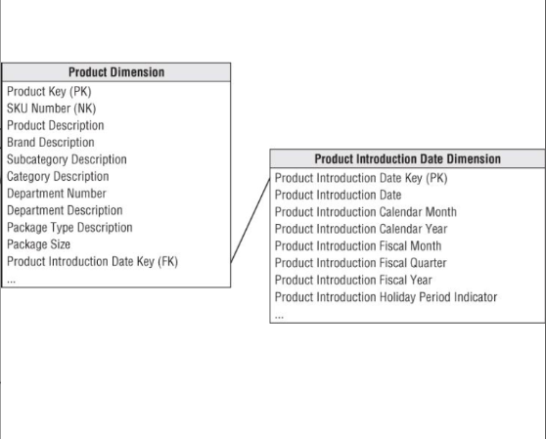
A permissible outrigger: filter and group dates by non-standard calendar attributes

Slide 52
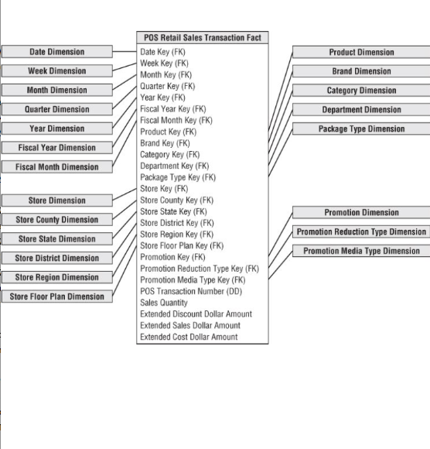
Centipede Fact Table: Too many dimensions
At 25 or more dimensions, look for ways to combine correlated dimensions into a single dimension.
Combine dimensions when the resulting new single dimension is relatively small.

