Slide 1
Practical SQL
Null-value and duplicate
row complications,
Optimizing SQL queries, and
Indexes

Slide 2
Null Values

Slide 3
Three-valued logic: NOT (Kleene Logic)
A | Not A
True | False
Unknown | Unknown
False | True
Notes:
Nulls are to be interpreted as unknown; as are the boolean operators they go into.

Slide 4
Three-valued logic: AND (Kleene Logic)
A AND B | True | Unknown | False
True | True | Unknown | False
Unknown | Unknown | Unknown | False
False | False | False | False
Notes:
Nulls are to be interpreted as unknown; as are the boolean operators they go into.

Slide 5
Three-valued logic: OR (Kleene Logic)
A OR B | True | Unknown | False
True | True | True | True
Unknown | True | Unknown | Unknown
False | True | Unknown | False
Notes:
Nulls are to be interpreted as unknown; as are the boolean operators they go into.

Slide 6
Examples
column ‘color’ contains the values RED, GREEN, or BLACK. Evaluate the filter for each color. Which colors are returned?
Color | where Color not in {‘BLUE’, ‘BLACK’, null} | where Color in {‘BLUE’, ‘BLACK’, null}
RED | unknown | unknown
GREEN | unknown | unknown
BLACK | false | true
rows returned in filter results | None | BLACK

Slide 7
Sakila sample database
Notes:
sakila database, download link: http://dev.mysql.com/doc/index-other.html

Slide 8
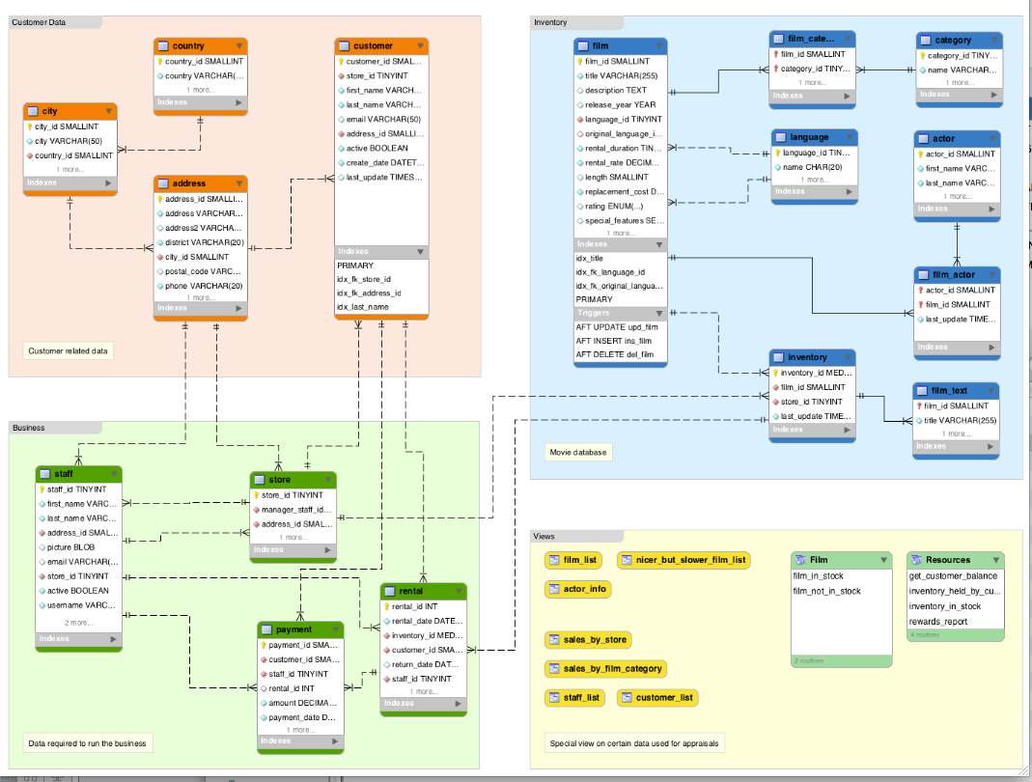
Notes:
sakila database, download link: http://dev.mysql.com/doc/index-other.html

Slide 9
Duplicate values

Slide 10
Distinct and its drawbacks
SELECT distinct c.last_name, c.first_name
from customer c,
rental r,
inventory i,
category cg,
film_category fc
where cg.name = 'Comedy'
and c.customer_id = r.customer_id
and r.inventory_id = i.inventory_id
and i.film_id = fc.film_id
and fc.category_id = cg.category_id
order by last_name;
Notes:
What does this query give us? see (ch 2?) loc 2186 “Art of SQL”

Slide 11
What if we forget a join?
SELECT distinct c.last_name, c.first_name
from customer c,
rental r,
inventory i,
category cg,
film_category fc
where cg.name = 'Comedy'
and c.customer_id = r.customer_id
and r.inventory_id = i.inventory_id
and i.film_id = fc.film_id
and fc.category_id = cg.category_id
order by last_name;

Slide 12
Preferred method to filter out duplicates
SELECT c.last_name, c.first_name from customer c
where c.customer_id in
(Select c.customer_id
from rental r,
inventory i,
category cg,
film_category fc,
customer c
where cg.name = 'Comedy'
and c.customer_id = r.customer_id
and r.inventory_id = i.inventory_id
and i.film_id = fc.film_id
and fc.category_id = cg.category_id);

Slide 13
Correlated subsquery: usually less efficient, compare the time 0.55 vs. 0.01 seconds
SELECT outer_cust.last_name, outer_cust.first_name from customer outer_cust
where exists
(select null from rental r,
inventory i,
category cg,
film_category fc,
customer inner_cust
where cg.name = 'Comedy'
and inner_cust.customer_id = outer_cust.customer_id
and inner_cust.customer_id = r.customer_id
and r.inventory_id = i.inventory_id
and i.film_id = fc.film_id
and fc.category_id = cg.category_id);

Slide 14
Using In clause instead of Distinct

Slide 15
Optimizing SQL queries

Slide 16
Limits of the optimizer
Their best work is in the “relational world”
mathematically equivalent transformations
Rely on information in the database
can’t use information embedded in triggers or application code
Its work adds to the overall response time
examining many alternative execution paths may take time
optimizer may “satisfice,” cutting short its search
Improves individual queries
Procedural code that executes a chain of queries will not benefit from the optimizer.
Notes:
From ch. 4 “Art of SQL”

Slide 17
Write the query. Ex. 1
Customer with id = 146 files an inquiry into a past rental. You need to identify the sales person on this rental. The customer happens to know the rental was the most recent to occur before July 24, 2005.

Slide 18
Correlated subquery
Customer with id = 146 files an inquiry into a past rental; you need to identify the sales person on this rental; the customer happens to know the rental was the most recent to occur before July 24, 2005.
Select s.first_name, s.last_name, p_outer.amount, p_outer.payment_date
From staff s, payment p_outer
Where s.staff_id = p_outer.staff_id And
p_outer.customer_id = 146
And p_outer.payment_date =
(
Select max(p_inner.payment_date) From payment p_inner
Where
p_inner.customer_id=p_outer.customer_id and
p_inner.payment_date <= '2005-7-24'
)
;
Notes:
Request: Customer with id = 146 files an inquiry into a past rental; you need to identify the sales person on this rental; the customer happens to know the rental was the most recent to occur before July 24, 2005. (loc 2237, loc 3647) in “Art of SQL” ch. 4?

Slide 19
Uncorrelating the subquery
Select p_outer.payment_id, p_outer.customer_id, s.first_name, s.last_name, p_outer.amount, p_outer.payment_date
from staff s, payment p_outer
where s.staff_id = p_outer.staff_id
and (p_outer.customer_id, p_outer.payment_date) in
(
select p_inner.customer_id, max(p_inner.payment_date)
from payment p_inner
where
p_inner.payment_date <= '2005-7-24'
and p_inner.customer_id = 146
group by p_inner.customer_id
)
;
Notes:
Customer with id = 146 files an inquiry into a past rental; you need to identify the sales person on this rental; the customer happens to know the rental was the most recent to occur before July 24, 2005.

Slide 20
Why is the correlated version faster in this example (Ex. 1)?
Use the Explain statement to compare the two query execution plans, correlated vs. uncorrelated versions.

Slide 21
Uncorrelated the subquery: What’s wrong with this?
select p_outer.payment_id, p_outer.customer_id, s.first_name, s.last_name, p_outer.amount, p_outer.payment_date
from staff s, payment p_outer
where s.staff_id = p_outer.staff_id
and (p_outer.customer_id, p_outer.payment_date) in
(
select p_inner.customer_id, max(p_inner.payment_date)
from payment p_inner
where
p_inner.payment_date <= '2005-7-24'
and p_inner.customer_id = 146
group by p_inner.payment_id
)
;

Slide 22
Write the query. Ex. 2
Identify the staff who processed the last payment larger than 4 on or prior to the date 7/10/2005.

Slide 23
Misuse of conditions, applied at the wrong place We want to identify the staff who processed the last payment larger than 4 on or prior to the date 7/10/2005;
Select s.first_name, s.last_name, p_outer.amount, p_outer.payment_date
from staff s, payment p_outer
where s.staff_id = p_outer.staff_id and
exists (select null from payment p2 where p2.amount > 4
and p2.payment_id = p_outer.payment_id)
And
p_outer.payment_date =
(
select max(p_inner.payment_date) from payment p_inner
where
p_inner.payment_date <= '2005-7-10'
and p_inner.payment_id = p_outer.payment_id);
Notes:
we want to identify the staff who processed the last payment larger than 4 on or prior to the date 7/24/2005; “Art of SQL: ch4 Loc (2375) – Loc(2434)

Slide 24
Why would correlating on payment_id actually give wrong results? We want to identify the staff who processed the last payment larger than 4 on or prior to the date 7/10/2005;
select s.first_name, s.last_name, p_outer.amount, p_outer.payment_date
from staff s, payment p_outer
where s.staff_id = p_outer.staff_id and
p_outer.payment_date =
(
select max(p_inner.payment_date) from payment p_inner
where
p_inner.payment_date <= '2005-7-10'
and p_inner.amount > 4
and p_inner.payment_id = p_outer.payment_id
);
Notes:
we want to identify the staff who processed the last payment larger than 4 on or prior to the date 7/24/2005. Correlating the payment id’s actually results in a wrong set of results in this case. Why? “Art of SQL: ch4 Loc (2375) – Loc(2434)

Slide 25
Why would correlating on payment_id actually give wrong results? We want to identify the staff who processed the last payment larger than 4 on or prior to the date 7/10/2005;
select s.first_name, s.last_name, p_outer.amount, p_outer.payment_date
from staff s, payment p_outer
where s.staff_id = p_outer.staff_id and
p_outer.payment_date =
(
select max(p_inner.payment_date) from payment p_inner
where
p_inner.payment_date <= '2005-7-10'
and p_inner.amount > 4
and p_inner.payment_id = p_outer.payment_id
);
Notes:
we want to identify the staff who processed the last payment larger than 4 on or prior to the date 7/24/2005. Correlating the payment id’s actually results in a wrong set of results in this case. Why? “Art of SQL: ch4 Loc (2375) – Loc(2434)

Slide 26
Home exercise: Is there a faster way to write the query for Ex. 2?
Can you write a correlated version of Ex. 2 that makes the query faster, as we could do for Ex. 1?

Slide 27
Union List of addresses for both staff and customers who transacted payments after 8-01-2005
Select a.address, a.district, a.phone
from address a where a.address_id in
(Select a.address_id from
staff s, payment p, address a
where p.staff_id = s.staff_id and
p.payment_date > '2005-08-01'
and s.address_id = a.address_id
)
Union
Select a.address, a.district, a.phone
from address a where a.address_id in
(Select a.address_id from
customer c, payment p, address a
where c.customer_id = p.customer_id and
p.payment_date > '2005-08-01'
and c.address_id = a.address_id
)

Slide 28
In-line view List of addresses for both staff and customers active after 8-01-2005
select a.address, a.district, a.phone
from address a
where a.address_id in
(Select person.address_id from
( Select s.address_id from staff s, payment p
where s.staff_id = p.staff_id and p.payment_date > '2005-08-01'
Union
Select c.address_id from customer c, payment p
where c.customer_id = p.customer_id and p.payment_date > '2005-08-01' ) person
)
Notes:
Art of SQL-- (loc 2346-2434)

Slide 29
Inline views, now add first name and last name
select person_outer.first_name, person_outer.last_name, a.address, a.district, a.phone
from address a,
(Select first_name, last_name, address_id from customer
Union
Select first_name, last_name, address_id from staff) person_outer
where a.address_id in
(Select person.address_id from
( Select s.address_id, s.staff_id id from staff s, payment p
where s.staff_id = p.staff_id and p.payment_date > '2005-08-01'
Union
Select c.address_id, c.customer_id id from customer c, payment p
where c.customer_id = p.customer_id and p.payment_date > '2005-08-01' ) person
)
And person_outer.address_id = a.address_id

Slide 30
Convert to a simpler subquery List of addresses for both staff and customers active after 8-01-2005 (if you don’t need the names)
select a.address, a.district, a.phone
from address a
where a.address_id in
( Select s.address_id id from staff s, payment p
where s.staff_id = p.staff_id and p.payment_date > '2005-08-01'
Union
Select c.address_id id from customer c, payment p
where c.customer_id = p.customer_id and p.payment_date > '2005-08-01' )

Slide 31
Inefficient use of in-line views Let’s get count of rentals for each staff member where payments are greater than 6, between 4 and 6, between 2 and 4, and less than 2.
select over_6.first_name, over_6.last_name, over_6.seg_count as "over 6 count", b_4_6.seg_count as "4 to 6 count", b_2_4.seg_count as "2 to 4 count", lessthan_2.seg_count as "under 2 count"
from
(select s.staff_id, s.first_name, s.last_name, avg(amount) seg_avg, count(amount) seg_count, "over_6" seg_name
from staff s, payment p
where p.staff_id = s.staff_id and amount > 6
group by s.first_name, s.last_name
) over_6,
(select s.staff_id, s.first_name, s.last_name, avg(amount) seg_avg, count(amount) seg_count, "4 to 6" seg_name
from staff s, payment p
where p.staff_id = s.staff_id and amount > 4 and amount <= 6
group by s.first_name, s.last_name
) b_4_6,
(select s.staff_id, s.first_name, s.last_name, avg(amount) seg_avg, count(amount) seg_count, "2 to 4" seg_name
from staff s, payment p
where p.staff_id = s.staff_id and amount > 2 and amount <= 4
group by s.first_name, s.last_name
) b_2_4,
(select s.staff_id, s.first_name, s.last_name, avg(amount) seg_avg, count(amount) seg_count, "less than 2" seg_name
from staff s, payment p
where p.staff_id = s.staff_id and amount <= 2
group by s.first_name, s.last_name
) lessthan_2
where b_4_6.staff_id = over_6.staff_id and
b_4_6.staff_id = b_2_4.staff_id and
lessthan_2.staff_id = b_2_4.staff_id;
Notes:
Let’s get count of rentals for each staff member where payments are greater than 6, between 4 and 6, between 2 and 4, and less than 2.
ART of SQL Ch 4 (loc 3036 – loc 3113)

Slide 32
Case statement here is more efficient: Let’s get average (or count) of rentals for each staff member where payments are greater than 6, between 4 and 6, between 2 and 4, and less than 2.
select first_name, last_name, sum(case when amount > 6 then 1 else 0 end) "count over 6",
avg (case when amount > 6 then amount else null end) "avg over 6",
sum(case when amount > 4 and amount <= 6 then 1 else 0 end) "4 to 6 count", sum(case when amount > 2 and amount <= 4 then 1 else 0 end) "2 to 4 count", sum(case when amount <=2 then 1 else 0 end) "under 2 count"
from staff s, payment p
where p.staff_id = s.staff_id
group by s.first_name, s.last_name;
Notes:
Art of SQL (loc 3036 – loc 3113); QUESTION: Can you find the average for each category

Slide 33
Using Execution plans
Explain

Slide 34
Using Indexes (examples)
show indexes from customer\G;
show indexes from rental\G;
explain select * from customer where last_name = "WOOD";
explain select * from customer where first_name = "Brian";
explain select count(*) from rental where rental_date <= '2005-9-30';
explain select count(*) from rental where rental_date = '2005-9-30';
explain select count(*) from customer where first_name = 'John';
Notes:
https://class2go.stanford.edu/db/Winter2013/problemsets/IndexesQuizVariation2

