Slide 1
Creating the Maximum Miniatures Manufacturing Data Mart using the SQL Server Management Studio This Tutorial is based on the Learn By Doing Exercise in Chapter 6 of Brian Larson’s Book: Delivering Business Intelligence with Microsoft SQL Server 2012, 3rd edition.

Slide 2
The Purpose of this Tutorial
To create a data mart (data warehouse) for the Maximum Miniature, Inc, a manufacturing company. The name of this data mart is MaxMinManufacturingDM.
The MaxMinManufacturingDM is based on the schema design shown on the next slide.
Note:
A data mart is a repository (database) for data to be used as a source for business intelligence. The data mart is not used as part of day-to-day transactions. Instead, the data mart periodically accumulates data from the Online Transactional Processing (OLTP) database.
Data mart is made up of measures, dimensions organized as hierarchy, and some attributes.

Slide 3
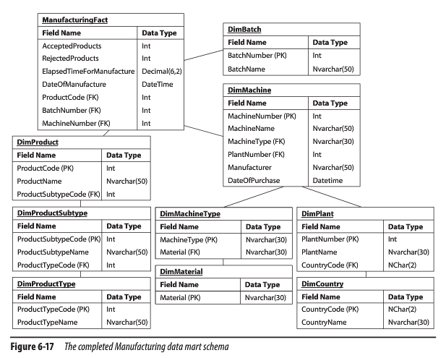
MaxMinManufacturingDM Data Mart Schema

Slide 4
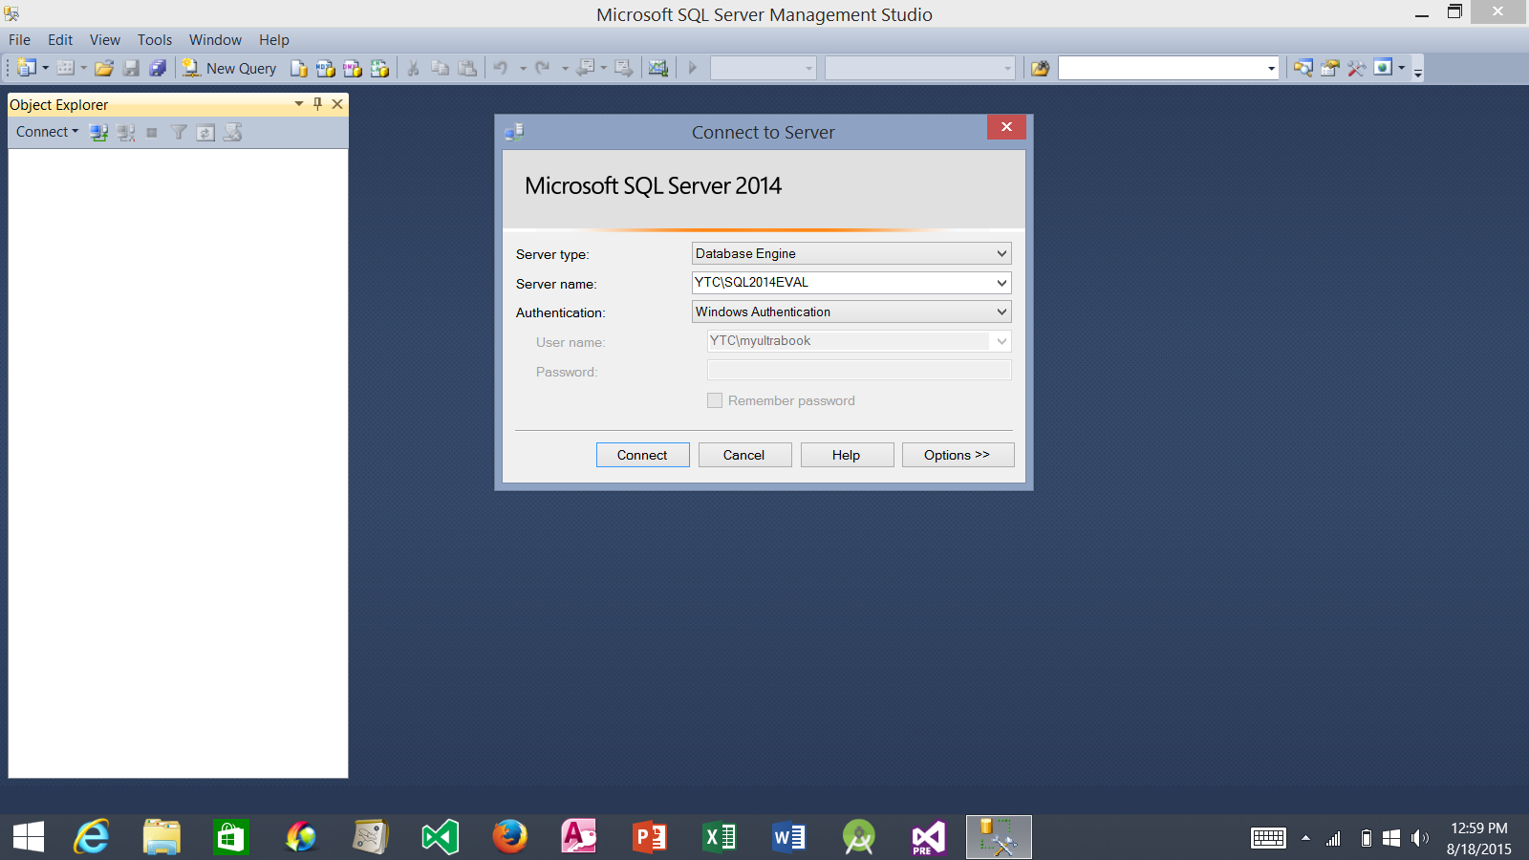
1. Launch the SQL Server Management Studio
2. Connect to the Database Engine
3. Select the server name in the form of YourComputerName\YourDatabaseInstanceName
4. Click the Connect button

Slide 5
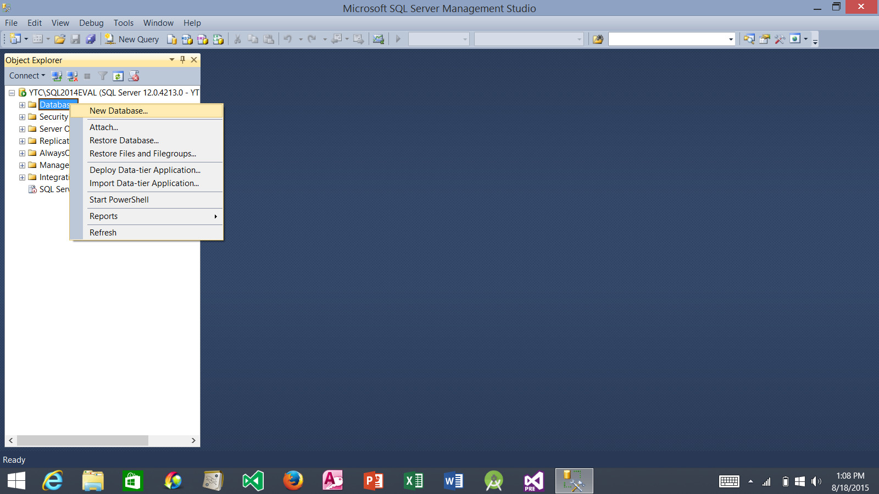
Right-click the Database folder
2. Select New Database…

Slide 6
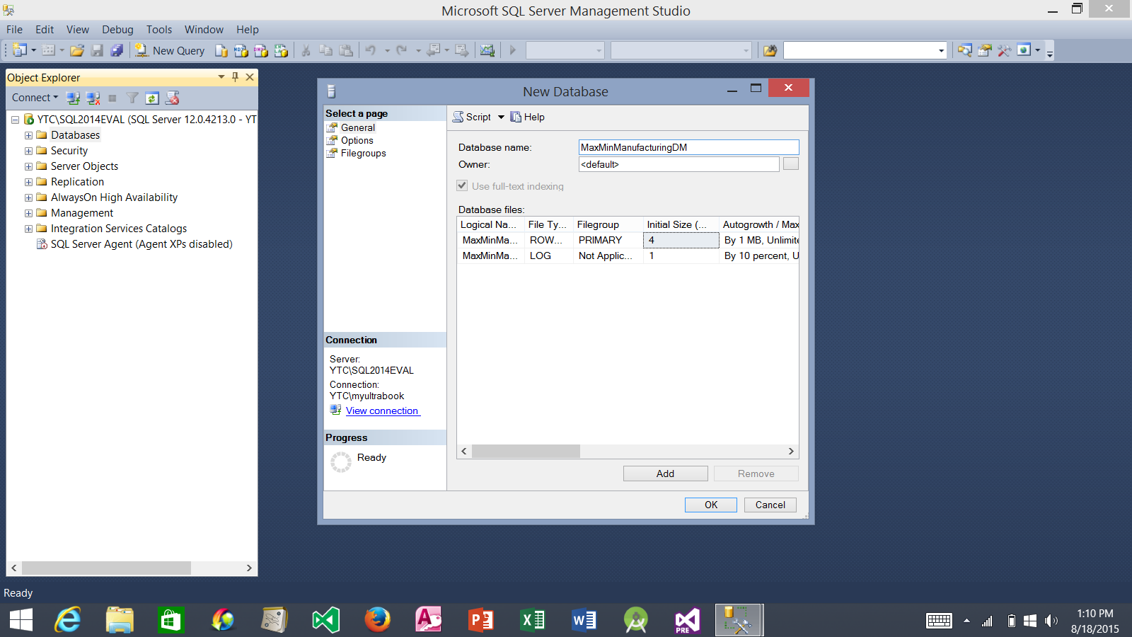
Enter MaxMinManufacturingDM for the Database name
2. Select the Options page

Slide 7
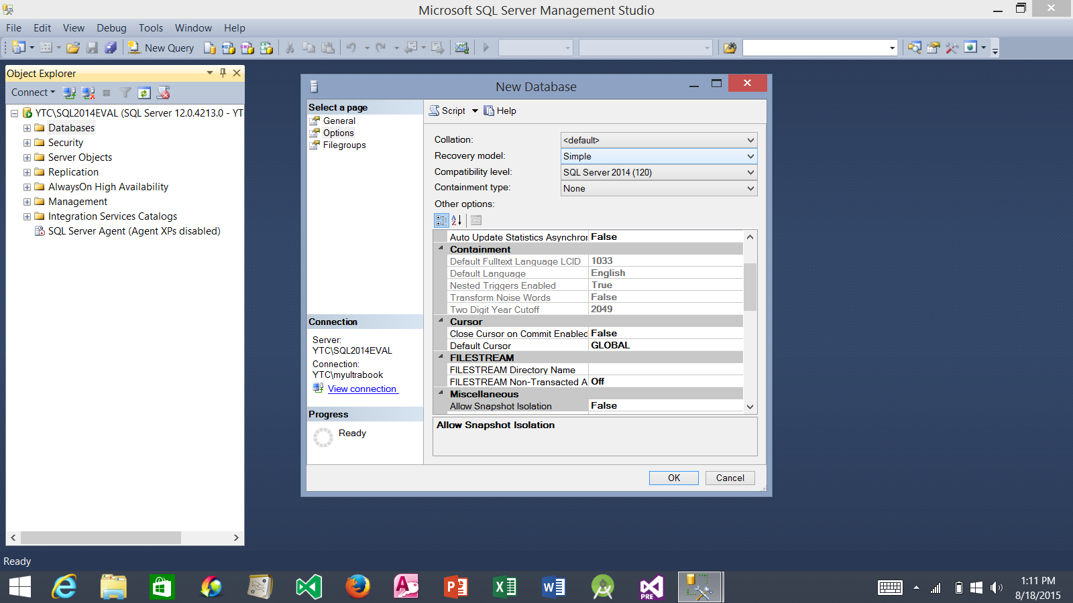
Select Simple for the Recovery model.
2. Click OK to create the database

Slide 8
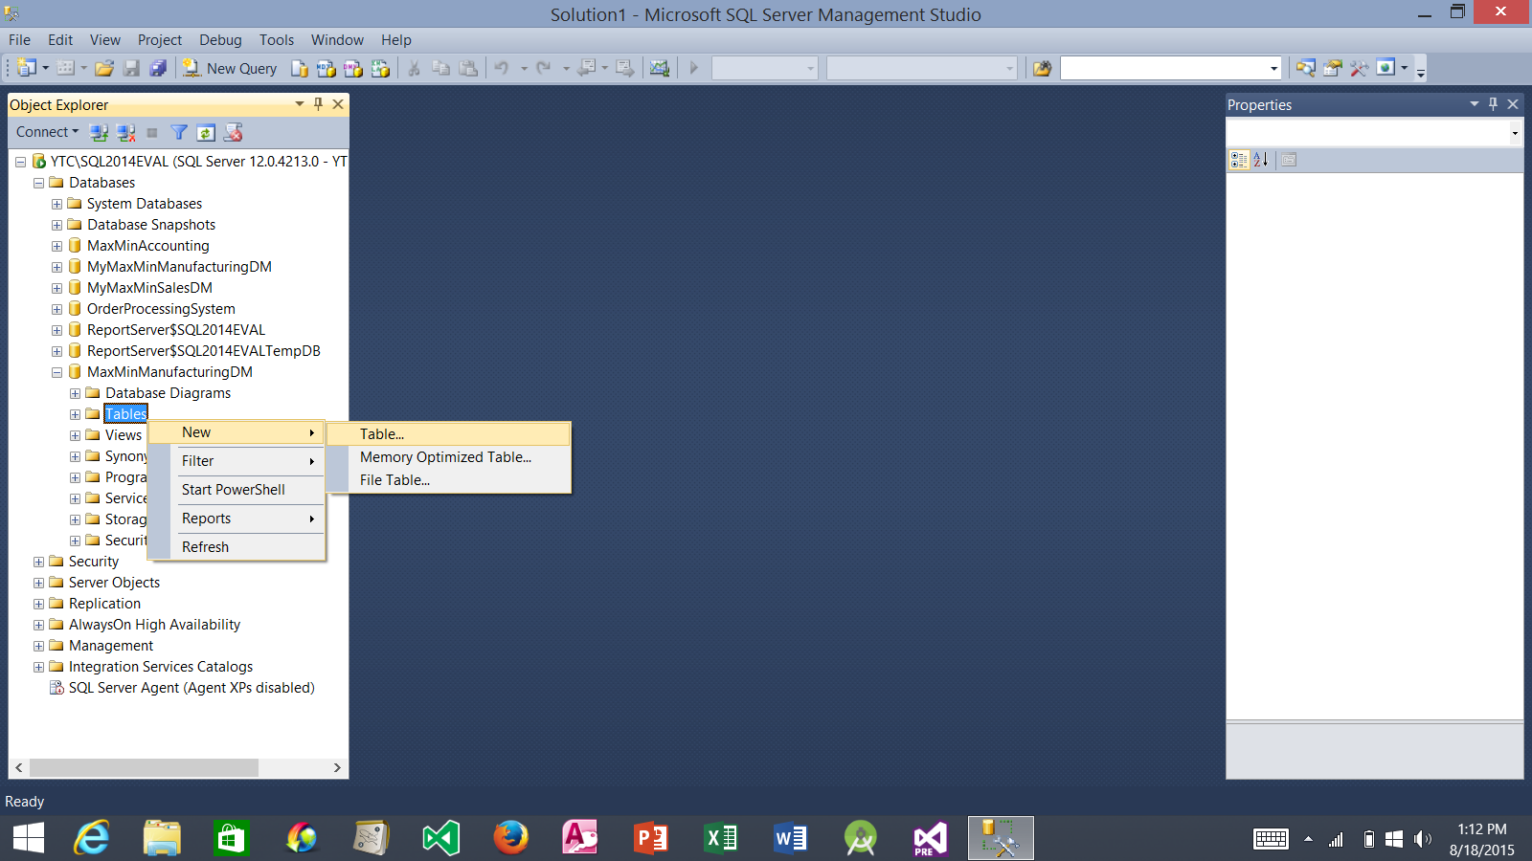
1. Expand the Database folder
2. Expand the MaxMinManufacturingDM
3. Right-click the Tables folder
4. Select New and then Table…

Slide 9
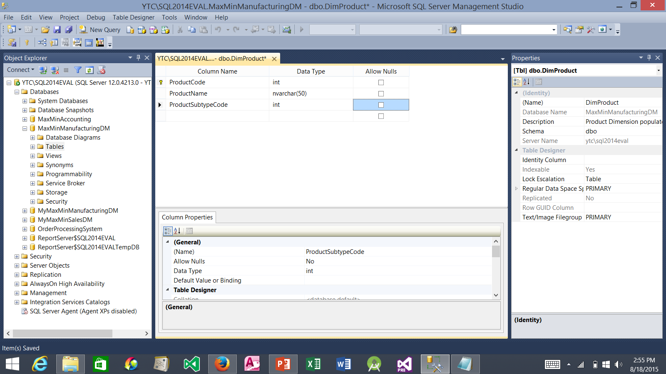
6. Click the Save button.
7. Click this x to close the Table Designer.
Enter DimProduct for (Name)
4. While the ProductCode column name is selected, click the Set Primary Key button to make this column the primary key.
3. In the first row of the Table Designer, enter ProductCode with data type int and uncheck Allow Nulls. Warning: be sure to exactly type upper or lower case in each column name.
2. Enter Product Dimension populated from the Manufacturing Automation System export file for Description
5. In the second and third rows, enter ProductName with data type nvarchar(50) and ProductSubtypeCode with data type int. Uncheck Allow Nulls for both rows.

Slide 10
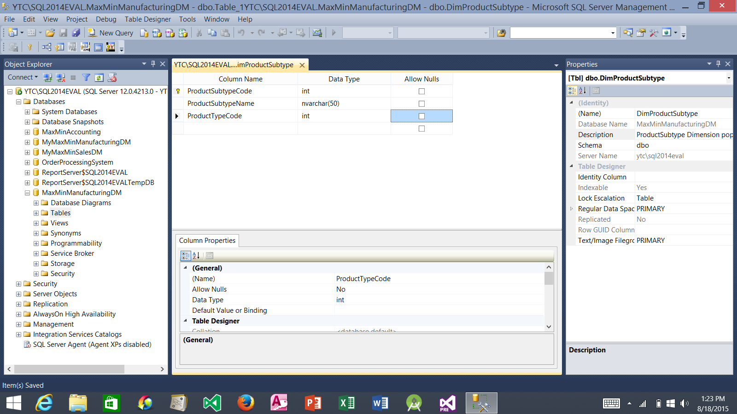
5. Click this x to close the Table Designer.
1. Create another table: DimProductSubtype
4. Click the Save button.
3. In the Table Designer, enter three rows as above. Be sure to set the ProductSubtypeCode as the primary key
2. Enter ProductSubtype Dimension populated from the Accounting System.ProductSubtype table for Description

Slide 11
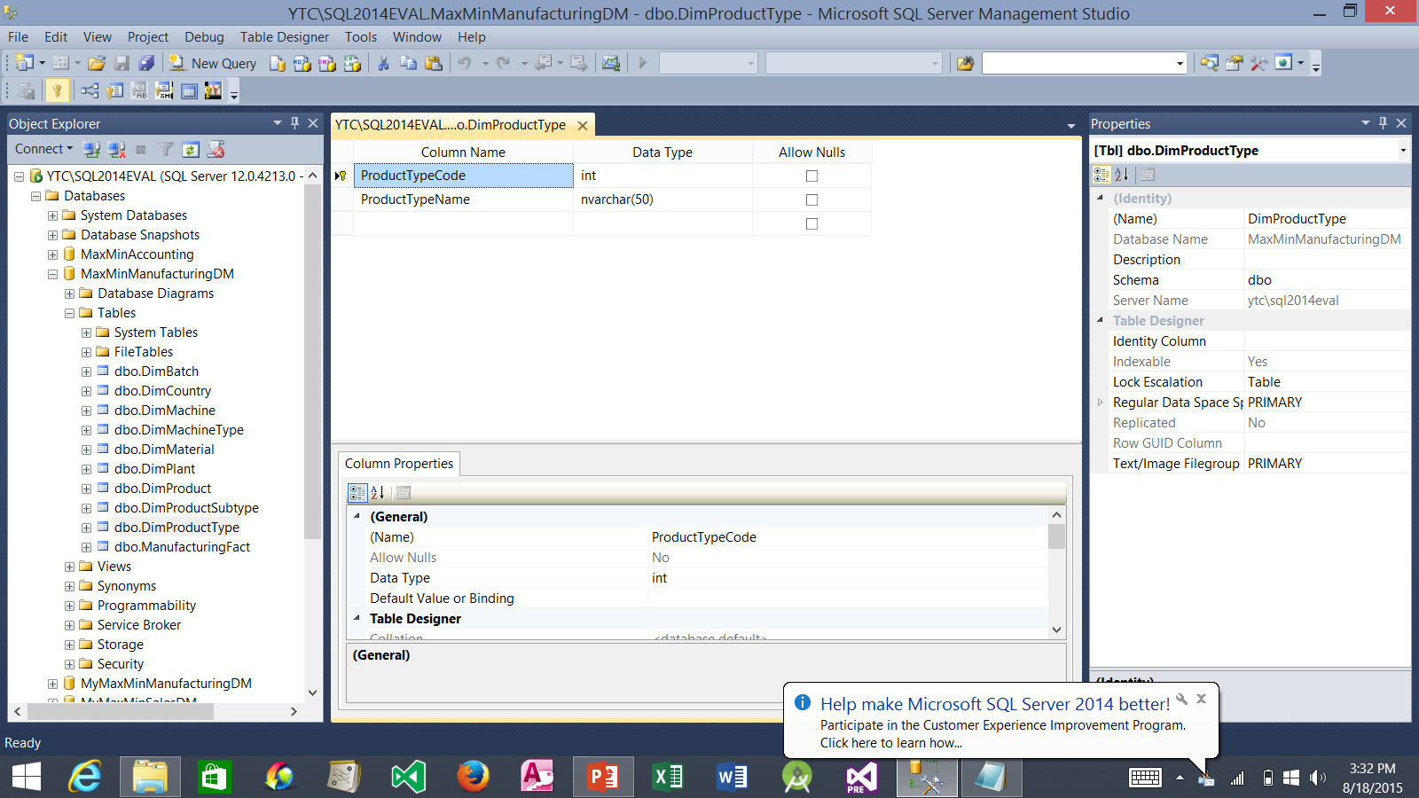
4. Click this x to close the Table Designer.
1. Use the same process to create DimProductType table. Leave the Description field empty.
3. Click the Save button.
2. Enter two rows in the Table Designer as above. Be sure to set ProductTypeCode as the primary key.

Slide 12
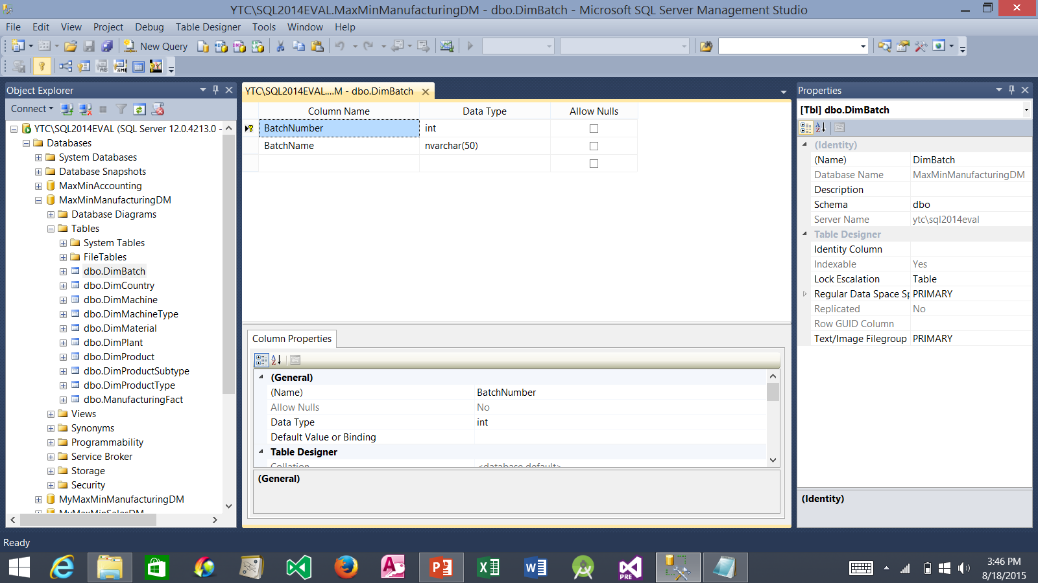
4. Click this x to close the Table Designer.
1. Use the same process to create DimBatch table. Leave the Description field empty.
3. Click the Save button.
2. Enter two rows in the Table Designer as above. Be sure to set BatchNumber as the primary key.

Slide 13
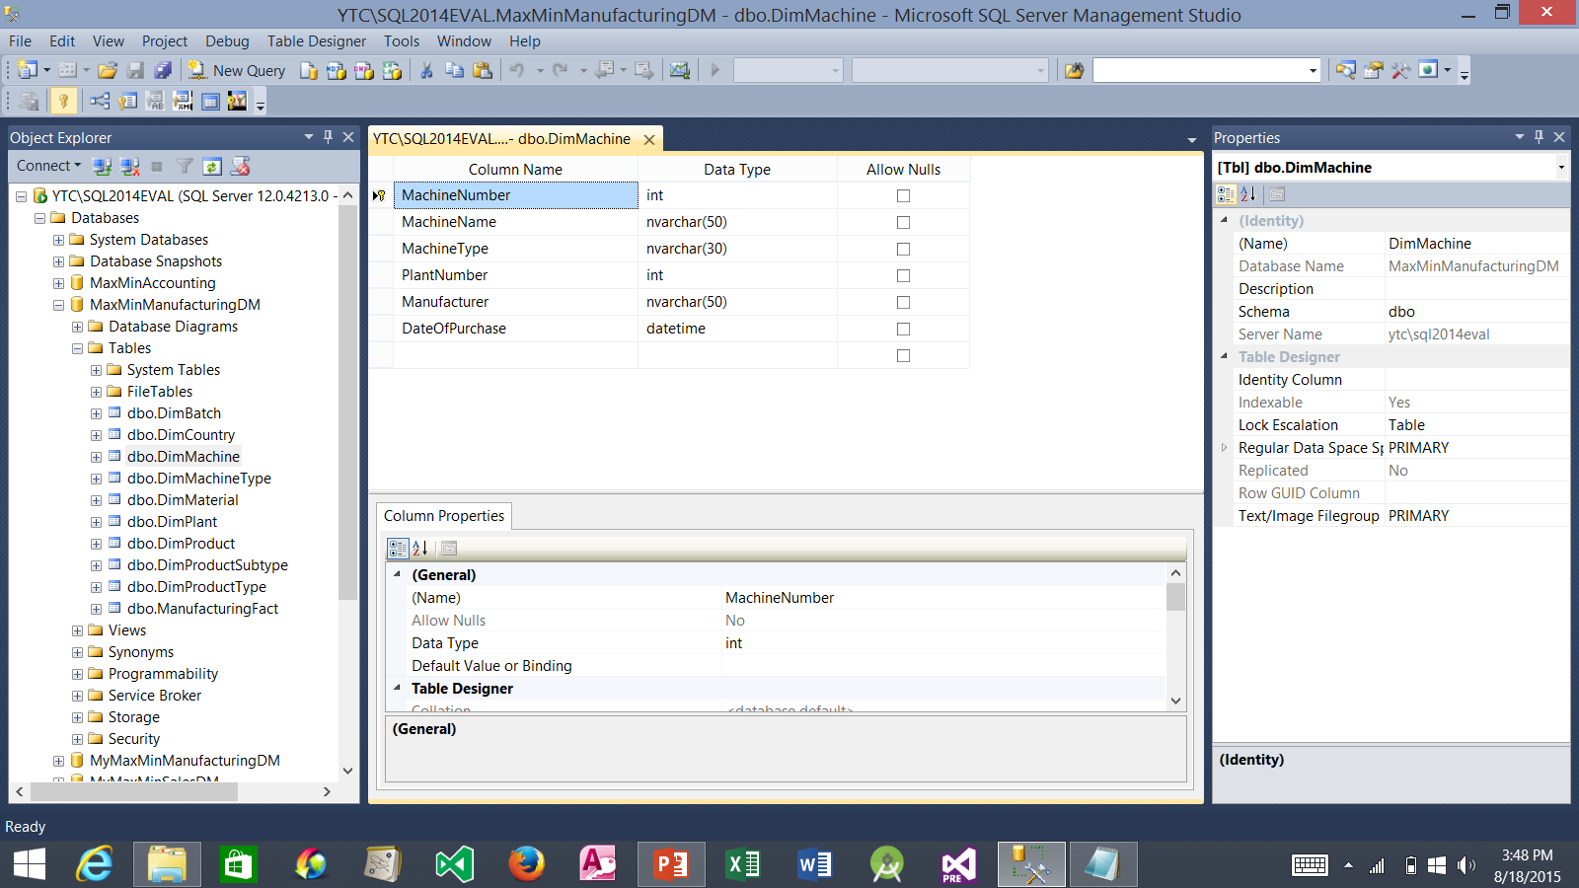
4. Click this x to close the Table Designer.
1. Use the same process to create DimMachine table. Leave the Description field empty.
3. Click the Save button.
2. Enter six rows in the Table Designer as above. Be sure to set MachineNumber as the primary key.

Slide 14
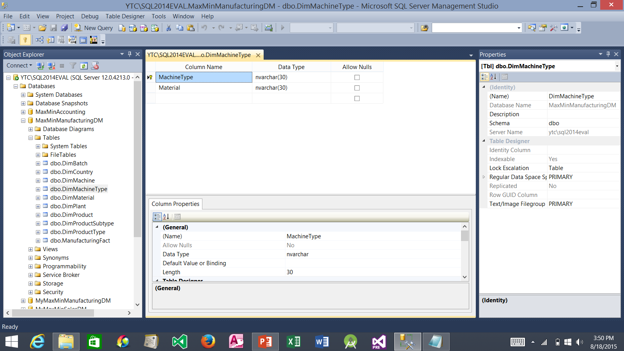
4. Click this x to close the Table Designer.
1. Use the same process to create DimMachineType table. Leave the Description field empty.
3. Click the Save button.
2. Enter two rows in the Table Designer as above. Be sure to set MachineType as the primary key.

Slide 15

4. Click this x to close the Table Designer.
1. Use the same process to create DimMaterial table. Leave the Description field empty.
3. Click the Save button.
2. Enter one row in the Table Designer as above. Be sure to set Material as the primary key.

Slide 16

4. Click this x to close the Table Designer.
1. Use the same process to create DimPlant table. Leave the Description field empty.
3. Click the Save button.
2. Enter three rows in the Table Designer as above. Be sure to set PlantNumber as the primary key.

Slide 17

4. Click this x to close the Table Designer.
1. Use the same process to create DimCountry table. Leave the Description field empty.
3. Click the Save button.
2. Enter two rows in the Table Designer as above. Be sure to set CountryCode as the primary key.

Slide 18
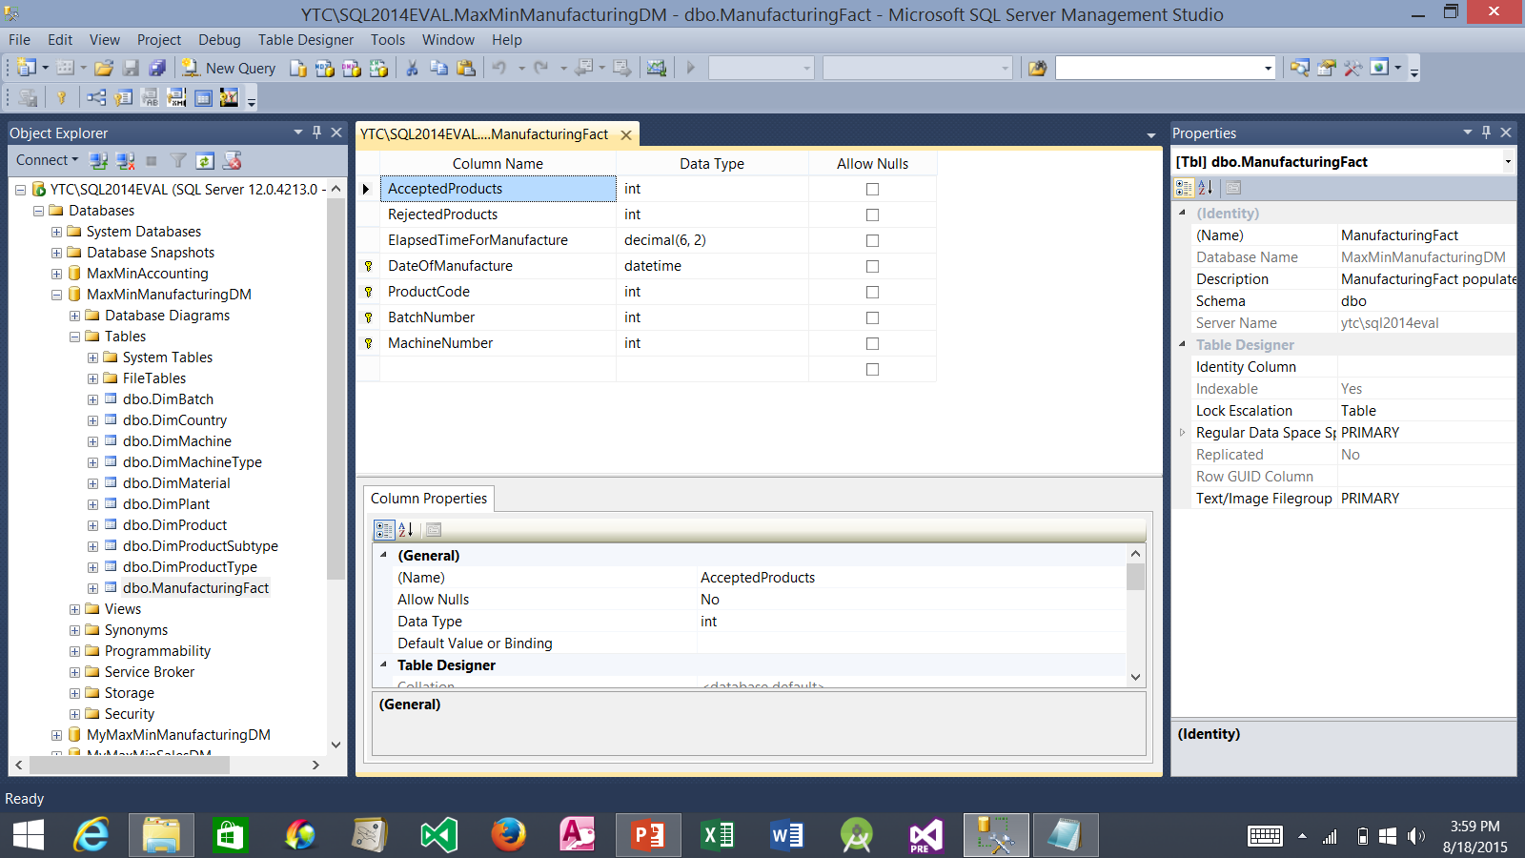
5. Click this x to close the Table Designer.
1. Use the same process to create ManufacturingFact table.
4. Click the Save button.
3. Enter seven rows in the Table Designer as above. Be sure to set DateOfManufacture, ProductCode, BatchNumber, and MachineNumber as the primary key. How? Highlight the last four rows and then click the primary key icon.
2. Enter ManufacturingFact populated from the Manufacturing Automation System export file for the Description.

Slide 19
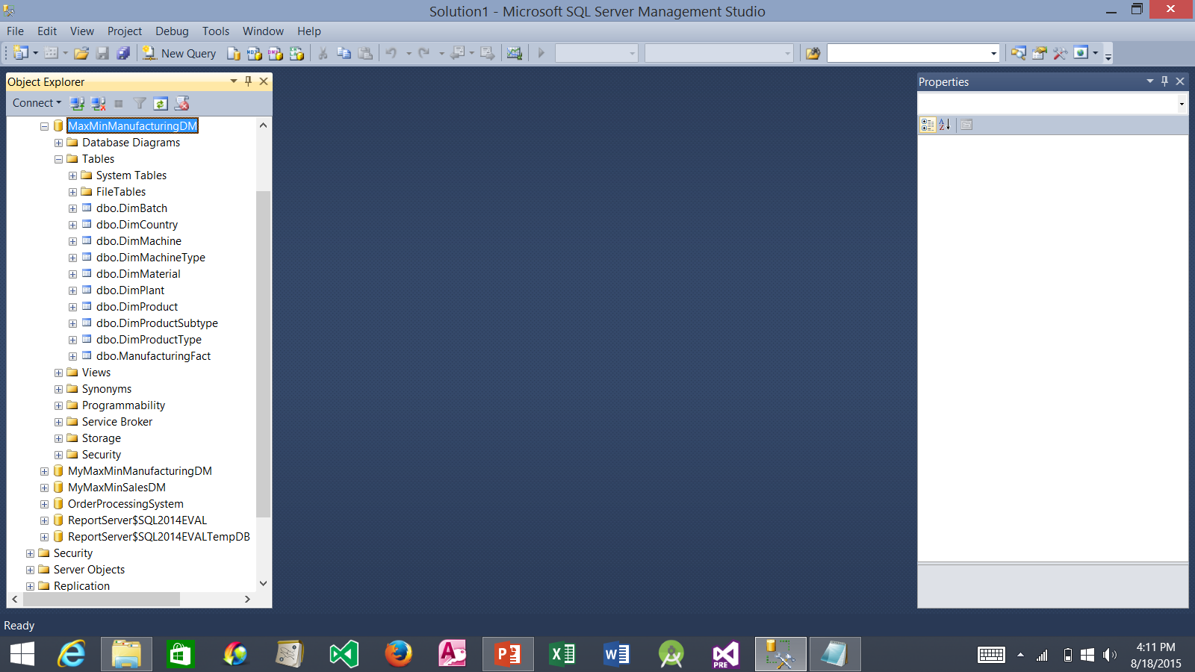
1. You have now manually built the MaxMinManufacturingDM data mart (data warehouse) structure using the SQL Server Management Studio. You should have ten tables from dbo.DimBatch to dbo.ManufacturingFact, as shown on the left.
2. We are only halfway done. In the next tutorial, you will complete the other half of the process by creating an Analysis Service project that uses this data mart as its data destination.

