Slide 1
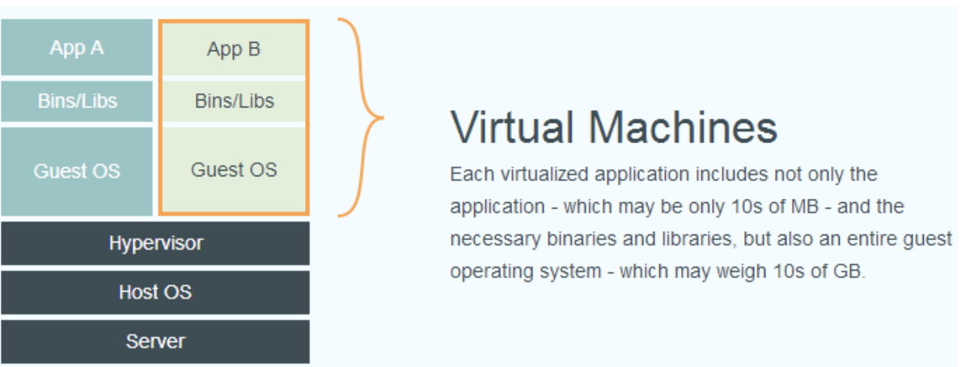
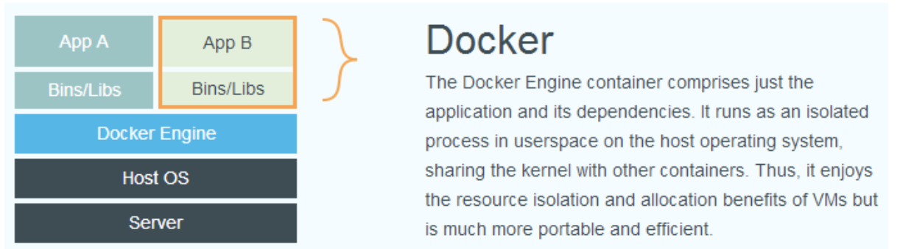
Docker and VMs

Slide 2
images and containers
A Docker image is containing everything needed to run an application as a container. The image can then be deployed to any Docker environment and executable as a container.
A Docker container is a runtime instance of an image. From one image you can create multiple containers (all running the sample application) on multiple Docker platform.

Slide 3
installation
for windows and mac
https://www.docker.com/products/docker-desktop
for Linux
I have a script to install Docker

Slide 4
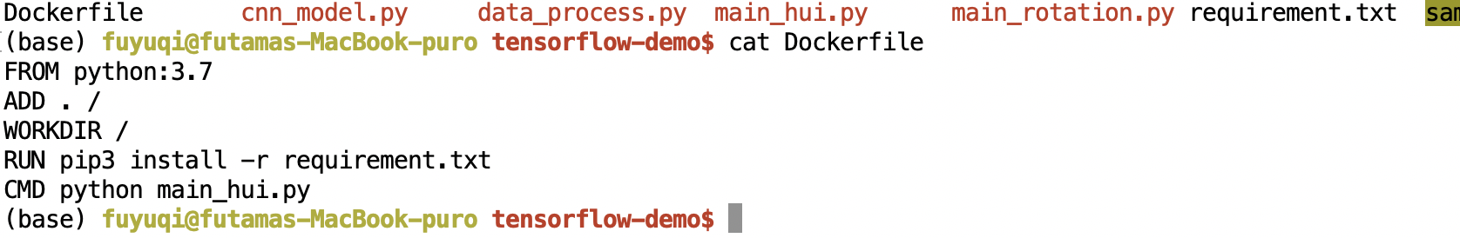
How to build a Docker images

Slide 5
build image:
docker build –t fuyuqi1995/tensorflow-demo-cpu[image_name] .
push image to Docker hub:
docker login
docker push fuyuqi1995/tensorflow-demo-cpu
run a Docker based on image
docker run --name=test fuyuqi1995/tensorflow-demo-cpu

Slide 6
https://docs.docker.com/engine/reference/commandline/run/
useful options
1.name
2.gpus(new version)
3.mount
4.rm
docker run --name mount2 --mount type=bind,source=$(pwd),target=/root/ fuyuqi1995/test-mount

Slide 7
docker image ls -a
docker container ls –a
docker rm [container_id or name]
docker rmi [image_id or name]

