Slide 1

LJ school of computer applications SEM 08 Fundamental of Data science Presentation

Slide 2
Crypto EDA Analysis, Prediction & forecasting
Members:
Guided by:
Dr. Jignesh Doshi
Name | Enrolment no.
Arnold Macwan | 21004500210065
Manthan Parmar | 21004500210094
Hitij Vaghela | 21004500210186

Slide 3
Table of content
Introduction
Problem definition
Data Summary
EDA analysis
Scatter plot
Heatmap & histogram
Feature engineering
Moving averages
BB bands
Daily change & ATR
RSI
Random forest model
XGBoost Regressor
LSTM Model
GRU
Conclusion

Slide 4
Introduction
Comprehensive exploratory data analysis (EDA) and advanced financial & crypto market analysis using cutting-edge machine learning models. Includes data preprocessing, trend analysis, predictive modelling, and risk assessment techniques.

Slide 5
Problem definition
Cryptocurrency markets are characterized by significant volatility and are affected by numerous elements. This project aims to create a predictive model capable of delivering precise price predictions, assisting users in refining their trading strategies and make decisions and predict the trends (up/down) and useful insights using past market data, technical indicators and other factors

Slide 6
About data
The "Cryptocurrency Price Analysis Dataset: BTC, ETH, XRP, LTC (2018-2023)" is a comprehensive dataset that captures the daily price movements of six popular cryptocurrencies. It covers a period from January 1, 2018, to May 31, 2023, providing a valuable resource for researchers, analysts, and enthusiasts interested in studying the historical price behavior of these digital assets.
https://www.kaggle.com/datasets/adityamhaske/cryptocurrency-price-analysis-dataset/data

Slide 7
Column descriptions
Column Name | Description
Date | The date on which the price data was recorded.
Open | The opening price of the cryptocurrency at the beginning of the day.
Close | The closing price of the cryptocurrency at the end of the day.
Low | The lowest price reached by the cryptocurrency during the day.
High | The highest price reached by the cryptocurrency during the day.

Slide 8
Used libraries
Numpy and pandas
Sci-kit learn
Tensorflow
Matplotlib
seaborn

Slide 9
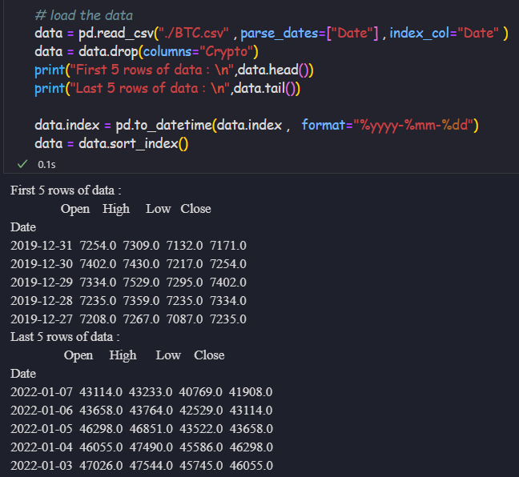
Data collection

Slide 10
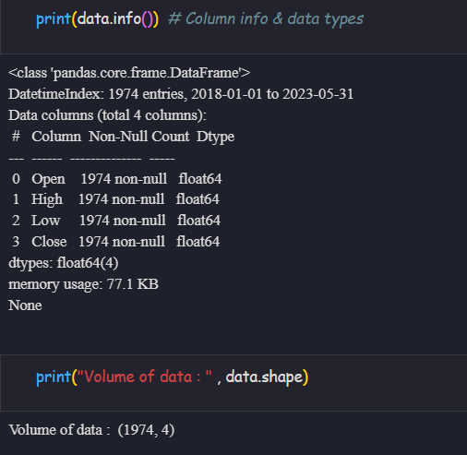
Volume & Column types

Slide 11
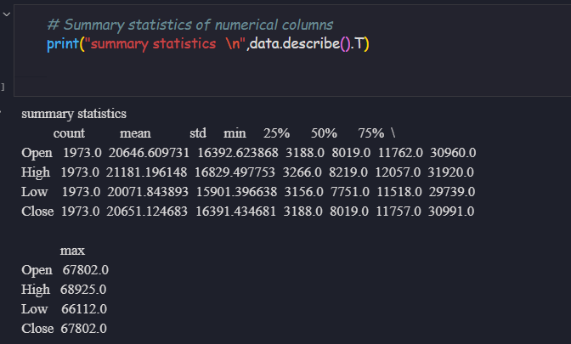
Statistical summary

Slide 12

EDA analysis
- Volume & Statistical Summary
- Correlation Heatmap
- Price Trend Line Charts

Slide 13
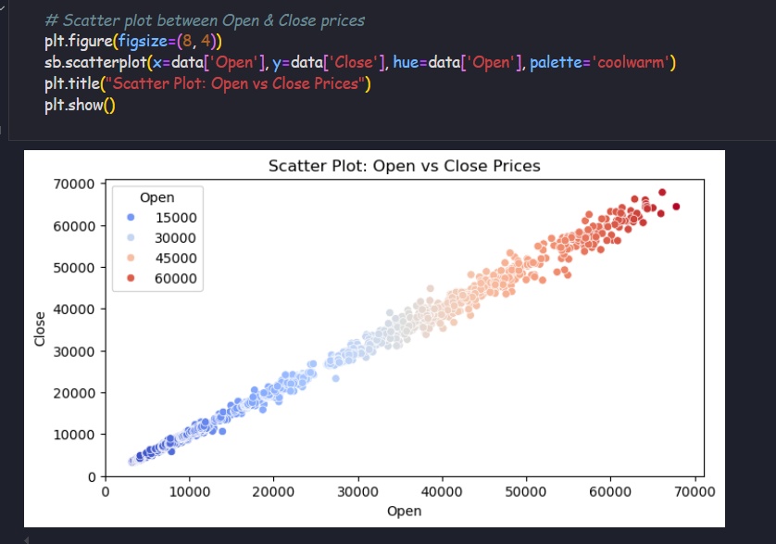
Scatter plot : open vs close

Slide 14
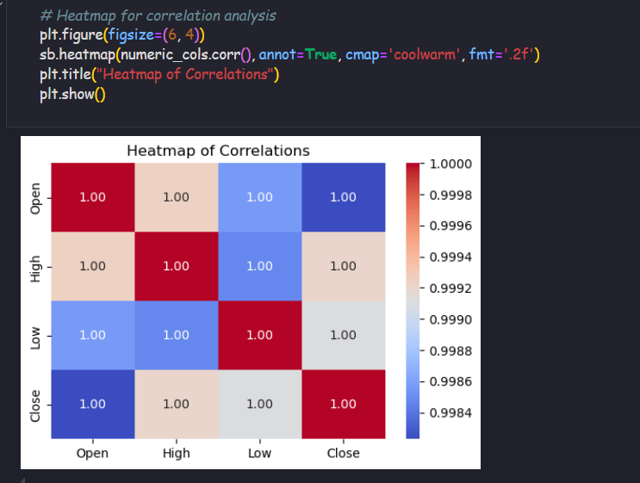
Heatmap for correlation analysis

Slide 15
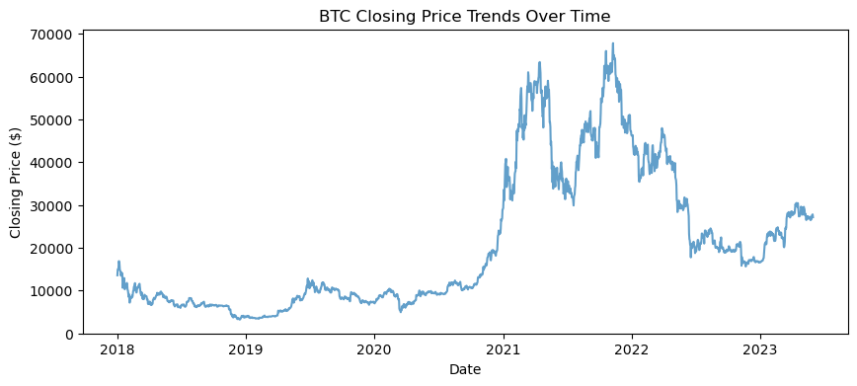
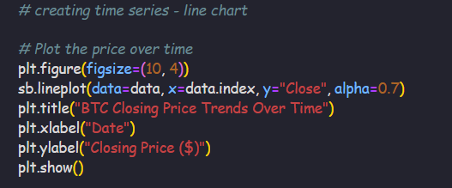
Price-chart : line chart analysis

Slide 16
Feature engineering and indicators
Moving average
Moving averages are technical indicators that smooth out price fluctuations by averaging prices over a specific period, helping traders to identify trends and potential support/resistance levels.
Daily Change %
Daily change shows the daily average changes in the price in percentage
Bollinger bands
Bollinger Bands are a technical analysis tool used to assess market volatility and identify potential trading opportunities, consisting of a simple moving average (SMA) and two bands (upper and lower) typically set two standard deviations away from the SMA.
ATR
The Average True Range (ATR) indicator is a technical analysis tool that measures market volatility.
RSI
The RSI provides immediate signals for buying and selling, helping you understand whether an asset is overbought or oversold.

Slide 17
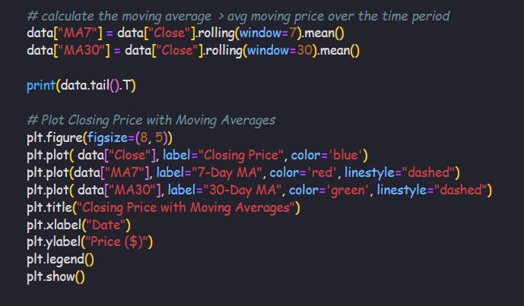
Moving averages

Slide 18
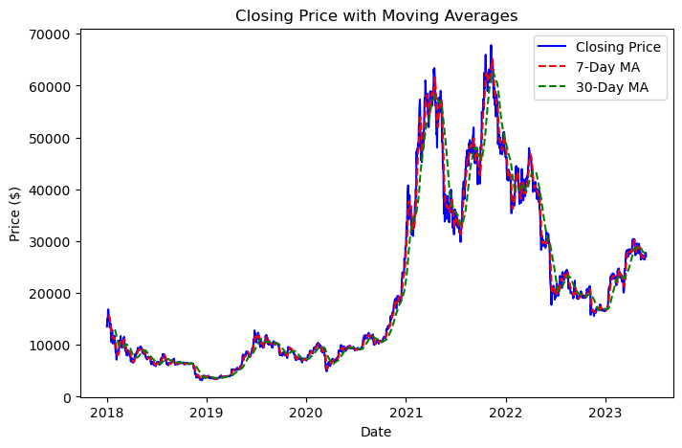
Visualizing the moving averages

Slide 19
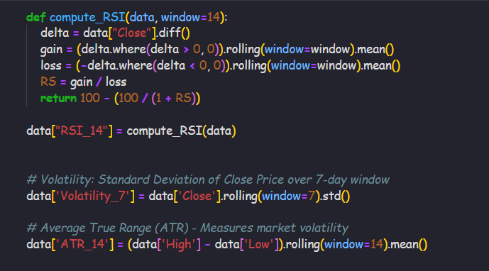
Other indicators

Slide 20
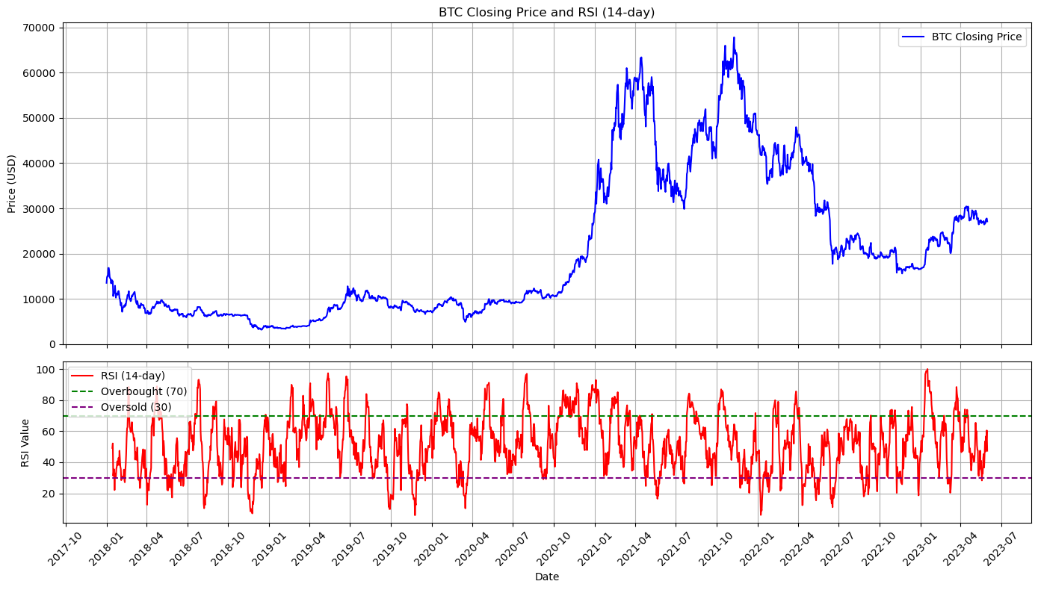

Slide 21
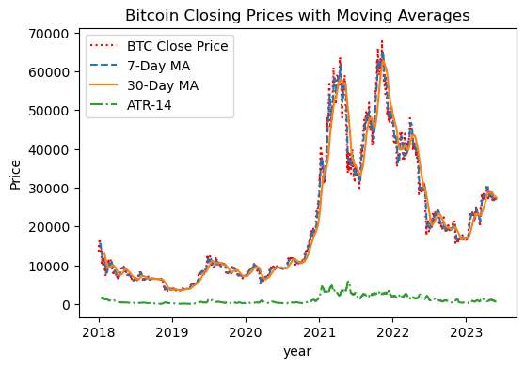
Visualizing the indicators

Slide 22
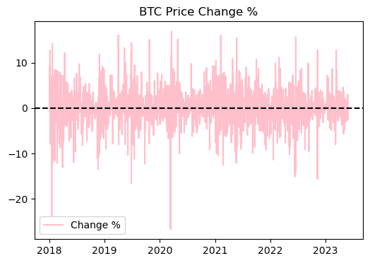
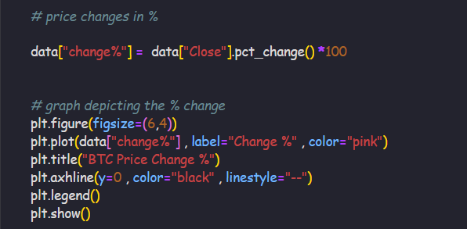
Percentage changes in price

Slide 23
Bollinger Bands
Bollinger Bands are a technical analysis tool that shows the price volatility of a financial instrument over time. It consists of three : upper band, lower band and middle band
In this case :
Upper band = MA30 + (2 * Std Dev.)
Lower band = MA30 - (2 * Std Dev.)
Middle band = MA30

Slide 24
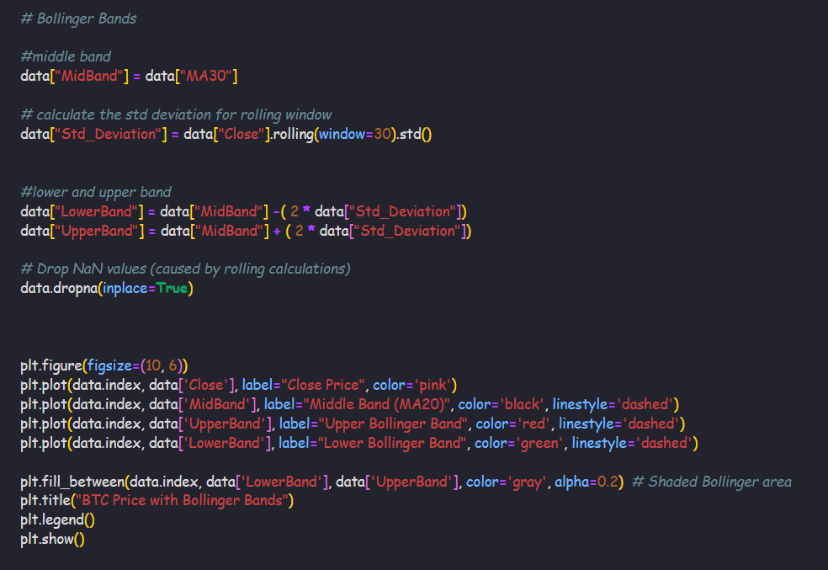

Slide 25
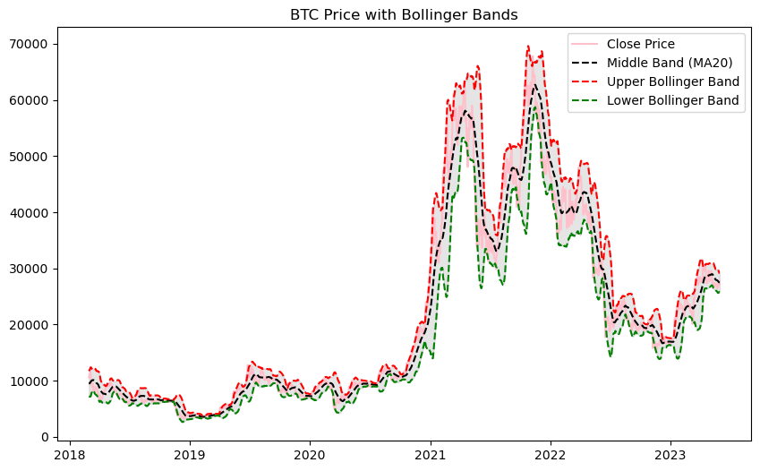
Visualizing the Bollinger's bands

Slide 26
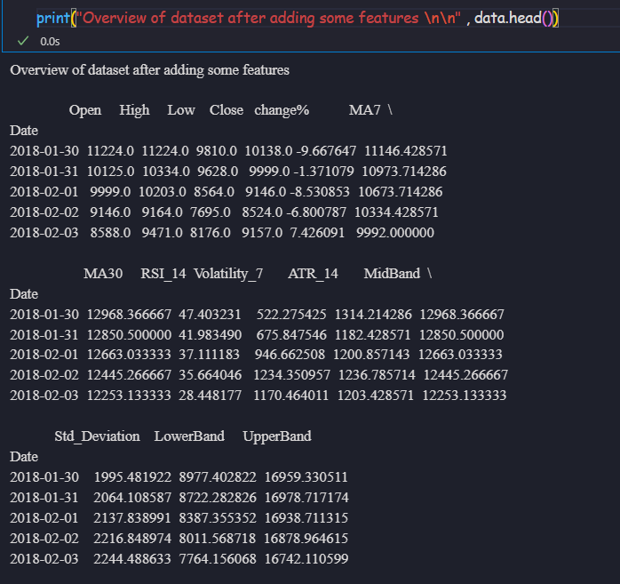
Overview of dataset after EDA

Slide 27
Price Prediction with advance models
XGBRegressor:
The XGBRegressor is a powerful machine learning algorithm that is commonly used for regression tasks. XGBoost uses gradient boosting, where decision trees are built sequentially, and each tree tries to correct the errors made by the previous tree.
Random Forest Regressor:
Random forest regressor model is used for regression tasks and works with continuous or numerous data.
Random Forest is a powerful algorithm for predicting stock prices due to its robustness and ability to handle complex, non-linear relationships in data.
LSTM
LSTM (Long Short-Term Memory) is a type of recurrent neural network (RNN) designed to process and predict sequential data, addressing the limitations of traditional RNNs by overcoming the problem of vanishing gradients.
GRU – Gated Recurrent Unit
It is a type of Recurrent Neural Network (RNN) that excels at processing sequential data.
It's designed to be more computationally efficient and easier to train than Long Short-Term Memory (LSTM)

Slide 28

XGBRegresssor

Slide 29

Feature selection and data splitting

Slide 30
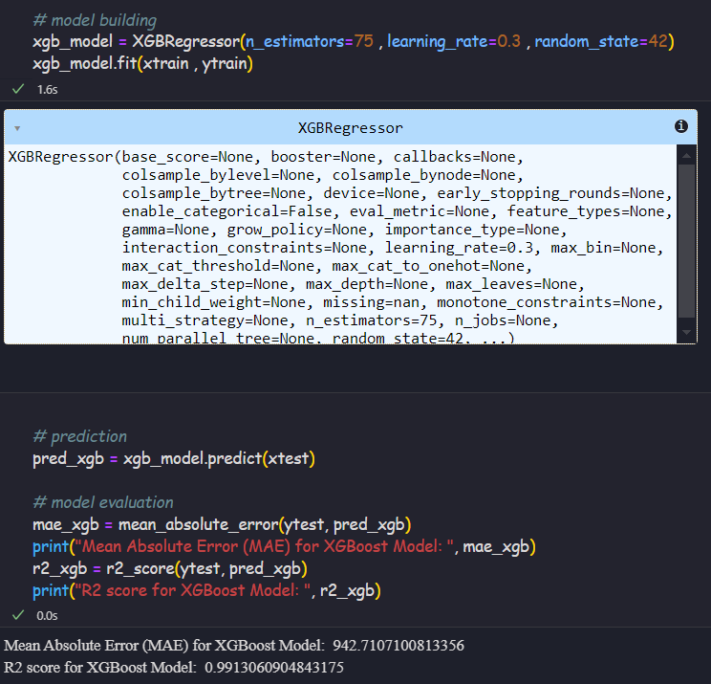
Model & evaluation

Slide 31
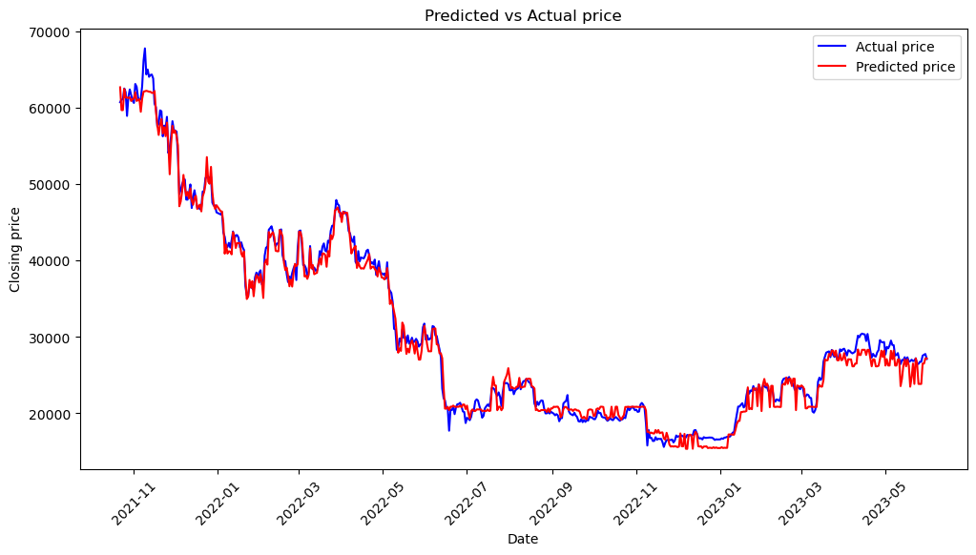
Predicated price vs Actual Price

Slide 32
Random Forest

Slide 33
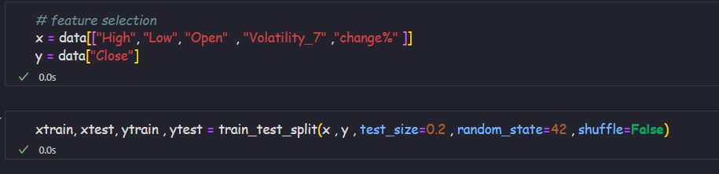
Feature selection and train-test split

Slide 34
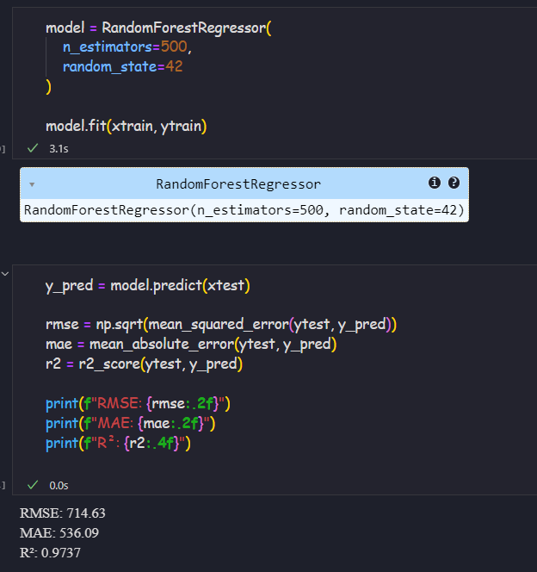
Fit and evaluate the model

Slide 35
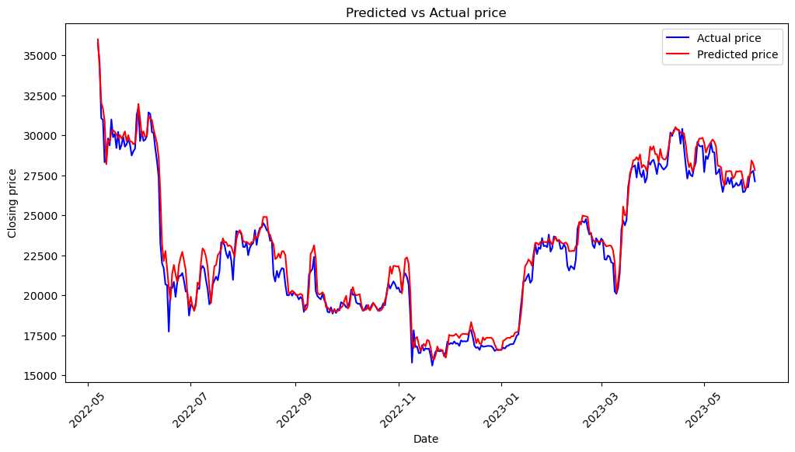
Visualize the predicated prices

Slide 36

LSTM Model

Slide 37
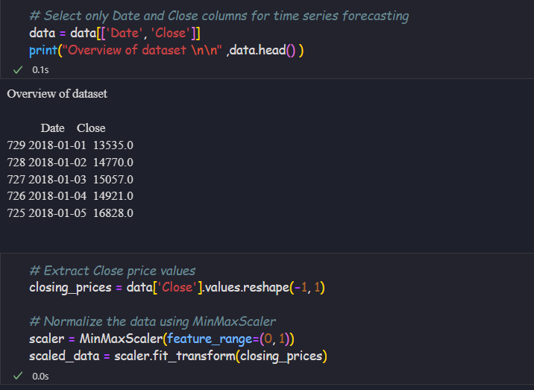
Feature selection and Data Scaling

Slide 38
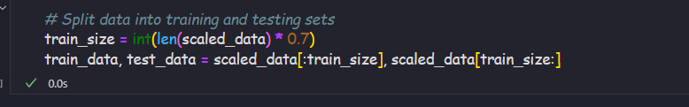
Training and Testing Dataset

Slide 39
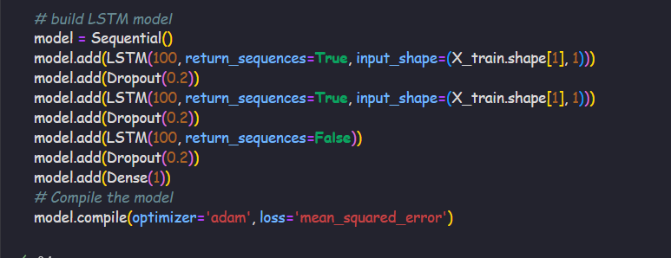
Model building

Slide 40
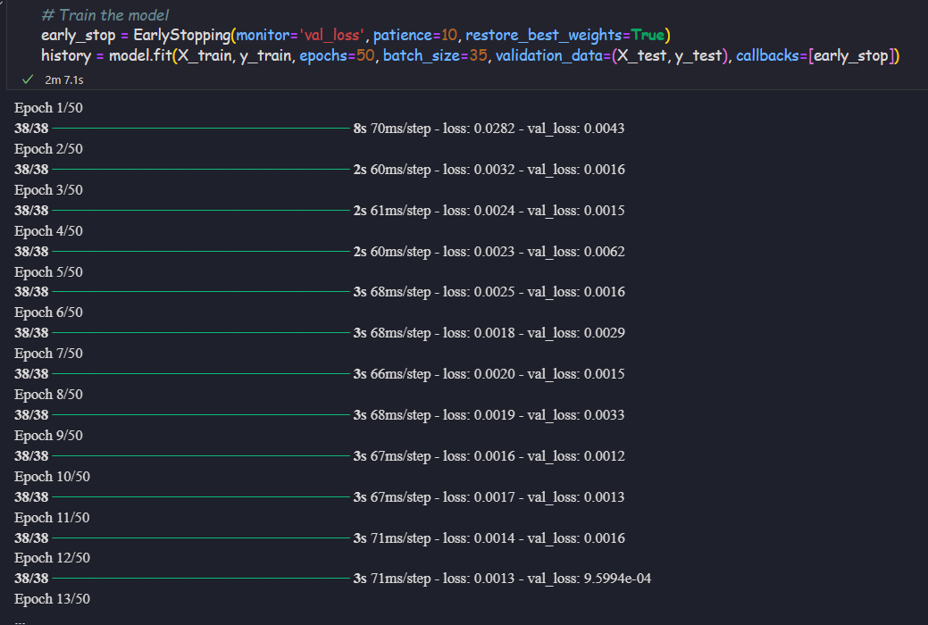
Fit the model with appropriate iterations

Slide 41
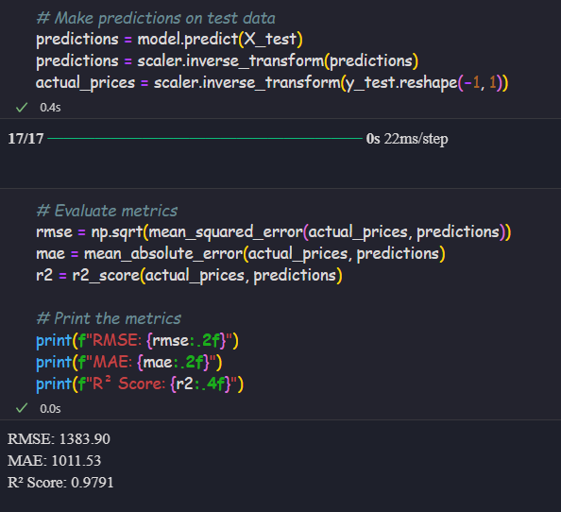
Predictions and model evaluation
Analysis:
RMSE (~1383) indicates that, on average, the model’s predicted price deviates by about $1455 from the actual price. Since BTC prices can be highly volatile, this error is relatively small compared to the typical price range.
R2 score 0.97 indicates that 97.7% of the variance in the BTC price is explained by the model.
Overall, the model is trained and performed well

Slide 42
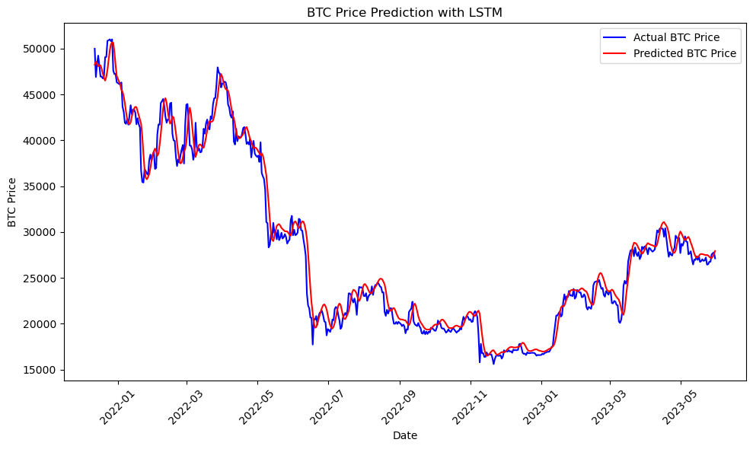
Predicated price vs Actual Price

Slide 43
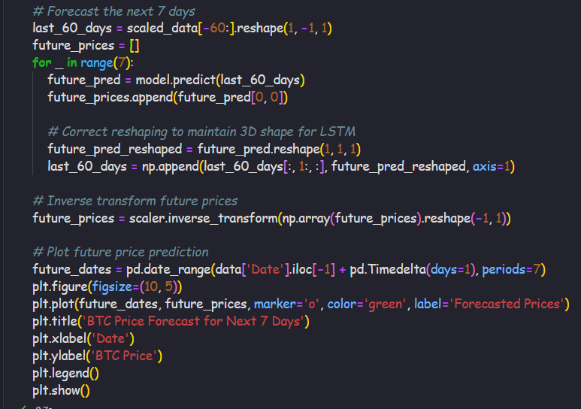
Price forecasting of 7 days based on last 60 days with LSTM

Slide 44
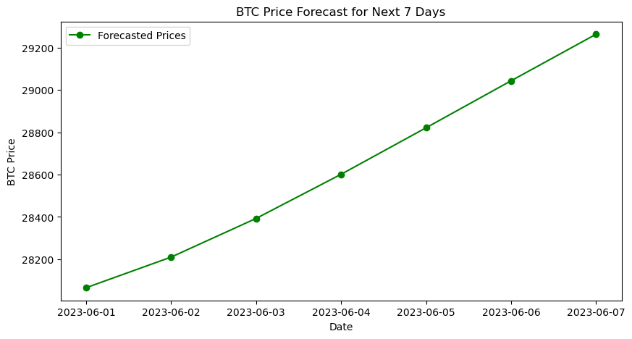

Slide 45
Model Comparison
XGBoost Model:
Fast and accurate for predicting trends and price changes.
Suitable for quick decision-making and broader market analysis.
LSTM Model:
Highly effective at capturing sequential price patterns.
Better suited for 7-day price forecasting with a high degree of reliability.

Slide 46

GRU-Gated Recurrent unit

Slide 47
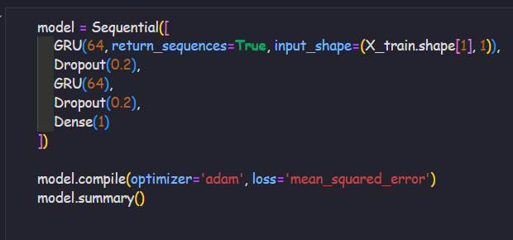
Model building

Slide 48
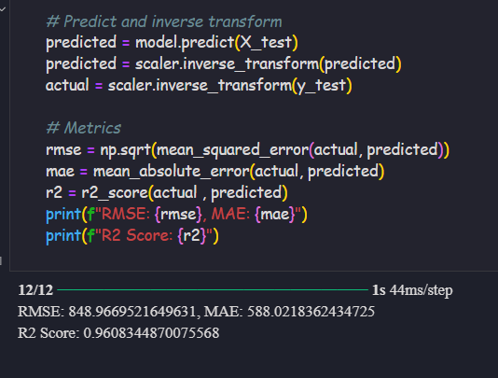
Evaluate the model
The GRU model has also provides the almost same accuracy like LSTM model even though taking less computational resources

Slide 49
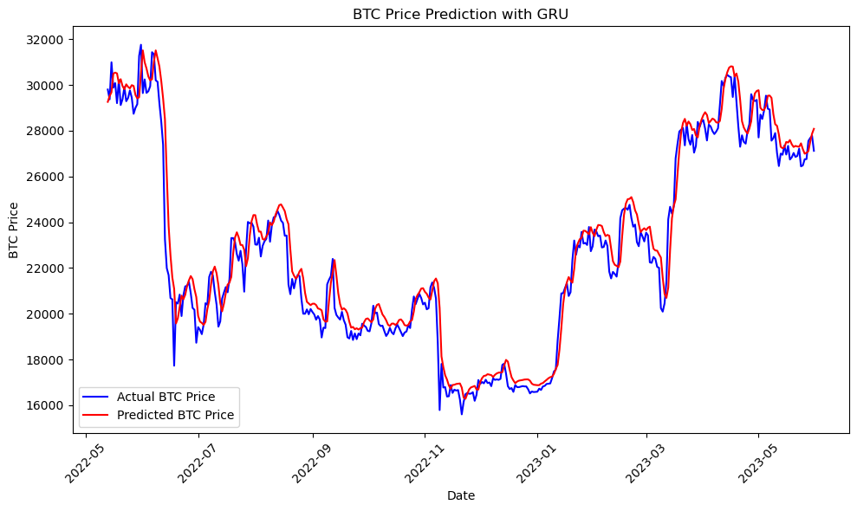

Slide 50
Model Comparison
Model | MAE | RMSE | R² Score
Random Forest | 536.09 | 714.63 | 97.37%
XGBoost | 942.71 | — | 99.13%
LSTM | 890 | 1383 | 97.7%
GRU | 649.95 | ~Same as LSTM | ~95%

Slide 51
Conclusion
This project successfully developed a predictive model for cryptocurrency market trends, focusing on Bitcoin price movements. Through advanced EDA, trend analysis, and machine learning, we were able to accurately forecast price directions (up/down) using historical data and technical indicators.
By comparing various models, the LSTM network & XGBRegressor stood out, providing the best results for capturing the complex patterns and volatility inherent in the market. This predictive tool empowers traders with better insights, enhancing decision-making and risk management strategies in the ever-changing cryptocurrency space.
In essence, this presentation demonstrates the power of data science and machine learning in transforming market analysis, paving the way for smarter, data-driven trading.

Slide 52
Proposed Enhancement
To further improve the model’s performance and practical usability, several enhancements are suggested. These will help make the predictions more dynamic, accurate, and aligned with real-world trading needs.
Multi-Cryptocurrency Forecasting
Live Price prediction
Automated Model Updates
Sentiment analysis and integration

Slide 53
THANKS!

