Slide 1

Web Development using Django
MSc(IT) SEM.: 05
LJ Institute of computer applications
LJ University
Created by: Arnold Macwan
Email: official.arnold.mac.2004@gmail.com

Slide 2
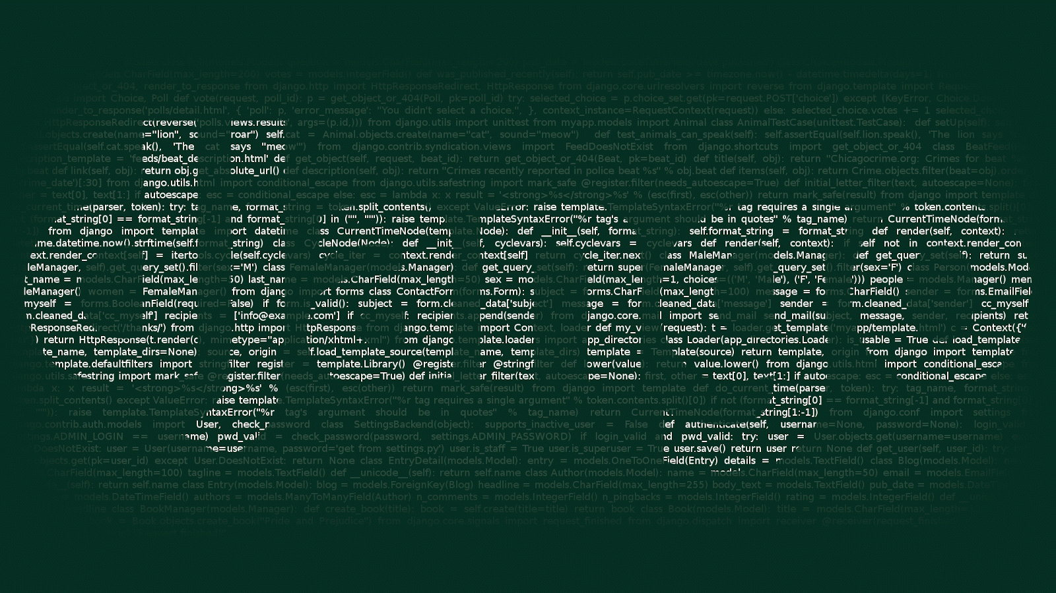
What is Django?
In 2003, Django was an internal project started by Adrian Holovaty and Simon Willison.
The first version of Django was released in July 2005, and the name is given Django based on the name of guitarist Django Reinhardt
A high-level Python web framework allows rapid development
Provides easily maintainable and scalable websites
Allows developers to build robust, scalable, and secure web applications quickly and efficiently
Follows MVT model (model-view-template)
“Don't Repeat Yourself" (DRY) and "Convention over Configuration"

Slide 3
Pre requisites
Python Core Programming
DBMS fundamentals
Object Oriented Programming
Familiar with web development concepts
IDE: Visual Studio Code (preferred)
DB: SQL (MySQL or Xamp)
Version control: Git and GitHub (optional)

Slide 4
Outcome
Strong backend development skills
MVC/MVT logic building
Able to work with real life applications

Slide 5
Django vs Laravel
Feature / Aspect | Django | Laravel
Language | Python 🐍 | PHP 🐘
Architecture | MVT (Model-View-Template) | MVC (Model-View-Controller)
Performance | Slightly faster (Python advantage) | Good, but can be slower under load
Learning Curve | Easier (Python syntax) | Moderate (needs PHP basics)
Built-in Features | More batteries-included (ORM, Admin) | Lots of built-in helpers + CLI tools
Admin Interface | Auto-generated & powerful | Needs third-party packages (e.g., Voyager)
Database ORM | Django ORM (built-in) | Eloquent ORM (intuitive, fluent)
Community Support | Large (Python + Django devs) | Very large (PHP is older and widespread)
Template Engine | DTL (Django Template Language) | Blade (clean, powerful)
Authentication | Built-in, extendable | Built-in, with easy role-based control
Frontend Integration | Good with React, Vue, HTMX | Good with Vue, InertiaJS, Livewire
Job Market | Data-heavy roles, AI/ML-ready | CMS, enterprise sites, agencies
Ideal Use Case | Data-driven apps, dashboards, APIs | Websites, eCommerce, CMSs, ERP systems

Slide 6
Features of using Django
Batteries included which allows built-In security mechanism such as CSRF token, Session management, User Authentication and many more
Customizable built-in Admin Interface
ORM-Object relational mapper makes easier transactions with database
ORM(Object relational mapping) Let's you interact with the database using Python objects rather than raw SQL queries.
Easy to build, develop and flexible architecture

Slide 7
Applications
Social network applications such as blogs, social media platforms (even Instagram originally used Django as their initial backend)
Widely used for CMS and booking engines (hotels, tickets, etc…)
Backend for mobile apps
Popular for inventory and CRM platforms
Scalable for enterprise applications
Flexible for creating visuals and dynamic dashboards

Slide 8
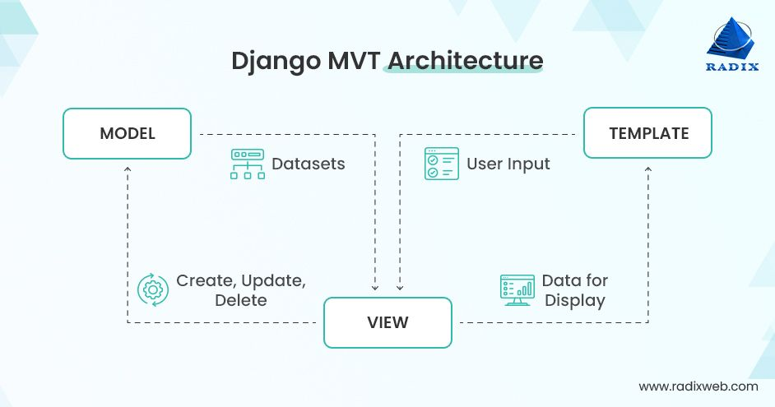
Architecture of Django

Slide 9
Let’s setup Django !
Needs python installed (recommended python 3.11+)
If not installed then install PIP
https://www.w3schools.com/django/django_create_virtual_environment.php
Set up Virtual environment:
# Create a virtual environment
> python -m venv venv
# Activate it:
# Windows:
> venv\Scripts\activate
# macOS/Linux:
source venv/bin/activate

Slide 10
Install and create project
Install Django
> (myworld) ... $ python -m pip install Django
Check installation
> (myworld)… $ django-admin --version
Create project using CLI
> django-admin startproject <project_name>
Start project
> py manage.py runserver

Slide 11
App/Module in Django
Django allows modular approach to build websites
App is used by Django project
Multiple apps could be built inside a single Django project
Apps or modules simplifies the complex structure and organizes large file systems used by Django
Provides reusability and makes scalable system design

Slide 12
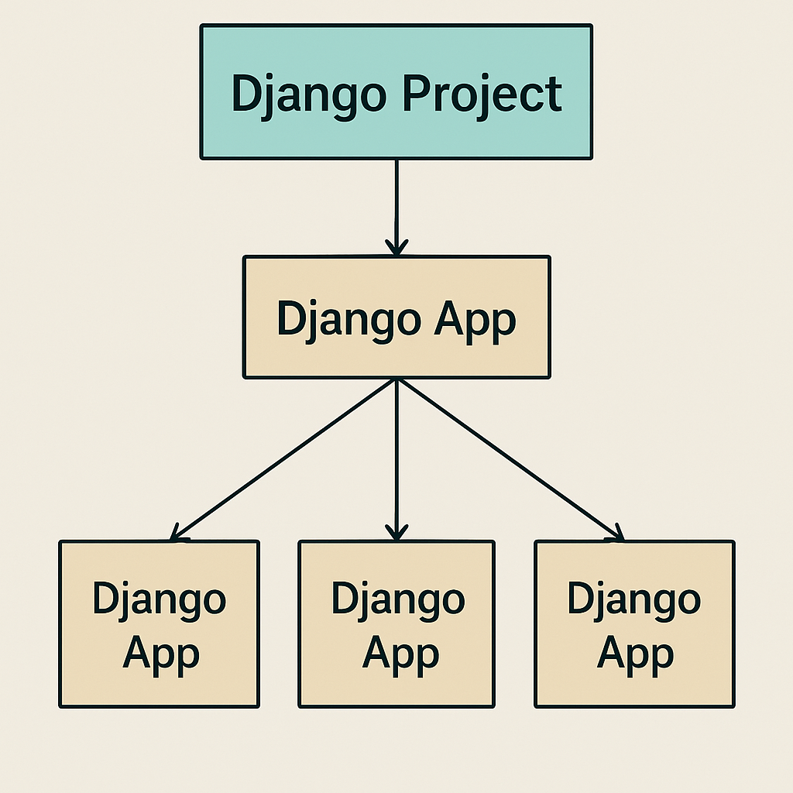
App structure example
mysite/
├── manage.py
├── mysite/ ← Project folder
│ ├── settings.py
│ ├── urls.py
│ └── ...
├── Amazon/ ← App #1
│ ├── models.py
│ ├── views.py
│ └── ...
├── Meesho/ ← App #2
│ ├── models.py
│ ├── views.py
│ └── ...

Slide 13
Common & useful commands
Create app
> python manage.py startapp <appName>
Create project
> Django-admin startproject <projectname>
Run server
> py manage.py runserver
Migrate database
> py manage.py migrate
> py manage.py makemigrations
Install third party packages
> pip install <pkgname>

Slide 14
Let’s understand the project file structure
myproject/
├── manage.py
├── myproject/
│ ├── __init__.py
│ ├── settings.py
│ ├── urls.py
│ └── wsgi.py
└── myapp/
├── admin.py
├── models.py
├── views.py
├── urls.py
└── templates/

Slide 15
myproject/ (Root Folder)
This is your main project folder (same name as your project). It contains “manage.py”, a command-line utility for managing your project (runserver, migrations, etc.)
Inside myproject
__init__.py | Marks this folder as a Python package
settings.py | Main config file (database, apps, static files, security, etc.)
urls.py | Root URL routing for the entire project; includes app-level urls.py
wsgi.py | Entry point for WSGI servers (for deployment)
(Optional) asgi.py | Used when deploying with ASGI for async support

Slide 16
Django app folder
File | Purpose
admin.py | Register models to Django Admin
models.py | Define your database tables using Django ORM
views.py | Define the logic for what to show when a URL is visited
urls.py | URL patterns specific to this app (you link this from the project urls.py)
templates/ | Store HTML templates (inside templates/myapp/)

Slide 17
Working of Databases
Most used databases with Django
SQLite (default)
MYSQL (preferred)
Postgresql (most used)
MongoDB(NoSQL – not suitable)

Slide 18
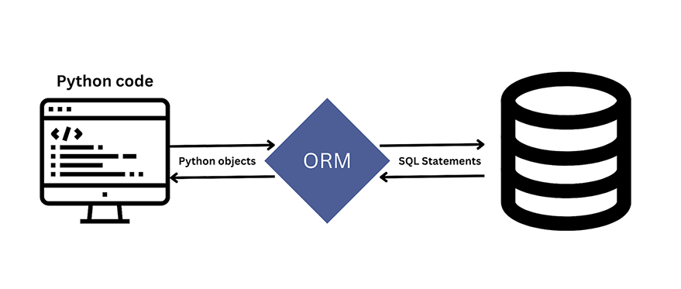
Django ORM
The Django ORM (Object-Relational Mapper) is a core component of the Django web framework that facilitates interaction with relational databases using Python code, rather than writing raw SQL.

Slide 19
MYSQL setup with Django
Install MYSQL server
https://dev.mysql.com/downloads/
Install mysql workbench for GUI
Note: remember your password for root user
Install MySQL Client for Python
pip install mysqlclient
Create MySQL database
Configure database in settings.py file
Run migrations

Slide 20
ALL THE BEST

