Slide 1


SkillSwap
MSc(IT)
SEM. 08
Developed By:
Yash Shah
Arnold Macwan
Nandini Bhavsar

Slide 2

Introduction
The new currency in today's fast-paced, constantly-changing world is talents. But not everyone can afford professional instruction, and not everyone has equal access to high-quality learning materials. This is the role of SkillSwap, a peer-to-peer collaborative network that allows people to share talents and information.
Using the MEAN (MongoDB, Express.js, Angular, and Node.js), SkillSwap is a full-stack online application that enables users to teach others new skills. People from different backgrounds may interact, teach, and learn according to their areas of expertise in this community-driven setting.

Slide 3
Need for new system
SkillSwap addresses these needs by introducing a skill-exchange-based learning model, allowing users to both teach and learn through direct interaction and provide centralized collaborative platform. By providing cost effective learning or gather various SkillSwappers across the globe. Such kind of platform that allows people to exchange skills, build networks, and grow together—without the barriers of medium and trust or location. It’s more than a platform — it’s a movement for democratized learning.

Slide 4

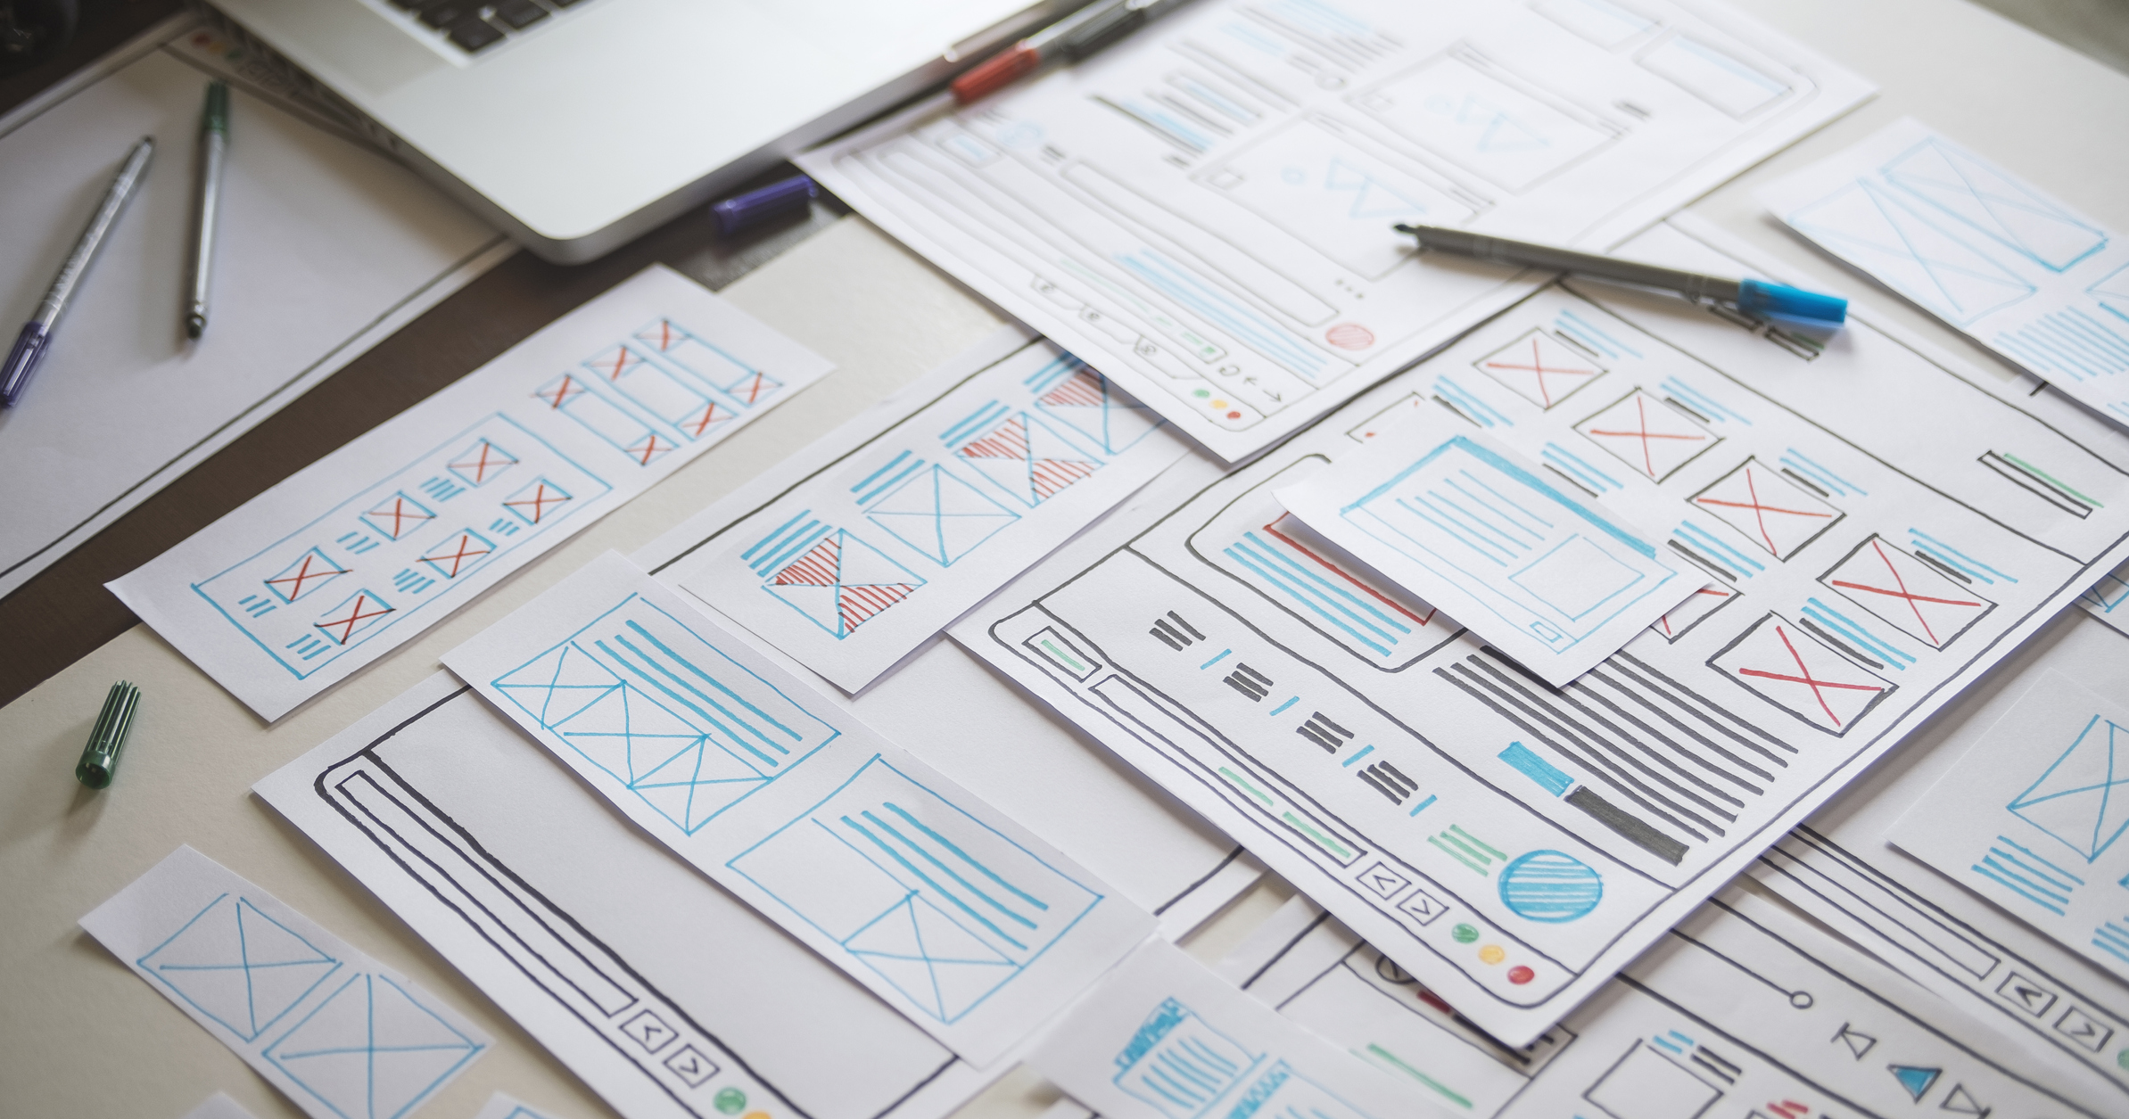
The objective of SkillSwap is to create a collaborative, peer-to-peer platform where users can exchange skills and knowledge. The system aims to connect individuals based on their teachable and learnable skills, enabling them to grow personally and professionally through mutual learning, interactive sessions, and a community-driven environment. It promotes affordable, accessible, and personalized education by facilitating skill listings, search, filtering, and request-based exchange workflows — all built on a secure and user-friendly MEAN stack infrastructure.
Objective

Slide 5
In the current digital age, acquiring new skills often requires enrolling in expensive courses, relying on static self-learning resources, or struggling to find personalized guidance. These traditional methods create financial, geographical, and accessibility barriers, especially for learners who seek affordable and collaborative learning opportunities. By overcoming these issues, the system provides centralized platform which enables users to interact with each other exchange their skills and thoughts by promoting community-based skill learning
Problem definition

Slide 6
Core components
User
Authentication
Provide Feedback
Admin
Authentication
Profile Manage
Get reminders
Skills exchange
Skills Filter & search
User management
Profile management
Skills Management
Manage transactions
Manage Blogs
Create Blog posts
Payment Management
Communication
Handle dashboard

Slide 7
Project profile
Project Title | Skill-Swap
Frontend | HTML5, SCSS, JavaScript, Angular
Libraries | Angular Material, Tailwind CSS
Back-end | NodeJS, ExpressJS
Database | MongoDB Cluster
Tools | MS-OFFICE, Visual Studio Code, Draw.io

Slide 8
Assumptions & constraints
Assumption
Users have access to the internet and a modern web browser to use the application effectively.
Users will have to provide accurate information when signing up and listing their skills.
Each user has at least one skill they can teach and one they want to learn.
The platform will initially target individual learners and educators, not organizations.
Constraints
The platform currently supports only English for content and communication.
OAuth login is limited to selected provider (Google).
Real-time communication or chat features may not scale efficiently in the early stages of the platform.

Slide 9
Pros & cons
Advantages
Role-based access control
Secure communication
Limitations
User adaption curve
Organised flow
Visual dashboards
Low maintanance
Cross-platform compatability

Slide 10
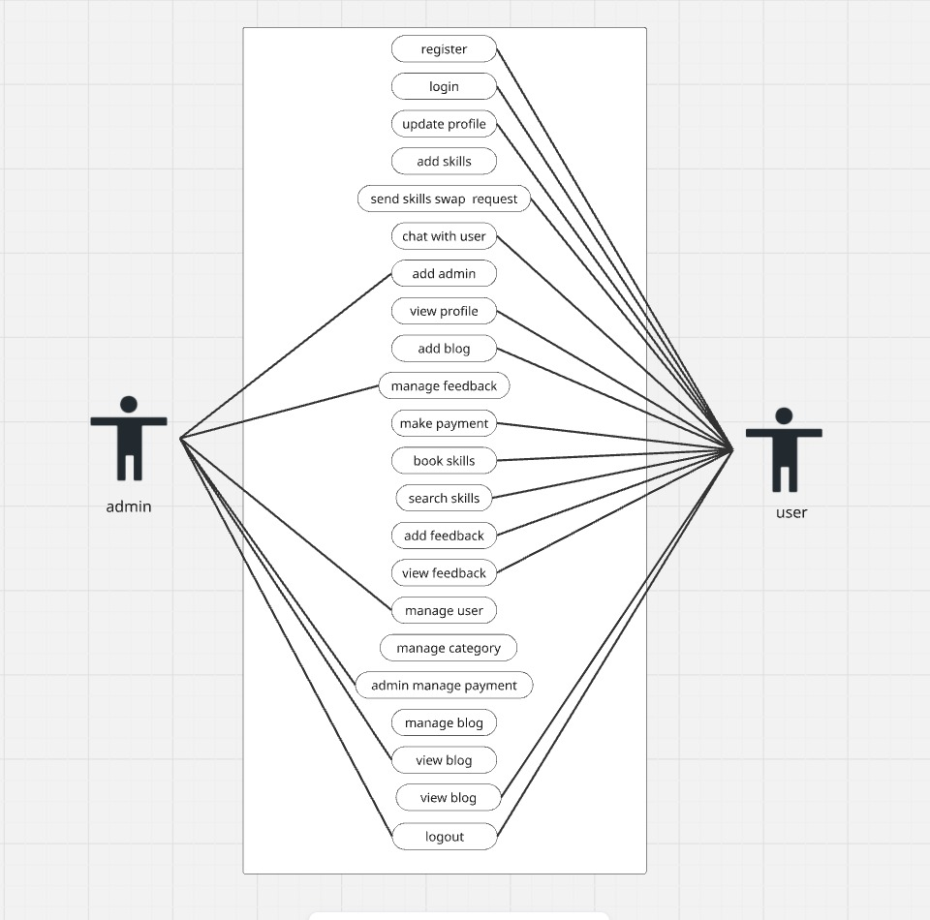
Use Case Diagram

Slide 11
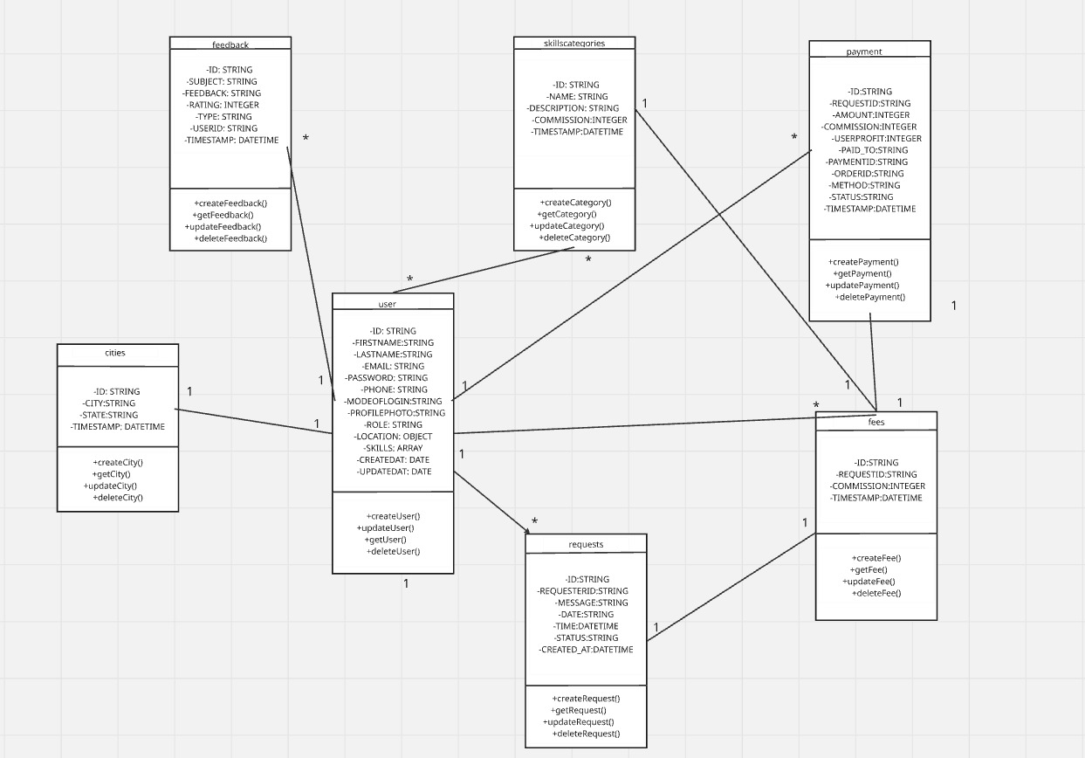
Class diagram

Slide 12
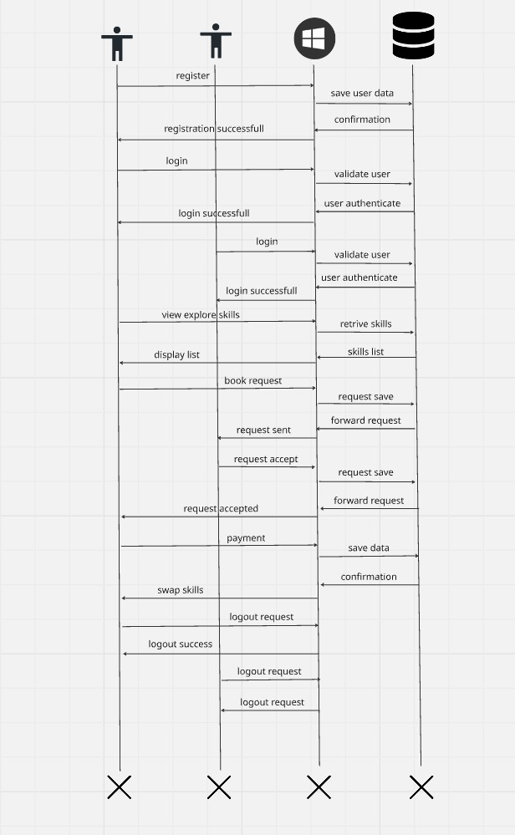
Sequence diagram

Slide 13
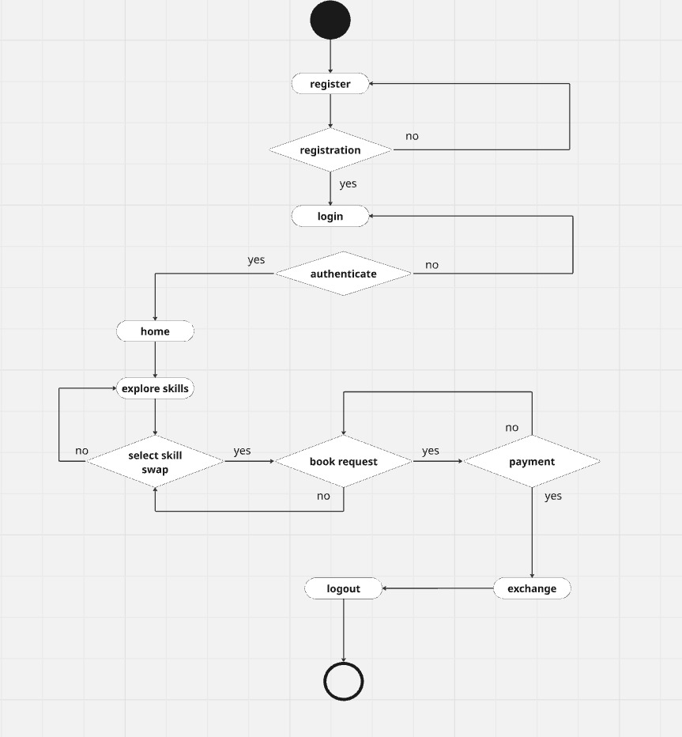
Activity diagram

Slide 14
Proposed enhancement
The proposed enhancements for the SkillSwap platform aim to take the system beyond its basic functionality and transform it into a highly scalable, feature-rich and user-centric application. The system also proposed to implement following features:
AI Chat Bot
Dynamic Skills Ratings & recommendation
More scalable reach
More enhanced Chat Module with storing of messages
Enhanced payment module
Regular maintenance

Slide 15
Conclusion
The Skill Swap platform offers a smart way for people to share and learn skills from each other. It helps users connect based on their interests, making learning more flexible, affordable, and community-driven. By allowing skill exchange, the platform encourages personal growth and builds a helpful network of learners and teachers. With planned improvements and user-friendly features, Skill Swap has the potential to become a valuable tool for lifelong learning and collaboration.

