Slide 1

HealthCare Web-Application
Developed by
Name | Enrollment
Arnold Macwan | 21004500210065
Tirth Panchal | 21004500210086
Dharmik Halani | 21004500210046

Slide 2
Table of content
Introduction
1.1 Introduction
1.2 Problem Statement
1.3 Objective
1.4 Core components
1.5 Advantages & Limitations
1.6 Assumptions & Constraints
1.7 Project Profile
Requirement Determination
2.1 Requirement Determination
2.2 Targeted Users
System design
3.1 Use-case Diagram
3.2 Data Dictionary
3.4 Class Diagram
4. Agile Documentation
4.1 Project Charter
4.2 User Story
4.3 Release Plan
4.4 Sprint Backlog
4.5 Test Plan
4.6 Burn Down & Earned Value
5. Proposed enhancement
6. Conclusion & References

Slide 3

Introduction
In today's digital era, technology plays a vital role in revolutionizing the healthcare industry.
The purpose of this project is to offer a comprehensive platform that connects people, healthcare experts, and important health services.

Slide 4

Problem statement
A web-based Healthcare Management System , which allows healthcare providers to efficiently manage patient records, appointments, and medical history and also it enables patients to access and interact with their health information.

Slide 5
Objective
Main goal of the project is to provide a primary healthcare services and reliable health information to the patients.
Provides a platform that helps to connect patients & service providers

Slide 6
Core components
Patient profile management
Staff logins
Home visit scheduling
Patient history
Reports & insights

Slide 7
Advantages & limitations
Advantages
Limitations
Only cash & debit cards accepted
Anytime anywhere
Cross-platform
Paperless work
Available only in web version

Slide 8
Assumptions : - we assumes that sources or patients provide reliable and trustable health information. - We also assume that sources follow regulations & protection laws on website.
Assumptions & constraints
Constraints :
- No Backup services
- Supported English language only

Slide 9
Project Profile
Project name | Healthcare
Front-end | HTML5,CSS3,Javascript,BootStrap
Back-end | Python, Django, MySQL
Tools | Vs code , MS office , Dia

Slide 10
Requirement Determination
Requirement determination for healthcare project involves gathering, analyzing, and documenting the needs and expectations of stakeholders .
This phase is consists of :
Surveys & sampling
Client’s requirements
Identifying the non-functional requirements
Review existing system if available
References

Slide 11
Targeted users
Admin
Patient
Staff
Doctor
Care taker
Tester
visitor
Presentation Title

Slide 12
System design

Slide 13
Use case diagram

Slide 14
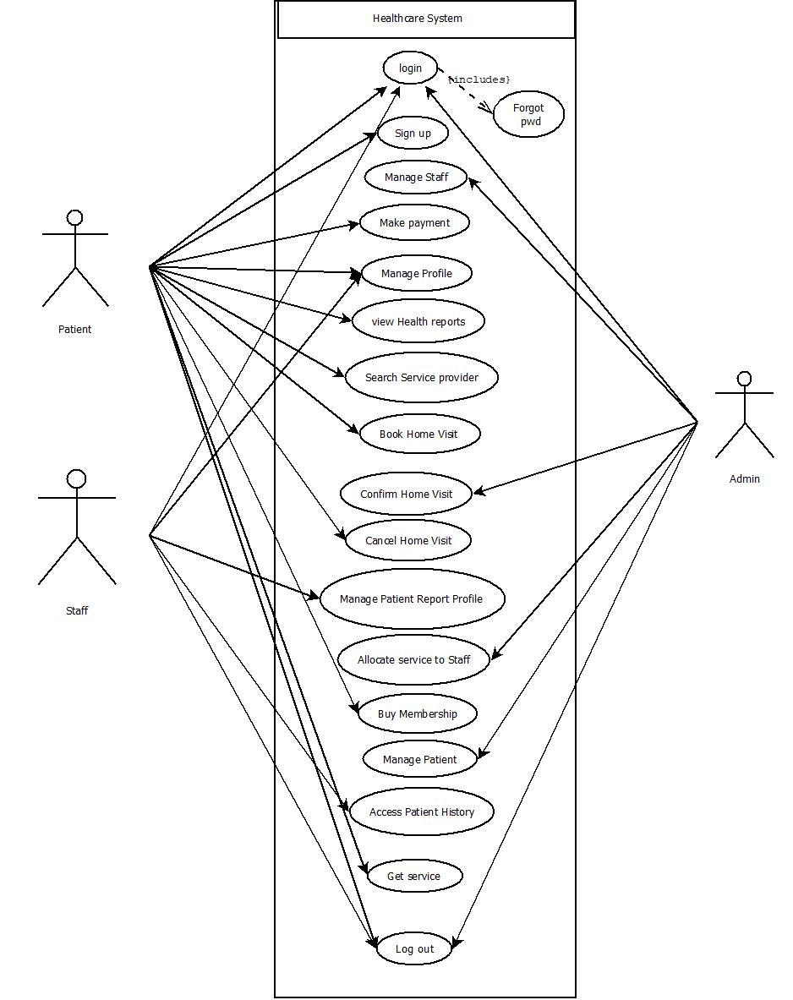

Slide 15
Class diagram

Slide 17
Data dictionary

Slide 18
User table
Field | Datatype | Constraints | Description | Sample
Id | Int(4) | primary key | Table id | 1
First name | Varchar2(25) | Not null | Firstname of the user | Arnold
Last name | Varchar2(25) | Not null | Lastname of the user | Macwan
Email | Varchar2(25) | Unique | Email of the user | abc@gmail.com
Password | Varchar2(10) | Not null | Password | abc@123
DOB | Date | Not null | Date of birth | 20-03-1969
Role | Varchar2(15) | Not null | Role of the user | Doctor
State | Varchar2(15) | Not null | State of user | Karnataka
City | Varchar2(15) | Not null | City of user | Pune
Pincode | Int(6) | Not null | Pincode of area | 382440
Apartment_no_nm | Varchar2(25) | Not null | Apartment no & name | B2 , harekrishna park
Userprofile | Varchar2(50) | Not null | Path of image of the user | pics/img.png

Slide 19
Staff_profile table
Field | Datatype | Constraints | Description | Sample
Id | Int(4) | primary key | Table id | 1
Qualification_doc | Varchar2(50) | Not null | Image path for Document of the qualification | doc/img.jpeg
Profilephoto | Varchar2(50) | Not null | Photo of the staff | pic/photo.png
Total_visit_done | Int(3) | Not null | No. of visit taken by staff | 12
Experience | Int(3) | Not null | Experience of the staff | 25 years
Joined_date | date | Not null | Date of joining | 20-09-2002
About | Varchar2(100) | Not null | About the staff | A supportive caretaker
Availability | Varchar2(10) | Not null | Status for staff Availability | Not available

Slide 20
Staff table
Field | Datatype | Constraints | Description | Sample
Id | Int(4) | primary key | Table id | 1
Firstname | Varchar2 | Not null | First name of staff | John
Lastname | Varchar2 | Not null | Last name of staff | Smith
Email | Varchar2 | Unique | Email of staff | abc@gmail.com
DOB | Date | Not null | Date of birth | 20-05-1996
Category | Varchar2 | Not null | Category of staff | Care taker

Slide 21
Services table
Field | Datatype | Constraints | Description | Sample
Id | Int(4) | primary key | Table id | 1
Staffid | Int(4) | Foreign key references staff table | Staff id | 11
Name | Varchar2(25) | Not null | Title of the service | Lab test
Status | Varchar2(15) | Not null | Status of service | Pending
Cost | Decimal(4,2) | Not null | Cost of the service | 499/-

Slide 22
test table
Field | Datatype | Constraints | Description | Sample
Id | Int(4) | primary key | Table id | 1
Category | Int(4) | Not null | Category of test | Full body
Cost | Decimal(4,2) | Not null | Cost for the service | 699
Dur | Int(3) | Not null | Result duration of the test In hours | 36

Slide 23
Staff_history table
Field | Datatype | Constraints | Description | Sample
Id | Int(4) | primary key | Table id | 1
Title | Varchar2(20) | Not null | Job title of staff | Lab tester
Perfomance_rating | Int(2) | Not null | Rating of staff based on user review | 3
Staffid | Int(4) | Foreign key references staff table | Staff id | 1
Status | Varchar2(15) | Not null | Status of the staff | Part-time
Pending_service | Int(3) | Not null | Pending services allocated to staff | 3
Completed_services | Int(3) | Not null | Completed services by staff | 5

Slide 24
Homevisit table
Field | Datatype | Constraints | Description | Sample
Id | Int(4) | primary key | Table id | 1
Userid | Int(4) | Foreign key references user table | Id of the user | 2
Date | Date | Not null | Date of the visit | 15-10-2023
Status | Varchar2(10) | Not null | Status of the visit | Pending
Staffid | Int(4) | Foreign key references staff table | Visit allocate to the staff | 2
Reason | Varchar2(25) | Not null | Reason for visit | Blood report

Slide 25
patientprofile table
Field | Datatype | Constraints | Description | Sample
Id | Int(4) | primary key | Table id | 1
Userid | Int(4) | Foreign key references user table | Id of the user | 2
Membership_holder | Boolean | Not null | If the user is membership holder | TRUE
no_of_visits | Int(3) | Not null | No. of visits to patient | 5
Height | Int(4) | Not null | Height of the patient | 165cm
Weight | Int(4) | Not null | Weight of the patient | 56kg
Blood_group | Varchar2(4) | Not null | Blood group of the user | O+
BMI | Int(5) | Not null | Body-mass index of the user | 23.6%
Date_joined | Date | Not null | Date of the joining organization | 20-03-2005

Slide 26
Billing table
Field | Datatype | Constraints | Description | Sample
Id | Int(4) | primary key | Table id | 1
Userid | Int(4) | Foreign key references user table | Id of the user | 2
Date | Date | Not null | Date of the bill | 20-04-2024
Discount | Decimal(6,2) | Not null | Discount price on bill | 2500/-
Total_amount | Decimal(6,2) | Not null | Amount of the bill | 9980/-
Payment_id | Int(10) | Foreign key references payment table | Payment id | 15002693

Slide 27
Payment table
Field | Datatype | Constraints | Description | Sample
Id | Int(4) | primary key | Table id | 1
Userid | Int(4) | Foreign key references user table | Id of the user | 2
Date | Date | Not null | Date of the payment | 20-04-2024
Status | Varchar2(15) | Not null | Status of the payment | pending
Payment_method | Varchar2(10) | Not null | Method of the payment | Cash

Slide 28
Medicalhistory table
Field | Datatype | Constraints | Description | Sample
Id | Int(4) | primary key | Table id | 1
Userid | Int(4) | Foreign key references user table | Id of the user | 2
Condition | Varchar2(15) | Not null | Medical condition of the patient | Critical
Patient_profile_id | Int(4) | Foreign key references patientprofile table | Id of the patient profile table | 5
Status | Varchar2(15) | Not null | Status of the medical condition | Not active
Last_visit_take | Date | Not null | Date of last visit taken by patient | 12-05-2003

Slide 29
Premium-user table
Field | Datatype | Constraints | Description | Sample
Id | Int(4) | primary key | Table id | 1
Userid | Int(4) | Foreign key references user table | Id of the user | 11
Startdate | Date | Not null | Date of buying the premium | 12-12-2022
Expirydate | Date | Not null | Date of expiry of premium | 10-11-2023
Renewal_option | Varchar(10) | Not null | Option to renew the premium | Manual

Slide 30
Feedback table
Field | Datatype | Constraints | Description | Sample
Id | Int(4) | primary key | Table id | 1
Userid | Int(4) | Foreign key references user table | Id of the user | 2
Date | Date | Not null | Date of the feedback received | 20-04-2024
Message | Varchar2(250) | Not null | Message description for feedback | It was good

Slide 31
Blogs table
Field | Datatype | Constraints | Description | Sample
Id | Int(4) | primary key | Table id | 1
Userid | Int(4) | Foreign key references user table | Id of the user | 2
Date | Date | Not null | Date of the feedback received | 20-04-2024
Message | Varchar2(250) | Not null | Message description for feedback | It was good

Slide 32
Agile Documentation

Slide 33
Project charter
Project name | Healthcare webApplication
Project Leader | Arnold Macwan
Project expected start date | 14-08-2023
Project expected end date | 30-11-2023
Project Scope | Integration of Booking health service Custom Admin UI deployment Report and documentation download Safe & secure storing patient information and medical history
Project mission | Our mission is to provide such a platform so that every customer using the system will get the enhanced online service for their health accordingly their customization.
Project vision | Our vision is to reach every person who is not able to take even primary healthcare services and provide them services at doorstep by using their phones.

Slide 34
User Story

Slide 35
Sr. | As a <user> | Want to <task> | So that <goal>
1 | Admin | Login | I can manage flow and activities as administrator
2 | Admin | Manage users / patient | I can control user activities & account related issues
3 | Admin | Manage staff | I can control & review staff activities
4 | Admin | Confirm home-visit request | I can verify & accept user’s request for home visit
5 | Admin | Allocate service to staff | Staff can handle service for patient
6 | Admin | Generate report | Insights can be visualized
7 | Admin | Manage lab test | Let the Lab tester know about it & patients can use
8 | Admin | Manage services | User can request for service provider accordingly
9 | Admin | Access medical history | Health reports can be made
10 | Admin | Post a blog | Article & blogs can be read
11 | Admin | Logout | No one can access system except me

Slide 36
Sr. | As a <user> | I Want to <task> | So that <goal>
1 | Patient | Login | I can use the system as existing user
2 | Patient | Sign up | I can use the system as new user
3 | Patient | Manage profile | I can edit or delete my profile account & review profile
4 | Patient | Buy premium | I can use extra benefits of system
5 | Patient | Search service provider | I can spectate particular provider
6 | Patient | Browse services | I can search & view services accordingly
7 | Patient | Give feedback | I can give feedback of system & enhancement can be done

Slide 37
Sr. | As a <user> | I Want to <task> | So that <goal>
8 | Patient | Request home visit | I can book a home visit
9 | Patient | View medical history | I can review health report & history
10 | Patient | Get service | I can book service according to need
12 | Patient | Cancel home visit | I can remove appointment for home visit If it isn’t needed
13 | Patient | Make payment | I can get confirmed service
14 | Patient | Subscribe newsletter | I can quickly get update of new news & events
15 | Patient | Download reports | I can soft copy of medical history
16 | Patient | Print bill | I can get a copy of payments
17 | Patient | Logout | No one can access my data

Slide 38
Sr. | As a <user> | I Want to <task> | So that <goal>
1 | Staff | Sign up | I can join system as service provider
2 | Staff | Login | I can use system as existing user
3 | Staff | Manage patient profile | I can update patient profile after providing service
4 | Staff | Manage profile | I can edit or remove personal profile from system
5 | Staff | Access patient medical history | I can provide service accordingly
6 | Staff | Post blog | I can publish articles
7 | Staff | Update Availability | I can take leave accordingly
8 | Staff | Manage tasks/appointments | I can review or update all pending tasks allocated
9 | Staff | Delete account | I can remove my self as a service provider from system
10 | Staff | Logout | No one can access my data

Slide 39
Release plan

Slide 40
Sprint | Task | Start date | End date | Duration(Days) | Status | Release date
1 | Login & signup | 16-08-2023 | 18-08-2023 | 3 | Released | 19-08-2023
2 | Admin home screen | 20-08-2023 | 23-08-2023 | 4 | Released | 26-08-2023

Slide 41
References
https://www.myhealthcare.co/
https://www.indimac.in/

