Slide 1
SolarWinds Supply Chain Attack
An analysis of the SUNBURST incident and its implications
Presented By:
Arnold Macwan

Slide 2
Introduction
This presentation delves into the intricate details of the SolarWinds Supply Chain Attack, known as SUNBURST, analyzing its timeline, malware mechanisms, and the profound impact it had on cybersecurity and web application security.

Slide 3
Attack Timeline
01

Slide 4

Initial access methods
The attack began in September 2019, with attackers likely exploiting weak passwords or known vulnerabilities in SolarWinds' internal systems. This initial access paved the way for subsequent attack.

Slide 5
Infection through Orion updates
From March to June 2020, malicious code was injected into the Orion platform's build system. This resulted in a trojanized version of the software that thousands of customers unknowingly downloaded.

Slide 6
Discovery of the breach
The breach came to light in December 2020, when the cybersecurity firm FireEye discovered that their own red-teaming tools were missing, leading to the identification of the broader attack.

Slide 7
02
Malware Mechanism

Slide 8
Backdoor implementation
Hackers inserted a backdoor into the Orion software updates, which was signed with a legitimate SolarWinds digital certificate, making it appear safe to users.

Slide 9
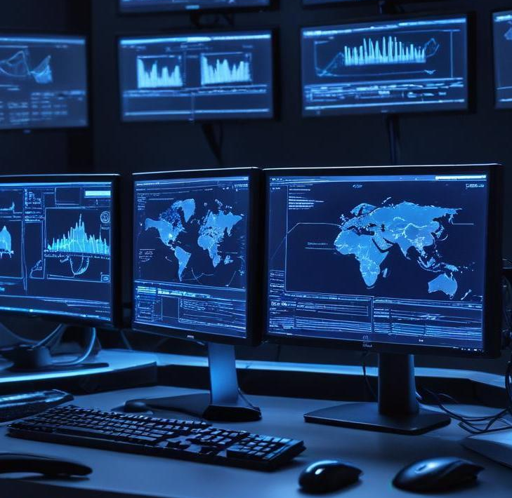
Execution tactics
The malware remained inactive for 7–14 days before executing. It used DNS tunneling to communicate with its command-and-control (C2) server and downloaded additional payloads while disguising itself as legitimate traffic.

Slide 10
Credential theft techniques
The attackers employed various methods to steal credentials, including Active Directory tokens and cloud credentials, facilitating lateral movement across internal systems and cloud services.

Slide 11
Impact Assessment
03

Slide 12
Scale of affected organizations
Approximately 18,000 organizations downloaded the compromised version of the Orion software, although only around 100 were actually targeted and exploited by the attackers. This extensive reach underscores the widespread vulnerability and the potential impact on organizational security.

Slide 13
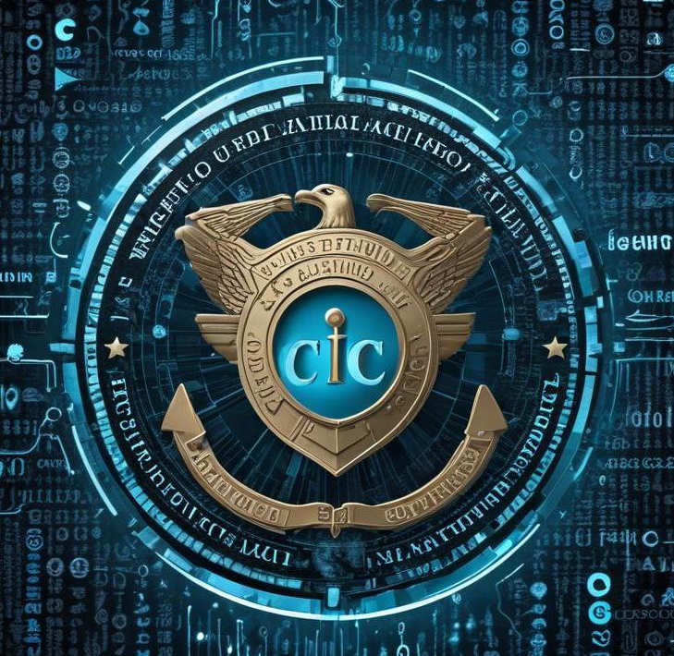
Notable victims
High-profile organizations such as the U.S. Treasury Department, Department of Homeland Security, Microsoft, Intel, Cisco, and FireEye were among the notable victims of the SolarWinds attack. The involvement of such significant entities highlights the far-reaching implications of the breach.

Slide 14
Consequences for cybersecurity
The attack revealed critical vulnerabilities in supply chain security and raised awareness about the risks of relying on third-party software. It has led to increased scrutiny on security practices, prompting organizations to reassess their cybersecurity strategies and improve their defenses.

Slide 15
04
Security Implications

Slide 16
Web app security risks
While the initial compromise was not through web applications, the repercussions were profound for web security. Access tokens were stolen, allowing unauthorized access to internal APIs and web services, emphasizing the need for vigilant security measures.

Slide 17
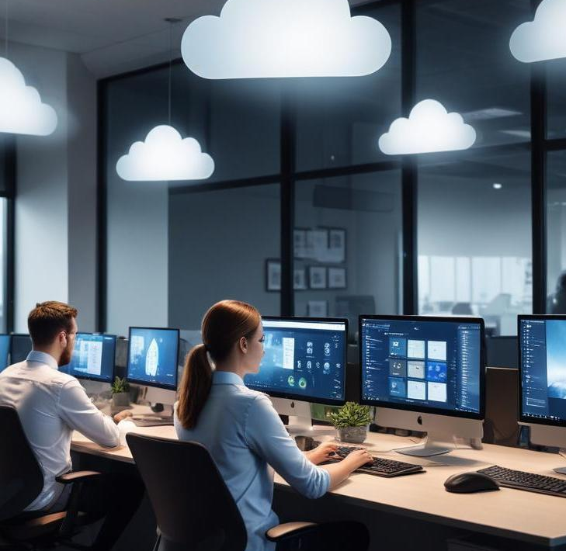
SaaS platform vulnerabilities
Attackers exploited vulnerabilities in SaaS platforms, including Office 365 and Azure AD, to gain access to sensitive data and applications. This highlighted the importance of securing cloud services in a landscape increasingly dependent on remote solutions.

Slide 18
Trust and third-party components
The attack exploited the implicit trust organizations placed in signed software and third-party components. This incident highlights the significant risks present in modern DevOps and CI/CD pipelines, necessitating more rigorous security assessments.

Slide 19
Lessons Learned
05

Slide 20
Mitigation strategies for trust issues
Organizations should implement strict Software Bill of Materials (SBOM) tracking to improve visibility and control over software components, minimizing reliance on questionable third-party supplies.

Slide 21
CI/CD security enhancements
To prevent CI/CD compromises, organizations should harden build environments through multi-factor authentication, continuous monitoring, and network segmentation, reducing potential attack vectors.

Slide 22
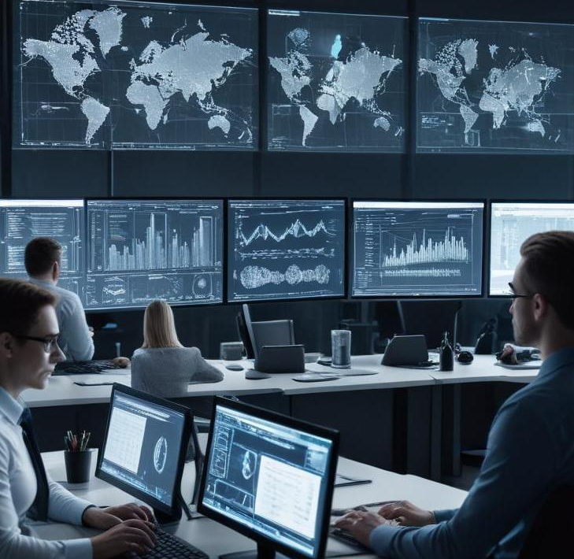
Response to lateral movement and credential theft
Adopting a zero trust architecture and employing strong network segmentation can mitigate lateral movement. Additionally, deploying behavioral analytics and session monitoring helps to detect and respond to credential theft more effectively.

Slide 23

Conclusion
The SolarWinds Supply Chain Attack serves as a crucial lesson in the importance of cybersecurity vigilance, particularly concerning third-party software. Organizations must enhance their security practices, reassess trust models, and adopt proactive measures to protect against similar threats in the future.

Slide 24
Reference
https://www.fortinet.com/resources/cyberglossary/solarwinds-cyber-attack
https://www.techtarget.com/whatis/feature/SolarWinds-hack-explained-Everything-you-need-to-know

Slide 25
Thank you

