Slide 1
Git and Github A short introduction

Slide 2
Terminology
repository
branch
commits
push
pull request
fork (demo)
Github explained visually: https://guides.github.com/introduction/flow/

Slide 3
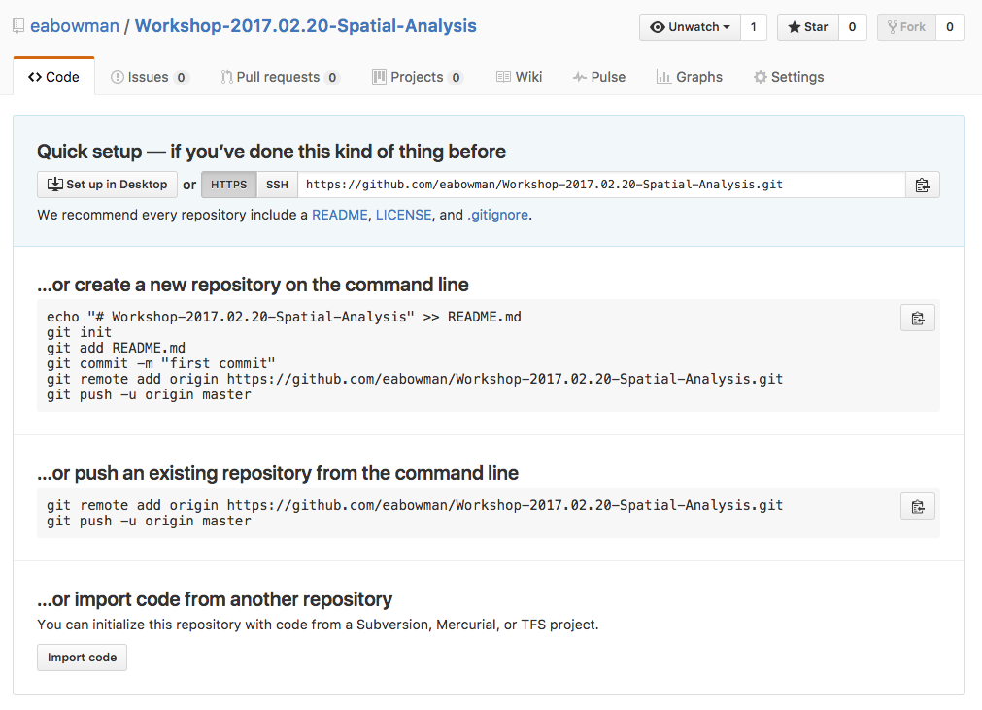

Slide 4
Demonstration

Slide 5
Installation
Macs:
Open terminal window.
Type ‘git’
You should receive a prompt for installation
Windows:
http://git-scm.com/download/win
http://windows.github.com
More information: https://git-scm.com/book/en/v2/Getting-Started-Installing-Git

Slide 6
Available help and guides:
git help –g
Lists git guides available
To access one type ‘git help <command>’ (i.e. git help workflow, git help tutorial)
https://www.youtube.com/githubguides

